Slide 1
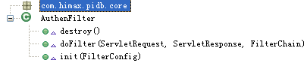
This class is a authentication servlet filter.
destroy()
Destroy a filter.
Returns | void.
doFilter(ServletRequest, ServletResponse, FilterChain)
Filter user’s authentication.
ServletRequest | Servlet request.
ServletResponse | Servlet response.
FilterChain | Filter chain.
Returns | void.
init(FilterConfig)
Initialize a filter.
FilterConfig | Filter config.
Returns | void.

Slide 2
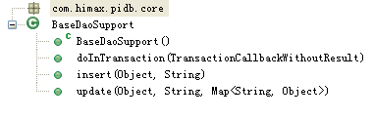
This is a base class for data access object.
BaseDaoSupport()
Default constructor.
Returns | void.
doInTransaction(TransactionCallbackWithoutResult)
Execute operation in transaction.
TransactionCallbackWithoutResult | Callback something need to do in transaction.
Returns | void.
insert(Object, String)
This is a universal method for inserting data.
Object | Must insert object.
String | Table name.
Returns | void.

Slide 3
update(Object, String, Map<String, Object>)
This is a universal method for update data.
Object | Must update object.
String | Table name.
Map<String, Object> | Update condition.
Returns | void.

Slide 4
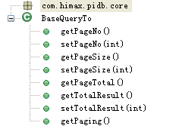
This is a base class for query transfer object.
getPageNo()
Get a page No.
Returns | Current page No.
setPageNo(int)
Set a page No.
int | Page No.
Returns | void.
getPageSize()
Get page size.
Returns | Page size.
setPageSize(int)
Set page size.
int | Page size.
Returns | void.
getPageTotal()
Get page total.
Returns | Page total.

Slide 5
getTotalResult()
Get result total.
Returns | Result total.
setTotalResult(int)
Set result total.
int | Result total.
Returns | void.
getPaging()
Get paging information.
Returns | A string presents HTML.

Slide 6
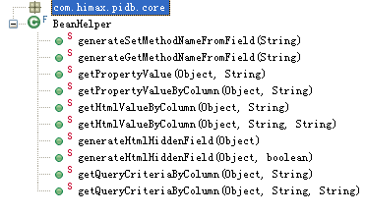
This class pick up java bean information.
generateSetMethodNameFromField(String)
Generate the setter method name from given field name.
String | Field name.
Returns | Setter method name.
generateGetMethodNameFromField(String)
Generate the getter method name from given field name.
String | Field name.
Returns | Getter method name.
getPropertyValue(Object, String)
Get object property value by property name.
Object | Object.
String | Property name.
Returns | Property value.
getPropertyValueByColumn(Object, String)
Get object property value by column name.
Object | Object.
String | Column name.
Returns | Property value.

Slide 7
getHtmlValueByColumn(Object, String)
Get object HTML value by column name.
Object | Object.
String | Column name.
Returns | HTML value.
getHtmlValueByColumn(Object, String, String)
Get object HTML value by column name.
Object | Object.
String | Column name.
String | Format pattern.
Returns | HTML value.
generateHtmlHiddenField(Object)
Generate the HTML hidden field by object.
Object | Object.
Returns | A string presents HTML.
generateHtmlHiddenField(Object, boolean)
Generate the HTML hidden field by object.
Object | Object.
booean | Whether check parent.
Returns | A string presents HTML.

Slide 8
getQueryCriteriaByColumn(Object, String)
Get criteria by column name.
Object | Object.
String | Column name.
Returns | HTML value.
getQueryCriteriaByColumn(Object, String, String)
Get criteria by column name.
Object | Object.
String | Column name.
String | Format pattern.
Returns | HTML value.

Slide 9
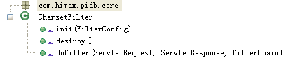
This class is a UTF-8 charset servlet filter.
init(FilterConfig)
Initialize filter.
FilterConfig | Filter config.
Returns | void.
destroy()
Destroy filter.
Returns | void.
doFilter(ServletRequest, ServletResponse, FilterChain)
Process filter.
ServletRequest | Servlet request.
ServletResponse | Servlet response.
FilterChain | Filter chain.
Returns | void.

Slide 10

The default name converter between java and database.
java2db(String)
Convert a java field name to database field name.
String | Java field name.
Returns | Database field name.
db2java(String)
Convert a database field name to java field name.
String | Database field name.
Returns | Java field name.

Slide 11
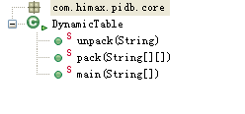
This class is uses for to pack dynamic table.
unpack(String)
Unpack a dynamic table.
String | A string segregated by separator.
Returns | Two-dimensional array.
pack(String[][])
Pack a dynamic table.
String[][] | Two-dimensional array.
Returns | A string segregated by separator.

Slide 12

This class is uses for to escape string.
escape(String)
Escape a string.
String | String.
Returns | String.
unescape(String)
Unescape a string.
String | String.
Returns | String.

Slide 13
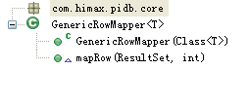
Convert from resultSet to POJO automatic.
GenericRowMapper(Class<T>)
The default constructor.
Class<T> | Class type.
Returns | void.
mapRow(ResultSet, int)
Convert current row in resultSet to an object.
ResultSet | Result collection.
int | Current result number.
Returns | Object.

Slide 14
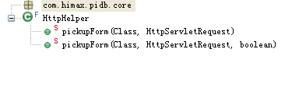
This class is uses for to pick up page form.
pickupForm(Class, HttpServletRequest)
Pick up page form.
Class | Current class.
HttpServletRequest | Http servlet request.
Returns | Object.
pickupForm(Class, HttpServletRequest, boolean)
Pick up page form.
Class | Current class.
HttpServletRequest | Http servlet request.
boolean | Whether check parent.
Returns | Object.

Slide 15
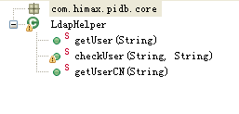
This class is uses for to control LDAP.
getUser(String)
Get user by user ID.
String | User ID.
Returns | User object.
checkUser(String, String)
Whether the judgement user does exist.
String | User ID.
String | Password.
Returns | true->exist,false->not exist.
getUserCN(String)
Get user's CN by user ID.
String | User ID.
Returns | user’s CN.

Slide 16
Java field name to db column name converter.This is a interface.
java2db(String)
Convert a java field name to database field name.
String | Java field name.
Returns | Database field name.
db2java(String)
Convert a database field name to java field name.
String | Database field name.
Returns | Java field name.

Slide 17
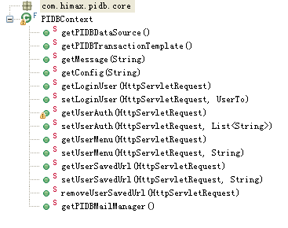
This class is a helper class for instance PIDBContext.xml configed classes.
getPIDBDataSource()
Return PIDB JDBC DataSource.
Returns | DataSource.
getPIDBTransactionTemplate()
Return a PIDB transaction template.
Returns | Transaction template.
getMessage(String)
Get a message from resource.
String | Resource key.
Returns | Message.
getConfig(String)
Get a config from resource.
String | Resource key.
Returns | Config.
getLoginUser(HttpServletRequest)
Get user from http session.
HttpServletRequest | Http servlet request.
Returns | User object.

Slide 18
setLoginUser(HttpServletRequest, UserTo)
Set user to http session.
UserTo | User object.
HttpServletRequest | Http servlet request.
Returns | void.
getUserAuth(HttpServletRequest)
Get user’s authentication from http session.
HttpServletRequest | Http servlet request.
Returns | A string list.
setUserAuth(HttpServletRequest, List<String>)
Set user’s authentication to http session.
HttpServletRequest | Http servlet request.
List<String> | User’s authentication string.
Returns | void.

Slide 19
getUserMenu(HttpServletRequest)
Get user’s menu from http session.
HttpServletRequest | Http servlet request.
Returns | Menu string.
setUserMenu(HttpServletRequest, String)
Set user’s menu to http session.
HttpServletRequest | Http servlet request.
String | Menu string.
Returns | void.
getUserSavedUrl(HttpServletRequest)
Get user’s saved URL to http session.
HttpServletRequest | Http servlet request.
Returns | User’s saved URL.

Slide 20
setUserSavedUrl(HttpServletRequest, String)
Set user’s saved URL to http session.
HttpServletRequest | Http servlet request.
String | User’s saved URL.
Returns | void.
removeUserSavedUrl(HttpServletRequest)
Remove user’s saved URL from http session.
HttpServletRequest | Http servlet request.
Returns | void.
getPIDBMailManager()
Get PIDB mail manager.
Returns | Mail manager.

Slide 21

The support data access object class for PIDB database.
PIDBDaoSupport()
Default constructor.
Returns | void.

Slide 22
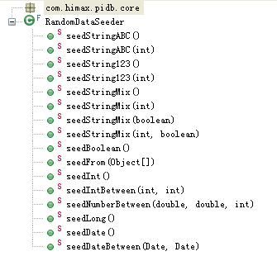
This class is uses for to get random data.
seedStringABC()
Seed method for capital alpha string.
Returns | Random string like "DEHCONSU", default length = 8.
seedStringABC(int)
Seed method for capital alpha string with special length.
int | Return string length.
Returns | Random string like "POEKDCZQELDCC" as specified length.
seedString123()
Seed method for digit string.
Returns | Random string like "39510392", default length = 8.
seedString123(int)
Seed method for digit string with special length.
int | Return string length.
Returns | Random string like "397501338503" as specified length.

Slide 23
seedStringMix()
Seed method for mixed string.
Returns | Random string with digits and alphas.
seedStringMix(int)
Seed method for mixed string with special length.
int | Return string length.
Returns | Random string with digits and alphas.
seedStringMix(boolean)
Seed method for mixed string always start with alpha.
boolean | StartWithAlpha whether start with alpha.
Returns | Random string with digits and alphas.
seedStringMix(int, boolean)
Seed method for mixed string always start with alpha and with special length.
int | Return string length.
boolean | StartWithAlpha whether start with alpha.
Returns | Random string with digits and alphas.

Slide 24
seedBoolean()
Seed a random boolean value.
Returns | True or false, it's random.
seedFrom(Object[])
Seed a random value from given dictionary.
Object[] | Source dictionary.
Returns | One of dictionary.
seedInt()
Seed a random integer value.
Returns | Random integer.
seedIntBetween(int, int)
Seed an int value from give range.
int | From min value.
int | To max value.
Returns | Integer value >= from and <= to

Slide 25
seedNumberBetween(double, double, int)
Seed a double value from give range.
double | From min value.
double | To max value.
int | The decimal digital numbers.
Returns | Double value >= from and <= to.
seedLong()
Seed a long value.
Returns | Long value.
seedDate()
Seed random date between 1900/01/01 00:00:00 to 2099/12/31 23:59:59.
Returns | Random date.
seedDateBetween(Date, Date)
Seed random date between give from and to date.
Date | From begin date.
Date | To end date.
Returns | Random date.

Slide 26

Support class for get next value of oracle sequence.
nextValue(String)
Return a sequence generator.
String | Sequence name.
Returns | Sequence generator.

Slide 27

This class is uses for to manage mail.This is a interface.
place(MailTo)
Send a mail.
MailTo | Mail object.
Returns | void.

Slide 28
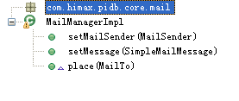
This class is uses for to manage mail.
setMailSender(MailSender)
Set mail sender.
MailSender | Mail sender.
Returns | void.
setMessage(SimpleMailMessage)
Set message.
SimpleMailMessage | Message.
Returns | void.
place(MailTo)
Send a mail.
MailTo | Mail object.
Returns | void.

Slide 29
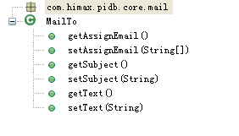
This is a transfer object for mail.
getAssignEmail()
Get Email address.
Returns | Email addresses.
setAssignEmail(String[])
Set Email address.
String[] | Email addresses.
Returns | void.
getSubject()
Get mail subject.
Returns | Mail subject.
setSubject(String)
Set mail subject.
String | Mail subject.
Returns | void.

Slide 30
getText()
Get mail text.
Returns | Mail text.
setText(String)
Set mail text.
String | Mail text.
Returns | void.

Slide 31

This class is uses for to get mask layer combine.
execute(ActionMapping, ActionForm, HttpServletRequest, HttpServletResponse)
Execute current action to get mask layer combine.
ActionMapping | ActionMapping.
ActionForm | ActionForm.
HttpServletRequest | HttpServletRequest.
HttpServletResponse | HttpServletResponse.
Returns | ActionForward.

Slide 32

This class is uses for to check BumpMask.
execute(ActionMapping, ActionForm, HttpServletRequest, HttpServletResponse)
Execute current action to check BumpMask.
ActionMapping | ActionMapping.
ActionForm | ActionForm.
HttpServletRequest | HttpServletRequest.
HttpServletResponse | HttpServletResponse.
Returns | ActionForward.

Slide 33

This class is uses for to check Cog.
execute(ActionMapping, ActionForm, HttpServletRequest, HttpServletResponse)
Execute current action to check Cog.
ActionMapping | ActionMapping.
ActionForm | ActionForm.
HttpServletRequest | HttpServletRequest.
HttpServletResponse | HttpServletResponse.
Returns | ActionForward.

Slide 34

This class is uses for to check Corner Lot Char.
execute(ActionMapping, ActionForm, HttpServletRequest, HttpServletResponse)
Execute current action to check Corner Lot Char.
ActionMapping | ActionMapping.
ActionForm | ActionForm.
HttpServletRequest | HttpServletRequest.
HttpServletResponse | HttpServletResponse.
Returns | ActionForward.

Slide 35

This class is uses for to check CP test program.
execute(ActionMapping, ActionForm, HttpServletRequest, HttpServletResponse)
Execute current action to check CP test program.
ActionMapping | ActionMapping.
ActionForm | ActionForm.
HttpServletRequest | HttpServletRequest.
HttpServletResponse | HttpServletResponse.
Returns | ActionForward.

Slide 36

This class is uses for to check Esd test.
execute(ActionMapping, ActionForm, HttpServletRequest, HttpServletResponse)
Execute current action to check Esd test.
ActionMapping | ActionMapping.
ActionForm | ActionForm.
HttpServletRequest | HttpServletRequest.
HttpServletResponse | HttpServletResponse.
Returns | ActionForward.

Slide 37

This class is uses for to check FT test program.
execute(ActionMapping, ActionForm, HttpServletRequest, HttpServletResponse)
Execute current action to check FT test program.
ActionMapping | ActionMapping.
ActionForm | ActionForm.
HttpServletRequest | HttpServletRequest.
HttpServletResponse | HttpServletResponse.
Returns | ActionForward.

Slide 38

This class is uses for to check Function.
execute(ActionMapping, ActionForm, HttpServletRequest, HttpServletResponse)
Execute current action to check Function.
ActionMapping | ActionMapping.
ActionForm | ActionForm.
HttpServletRequest | HttpServletRequest.
HttpServletResponse | HttpServletResponse.
Returns | ActionForward.

Slide 39

This class is uses for to check Htol Ra.
execute(ActionMapping, ActionForm, HttpServletRequest, HttpServletResponse)
Execute current action to check Htol Ra.
ActionMapping | ActionMapping.
ActionForm | ActionForm.
HttpServletRequest | HttpServletRequest.
HttpServletResponse | HttpServletResponse.
Returns | ActionForward.

Slide 40

This class is uses for to check IC finish goods.
execute(ActionMapping, ActionForm, HttpServletRequest, HttpServletResponse)
Execute current action to check IC finish goods.
ActionMapping | ActionMapping.
ActionForm | ActionForm.
HttpServletRequest | HttpServletRequest.
HttpServletResponse | HttpServletResponse.
Returns | ActionForward.

Slide 41

This class is uses for to check IC tape.
execute(ActionMapping, ActionForm, HttpServletRequest, HttpServletResponse)
Execute current action to check IC tape.
ActionMapping | ActionMapping.
ActionForm | ActionForm.
HttpServletRequest | HttpServletRequest.
HttpServletResponse | HttpServletResponse.
Returns | ActionForward.

Slide 42

This class is uses for to check IC wafer.
execute(ActionMapping, ActionForm, HttpServletRequest, HttpServletResponse)
Execute current action to check IC wafer.
ActionMapping | ActionMapping.
ActionForm | ActionForm.
HttpServletRequest | HttpServletRequest.
HttpServletResponse | HttpServletResponse.
Returns | ActionForward.

Slide 43

This class is uses for to check Mask layer mapping.
execute(ActionMapping, ActionForm, HttpServletRequest, HttpServletResponse)
Execute current action to check Mask layer mapping.
ActionMapping | ActionMapping.
ActionForm | ActionForm.
HttpServletRequest | HttpServletRequest.
HttpServletResponse | HttpServletResponse.
Returns | ActionForward.

Slide 44

This class is uses for to check MP list.
execute(ActionMapping, ActionForm, HttpServletRequest, HttpServletResponse)
Execute current action to check MP list.
ActionMapping | ActionMapping.
ActionForm | ActionForm.
HttpServletRequest | HttpServletRequest.
HttpServletResponse | HttpServletResponse.
Returns | ActionForward.

Slide 45

This class is uses for to check Package Ra.
execute(ActionMapping, ActionForm, HttpServletRequest, HttpServletResponse)
Execute current action to check Package Ra.
ActionMapping | ActionMapping.
ActionForm | ActionForm.
HttpServletRequest | HttpServletRequest.
HttpServletResponse | HttpServletResponse.
Returns | ActionForward.

Slide 46

This class is uses for to check Product standard test reference table.
execute(ActionMapping, ActionForm, HttpServletRequest, HttpServletResponse)
Execute current action to check Product standard test reference table.
ActionMapping | ActionMapping.
ActionForm | ActionForm.
HttpServletRequest | HttpServletRequest.
HttpServletResponse | HttpServletResponse.
Returns | ActionForward.

Slide 47

This class is uses for to check Project.
execute(ActionMapping, ActionForm, HttpServletRequest, HttpServletResponse)
Execute current action to check Project.
ActionMapping | ActionMapping.
ActionForm | ActionForm.
HttpServletRequest | HttpServletRequest.
HttpServletResponse | HttpServletResponse.
Returns | ActionForward.

Slide 48

This class is uses for to check Role.
execute(ActionMapping, ActionForm, HttpServletRequest, HttpServletResponse)
Execute current action to check Role.
ActionMapping | ActionMapping.
ActionForm | ActionForm.
HttpServletRequest | HttpServletRequest.
HttpServletResponse | HttpServletResponse.
Returns | ActionForward.

Slide 49

This class is uses for to check Traditional package.
execute(ActionMapping, ActionForm, HttpServletRequest, HttpServletResponse)
Execute current action to check Traditional package.
ActionMapping | ActionMapping.
ActionForm | ActionForm.
HttpServletRequest | HttpServletRequest.
HttpServletResponse | HttpServletResponse.
Returns | ActionForward.

Slide 50

This class is uses for to check User.
execute(ActionMapping, ActionForm, HttpServletRequest, HttpServletResponse)
Execute current action to check User.
ActionMapping | ActionMapping.
ActionForm | ActionForm.
HttpServletRequest | HttpServletRequest.
HttpServletResponse | HttpServletResponse.
Returns | ActionForward.

Slide 51

This class is uses for to check User on AD.
execute(ActionMapping, ActionForm, HttpServletRequest, HttpServletResponse)
Execute current action to check User on AD.
ActionMapping | ActionMapping.
ActionForm | ActionForm.
HttpServletRequest | HttpServletRequest.
HttpServletResponse | HttpServletResponse.
Returns | ActionForward.

Slide 52

This class is uses for to fetch Cog.
execute(ActionMapping, ActionForm, HttpServletRequest, HttpServletResponse)
Execute current action to fetch Cog.
ActionMapping | ActionMapping.
ActionForm | ActionForm.
HttpServletRequest | HttpServletRequest.
HttpServletResponse | HttpServletResponse.
Returns | ActionForward.

Slide 53

This class is uses for to fetch CP materia number.
execute(ActionMapping, ActionForm, HttpServletRequest, HttpServletResponse)
Execute current action to fetch CP materia number.
ActionMapping | ActionMapping.
ActionForm | ActionForm.
HttpServletRequest | HttpServletRequest.
HttpServletResponse | HttpServletResponse.
Returns | ActionForward.

Slide 54

This class is uses for to fetch Email.
execute(ActionMapping, ActionForm, HttpServletRequest, HttpServletResponse)
Execute current action to fetch Email.
ActionMapping | ActionMapping.
ActionForm | ActionForm.
HttpServletRequest | HttpServletRequest.
HttpServletResponse | HttpServletResponse.
Returns | ActionForward.

Slide 55
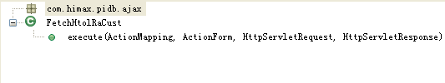
This class is uses for to fetch HTOL RA customer.
execute(ActionMapping, ActionForm, HttpServletRequest, HttpServletResponse)
Execute current action to fetch HTOL RA customer.
ActionMapping | ActionMapping.
ActionForm | ActionForm.
HttpServletRequest | HttpServletRequest.
HttpServletResponse | HttpServletResponse.
Returns | ActionForward.

Slide 56

This class is uses for to fetch IC finish goods.
execute(ActionMapping, ActionForm, HttpServletRequest, HttpServletResponse)
Execute current action to fetch IC finish goods.
ActionMapping | ActionMapping.
ActionForm | ActionForm.
HttpServletRequest | HttpServletRequest.
HttpServletResponse | HttpServletResponse.
Returns | ActionForward.

Slide 57

This class is uses for to fetch IC finish goods material number.
execute(ActionMapping, ActionForm, HttpServletRequest, HttpServletResponse)
Execute current action to fetch IC finish goods material number.
ActionMapping | ActionMapping.
ActionForm | ActionForm.
HttpServletRequest | HttpServletRequest.
HttpServletResponse | HttpServletResponse.
Returns | ActionForward.

Slide 58

This class is uses for to fetch Package type.
execute(ActionMapping, ActionForm, HttpServletRequest, HttpServletResponse)
Execute current action to fetch Package type.
ActionMapping | ActionMapping.
ActionForm | ActionForm.
HttpServletRequest | HttpServletRequest.
HttpServletResponse | HttpServletResponse.
Returns | ActionForward.

Slide 59

This class is uses for to fetch Project.
execute(ActionMapping, ActionForm, HttpServletRequest, HttpServletResponse)
Execute current action to fetch Project.
ActionMapping | ActionMapping.
ActionForm | ActionForm.
HttpServletRequest | HttpServletRequest.
HttpServletResponse | HttpServletResponse.
Returns | ActionForward.

Slide 60

This class is uses for to fetch Project code list.
execute(ActionMapping, ActionForm, HttpServletRequest, HttpServletResponse)
Execute current action to fetch Project code list.
ActionMapping | ActionMapping.
ActionForm | ActionForm.
HttpServletRequest | HttpServletRequest.
HttpServletResponse | HttpServletResponse.
Returns | ActionForward.

Slide 61

This class is uses for to fetch Project fab.
execute(ActionMapping, ActionForm, HttpServletRequest, HttpServletResponse)
Execute current action to fetch Project fab.
ActionMapping | ActionMapping.
ActionForm | ActionForm.
HttpServletRequest | HttpServletRequest.
HttpServletResponse | HttpServletResponse.
Returns | ActionForward.

Slide 62

This class is uses for to fetch User from AD.
execute(ActionMapping, ActionForm, HttpServletRequest, HttpServletResponse)
Execute current action to fetch User from AD.
ActionMapping | ActionMapping.
ActionForm | ActionForm.
HttpServletRequest | HttpServletRequest.
HttpServletResponse | HttpServletResponse.
Returns | ActionForward.

Slide 63

This class is uses for to handle user’s misoperation.
execute(ActionMapping, ActionForm, HttpServletRequest, HttpServletResponse)
Execute current action to handle user’s misoperation.
ActionMapping | ActionMapping.
ActionForm | ActionForm.
HttpServletRequest | HttpServletRequest.
HttpServletResponse | HttpServletResponse.
Returns | ActionForward.

Slide 64
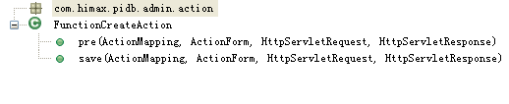
This class is uses for to create Function.
pre(ActionMapping, ActionForm, HttpServletRequest, HttpServletResponse)
Do action before go to create page of Function.
ActionMapping | ActionMapping.
ActionForm | ActionForm.
HttpServletRequest | HttpServletRequest.
HttpServletResponse | HttpServletResponse.
Returns | ActionForward.

Slide 65
save(ActionMapping, ActionForm, HttpServletRequest, HttpServletResponse)
Do create action after set one Function object.
ActionMapping | ActionMapping.
ActionForm | ActionForm.
HttpServletRequest | HttpServletRequest.
HttpServletResponse | HttpServletResponse.
Returns | ActionForward.

Slide 66
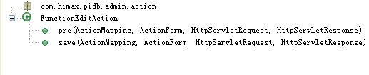
This class is uses for to edit Function.
pre(ActionMapping, ActionForm, HttpServletRequest, HttpServletResponse)
Do action before go to edit page of Function.
ActionMapping | ActionMapping.
ActionForm | ActionForm.
HttpServletRequest | HttpServletRequest.
HttpServletResponse | HttpServletResponse.
Returns | ActionForward.

Slide 67
save(ActionMapping, ActionForm, HttpServletRequest, HttpServletResponse)
Do save action after edit one Function object.
ActionMapping | ActionMapping.
ActionForm | ActionForm.
HttpServletRequest | HttpServletRequest.
HttpServletResponse | HttpServletResponse.
Returns | ActionForward.

Slide 68
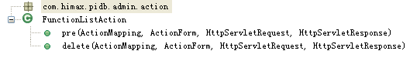
This class is uses for to list Function.
pre(ActionMapping, ActionForm, HttpServletRequest, HttpServletResponse)
Do action before go to list page of Function.
ActionMapping | ActionMapping.
ActionForm | ActionForm.
HttpServletRequest | HttpServletRequest.
HttpServletResponse | HttpServletResponse.
Returns | ActionForward.

Slide 69
delete(ActionMapping, ActionForm, HttpServletRequest, HttpServletResponse)
Do save action after list one Function object.
ActionMapping | ActionMapping.
ActionForm | ActionForm.
HttpServletRequest | HttpServletRequest.
HttpServletResponse | HttpServletResponse.
Returns | ActionForward.

Slide 70

This class is uses for to draw Function table.
draw(List<FunctionTo>, List<FunctionTo>)
Draw a Function table.
List<FunctionTo> | All Function list.
List<FunctionTo> | Checked Function list.
Returns | A string presents HTML.

Slide 71
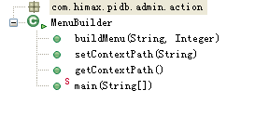
This class is uses for to build menu.
buildMenu(String, Integer)
Build a menu.
String | A prefix of HTML.
Integer | User’s ID.
Returns | A string presents HTML.
setContextPath(String)
Set context path.
String | Context path.
Returns | void.
getContextPath()
Get context path.
Returns | Context path.

