Slide 1

This class create role actions to save ROLE.
pre(ActionMapping, ActionForm, HttpServletRequest, HttpServletResponse)
Do action before go to create page of Role.
ActionMapping | mapping.
ActionForm | form
HttpServletRequest | request
HttpServletResponse | response
Returns | ActionForward to "/admin/role_create.jsp"
save(ActionMapping, ActionForm, HttpServletRequest, HttpServletResponse)
Do create action after set one Role object.
ActionMapping | mapping.
ActionForm | form
HttpServletRequest | request
HttpServletResponse | response
Returns | ActionForward

Slide 2

This class edit role actions to save ROLE.
pre(ActionMapping, ActionForm, HttpServletRequest, HttpServletResponse)
Do action before go to edit page of Role.
ActionMapping | mapping.
ActionForm | form
HttpServletRequest | request
HttpServletResponse | response
Returns | ActionForward to “/admin/role_edit.jsp”
save(ActionMapping, ActionForm, HttpServletRequest, HttpServletResponse)
Do edit action after set one Role object.
ActionMapping | mapping.
ActionForm | form
HttpServletRequest | request
HttpServletResponse | response
Returns | ActionForward

Slide 3

This class list of role actions to show a role record.
pre(ActionMapping, ActionForm, HttpServletRequest, HttpServletResponse)
Do action go to show list page of Role.
ActionMapping | mapping.
ActionForm | form
HttpServletRequest | request
HttpServletResponse | response
Returns | ActionForward to”/admin/role_list.jsp”
delete(ActionMapping, ActionForm, HttpServletRequest, HttpServletResponse)
The method to delete a role record.
ActionMapping | mapping.
ActionForm | form
HttpServletRequest | request
HttpServletResponse | response
Returns | ActionForward to “/admin/role_list.jsp”

Slide 4

This class create user actions to save USER.
pre(ActionMapping, ActionForm, HttpServletRequest, HttpServletResponse)
Do action before go to create page of user.
ActionMapping | mapping.
ActionForm | form
HttpServletRequest | request
HttpServletResponse | response
Returns | ActionForward to "/admin/user_create.jsp"
save(ActionMapping, ActionForm, HttpServletRequest, HttpServletResponse)
Do create action after set one user object.
ActionMapping | mapping.
ActionForm | form
HttpServletRequest | request
HttpServletResponse | response
Returns | ActionForward

Slide 5

This class edit user actions to save USER.
pre(ActionMapping, ActionForm, HttpServletRequest, HttpServletResponse)
Do action before go to edit page of User.
ActionMapping | mapping.
ActionForm | form
HttpServletRequest | request
HttpServletResponse | response
Returns | ActionForward to “/admin/user_edit.jsp”
save(ActionMapping, ActionForm, HttpServletRequest, HttpServletResponse)
Do edit action after set one User object.
ActionMapping | mapping.
ActionForm | form
HttpServletRequest | request
HttpServletResponse | response
Returns | ActionForward

Slide 6

This class list of role actions to show a user record.
pre(ActionMapping, ActionForm, HttpServletRequest, HttpServletResponse)
Do action go to show list page of Role.
ActionMapping | mapping.
ActionForm | form
HttpServletRequest | request
HttpServletResponse | response
Returns | ActionForward to “/admin/user_list.jsp”
query(ActionMapping, ActionForm, HttpServletRequest, HttpServletResponse)
The method to query .
ActionMapping | mapping.
ActionForm | form
HttpServletRequest | request
HttpServletResponse | response
Returns | ActionForward to “/admin/user_list.jsp”

Slide 7
delete(ActionMapping, ActionForm, HttpServletRequest, HttpServletResponse)
The method to delete a user record.
ActionMapping | mapping.
ActionForm | form
HttpServletRequest | request
HttpServletResponse | response
Returns | ActionForward to “/admin/user_list.jsp”

Slide 8
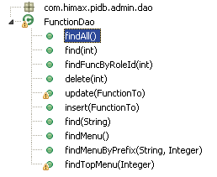
This is an Interface for the DAO about the object FUNCTION
findAll()
The method to find a list of all Function record.
Returns | A list of FunctionTo.
find(int)
The method to find a Function record by given id.
int | id
Returns | A Function record.
findFuncByRoleId(int)
The method to find a Function record by role id.
int | roleId
Returns | A list of FunctionTo.
delete(int)
The method to delete a Function record by id.
int | id
Returns | Void.
Update(FunctionTo)
The method to update a Function record.
FunctionTo | newInstance
Returns | Void.

Slide 9
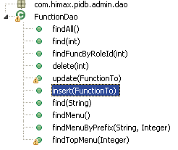
insert(FunctionTo)
The method to create a new Function record.
FunctionTo | newInstance
Returns | Void.
find(String)
The method to find a Function record by function name.
String | funcName
Returns | A Function record.
findMenu()
The method to find a list of Function by IS_MENU is true.
Returns | A list of FunctionTo.
findMenuByPrefix(String,Integer)
The method to find a list of Function by prefix and userId.
String | prefix
Integer | userId
Returns | A list of FunctionTo.
findTopMenu(Integer)
The method to find a list of String by userId.
Integer | userId
Returns | A list of String

Slide 10
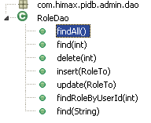
This is an Interface for the DAO about the object ROLE
findAll()
The method to find a list of all Function record.
Returns | A list of RoleTo.
find(int)
The method to find a Role record by given id.
int | id
Returns | A Role record.
insert(RoleTo)
The method to create a new Role record.
FunctionTo | newInstance
Returns | Void.
delete(int)
The method to delete a Role record by id.
int | id
Returns | Void.
Update(RoleTo)
The method to update a Role record.
RoleTo | newInstance
Returns | Void.

Slide 11
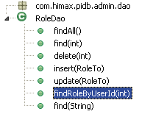
findRoleByUserId(int)
The method to find a list of Role by id.
Int | id
Returns | A list of RoTo.
find(String)
The method to find a list of Role by role name.
String | roleName
Returns | A RoleTo

Slide 12
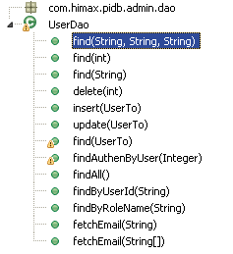
This is an Interface for the DAO about the object FUNCTION
find(String,String,String)
The method to find users by given user id, first name and last name.
String | userId
String | firstName
String | lastName
Returns | A list of UserTo.
find(int)
The method to find a user record by given id.
int | id
Returns | A User record.
find(String)
The method to find a user record by user id.
String | userId
Returns | A User record.
delete(int)
The method to delete a Users by user id.
int | id
Returns | Void.
insert(FunctionTo)
The method to create a new Function record.
FunctionTo | newInstance
Returns | Void.

Slide 13
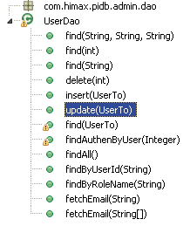
Update(UserTo)
The method to update a User record.
UserTo | newInstance
Returns | Void.
find(UserTo)
The method to find a user record by UserTo.
UserTo | queryTo
Returns | A list of users.
findAuthenByUser(Integer)
The method to find a list of String by id
Integer | id
Returns | A list of String
findAll()
The method to find a list of all Users record.
Returns | A list of Users.
findByUserId(String)
The method to find a list of Users by user id.
String | userId
Returns | A list of users.

Slide 14
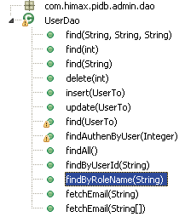
findByRoleName(String)
The method to find a list of Users by role name.
String | roleName
Returns | A list of users.
fetchEmail(String)
The method to fetch a email by assigns.
String | assigns
Returns | a string of email.
fetchEmail(String[])
The method to fetch a email by a list of assigns.
String[] | assigns
Returns | a string of email.

