Slide 1

This is an Interface for the DAO about the object FAB CODE
findAll()
The method to find a list of all Fab code.
Returns | A list of FabCodeTo.
getByFab(String)
The method to get a Fab code by fab.
String | fab
Returns | a fab code.
getFabDescr(String)
The method to get a fab describable by fab.
String | fab
Returns | a string of fab describable.

Slide 2

This is an Interface for the DAO about the table WM_SAP_MASTER_APP_CATEGORY
findAll()
The method to find a list.
Returns | A list of SapAppCategoryTo.

Slide 3
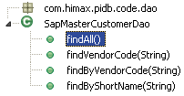
This is an Interface for the DAO about the table WM_SAP_MASTER_CUSTOMER
findAll()
The method to find a list of all record from WM_SAP_MASTER_CUSTOMER.
Returns | A list of SapMasterCustomerTo.
findVendorCode(String)
The method to find a list of SapMasterCustomerTo.
String | customerCode
Returns | A list of SapMasterCustomerTo.
findByVendorCode(String)
The method to find a SapMasterCustomerTo.
String | customerCode
Returns | a SapMasterCustomerTo.

Slide 4

This is an Interface for the DAO about the table WM_SAP_MASTER_IC_TYPE
findAll()
The method to find a list of all record from WM_SAP_MASTER_IC_TYPE.
Returns | A list of SapMasterIcTypeTo.

Slide 5

This is an Interface for the DAO about the table WM_SAP_MASTER_PACKAGE_TYPE
findAll()
The method to find a list of all record from WM_SAP_MASTER_PACKAGE_TYPE.
Returns | A list of SapMasterPackageTypeTo.
findByPkgType(String)
The method to find a SapMasterPackageTypeTo.
String | pkgType
Returns | A SapMasterPackageTypeTo.
findByDesc(String)
The method to find a SapMasterPackageTypeTo.
String | desc
Returns | a SapMasterPackageTypeTo.

Slide 6

This is an Interface for the DAO about the table WM_SAP_MASTER_PRODUCT_FAMILY
findAll()
The method to find a list of all record from WM_SAP_MASTER_PRODUCT_FAMILY.
Returns | A list of SapMasterProductFamilyTo.
findProdFamily()
The method to find a list of PRODUCT_FAMILY.
Returns | A list of string.
findByDescByProdFamily(String)
The method to find a list of Description from WM_SAP_MASTER_PRODUCT_FAMILY.
String | prodFamily
Returns | A string of Description.

Slide 7
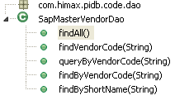
This is an Interface for the DAO about the table WM_SAP_MASTER_VENDOR
findAll()
The method to find a list of all record from WM_SAP_MASTER_CUSTOMER.
Returns | A list of SapMasterVendorTo.
findVendorCode(String)
The method to find a list of SapMasterVendorTo.
String | vendorCode
Returns | A list of SapMasterVendorTo.
queryByVendorCode(String)
The method to find a list of SapMasterVendorTo.
String | vendorCode
Returns | a list of SapMasterVendorTo.
findByVendorCode(String)
The method to find a SapMasterVendorTo.
String | vendorCode
Returns | a SapMasterVendorTo.
findByShortName(String)
The method to find a SapMasterVendorTo.
String | shortName
Returns | a SapMasterVendorTo.

Slide 8

This is an Action including 'execute‘ to validate user.
execute(ActionMapping, ActionForm, HttpServletRequest, HttpServletResponse)
Validate the user name and password.
ActionMapping | mapping.
ActionForm | form
HttpServletRequest | request
HttpServletResponse | response
Returns | the value associated with the ActionForward to "/common/main.jsp".

Slide 9

This is an Action including 'execute‘ to login out.
execute(ActionMapping, ActionForm, HttpServletRequest, HttpServletResponse)
Login out user.
ActionMapping | mapping.
ActionForm | form
HttpServletRequest | request
HttpServletResponse | response
Returns | the value associated with the ActionForward to "/index.jsp“.

Slide 10
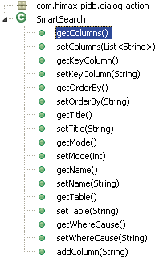
This class smart search to format bean.
getColumns()
Get a list of columns.
Returns | A list of string.
setColumns(List<String>)
Set a list of columns.
List<String> | columns
Returns | void.
getKeyColumn()
Get a list of keyColumn.
Returns | A list of string.
setKeyColumn(String)
Set a list of keyColumn.
String | keyColumn
Returns | void
getOrderBy()
Get a string of orderBy.
Returns | a string.
setOrderBy(String)
Set a string of orderBy.
String | orderBy
Returns | void

Slide 11
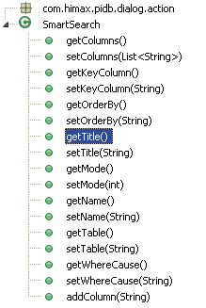
getTitle()
Get a string of title.
Returns | A string of title.
setTitle(String)
Set a string of title.
String | title
Returns | void.
getMode()
Get a int of mode.
Returns | A int .
setMode(int)
Set a int of mode.
int | mode
Returns | void
getName()
Get a string of name.
Returns | a string of name.
setName(String)
Set a string of name.
String | name
Returns | void

Slide 12
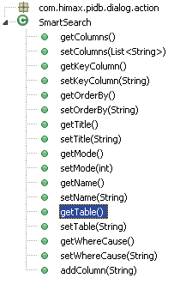
getTable()
Get a string of table.
Returns | A string of string.
setTitle(String)
Set a string of table.
String | table
Returns | void.
getWhereCause()
Get a string of whereCause.
Returns | A string of whereCause .
setWhereCause(String)
Set a string of whereCause.
String | whereCause
Returns | void
addColumn(String)
Add a string of column to columns list.
String | column
Returns | void

Slide 13

This is an Action including search method to smart search.
search(ActionMapping, ActionForm, HttpServletRequest, HttpServletResponse)
Smart search data by table name and keyColumn.
ActionMapping | mapping.
ActionForm | form
HttpServletRequest | request
HttpServletResponse | response
Returns | the value associated with the ActionForward to "/dialog/smart_search.jsp"

Slide 14

This is an Action including search method to smart search.
getSmartSearch(String)
Get lov according to name.
string | name.
Returns | SmartSearch.
addSmartSearch(SmartSearch)
Add a lov according to ld.
SmartSearch | ld.
Returns | void.

