Slide 1

This class helps to download query result.

Slide 2
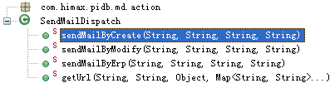
This class helps to download query result.
sendMailByCreate(String, String, String, String)
Create and send email.
String | Master id.
String | Maste code.
String | Email address list.
String | http link.
Returns | Void.
sendMailByModify(String, String, String, String)
Modify and send email.
String | Master id.
String | Maste code.
String | Maste code.
String | Maste code.
Returns | Void.
sendMailByErp(String, String, String, String)
Send email after ERP.
String | Master id.
String | Maste code.
String | Maste code.
String | Maste code.
Returns | Void.

Slide 3
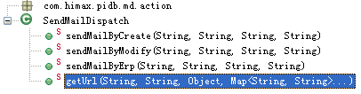
getUrl(String, String, Object, Map<String, String>…)
Get URL String.
String | Master id.
String | Context path.
Object | Current master object.
String… | A Map.
Returns | A URL String.

Slide 4

This class helps to create Traditional Package object.
pre(ActionMapping, ActionForm, HttpServletRequest, HttpServletResponse)
Do action before go to create page of Traditional Package.
ActionMapping | ActionMapping.
ActionForm | ActionForm.
HttpServletRequest | HttpServletRequest
HttpServletResponse | HttpServletResponse
Returns | ActionForward
save(ActionMapping, ActionForm, HttpServletRequest, HttpServletResponse)
Do create action after set one Traditional Package object.
ActionMapping | ActionMapping.
ActionForm | ActionForm.
HttpServletRequest | HttpServletRequest
HttpServletResponse | HttpServletResponse
Returns | ActionForward

Slide 5

This class helps to edit Traditional Package object.
pre(ActionMapping, ActionForm, HttpServletRequest, HttpServletResponse)
Do action before go to edit page of one Traditional Package object.
ActionMapping | ActionMapping.
ActionForm | ActionForm.
HttpServletRequest | HttpServletRequest
HttpServletResponse | HttpServletResponse
Returns | ActionForward
save(ActionMapping, ActionForm, HttpServletRequest, HttpServletResponse)
Do save action after edit one Traditional Package object.
ActionMapping | ActionMapping.
ActionForm | ActionForm.
HttpServletRequest | HttpServletRequest
HttpServletResponse | HttpServletResponse
Returns | ActionForward

Slide 6
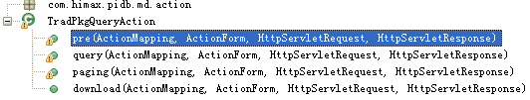
This class helps to edit Traditional Package object.
pre(ActionMapping, ActionForm, HttpServletRequest, HttpServletResponse)
Do action before go to query page of Traditional Package.
ActionMapping | ActionMapping.
ActionForm | ActionForm.
HttpServletRequest | HttpServletRequest
HttpServletResponse | HttpServletResponse
Returns | ActionForward
query(ActionMapping, ActionForm, HttpServletRequest, HttpServletResponse)
Do query action for Traditional Package.
ActionMapping | ActionMapping.
ActionForm | ActionForm.
HttpServletRequest | HttpServletRequest
HttpServletResponse | HttpServletResponse
Returns | ActionForward

Slide 7
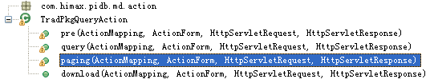
paging(ActionMapping, ActionForm, HttpServletRequest, HttpServletResponse)
Do paging action in the query result page for Traditional Package.
ActionMapping | ActionMapping.
ActionForm | ActionForm.
HttpServletRequest | HttpServletRequest
HttpServletResponse | HttpServletResponse
Returns | ActionForward
download(ActionMapping, ActionForm, HttpServletRequest, HttpServletResponse)
Do download action for Traditional Package.
ActionMapping | ActionMapping.
ActionForm | ActionForm.
HttpServletRequest | HttpServletRequest
HttpServletResponse | HttpServletResponse
Returns | ActionForward

Slide 8
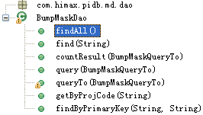
This class do action with table PIDB_BUMPING_MASK.
findAll()
Find all DumpMaskTo objects in database order by field ‘ MASK_NAME ’
Returns | A list of DumpMaskTo objects.
find(String)
Find one DumpMaskTo object by ‘ MASK_NAME ’ equals.
String | Value of ‘ MASK_NAME ’
Returns | One DumpMaskTo object.
countResult(BumpMaskQueryTo)
Count the number of query result of DumpMaskTo object.
BumpMaskQueryTo | One DumpMaskQueryTo object.
Returns | The number of query result.
query(BumpMaskQueryTo)
Do query action by the criteria of BumpMaskQueryTo
BumpMaskQueryTo | One DumpMaskQueryTo object.
Returns | A list of DumpMaskTo object.

Slide 9
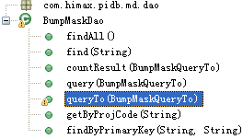
queryTo(BumpMaskQueryTo)
Query BumpMaskTo objects by BumpMaskQueryTo.
BumpMaskQueryTo | One Bumping Mask object.
Returns | A list of Dumping Mask objects.
getByProjCode(String)
Find a list of Dumping Mask objects by ‘ PROJ_CODE ’.
String | Value of field ‘ PROJ_CODE ’.
Returns | A list of Dumping Mask objects.
findByPrimaryKey(String, String)
Find one Dumping Mask object by ‘ MASK_NAME ’ and ‘ PROJ_CODE ’.
String | Value of ‘ MASK_NAME ’.
String | Value of ‘ PROJ_CODE ’.
Returns | One Dumping Mask object.

Slide 10
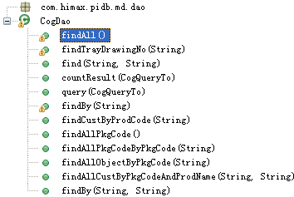
This class do action with table PIDB_COG.
findAll()
Find all COG objects in database order by field ‘PROD_CODE ’
Returns | A list of COG objects.
findTrayDrawingNo(String)
Find all distinct value of ‘TRAY_DRAWING_NO’ in table TRAY_DRAWING_NO by ’TRAY_DRAWING_NO1’ and ‘TRAY_DRAWING_NO2’ and ‘TRAY_DRAWING_NO3’ and ‘TRAY_DRAWING_NO4’ and ‘TRAY_DRAWING_NO5’ and ‘TRAY_DRAWING_NO6’.
String | A string .
Returns | A list value of ‘TRAY_DRAWING_NO’.
Find(String, String)
Find one COG object by ‘PROD_CODE’ and ‘PKG_CODE’.
String | Value of ‘PROD_CODE’.
String | Value of ‘PKG_CODE’.
Returns | One COG object.
countResult(CogQueryTo)
Count the number of query result.
CogQueryTo | One COG object.
Returns | The number of query result.

Slide 11
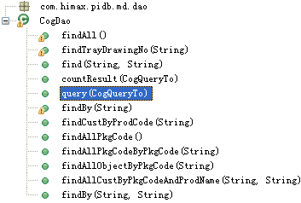
Query(CogQueryTo)
Query COG by criteria CogQueryTo.
CogQueryTo | A COG object.
Returns | A list of CogTo object.
Find By(String)
Find distinct ‘PKG_CODE’ value by ‘PROD_CODE’.
String | Value of ‘PROD_CODE’.
Returns | A list value of ‘PKG_CODE’.
findCustByProdCode(String)
Find all distinct COG_CUST_NAME (including name1,name2,name3,name4,name5 and name6) by PROD_CODE.
String | Value of ‘PROD_CODE’.
Returns | A list of COG_CUST_NAME values.
findAllPkgCode()
Find all distinct ‘PKG_CODE’ in table PIDB_COG.
Returns | A list of PKG_CODE values.

Slide 12
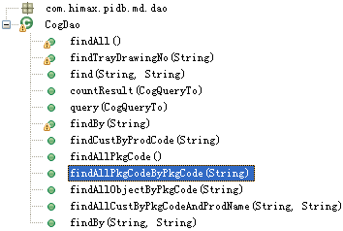
findAllPkgCodeByPkgCode(String)
Find a list of PKG_CODE’s value illegible by PKG_CODE
String | A String
Returns | A list of CogTo object.
findAllObjectByPkgCode(String)
Find all CogTo object by PKG_CODE.
String | Value of ‘PKG_CODE’.
Returns | A list of CogTo object.
findAllCustByPkgCodeAndProdName(String, String)
Find all CogTo object by PKG_CODE and PROD_NAME
String | Value of ‘PKG_CODE’.
String | Value of ‘PROD_NAME’.
Returns | A list of CogTo object.
findBy(String, String)
Find one CogTo object by PROD_CODE and PKG_CODE.
Returns | A list of PKG_CODE values.

Slide 13
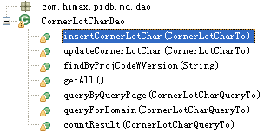
This class do action with table PIDB_CORNER_LOT_CHAR.
insertCornerLotChar(CornerLotCharTo)
Insert one CornerLotCharTo object into table PIDB_CORNER_LOT_CHAR.
CornerLotCharTo | A CornerLotCharTo object.
Returns | void
updateCornerLotChar(CornerLotCharTo)
Update one CornerLotCharTo object in table PIDB_CORNER_LOT_CHAR.
CornerLotCharTo | A CornerLotCharTo object.
Returns | void
findByProjCodeWVersion(String)
Find one CornerLotCharTo object by PROJ_CODE_W_VERSION.
String | PROJ_CODE_W_VERSION value.
Returns | One CornerLotCharTo object.
getAll()
Get all CornerLotCharTo objects from database.
Returns | A list of CornerLotCharTo object.
queryByQueryPage(CornerLotCharQueryTo)
Query a list of CornerLotCharQueryTo objects by a CornerLotCharQueryTo object.
CornerLotCharQueryTo |  | A CornerLotCharQueryTo object
Returns |  | A list of CornerLotCharQueryTo object.

Slide 14
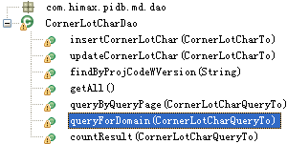
queryForDomain(CornerLotCharQueryTo)
Query a list of CornerLotCharTo objects by a CornerLotCharQueryTo object.
CornerLotCharQueryTo | A CornerLotCharQueryTo object
Returns | A list of CornerLotCharTo object.
countResult(CornerLotCharQueryTo)
Count the number of query result by a CornerLotCharQueryTo object.
CornerLotCharQueryTo | A CornerLotCharQueryTo object
Returns | Number of query result.

Slide 15
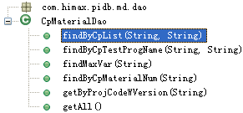
This class do action with table PIDB_CP_MATERIAL.
findByCpList(String, String)
Find a CpMaterialTo object by CP_TEST_PROGRAM_NAME_LIST and PROJECT_CODE_W_VERSION.
String | A CP_TEST_PROGRAM_NAME_LIST value.
String | A PROJECT_CODE_W_VERSION value.
Returns | One CpMaterialTo object.
findByCpTestProgName(String, String)
Find a list of CpMaterialTo objects by CP_TEST_PROGRAM_NAME_LIST and PROJECT_CODE_W_VERSION.
String | A CP_TEST_PROGRAM_NAME_LIST value.
String | A PROJECT_CODE_W_VERSION value.
Returns | A list of CpMaterialTo objects.
findMaxVar(String)
Find the max value of CP_VARIANT by PROJECT_CODE_W_VERSION .
String | PROJ_CODE_W_VERSION value.
Returns | Object.
findByCpMaterialNum(String)
Find a CpMaterialTo object by CP_MATERIAL_NUM.
String | A CP_MATERIAL_NUM value.
Returns | One CpMaterialTo object.

Slide 16
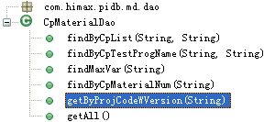
getByProjCodeWVersion(String)
Find a list of CpMaterialTo objects by PROJECT_CODE_W_VERSION .
String | PROJ_CODE_W_VERSION value.
Returns | A list of CpMaterialTo objects.
getAll()
Find all CpMaterialTo objects in table PIDB_CP_MATERIAL.
Returns | A list of CpMaterialTo objects.

Slide 17
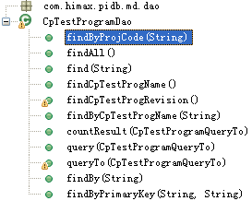
This class do action with table PIDB_CP_TEST_PROGRAM.
findByProjCode(String)
Find a list of CpTestProgramTo objects by PROJ_CODE.
String | PROJ_CODE value.
Returns | A list of CpTestProgramTo objects.
findAll()
Find all CpTestProgramTo objects.
Returns | A list of CpTestProgramTo objects.
Find(String)
Find a CpTestProgramTo object by CP_TEST_PROG_NAME.
String | CP_TEST_PROG_NAME value.
Returns | One CpTestProgramTo object .
findCpTestProgName()
Find all distinct value of CP_TEST_PROG_NAME from table PIDB_CP_TEST_PROGRAM.
Returns | A list value of CP_TEST_PROG_NAME,
findCpTestProgRevision()
Find all distinct value of CP_TEST_PROG_VERSION from table PIDB_CP_TEST_PROGRAM.
Returns | A list value of CP_TEST_PROG_VERSION ,
findByCpTestProgName(String)
Find a CpTestProgramTo object by CP_TEST_PROG_NAME.
String | CP_TEST_PROG_NAME value.
Returns | A CpTestProgramTo object .

Slide 18
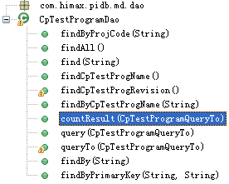
countResult(CpTestProgramQueryTo)
Count the number of query result by a CpTestProgramQueryTo object.
Returns | Number of query Result.
query(CpTestProgramQueryTo)
Query CpTestProgramTo objects by a CpTestProgramQueryTo object.
CpTestProgramQueryTo | A CpTestProgramQueryTo object.
Returns | A list of CpTestProgramTo objects .
queryTo(CpTestProgramQueryTo)
Query CpTestProgramTo objects by a CpTestProgramQueryTo object.
CpTestProgramQueryTo | A CpTestProgramQueryTo object.
Returns | A list of CpTestProgramTo objects .
findBy(String)
Find all value of PKG_CODE by PROD_CODE.
String | PROD_CODE value.
Returns | A list of PKG_CODE value.
findByPrimaryKey(String, String)
Find a CpTestProgramTo object by CP_TEST_PROG_NAME and PROG_CODE_W_VERSION .
String | CP_TEST_PROG_NAME value.
String | PROG_CODE_W_VERSION value.
Returns | A CpTestProgramTo object .

Slide 19
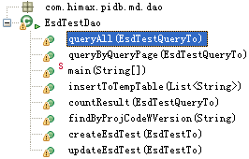
This class do action with table PIDB_ESD_TEST.
queryAll(EsdTestQueryTo)
Query all EsdTestQueryTo objects from table.
EsdTestQueryTo | A EsdTestQueryTo object.
Returns | A list of EsdTestQueryTo objects.
queryByQueryPage(EsdTestQueryTo)
Find EsdTestTo objects by a EsdTestQueryTo object.
EsdTestQueryTo | A EsdTestQueryTo object.
Returns | A list of CpTestProgramTo objects.
insertToTempTable(List)
Insert a list of PROJ_NAME into table PIDB_TEMP_PROJ_NAME.
List | A list of PROJ_NAME value.
Returns | Void.
countResult(EsdTestQueryTo )
Count the number of query result.
EsdTestQueryTo | A EsdTestQueryTo object.
Returns | The number of query result.
findByProjCodeWVersion(String)
Find a EsdTestTo object by PROJ_CODE_W_VERSION.
String | PROJ_CODE_W_VERSION value.
Returns | A CpTestProgramTo object.

Slide 20
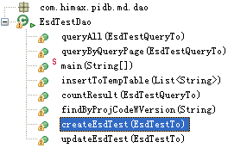
createEsdTest(CpTestProgramTo )
Insert a CpTestProgramTo object to the table PIDB_ESD_TEST.
CpTestProgramTo | A CpTestProgramTo object.
Returns | void
updateEsdTest(CpTestProgramTo )
Insert a CpTestProgramTo object in the table PIDB_ESD_TEST.
CpTestProgramTo | A CpTestProgramTo object.
Returns | void

Slide 21
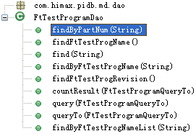
This class do action with table PIDB_FT_TEST_PROGRAM.
findByPartNum(String)
Find FtTestProgramTo objects by PART_NUM.
String | PART_NUM value.
List | List of object, null object will skipped.
Returns | A list of FtTestProgramTo objects .
findFtTestProgName()
Find all distinct FT_TEST_PROG_NAME values.
Returns | A list of FT_TEST_PROG_NAME values.
find(String)
Find a FtTestProgramTo object by FT_TEST_PROG_NAME.
String | FT_TEST_PROG_NAME value.
Returns | A FtTestProgramTo object.
findByFtTestProgName(String)
Find a FtTestProgramTo object by FT_TEST_PROG_NAME.
String | FT_TEST_PROG_NAME value.
Returns | A FtTestProgramTo object.
findFtTestProgRevision()
Find all distinct FT_TEST_PROG_REVISION values.
Returns | A list of FT_TEST_PROG_REVISION values.

Slide 22
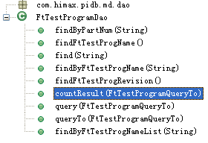
countResult(FtTestProgramQueryTo)
Count the number of queryResult by FtTestProgramQueryTo.
FtTestProgramQueryTo |  | A FtTestProgramQueryTo object
Returns |  | The number of the query result.
query(FtTestProgramQueryTo)
Query FtTestProgramTo objects by a FtTestProgramQueryTo object.
FtTestProgramQueryTo |  | A FtTestProgramQueryTo object.
Returns |  | A list of FtTestProgramTo objects.
queryTo(FtTestProgramQueryTo)
Query FtTestProgramTo objects by a FtTestProgramQueryTo object.
FtTestProgramQueryTo |  | A FtTestProgramQueryTo object.
Returns |  | A list of FtTestProgramTo objects.
findByFtTestProgNameList(String)
Find FtTestProgramTo objects by FT_TEST_PROG_NAME.
String |  | FT_TEST_PROG_NAME value.
Returns | A list of FtTestProgramTo objects.

Slide 23
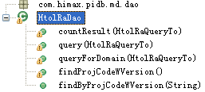
This class do action with table PIDB_HTOL_RA.
countResult(HtolRaQueryTo)
Count the number of query result by a HtolRaQueryTo object.
HtolRaQueryTo |  | A HtolRaQueryTo object.
Returns |  | Number of query result.
query(HtolRaQueryTo)
Find HtolRaQueryTo objects by a HtolRaQueryTo object.
Returns |  | A list of HtolRaQueryTo objects .
queryForDomain(HtolRaQueryTo)
Find HtolRaQueryTo objects by a HtolRaQueryTo object.
HtolRaQueryTo |  | A HtolRaQueryTo object.
Returns |  | A list of HtolRaQueryTo objects .
findProjCodeWVersion(String)
Find all distinct PROJ_CODE_W_VERSION value illegible by PROJ_CODE_W_VERSION.
String | PROJ_CODE_W_VERSION value.
Returns | A list of HtolRaTo objects including all distinct PROJ_CODE_W_VERSION .
findByProjCodeWVersion(String)
Find a HtolRaTo object by PROJ_CODE_W_VERSION .
String | PROJ_CODE_W_VERSION value.
Returns | A HtolRaTo object .

Slide 24
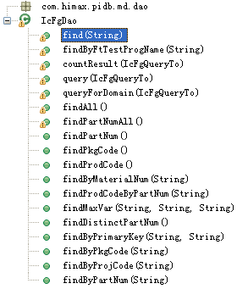
This class do action with table PIDB_IC_FG.
find(String)
Find a IcFgTo object by PART_NUM.
String |  | PART_NUM value.
Returns |  | A IcFgTo object.
findByFtTestProgName(String)
Find IcFgTo objects by ftTestProgName.
String |  | ftTestProgName
Returns |  | A list of IcFgTo objects .
countResult(IcFgQueryTo)
Count the number of query result by a IcFgQueryTo object.
IcFgQueryTo |  | A IcFgQueryTo object.
Returns |  | The number of query result.
query(IcFgQueryTo)
Find IcFgTo objects by a IcFgQueryTo object.
IcFgQueryTo |  | A IcFgQueryTo object.
Returns |  | A list of IcFgTo objects .
queryForDomain(IcFgQueryTo)
Find IcFgTo objects by a IcFgQueryTo object.
IcFgQueryTo |  | A IcFgQueryTo object.
Returns | A list of IcFgTo objects .

Slide 25
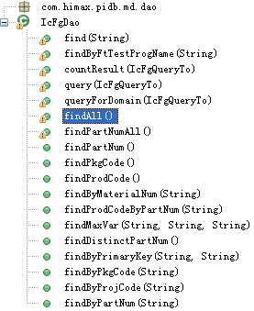
findAll()
Find all IcFgTo objects.
Returns |  | A list of IcFgTo objects.
findPartNumAll()
Find IcFgTo objects with distinct PART_NUM, PROD_CODE, MATERIAL_NUM and PKG_CODE.
Returns |  | A list of IcFgTo objects.
findPartNum()
Find IcFgTo objects with distinct PART_NUM.
Returns |  | A list of IcFgTo objects.
findPkgCode()
Find IcFgTo objects with distinct PKG_CODE.
Returns |  | A list of IcFgTo objects .
findProdCode()
Find all distinct PROD_CODE value.
Returns | A list of PROD_CODE value .
findByMaterialNum(String)
Find a IcFgTo object by MATERIAL_NUM.
String |  | MATERIAL_NUM value.
Returns |  | A IcFgTo object.

Slide 26
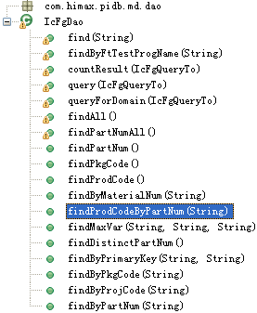
findProdCodeByPartNum(String)
Find a PROD_CODE value by PART_NUM.
String |  | PART_NUM value.
Returns |  | A PROD_CODE value .
findMaxVar(String, String, String)
Find a IcFgTo object with max VARIANT value by PROD_NAME, PROJ_CODE and PKG_CODE..
String |  | PROD_NAME value.
String |  | PROJ_CODE value.
String |  | PKG_CODE value.
Returns |  | A IcFgTo object with max VARIANT value .
findDistinctPartNum()
Find IcFgTo objects with distinct PART_NUM value.
Returns |  | A IcFgTo object.
findByPrimaryKey(String, String)
Find a IcFgTo object by MATERIAL_NUM and PART_NUM.
String |  | MATERIAL_NUM value.
String |  | PART_NUM value.
Returns |  | A cFgTo object .
findByPkgCode(String)
Find IcFgTo objects by PKG_CODE.
String |  | PKG_CODE value.
Returns | A list of IcFgTo objects .

Slide 27
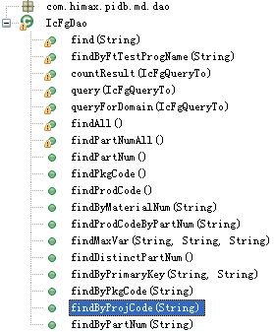
findByProjCode(String)
Find IcFgTo objects by PROJ_CODE.
String | PROJ_CODE value.
Returns | A list of IcFgTo objects .
findByPartNum(String)
Find IcFgTo objects by PART_NUM.
String | PART_NUM value.
Returns | A list of IcFgTo objects .

Slide 28
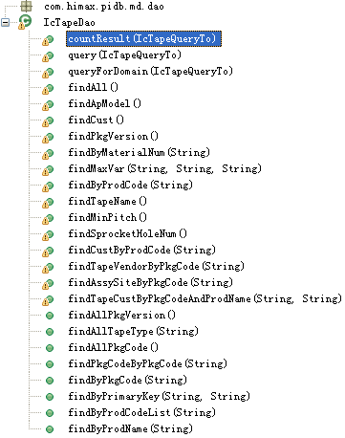
This class do action with table PIDB_IC_TAPE.
countResult(IcTapeQueryTo)
Count the number of query result by a IcTapeQueryToobject.
IcTapeQueryTo |  | A IcTapeQueryTo object.
Returns |  | The number of query result.
Query(IcTapeQueryTo )
Find IcTapeQueryT oobjects by a IcTapeQueryTo object
IcTapeQueryTo |  | A IcTapeQueryTo object
Returns |  | A list of IcFgTo objects .
queryForDomain(IcTapeQueryTo)
Find IcTapeQueryT oobjects by a IcTapeQueryTo object
IcTapeQueryTo |  | A IcTapeQueryTo object.
Returns |  | A list of IcFgTo objects .
findAll()
Find all IcFgTo objects.
Returns |  | A list of IcFgTo objects .
findApModel()
Find IcFgTo objects with distinct TAPE_CUST_PROJ_NAME.
Returns | A list of IcFgTo objects .
findCust()
Find IcFgTo objects with distinct TAPE_CUST.
Returns | A list of IcFgTo objects .

Slide 29
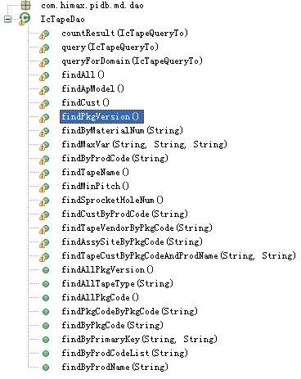
findPkgVersion()
Find IcFgTo objects with distinct PKG_VERSION.
Returns | A list of IcFgTo objects .
findByMaterialNum(String)
Find a IcTapeQueryT object by MATERIAL_NUM.
String | MATERIAL_NUM value
Returns | A IcFgTo object.
findMaxVar(String, String, String)
Find a IcTapeQueryT object with max TAPE_VARIANT value.
String | PROD_NAME value.
String | PKG_CODE value.
String | PKG_VERSION value.
Returns | A IcFgTo object.
findByProdCode(String)
Find all distinct PKG_CODE, TAPE_CUST and TAPE_CUST_PROJ_NAME by PROD_CODE.
String | PROD_CODE value.
Returns | A list of map.
findTapeName()
Find a IcTapeQueryT object with distinct TAPE_NAME.
Returns | A list of IcFgTo objects .

Slide 30
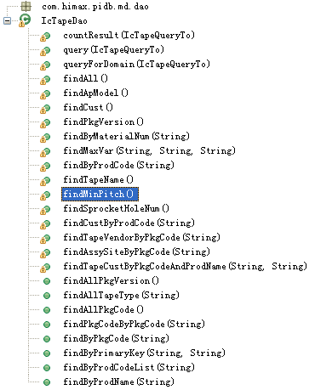
findMinPitch()
Find IcFgTo objects with distinct MIN_PITCH value..
Returns | A list of IcFgTo objects .
findSprocketHoleNum()
Find IcFgTo objects with distinct SPROCKET_HOLE_NUMvalue..
Returns | A list of IcFgTo objects .
findCustByProdCode(String)
Find all TAPE_CUST values by PROD_CODE..
String | PROD_CODE value.
Returns | A list of TAPE_CUST values.
findTapeVendorByPkgCode(String)
Find all distinct TAPE_VENDOR valuesby PKG_CODE.
String | PKG_CODE value.
Returns | A list of TAPE_VENDOR values.
findAssySiteByPkgCode(String)
Find all distinct ASSY_SITE values by PKG_CODE.
String | PKG_CODE value.
Returns | A list of ASSY_SITE values.

Slide 31
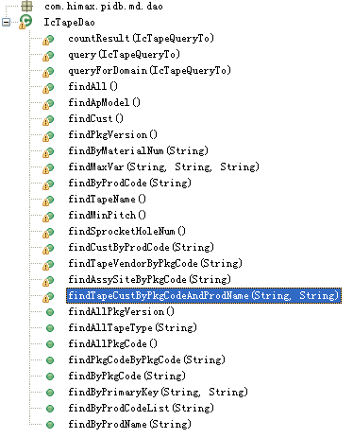
findTapeCustByPkgCodeAndProdName(String, String)
Find all distinct TAPE_CUST values by PKG_CODE and PROD_NAME.
String | PKG_CODE value.
String | PROD_NAME value.
Returns | A list of TAPE_CUST values .
findAllPkgVersion()
Find all distinct PKG_VERSION values.
Returns | A list of PKG_VERSION values .
findAllTapeType(String)
Find all distinct APE_TYPE values by PKG_CODE..
String | PKG_CODE value.
Returns | A list of APE_TYPE values.
findAllPkgCode()
Find all distinct PKG_CODE values.
Returns | A list of PKG_CODE values.
findPkgCodeByPkgCode(String)
Find all distinct PKG_CODE values by PKG_CODE.
String | PKG_CODE value.
Returns | A list of PKG_CODE values.

Slide 32
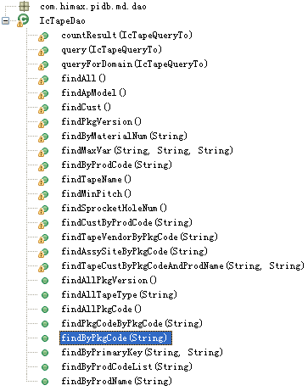
findByPkgCode(String)
Find all IcTapeTo objects by PKG_CODE.
String | PKG_CODE value.
Returns | A list of IcTapeTo objects.
findByPrimaryKey(String, String)
Find a IcTapeTo object by MATERIAL_NUM and TAPE_NAME.
String | MATERIAL_NUM value.
String | TAPE_NAME value.
Returns | A IcTapeTo object.
findByProdCodeList(String)
Find all IcTapeTo object by PROD_CODE.
String | A list of PROD_CODE value.
Returns | A list of IcTapeTo objects.
findByProdName(String)
Find all IcTapeTo objects by PROD_NAME.
String | PROD_NAME value.
Returns | A list of IcTapeTo objects .

Slide 33
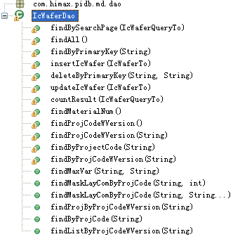
This class do action with table PIDB_IC_WAFER.
findBySearchPage(IcWaferTo)
Query IcWaferTo objects by a IcWaferTo object.
IcWaferTo | A IcWaferTo object.
Returns | A list of IcWaferTo objects.
findAll()
Find all IcWaferTo objects.
Returns | A list of IcWaferTo objects.
findByPrimaryKey(String)
Find a IcWaferTo object by MATERIAL_NUM.
String | MATERIAL_NUM value.
Returns | A IcWaferTo object.
insertIcWafer(IcWaferTo)
Insert a IcWaferTo object to table PIDB_IC_WAFER.
IcWaferTo | A IcWaferTo object.
Returns | Void.
deleteByPrimaryKey(String, String)
Delete a IcWaferTo object by MATERIAL_NUM and PROJ_CODE_W_VERSION from table PIDB_IC_WAFER.
String | MATERIAL_NUM value.
String | PROJ_CODE_W_VERSION value.
Returns | void

Slide 34
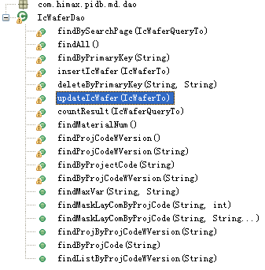
updateIcWafer(IcWaferTo)
Update one IcWaferTo objec.
IcWaferTo | A IcWaferTo object.
Returns | Void.
countResult(IcWaferQueryTo)
Count the number of query result by IcWaferQueryTo.
IcWafeQueryrTo | A IcWafeQueryrTo object.
Returns | Number of query result.
findMaterialNum()
Find all distinct MATERIAL_NUM values.
Returns | A list of MATERIAL_NUM values.
findProjCodeWVersion()
Find all distinct PROJ_CODE_W_VERSION values.
Returns | A list of PROJ_CODE_W_VERSIONvalues values.
findProjCodeWVersion(String)
Find distinct PROJ_CODE_W_VERSION values by PROJ_CODE..
String | PROJ_CODE value.
Returns | A list of PROJ_CODE_W_VERSIONvalues values.
findByProjectCode(String)
Find IcWaferTo objects by PROJ_CODE.
String | PROJ_CODE value.
Returns | A list of IcWaferTo objects.

Slide 35
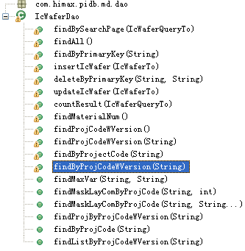
findByProjCodeWVersion(String)
Find a IcWaferTo objec by PROJ_CODE_W_VERSION.
String | PROJ_CODE_W_VERSION value.
Returns | A IcWaferTo objec .
findMaxVar(String, String)
Find the max VARIANT value by PROJ_CODE_W_VERSION and FAB.
String | PROJ_CODE_W_VERSION value.
String | FAB value
Returns | The max VARIANT value.
findMaskLayComByProjCode(String, int)
Find all distinct MASK_LAYER_COM values by PROJ_CODE.
String | PROJ_CODE value
int | The length of PROJ_CODE.
Returns | A list of MASK_LAYER_COM values .
findMaskLayComByProjCode(String, String…)
Find all distinct MASK_LAYER_COM values by PROJ_CODE.
String | PROJ_CODE value
String…
Returns | A list of PROJ_CODE_W_VERSION values values.

Slide 36
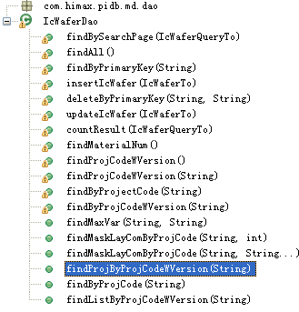
findProjByProjCodeWVersion(String)
Find IcWaferTo objecs by PROJ_CODE_W_VERSION.
String | PROJ_CODE_W_VERSION value
Returns | A list of IcWaferTo objects .
findByProjCode(String)
Find IcWaferTo objecs by PROJ_CODE.
String | PROJ_CODE value.
Returns | A list of IcWaferTo objects .
findListByProjCodeWVersion(String)
Find IcWaferTo objecs by PROJ_CODE_W_VERSION.
String | PROJ_CODE_W_VERSION value.
Returns | A list of IcWaferTo objects .

Slide 37

This class do action with table PIDB_IF_MATERIAL_CHARACTER.
batchInsert(List<IfMaterialCharacterTo>, String)
Insert a list of IfMaterialCharacterTo objects to table PIDB_IF_MATERIAL_CHARACTER.
List<IfMaterialCharacterTo> | A list of IfMaterialCharacterTo objects
String | Table name
Returns | void
Insert(IfMaterialCharacterTo)
Insert one IfMaterialCharacterTo object to table PIDB_IF_MATERIAL_CHARACTER.
IfMaterialCharacterTo | A IfMaterialCharacterTo object.
Returns | Void .

Slide 38

This class do action for IfMaterialMaster.
batchInsert(List<IfMaterialMasterTo>, String)
Insert a list of IfMaterialMasterTo objects to table.
List< IfMaterialMasterTo > | A list of IfMaterialMasterTo objects
String | Table name
Returns | void

Slide 39

This class do action with table PIDB_IF_PROJECT_CODE.
insert(IfProjectCodeTo)
Insert one IfProjectCodeTo object in to table PIDB_IF_PROJECT_CODE.
IfProjectCodeTo | A IfProjectCodeTo object.
Returns | void
findByProjCode(String)
Find one IfProjectCodeTo object by PROJ_CODE.
String | PROJ_CODE value.
Returns | IfProjectCodeTo object.

Slide 40
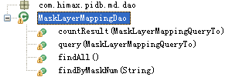
This class do action with table PIDB_MASK_LAYER_MAPPING.
countResult(MaskLayerMappingQueryTo)
Count the number of query resuult by a MaskLayerMappingQueryTo object.
MaskLayerMappingQueryTo |  | A MaskLayerMappingQueryTo object.
Returns |  | The number of query resuult.
query(MaskLayerMappingQueryTo)
Query MaskLayerMappingTo objects by a MaskLayerMappingQueryTo object.
MaskLayerMappingQueryTo |  | A MaskLayerMappingQueryTo object.
Returns |  | A list of MaskLayerMappingTo objects.
findAll()
Find all MaskLayerMappingTo objects.
Returns | A list of MaskLayerMappingTo objects.
findByMaskNum(String)
Find one MaskLayerMappingTo object by MASK_NUM.
String |  | MASK_NUM value.
Returns |  | A MaskLayerMappingTo object.

Slide 41
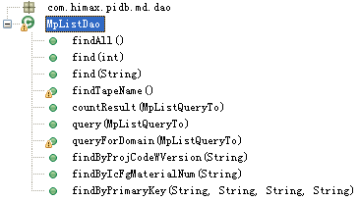
This class do action with table PIDB_MP_LIST.
findAll()
Find all MpListTo objects.
Returns | A list of MpListTo objects.
Find(int)
Find onel MpListTo object by ID.
Int | ID value.
Returns | A MpListTo object.
Find(String)
Find onel MpListTo object by PART_NUM.
String | PART_NUM value.
Returns | A MpListTo object.
findTapeName()
Find all distinct TAPE_NAME values.
Returns | A list of TAPE_NAME values.
countResult(MpListQueryTo)
Count the number of query result by a MpListQueryTo object.
MpListQueryTo | A MpListQueryTo object.
Returns | The number of query result.

Slide 42
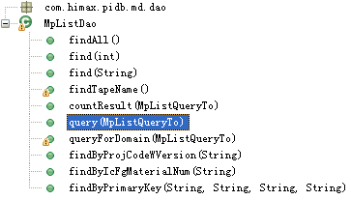
Query(MpListQueryTo)
Query MpListTo objects by a MpListQueryTo object.
MpListQueryTo | A MpListQueryTo object.
Returns | A list of MpListTo objects.
queryForDomain(MpListQueryTo)
Query MpListTo objects by a MpListQueryTo object.
MpListQueryTo | A MpListQueryTo object.
Returns | A list of MpListTo objects.
findByProjCodeWVersion(String)
Find one MpListTo object by PROJ_CODE_W_VERSION.
String | PROJ_CODE_W_VERSION value.
Returns | One MpListTo object.
findByIcFgMaterialNum(String)
Find MpListTo objecst by IC_FG_MATERIAL_NUM.
String | IC_FG_MATERIAL_NUM value..
Returns | A list of MpListTo objects.
findByPrimaryKey(String, String, String, String)
Find one MpListTo object by primaryKey.
String | IC_FG_MATERIAL_NUM value.
String | PROJ_CODE_W_VERSION value
String | TAPE_NAME value
String | PKG_CODE value
Returns | One MpListTo object.

Slide 43
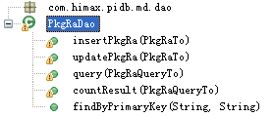
This class do action with table PIDB_PACKAGE_RA.
insertPkgRa(PkgRaTo)
Insert one PkgRaTo object into table PIDB_PACKAGE_RA.
PkgRaTo | A PkgRaTo object.
Returns | Void.
updatePkgRa(PkgRaTo)
Update one PkgRaTo object.
PkgRaTo | A PkgRaTo object.
Returns | Void.
Query(PkgRaQueryTo)
Query PkgRaTo objects by a PkgRaQueryTo object.
PkgRaQueryTo | A PkgRaQueryTo object.
Returns | A list of PkgRaTo objects.
countResult(PkgRaQueryTo)
Count the number of query result by PkgRaQueryTo.
PkgRaQueryTo | A PkgRaQueryTo object.
Returns | The number of query result.
findByPrimaryKey(String, String)
Find one PkgRaTo object by PROD_NAME and PKG_CODE.
String | PROD_NAME value.
String | PKG_CODE value.
Returns | A PkgRaTo object.

Slide 44
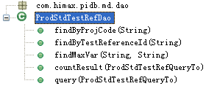
This class do action with table PIDB_PROD_STD_TEST_REF.
findByProjCode(String)
Find ProdStdTestRefTo objects by PROJ_CODE.
String | PROJ_CODE value.
Returns | A list of ProdStdTestRefTo objects.
findByTestReferenceId(String)
Find one ProdStdTestRefTo object by TEST_REFERENCE_ID.
String | TEST_REFERENCE_ID value.
Returns | One ProdStdTestRefTo object.
findMaxVar(String, String)
Find a Object with max VARIANT by PRODUCT_LINE and PRODUCT_FAMILY.
String | PRODUCT_LINE value.
String | PRODUCT_FAMILY value.
Returns | A object with max VARIANT value.
countResult(ProdStdTestRefQueryTo)
Count the number of query result by ProdStdTestRefQueryTo.
ProdStdTestRefQueryTo |  | A ProdStdTestRefQueryToobject.
Returns |  | The number of query result.
Query(ProdStdTestRefQueryTo)
Query ProdStdTestRefTo objects by a ProdStdTestRefQueryTo object.
ProdStdTestRefQueryTo |  | A ProdStdTestRefQueryToobject.
Returns |  | A list of ProdStdTestRefTo objects .

Slide 45
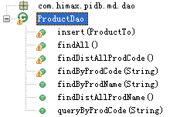
This class do action with table PIDB_PRODUCT.
Insert(ProductTo)
Insert one ProductTo object into table PIDB_PRODUCT.
ProductTo | A ProductTo object.
Returns | Void.
findAll()
Find all ProductTo objects.
Returns | A list fo ProductTo objects.
findDistAllProdCode()
Find all distinct PROD_CODE values.
Returns | A list of distinct PROD_CODE values.
findByProdCode(String)
Find one ProductTo object by PROD_CODE .
String |  | PROD_CODE value.
Returns |  | One ProductTo object.
findByProdName(String)
Find ProductTo objects by PROD_NAME.
String |  | PROD_NAME value.
Returns |  | A list of ProductTo objects .
findDistAllProdName()
Find all distinct PROD_NAME values.
Returns |  | A list of PROD_NAME values .

Slide 46
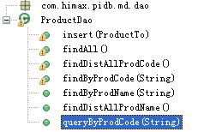
queryByProdCode(String)
Find ProductTo objects by PROD_CODE.
String | PROD_CODE value.
Returns | A list of ProductTo objects .

Slide 47
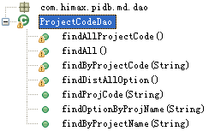
This class do action with table PIDB_PROJECT_CODE.
findAllProjectCode()
Find all PROJ_CODE values.
Returns | A list of PROJ_CODE values.
findAll()
Find all ProjectCodeTo objects.
Returns | A list fo ProjectCodeTo objects.
findByProjectCode(String)
Find ProjectCodeTo objects by PROJ_CODE.
String |  | PROJ_CODE value.
Returns | A list fo ProjectCodeTo objects.
findDistAllOption()
Find all distinct PROJ_OPTION values.
Returns |  | A list of PROJ_OPTION values.
findProjCode(String)
Find all distinct PROJ_CODE values by PROJ_NAME.
String |  | PROJ_NAMEvalue.
Returns |  | A list of PROJ_CODE values .
findOptionByProjName(String)
Find one PROJ_OPTION value by PROJ_NAME.
String |  | PROJ_NAME value.
Returns |  | A String of PROJ_OPTION value.

Slide 48
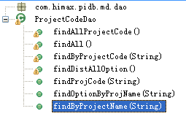
findByProjectName(String)
Find ProjectCodeTo objects by PROJ_NAME.
String | PROJ_NAME value.
Returns | A list fo ProjectCodeTo objects.

Slide 49
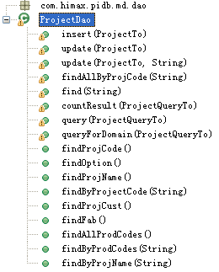
This class do action with table PIDB_PROJECT.
insert(ProjectTo)
Insert one ProjectTo object into table.
ProjectTo | A ProjectTo object.
Returns | Void.
Update(ProjectTo)
Update one ProjectTo object.
ProjectTo | A ProjectTo object.
Returns | Void.
Update(ProjectTo, String)
Update one ProjectTo object.
ProjectTo | A ProjectTo object.
String | Action description.
Returns | Void.
findAllByProjCode(String)
Find ProjectTo objects by PROJ_CODE.
String |  | PROJ_CODE value.
Returns |  | A list of ProjectTo objects .
Find(String)
Find one ProjectTo object.
String |  | PROJ_NAME value.
Returns |  | A ProjectTo object.

Slide 50
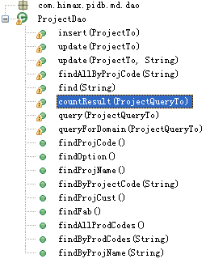
countResult(ProjectQueryTo)
Count the number of query result by a ProjectQueryTo object.
ProjectQueryTo | A ProjectQueryTo object.
Returns | The number of query result.
Query(ProjectQueryTo)
Query ProjectTo objects by a ProjectQueryTo object.
ProjectQueryTo | A ProjectQueryTo object.
Returns | A list of ProjectTo objects.
queryForDomain(ProjectQueryTo)
Query ProjectTo objects by a ProjectQueryTo object.
ProjectQueryTo | A ProjectQueryTo object.
Returns | A list of ProjectTo objects.
findProjCode()
Find all distinct PROJ_CODE vaues.
Returns |  | A list of PROJ_CODE vaues.
findOption()
Find all distinct PROJ_OPTION vaues.
Returns |  | A list of PROJ_OPTION vaues.
findProjName()
Find all distinct PROJ_NAME vaues.
Returns |  | A list of PROJ_NAME vaues.

Slide 51
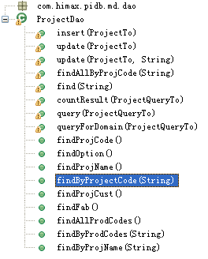
findByProjectCode(String)
Find one ProjectTo object by PROJ_CODE.
String | PROJ_CODE value.
Returns | One ProjectTo objeect.
findProjCust()
Find all distinct CUST values.
Returns | A list of CUST values
findFab()
Find all distinct FAB values.
Returns | A list of FAB values
findAllProdCodes()
Find all PROD_CODE values.
Returns | A list of PROD_CODE values.
findByProdCodes(String)
Find ProjectTo objects by PROD_CODE.
String | PROD_CODE value.
Returns | A list of ProjectTo objects .
findByProjName(String)
Find one ProjectTo object by PROJ_NAME.
String | PROJ_NAME value.
Returns | One ProjectTo object .

Slide 52


Slide 53
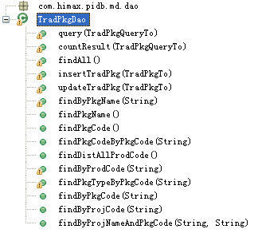
This class do action with table PIDB_TRADITIONAL_PKG.
Query(TradPkgQueryTo)
Query TradPkgTo objects by a TradPkgQueryTo object.
TradPkgQueryTo | A TradPkgQueryTo object.
Returns | A list of TradPkgTo objects.
countResult(TradPkgQueryTo)
Count the number of query result by TradPkgQueryTo.
TradPkgQueryTo | A TradPkgQueryTo object.
Returns | The number of query result.
findAll()
Fjind all TradPkgTo objects.
Returns | A list of TradPkgTo objects.
insertTradPkg(TradPkgTo )
Insert a TradPkgTo object into table.
TradPkgTo |  | A TradPkgTo object.
Returns |  | Void.
updateTradPkg(TradPkgTo )
Update a TradPkgTo obeject in table.
TradPkgTo |  | A TradPkgTo object.
Returns |  | Void.

Slide 54
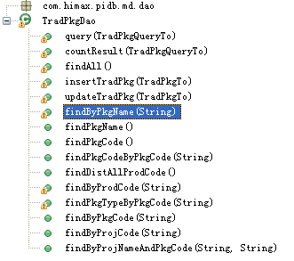
findByPkgName(String)
Find one TradPkgTo object by PKG_NAME.
String | PKG_NAME value.
Returns | One TradPkgTo object.
findPkgName()
Find all distinct PKG_NAME values.
Returns | A list of PKG_NAME values.
findPkgCode()
Find all distinct PKG_CODE values.
Returns | A list of PKG_CODE values.
findPkgCodeByPkgCode(String)
Find PKG_CODE values by PKG_CODE.
String |  | PKG_CODE value..
Returns |  | A list of PKG_CODE values.
findDistAllProdCode()
Find all distinct PROD_CODEvalues.
Returns |  | A list of PROD_CODEvalues values.
findByProdCode(String)
Find all distinct PKG_CODE values illegible by a String.
String |  | A String.
Returns |  | A list of PKG_CODE values .

Slide 55
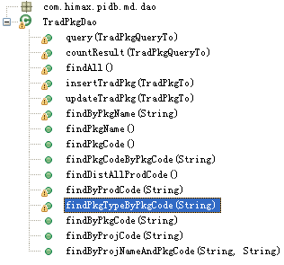
findPkgTypeByPkgCode(String)
Find distinct TRAD_PKG_TYPE values by PKG_CODE..
String | PKG_CODE value.
Returns | A list of TRAD_PKG_TYPE values.
findByPkgCode(String)
Find TradPkgTo objects by PKG_CODE.
String | PKG_CODE value.
Returns | A TradPkgTo object.
findByProjCode(String)
Find PKG_CODE values by PROJ_CODE.
String | PROJ_CODE value.
Returns | A list of PKG_CODE values.
findByProjNameAndPkgCode(String, String)
Find TradPkgTo objects by PROJ_NAME and PKG_CODE.
String |  | PROJ_NAME value..
String |  | PKG_CODE value..
Returns |  | A list of TradPkgTo objects.

Slide 56

This class is BumpMaskERP release to ERP.
release(Object, UserTo)
For all IC_Wafer with same project code, If T_IC_Wafer.ROUTING_BP = yes, Insert Bumping Mask(With same project code) record into PIDB_IF_MATERIAL_MASTER (Materila Number為Wafer Material Number的第一碼從”W”改成”B”) & PIDB_IF_MATERIAL_CHARACTER.
Object | BumpMaskTo object.
UserTo | userTo object.
Returns | Return “null” if finished release to ERP or return error message.

Slide 57

This class is CpTestProgramERP release to ERP.
release(Object, UserTo)
Insert CP (Get Material Number from T_CP_MATERIAL where T_CP_MATERIAL.CP_TEST_PROGRAM_NAME_LIST contains this CP Test Program Name ) record into PIDB_IF_MATERIAL_MASTER & PIDB_IF_MATERIAL_CHARACTER。 If T_CP_MATERIAL.CP_TEST_PROGRAM_NAME_LIST contains more than one CP test program, need to add up characteristics CP_CPU_Time and CP_Index_Time before inserting into interface table, other characteristics from CP test program master needs to be connected by “,” before inserting into interface table .
Object | CpTestProgramTo object .
UserTo | UserTo object .
Returns | Return “null” if finished release to ERP or return error message.

Slide 58

ERPHelper is a helper class that gets messages from PIDBContext class release to ERP.
getMaterialType(String)
Get a material type from resource.
String | md.
Returns | A string of material type .
getMaterialGroup(String, String)
Get a message from resource.
String | Material type.
String | arg2.
Returns | A string of message.
getErrorMessage(String)
Get a error message from resource.
String | Error code.
Returns | A string of error message .

Slide 59

This class is FtTestProgramERP release to ERP.
release(Object, UserTo)
Insert FG (Get from T_IC_FG where T_IC_FG.FT_TEST_PROGRAM_LIST contains this FT test program) record into PIDB_IF_MATERIAL_MASTER & PIDB_IF_MATERIAL_CHARACTER according to class CLFT_01, if T_IC_FG. CP_TEST_PROGRAM_NAME_LIST contains more than one FT test programs, need to add up characteristics FT_CPU_Time and FT_Index_Time before inserting into .
Object | FtTestProgramTo object.
UserTo | UserTo object.
Returns | Return “null” if finished release to ERP or return error message.

Slide 60

This class is IcFgERP release to ERP.
release(Object, UserTo)
Insert FG record into PIDB_IF_MATERIAL_MASTER. If T_IC_FG.PKG_TYPE =Traditional Package, Insert into PIDB_IF_MATERIAL_CHARACTER according to class CLFG_01, else insert into PIDB_IF_MATERIAL_CHARACTER according to class CLFT_01. if T_IC_FG. CP_TEST_PROGRAM_NAME_LIST contains more than one FT test programs, need to add up characteristics FT_CPU_Time and FT_Index_Time before inserting into interface table, other characteristics from FT test program master needs to be connected by “,” before inserting into interface table . If T_IC_FG.ROUTING_AS = yes Insert AS record into PIDB_IF_MATERIAL_MASTER. If T_IC_FG.PKG_TYPE =Traditional Package, Insert into PIDB_IF_MATERIAL_CHARACTER according to class CLAS_01, else insert into PIDB_IF_MATERIAL_CHARACTER according to class CLIL_01 According to T_IC_FG.CP_MATERIAL_NUM. Insert CP (Get from T_CP_MATERIAL by PRODJECT_CODE_W_VERSION) record into PIDB_IF_MATERIAL_MASTER & PIDB_IF_MATERIAL_CHARACTER. If T_CP_MATERIAL.CP_TEST_PROGRAM_NAME_LIST contains more than one CP test program, need to add up characteristics CP_CPU_Time and CP_Index_Time before inserting into interface table, other characteristics from CP test program master needs to be connected by “,” before inserting into interface table . Insert DS record into PIDB_IF_MATERIAL_MASTER (Materila Number為CP Material Number的第一碼從”C”改成”D”) & PIDB_IF_MATERIAL_CHARACTER .
Object | IcFgTo object.
UserTo | UserTo object.
Returns | Return “null” if finished release to ERP or return error message.

Slide 61

This class is IcTapeERP release to ERP.
release(Object, UserTo)
Insert Tape record into PIDB_IF_MATERIAL_MASTER & PIDB_IF_MATERIAL_CHARACTER .
Object | IcTapeTo object.
UserTo | UserTo object.
Returns | Return “null” if finished release to ERP or return error message.

Slide 62
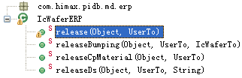
This class is IcWaferERP release to ERP.
release(Object, UserTo)
Insert Wafer record into PIDB_IF_MATERIAL_MASTER & PIDB_IF_MATERIAL_CHARACTER.
Object | IcWaferTo object .
UserTo | UserTo object .
Returns | Return “null” if finished release to ERP or return error message.
releaseBumping(Object, UserTo,IcWaferTo)
If T_IC_Wafer.ROUTING_BP = yes, Insert Bumping Mask(With same project code) record into PIDB_IF_MATERIAL_MASTER (Materila Number為Wafer Material Number的第一碼從”W”改成”B”) & PIDB_IF_MATERIAL_CHARACTER.
Object | IcWaferTo object .
UserTo | UserTo object .
IcWaferTo | IcWaferTo object .
Returns | Return “null” if finished release to ERP or return error message.

Slide 63
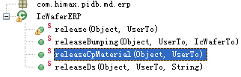
releaseCpMaterial(Object, UserTo)
If T_IC_Wafer.ROUTING_CP = yes, Insert CP (Get from T_CP_MATERIAL by PRODJECT_CODE_W_VERSION) record into PIDB_IF_MATERIAL_MASTER & PIDB_IF_MATERIAL_CHARACTER。If T_CP_MATERIAL.CP_TEST_PROGRAM_NAME_LIST contains more than one CP test program, need to add up characteristics CP_CPU_Time and CP_Index_Time before inserting into interface table, other characteristics from CP test program master needs to be connected by “,” before inserting into interface table .
Object | CpMaterialTo object.
UserTo | UserTo object.
Returns | Return “null” if finished release to ERP or return error message.
releaseDs(Object, UserTo,String)
Insert DS record into PIDB_IF_MATERIAL_MASTER (Materila Number為CP Material Number的第一碼從”C”改成”D”) & PIDB_IF_MATERIAL_CHARACTER.
Object | CpMaterialTo object.
UserTo | UserTo object.
string | ProjCodeWVersion object.
Returns | Return “null” if finished release to ERP or return error message.

Slide 64

This class is ProjERP release to ERP.
release(ProjectTo, UserTo)
當User一按下畫面中的”Release To ERP”, 就立刻Insert Project record into PIDB_ IF_PROJECT_CODE 當User按下“Release To ERP”時，請跳出一個視窗列出所有要Release的Project Code(for all project code with same project name),並讓User可以確定是否要Release這些Project Code到ERP，如果User確定要Release這些Project Code，請執行下列動作：<1> For all IC wafer with these project codes, please execute the “Release To ERP logic” of “MD-4 IC Wafer”. <2> For all IC FG with these project codes and PKG_TYPE <> traditional package, please execute the “Release To ERP logic” of “MD-9 IC Finished Goods”.
ProjectTo | ProjectTo object.
UserTo | UserTo object.
Returns | Return “null” if finished release to ERP or return error message.

Slide 65

ReleaseERPException is an exception class extends RuntimeException classes.
ReleaseERPException()
Extend RuntimeException class .
Returns | The method is constructor so it have not return value.
ReleaseERPException(String)
Extend RuntimeException class,and user error string .
Stirng | A String of error message.
Returns | The method is a constructor method without returns.

Slide 66

This class is TradPkgERP release to ERP.
release(Object, UserTo)
Insert AS (Get Data from T_IC_FG by Package Code) record into PIDB_IF_MATERIAL_MASTER & PIDB_IF_MATERIAL_CHARACTER according to class CLAS_01.
Object | TradPkgTo object.
UserTo | UserTo object.
Returns | Return “null” if finished release to ERP or return error message.

