Slide 1
Project: Virtual Memory Manager
Lubomir Bic

Slide 2
Assignment
Design and implement a virtual memory system (VM) using segmentation and paging
The system manages the necessary segment and page tables in a simulated main memory
It accepts VA’s and translates them into PA’s
It also utilizes a translation look-aside buffer (TLB) to make the translation process more efficient

Slide 3
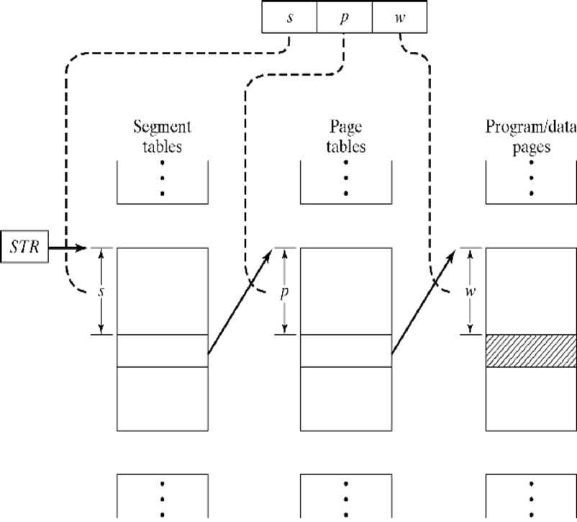
Segmentation with Paging

Slide 4
Organization of the VM system
There is only a single process and hence a single ST
Each ST entry points to a PT
Each PT entry points to a program/data page
A VA is an integer (32 bits), divided into s, p, w.
|s|=9, i.e., ST size is 512 words (int)
|p|=10, i.e., PT size is 1024 words
|w|=9, i.e., page size is 512 words
The leading 4 bits of the VA are unused.

Slide 5
Organization of the VM system
Each ST entry can have three types of entry:
-1: PT is currently not resident in PM (page fault)
0: corresponding PT does not exist
read: error; write: create blank PT
f: PT starts at physical address f (address, not frame #)
Each PT entry can also have three types of entry:
-1: page is currently not resident in PM (page fault)
0: corresponding page does not exist
read: error; write: create blank page
f: page starts at physical address f

Slide 6
Organization of PM
PM is represented as an array of integers
each corresponds to one addressable memory word
PM is divided into frames of size 512 words (integers)
consequently, ST occupies one frame
each PT occupies two (consecutive) frames
each program/data page occupies one frame
PA consists of 1024 frames (=array of 524,288 int, =2MB)
Consequently the size of PA is 19 bit
ST always resides in frame 0 and is never paged out
A page may be placed into any free frame
A PT may be placed into any pair of consecutive free frames

Slide 7
Organization of PM
PM[s]
PM[PM[s]+p]
s
p
w
…
…
…
ST
PT
page
PM[s] accesses the ST
If the entry is >0 then it points to a resident PT
PM[PM[s]+p] accesses the PT
If the entry is >0 then it points to a resident page
All ST/PT entries are multiples of 512 (fame size)

Slide 8
Organization of PM
A bit map is used to keep track of free/occupied frames
The bit map consists of 1024 bits (one per frame)
It can be implemented as an array of 32 integers
Normally this would be maintained inside the PM but in this project it may be implemented as a separate data structure

Slide 9
Address Translation Process
Break each VA into s, p, w
For read access:
If ST or PT entry is -1 then output “pf” (page fault) and continue with next VA
If ST or PT entry is 0 then output “error” and continue with next VA
Otherwise output PA = PM[PM[s] + p] + w
PM[s]
PM[PM[s]+p]
s
p
w
…
…
…
ST
PT
page

Slide 10
Address Translation Process
For write access:
If ST or PT entry is -1 then output “pf”
If ST entry is 0 then
allocate new blank PT (all zeroes)
update the ST entry accordingly
continue with the translation process;
PM[s]
PM[PM[s]+p]
s
p
w
…
…
…
ST
PT
page

Slide 11
Address Translation Process
For write access (cont.):
if PT entry is 0 then
create a new blank page
update the PT entry accordingly
continue with the translation process
Otherwise output the corresponding PA
PM[s]
PM[PM[s]+p]
s
p
w
…
…
…
ST
PT
page

Slide 12
Initialization of PM
Read init file:
s₁ f₁ s₂ f₂ … s_{n} f_{n}
p₁ s₁ f₁ p₂ s₂ f₂ … p_{m} s_{m} f_{m}
s_{i} f_{i} : PT of segment s_{i} starts at address f_{i}
If f_{i} = ‒1 then the corresponding PT is not resident
Example: 15 512: PT of seg 15 starts at address 512.
9 -1: PT of seg 9 is not resident
p_{j} s_{j} f_{j} : page p_{j} of segment s_{j} starts at address f_{j}
If f_{i} = ‒1 then the corresponding page is not resident
Example: 7 13 4096: page 7 of seg 13 starts at 4096
8 13 -1: page 8 of seg 13 is not resident

Slide 13
Initialization of PM
Initialize PM as follows:
Read s_{i} f_{i} pairs and make corresponding entries in ST
Read p_{j} s_{j} f_{j} triples and make entries in the PT’s
Create bitmap to show which frames are free
Note: each f is a PA, not just a frame number!!

Slide 14
Running the VM Translations
Read input file:
o₁ VA₁ o₂ VA₂ … o_{n} VA_{n}
each o_{i} is either a 0 (read) or 1 (write)
each VA_{i} is a positive integer (virtual address)
For each o_{i} VA_{i} pair attempt to translate the VA to PA
Write results into an output file

Slide 15
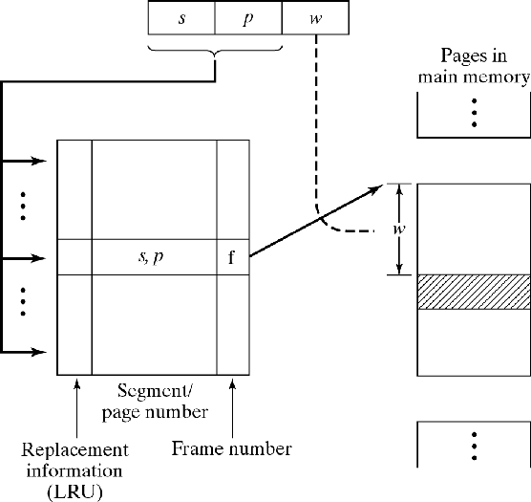
The TLB
Size: 4 lines
LRU: int 0:3
0: least recently accessed
sp: int
f: int (starting frame address, not frame #)

Slide 16
Running Translations with TLB
Break VA into sp and w
Search TLB for match on sp
If TLB hit:
use f from TLB to form PA = f+w
update LRU fields as follows:
assume the match is in line k, then:
decrement all LRU values greater than LRU[k] by 1
set LRU[k] = 3

Slide 17
Running Translations with TLB
If TLB miss:
resolve VA as before
in case of error or page fault, no change to TLB
if a valid PA is derived then TLB is updated as follows:
select line with LRU = 0 and set this LRU = 3
replace sp field of that line with the new sp value
replace f field of that line with PM[PM[s] + p]
decrement all other LRU values by 1

Slide 18
The Bit Map (pg 217)
Creating a new page or PT requires searching and updating the BM
BM size: # of bits needed = # of page frames
represent bit map as an array of int (32 bits each): BM[n]
How to set, reset, and search for bits in BM?
prepare a mask array: MASK[32]
diagonal contains “1”, all other fields are “0”
use bit operations (bitwise or/and) to manipulate bits

Slide 19
The Bit Map
MASK (assume 16 bits only to simplify presentation)
0 | 10…
1 | 010…
2 | 0010…
3 | 00010…
… | …
15 | 0 … 01
to set bit i of BM[j] to “1”:
BM[j] = BM[j] | MASK[i]

Slide 20
The Bit Map
how to create MASK?
MASK[0] = 0x8000 (1000 0000 0000 0000)
MASK[1] = 0x4000 (0100 0000 0000 0000)
MASK[2] = 0x2000 (0010 0000 0000 0000)
MASK[3] = 0x1000 (0001 0000 0000 0000)
MASK[4] = 0x0800 (0000 1000 0000 0000)
…
MASK[15] = 0x0001 (0000 0000 0000 0001)
another approach:
MASK[15] = 1;
MASK[i] = MASK[i+1] <<

Slide 21
The Bit Map
to set a bit to “0”:
create MASK2, where MASK2[i] = ~MASK[i]
e.g., 0010 0000 0000 0000 → 1101 1111 1111 1111
set bit i of BM[j] to “0”:
BM[j] = BM[j] & MASK2[i]

Slide 22
The Bit Map
to search for a bit equal to “0” in BM:
for (i=0; … /* search BM from the beginning
for (j=0; … /* check each bit in BM[i] for “0”
test = BM[i] & MASK[j])
if (test == 0) then
bit j of BM[i] is “0”;
stop search

Slide 23
Summary of tasks
Design and implement a VM memory system using segmentation and paging as described above.
Design and implement a TLB to speed up the address translation process
Design and implement a driver program that initializes the system from a given input file. It then reads another input file and, for each VA, attempts to translate it to the corresponding PA. It outputs the result of each address translation into a new file.
Submit documentation
Schedule testing

