Slide 1
Current Implementation

Slide 2
Construct (basic block of accelerator design)
run_command: for value aware simulation
pop input data from input_list
DO execute operation defined by the command
push output data to input_list of construct pointed to by the output_list
increment crnt_time of the construct
increment_time: for non value aware simulation
pop input data from input_list
DON’T execute operation defined by the command
push output data to input_list of construct pointed to by the output_list
increment crnt_time of the construct

Slide 3
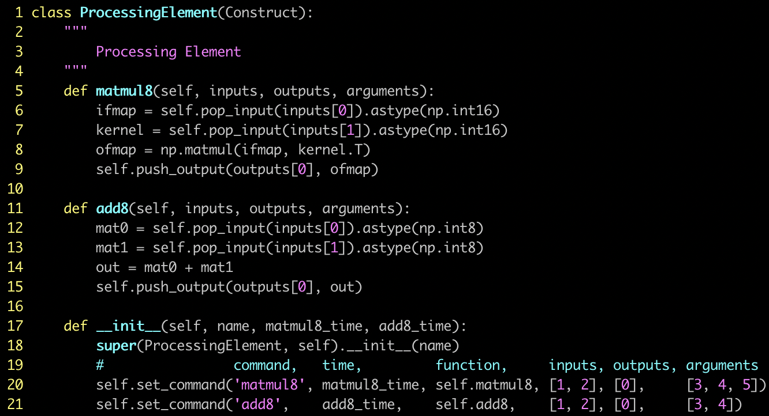
Construct: how to use it
define basic blocks of choice for accelerator design by inheriting from Construct
one function per command to
define functionality of each
command
one line per command to add it to construct
** little modification can add the functionality of value dependent latency

Slide 4
SimulationEngine
each block is a Construct
each arrow line means a connection from source of the data to destination of the data
adding connection means to include entry to input and output

Slide 5
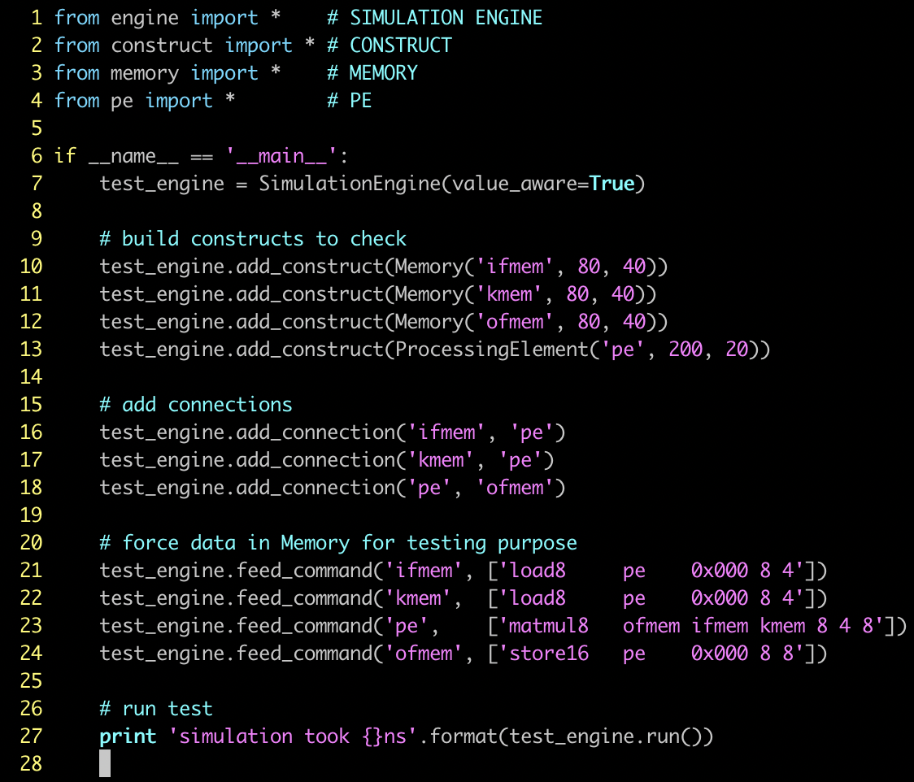
Engine: how to use it
add Constructs to the engine
add connections between Constructs in the engine
add commands to each Construct in the engine
enter run() to run all commands

Slide 6

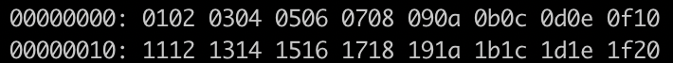
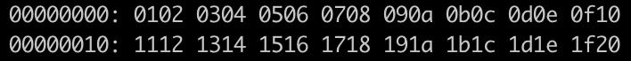
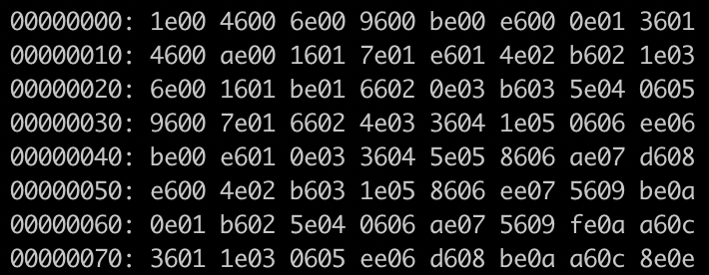
Engine: result verification (value)
1 2 3 4
5 6 7 8
9 10 11 12
13 14 15 16
17 18 19 20
21 22 23 24
25 26 27 28
29 30 31 32
30 70 110 150 190 230 270 310
70 174 278 382 486 590 694 798
110 278 446 614 782 950 1118 1286
150 382 614 846 1078 1310 1542 1774
190 486 782 1078 1374 1670 1966 2262
230 590 950 1310 1670 2030 2390 2750
270 694 1118 1542 1966 2390 2814 3238
310 798 1286 1774 2262 2750 3238 3726
1 5 9 13 17 21 25 29
2 6 10 14 18 22 26 30
3 7 11 15 19 23 27 31
4 8 12 16 20 24 28 32
*
=

Slide 7
Engine: result verification (cycle)
critical path is 320ns

Slide 8
Proposed Project Plan

Slide 9
Simulator Pipeline
COMPILER SHOULD GENERATE THIS
LANGUAGE NEED TO BE
DEFINED MORE FORMALLY
THIS NEEDS TO BE (RE)IMPLEMENTED IN C++
NEEDS TO BE IMPLEMENTED FOR EACH ARCHITECTURE
COULD ADD PyMTL BACKEND OR SOMETHING IN LONG-TERM…

