Slide 1
Capybara

Slide 2
Environment required:
Ruby v2.3.3
Install gem selenium-webdriver
Install gem capybara

Slide 3
Start driver
Selenium
# Star driver driver = Selenium::WebDriver.for :chrome
Capybara
Capybara.register_driver :chrome do |app| Capybara::Selenium::Driver.new(app, :browser => :chrome) end Capybara.current_driver = :chrome

Slide 4
Navigate
Selenium
# Navigate driver.get('https://www.google.com')
Capybara
# Navigate visit('https://tiki.vn')

Slide 5
Searching web elements
Selenium
driver.find_element(:css, "input[name='q']")
Capybara
# Search element find(:css, "input[name='q']")

Slide 6
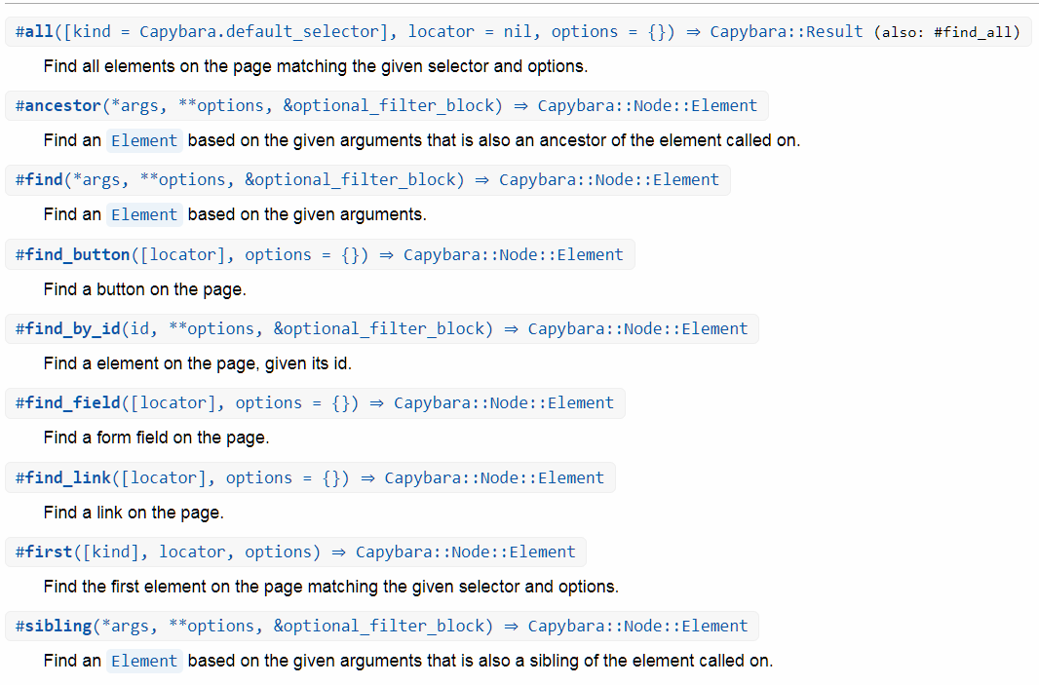
Searching web elements

Slide 7
Implicit wait
Selenium
# Implicit wait driver.manage.timeouts.implicit_wait = 30 # Search element driver.find_element(:css, "input[name='q']")
Capybara
Don’t care about it!

Slide 8
Explicit wait
Selenium
# Explicit wait wait = Selenium::WebDriver::Wait.new(timeout: 30) # seconds wait.until { driver.find_element(:css, "input[name='q']") }
Capybara
#Default max wait time Capybara.default_max_wait_time = 20

Slide 9
Send keys
Selenium
# Explicit wait wait = Selenium::WebDriver::Wait.new(timeout: 30) # seconds wait.until { driver.find_element(:css, "input[name='q']") } driver.find_element(:css, "input[name='q']").send_keys('tivi')
Capybara
# Search and input element find(:css, "input[name='q']").set 'tivi'

Slide 10
Click
Selenium
# Explicit wait wait = Selenium::WebDriver::Wait.new(timeout: 30) # seconds wait.until { driver.find_element(:css, "input[name='q']") } driver.find_element(:css, "input[name='q']").send_keys('tivi') driver.find_element(:css, '.search-wrap > button').click
Capybara
# Search and input element find(:css, "input[name='q']").set 'tivi' find(:css, '.search-wrap > button').click

Slide 11
What’s next?
Frame
Multi window handling
Execute Javascript

