Slide 1

Presentation react hooks
Tung Le

Slide 2
About this topic
What is hook?
Rules of hooks
useState
useEffect
Custom hook
Q&A

Slide 3
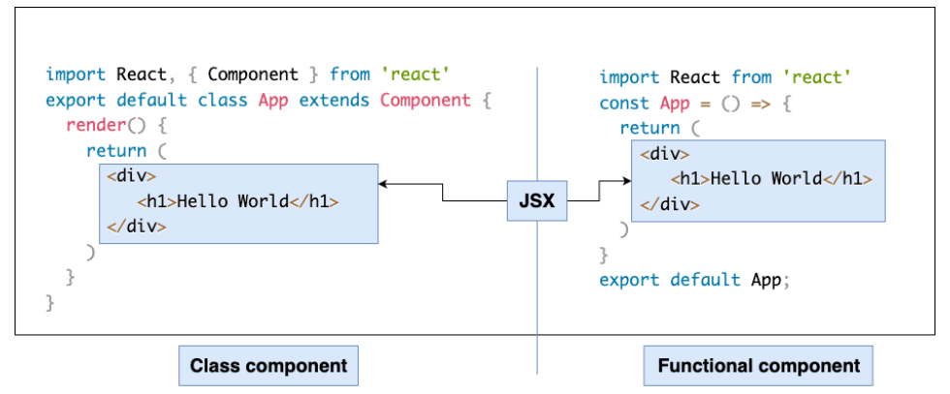
What is hook?

Slide 4
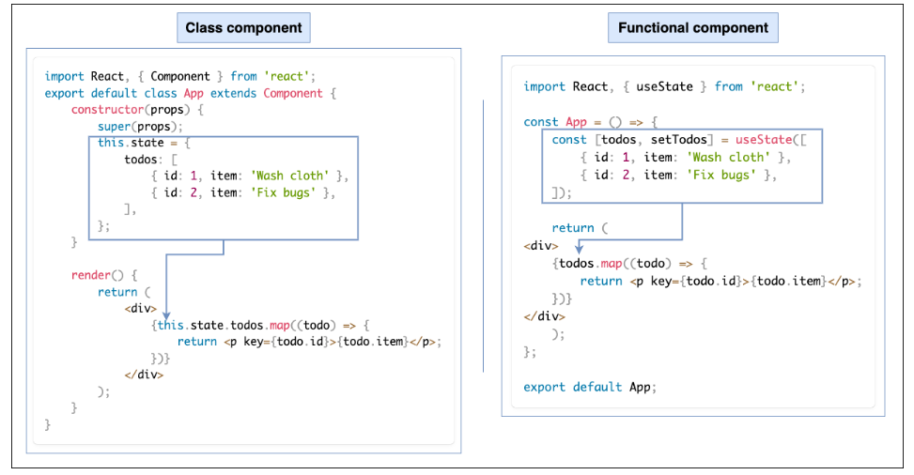
What is hook?

Slide 5
What is hook?
Hooks are functions that let you “hook into” React state and lifecycle features from function components.
Hooks are reusable functions
Basic hooks:
- State Hooks: useState, useReducer
- Effect Hooks: useEffect, useLayoutEffect, useInsertionEffect
- Performance Hooks: useMemo, useCallback, useTransition,….
- …..

Slide 6
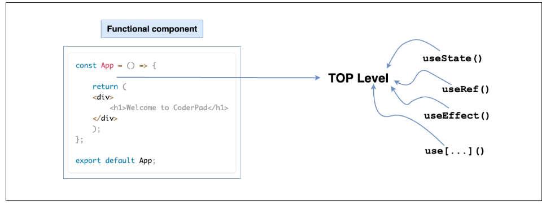
Rules of hooks?
Hooks can only be called at the top level of a component.
Call Hooks at the top level of your functional component to ensure that every time your component renders, these Hooks are called in the same order. The call order is essential for Hooks to work correctly.

Slide 7
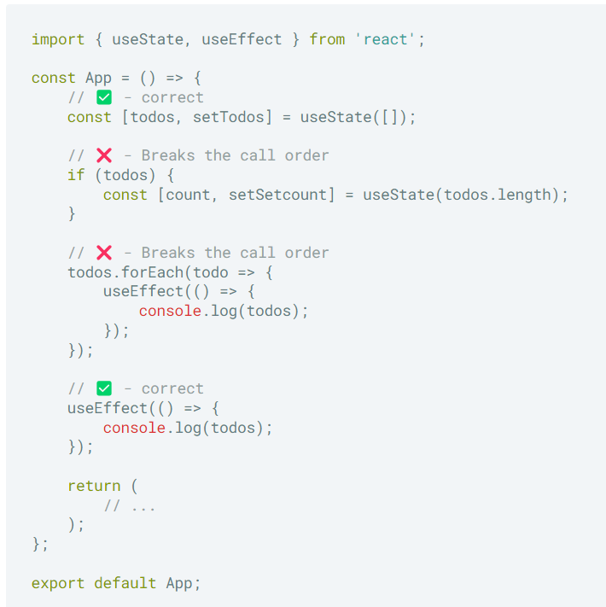
Rules of hooks?
Calling your Hooks at the top of the function means you must not be calling them within loops, conditions, and nested functions.

Slide 8
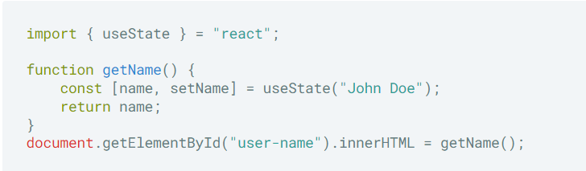
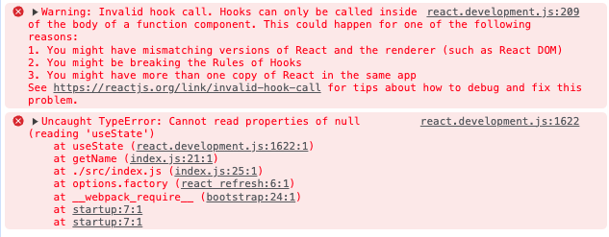
Rules of hooks?
Hooks can only be called inside React functional component or custom hooks

Slide 9

usestate
useState is a React Hook that lets you add a state variable to a functional component
useState return:
- A state variable to retain the data between renders.
- A state setter function to update the variable and trigger React to render the component again.

Slide 10
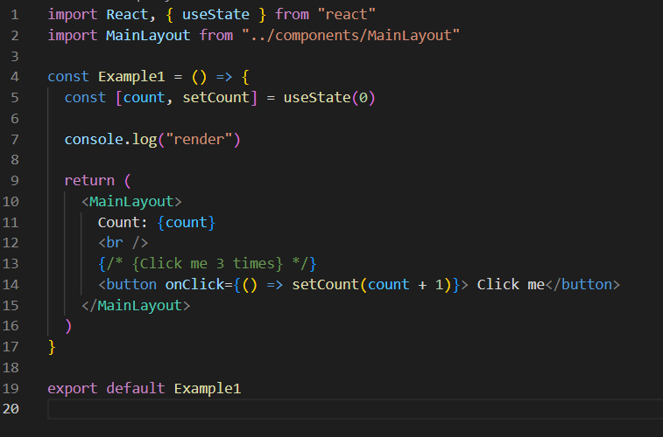
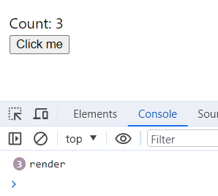
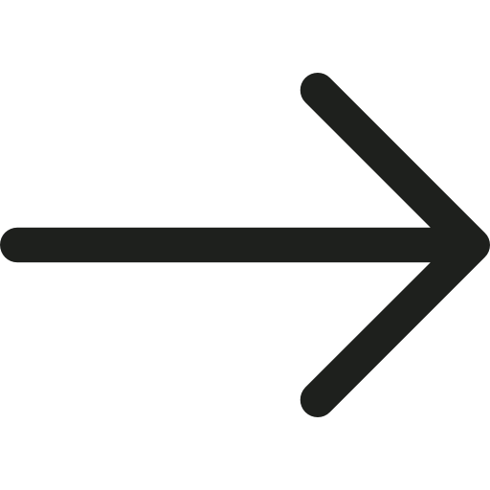
usestate
Example 1

Slide 11
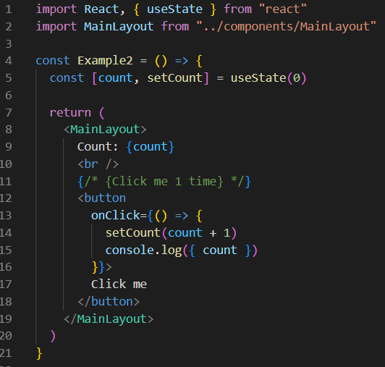
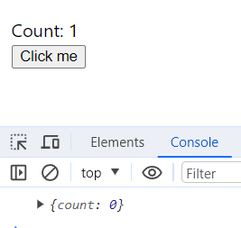
usestate
The set function only updates the state variable for the next render
Example 2

Slide 12
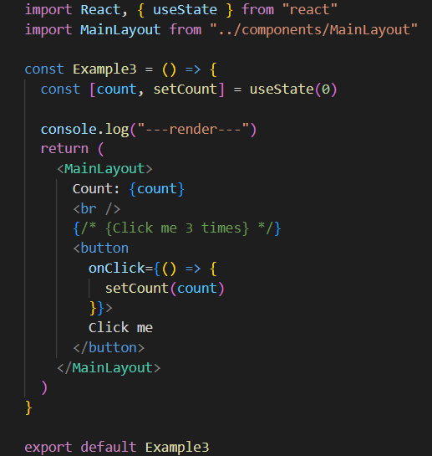
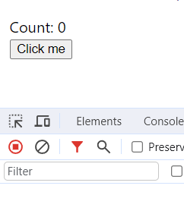
usestate
If the new value you provide is identical to the current state, as determined by an Object.is comparison, React will skip re-rendering the component and its children
Example 3

Slide 13
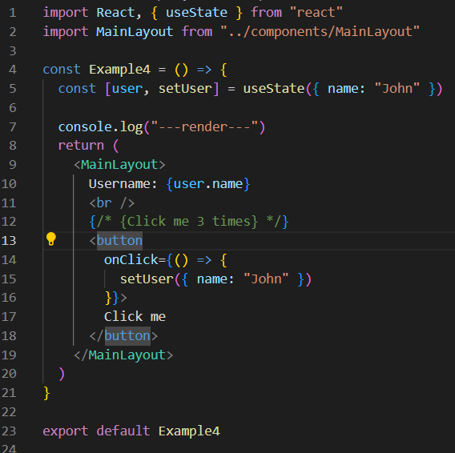
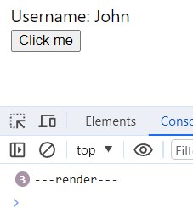
usestate
Example 4

Slide 14
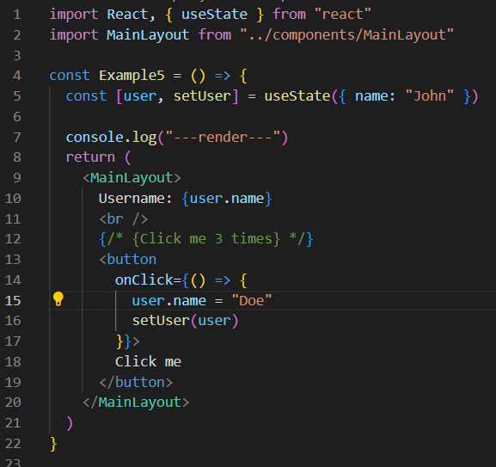
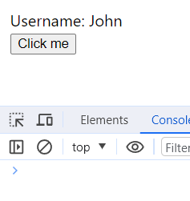
usestate
Example 5

Slide 15
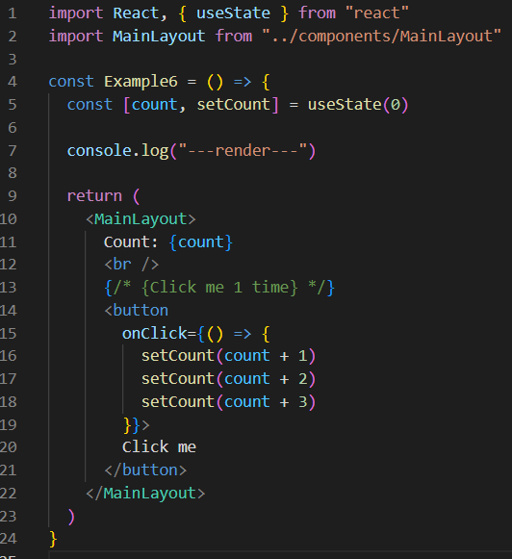
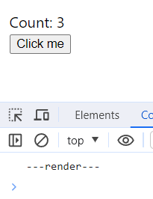
usestate
=> React batches state updates
React waits until all code in the event handlers has run before processing your state updates.
React does not batch across multiple intentional events like clicks
Example 6

Slide 16
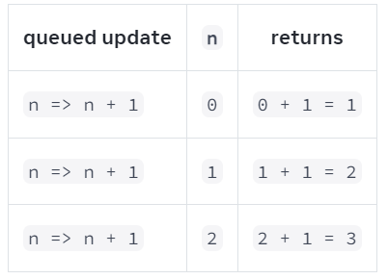
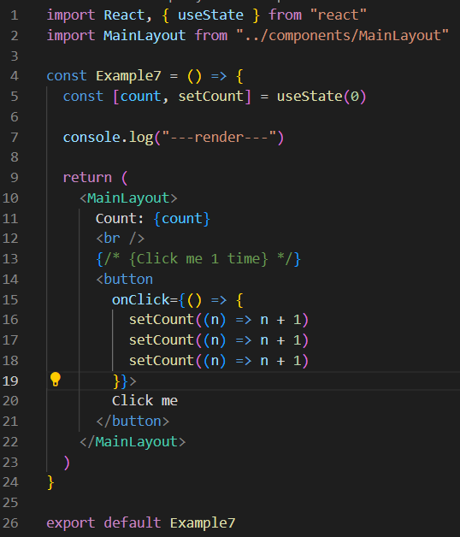
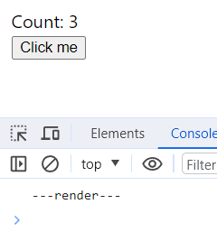
usestate
Pass an updater function to a state setter:
React queues this function to be processed after all the other code in the event handler has run.
2.During the next render, React goes through the queue and gives you the final updated state.
Example 7

Slide 17
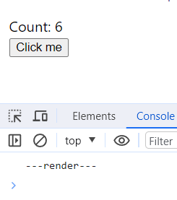
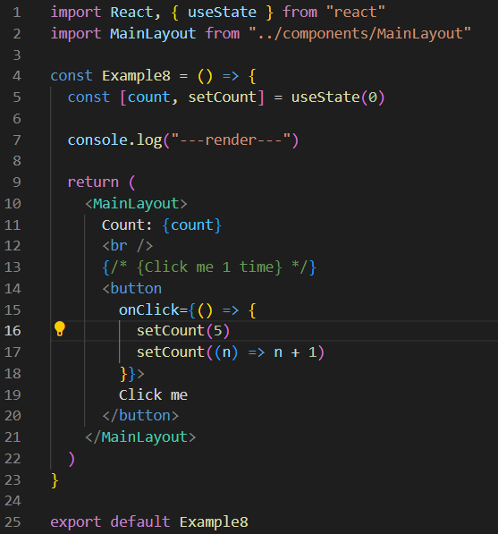
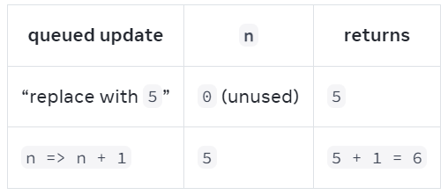
usestate
Example 8

Slide 18
useEffect
The useEffect Hook allows you to perform side effects in your components.
=> Data fetching, setting up a subscription, and manually changing the DOM in React components…
Parameters:
- setup: The function with your Effect’s logic. setup is synchronous function
- optional dependencies: The list of all reactive values referenced inside of the setup

Slide 19
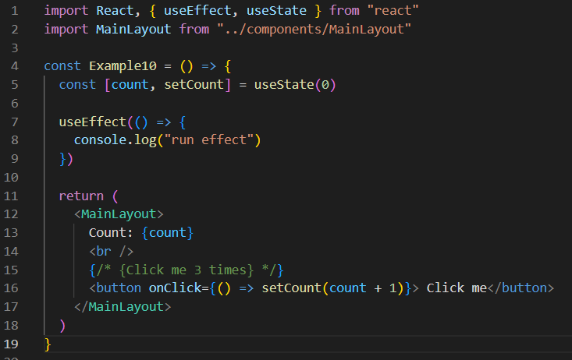

useEffect
Passing no dependency array:
=> Effect runs after every single render (and re-render) of component.
Example 9

Slide 20
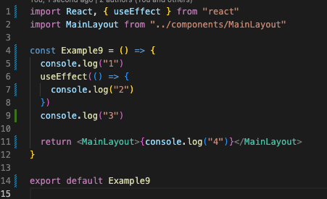
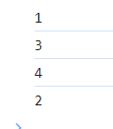
useEffect
Example 10

Slide 21
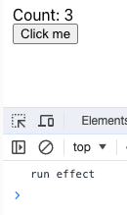
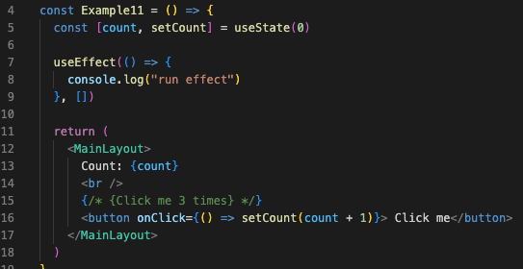
useEffect
Passing an empty dependency array
=> Effect will only run after the initial render
Example 10

Slide 22
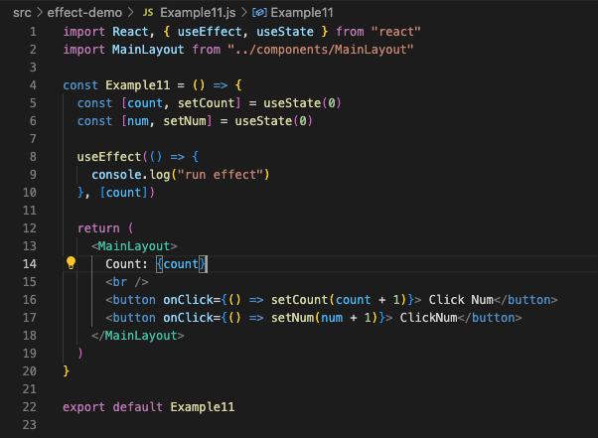
useEffect
Passing a dependency array
=> Effect runs after the initial render and after re-renders with changed dependencies
Example 12

Slide 23
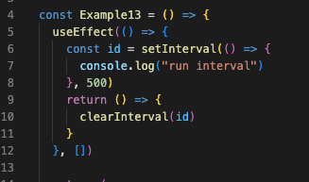
useEffect
Effects with Cleanup
React will call your cleanup function each time before the Effect runs again, and one final time when the component unmounts (gets removed).
Example 13

Slide 24
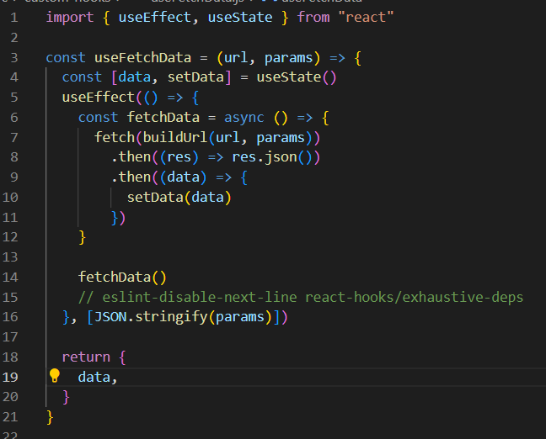
Custom hooks
Custom Hooks are a mechanism to reuse stateful logic
Hook names must start with use followed by a capital letter
Hooks may return arbitrary values.

Slide 25

Q&A

Slide 26
Thank you

