Slide 1
Presentation react hooks
Tung Le

Slide 2
content
What is hook?
Rules of hooks
useState hooks
useEffect hooks
Custom hooks
Demo
Q&A

Slide 3
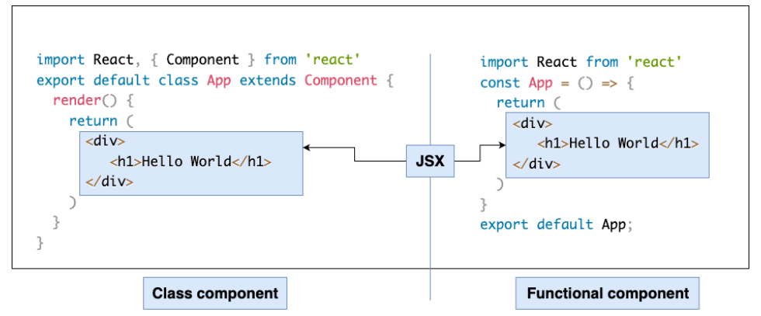
What is hook?

Slide 4
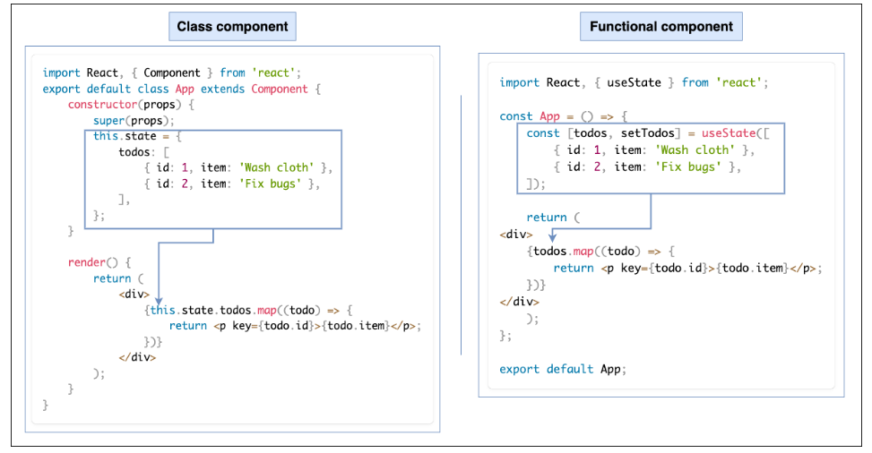
What is hook?

Slide 5
What is hook?
Hooks are functions that let you “hook into” React state and lifecycle features from function components.
Hooks let you use different React features from your components
Hooks are reusable functions
React hooks:
- State Hooks: useState, useReducer
- Effect Hooks: useEffect, useLayoutEffect, useInsertionEffect
- Performance Hooks: useMemo, useCallback, useTransition,….
- …..

Slide 6
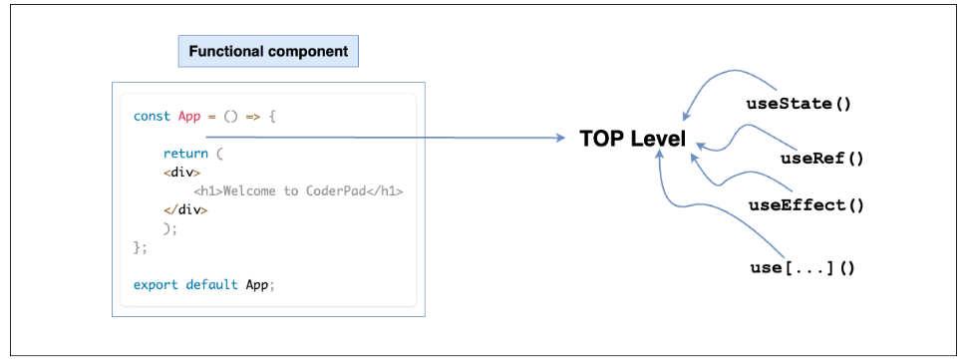
Rules of hooks?
1) Hooks can only be called at the top level of a component.
It is necessary to call Hooks at the top level of your functional component to ensure that every time your component renders, these Hooks are called in the same order. The call order is essential for Hooks to work correctly.

Slide 7
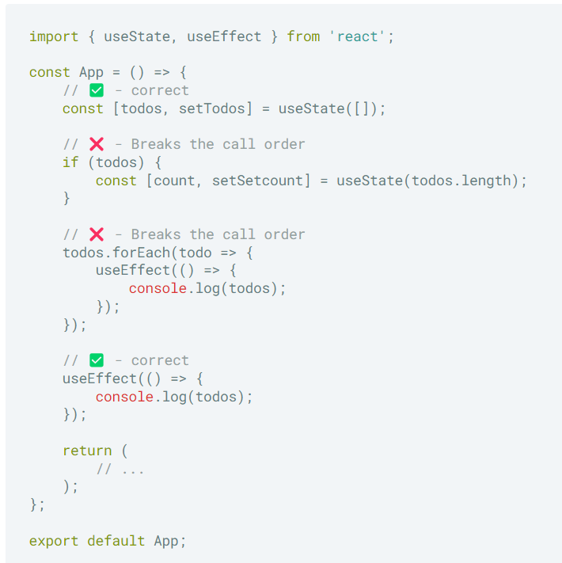
Rules of hooks?
Calling your Hooks at the top of the function means you must not be calling them within loops, conditions, and nested functions.

Slide 8
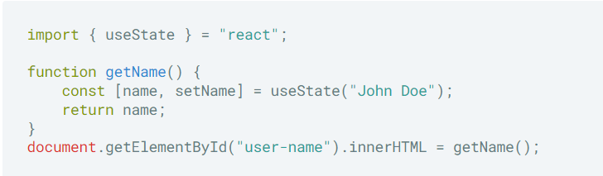
Rules of hooks?
2) Hooks can only be called inside React functional component or custom hooks

Slide 9

usestate
useState is a React Hook that lets you add a state variable to a functional component
useState return:
- A state variable to retain the data between renders.
- A state setter function to update the variable and trigger React to render the component again.

Slide 10
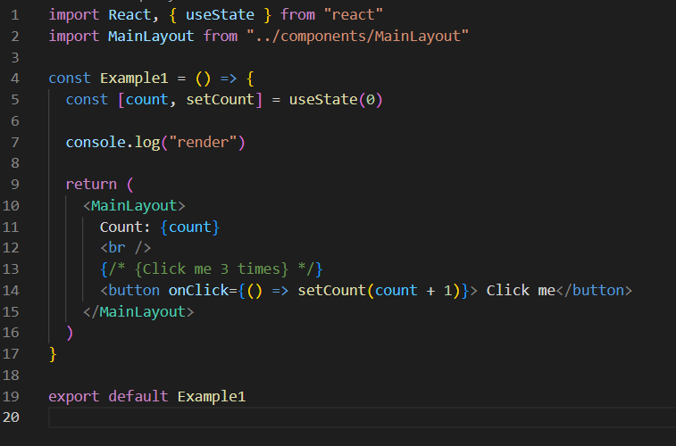
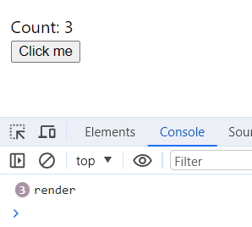
usestate
=>
Example 1

Slide 11
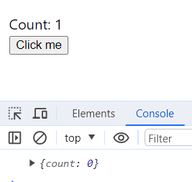
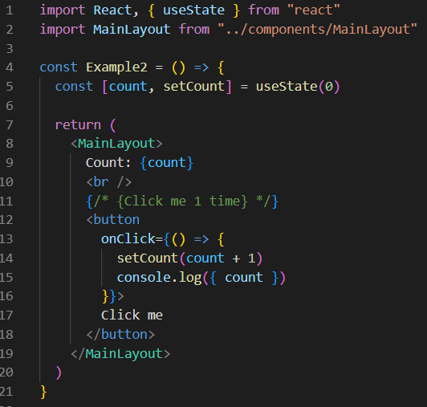
usestate
=>
The set function only updates the state variable for the next render
Example 2

Slide 12
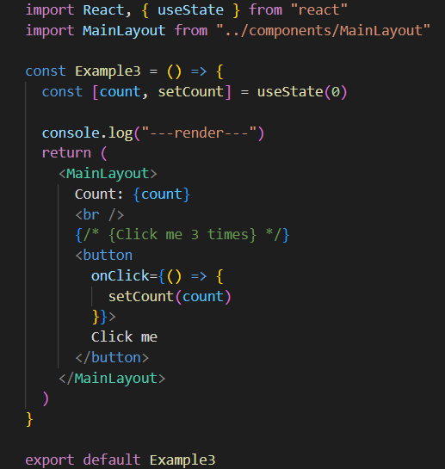
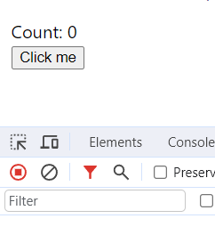
usestate
=>
If the new value you provide is identical to the current state, as determined by an Object.is comparison, React will skip re-rendering the component and its children
Example 3

Slide 13
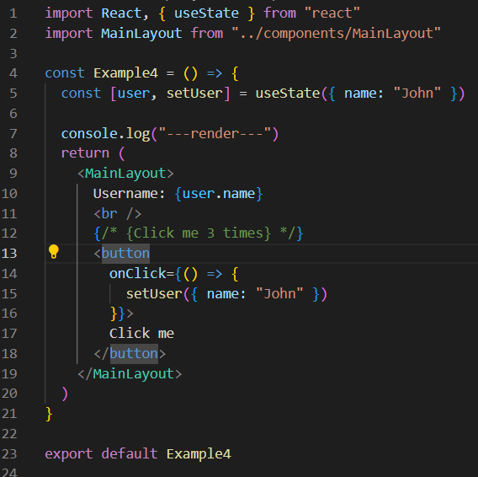
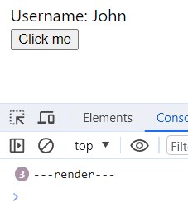
usestate
=>
Example 4

Slide 14
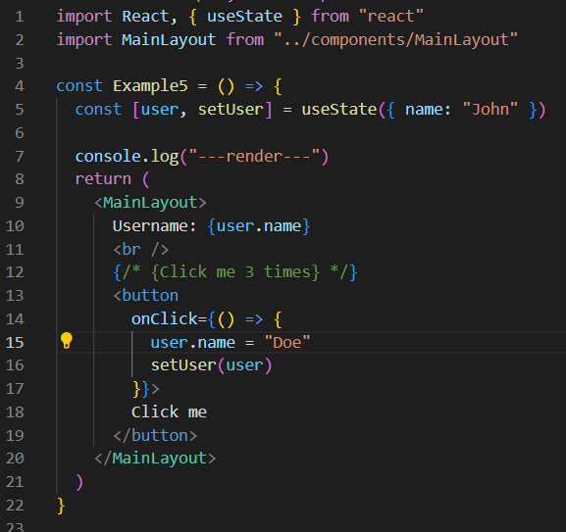
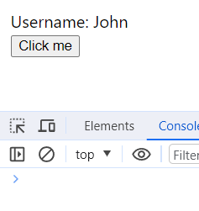
usestate
=>
Example 5

Slide 15
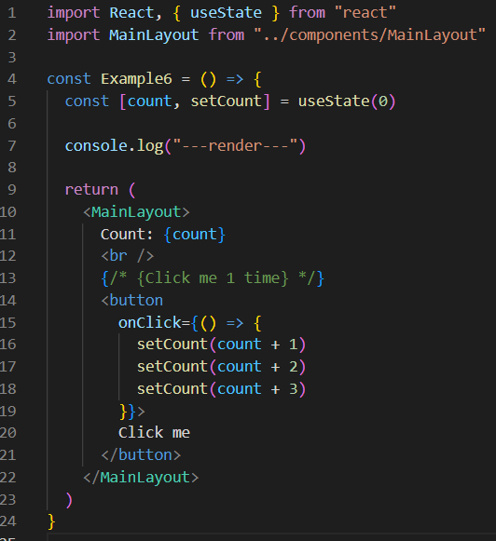
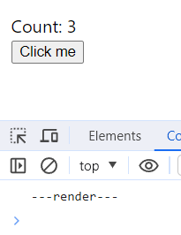
usestate
=>
=> React batches state updates
React waits until all code in the event handlers has run before processing your state updates.
React does not batch across multiple intentional events like clicks
Example 6

Slide 16
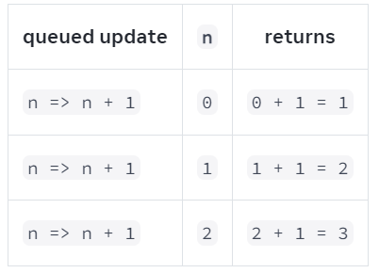
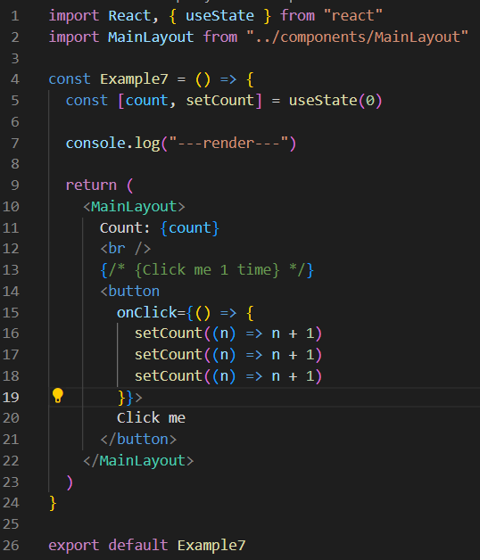
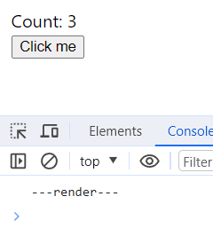
usestate
=>
When you pass an updater function to a state setter:
React queues this function to be processed after all the other code in the event handler has run.
2.During the next render, React goes through the queue and gives you the final updated state.
Example 7

Slide 17
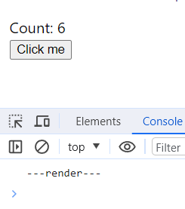
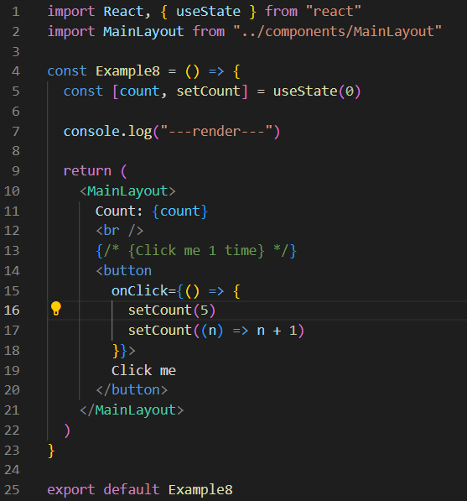
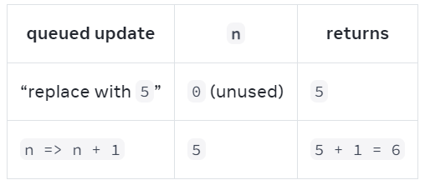
usestate
=>
Example 8

Slide 18
useEffect
The useEffect Hook allows you to perform side effects in your components.
=> Data fetching, setting up a subscription, and manually changing the DOM in React components are all examples of side effects
Parameters:
- setup: The function with your Effect’s logic. setup is synchronous function
- optional dependencies: The list of all reactive values referenced inside of the setup

Slide 19
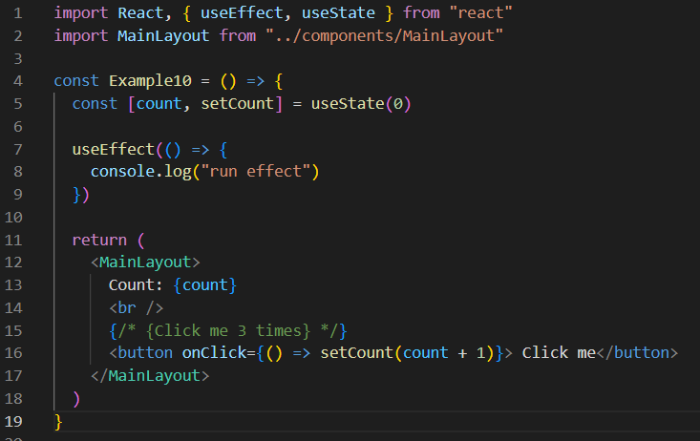

useEffect
=>
Passing no dependency array:
=> Effect runs after every single render (and re-render) of component.
Example 9

Slide 20
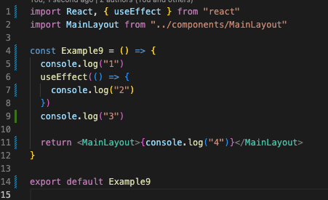
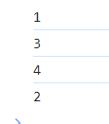
useEffect
=>
Example 10

Slide 21
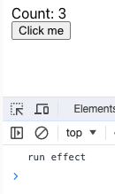
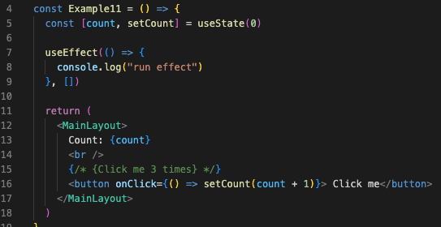
useEffect
=>
Passing an empty dependency array
=> Effect will only run after the initial render
Example 10

Slide 22
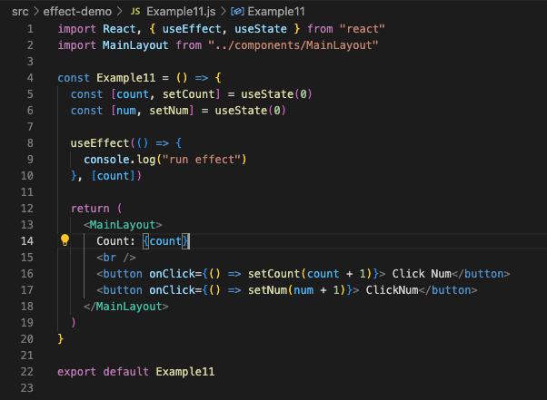
useEffect
Passing a dependency array
=>
=> Effect runs after the initial render and after re-renders with changed dependencies
Example 12

Slide 23
useEffect
Passing a dependency array
=>
=> Effect runs after the initial render and after re-renders with changed dependencies
Example 12

Slide 24
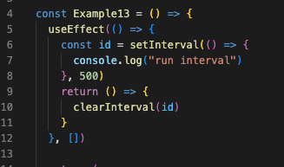
useEffect
Clean up function
=>
Example 12

