Slide 1
3
Models
Handwritten Digit Classification
10
A Comparative Study of MLP, SVM, and k-NN on MNIST
Classes
Tung Nguyen
EE559 / CSCI 559 • USC • Spring 2026
98.3%
Best Acc
1 / 10
Notes:
Hi everyone, my name is Tung Nguyen, and today I'll be presenting my EE559 final project on handwritten digit classification. The goal of this project was to systematically compare three supervised learning algorithms — k-Nearest Neighbors, Support Vector Machines, and a Multi-Layer Perceptron — on the classic MNIST dataset. MNIST is a 10-class digit recognition problem with 70,000 images, and it's been a benchmark in machine learning for decades. By the end of this presentation, I'll show you not just which model performed best, but why — from a mathematical and theoretical standpoint.

Slide 2
Problem Motivation
2 / 10
Why?
Digit recognition underlies postal automation, bank check processing, and document digitization.
MNIST at a Glance
70,000
Total Images
Goal
Systematically compare k-NN, SVM, and MLP under identical preprocessing and evaluation conditions.
28×28
Pixel Size
784
Features
Depth
Not just benchmark accuracy — explain mathematically why certain models outperform others.
10
Digit Classes
Scope
MNIST: 70,000 grayscale images, 10 classes (0–9), 784 features per sample.
~7,000
Samples / Class
Notes:
So why digit recognition? It's not just an academic exercise — it powers real systems like postal mail sorting, bank check processing, and document scanning. The reason I chose this problem is that it's well-scoped enough to do a rigorous comparison, but rich enough to produce meaningful insights. My goal wasn't simply to get high accuracy — honestly on MNIST that's not hard. The real challenge I set for myself was to deeply analyze why one model outperforms another. On the right you can see the dataset at a glance: 70,000 images, each 28 by 28 pixels, giving us 784 input features, spread across 10 balanced digit classes with roughly 7,000 samples each.

Slide 3
Dataset & Preprocessing
3 / 10
Data Splits
Normalization
PCA Reduction
Train: 70% (~49,000)
Validation: 10% (~7,000)
Test: 20% (~14,000)
Stratified by class
Z-score standardization
μ and σ from train only
Prevents data leakage
Equal feature scale
90% variance → 60 dims
95% variance → 87 dims
99% variance → 178 dims
Used 87 comps for kNN/SVM
Normalization formula: x̃ᵢ = (xᵢ − μᵢ) / σᵢ | MLP uses full 784-dim; k-NN and SVM use 87-dim PCA features
Notes:
Let me walk through the preprocessing pipeline. I split the data into three sets: 70% for training, 10% for validation to tune hyperparameters, and 20% held out for the final test. Critically, all splits are stratified, so every class is represented proportionally in each set. For normalization, I applied z-score standardization — subtracting the mean and dividing by the standard deviation — computed only on the training set to prevent any data leakage into validation or test. For k-NN and SVM, I then applied PCA. Retaining 87 principal components captures 95% of the total variance while cutting the dimensionality from 784 down to 87 — that's an 89% reduction which is essential for the speed of distance-based methods. The MLP, on the other hand, operates on the full 784-dimensional normalized features, since it can learn its own internal representations

Slide 4
Methodology — Three Models Compared
4 / 10
k-NN
k-Nearest Neighbors
SVM
RBF Kernel SVM
MLP
Multi-Layer Perceptron
Tuned: k ∈ {1,3,5,7,9,11,15}
Tuned: C ∈ {0.1, 1, 10, 50}
Tuned: LR=1e-3, BS=256
Instance-based, non-parametric. Classifies by majority vote among k nearest neighbors (Euclidean distance). No explicit training — inference cost O(n·d).
Finds max-margin hyperplane in kernel-induced space. RBF kernel: K(x,x') = exp(−γ‖x−x'‖²). Margin balances via regularization C.
784→512→256→128→10. BatchNorm + ReLU + Dropout after each hidden layer. Adam optimizer + L2 weight decay + early stopping.
+ Simple, no assumptions
+ Excellent generalization
+ Hierarchical features
− Slow inference, sensitive to noise
− Slow to train at scale
− Needs regularization
Notes:
Now let's talk about the three models. k-NN is instance-based — there's literally no training phase. At inference time it finds the k nearest neighbors by Euclidean distance and takes a majority vote. Simple, but expensive at inference: O(n times d) per query, which is why PCA is critical. SVM with an RBF kernel finds the maximum-margin hyperplane in a kernel-induced feature space. The RBF kernel computes a smooth, localized similarity between images — two digit images are 'close' in kernel space if their pixel patterns match. The regularization parameter C controls how strictly the margin is enforced. The MLP is a four-layer fully connected network: 784 input, then 512, 256, 128 hidden units, and finally 10 output logits. Each hidden layer has batch normalization, ReLU activation, and dropout. I tuned each model's key hyperparameter using the validation set — k for k-NN, C for SVM, and learning rate and architecture for MLP.

Slide 5
MLP Architecture & Regularization
5 / 10
Input
784
FC 512
BN+ReLU
Drop 0.3
FC 256
BN+ReLU
Drop 0.3
FC 128
BN+ReLU
Drop 0.2
Output
10
Dropout
Batch Norm
L2 Decay
Early Stop
Step LR
Randomly zeroes activations (p=0.3/0.3/0.2) to prevent co-adaptation of neurons
Normalizes layer inputs per mini-batch, stabilizes training, allows higher LR
Weight penalty λ=1e-4 in Adam optimizer; discourages large weight magnitudes
Stops training when val accuracy stalls for 10 epochs; restores best checkpoint
Halves learning rate every 15 epochs; refines convergence near optimum
Notes:
Let me go deeper on the MLP since it's the most complex model here. The architecture flows from 784 inputs down to 10 outputs through three hidden layers. After each hidden layer I apply three regularization techniques in sequence: Batch Normalization first, which normalizes the layer's activations per mini-batch — this stabilizes training and allows a higher learning rate. Then ReLU activation. Then Dropout, which randomly zeroes out activations during training to prevent neurons from co-adapting. On top of that, I use L2 weight decay in the Adam optimizer to penalize large weights, early stopping with a patience of 10 epochs to halt training when validation accuracy stops improving and restore the best checkpoint, and a step learning rate scheduler that halves the learning rate every 15 epochs to refine convergence. Together these five techniques keep the model from overfitting despite the large number of parameters.

Slide 6
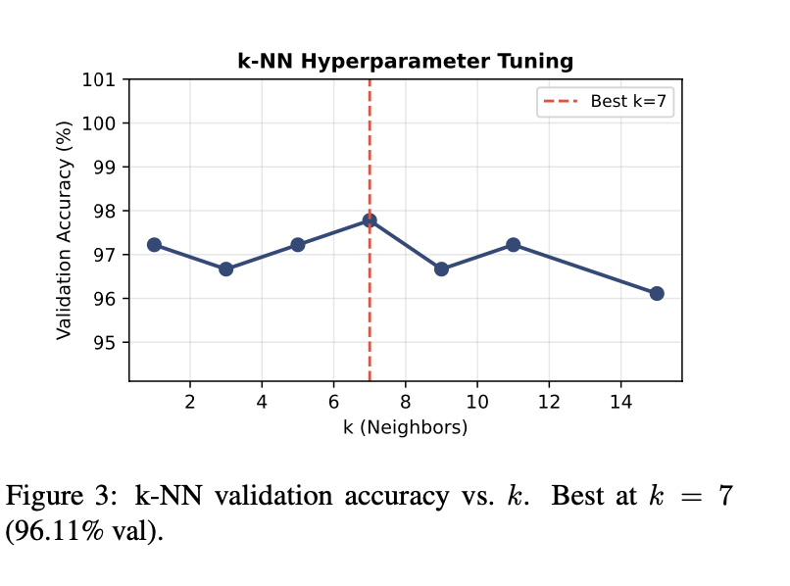
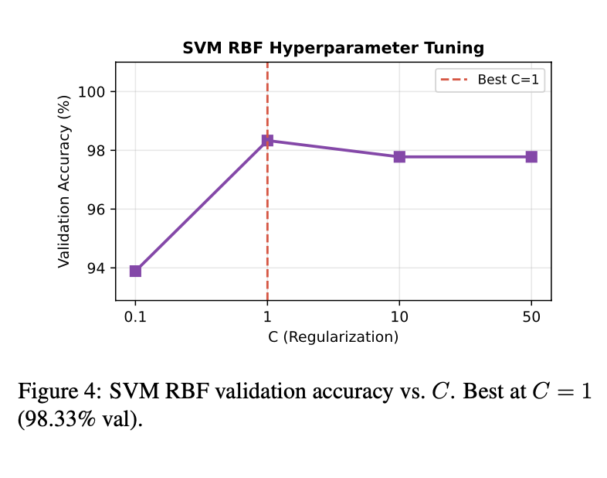
Hyperparameter Tuning (Validation Set)
6 / 10
k-NN: Validation Accuracy vs. k
SVM RBF: Validation Accuracy vs. C
Best: k = 7 (97.78% val, 96.11% test)
Best: C = 1 (98.33% val, 97.78% test)
Notes:
For k-NN, I swept k from 1 to 15. At k equals 1, the model memorizes individual training points — high variance. As k grows the boundary over-smooths and accuracy drops. The sweet spot is k equals 7, which gave 97.78% validation accuracy and 96.11% on the test set. For SVM, I swept the regularization parameter C over 0.1, 1, 10, and 50. At C equals 0.1 the model is too relaxed — it allows too many margin violations and underfits, dropping to 93.89% validation accuracy. C equals 1 is the sweet spot at 98.33% validation, and larger values of C show diminishing returns or slight overfitting. The final test accuracy for SVM is 97.78%.

Slide 7
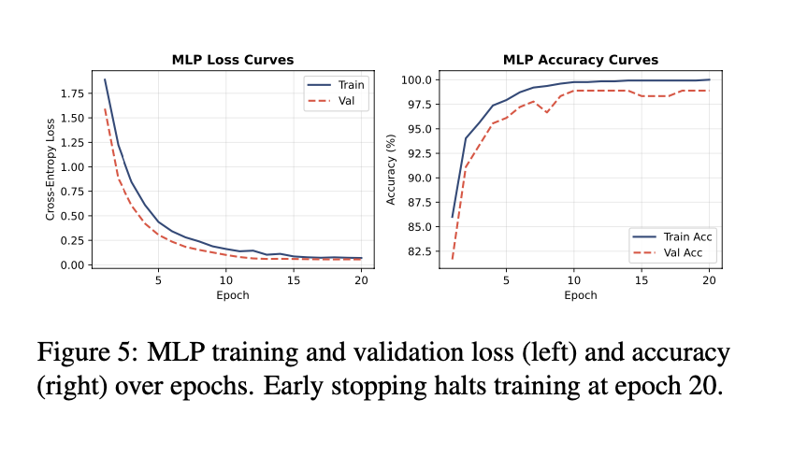
MLP Training Dynamics
7 / 10
Accuracy over Epochs
Early Stopping Triggered at epoch 20 — val accuracy plateaued at 98.89%
Train-Val Gap ~1.1% gap (100% train vs 98.89% val) — mild overfitting, controlled by dropout & L2
Notes:
Here are the MLP's training dynamics. You can see the training accuracy climbs quickly and reaches essentially 100% by around epoch 15. The validation accuracy tracks closely, plateauing near 98.89%. Early stopping kicks in at epoch 20 when the validation accuracy hasn't improved for 10 consecutive epochs. The gap between training and validation accuracy is about 1.1 percentage points — this is mild overfitting, which is expected. The regularization techniques I described earlier — dropout, batch norm, weight decay — are what keep this gap small. Without them, you'd see the training curve stay at 100% while the validation curve drops off much more sharply. The final test accuracy for MLP is 98.33%.

Slide 8
Final Test Results
8 / 10
Summary Table
Model | Acc | F1
k-NN | 96.11% | 0.9609
SVM | 97.78% | 0.9777
MLP ★ | 98.33% | 0.9834
MLP best — learns hierarchical pixel features across full 784-dim space
SVM strong — kernel similarity captures stroke patterns in 87-dim PCA space
k-NN baseline — limited by Euclidean distance in high dimensions
Notes:
Here are the final test results. The MLP comes out on top with 98.33% accuracy and an F1 score of 0.9834. SVM follows at 97.78% and 0.9777, and k-NN at 96.11% and 0.9609. The gap between MLP and SVM is about 0.55 percentage points, and between SVM and k-NN about 1.67 points. These numbers are consistent — accuracy and F1 are nearly identical across all three models, which makes sense given the balanced class distribution in MNIST. The bar chart makes it visually clear that the ranking is stable: MLP, then SVM, then k-NN.

Slide 9
Discussion: Why Does Each Model Perform This Way?
9 / 10
MLP > SVM
SVM > k-NN
Bias-Variance
MLP uses full 784-dim space; SVM uses 87-dim PCA (loses 5% variance)
MLP learns hierarchical features: edges → strokes → digits
Universal Approximation: MLP can fit arbitrarily complex boundaries
SVM boundary fully determined by support vectors — no compositional learning
RBF kernel captures smooth, global stroke-level similarity
Euclidean distance in 87-dim is noisy — shifted digits look far from neighbors
SVM ignores non-support vectors; k-NN is vulnerable to outlier training points
SVM structural risk minimization explicitly controls generalization
k-NN (k=7): moderate bias + variance — Voronoi boundary approximates truth
SVM (C=1): low bias + low variance — kernel margin maximizes structural risk min.
MLP: very low bias; dropout + L2 + early stopping control variance
Train-val gap for MLP: ~1.1% → mild overfitting, well-managed
Notes:
Now the most important question — why does each model rank the way it does? MLP outperforms SVM because it operates on the full 784-dimensional space and learns hierarchical features — early layers pick up edges, deeper layers compose those into digit-specific strokes and shapes. The SVM can't do this. Its decision boundary is fixed entirely by kernel similarities to support vectors, and it works in the PCA-reduced 87-dimensional space, losing 5% of variance. The Universal Approximation Theorem guarantees that with enough capacity the MLP can approximate any boundary, and MNIST's boundaries are genuinely nonlinear in pixel space. SVM beats k-NN because the RBF kernel is a much richer similarity measure than raw Euclidean distance. A slightly shifted or rotated digit can look very far from its correct neighbors in Euclidean space but will still be close in kernel space. SVM's margin-based training also explicitly discards noisy non-support vectors. From a bias-variance standpoint: k-NN has moderate bias and variance, SVM achieves low bias and variance through margin maximization, and MLP achieves very low bias with variance controlled by the regularization stack.

Slide 10
Conclusion
k-NN
SVM
MLP
Acc: 96.11%
Acc: 97.78%
Acc: 98.33%
F1: 0.9609
F1: 0.9777
F1: 0.9834
★ Best
MLP's hierarchical, full-dimension representation outperforms classical methods
SVM's kernel similarity is powerful but limited by PCA-reduced input space
Future: data augmentation, CNN architectures to further close the train-val gap
Tung Nguyen • EE559/CSCI 559 • USC • Spring 2026
Thank you!
github.com/tungnd237/ee559-mnist-project
Notes:
To wrap up — I built an end-to-end pipeline comparing k-NN, SVM, and MLP on digit classification. The MLP achieved the best performance at 98.33% accuracy, followed by SVM at 97.78%, and k-NN at 96.11%. The key takeaway is that the MLP's ability to learn hierarchical, nonlinear representations directly from raw pixels is what gives it the edge — not just more parameters, but a fundamentally more expressive inductive bias. SVM is a strong second thanks to kernel-induced similarity. For future work, data augmentation with random shifts and rotations would further close the train-val gap, and replacing the dense MLP with a CNN would be the natural next step since convolutions explicitly model the spatial structure of pixels. Thank you, and I'm happy to take any questions

