Slide 1
DS 5020 MINI-PROJECT
Customers Like You
A smaller, faster “also bought” box and four customer groups for GiftLane
Tung Nguyen
Data Engineer and ML Engineer · 12 October 2026
Notes:
I'm Tung, and I did both roles on this project: the data engineering and the modelling. Sarah asked for two things before Q4 planning: a faster 'customers who bought this also bought' box that beats best sellers, and one simple picture of our customer groups for marketing. I'll show what we built, what it costs, and how we know it works.

Slide 2
SARAH'S REQUEST, MEASURED
All four success targets are met
31×
0.7 s
+13.5
4
smaller stored model
whole nightly job
points over baseline
customer groups
5.1 MB of factors instead of the 160.6 MB customer × product table
Refit, an “also bought” list for 3,680 products, 10 suggestions for 5,456 customers
40.4% hit rate at 10 against 26.9% for best sellers, on purchases the model never saw
The smallest holds 10% of customers; each is named from what it buys
Target: at least 10× smaller
✓ Met
Target: under 1 minute
✓ Met
Target: at least +3 points
✓ Met
Target: 3 to 6 nameable groups
✓ Met
Targets 1 to 3 answer the product-page request; target 4 answers marketing.
Notes:
Before the detail, the answer. We set four measurable targets on day one, and all four are met. The stored model is 31 times smaller than the table the old job builds. The whole nightly job runs in under a second. On purchases the model never saw, it beats best sellers by 13.5 points. And we found four customer groups marketing can name.

Slide 3
DATA ENGINEERING
From 1.07 million order lines to one sparse matrix
Lines removed by each cleaning rule, in order
The two yearly sheets overlap
1–9 Dec 2010 is in both, line for line: 22,523 lines kept once.
Cancellations undo purchases
Cancelled units are subtracted from the order they cancel, so a 74,215-unit order cancelled the same day no longer counts.
A leak-free split
Test = the last 2 months, only products new to each customer: 44,552 purchases by 1,903 customers.
The matrix
5,456 customers × 3,680 products, 98% zeros, 5.0 MB sparse. One command rebuilds it: python build_matrix.py
776,577 clean purchase lines remain (73% of raw).
Notes:
The raw file has 1.07 million lines. Two things are easy to get wrong here. First, the two yearly sheets overlap by a week, so a plain concat double-counts it. Second, deleting cancellation lines still leaves the original order counted as a purchase, so I subtract cancelled units instead. Most removed lines have no customer ID. The test set is the last two months, and only products the customer never bought before, so we measure discovery, not repeat orders.

Slide 4
METHOD CHOICE (DECIDED BEFORE FITTING)
PCA or SVD? On our data they agree
Same matrix, k = 70 | PCA | Truncated SVD
Fit time | 0.27 s | 0.29 s
Peak memory during fit | 10.8 MB (493 MB if centred by hand) | 15.6 MB
Stored factors | 5.15 MB | 5.12 MB
Relative reconstruction error | 0.809 | 0.809
Hit rate at 10 (test) | 40.6% | 40.4%
Component 1 means | Overall buying | Overall buying
4.7%
of the matrix is the “average customer” PCA removes. 98% of cells are zero, so centring barely changes the model.
96%
of “also bought” lists are identical between the two methods.
Decision: Truncated SVD
PCA is ahead by only 0.2 points, under the 1-point bar set before fitting. SVD works on the sparse table as it is.
Notes:
I chose truncated SVD before fitting anything, because it works on the sparse table directly and gives product and customer factors in one fit. Then I ran PCA on the same matrix and k. They agree almost exactly: the average customer that PCA subtracts is under 5% of the matrix, because 98% of cells are zero. One of my predictions was wrong: I expected PCA's first component to be a contrast between kinds of shops, but in both methods it is simply how much a customer buys. Centring only hurts if you do it by hand: 493 megabytes.

Slide 5
CHOOSING THE SETTINGS
Chosen on a validation period, never on the test set
Validation hit rate at 10, by k and purchase value
A validation period
The same 2-month split, inside the training data: 9 Aug to 9 Oct 2011 (1,397 customers).
What won
1/0 “bought it” cells, k = 70, and rebuilt-row scoring: 42.4% against 25.6% for best sellers. We take the smallest k within 1 point of the best.
The brief's cosine rule lost
It stayed below best sellers at every k: scaling every product to the same length throws away how much it sells.
Notes:
Three settings had to be chosen: k, what goes in each cell, and how to score products. To keep the test honest I repeated the split inside the training data and chose everything there. A plain 'bought it or not' flag beat counting units, and 70 components was the smallest k close to the best. The scoring rule in the brief, cosine similarity, lost to best sellers at every k, because it normalises away popularity. Using dot products, which is the same as rebuilding the customer's row, keeps it.

Slide 6
EVALUATION
Tested once, on purchases the model never saw
Hit rate at 10: share of 1,903 test customers who bought one of their 10 suggestions
+13.5 points
over best sellers (95% interval +10.9 to +16.1). The suggestions use 1,083 different products.
Customers who bought the White Hanging Heart T-Light Holder also bought
Red Hanging Heart T-Light Holder
Candleholder Pink Hanging Heart
Zinc Metal Heart Decoration
Cream Heart Card Holder
Natural Slate Heart Chalkboard
Colour Glass. Star T-Light Holder
Notes:
Only after every choice was fixed did I score the test period once. 40 percent of test customers bought at least one of their ten suggestions, against 27 percent for the best sellers they hadn't bought. That's 13.5 points, with a bootstrap interval from about 11 to 16. The brief's cosine rule would have lost. And the suggestions look sensible: people who buy the white hanging heart get other hanging hearts and heart decor.

Slide 7
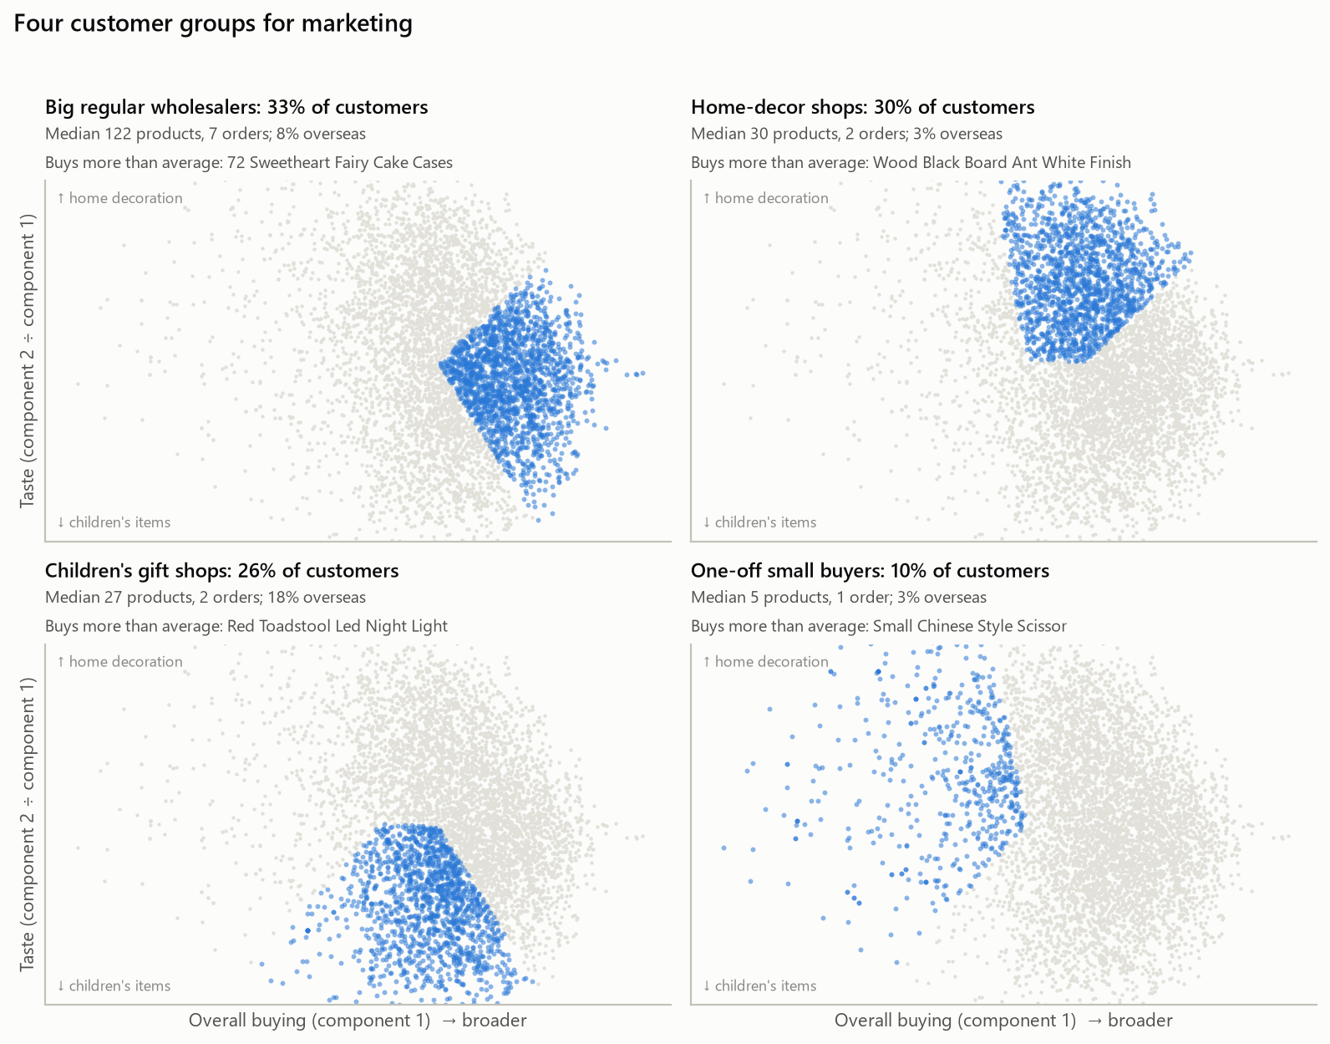
FOR MARKETING
Four customer groups to plan campaigns around
Big regular wholesalers 33%
Buy across the range: baking, bags, storage
Campaign: Volume pricing, early access to new ranges
Home-decor shops 30%
Hanging hearts, antique-white wood, frames
Campaign: Seasonal decoration collections
Children's gift shops 26%
Lunch boxes, plasters in tins, paint sets; 18% overseas
Campaign: Back-to-school and kids' ranges; EU delivery offers
One-off small buyers 10%
One small order, few products in common
Campaign: A second-order incentive
Notes:
For marketing, the map uses the model's first two components, reshaped so the axes read as how much a shop buys and what it buys. Four groups come out: big regular wholesalers, home-decor shops, children's gift shops, which have the most overseas buyers, and one-off small buyers. Each holds at least 10 percent of customers, and no two share a distinctive product, so each can get its own campaign. No customer IDs appear anywhere.

Slide 8
What could go wrong, and what comes next
RISKS
NEXT STEPS
New customers and products. The model knows nothing about them; 15% of test-period purchases came from customers with no history. Show them best sellers.
Seasonality. Tested on the pre-Christmas peak; quieter months may differ.
Popularity. The model leans on what sells well.
Data gaps. 23% of order lines have no customer ID and are not used.
Test it live. A 4-week test on product pages against best sellers, measuring clicks and added revenue.
Run it nightly. Schedule python nightly_job.py and re-check the hit rate every month.
Cover new products. Fall back to items from the same range until they have buyers.
Code, reports and memo: github.com/tungnguyenasu/DE-ML-project-Customers-Like-You
Notes:
The main risks: new customers and new products get no personal suggestions, so they should see best sellers. We tested on the Christmas peak, so the monthly check matters. Next, I'd run a four-week live test on product pages against best sellers, and schedule the nightly job. Everything is in the repository. Thank you.

