Slide 1
TIME MACHINE
Buffer over Flow Team

Slide 2

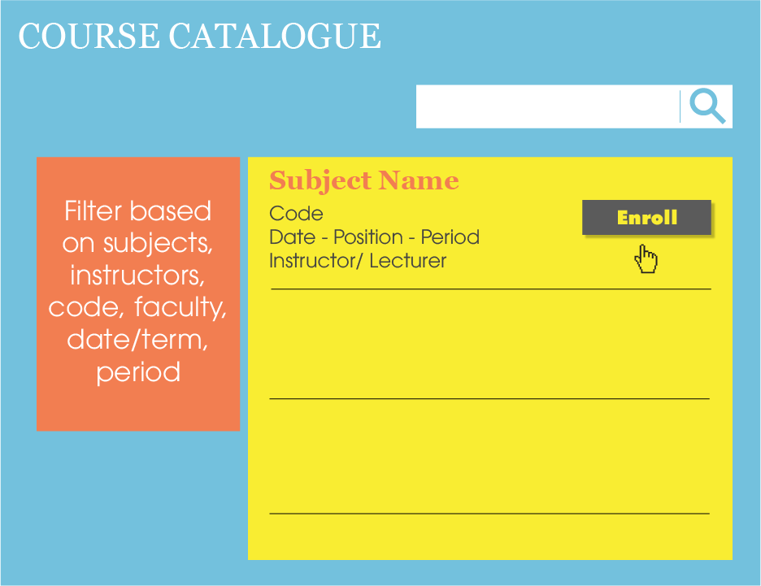

Slide 3



Slide 4


