Slide 1
.NET Memory Primer
Martin Kulov

Slide 2
"Out of CPU, memory and disk, memory is typically the most important for overall system performance."
Mark Russinovich
“All you worry about in a .NET application is the memory.”
John Robbins

Slide 3
Addressing Limits /Virtual Limits/
x86
2 ^ 32 bits = 4GB /0x FFFF FFFF/
x64
2 ^ 64 bits = 16 EB /0x FFFF FFFF' FFFF FFFF/

Slide 4
Physical Memory Limits
x86
4GB Windows Client, Windows Srv 2008 Standard
128GB Windows Srv 2003 SP1 Datacenter (PAE)
Notes:
Operating Systems and PAE Support
http://msdn.microsoft.com/en-us/windows/hardware/gg487512.aspx
Physical Address Extension
Http://en.wikipedia.org/wiki/Physical_Address_Extension
Memory Limits for Windows Releases
http://msdn.microsoft.com/en-us/library/aa366778.aspx

Slide 5
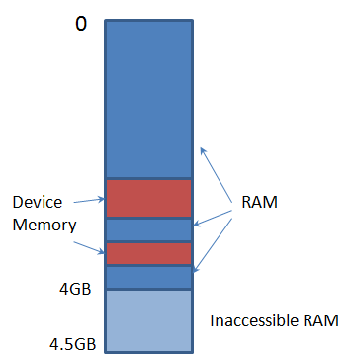
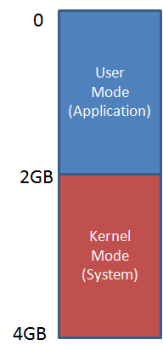
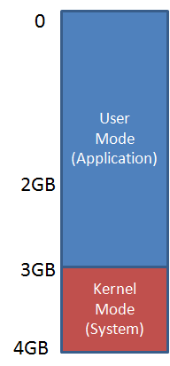
x86 Memory Mapping
* PFN - Page Frame Number database
Notes:
Pushing the Limits of Windows: Physical Memory
http://blogs.technet.com/b/markrussinovich/archive/2008/07/21/3092070.aspx
Pushing the Limits of Windows: Virtual Memory
http://blogs.technet.com/b/markrussinovich/archive/2008/11/17/3155406.aspx
Page Frame Number (PFN) database
http://social.technet.microsoft.com/wiki/contents/articles/15259.page-frame-number-pfn-database.aspx

Slide 6
Physical Memory Limits
x64
4TB Windows Srv 2012 Standard
per SKU
Notes:
Operating Systems and PAE Support
http://msdn.microsoft.com/en-us/windows/hardware/gg487512.aspx
Physical Address Extension
Http://en.wikipedia.org/wiki/Physical_Address_Extension
Memory Limits for Windows Releases
http://msdn.microsoft.com/en-us/library/aa366778.aspx

Slide 7
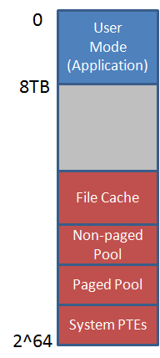
x64 Memory Mapping (AMD64)

Slide 8
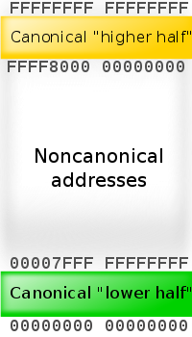
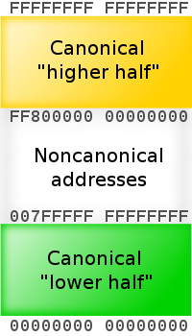
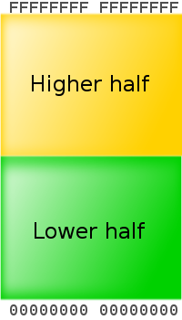
Canonical Form Addresses
48-bit implementation
56-bit implementation
64-bit implementation
Notes:
x86-64
http://en.wikipedia.org/wiki/X86-64

Slide 9
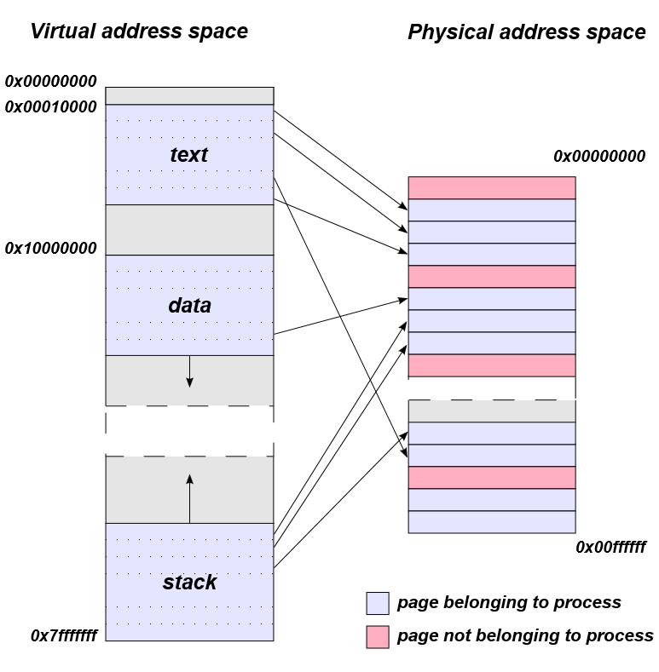
Virtual Address Space
Notes:
Virtual address space
http://en.wikipedia.org/wiki/Virtual_address_space

Slide 10
User Mode Memory
Code
Data
Heaps
Stacks

Slide 11
Stacks
Created for Each Thread
Default to 1MB
Hold Method Data /stack frame/
Parameters
Local variables
Return address

Slide 12
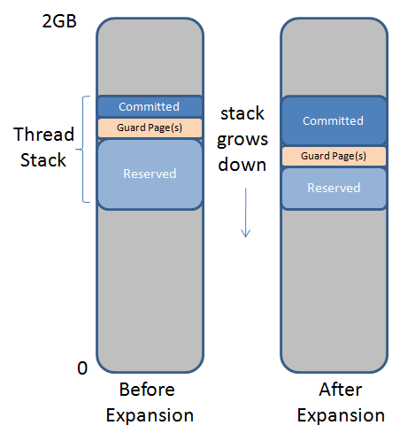
Stack Layout
Notes:
Pushing the Limits of Windows: Processes and Threads
http://blogs.technet.com/b/markrussinovich/archive/2009/07/08/3261309.aspx

Slide 13
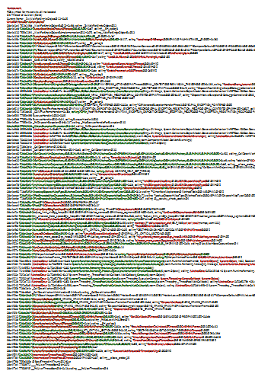
Call Stack Example
ChildEBP RetAddr Caller,Callee
08e4e1a4 751b149d _WaitForSingleObjectEx@12+0x98, calling _ZwWaitForSingleObject@12
08e4e1e8 718b53c2 ?LeaveRuntimeNoThrow@Thread@@SGJI@Z+0xd7, calling __EH_epilog3
08e4e210 755b1194 _WaitForSingleObjectExImplementation@12+0x75, calling _WaitForSingleObjectEx@12
08e4e228 718b54d7 ?LoadImage@PEImage@@SGPAV1@PAUHINSTANCE__@@@Z+0x1af
...
08e4f5f4 71a10647 ?intermediateThreadProc@Thread@@CGKPAX@Z+0x49
08e4f784 71a10635 ?intermediateThreadProc@Thread@@CGKPAX@Z+0x37, calling __alloca_probe_16
08e4f798 755b336a @BaseThreadInitThunk@12+0xe
08e4f7a4 77639f72 ___RtlUserThreadStart@8+0x70
08e4f7e4 77639f45 __RtlUserThreadStart@8+0x1b, calling ___RtlUserThreadStart@8

Slide 14
Heaps
Hold Dynamically Allocated Data
Code Heap /JITed code/
Small Object Heap /SOH/
Large Object Heap /LOH/
Process Heap

Slide 15
Allocating .NET Memory
Stack
Value Types /Int32, Bool, Struct, etc…/
Pointers to Reference Types
Heap
Reference Types /Object, String, Array, etc…/
Free Areas

Slide 16
DEMO: Allocating Memory
Notes:
.load sos
Argument passed by val and ref – !clrstack -a
Show stack objects – !clrstack -a
Modify arguments by val
Reference types
Stop on unrooted reference type
Show !gcroot
Show !eeheap -gc

Slide 17
Object Roots /GC Roots/
Stack References
Static References /Fields, ThreadStatic/
CPU Registers
Interop References /COM, API calls/
Finalization Queue References

Slide 18
Nondeterministic Finalization
a.k.a. Generational Garbage Collector /GC/
Three Generations /SOH/
Gen0 – short lived
Gen1 – medium lived
Gen2 – long lived

Slide 19
Segments
Contiguous Memory Areas
Ephemeral Segment
Holds Gen0, Gen1
There Can Be Only One
Gen2 Segments

Slide 20
Before GC #0
Gen0
Before GC #1
Gen1
Gen0
Before GC #2
Gen2
Gen1
Gen0
Before GC #100
Gen2
Gen2
Gen1
Gen0
Before GC #500
Gen2
Gen2
Gen2
Gen1
Gen0
Notes:
http://blogs.msdn.com/b/tess/archive/2008/04/17/how-does-the-gc-work-and-what-are-the-sizes-of-the-different-generations.aspx
http://blogs.msdn.com/cfs-file.ashx/__key/communityserver-components-postattachments/00-08-40-25-69/FUN421_5F00_Stephens.ppt

Slide 21
Allocation - Cost
Cheap Lock on UP; Lock Free on MP
Moving a Pointer Forward
Clearing the Memory for New Objects
Register for Finalization if Applicable
Object Proximity

Slide 22
Collection - When
Gen0 is Full
Induced GC /System.GC.Collect()/
System Pressure

Slide 23
DEMO: Collecting Memory
Notes:
Call GC.Collect()
!eeheap -gc
!heapstat
!gcwhere

Slide 24
Collection - Cost
Rule of Thumb – Ratio 1:10:100
.NET CLR Memory\% time in GC
.NET CLR Memory\# Induced GC
.NET CLR Memory\# Gen X collections
Notes:
.NET CLR Memory\% time in GC - This counter measures the amount of CPU time you spend in GC and it is calculated as (CPU time for GC/CPU time since last GC)
.NET CLR Memory\# Induced GC – This is the number of garbage collections that have occurred as a result of someone calling GC.Collect(). Ideally this should be 0 since inducing full collections means that you spend more time in the GC, and also because the GC continuously adapts itself to the allocation patterns in the application, and performing manual GCs skews this optimization.
.NET CLR Memory\# Gen X collections – This counter displays the amount of collections that have been performed for a given generation. Since the cost of gen 2 collections is high compared to Gen 1 and Gen 0 you want to have as few Gen 2 collections per Gen 1 and Gen 0 collections as possible. A ratio of 1:10:100 is pretty good.

Slide 25
Large Object Heap
> 85KB /or >1,000 doubles/
Memory is Swept During Gen2 /Marked as Free/
Avoid Temporary Large Objects in LOH
Reuse Objects in LOH If Possible
Many LOH Segments
Fragmentation Problems

Slide 26
Collection - How
Suspend Managed Threads
Collect Garbage
Resume Managed Threads
Two Phases of GC
Mark
Compact

Slide 27
GC Types
Workstation GC – Non Concurrent
Server GC – Non Concurrent
Workstation GC – Concurrent
Background GC /New in .NET 4/
Server GC – Background /New in .NET 4.5/

Slide 28
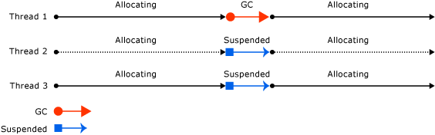
Workstation GC – Non Concurrent
Notes:
http://msdn.microsoft.com/library/ee787088(v=vs.110).aspx

Slide 29
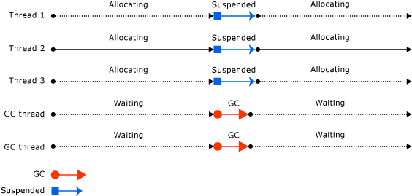
Server GC – Non Concurrent

Slide 30
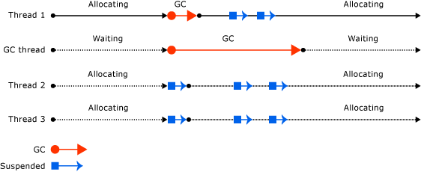
Workstation GC - Concurrent

Slide 31
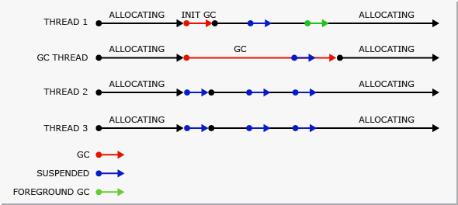
Workstation GC - Background

Slide 32
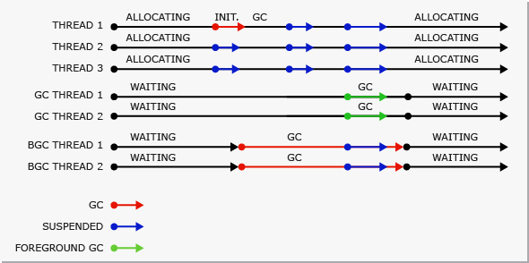
Server GC - Background

Slide 33
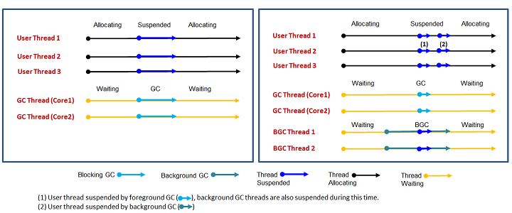
Server GC – Before and After

Slide 34
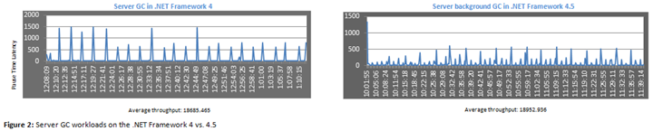
Testing Server GC

Slide 35
New in .NET 4.5.1 RC
LOH Compacting!
GCSettings.LargeObjectHeapCompactionMode = GCLargeObjectHeapCompactionMode.CompactOnce;
GC.Collect();
Notes:
http://msdn.microsoft.com/en-us/library/system.runtime.gcsettings.largeobjectheapcompactionmode.aspx

Slide 36
Resource Management
Very Fast Allocation
Automatic GC
Nondeterministic Finalization
Finalizers and Finalization Queue
Deterministic Finalization - IDisposable
Notes:
Resource management
http://blogs.msdn.com/b/brada/archive/2005/02/11/371015.aspx
http://www.vineetgupta.com/2007/01/notes-on-the-clr-garbage-collector/

Slide 37
CHALLENGE: Implement Dispose Pattern / Volunteer is Needed /
Notes:
protected virtual void Dispose(bool disposing)
{
if (!disposed)
{
if (disposing)
{
// dispose-only, i.e. non-finalizable logic
}
// shared cleanup logic
disposed = true;
}
}
~ComplexCleanupBase()
{
Dispose(false);
}
public void Dispose()
{
Dispose(true);
GC.SuppressFinalize(this);
}

Slide 38
Memory Visualization
CLR Profiler
Visual Studio Memory Profiler
Visual Studio 2013 - Debug Managed Memory
3rd Party Commercial Tools

Slide 39
martin@kulov.net

