Slide 1

IDisposable Best Practices for C# Developers
Introducing IDisposable
Elton Stoneman
geekswithblogs.net/eltonstoneman @EltonStoneman

Slide 2
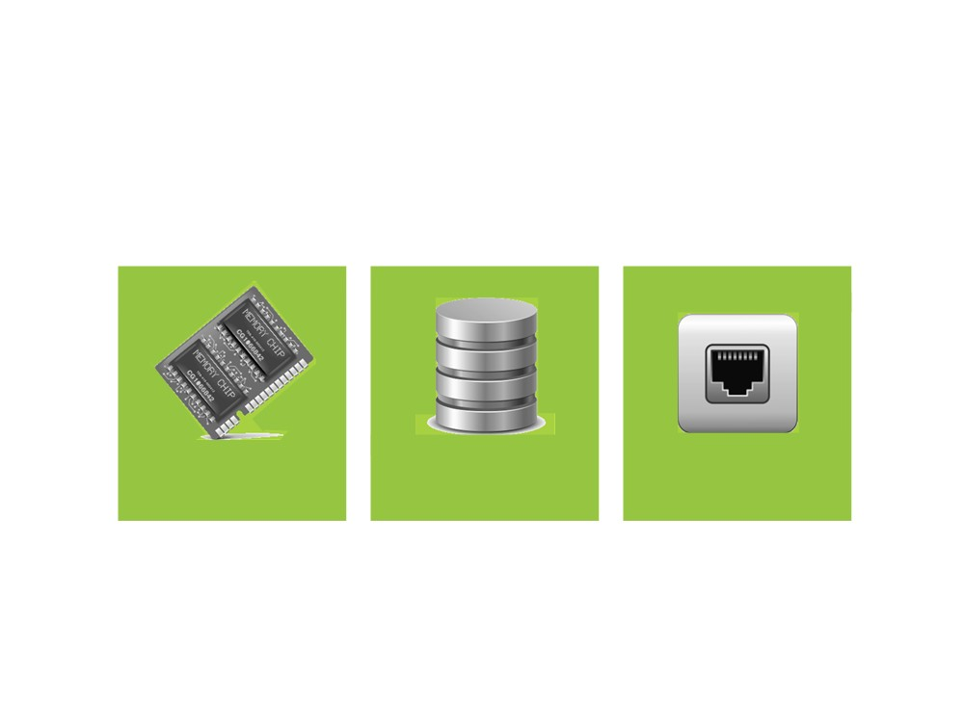
Introducing IDisposable
Memory
Databases
Network

Slide 3
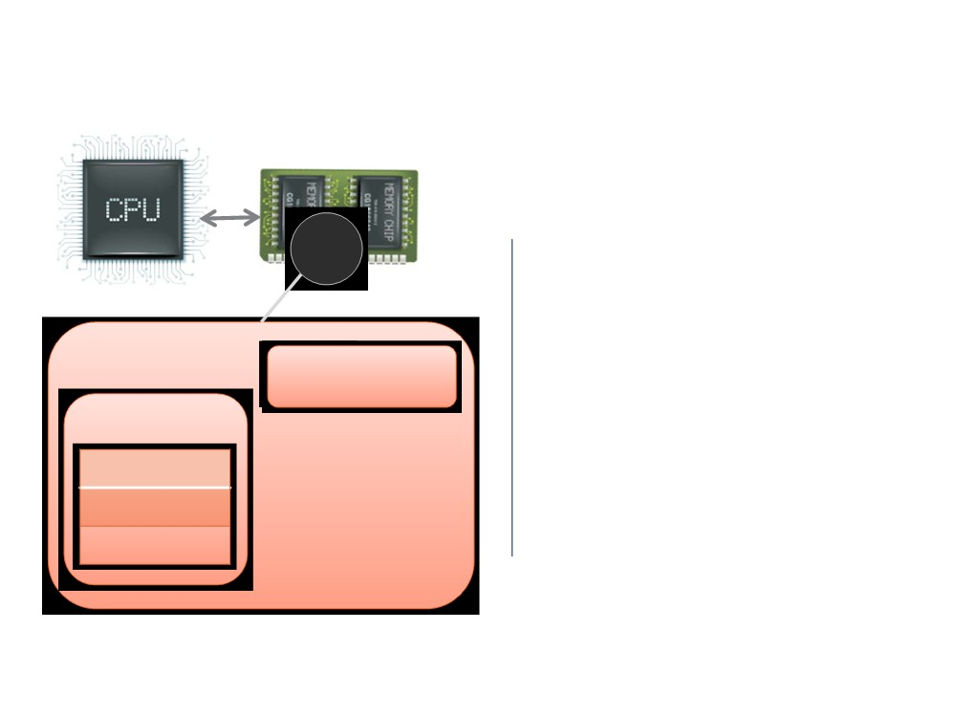
Introducing IDisposable
Process allocates memory
AppDomain
Heap
Stack

Slide 4
Introducing IDisposable
Process allocates memory
AppDomain
Heap
Stack
{...} int32

Slide 5
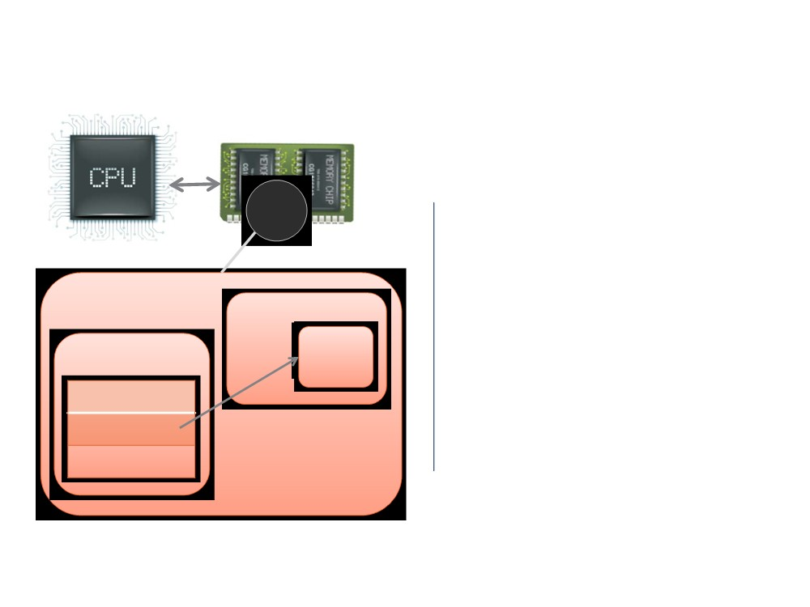
Introducing IDisposable
Process allocates memory
AppDomain
Heap obj1
Runs processing
Stack
{...} int32 {...}pointer

Slide 6
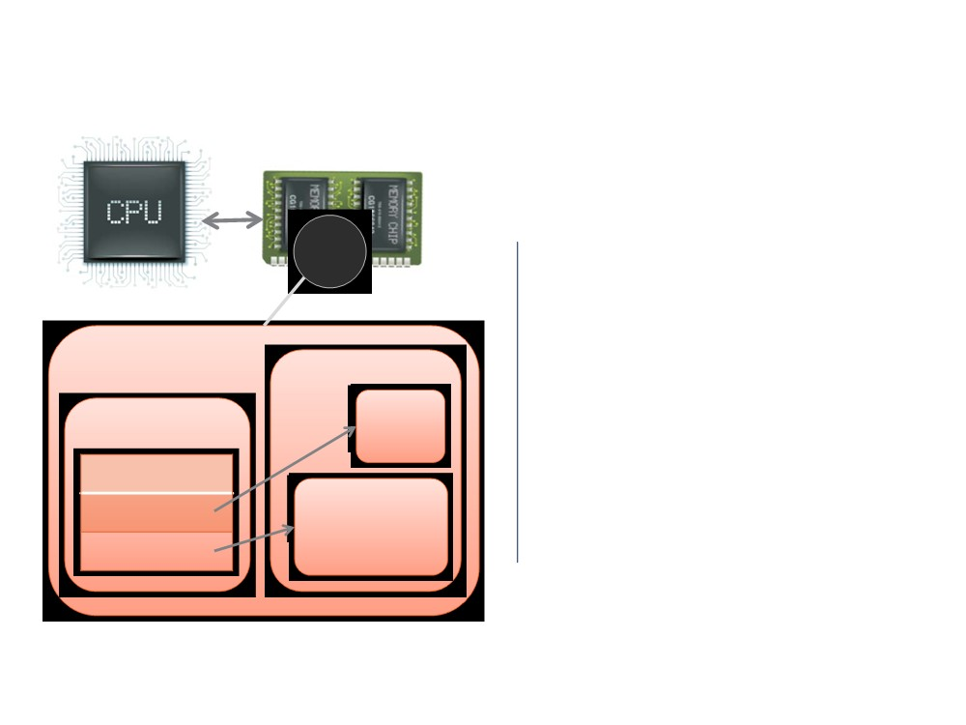
Introducing IDisposable
Process allocates memory
AppDomain
Heap obj1
Runs processing
Stack
{...} int32 {...}pointer {...}pointer
obj2

Slide 7
Introducing IDisposable
Process allocates memory
AppDomain
Heap obj1
Runs processing
Stack
{...} int32 {...}pointer {...}pointer
obj2

Slide 8
Introducing IDisposable
Process allocates memory
AppDomain
Runs processing Releases memory
Heap
Stack

Slide 9
Introducing IDisposable
Process allocates memory
AppDomain
Heap obj1
Runs processing
Stack
{...} int32 {...}pointer {...}pointer
obj2

Slide 10
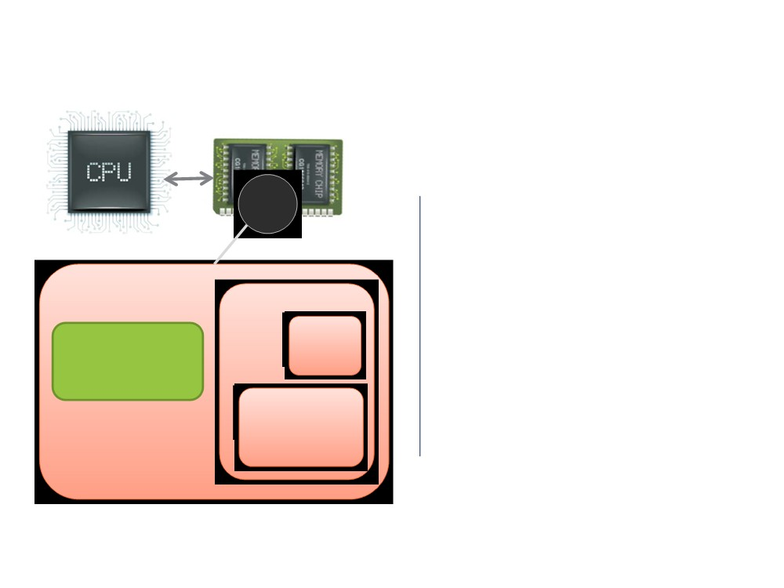
Introducing IDisposable
Process allocates memory
AppDomain
Runs processing Garbage collector
Heap obj1
Garbage Collector
obj2

Slide 11

Introducing IDisposable
Process allocates memory
AppDomain
Runs processing Garbage collector
Heap obj1
Garbage Collector
obj2

Slide 12
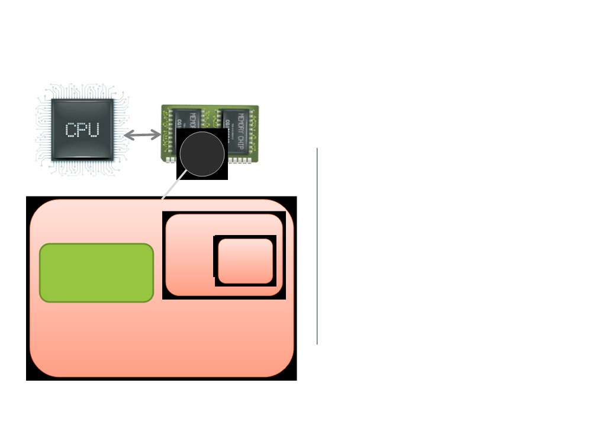
Introducing IDisposable
Process allocates memory
AppDomain
Runs processing Garbage collector Releases memory
Heap obj1
Garbage Collector

Slide 13

Introducing IDisposable
Process allocates memory
AppDomain
Runs processing Garbage collector Releases memory
Heap obj1
Garbage Collector

Slide 14
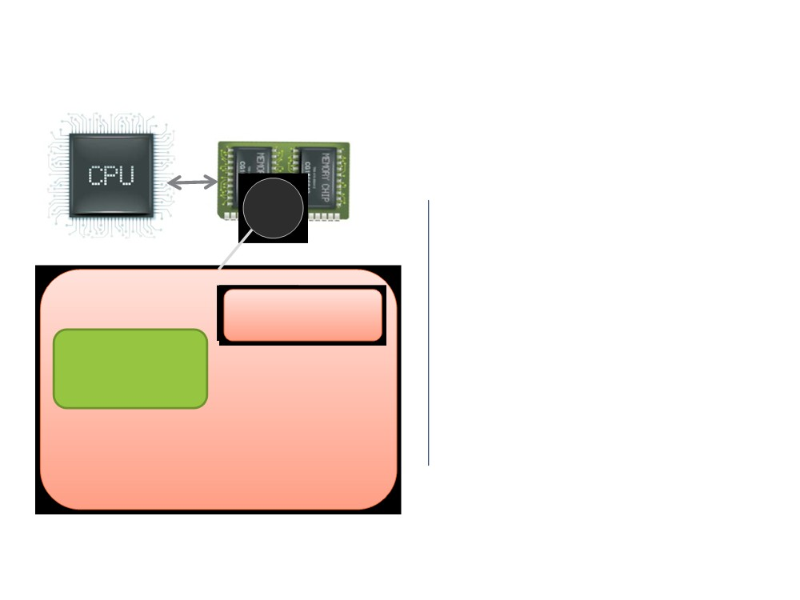
Introducing IDisposable
Process allocates memory
AppDomain
Runs processing Garbage collector Releases memory
Heap
Garbage Collector

Slide 15
Not Using IDisposable?
6
w
b
Expanding memory profile
Hogging external resources
Functional defects

Slide 16

Introducing IDisposable
IDisposable
Usin and
Demo wit file I
,
interface
implementing
SQ an WCF
IDisposable

Slide 17

Course Outline
What Happens when the GC Runs?
What Happens if you don't
Introducing IDisposable
Dispose?
Summary
You are here

Slide 18

Simple Interfaces
public interface IDontDoAnything {
}
public class
DoesntDoAnything : IDontDoAnything
{
}

Slide 19

Simple Interfaces
public interface IDoOneThing {
void DoTheThing();
}
public class
DoesOneThng
: IDoOneThing
{
public void DoTheThing()
{
}
}

Slide 20

Simple Interfaces
namespace System
{
public interface
IDisposable
{
void Dispose();
}
}

Slide 21
IDisposable
provides a mechanism for releasing unmanaged resources

Slide 22
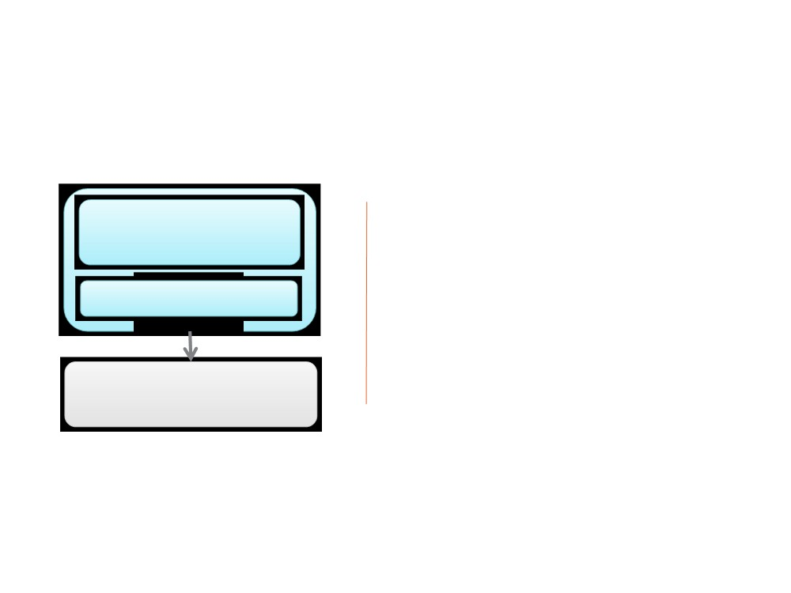
Unmanaged Resources
Runtime-callable wrapper
Managed code
External COM library
Interop
Explicitly unmanaged
DllImport PInvoke IntPtr
Native library

Slide 23
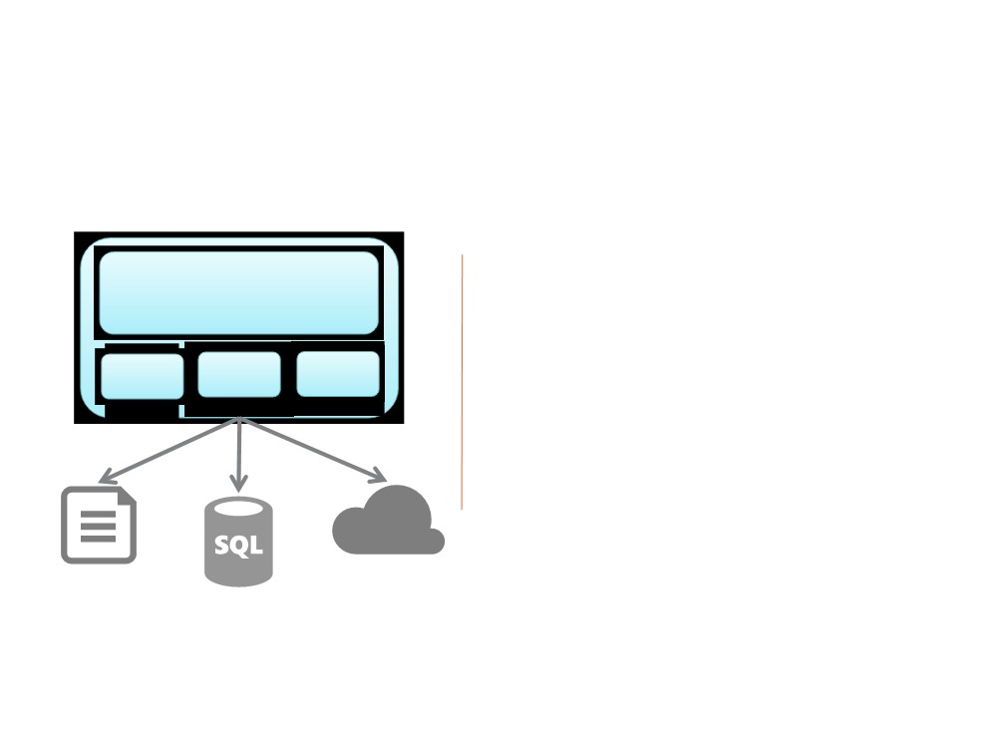
Unmanaged Resources
Managed access
Managed code
External resources
IO Data Svc
Implicitly unmanaged
System.IO System.Data
System.ServiceModel

Slide 24

Using IDisposable
public class
MayUseUnmanagedResources : IDisposable
{
public void Method() { /* ... */
}
public void Dispose() { /* ... */ }
}
static void Main() {
using (var obj = new MayUseUnmanagedResources()) {
obj.Method();
}
}

Slide 25
Demo 1: SqlConnection

Slide 26
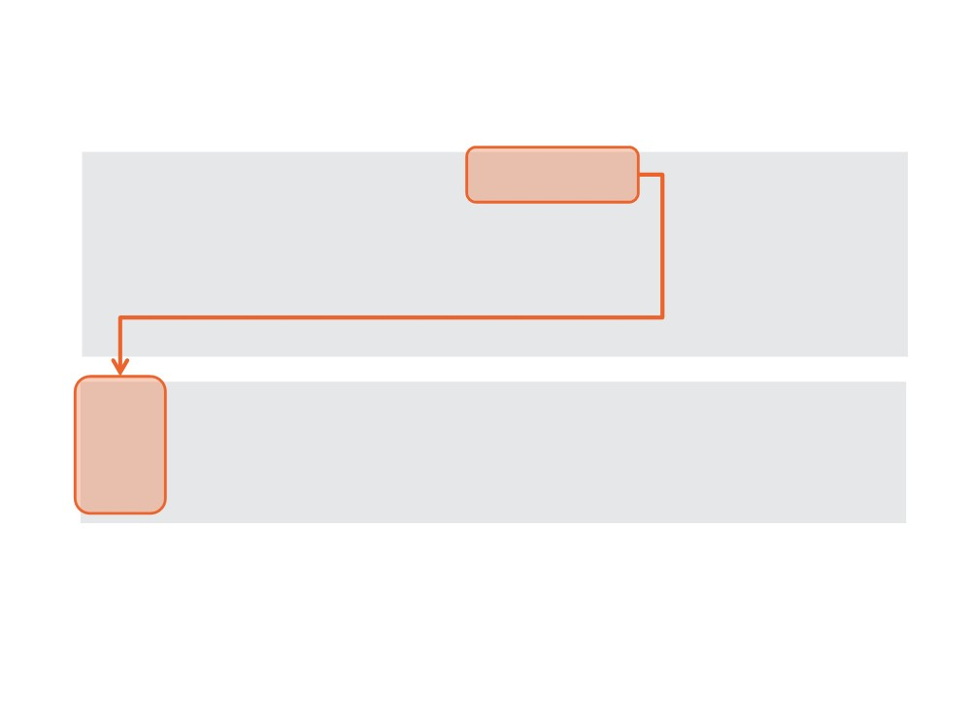
Demo 1: SqlConnection
public class DatabaseState : {
private SqlConnection _connection;
/* ... */
}
(var state = new DatabaseState()) state.GetDate().Dump();

Slide 27
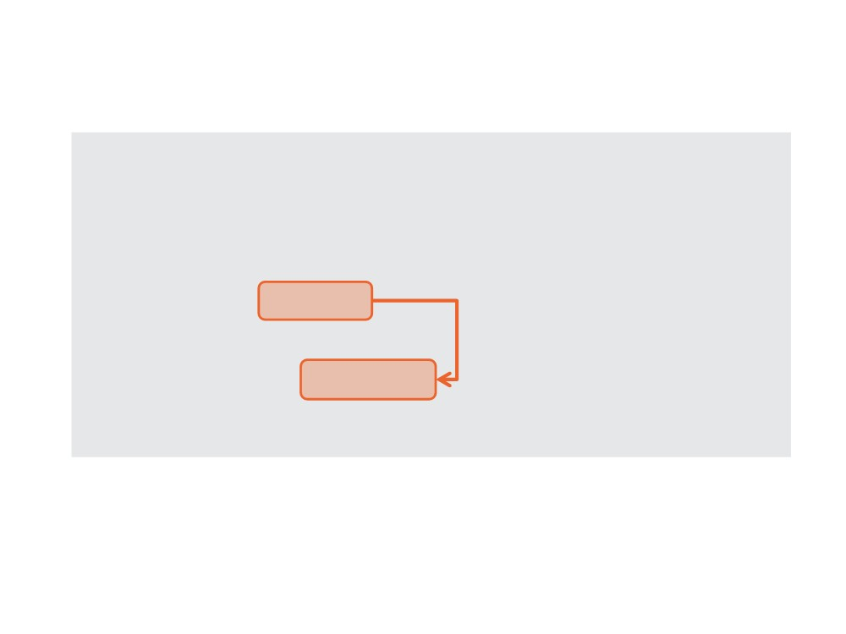
Demo 1: SqlConnection
public class DatabaseState : IDisposable {
private SqlConnection _connection;
/* ... */
public void
{
_connection.Close(); _connection
}
}

Slide 28

Demo 1: SqlConnection
(var command = _connection.CreateCommand())
command.CommandText = "SELECT getdate()"; command.ExecuteScalar().ToString(); }

Slide 29
Best Practice #1
Dispose of IDisposable
objects as soon as you can

Slide 30

✮
Best Practice #1
(var state = new DatabaseState())
state.GetDate().Dump(); }
var state = new DatabaseState(); try
{
state.GetDate().Dump(); }

Slide 31
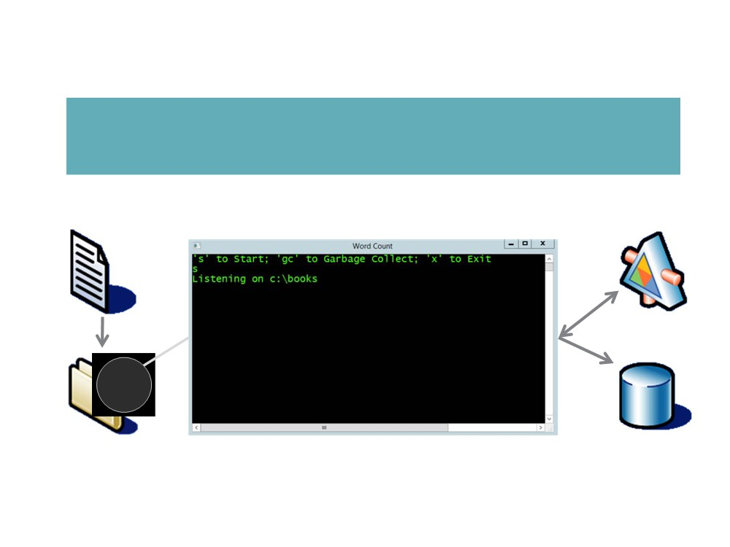
The Word Counting App
Σ(B)= 40,000 words

Slide 32
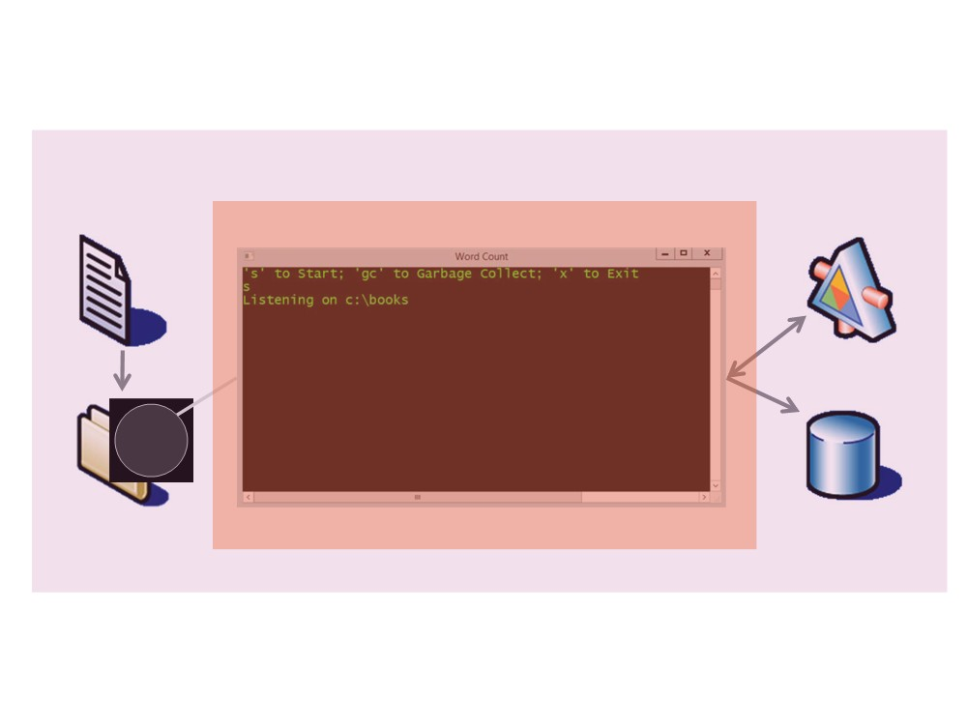
The Word Counting App
Everything Else
Managed Code

Slide 33

Demo 2: The Word Counting App
Walkthrough Verify file drops
Walkthrough App failing because of neglecting IDisposable
Feature
Compute number of words in text file & store count in database
have word count persisted

Slide 34
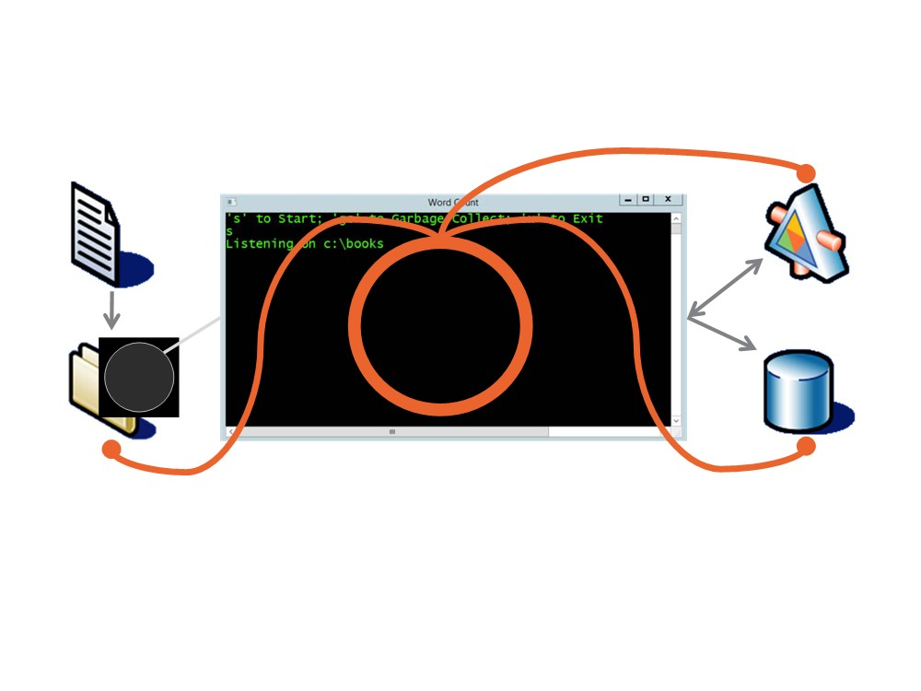
Demo 2: The Word Counting App
b

Slide 35

Summary
▪ Introducing IDisposable
□ Interface definition
□ Meaning
▪ Unmanaged resources
□ Native code- IntPtr & interop
□
*And* managed code
□ Which implements IDisposable □ May or may not use unmanaged resources
What Happens when the GC Runs?
▪ Demo solution

□ File IO, SQL and WCF

