Slide 1

What Happens When the Garbage Collector Runs?
Elton Stoneman
geekswithblogs.net/eltonstoneman @EltonStoneman

Slide 2

What is the
Ho IDisposable
Best Practice
Garbage Collecto ?
works with the GC
implementation of
IDisposable
D

Slide 3

The .NET Framework's garbage
collector manages the allocation and release of memory for your application
— MSDN
Do Not Place Anything in This Space
(Add watermark during editing)
Note: Warning will not appear during Slide Show view.

Slide 4
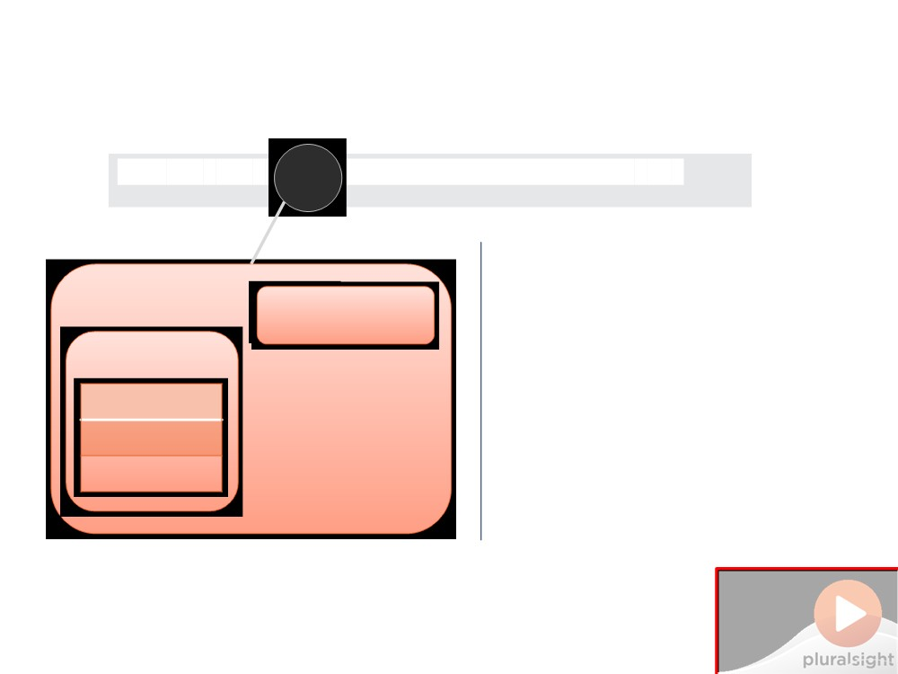
GC 101
var obj
ayUseUnmanagedResources();
AppDomain
App creates instance
Heap
Stack
Do Not Place Anything in This Space
(Add watermark during editing)
Note: Warning will not appear during Slide Show view.

Slide 5
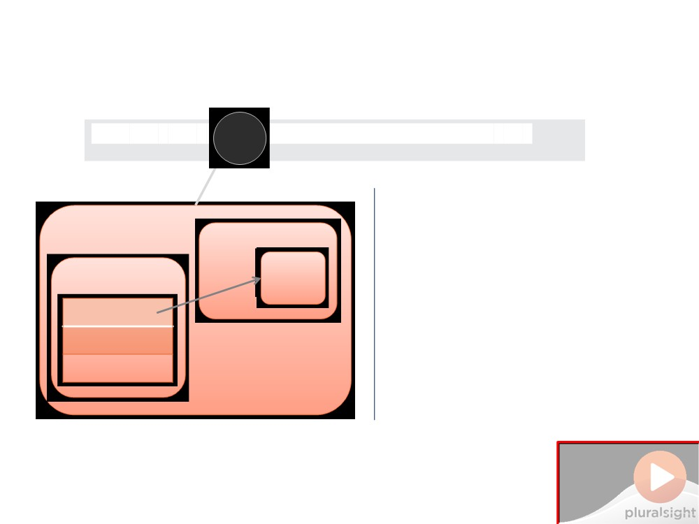
GC 101
var obj
ayUseUnmanagedResources();
App creates instance .NET allocates memory
AppDomain
Heap obj1
Stack
{...} pointer
Do Not Place Anything in This Space
(Add watermark during editing)
Note: Warning will not appear during Slide Show view.

Slide 6
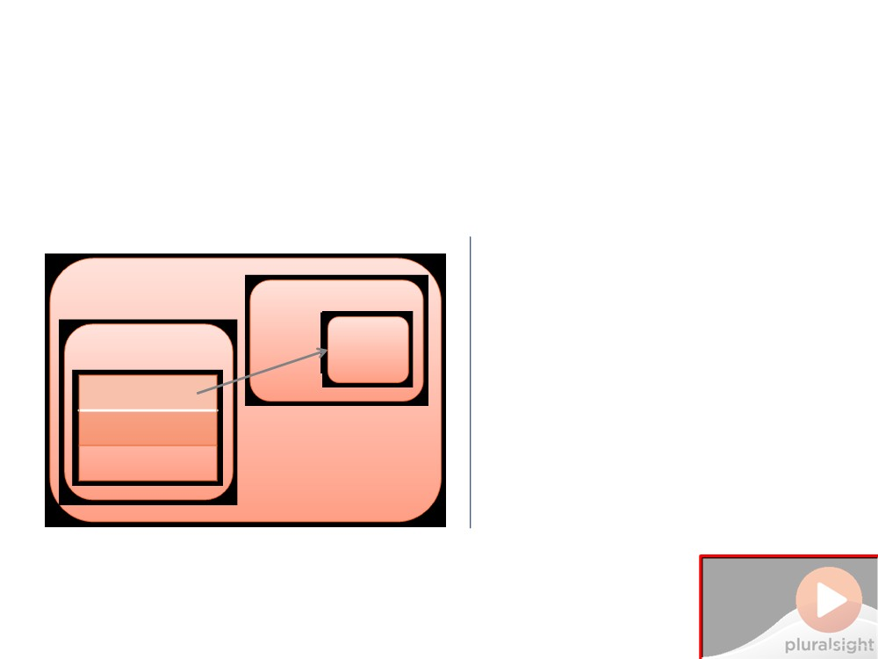
GC 101
App creates instance .NET allocates memory App ends
AppDomain
Heap obj1
Stack
{...} pointer
Do Not Place Anything in This Space
(Add watermark during editing)
Note: Warning will not appear during Slide Show view.

Slide 7

GC 101
App creates instance .NET allocates memory App ends
Do Not Place Anything in This Space
(Add watermark during editing)
Note: Warning will not appear during Slide Show view.

Slide 8
GC 101
App creates instance .NET allocates memory GC runs
AppDomain
Heap
obj1L
Stack
{...} pointer
Do Not Place Anything in This Space
(Add watermark during editing)
Note: Warning will not appear during Slide Show view.

Slide 9
GC 101
App creates instance .NET allocates memory GC runs
AppDomain
Heap
obj1L
Stack
{...} pointer
Deallocates dead objects
Do Not Place Anything
in This Space
(Add watermark during editing)
Note: Warning will not appear during Slide Show view.

Slide 10
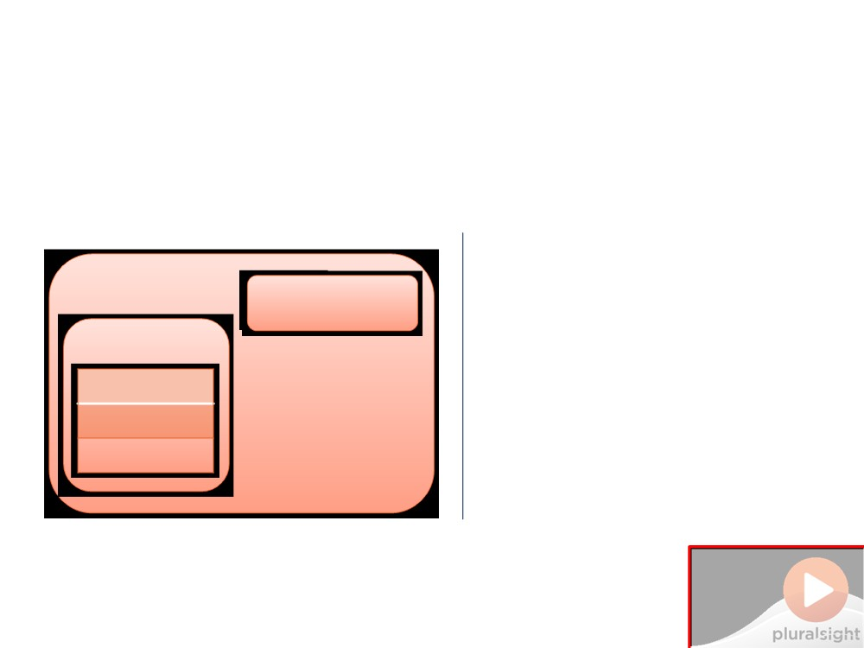
GC 101
App creates instance .NET allocates memory GC runs
AppDomain
Heap
Stack
Deallocates dead objects
Do Not Place Anything
in This Space
(Add watermark during editing)
Note: Warning will not appear during Slide Show view.

Slide 11
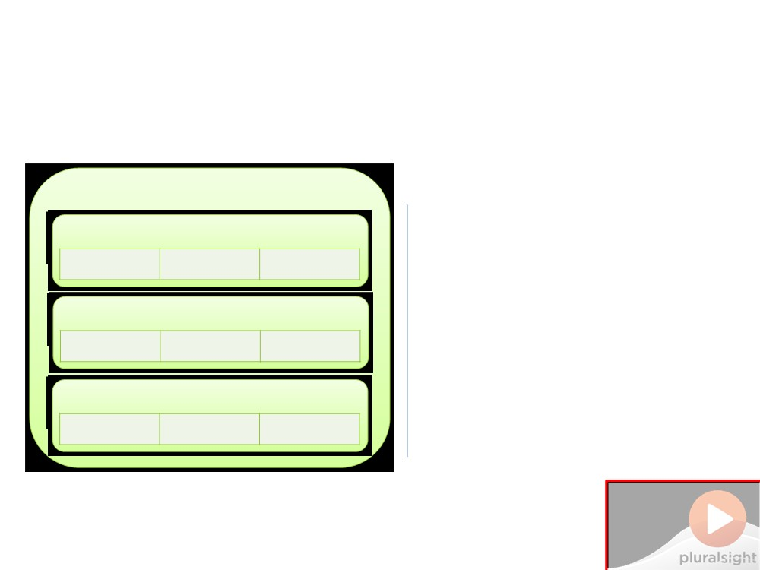
GC Generations
GC
Gen-0
Short-lived in gen-0
a1 a2 a3
Gen-1
Gen-2
Do Not Place Anything in This Space
(Add watermark during editing)
Note: Warning will not appear during Slide Show view.

Slide 12
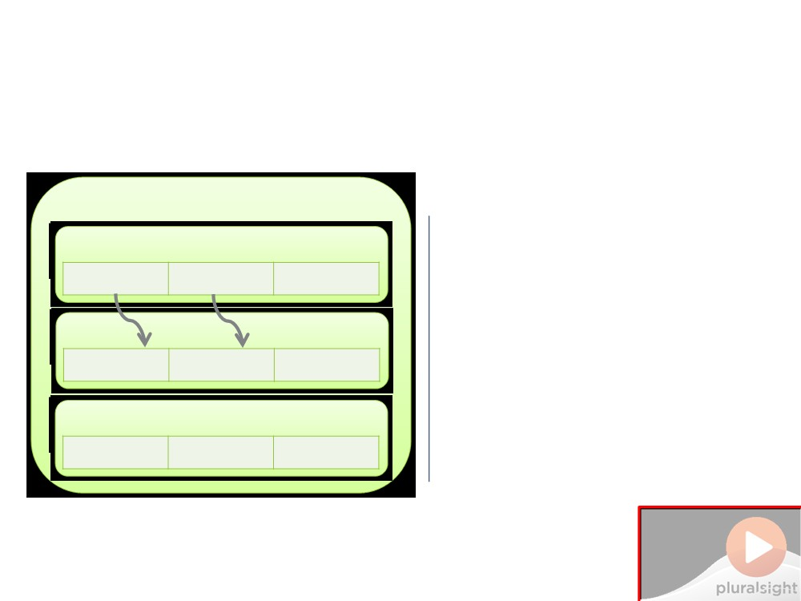
GC Generations
GC
Short-lived in gen-0 Move from gen-0 to gen-1
Gen-0
a1 a2 a3
L
Gen-1
Gen-2
Do Not Place Anything in This Space
(Add watermark during editing)
Note: Warning will not appear during Slide Show view.

Slide 13
GC Generations
GC
Short-lived in gen-0 Move from gen-0 to gen-1
Gen-0
Gen-1
a1 a2
Gen-2
Do Not Place Anything in This Space
(Add watermark during editing)
Note: Warning will not appear during Slide Show view.

Slide 14
GC Generations
GC
Short-lived in gen-0 Move from gen-0 to gen-1
Gen-0
a4 a5 a6
Gen-1
a1 a2
Gen-2
Do Not Place Anything in This Space
(Add watermark during editing)
Note: Warning will not appear during Slide Show view.

Slide 15
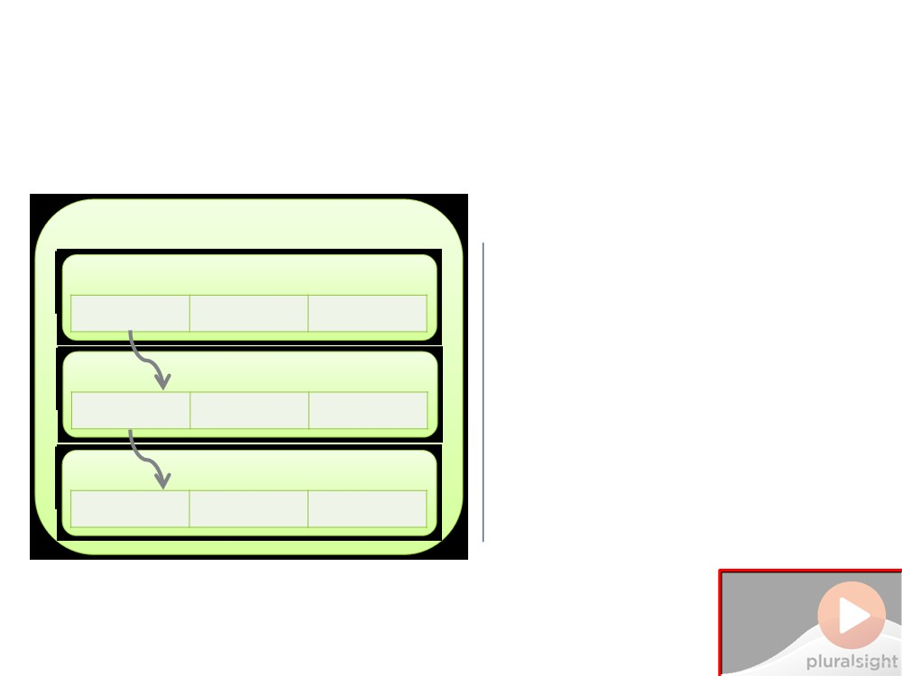
GC Generations
GC
Short-lived in gen-0 Move from gen-0 to gen-1
Gen-0
a4 a5
L
a6
L
Gen-1
a1 a2
L
Move from gen-1 to gen-2
Gen-2
Do Not Place Anything in This Space
(Add watermark during editing)
Note: Warning will not appear during Slide Show view.

Slide 16
GC Generations
GC
Short-lived in gen-0 Move from gen-0 to gen-1 Move from gen-1 to gen-2
Gen-0
Gen-1
a4
Gen-2
a1
Do Not Place Anything in This Space
(Add watermark during editing)
Note: Warning will not appear during Slide Show view.

Slide 17
GC Generations
GC
Short-lived in gen-0 Move from gen-0 to gen-1 Move from gen-1 to gen-2 Minimizing GC workload
Gen-0
a7 a8 a9
Gen-1
a4
Gen-2
a1
Do Not Place Anything in This Space
(Add watermark during editing)
Note: Warning will not appear during Slide Show view.

Slide 18
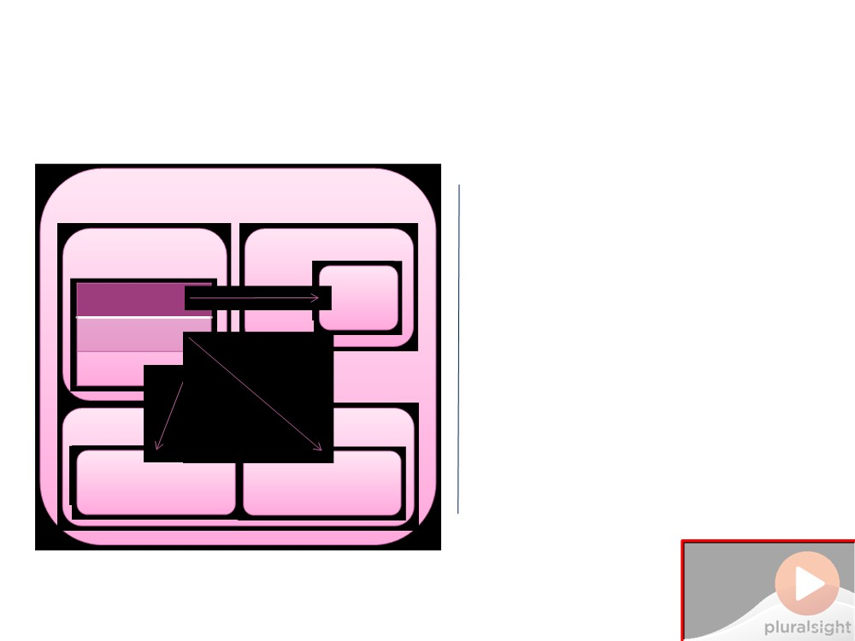
Heap Compression
Heap Large object heap
AppDomain
Stack Heap
obj1
{...} pointer
{...} pointer {...} pointer
Large O
obj2
obj3
Do Not Place Anything in This Space
(Add watermark during editing)
Note: Warning will not appear during Slide Show view.

Slide 19
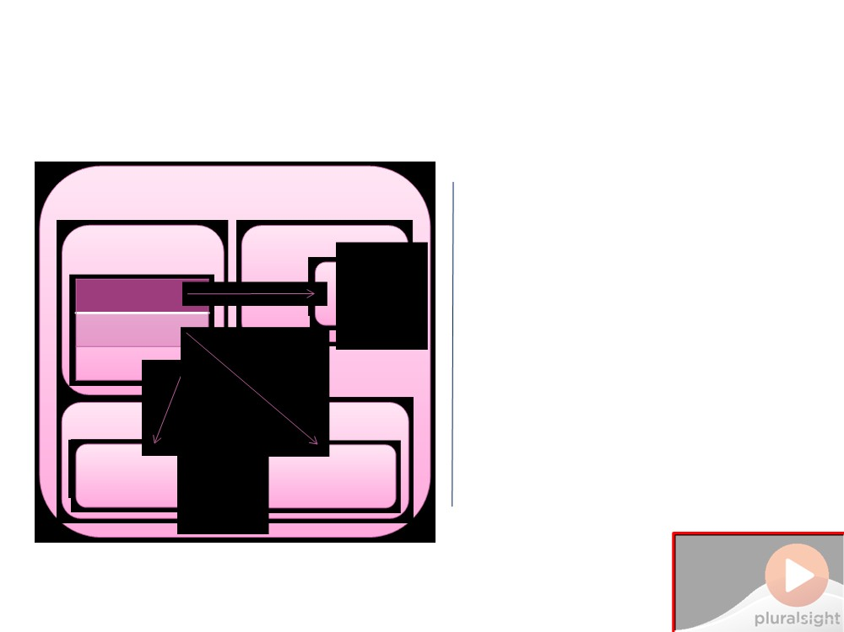
Heap Compression
Heap
AppDomain
Large object heap GC Runs
Stack Heap
o
L
{...} pointer
{...} pointer {...} pointer
Large O
obj2
L
j3
Do Not Place Anything in This Space
(Add watermark during editing)
Note: Warning will not appear during Slide Show view.

Slide 20

Heap Compression
Heap
AppDomain
Large object heap GC Runs
Stack Heap
{...} pointer
Deallocates objects
Large Objec
obj3
Do Not Place Anything in This Space
(Add watermark during editing)
Note: Warning will not appear during Slide Show view.

Slide 21
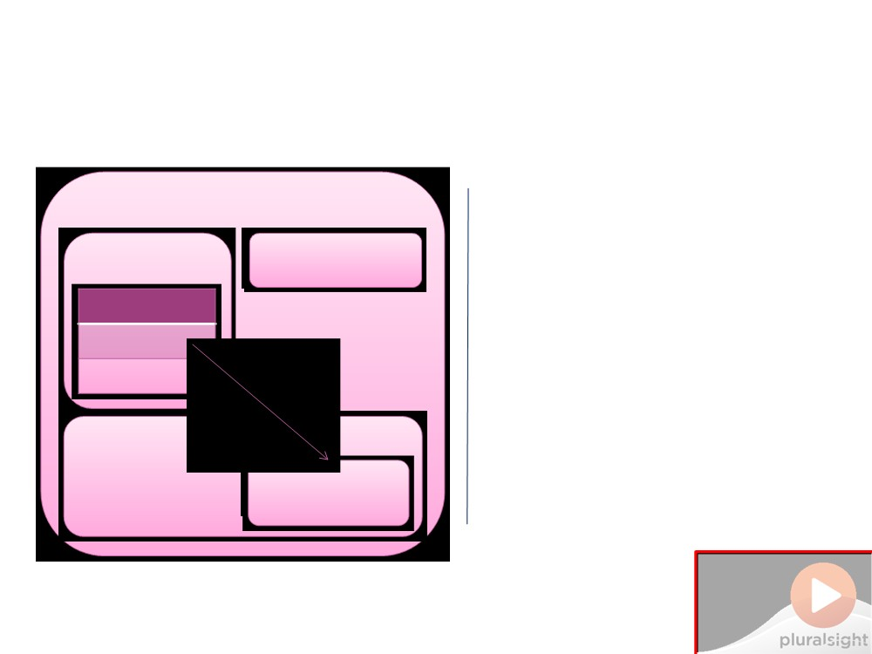
Heap Compression
AppDomain Stack
Heap
Large object heap GC Runs
Heap
{...} pointer
Deallocates objects
Large Objec obj3
Compresses Heap
Do Not Place Anything in This Space
(Add watermark during editing)
Note: Warning will not appear during Slide Show view.

Slide 22
Heap Compression
AppDomain Stack
Heap
Large object heap GC Runs
Heap
{...} pointer
Deallocates objects
Large Objec obj3
Compresses Heap Not Large Object Heap
Do Not Place Anything
in This Space
(Add watermark during editing)
Note: Warning will not appear during Slide Show view.

Slide 23
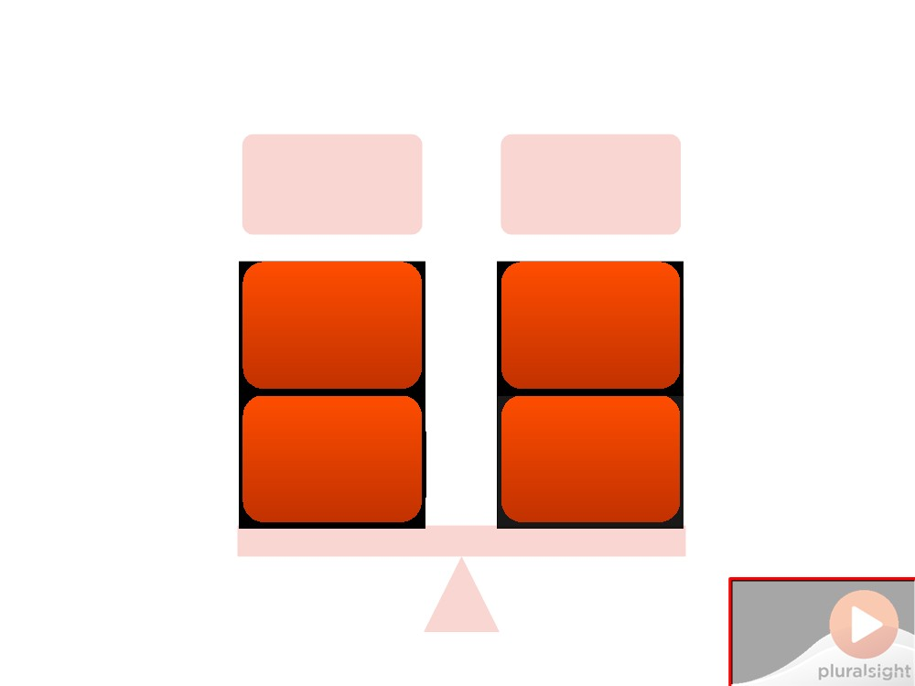
Balancing Concerns
Memory
Collections
Available
Infrequently
Contiguous
Efficiently
Do Not Place Anything in This Space
(Add watermark during editing)
Note: Warning will not appear during Slide Show view.

Slide 24
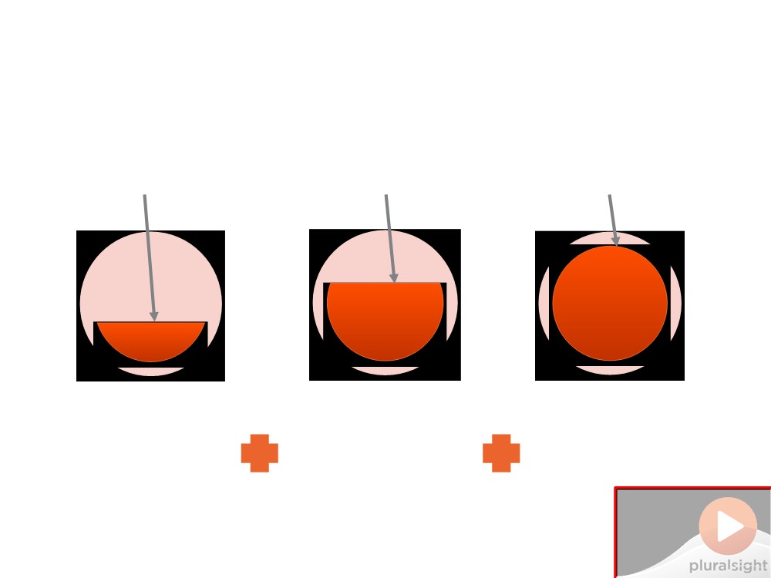
When Does the GC Collect?
Gen-0
Gen-0 Threshold
Gen-1 Threshold
Gen-2 Threshold
Gen-1 Threshold
Gen-2 Threshold
Generation 0 collection + Generation 1 collection +
Generation
Generation 0 collection + GGeneration -1
Generati -0 Collection
Generation-2 Collection
Collection
Do Not Place Anything in This Space
(Add watermark during editing)
Note: Warning will not appear during Slide Show view.

Slide 25
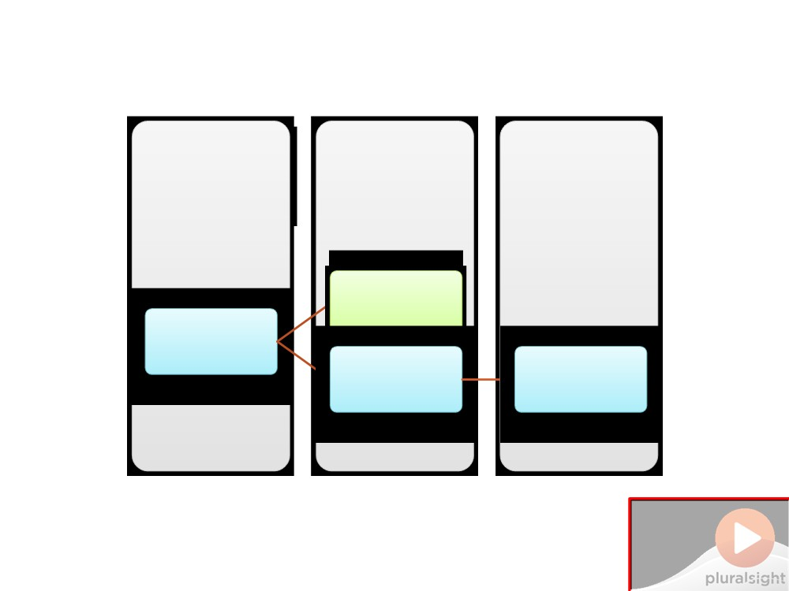
How Does the GC Run?
Threshold Check
GC
App
Collects
Continues
GC App
App
App
Do Not Place Anything in This Space
(Add watermark during editing)
Note: Warning will not appear during Slide Show view.

Slide 26
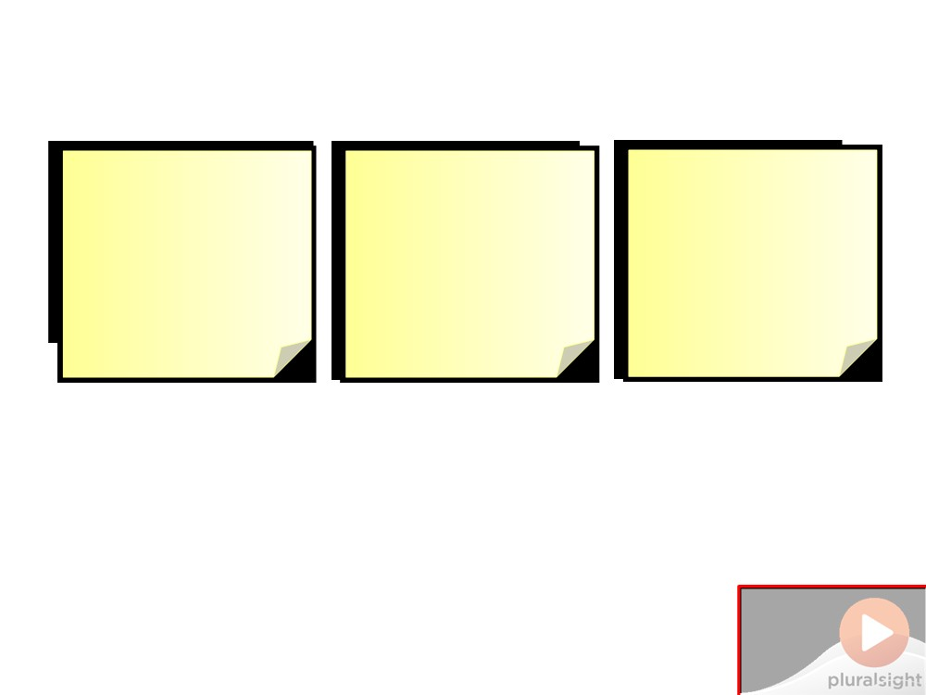
Demo 1: Profiling DatabaseState
Goal
Walkthrough
Walkthrough
Demonstrate
Profile memory
Force garbage
object allocation
usage for app
collection and
and GC collection
using
show memory
DatabaseState
usage
Do Not Place Anything in This Space
(Add watermark during editing)
Note: Warning will not appear during Slide Show view.

Slide 27

Demo 1: Profiling DatabaseState
Do Not Place Anything
in This Space
(Add watermark during editing)
Note: Warning will not appear during Slide Show view.

Slide 28
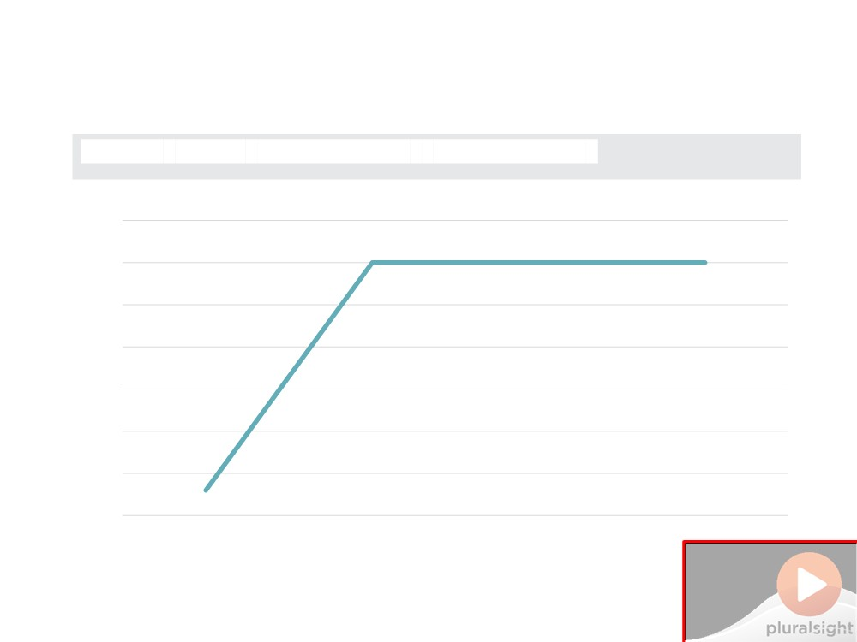
Demo 1: Profiling DatabaseState
private static DatabaseState _DatabaseState;
3500
3000 2500 2000 1500 1000
500
0
Startup
First Run
Multiple Runs
GC.Collect
Do Not Place Anything in This Space
(Add watermark during editing)
Note: Warning will not appear during Slide Show view.

Slide 29
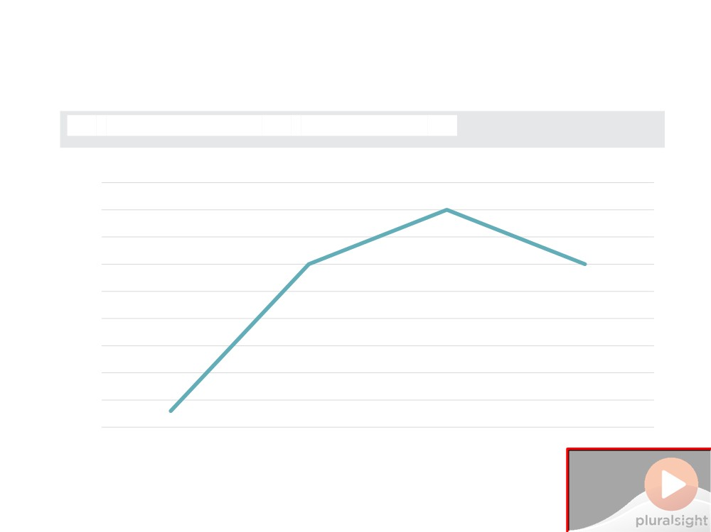
Demo 1: Profiling DatabaseState
var databaseState = new DatabaseState();
4500
4000 3500 3000 2500 2000 1500 1000
500 0
Startup
First Run
Multiple Runs
GC.Collect
Do Not Place Anything in This Space
(Add watermark during editing)
Note: Warning will not appear during Slide Show view.

Slide 30
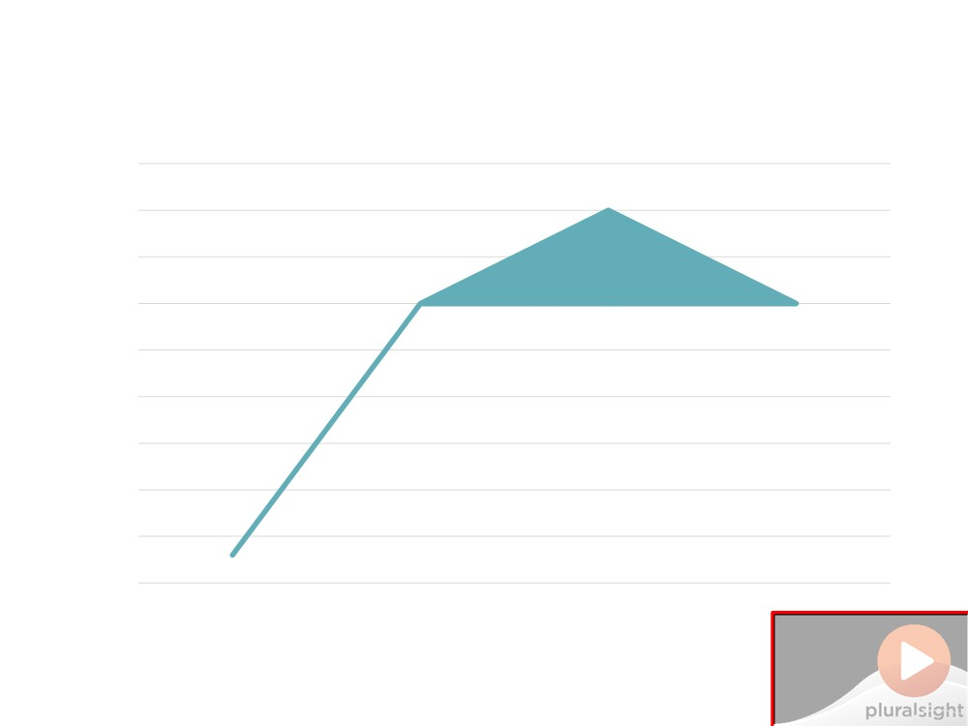
Demo 1: Profiling SqlConnection
4500
4000 3500 3000 2500 2000 1500 1000
500
0
Startup
First Run
Multiple Runs
GC.Collect
Do Not Place Anything in This Space
(Add watermark during editing)
Note: Warning will not appear during Slide Show view.

Slide 31
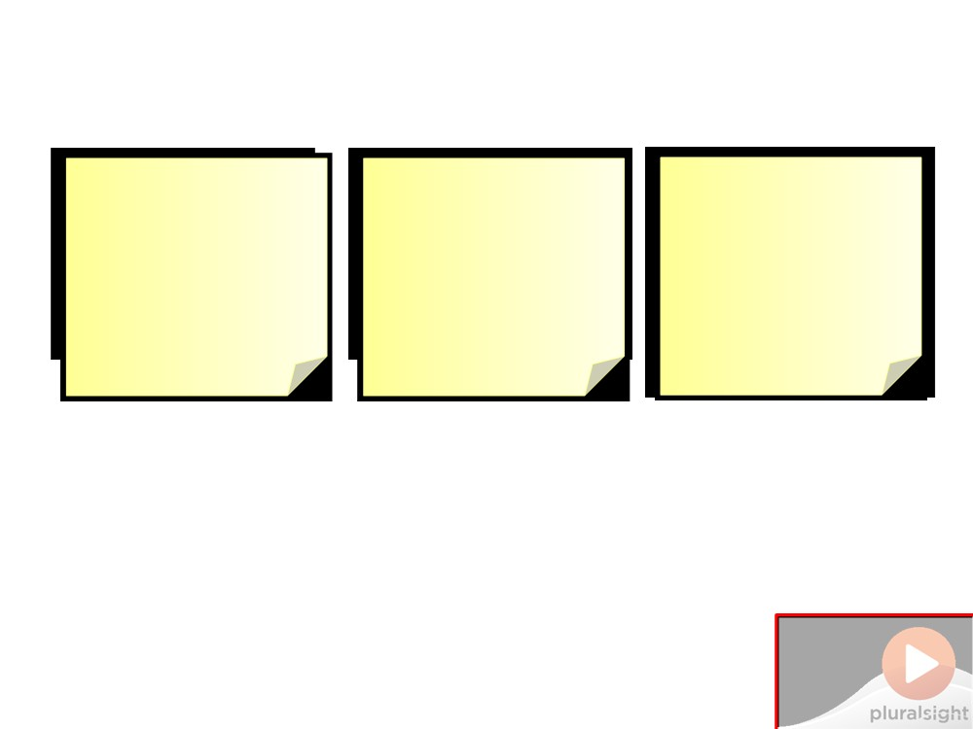
Demo 2: Implementing IDisposable
Walkthrough Run under
Goal Walkthrough
Show correct Implement
implementation IDisposable using
memory profiler and show memory usage
of IDisposable standard pattern
Do Not Place Anything in This Space
(Add watermark during editing)
Note: Warning will not appear during Slide Show view.

Slide 32
Demo 2: Implementing IDisposable
Do Not Place Anything
in This Space
(Add watermark during editing)
Note: Warning will not appear during Slide Show view.

Slide 33
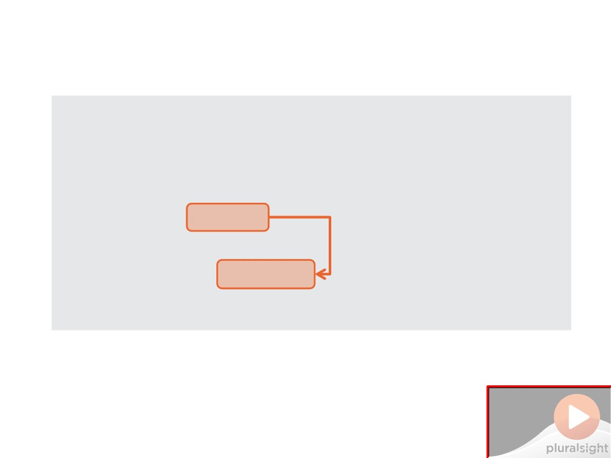
Demo 2: Implementing IDisposable
public class DatabaseState : IDisposable {
private SqlConnection _connection;
/* ... */
public void
{
_connection.Close(); _connection
}
}
Do Not Place Anything in This Space
(Add watermark during editing)
Note: Warning will not appear during Slide Show view.

Slide 34
Best Practice #2
If you use IDisposable
objects as instance fields, implement IDisposable
Do Not Place Anything
in This Space
(Add watermark during editing)
Note: Warning will not appear during Slide Show view.

Slide 35
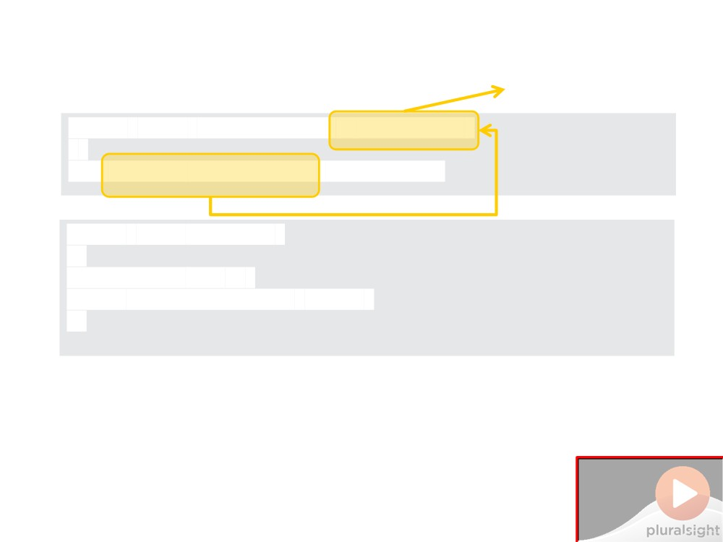
✮
Best Practice #2
public class
DatabaseState
{
_connection;
public void Dispose() {
Dispose(true);
GC.SuppressFinalize(this);
}
Do Not Place Anything in This Space
(Add watermark during editing)
Note: Warning will not appear during Slide Show view.

Slide 36
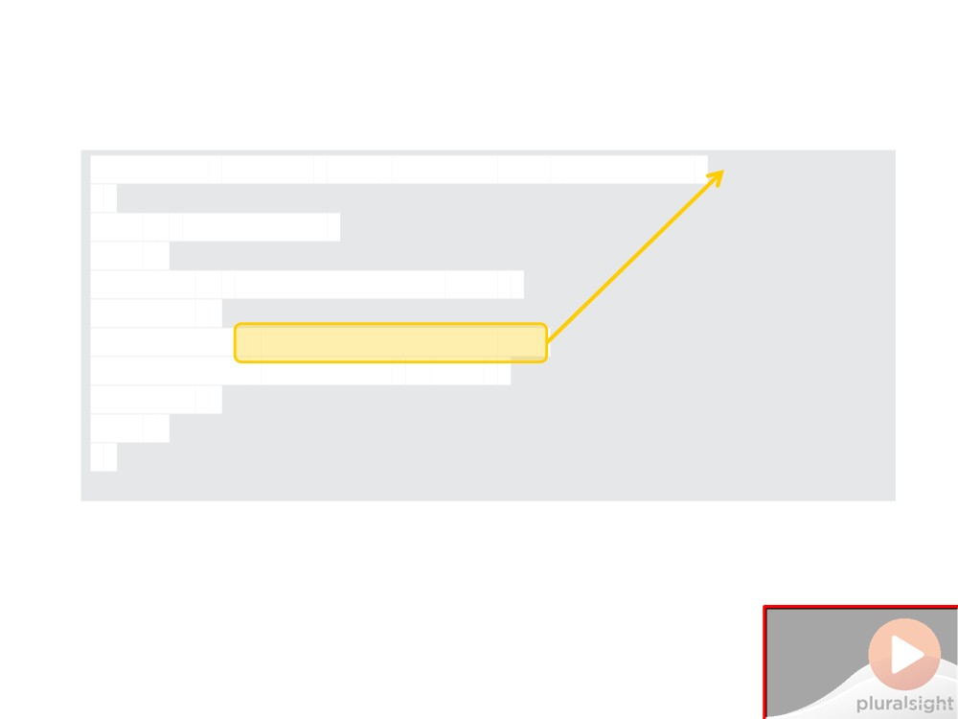
Best Practice #2
✮
protected virtual
void Dispose(bool disposing)
{
if (disposing) {
if (_connection != null)
{
_connection = null;
}
}
}
Do Not Place Anything in This Space
(Add watermark during editing)
Note: Warning will not appear during Slide Show view.

Slide 37
Best Practice #3
Allow Dispose() to be called multiple times and don't throw exceptions
Do Not Place Anything
in This Space
(Add watermark during editing)
Note: Warning will not appear during Slide Show view.

Slide 38
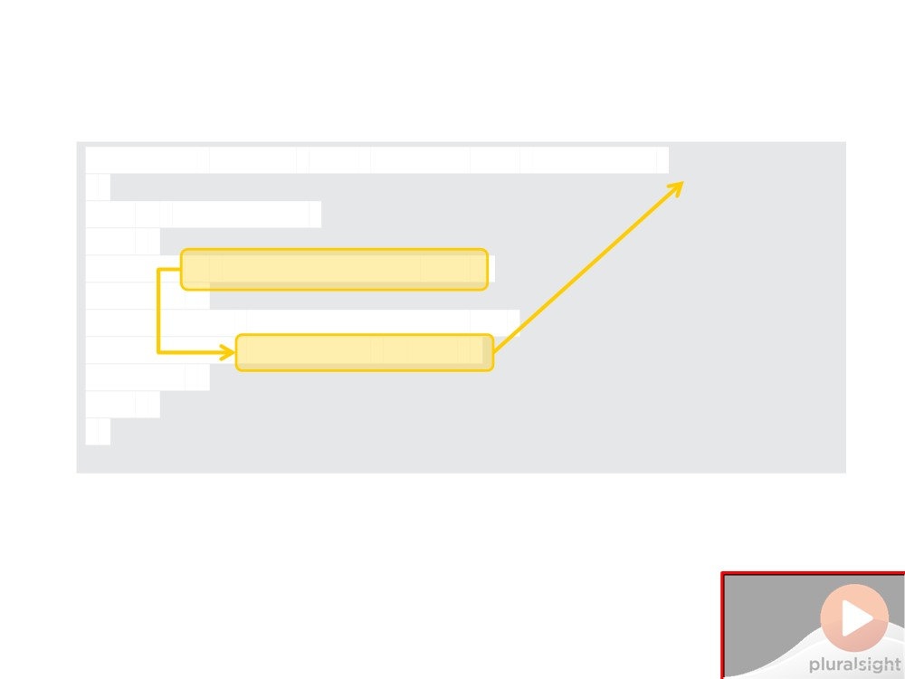
Best Practice #3
✮
protected virtual
void Dispose(bool disposing)
{
if (disposing) {
{
_connection.Dispose();
}
}
}
Do Not Place Anything in This Space
(Add watermark during editing)
Note: Warning will not appear during Slide Show view.

Slide 39
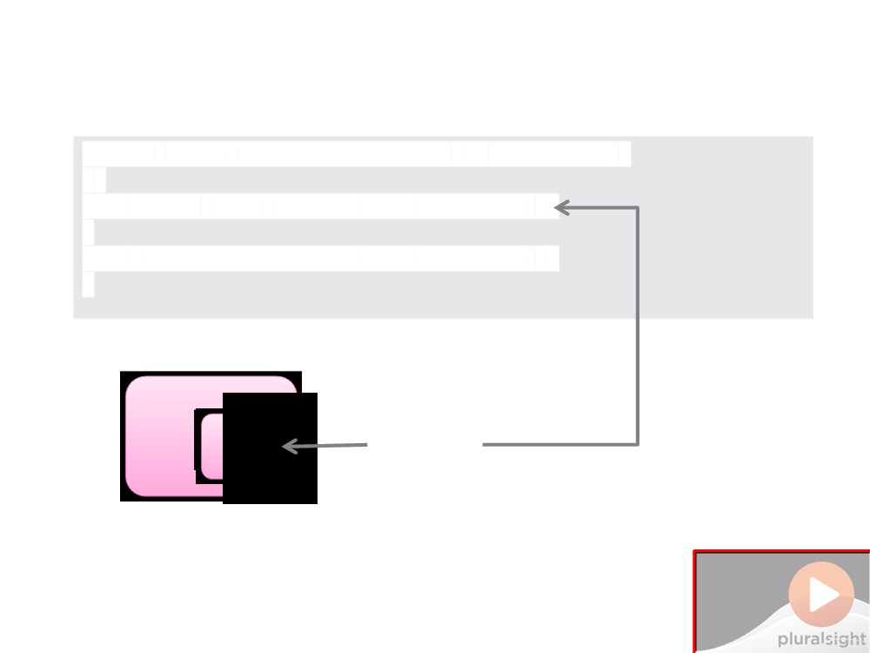
Dispose and Finalize
public class
ClassWithFinalizer : IDisposable
{
public void Dispose() { /* ... */ }

~ClassWithFinalizer() { /* ... */ } }
o
Heap
o L
Do Not Place Anything in This Space
(Add watermark during editing)
Note: Warning will not appear during Slide Show view.

Slide 40

Dispose and Finalize
public class
ClassWithFinalizer : IDisposable
{
public void Dispose() { /* ... */ }
~ClassWithFinalizer() { /* ... */ } }

o
Heap
o L
Do Not Place Anything in This Space
(Add watermark during editing)
Note: Warning will not appear during Slide Show view.

Slide 41
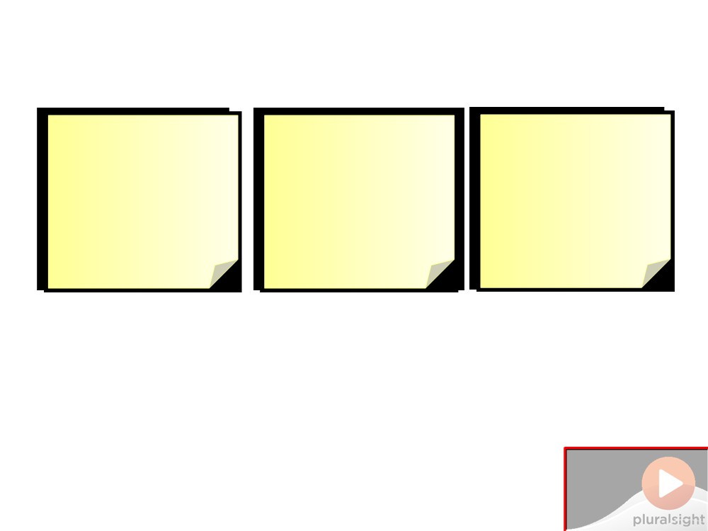
Demo 3: Dispose and Finalize
Walkthrough Clean up
Goal Walkthrough
Show correct Clean up managed
implementation resources when
unmanaged
of Dispose and disposing in the
resources in the finalizer
Finalize derived class
Do Not Place Anything in This Space
(Add watermark during editing)
Note: Warning will not appear during Slide Show view.

Slide 42
Demo 3: Dispose and Finalize
Do Not Place Anything
in This Space
(Add watermark during editing)
Note: Warning will not appear during Slide Show view.

Slide 43
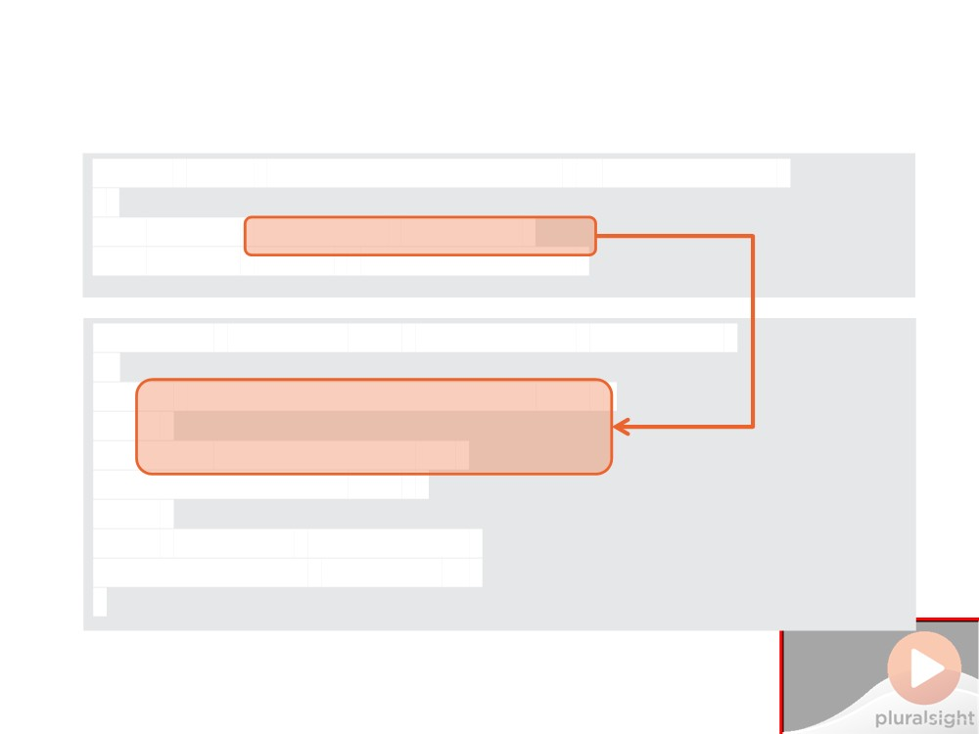
Demo 3: Dispose and Finalize
public class
UnmanagedDatabaseState : DatabaseState
{
private
private IntPtr _unmanagedPointer;
protected override void Dispose(bool disposing) {
_command = null;
}
//unmanaged resources... base.Dispose(disposing); }
Do Not Place Anything in This Space
(Add watermark during editing)
Note: Warning will not appear during Slide Show view.

Slide 44
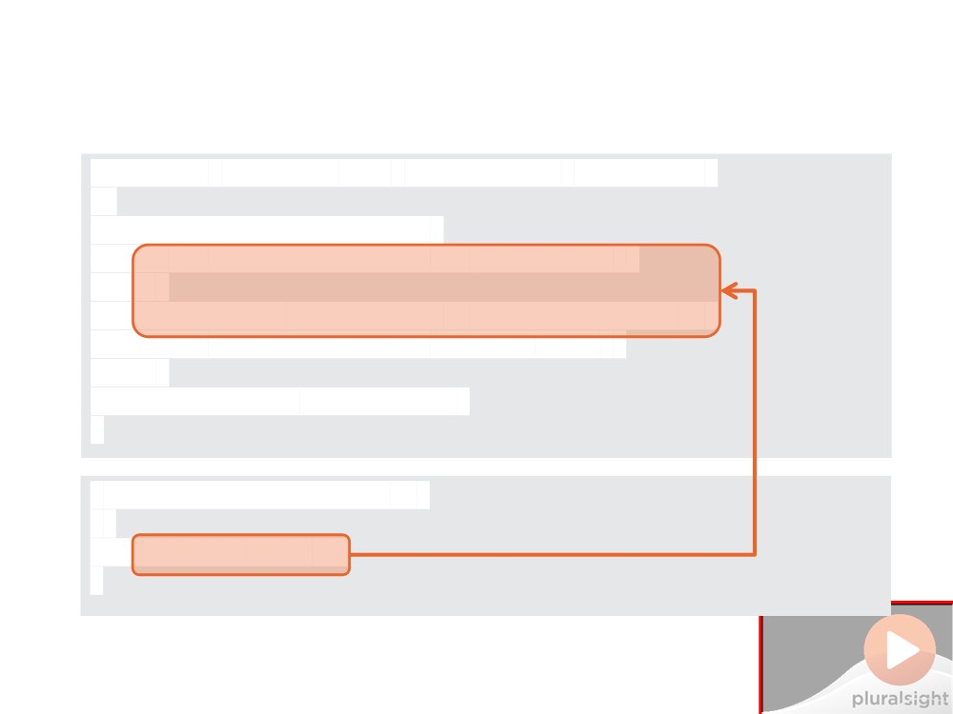
Demo 3: Dispose and Finalize
protected override void Dispose(bool disposing) {
//managed resources...
_unmanagedPointer = IntPtr.Zero;
}
base.Dispose(disposing);
}
~UnmanagedDatabaseState() {
}
Do Not Place Anything in This Space
(Add watermark during editing)
Note: Warning will not appear during Slide Show view.

Slide 45
Best Practice #4
Implement IDisposable to
support disposing resources in a class hierarchy
Do Not Place Anything
in This Space
(Add watermark during editing)
Note: Warning will not appear during Slide Show view.

Slide 46
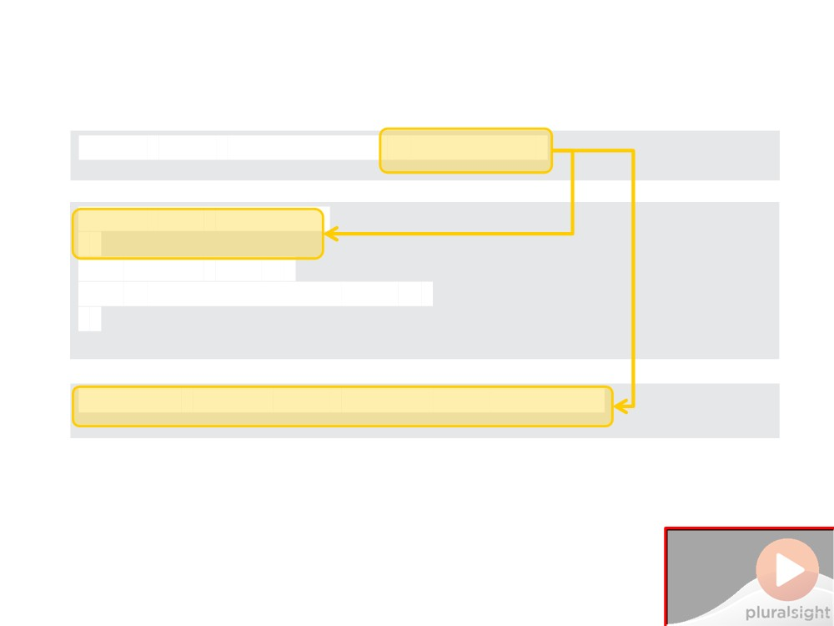
✮
Best Practice #4
public class
DatabaseState
Dispose(true);
GC.SuppressFinalize(this);
}
Do Not Place Anything in This Space
(Add watermark during editing)
Note: Warning will not appear during Slide Show view.

Slide 47
Best Practice #5
If you use unmanaged
resources, declare a finalizer which cleans them up
Do Not Place Anything
in This Space
(Add watermark during editing)
Note: Warning will not appear during Slide Show view.

Slide 48
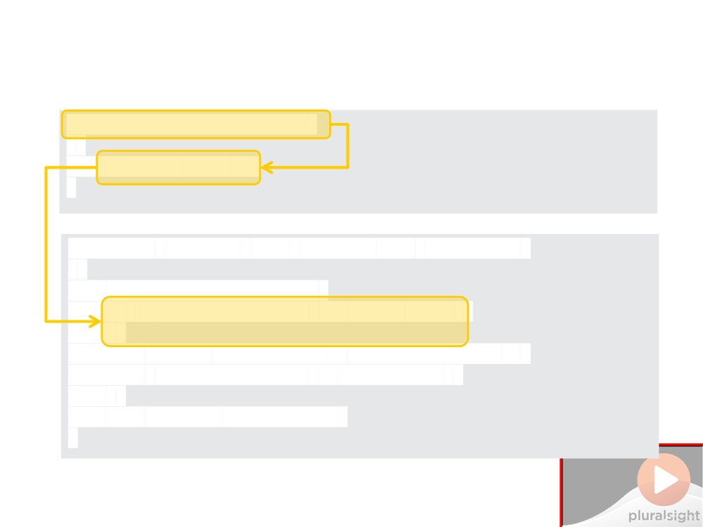
✮
Best Practice #5
{ }
protected
override void
Dispose(bool
disposing)
{
//managed resources...
Marshal.FreeHGlobal(_unmanagedPointer);
_unmanagedPointer =
IntPtr.Zero;
}
base.Dispose(disposing);
}
D
ything
in This Space
(Add watermark during editing)
Note: Warning will not appear during Slide Show view.

Slide 49
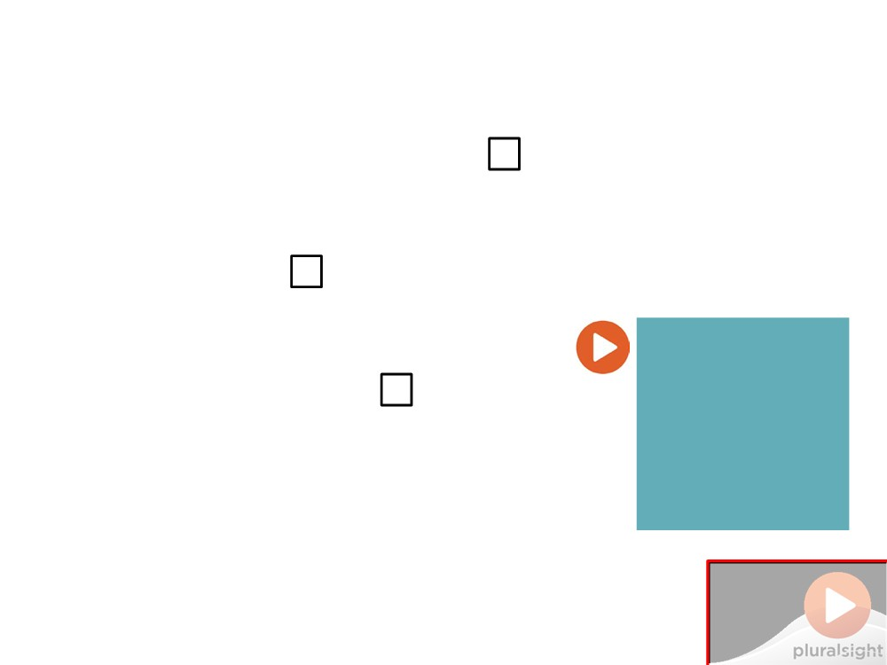
Summary
▪ What does the Garbage Collector do?
□ Keeping available memory free
□ Without impacting performance
▪ When the GC runs
□ When it decides to
□ Could have build-up of dead objects
▪ Implementing IDisposable
What Happens if you don't
□ Disposing managed resources
□ Expecting Dispose to be repeatedly called □ Allowing inheritors to dispose their resources
Dispose?
□ Using finalizers to clean up unmanaged resources
Do Not Place Anything in This Space
(Add watermark during editing)
Note: Warning will not appear during Slide Show view.

