Slide 1

What Happens If You Don't Dispose?
Elton Stoneman
geekswithblogs.net/eltonstoneman @EltonStoneman

Slide 2

What Happens If You Don't Dispose?
Finding
IDisposabl and
Fixin IDisposable
IDisposabl issues
omai driven
issues
design
D

Slide 3
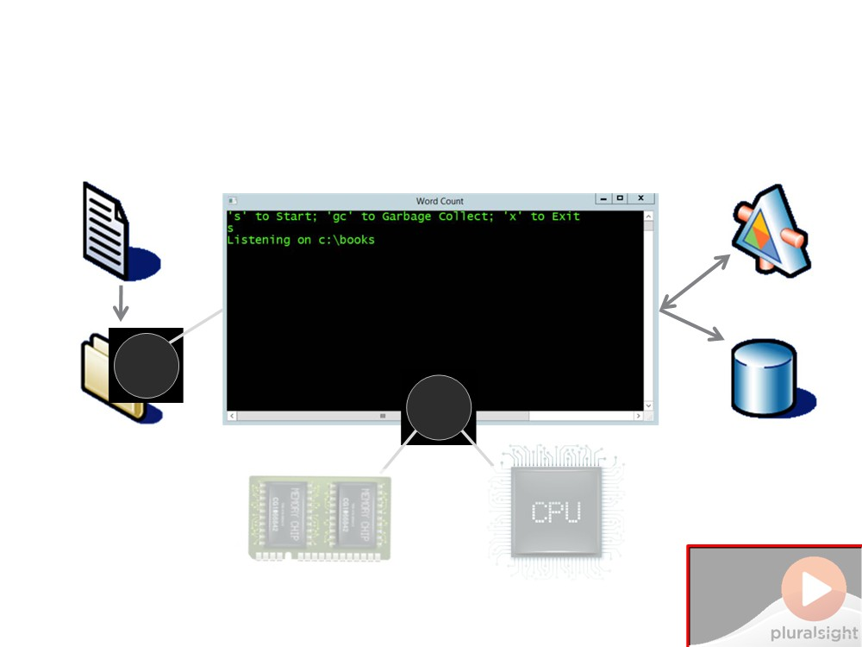
What Happens If You Don't Dispose
b
b
6
6
Do Not Place Anything in This Space
(Add watermark during editing)
Note: Warning will not appear during Slide Show view.

Slide 4
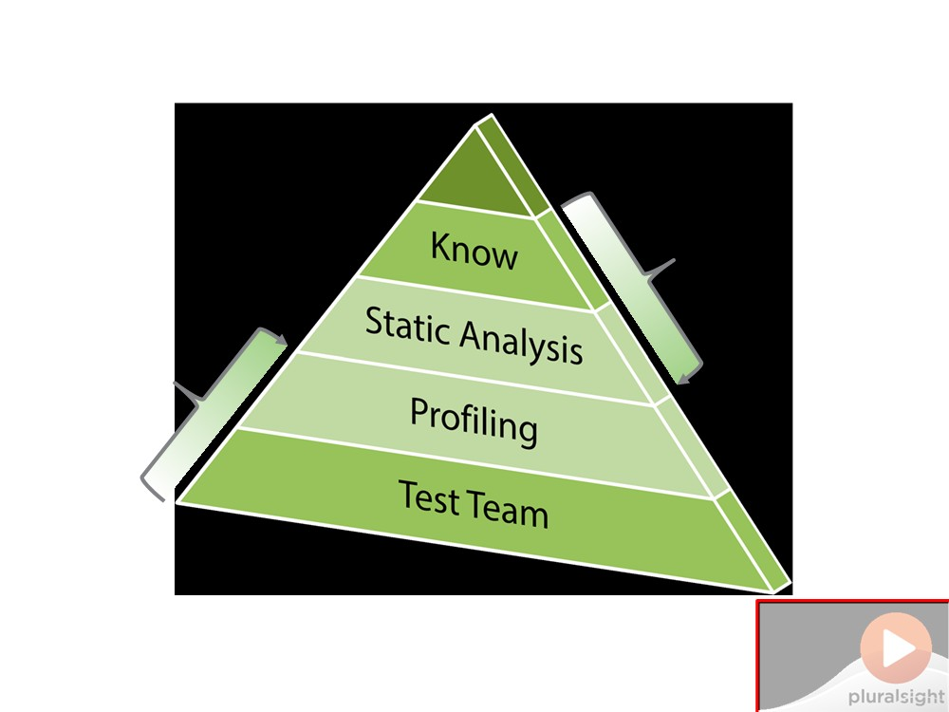
Diagnosing IDisposable Issues
Design time
Run time
Do Not Place Anything in This Space
(Add watermark during editing)
Note: Warning will not appear during Slide Show view.

Slide 5
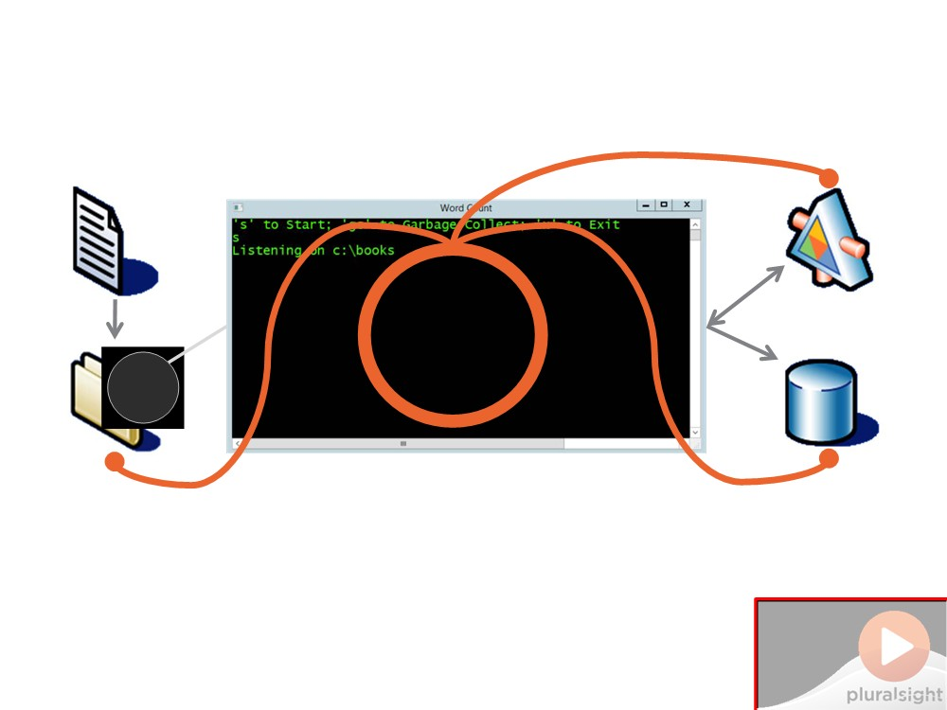
Fixing the Word Counting App
b
Do Not Place Anything in This Space
(Add watermark during editing)
Note: Warning will not appear during Slide Show view.

Slide 6
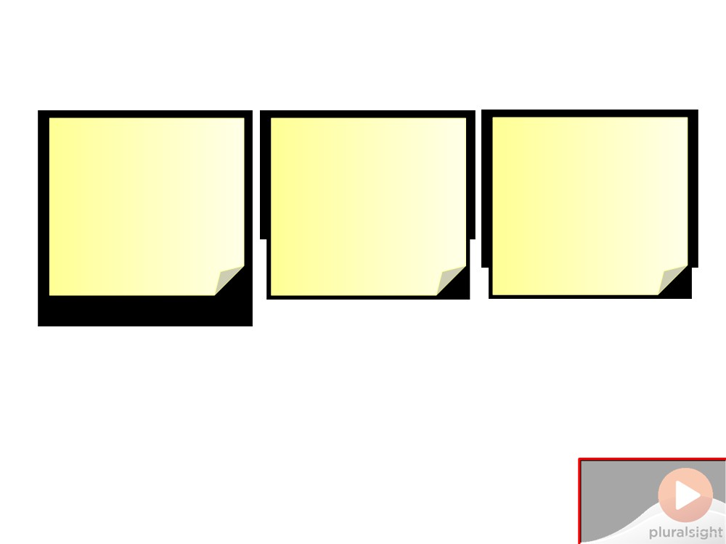
Demo 1: Finding Problems at Run-Time
Goal
Walkthrough Walkthrough
Identify potential run-time issues from not
Check for defects Check for memory
running the app issues profiling
the app
disposing resources
Do Not Place Anything in This Space
(Add watermark during editing)
Note: Warning will not appear during Slide Show view.

Slide 7

Demo 1: Finding Problems at Run-Time
Do Not Place Anything
in This Space
(Add watermark during editing)
Note: Warning will not appear during Slide Show view.

Slide 8
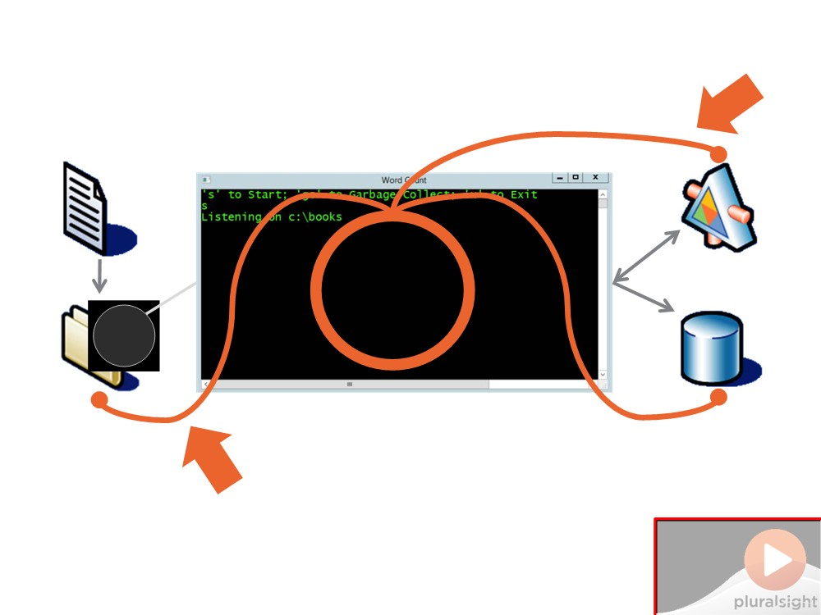
Demo 1: Finding Problems at Run-Time
b
Do Not Place Anything in This Space
(Add watermark during editing)
Note: Warning will not appear during Slide Show view.

Slide 9
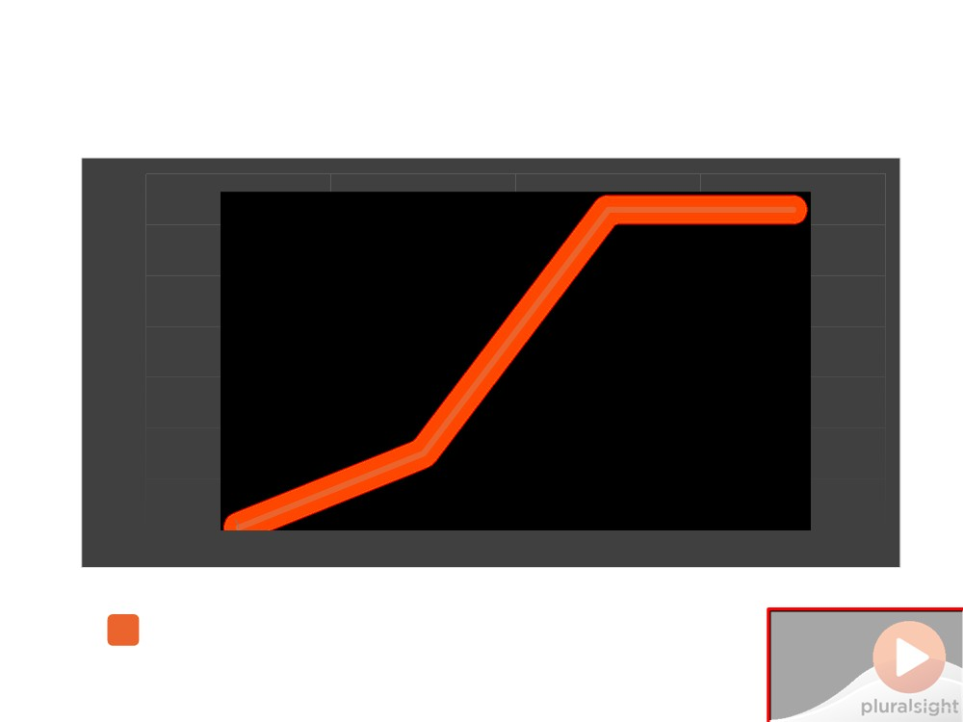
Demo 1: Finding Problems at Run-Time
70000
63000
63000
60000
50000
40000
30000
20000
15000
10000
392
0
Startup
First Run
Multiple Runs
GC.Collect
- original app
Do Not Place Anything
in This Space
(Add watermark during editing)
Note: Warning will not appear during Slide Show view.

Slide 10
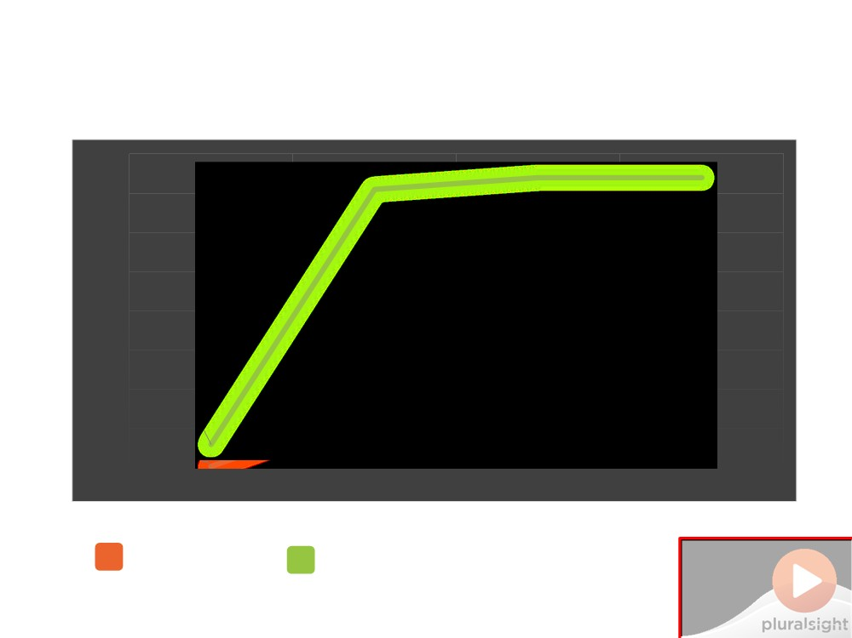
Demo 1: Finding Problems at Run-Time
80000
74000 74000 71000
70000
63000 63000
60000
50000
40000
30000
20000
6000
15000
10000
0 392
Startup
First Run Multiple Runs GC.Collect
- original app
- domain-driven app
Do Not Place Anything in This Space
(Add watermark during editing)
Note: Warning will not appear during Slide Show view.

Slide 11
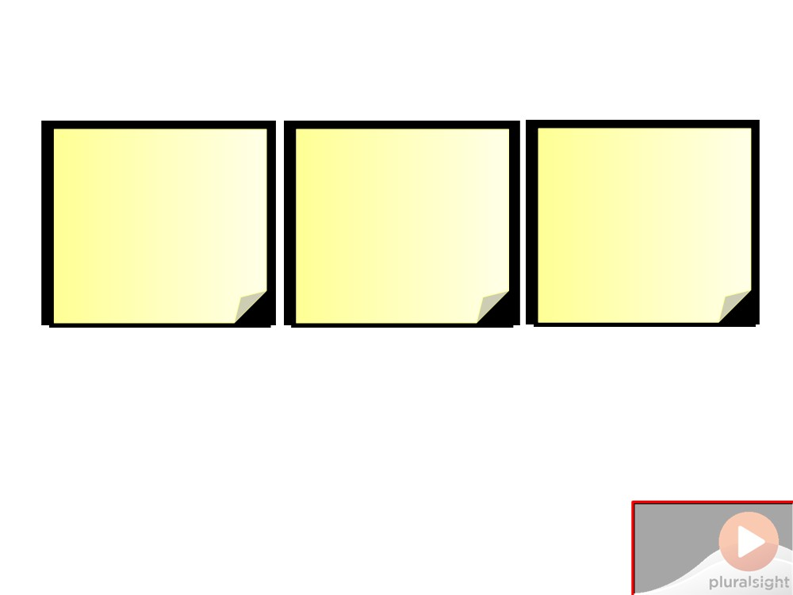
Demo 2: Finding Problems at Design-Time
Goal Walkthrough
Walkthrough Fix issues and check
Identify potential Check for issues
design-time using static code
issues from not analysis & manual
performance with profiler
disposing checks
Do Not Place Anything in This Space
(Add watermark during editing)
Note: Warning will not appear during Slide Show view.

Slide 12
Demo 2: Finding Problems at Design-Time
Do Not Place Anything
in This Space
(Add watermark during editing)
Note: Warning will not appear during Slide Show view.

Slide 13
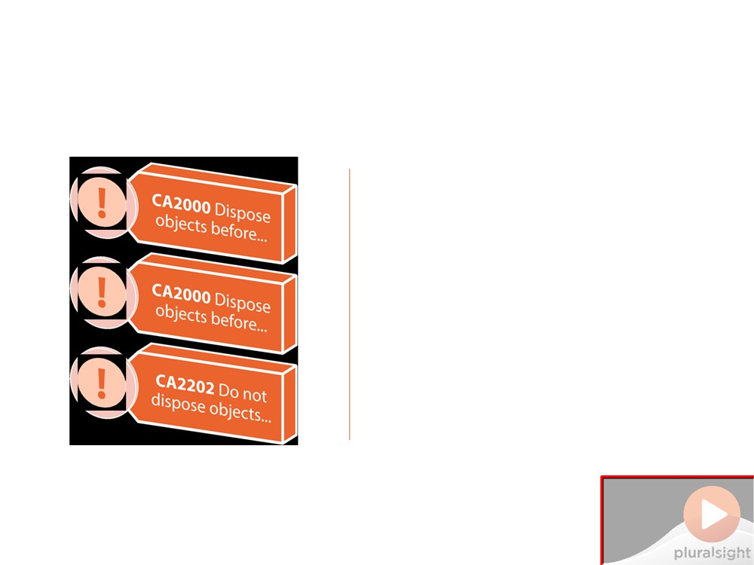
Demo 2: Finding Problems at Design-Time
Static code analysis
Not enabled by default
"Recommended" rules
Do not include CA2000
Correctly set up
Find and fix issues quickly But not all issues
Do Not Place Anything
in This Space
(Add watermark during editing)
Note: Warning will not appear during Slide Show view.

Slide 14
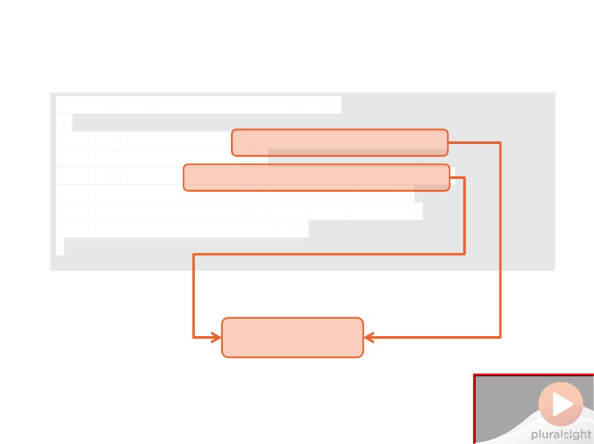
Demo 2: Finding Problems at Design-Time
public void CreateFeedResults(...)
{
var sqlConnection
sqlConnection.Open(); var command
command.CommandType = CommandType.Text;
command.CommandText = "...", command.ExecuteNonQuery(); }
 
CA2000 warning
Do Not Place Anything in This Space
(Add watermark during editing)
Note: Warning will not appear during Slide Show view.

Slide 15
Demo 2: Finding Problems at Design-Time
70000
63000
63000
60000
50000
40000
30000
20000
15000
10000
392
0
Startup
First Run
Multiple Runs
GC.Collect
- original app
Do Not Place Anything
in This Space
(Add watermark during editing)
Note: Warning will not appear during Slide Show view.

Slide 16
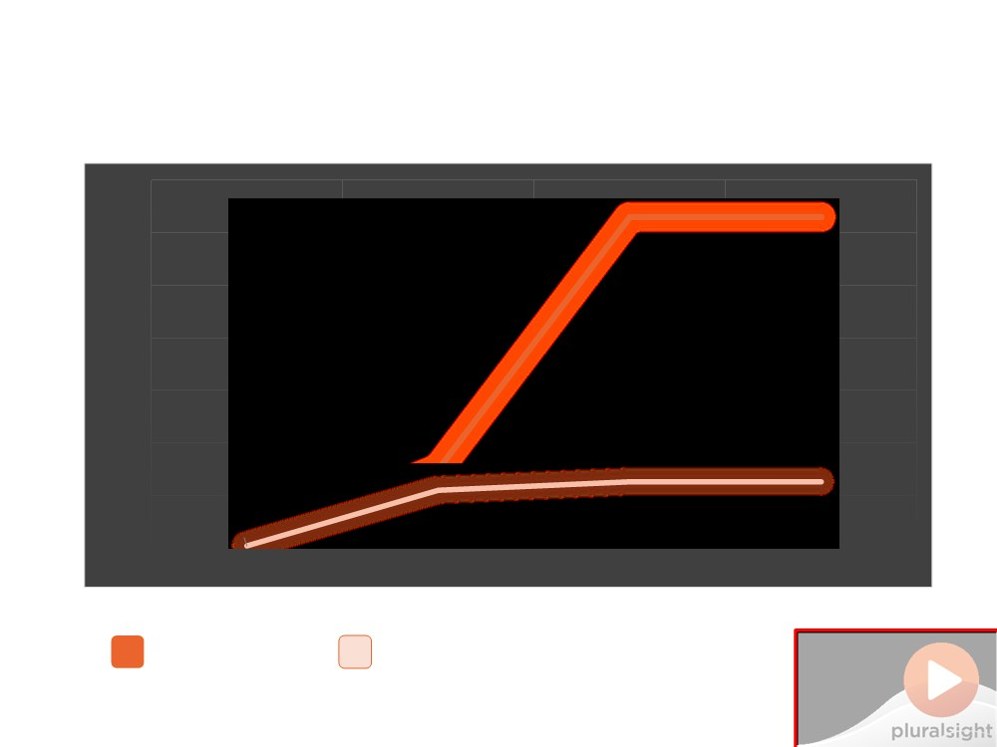
Demo 2: Finding Problems at Design-Time
70000
63000 63000
60000
50000
40000
30000
20000
15000
10000
11000 12600 12600
392
0 394
Startup
First Run Multiple Runs GC.Collect
- original app
- best practice version
Do Not Place Anything
in This Space
(Add watermark during editing)
Note: Warning will not appear during Slide Show view.

Slide 17
Best Practice #6
Enable Code Analysis with CA2000 enabled - but don’t rely on it
Do Not Place Anything in This Space
(Add watermark during editing)
Note: Warning will not appear during Slide Show view.

Slide 18
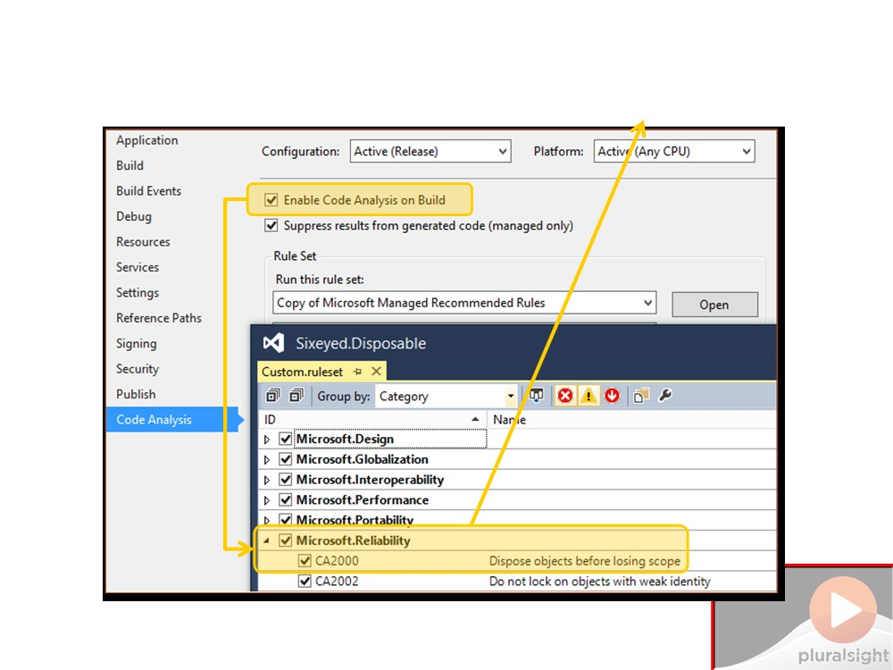
✮
Best Practice #6
D
lace Anything
ace
(Add watermark during editing)
Note: Warning will not appear during Slide Show view.

Slide 19
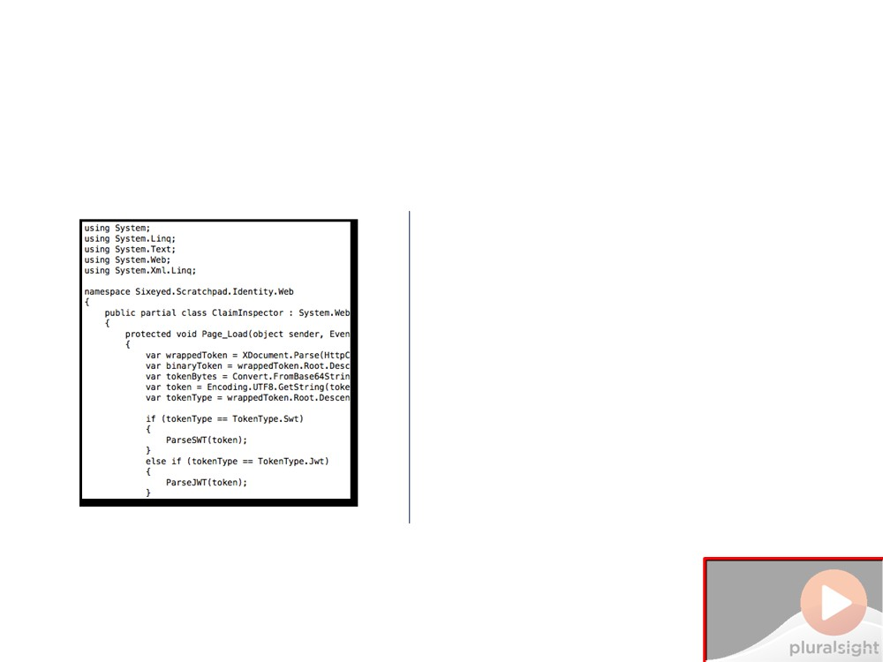
Discovering IDisposables
Check class hierarchy
L
Go to definition Code map
Trial-and-error Try using{} block
Intellisense
Look for .Dispose()
Do Not Place Anything in This Space
(Add watermark during editing)
Note: Warning will not appear during Slide Show view.

Slide 20
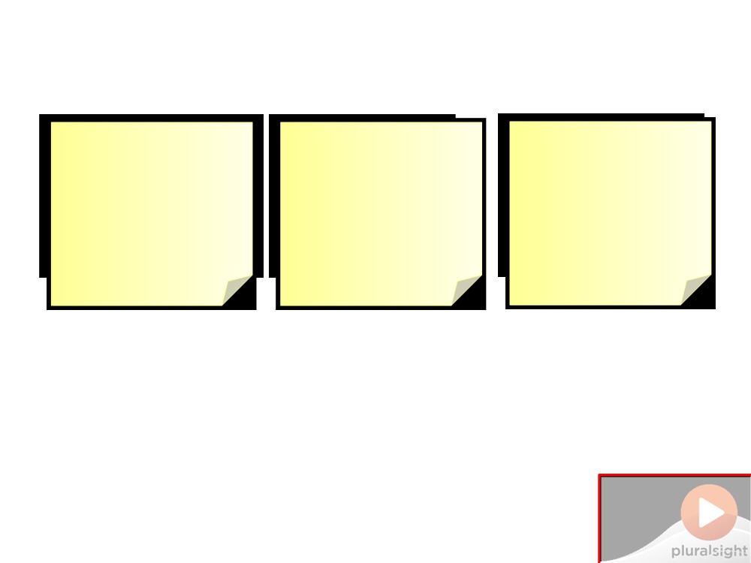
Demo 3: Making IDisposable Discoverable
Goal
Walkthrough
Walkthrough
Implement
Fix issues in
Implementing
IDisposable to aid
domain-driven
IDisposable and
discovery
version of app
other interfaces
Do Not Place Anything in This Space
(Add watermark during editing)
Note: Warning will not appear during Slide Show view.

Slide 21
Demo 3: Making IDisposable Discoverable
Do Not Place Anything
in This Space
(Add watermark during editing)
Note: Warning will not appear during Slide Show view.

Slide 22
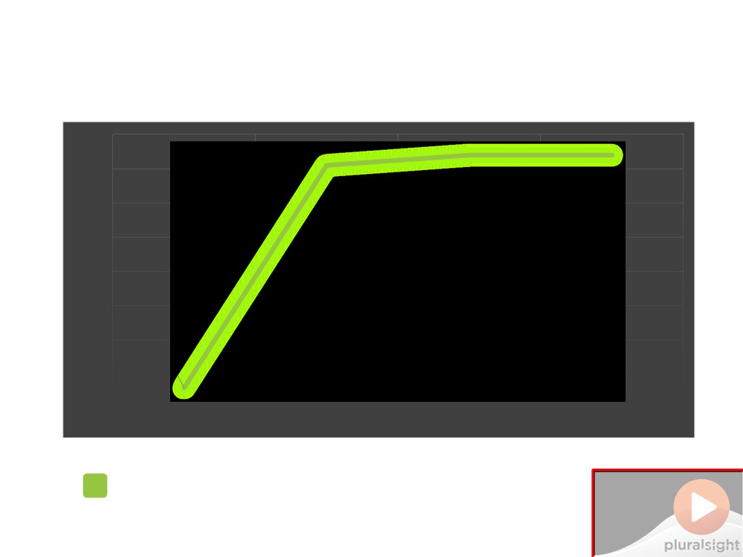
Demo 3: Making IDisposable Discoverable
80000
74000 74000 71000
70000
60000
50000
40000
30000
20000
6000
10000
0
Startup
First Run Multiple Runs GC.Collect
- domain-driven app
Do Not Place Anything
in This Space
(Add watermark during editing)
Note: Warning will not appear during Slide Show view.

Slide 23

Demo 3: Making IDisposable Discoverable
80000
74000 74000
71000
70000
68000
69000 69000
60000
50000
40000
30000
20000
6000
10000
6000
0
Startup First Run
Multiple Runs GC.Collect
- domain-driven app
- best-practice version
Do Not Place Anything in This Space
(Add watermark during editing)
Note: Warning will not appear during Slide Show view.

Slide 24
Best Practice #7
If you implement an interface and use IDisposable fields, extend your interface from IDisposable
Do Not Place Anything
in This Space
(Add watermark during editing)
Note: Warning will not appear during Slide Show view.

Slide 25
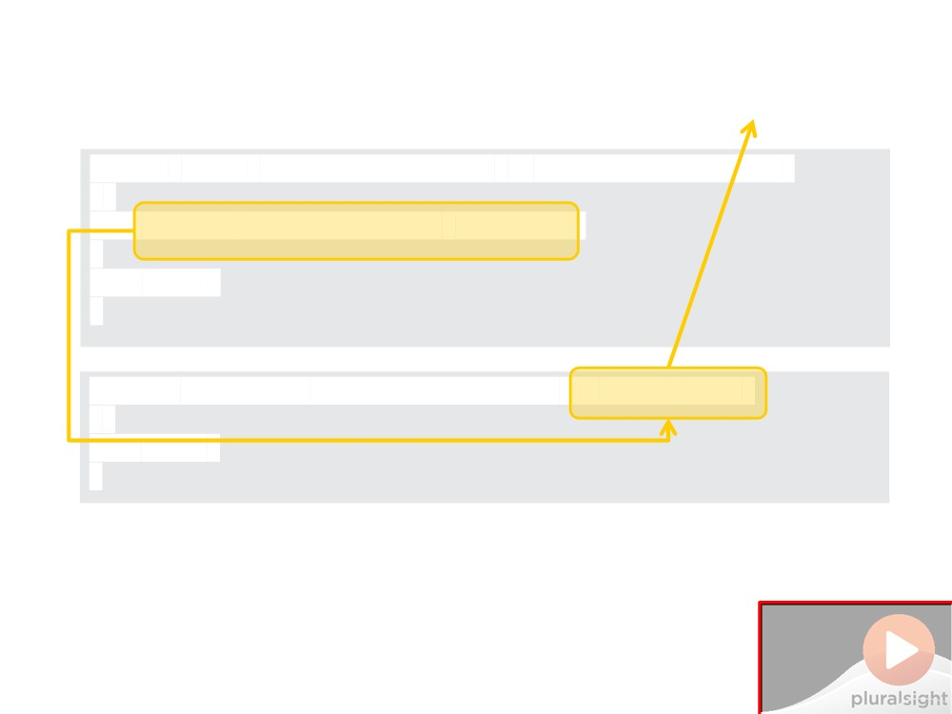
✮
Best Practice #7
public class
BookFeedRepository : IBookFeedRepository
{
//...
}
public
interface
IBookFeedRepository
{
//...
}
Do Not Place Anything in This Space
(Add watermark during editing)
Note: Warning will not appear during Slide Show view.

Slide 26
Best Practice #8
If you implement IDisposable, don’t implement it explicitly
Do Not Place Anything
in This Space
(Add watermark during editing)
Note: Warning will not appear during Slide Show view.

Slide 27
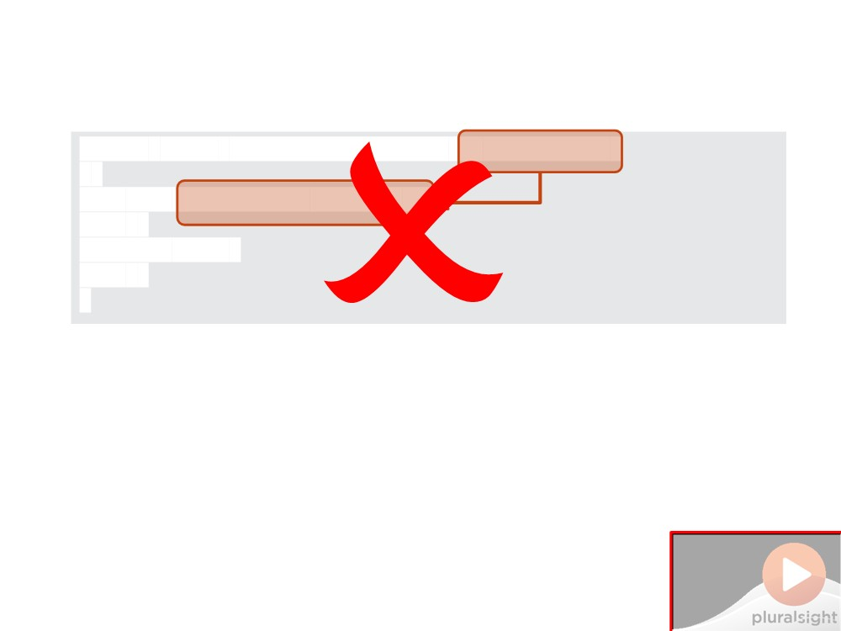
Best Practice #8
public class
DifficultToDiscover
{
void
{
//...
}
}
Do Not Place Anything in This Space
(Add watermark during editing)
Note: Warning will not appear during Slide Show view.

Slide 28
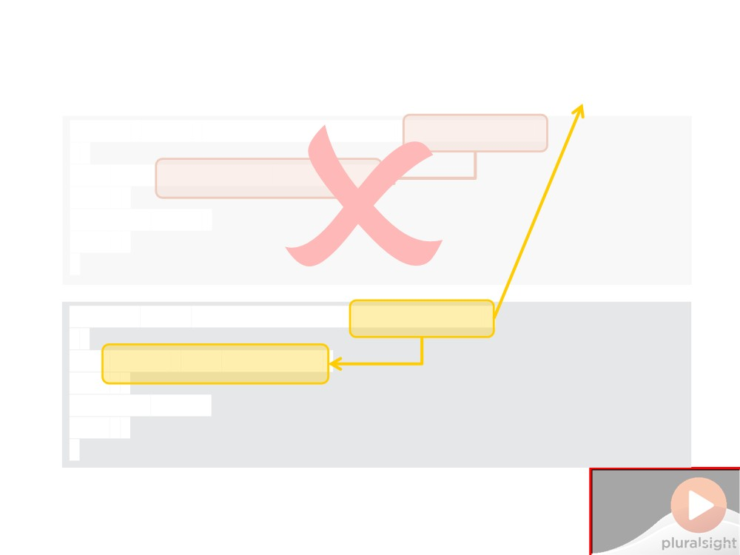
✮
Best Practice #8
public class
EasyToDiscover
{
//...
}
}
Do Not Place Anything in This Space
(Add watermark during editing)
Note: Warning will not appear during Slide Show view.

Slide 29

Summary
▪ What happens if you don't dispose?

□ File locks & event handlers
□ Starving SQL connection pool & object leaks
▪ Finding problems from not disposing

□ Run-time
□ Test team & profiling
□ Design-time
Summary
□ Static analysis & class knowledge
▪ Fixing the demo solution

□ Applying the 8 best practices
Do Not Place Anything
in This Space
(Add watermark during editing)
Note: Warning will not appear during Slide Show view.

