Slide 1

Course Summary
Elton Stoneman
geekswithblogs.net/eltonstoneman @EltonStoneman

Slide 2
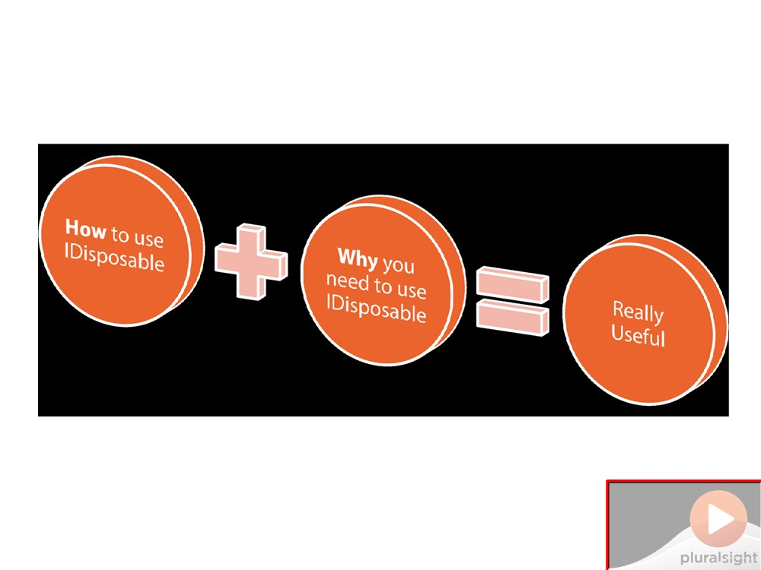
Why write this course?
Do Not Place Anything
in This Space
(Add watermark during editing)
Note: Warning will not appear during Slide Show view.

Slide 3
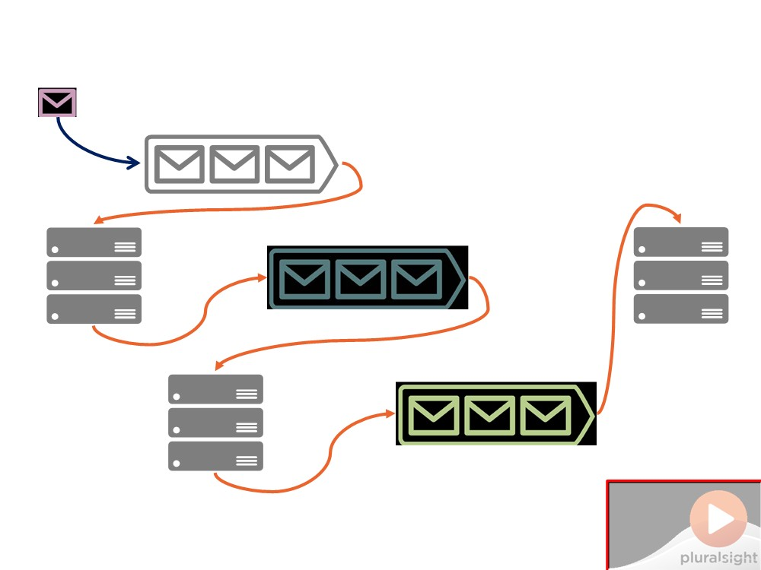
Why write this course?
Do Not Place Anything
in This Space
(Add watermark during editing)
Note: Warning will not appear during Slide Show view.

Slide 4
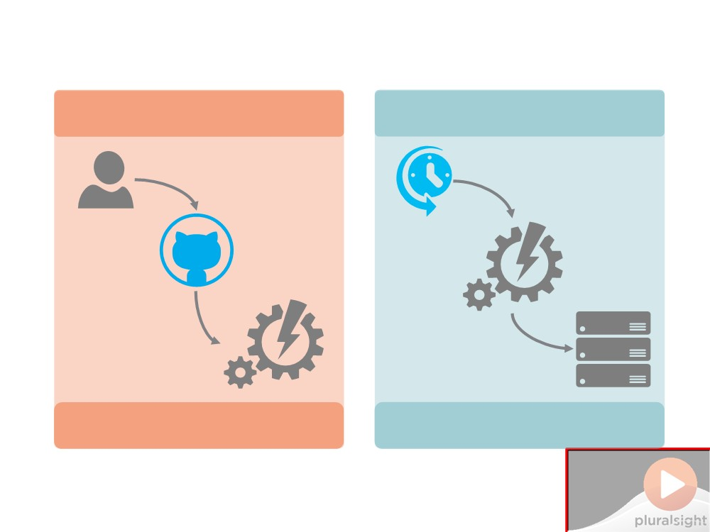
Why write this course?
Continuous Integration
Nightly Build


Build & Test
Build, Test & Deploy
Do Not Place Anything in This Space
(Add watermark during editing)
Note: Warning will not appear during Slide Show view.

Slide 5
Why write this course?
Continuous Integration
Nightly Build


Build & Test
Build, Test & Deploy
Do Not Place Anything in This Space
(Add watermark during editing)
Note: Warning will not appear during Slide Show view.

Slide 6
Why write this course?
Continuous Integration
Nightly Build


Build & Test
Build, Test & Deploy
Do Not Place Anything in This Space
(Add watermark during editing)
Note: Warning will not appear during Slide Show view.

Slide 7
Why write this course?
Continuous Integration
Nightly Build






Build & Test
Build, Test & Deploy
Do Not Place Anything in This Space
(Add watermark during editing)
Note: Warning will not appear during Slide Show view.

Slide 8
Why write this course?
Do Not Place Anything
in This Space
(Add watermark during editing)
Note: Warning will not appear during Slide Show view.

Slide 9
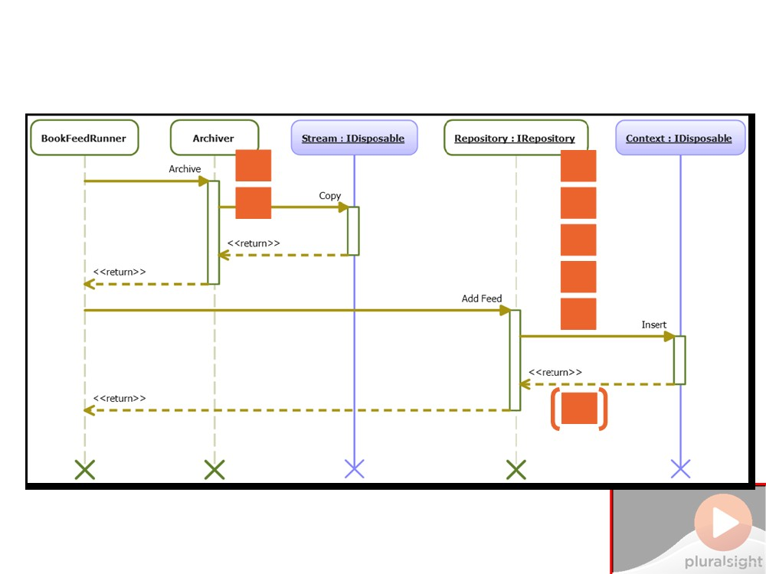
The Best Practices
#1
#2
#6
#3
#4 #5 #7
#8
Do Not Place Anything in This Space
(Add watermark during editing)
Note: Warning will not appear during Slide Show view.

Slide 10
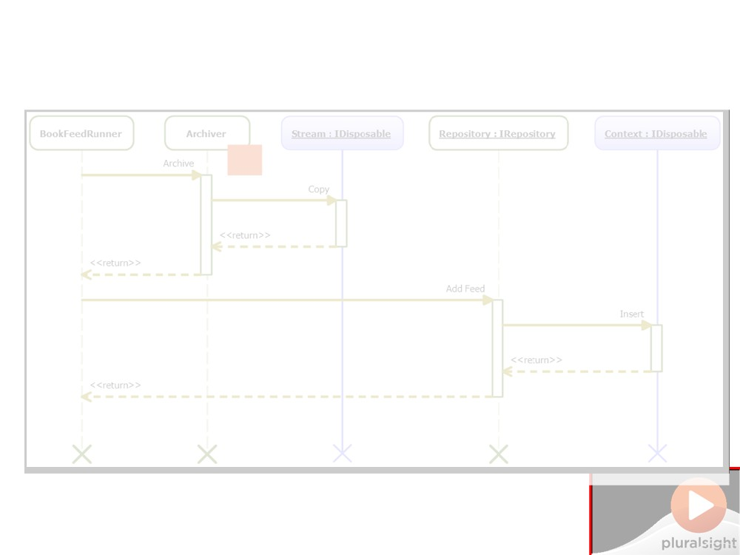
Best Practice #1
Dispose of IDisposable
objects as soon as you can
D
in This Space
(Add watermark during editing)
Note: Warning will not appear during Slide Show view.

Slide 11

Best Practice #2
If you use IDisposable
objects as instance fields, implement IDisposable
D
in This Space
(Add watermark during editing)
Note: Warning will not appear during Slide Show view.

Slide 12
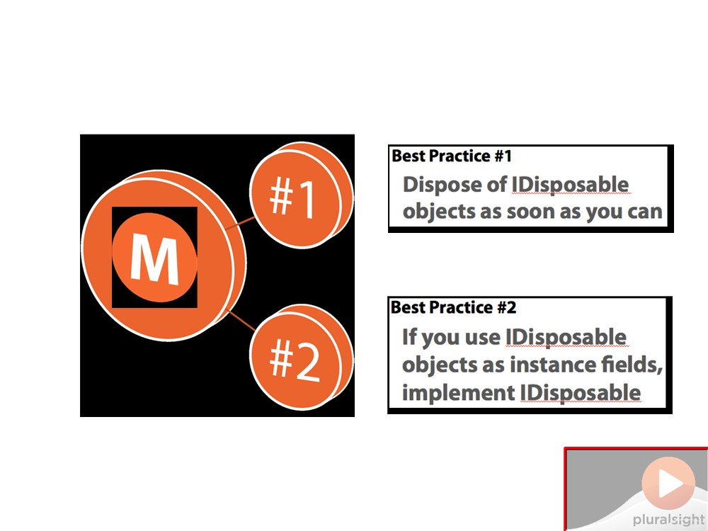
Best Practice MoSCoW
Do Not Place Anything
in This Space
(Add watermark during editing)
Note: Warning will not appear during Slide Show view.

Slide 13
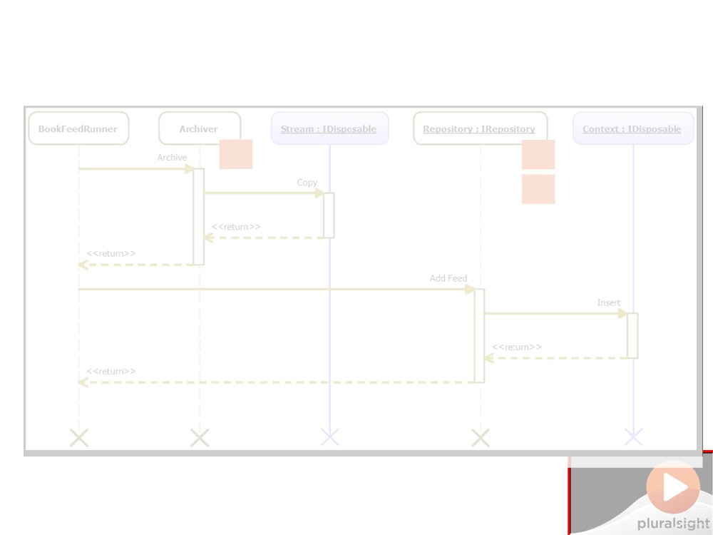
Best Practice #3
Allow Dispose() to be called multiple times and don't throw exceptions
D
in This Space
(Add watermark during editing)
Note: Warning will not appear during Slide Show view.

Slide 14
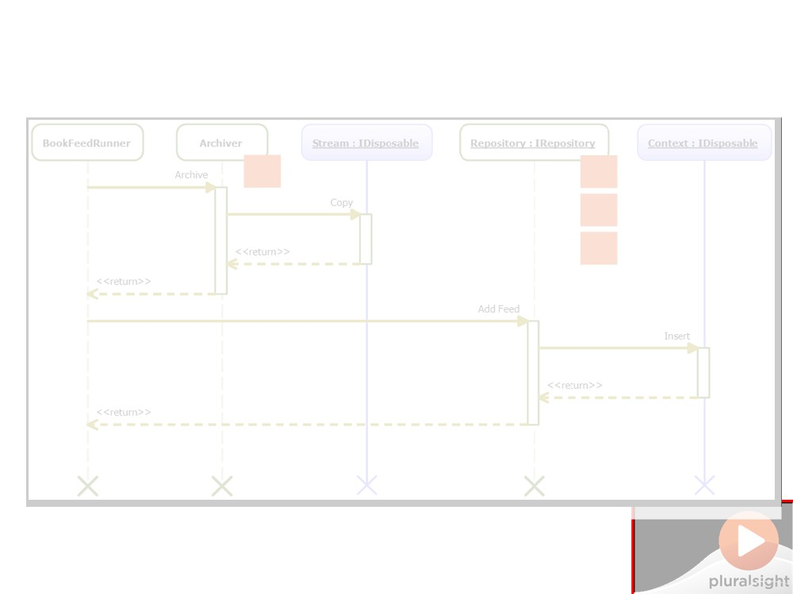
Best Practice #4
Implement IDisposable to
support disposing resources in a class hierarchy
D
in This Space
(Add watermark during editing)
Note: Warning will not appear during Slide Show view.

Slide 15

Best Practice #5
If you use unmanaged
resources, declare a finalizer which cleans them up
D
in This Space
(Add watermark during editing)
Note: Warning will not appear during Slide Show view.

Slide 16
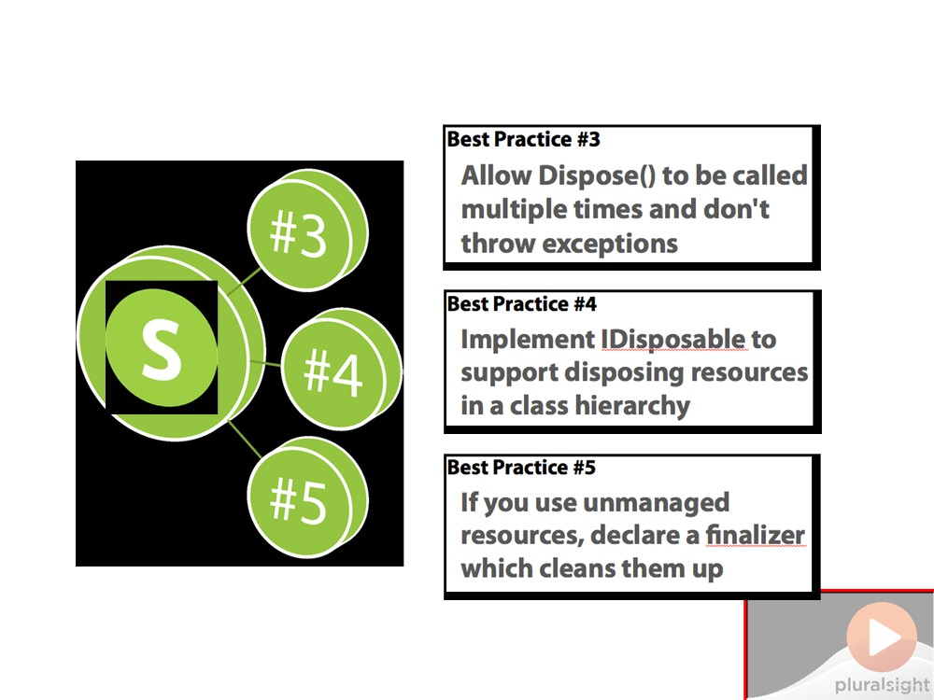
Best Practice MoSCoW
Do Not Place Anything
in This Space
(Add watermark during editing)
Note: Warning will not appear during Slide Show view.

Slide 17
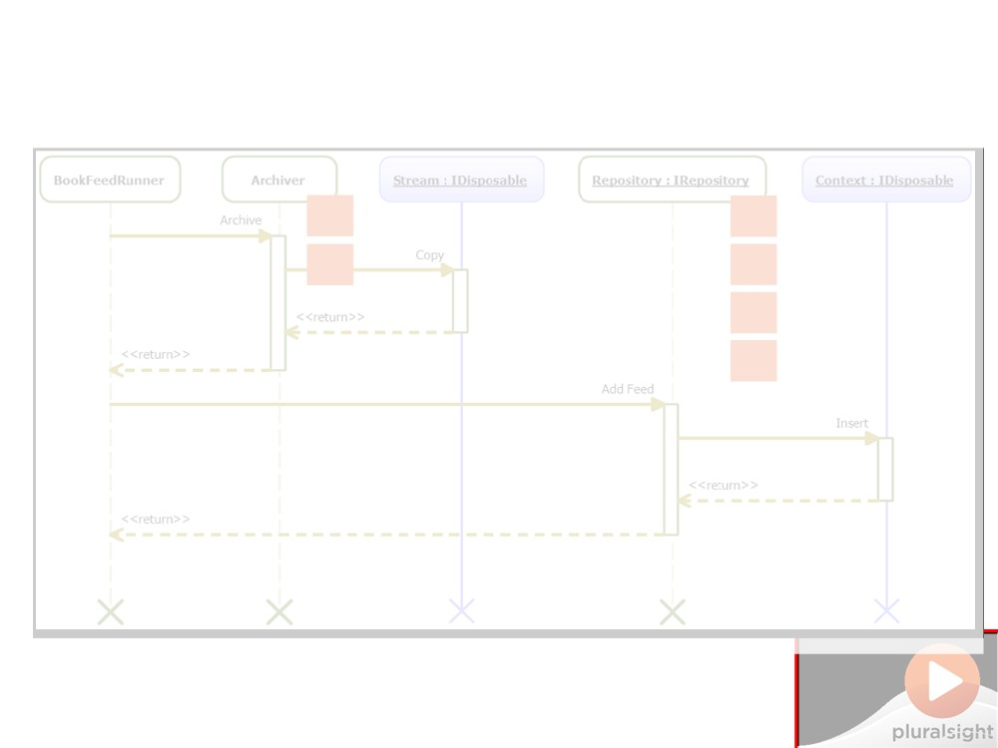
Best Practice #6
Enable Code Analysis with CA2000 enabled - but don’t rely on it
D
in This Space
(Add watermark during editing)
Note: Warning will not appear during Slide Show view.

Slide 18

Best Practice #7
If you implement an interface and use IDisposable fields, extend your interface from IDisposable
D
in This Space
(Add watermark during editing)
Note: Warning will not appear during Slide Show view.

Slide 19
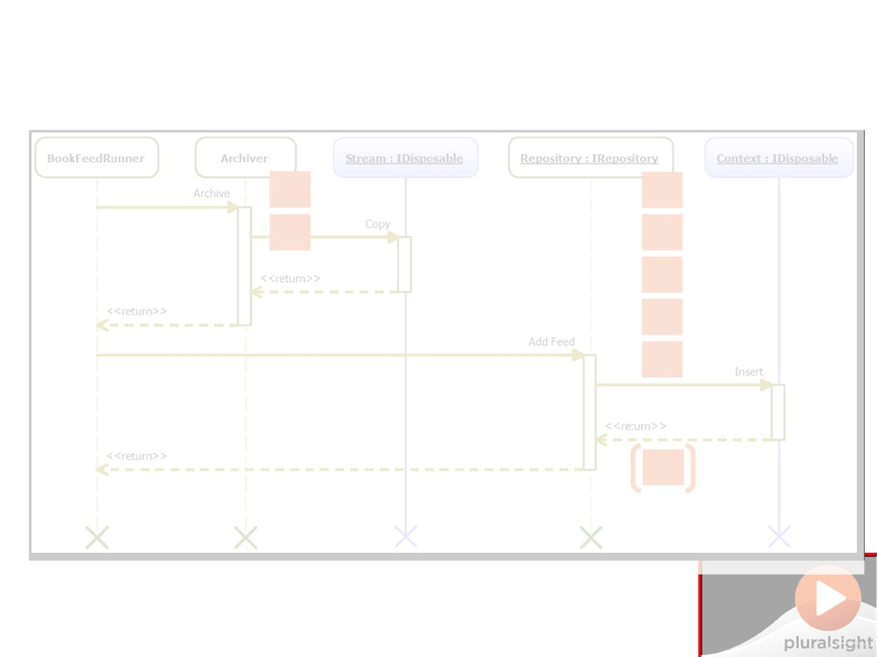
Best Practice #8
If you implement IDisposable, don’t implement it explicitly
D
in This Space
(Add watermark during editing)
Note: Warning will not appear during Slide Show view.

Slide 20
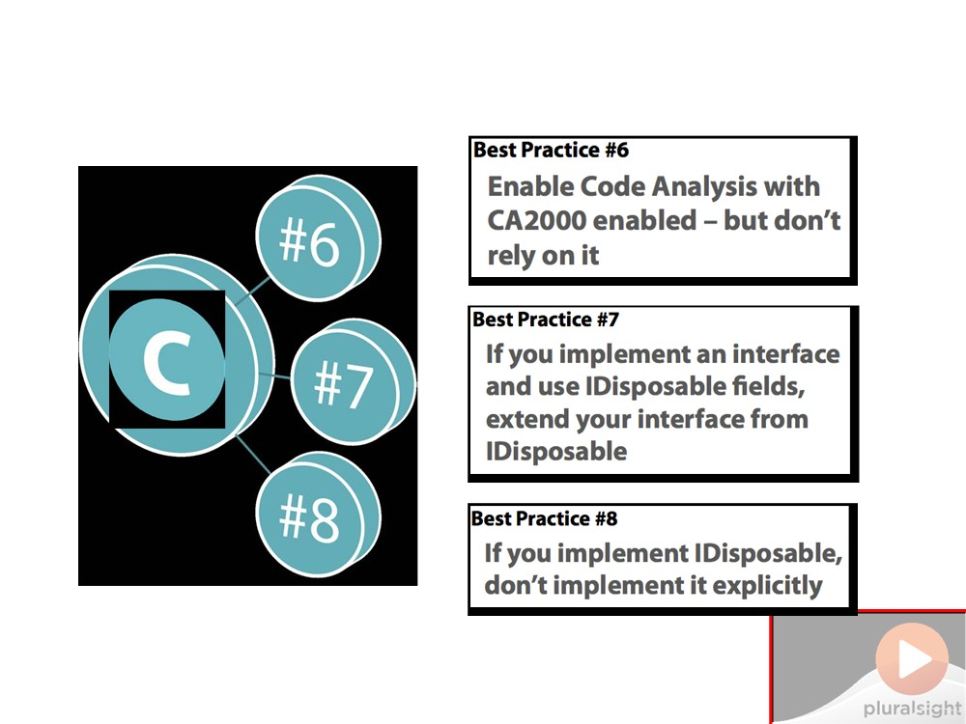
Best Practice MoSCoW
Do Not Place Anything
in This Space
(Add watermark during editing)
Note: Warning will not appear during Slide Show view.

Slide 21
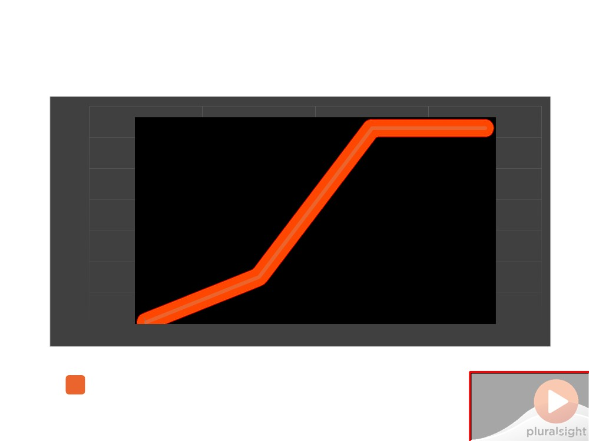
Using IDisposable Correctly
70000
63000
63000
60000
50000
40000
30000
20000
15000
10000
392
0
Startup
First Run
Multiple Runs
GC.Collect
- original app
Do Not Place Anything
in This Space
(Add watermark during editing)
Note: Warning will not appear during Slide Show view.

Slide 22
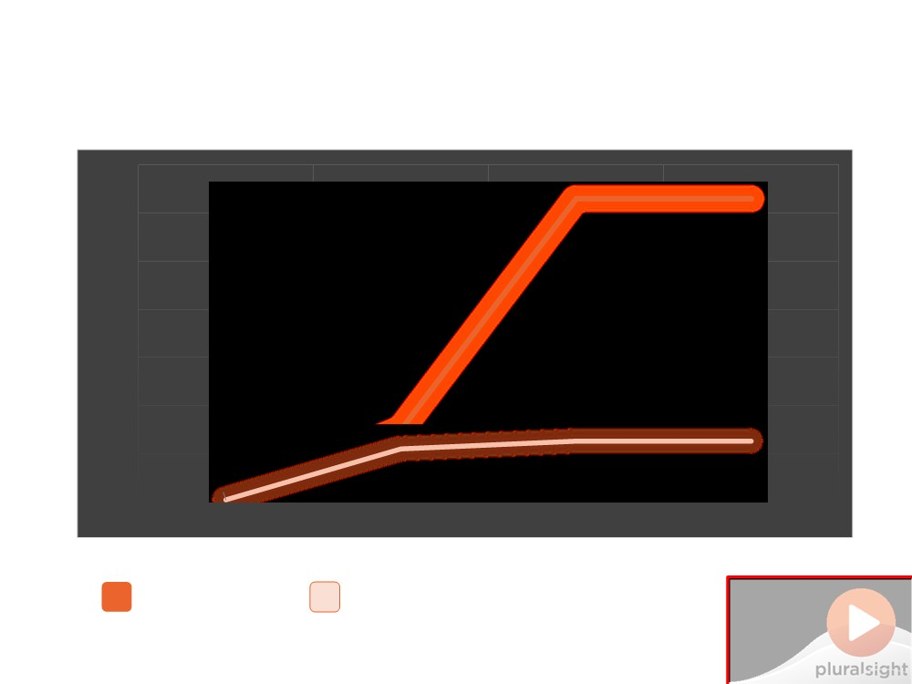
Using IDisposable Correctly
70000
63000 63000
60000
50000
40000
30000
20000
15000
10000
11000 12600 12600
392
0 394
Startup
First Run Multiple Runs GC.Collect
- original app
- best practice version
Do Not Place Anything
in This Space
(Add watermark during editing)
Note: Warning will not appear during Slide Show view.

Slide 23

Summary
▪ Introducing IDisposable

□ Interface definition
□ Unmanaged resources & other IDisposables
▪ What happens when the GC runs?

□ GC what and when □ Where IDisposable fits in

▪ What happens when you don't dispose?
□ Functional defects □ Performance problems □ How to find & fix problems
Do Not Place Anything in This Space
(Add watermark during editing)
Note: Warning will not appear during Slide Show view.

