Slide 1

How to detect and avoid memory and resources leaks in .NET applications
Fabrice MARGUERIE
Independent .NET expert Microsoft MVP
metaSapiens / Tuneo
Notes:
1 min

Slide 2




Who am I?
Independent .NET expert
Microsoft MVP since 2004
Book author: LINQ in Action
Entrepreneur
metaSapiens
Tuneo
Proagora.com
SharpToolbox.com
JavaToolbox.com
metaSapiens

Slide 3
Agenda
Basics
Detecting and fixing
Prevention is better than cure

Slide 4
Agenda
Basics
Detecting and fixing
Prevention is better than cure

Slide 5
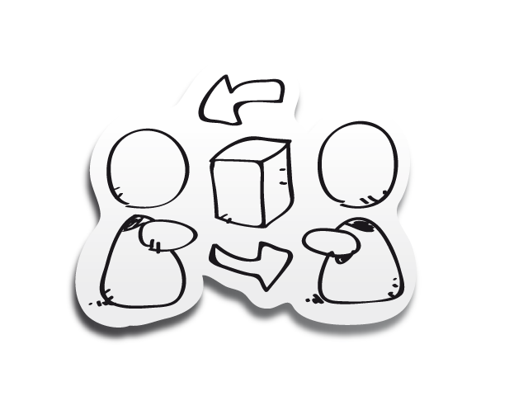
Memory in .NET
Memory of a process
stack, heap
The great GC aka the Garbage Collector
What keeps things alive
Static references
GCHandles
Stack references (one stack per thread)
The finalization queue
Notes:
3 min

Slide 6
Memory leaks
Definition
In computer science, a memory leak is a particular type of unintentional memory consumption by a computer program where the program fails to release memory that it no longer needs.
The most common causes of this condition are:
carelessness
bugs
lack of knowledge
Notes:
4 min

Slide 7
Memory leaks
Languages that provide automatic memory management, like Java, C#, VB.NET or LISP, are not immune to memory leaks .
The garbage collector recovers only memory that has become unreachable. It does not free memory that is still reachable. In .NET, this means that objects reachable by at least one reference won't be released by the garbage collector.
Notes:
Rappeler la différence entre managé et non-managé :
en C, C++ classique, Delphi classique, etc., on doit libérer soi-même la mémoire avec des appels à free, Free, delete, ou autre
en .NET la libération est automatique.
Rappeler que ça ne veut pas dire qu'on ne doit se soucier de rien. On est en managé, mais on peut maintenir facilement en vie bcp de mémoire. On référence aussi des ressources non-managées - connexions à des bases de données, objets graphiques, et autres objets systèmes.
Transition vers la suite en disant qu'en .NET il y a des pièges (événements, etc.) qu'on va détailler dans le reste de la session.

Slide 8
Memory leaks
A drop of water is not a big issue. But drop by drop, a leak can become a major problem.
In computing, even a little leak can bring down the system if it occurs many times.

Slide 9
Agenda
Basics
Detecting and fixing
Prevention is better than cure
Notes:
T5

Slide 10

Steps in leak eradication
1. Detect a leak
2. Find the leaking resource
3. Decide where and when the resource should be released in the source code
Notes:
1 min

Slide 11


Demo
the wonderful PhotoLight application
Notes:
8 min (PhotoLight + TaskManager + PerfMon)

Slide 12
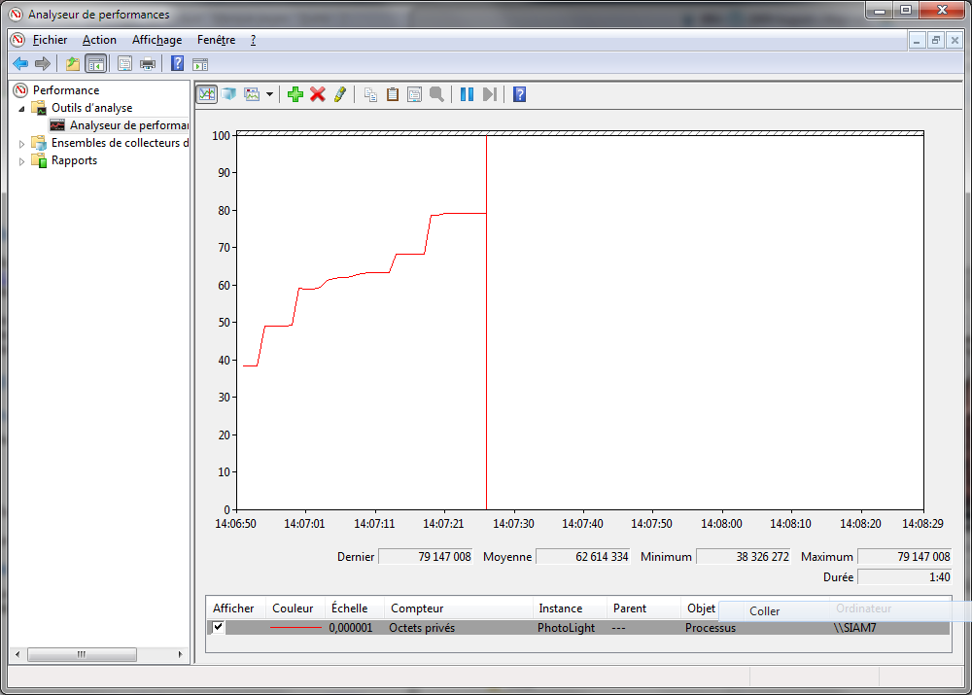
Photo…Light ?

Slide 13
Tools for action
Three complementary approaches
High level view, general audit : dotTrace
More in depth: .NET Memory Profiler
For explorers and ninjas: WinDbg
Notes:
4 min
La recherche de fuites mémoire n'est pas forcément chose compliquée. Il existe différents outils pour différents cas de figure et utilisateurs : - Pour une vue haut niveau, un audit général : dotTrace
Pour creuser la question et analyser d'éventuels problème (mais nécessitant une connaissance plus poussée du modèle mémoire de la CLR) : .NET Memory Profiler
Pour une approche exploratoire, et pour ceux habitués aux outils bas niveau (if you like to get your hands dirty) : windbg

Slide 14
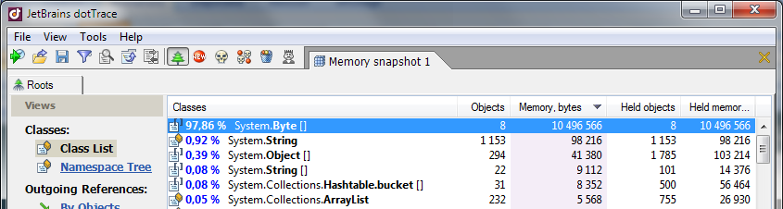
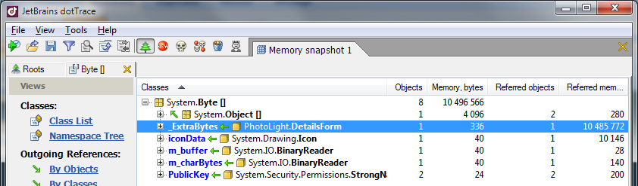
dotTrace
Notes:
9 min

Slide 15
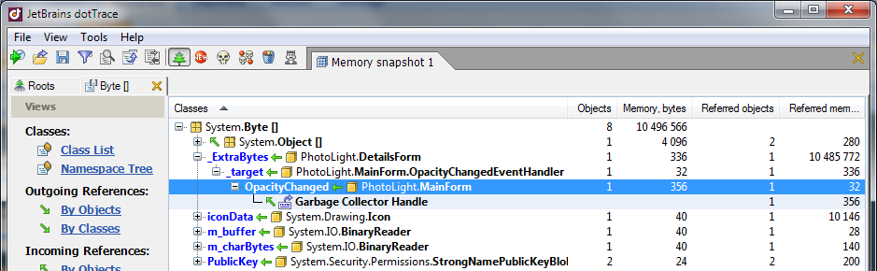
dotTrace

Slide 16
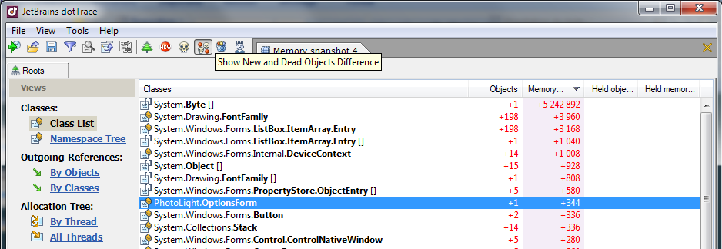
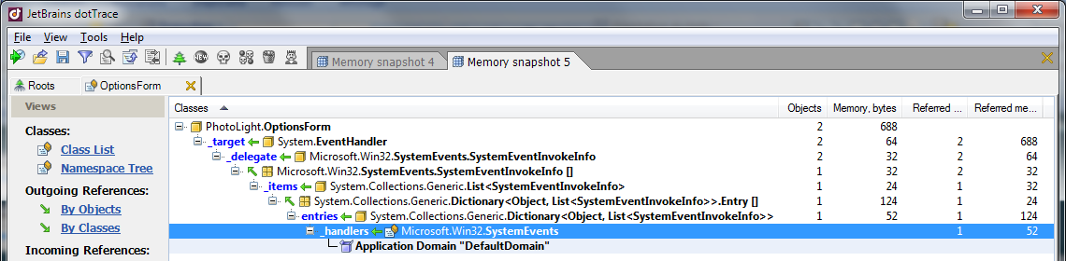
dotTrace

Slide 17
Identified issue
Static event
PhotoLight.exe
MainForm
OptionsForm
DetailsForm
SystemEvents.InstalledFontsChanged

Slide 18
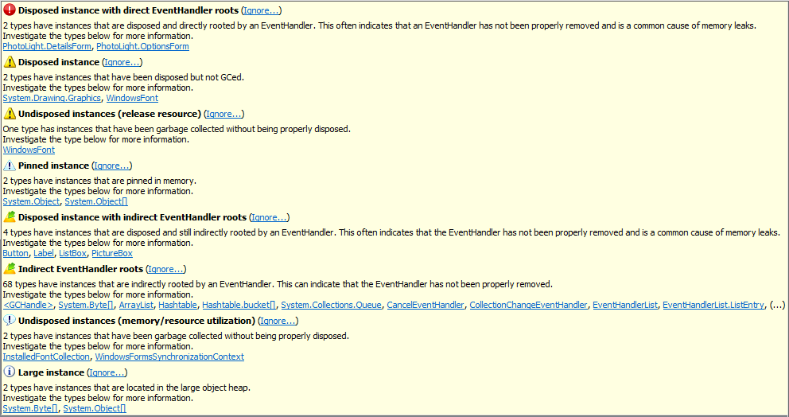
.NET Memory Profiler
Notes:
8 min

Slide 19
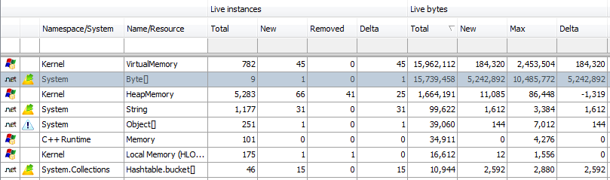
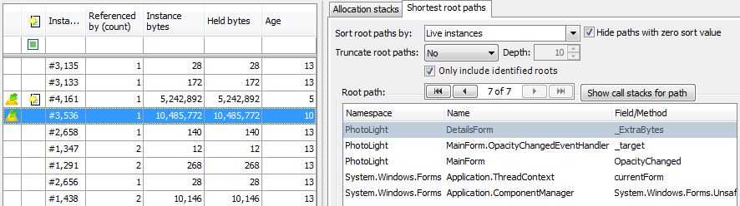
.NET Memory Profiler

Slide 20
Identified issue
Lapsed listener (missing unsubscription)
PhotoLight.exe
MainForm
OpacityChanged
OptionsForm
DetailsForm

Slide 21

WinDbg
Native/managed and « graphical » debugger
Free
Lightweight installation
Can attach to a process or explore a memory dump
Ideal to dive into the internals of a process
Notes:
10 min

Slide 22
WinDbg extensions
Sos.dll for inspecting managed memory
!DumpHeap for listing objects from the heap
!DumpObj (do)
!GCRoot finds the root object for a given object

Slide 23
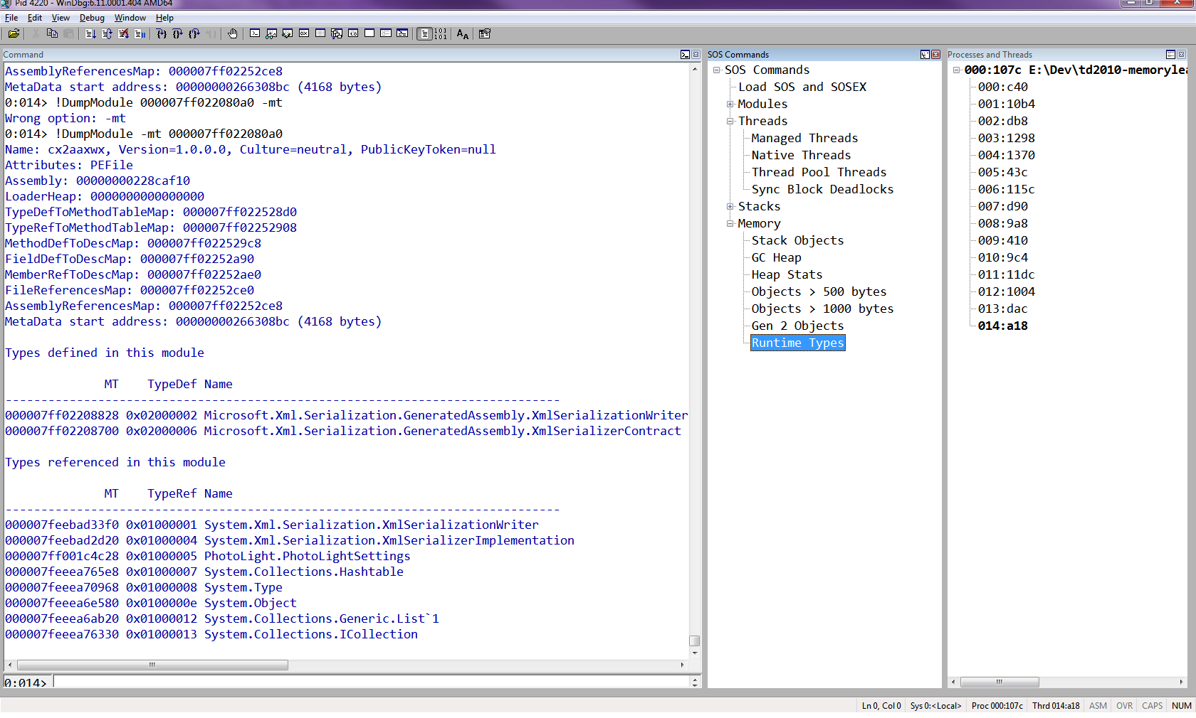
WinDbg
Notes:
Montrer fenêtre Modules en debug sous VS ?

Slide 24
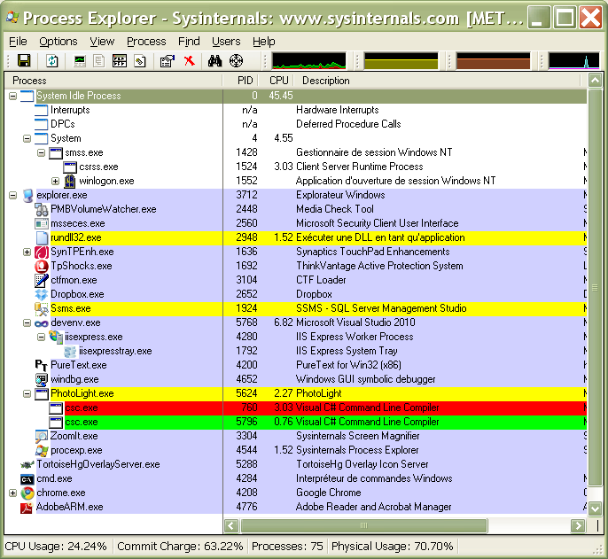
Process Explorer

Slide 25
Identified issue
Dynamically generated code
PhotoLight.exe
MainForm
Settings Manager
XmlSerializer assemblies
XmlSerializer assemblies
OptionsForm
DetailsForm

Slide 26
Agenda
Basics
Detecting and fixing
Prevention is better than cure

Slide 27
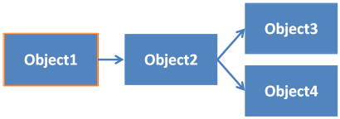
Common leak causes
Static references
Notes:
3 min

Slide 28

Common leak causes
Static events
Lapsed event listeners

Slide 29

Common leak causes
Dispose method not invoked
Incomplete Dispose method

Slide 30
You’ll never be bored…
On-the-fly code generation
Technology-specific issues (Silverlight, WPF, composite applications, etc.)

Slide 31

Prevention is better than cure
Control objects ownership
Static analysis
Above all a good knowledge of your code
Each += (or AddHandler) is a potential enemy!
use -= !
using and Dispose
WeakEvents
EventBroker
Or simply restart the app…
Notes:
5 min

Slide 32
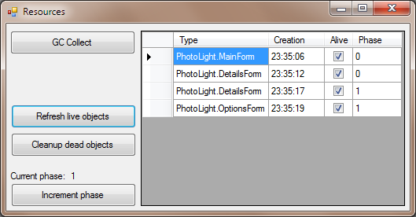
Prevention is better than cure
We are not immune to oversight
Custom tooling – Here a built-in monitoring screen

Slide 33

Tools
Tools dedicated to profiling in .NET dotTrace, .NET Memory Profiler, ANTS Profiler, YourKit Profiler, PurifyPlus, Aqtime, CLR Profiler… http://sharptoolbox.com/categories/profilers-debuggers
WinDbg, SOS.dll, linqdbg http://www.microsoft.com/whdc/devtools/debugging/ http://code.google.com/p/linqdbg/
VMMap http://sysinternals.com
Bear, GDI Usage http://thesz.diecru.eu/content/bear.php http://msdn.microsoft.com/en-us/magazine/cc301756.aspx
Notes:
1 min

Slide 34
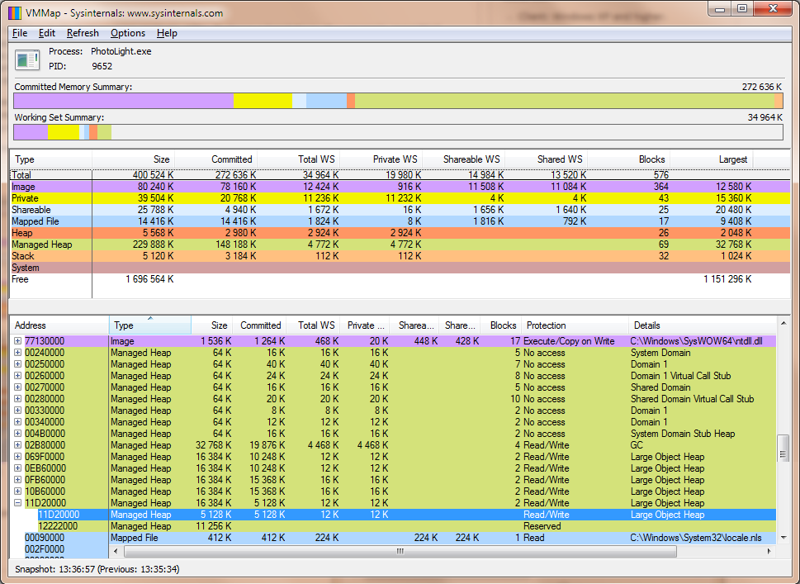
VMMap

Slide 35
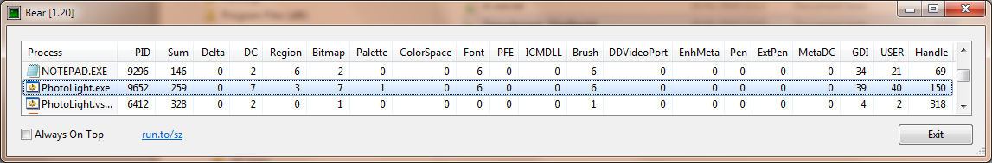
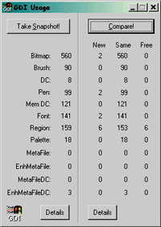
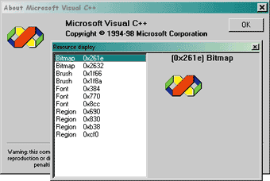
Bear and GDIUsage
http://marketingscience.co/2010/12/facebook-and-adobe-sitecatalyst-google-analytics-implementation/
http://marketingscience.co/2010/12/facebook-and-adobe-sitecatalyst-google-analytics-implementation/

Slide 36

Resources
Article How to detect and avoid memory and resources leaks in .NET applications
http://msdn.microsoft.com/en-us/library/ee658248.aspx
Book Advanced .NET Debugging Mario Hewardt, also author of Advanced Windows Debugging
Book Debugging Microsoft .NET 2.0 Applications John Robbins

Slide 37
Resources
Tess Ferrandez’ blog, ASP.NET Escalation Engineer at Microsoft http://blogs.msdn.com/tess/archive/tags/Memory+issues/default.aspx
Detecting event handlers leaks with WinDbg http://is.gd/79Qlk (David Anson’s blog, MS)
More links at the end of my article

Slide 38

Contacts
Architecture and .NET Expertise
fabrice@metasapiens.com
http://weblogs.asp.net/fmarguerie
http://metaSapiens.com

