Slide 1

Analyzing Memory Usage and Leaks
Ronn Black October 2010
Notes:
Introduction
This is my first time doing this and I’m sure I’ll muck things up somewhere along the way.
I don’t consider myself an expert on this subject. I simply have done enough investigation in this area to have some interesting insights on the subject.
How many of you are here because you are currently experiencing a memory leak (or suspect you may have a memory leak)?
Ahh… The lucky ones.
Why lucky?
Lucky because you have been given the opportunity to learn something new… Something many people don’t know.
It’s rare you encounter this situation in a managed environment. After all managed memory shouldn’t leak right?
In some situations it can and in a complex application it can be difficult to track down.
Why should I worry about garbage collector? Can I really optimize for it (or should I even try).
You don’t need to obsess about it but you should be cognoscente of it and there are things you can do to minimize the work done by the garbage collector which will make your application more efficient.

Slide 2
NextObjPtr
NextObjPtr
Notes:
A very quick review of .Net Memory
I don’t want to waste a lot of time but before we can really dig into this we need to understand a bit about .NET memory and the garbage collector.
Hopefully this will be a review for most of you. If it isn’t then I highly suggest you come to my Garbage Collector session.
Recall that .Net simply allocates objects from a reserved block of contiguous memory called the heap. As objects are created it simply allocates them at the location of NextObjPtr and advances the pointer to the next block. If objects are no longer used they stick around until the heap space is exhausted.

Slide 3
Roots
Gen0
Gen1
Gen2
Large Object Heap
NextPtr
Roots
Gen0
Gen1
Gen2
Large Object Heap
NextPtr
Notes:
When the heap space is exhausted a garbage collection is triggered and the garbage collector considers everything garbage and then follows the references for all objects to determine what is not garbage. Things that are not garbage are then compacted.
Those objects that survived the garbage collection and are compacted are moved into the next higher generation and gen0 is complete emptied. (so that garbage collection only needs to deal with a small fraction of the allocated memory at a time)

Slide 4

Things that can cause Memory Leaks
Circular References?
Form
Control
Control
+Controls
Control
+Parent
Control
+Parent
+Parent
+Parent
Notes:
Anyone who has done any WinForms development is familiar with this diagram.
It’s a circular reference. Forms have a controls collection and each control has a reference back to the parent. If you remember we talked about how the garbage collector traces all references and when if finds objects that are not referenced by anything it disposes of them. This arrangement is not a problem as long as there is nothing referencing one of the objects in the loop.

Slide 5
Things that can cause memory leaks
Rooted References?
public class Preferences
{
static Preferences instance;
public static Preferences GetPrefs()
{
if (instance == null)
instance = new Preferences();
return instance;
}
public event PrefsChanged;
}
Notes:
Rooted objects or Singletons
Problems can arise when you start adding references to rooted objects (singletons or statics).
A common pattern is that you create a singleton to hold preferences and that singleton implements IPropertyModified that controls and forms subscribe to. (Observer pattern).

Slide 6

Things that can cause memory leaks
Rooted References?
Preferences
Form
Control
Control
$GetPrefs
+PrefsChanged
+Controls
Control
+Parent
Control
+Parent
+Parent
+Parent
Notes:
If you aren’t careful to unsubscribe for the events when windows are closed the reference will keep the window and all the controls alive.
The same holds true when there are references from a static member.
.Net 4.0 has a design pattern called Weak Event Pattern that was specifically created to address this problem. However, I am not going to go into it in this session because I believe the pattern is somewhat dubious. In an observer pattern the publisher shouldn’t really care about the lifecycle of the listener. If you unsubscribe from the events like you are supposed to then you won’t have a problem.
However, there are cases where it makes sense and if you really need it I have a reference to it at the end of the deck.

Slide 7
Things that can cause memory leaks
Lists, Hashtables, Dictionaries?
List<T>
T
Control
Control
…
Control
+Parent
+Parent
+Parent
Notes:
Another situation is Lists, hashtables, arrays etc.
These also are not a problem.

Slide 8
Things that can cause memory leaks
public class Foo
{
public static void DoSomething()
{
List<Bar> bars;
...
//Do Something
bar.Clear();
bar = null;
}
}
Notes:
Not necessary at all but it doesn’t hurt to clear the contents of any large hash tables or lists.
If for some reason there is a rooted reference to the list, then at least the contents of it are empty and there are no links to follow therefore the GC should have less work to do.

Slide 9
Things that can cause memory leaks
Type Initializers?
public class Foo
{
static Dictionary<string, Bar> _bars;
public static Foo()
{
//Initialize the Lookup table
_bars = new Dictionary<string, Bar>();
_bars.Add(“EndUp”, new Bar());
...
}
}
Notes:
One place it is particularly important to do this is when you are type initializers.
These are particularly problematic because once the class is referenced the data is consumed even if it is never used.
It can never be reclaimed unless you provide a mechanism to clear the dictionary or tear down the app domain.
If you use this technique a lot you can end up consuming a lot of resources that are infrequently used and just take up space.
You might be better off using a cache because if there is memory pressure the cache can be trimmed.

Slide 10
Things that can cause memory leaks
Leaking Stack Memory
Uncontrolled thread creation.
Buggy Thread cleanup
Never ending recursion.
Notes:
Demo

Slide 11
Things that can cause memory leaks
Leaking Unmanaged Heap memory
Interoperating with Unmanaged code through Invoke & Com interop.
Abort Finalizers
Dynamically generating an assembly in memory.
XmlSerializer
Notes:
Demo

Slide 12
Things that can cause memory leaks
Leaking Managed Heap memory
Large Object Heap Fragmentation.
Unneeded Rooted References.
Excessive time in GC
Finalizers
Logging items removed from Cache.
Delegates
Notes:
Demo

Slide 13
General approach to troubleshooting
Identify if is actually a leak.
Determine the type of leak (Managed or unmanaged)
Analyze objects on the heaps to determine what is being kept alive.
Notes:
General approach to memory troubleshooting.
Identify if it is actually a leak.
Sometimes (particularly with desktop applications) you have someone complain that your application is taking up a lot of memory and insist it must have a memory leak and sometimes it is hard to know if it really is a memory leak or not because if there is no memory pressure the garbage collector won’t run and compact the heaps.
The only sure sign that you have a memory leak is long term monitoring and looking for a pattern of memory growth beyond what would be expected.
For example if you have a desktop application you will see more and more memory consumed as you open more windows and perform more operations that create new objects. Over a period of time the growth rate should level off and potentially shrink if garbage collections occur. If it never really levels off and just keeps growing it is a pretty good sign that it does have a leak.
One thing you can do for a windows forms application is force a garbage place in a hidden location that testers know the location of (For instance opening the about dialog). Testers who suspect a memory leak can go to this location and confirm if the memory is trimmed down properly.
The definitive proof of this is when the application fails with an out of memory error after running for a long time. However, long before this happens you will see the application slow to a crawl and the %GC amount grow as it burns more and more cycles evaluating an ever increasing number of objects.
It is also likely that the entire system will get slow as the process starts paging heavily.
Determine the type of memory leak.
Once you have determined that the application is actually leaking you need to determine if it is a managed leak or an unmanaged leak.
This will give you an indication if you are looking for some com object or 3rd party component (Like a certain well known reporting package) or you are looking for some logic problems in your .Net code.
Analyze objects on the heaps to determine what objects are being kept alive.
This requires some sort of tool to capture this information and cull the data into something useful. This can be a very daunting task.

Slide 14
Terms
% Time in GC – Percentage of time spent performing GC since last GC cycle.
# Bytes in all Heaps – Current memory allocated in all .Net heaps (Gen0-2 + LOH)
Gen0, Gen1, Gen2, LargeObject Heap – Current bytes in each of the heaps.
Promoted Memory from Gen0, Gen1 – bytes promoted from Gen0 to Gen1 (Gen1 to Gen2)
Finalization Survivors - # of objects that survive collection because they are waiting finalization.
Private Bytes (Process) – total memory allocated by process that can’t be shared with other processes (includes .Net memory and unmanaged memory)
Notes:
% Time in GC – The percentage of elapsed time that was spent in performing a garbage collection since the last GC cycle.
# Bytes in all heaps. – Indicates the current memory allocation in bytes on the GCHeaps. It is the sum of Gen0 Heap Size, Gen1 heap size, Gen 2 Heap size and Large Object Heap.
Gen0, Gen1, Gen2, LargeObject heap size – Current bytes in each of the heaps.
Promoted Memory from Gen0, Gen1 – bytes of memory that survive garbage collection and are promoted from Gen0 to Gen1 (Gen1 to Gen2).
Finalization Survivors – The number of garbage collection objects that survive a collection because they are waiting to be finalized (I didn’t discuss finalization but if you don’t understand it you should attend my GC talk).
Private bytes (under Process, not .NET)is the current size of memory that a process has allocated that cant be shared with other processes. This includes the .Net heaps, stack and any unmanaged memory that the process has allocated either through COM objects, or other DLLs.

Slide 15
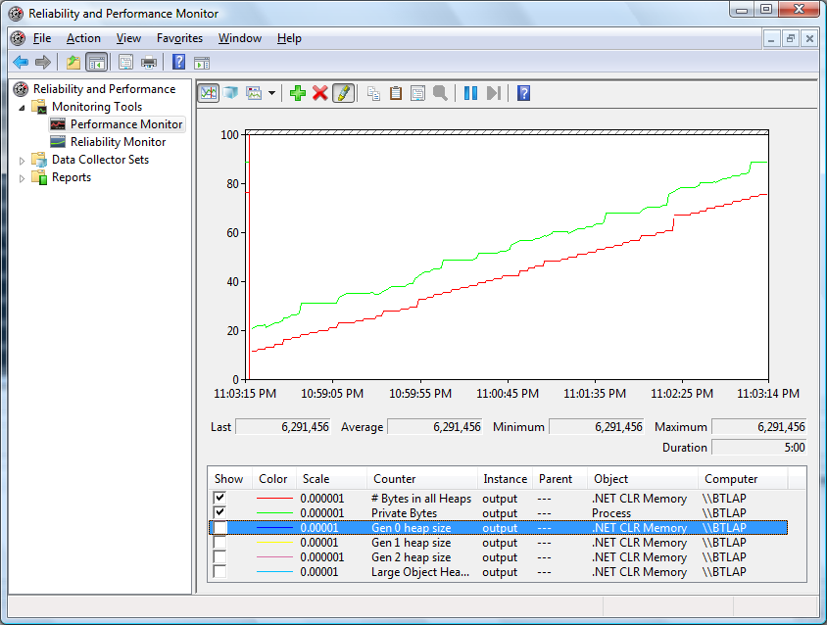

Slide 16
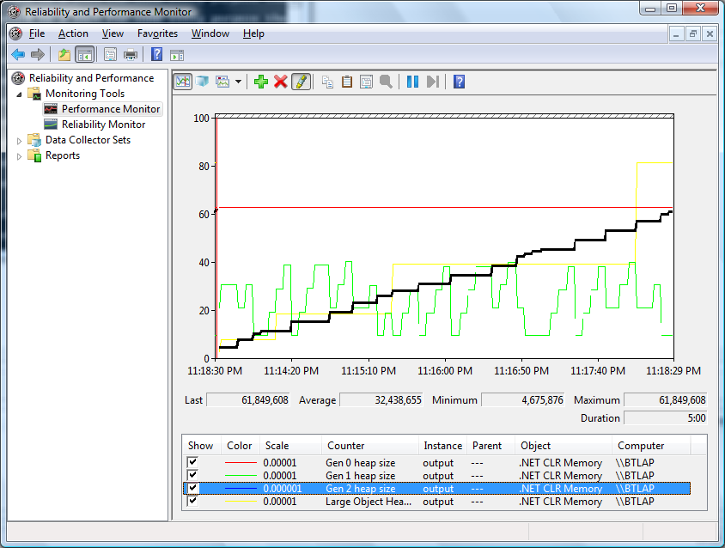

Slide 17
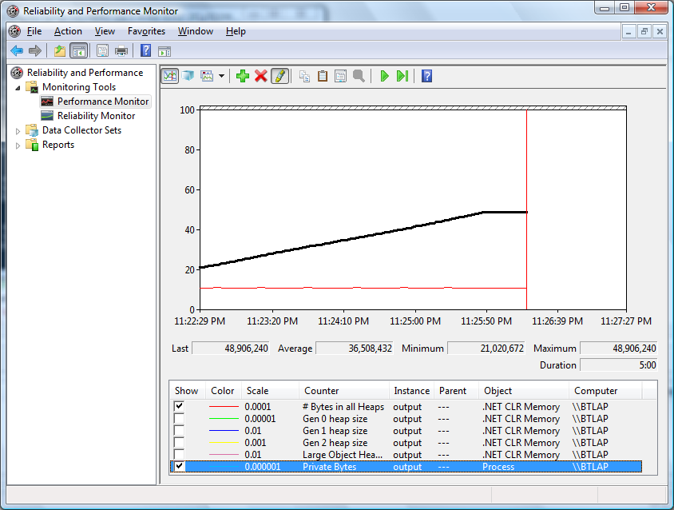

Slide 18
Demo 7 - Leaky program?

Slide 19
Contact & Reference Material
Ronn Black rblack@btsoft.org
http://msdn.microsoft.com/en-us/library/ms973837.aspx (Garbage Collector Basics and Performance Hints)
http://www.microsoft.com/downloads/details.aspx?FamilyID=a362781c-3870-43be-8926-862b40aa0cd0&DisplayLang=en (CLR Profiler for .Net 2.0)
http://www.openasthra.com/multithreading/heap-overview/ (Heap Overview)
http://74.125.155.132/search?q=cache:44hDjSztDf4J:doc.bughunter.net/buffer-overflow/advanced-malloc-exploits.html+malloc+overview&cd=21&hl=en&ct=clnk&gl=us Advanced Malloc exploits
http://msdn.microsoft.com/en-us/magazine/cc534993.aspx (Large Object Heap Uncovered)
http://msdn.microsoft.com/en-us/library/aa970850.aspx (Weak Event Patterns)

