Slide 1
GC & Memory leak
Author : Toan Vo

Slide 2
Overview
What is garbage collector (GC)?
GC algorithm.
Generation.
Type of Garbage collector
GC in .Net framework 4
Improve performance
Common memory leak in WPF or Silverlight
Detect memory leak.

Slide 3
What is Garbage collector
Automatic garbage collection is a process by which the system will automatically take care of the memory used by unwanted objects (we call them as garbage) to be released
Garbage collection is a process of releasing the memory used by the objects, which are no longer referenced.

Slide 4
What is Garbage collector
Garbage collector as a separate thread. This thread will be running always at the back end.
Lowest priority.
When GC already called?
When system finds there is no space in the managed heap (managed heap is nothing but a bunch of memory allocated for the program at run time).
GC thread will be given REALTIME priority (REALTIME priority is the highest priority in Windows) and collect all the un wanted objects.

Slide 5
GC Benefits
Improve performance (down size manage heap).
No longer have to implement any code that. Manages the lifetime of any resources.
It is not possible to leak resources.
It is not possible to access a resource that is freed.
Notes:
However, keep in mind that GCs only occur when the heap is full and, until then, the managed heap is significantly faster than a C-runtime heap

Slide 6
GC Algorithm
Each application has a set of roots.
Roots identify storage location which refers to object on the managed heap or the objects that are set to be null.
Application roots are maintained by JIT and CLR.
Notes:
E.g : all the global and static object pointers are considered as application roots
Local variable/parameter object pointers on a thread stack are considered as a part of application roots

Slide 7
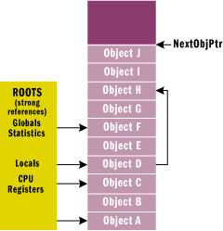
GC Algorithm
Check from roots
Build a graph objects
If roots added new objects. Then add object into graph.
Continue with another roots.
If root added another object already in map then move to next root.

Slide 8
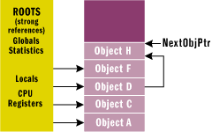
GC Algorithm
The garbage collector now walks through the heap linearly.
The garbage collector then shifts the non-garbage objects down in memory removing all of the gaps in the heap.
Notes:
Of course, moving the objects in memory invalidates all pointers to the objects. So the garbage collector must modify the application's roots so that the pointers point to the objects' new locations. In addition, if any object contains a pointer to another object, the garbage collector is responsible for correcting these pointers as well.

Slide 9
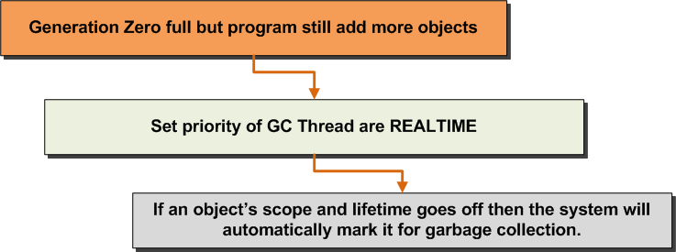
GC Algorithm
Notes:
When Generation Zero is full and it does not have enough space to occupy other objects but still the program wants to allocate some more memory for some other objects, then the garbage collector will be given the REALTIME priority and will come in to picture.
Now the garbage collector will come and check all the objects in the Generation Zero level. If an object’s scope and lifetime goes off then the system will automatically mark it for garbage collection.

Slide 10
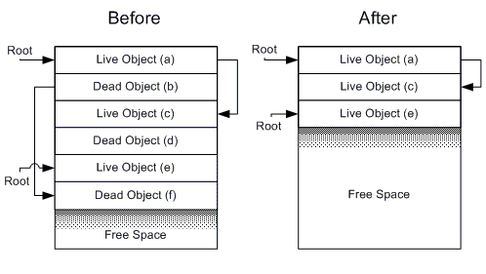
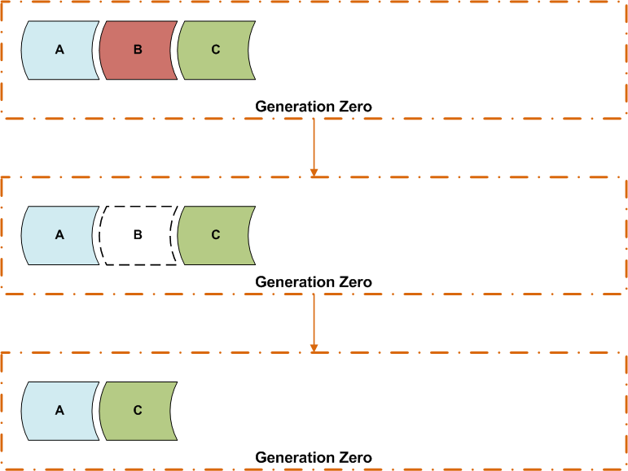
GC Algorithm
GC Start examining all the objects in the level Generation Zero. If it finds any object marked for garbage collection, it will simply remove those objects from the memory.
GC to compact the memory structure after collecting the objects
GC will look which are all the objects survive after the sweep (collection). Those objects will be moved to Generation One and now the Generation Zero is empty for filling new objects.
Happen with Generation One same as Generation Zero as well.
Notes:
If Generation One does not have space for objects from Generation Zero, then the process happened in Generation Zero will happen in Generation one as well.
All the generations are filled with the referred objects and still system or our program wants to allocate some objects, then what will happen? If so, then the MemoryOutofRangeException will be thrown.

Slide 11
GC Algorithm
What’s happen when Gen 1 filled?
Expand size of gen 2 when if it can
Move all of objects still alive at Gen 1 to Gen 2
Note:
If object has size 85,000 bytes or greater will start off in Generation 2 directly.
Only generation 2 is allow to grow as needed.
Notes:
Usually Gen 0 was 256KB (fits the cpu's l2 cache ) Gen1 2MB Gen2 10MB

Slide 12
GC Algorithm
Generation 0 (Gen 0). This consists of newly created objects. Gen 0 is collected frequently to ensure that short-lived objects are quickly cleaned up. Those objects that survive a Gen 0 collection are promoted to Generation 1.
Generation 1 (Gen 1). This is collected less frequently than Gen 0 and contains longer-lived objects that were promoted from Gen 0.
Generation 2 (Gen 2). This contains objects promoted from Gen 1 (which means it contains the longest-lived objects) and is collected even less frequently. The general strategy of the garbage collector is to collect and move longer-lived objects less frequently.

Slide 13
GC Algorithm - Type of GC
Server GC
Multiprocessor (MP) Scalable, Parallel
One GC thread per CPU
Program paused during marking
Workstation GC
Minimizes pauses by running concurrently during full collections
Notes:
The server GC is designed for maximum throughput, and scales with very high performance.
The Server GC uses multiple heaps and collection threads to maximize throughput and scale better.
The Workstation GC uses the second processor to run the collection concurrently, minimizing delays while diminishing throughput

Slide 14
GC Algorithm - Concurrent GC
Concurrent GC can be used in Workstation mode on a multi-proc machine.
Performs full collections (generation 2) concurrently with the running program, therefore minimizing the pause time.
This mode is particularly useful for applications with graphical user interfaces or applications where responsiveness is essential.
Concurrent GC is only used with generation 2; generations 0 and 1 are always non-concurrent because they finish very fast.

Slide 15
Configuration Type of GC
Specify the GC mode in the application’s config file:
<configuration> <runtime> <gcServer enabled=”true” /> </runtime> </configuration>
Specify the GC mode to Concurrent:
<configuration> <runtime> <gcConcurrent enabled=”true” /> </runtime> </configuration>

Slide 16
What’s new GC in .net framework 4
Problem:
The single GC thread cannot handle two operations at same time
Scanning generation 0 and 1.
Space may also run out (for gen 0 and 1) before GC collection finishes. And this is the reason why Microsoft always recommended not to call GC.Collect method.

Slide 17
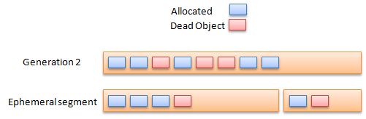
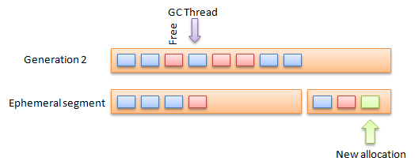
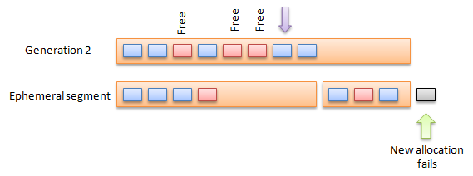
Concurrency problem
Notes:
It will start marking the objects, checking the stacks and the GC roots. This operation will allow further allocations, this means that your application may create a new object and this will be allocated in generation 0.
Now there are further allocations that the GC needs to suspend the EE (Execution engine) and this will stop all threads on your application. At this stage no allocation is allowed and your application may suffer some latency.
The EE is resumed in order to continue working on the heap and other bits and pieces that the GC needs to handle; at this stage the allocation is allowed. But what happen if our ephemeral segment is full while this collection happens?
At this stage the ephemeral collection cannot swap segments and the allocation will be delayed, adding latency to your application.

Slide 18
What’s new GC in .net framework 4
Approach
Reduce the latency problem described above and run the collection on ephemeral segment while performing generation 2 collection.

Slide 19
What’s new GC in .net framework 4
Solution
The Background GC: this will work as the scenario described above. Means, background GC will work on the generation 2 collection and allocation of new objects into generation 0.
The Foreground GC: This will be only triggered when the ephemeral segment needs to be collected while performing a generation 2 collection.

Slide 20
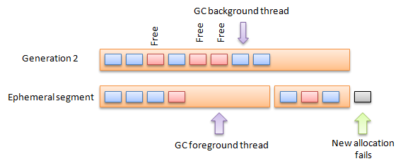
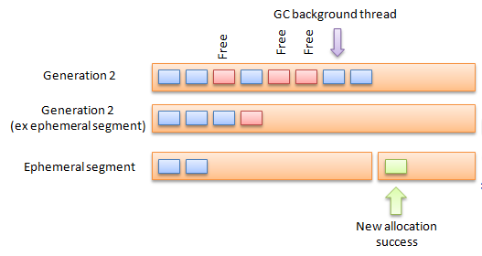
Solution of .net framework 4
Notes:
The ephemeral foreground thread will mark the dead objects and will swap segments (as this is more efficient rather than copying the objects to generation 2. The ephemeral segment with the free and allocated objects becomes a generation 2 segment. As you can see now the allocation is allowed and your application will not need to wait for the full GC to finish before allowing you the allocation.

Slide 21
Improve performance

Slide 22
Improve performance
Choose type of GC
Server GC
The server GC is designed for maximum throughput, and scales with very high performance.
The Server GC uses multiple heaps and collection threads to maximize throughput and scale better.
Workstation GC
The Workstation GC uses the second processor to run the collection concurrently, minimizing delays while diminishing throughput

Slide 23
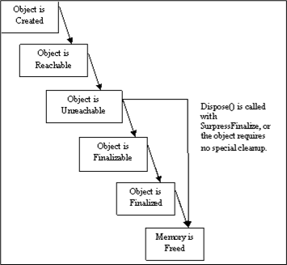
Improve performance - Finalizes
In a scenario where you have resources that need to be released at a specific time, you lose control with finalizes.
N objects that require disposal in a certain order may not be handled correctly.
An enormous object and its children may take up far too much memory, require additional collections and hurt performance.
A small object to be finalized may have pointers to large resources that could be freed at any time.
Disposal and finalization paths an object can take

Slide 24
Improve performance
A Finalize() method:
Is called by the GC
Is not guaranteed to be called in any order, or at a predictable time
After being called, frees memory after the next GC
Keeps all child objects live until the next GC
A Dispose() method:
Is called by the programmer
Is ordered and scheduled by the programmer
Returns resources upon completion of the method

Slide 25
Improve performance
Recommendation
Release objects when we’re done with them and keep an eye out for leaving pointers to objects.
When it comes to object cleanup, implement both a Finalize() and Dispose() method for objects with unmanaged resources. This will prevent unexpected behavior later, and enforce good programming practices.

Slide 26
Improve performance
Identify and analyze your application's allocation profile.
Avoid calling GC.Collect.
Consider weak references with cached data.
Prevent the promotion of short-lived objects.
Set unneeded member variables to Null before making long-running calls.
Minimize hidden allocations.
Avoid or minimize complex object graphs.

Slide 27
Detect memory leak
What is memory leak?
A memory leak occurs when memory is allocated in a program and is never returned to the operating system.

Slide 28
Detect memory leak
Memory leak in .Net framework:
Memory is disposed of but never collected, because a reference to the object is still active.
The garbage collector can collect and free the memory but never returns it to the operating system.
E.g: if that object was registered to an event published by another object, it won’t be collected by the GC
=> When you register to an event => a reference from the object that published the event to the registering object.
Notes:
A reference to the object is still active, the garbage collector never collects that memory. This can occur with a reference that is set by the system or the program.
The garbage collector can collect and free the memory but never returns it to the operating system. This occurs when the garbage collector cannot move the objects that are still in use to one portion of the memory and free the rest.
Poor memory management can result when many large objects are declared and never permitted to leave scope. As a result, memory is used and never freed.

Slide 29
Avoid memory leak
Weak references
Weak references allow the garbage collector to collect the object, but they also allow the application to access the object.
Weak references are useful for objects that use a lot of memory, but can be recreated easily if they are reclaimed by garbage collection.

Slide 30
Avoid memory leak
Guide lines for memory leak
Use long weak references only when necessary as the state of the object is unpredictable after finalization.
Avoid using weak references to small objects because the pointer itself may be as large or larger.
Avoid using weak references as an automatic solution to memory management problems. Instead, develop an effective caching policy for handling your application's objects.

Slide 31
Avoid memory leak
Using disposable pattern
Create a class that derives from IDisposable.
Add a private member variable to track whether IDisposable.Dispose has already been called.
Implement a protected virtual void override of the Dispose method that accepts a single bool parameter.
Implement the IDisposable.Dispose method that accepts no parameters. call Dispose(true) and then prevent finalization by calling GC.SuppressFinalize(this).
Create a finalizer, by using destructor syntax. In the finalizer, call Dispose(false).

Slide 32
Detect memory leak
Stack Memory
Stack memory gets reclaimed after the method returns
Stack memory can get leaked in two ways:
A method call consumes a significant amount of stack resources that never returns
The other is by creating background threads and never terminating them. Thus leaking the thread stack

Slide 33
Detect memory leak
Unmanaged Heap Memory
If the managed code is interoperating with unmanaged code and a leak exists in the unmanaged code.
There exists a finalizer which blocks this thread, then the other finalizer will never get called and the unmanaged memory will leak which was supposed to be released.

Slide 34
Detect memory leak
Managed Heap Memory
Get leaked by several ways like fragmentation of the Large Object Heap.
The memory in the Large Object Heap never gets compacted, so there is a loss in memory over there.
There exist some objects which are not needed, but there exists a reference to the objects, then GC never claims the memory assigned to these objects.

Slide 35
Detect memory leak
Detecting memory leak in .Net
Memory leaks can occur either in the stack, unmanaged heap, or the managed heap.
Using Perfmon tool
Examine counters such as Process/Private bytes
Examine .NET CLR Memory/# bytes in all heaps
Examine .NET CLR LocksAndThreads/#

Slide 36
Detect memory leak
If .NET CLR LocksAndThreads/# is increasing unexpectedly, then the thread stack is leaking.
If only Process/Private bytes are increasing but the .NET CLR Memory is not increasing then unmanaged memory is leaking.
If Process/Private bytes and the .NET CLR Memory is increasing then then managed memory is leaking.

Slide 37
Detect memory leak
Using Memprofiler or Ant Profiler
Step 1: Attach process into
Step 2: Execute action on our application
Step 3: Take snapshot memory
Step 4: Do action again as Step 2
Step 5: Take snapshot again
Step 6: Review and diagnostics memory base on significant of memory profiler.

Slide 38
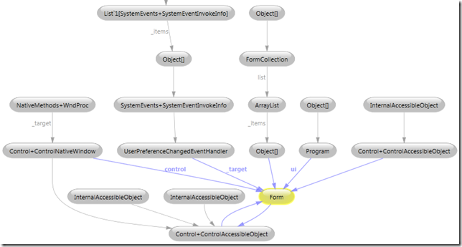
Detect memory leak – Graph objects
We can see for example that the Form is linked by a UserPreferenceChangedEventHandler through the _target member variable, in other words, one reason that the Form can’t be garbage collected is because it is handling a UserPreferenceChangedEvent.

Slide 39
Common scenarios leak in WPF
Case 1: Unregistered events
newOrder.OnPlaced += OrderPlaced; _pendingDeals.Add(newOrder);
void DeleteOrder (Order placedOrder)
{
_pendingDeals.Remove(placedOrder);
}
Notes:
the framework has to subscribe to the ValueChanged event, which in turn sets up a strong reference chain.

Slide 40
Common scenarios leak in WPF
Solution case 1:
Unregistered Event before we remove or dispose object
void DeleteOrder (Order placedOrder)
{
_pendingDeals.Remove(placedOrder);
}

Slide 41
Common scenarios leak in WPF
Case 2: DataBinding
If we have a child object that data binds to a property of its parent, a memory leak can occur.
<Grid Name="mainGrid">
<TextBlock Name=”txtMainText” Text="{Binding ElementName=mainGrid, Path=Children.Count}" />
</Grid>

Slide 42
Common scenarios leak in WPF
Solution case 2:
1. Add a DependencyProperty to the page/window returns the value of the required PropertyDescriptor property. Binding to this property instead will get solve the problem.
2. Make the binding OneTime
3. Clear bingdings when unloaded
BindingOperations.ClearBinding(txtMainText, TextBlock.TextProperty);

Slide 43
Common scenarios leak in WPF
Case 3: Static Events
MyStaticClass.MyEvent += new EventHandler(MyHandler)
public override void MyHandler(EventArgs e)
{
// DO something
…..
}
Notes:
Subscribing to an event on a static object will set up a strong reference to any objects handling that event. And strong references preventing garbage collection are just memory leaks by another name.

Slide 44
Common scenarios leak in WPF
Solution case 3
We will unsubscribe, simply add the code line
MyStaticClass.EventToLeak -= this.AnEvent;

Slide 45
Common scenarios leak in WPF
Case 4: Command binding
CommandBinding cutCmdBinding = new CommandBinding(ApplicationCommands.Cut, OnMyCutHandler, CanExecuteCut);
mainWindow.main.CommandBindings.Add(cutCmdBinding);
void OnMyCutHandler (object target, ExecutedRoutedEventArgs e)
{
// To Do Something
}
void CanExecuteCut(object sender, CanExecuteRoutedEventArgs e)
{
e.CanExecute = true;
}

Slide 46
Common scenarios leak in WPF
Solution case 4:
We will clear bindings
mainWindow.main.CommandBindings.Remove(cutCmdBinding);

Slide 47
Common scenarios leak in WPF
Case 5: Dispatcher timer leak
DispatcherTimer _timer = new DispatcherTimer();
int count = 0;
private void MyLabel_Loaded(object sender, RoutedEventArgs e)
{
_timer.Interval = TimeSpan.FromMilliseconds(1000);
_timer.Tick += new EventHandler(delegate(object s, EventArgs ev)
{
count++;
textBox1.Text = count.ToString();
});
_timer.Start();
}

Slide 48
Common scenarios leak in WPF
Solution Case 5
We will stop timer and set null
_timer.Stop();
_timer=null;

Slide 49
Common scenarios leak in WPF
Case 5b: TEXTBOX UNDO LEAK
Not really leak but it take longer time when release memory
Solution:
Fixed by Disable undo ability
textBox1.IsUndoEnabled=false;
Or
textBox1.UndoLimit=100;

Slide 50
Q & A
Reference
http://msdn.microsoft.com/en-us/magazine/bb985010.aspx
http://msdn.microsoft.com/en-us/library/ms404247.aspx
http://support.microsoft.com/kb/318263/en-us?fr=1
http://www.codeproject.com/KB/dotnet/Memory_Leak_Detection.aspx
http://blogs.msdn.com/b/ricom/archive/2004/12/10/279612.aspx
http://blogs.msdn.com/b/delay/archive/2009/03/11/where-s-your-leak-at-using-windbg-sos-and-gcroot-to-diagnose-a-net-memory-leak.aspx
http://memprofiler.com/instancegraph.aspx
http://www.red-gate.com/products/dotnet-development/ants-memory-profiler/learning-memory-management/WPF-silverlight-pitfalls

