Slide 1
Everything* you need to know about .NET Memory
Ben Emmett - KCDC – 17 May 2014
*Most stuff

Slide 2


































Titanium Sponsors
Platinum Sponsors
Gold Sponsors

Slide 3

Some of what I’m about to say is a lie*
*The good kind.

Slide 4
public void CaffeineCheck(int coffeesConsumed)
{
CaffeineAlert alert = new CaffeineAlert();
int coffeesRequired = 3;
if (coffeesConsumed < coffeesRequired)
{
alert.Announce("Send help.");
}
}

Slide 5
The Stack
For each thread
Alert()
CaffeineCheck (int coffeesRequired)
int coffeesRequired
int coffeesConsumed
.....
[Return address]
CaffeineCheck()
ParentMethod()

Slide 6
eg:
byte
int
char
Pointers
eg:
strings
classes
objects
arrays
Stack
Heap

Slide 7
CaffeineCheck(int coffeesRequired)
int coffeesRequired
int coffeesConsumed
CaffeineAlert alert
[Return address]
CaffeineAlert
Stack
Heap

Slide 8
Value Type
Reference Type
public class ValueTypeTest
{
public void ValueTypes()
{
int a = 1;
int b = a;
b = 2;
Console.WriteLine(a); // 1
}
}
public class ReferenceTypeTest
{
public void ReferenceTypes()
{
TestClass a = new TestClass();
a.Test = 1;
TestClass b = a;
b.Test = 2;
Console.WriteLine(a.Test); // 2
}
}
public class TestClass
{
public int Test;
}

Slide 9
public class CaffeineAlert
{
private List<Contact> Recipients;
}
public class Contact
{
private string Name;
private string Email;
}
string
Email
string
Name
Contact
list
string
Email
string
Name
CaffeineCheck(int coffeesRequired)
int coffeesRequired
int coffeesConsumed
CaffeineAlert alert
[Return address]
Contact
list
List<Contact>
Recipients
CaffeineAlert
alert
Stack
Heap

Slide 10
public class CaffeineAlert
{
private List<Contact> Recipients;
}
public class Contact
{
private string Name;
private string Email;
}
CaffeineAlert
alert
List<Contact>
Recipients
Contact
list
string
Email
string
Name
WRONG
Contact
list
string
Email
string
Name
CaffeineCheck(int coffeesRequired)
int coffeesRequired
int coffeesConsumed
CaffeineAlert alert
[Return address]
Stack
Heap

Slide 11
public class CaffeineAlert
{
private List<Contact> Recipients;
}
public class Contact
{
private string Name;
private string Email;
}
string
Email
string
Name
Contact
list
string
Email
string
Name
CaffeineCheck(int coffeesRequired)
int coffeesRequired
int coffeesConsumed
CaffeineAlert alert
[Return address]
Contact
list
List<Contact>
Recipients
CaffeineAlert
alert
Stack
Heap

Slide 12
CaffeineAlert
alert
List<Contact>
Recipients
Contact
list
Contact
list
string
Name
string
Email
string
Name
string
Email

Slide 13
Object reference
Stack
Heap

Slide 14
Object reference
Stack
Heap

Slide 15
Object reference
Stack
Heap

Slide 16
Object reference
Stack
Heap

Slide 17
Gen 0
Gen 1
Gen 2

Slide 18
Gen 0
Gen 1
Gen 2

Slide 19
Gen 0
Gen 1
Gen 2

Slide 20
Gen 0
Gen 1
Gen 2

Slide 21
Gen 0
Gen 1
Gen 2

Slide 22
Gen 0
Gen 1
Gen 2

Slide 23
Gen 0
Gen 1
Gen 2

Slide 24
Address range | Dirty?
0-127
128-255
256-383
384-511 | YES
512-639
640-767
768-895
896-1023

Slide 25
The Heap
Small Object Heap (SOH)
Large Object Heap (LOH)
Gen 2
Gen 1
Gen 0

Slide 26
Address
1100k
1000k
900k
800k
700k
600k
500k
400k
300k
200k
100k
0
LOH

Slide 27
 | Allocate | Remove
Stack | Quick | Quick
Small Object Heap | Quick | Slow(ish)
Large Object Heap | Slow(ish) | Quick(ish)

Slide 28
1
2
3
4
5
6
public void NaughtyStringMessage(string name)
{
string message = "Hello ";
message += name;
Console.WriteLine(message);
}
NaughtyStringMessage(string name)
ref string name
[Return address]
string
name
"Ted"
Stack
Heap

Slide 29
1
2
3
4
5
6
public void NaughtyStringMessage(string name)
{
string message = "Hello ";
message += name;
Console.WriteLine(message);
}
NaughtyStringMessage(string name)
ref string message
ref string name
[Return address]
string
message
"Hello"
string
name
"Ted"
Stack
Heap

Slide 30
1
2
3
4
5
6
public void NaughtyStringMessage(string name)
{
string message = "Hello ";
message += name;
Console.WriteLine(message);
}
NaughtyStringMessage(string name)
ref string message
ref string name
[Return address]
string
message
"Hello Ted"
string
message
"Hello"
string
name
"Ted"
Stack
Heap

Slide 31

public static event EventHandler UserLoggedOut;
Main form
MainForm.UserLoggedOut += HideFormData;
Child form

Slide 32
MainForm
EventHandler
UserLoggedOut
ChildForm
SecretDataWindow
Loads
Of
Other
Junk

Slide 33
public class UnmanagedClass
{
~UnmanagedClass()
{
//Clear up the unmanaged resources
}
}

Slide 34

public class UnmanagedClass : IDisposable
{
public void Dispose()
{
//Clear up the unmanaged resources
GC.SuppressFinalize(this);
}
~UnmanagedClass()
{
this.Dispose();
}
}
Not a complete IDisposable implementation

Slide 35




2013
Most awesome ☺
Notes:
http://www.red-gate.com/memoryprofiler

Slide 36
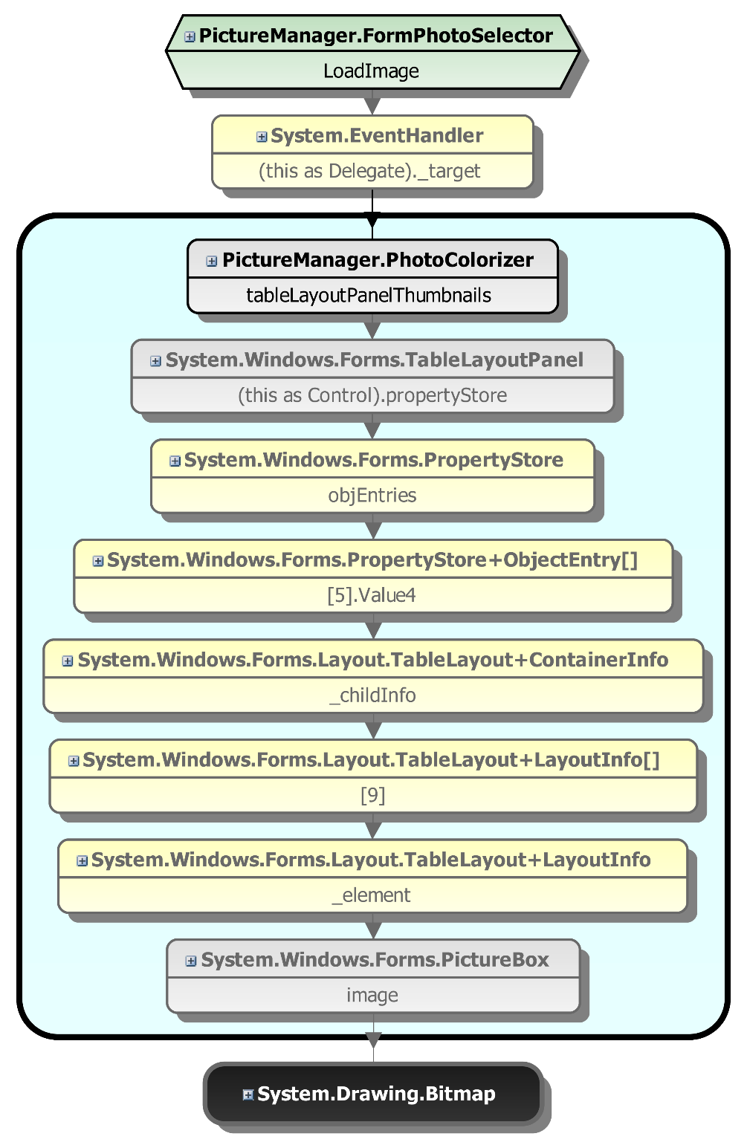

Slide 37
ben.emmett@red-gate.com
@bcemmett
slideshare.net/benemmett

