Slide 1
DEPLOY A WEB APPLICATION TO AZURE
Group 12

Slide 2
MEMBERS:
1. Lê Minh Nhã - 20521690
2. Phan Ngọc Yến Nhi - 20521717
3. Nguyễn Tú Ngọc - 20521665

Slide 3
TABLE OF CONTENTS
1. INTRODUCTION
Overview
Operation
2. IMPLEMENTATION
Installation
Configure
3. DEMO
Component
Topology
Demo
Result

Slide 4
I. INTRODUCTION

Slide 5
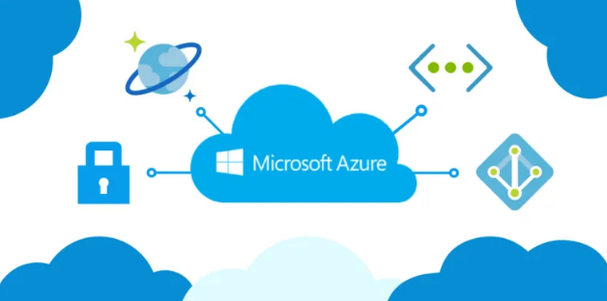
1.1. Overview
1. Microsoft Azure
A cloud computing service for building, testing, deploying, and managing applications and services.
Supports many different programming languages, tools, and frameworks.

Slide 6
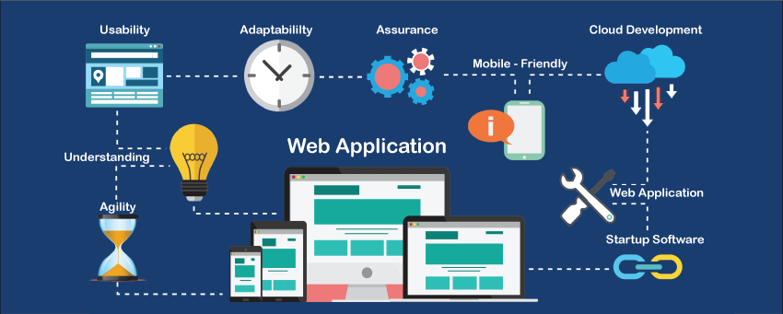
1.1. Overview
2. Web Application
An application program stored on a remote server and delivered over the Internet through a browser interface.
The salient features of a web application:
Be interactive, adaptive and constant
Be able to solve specific problems, even if just looking for information
Has a content management system

Slide 7

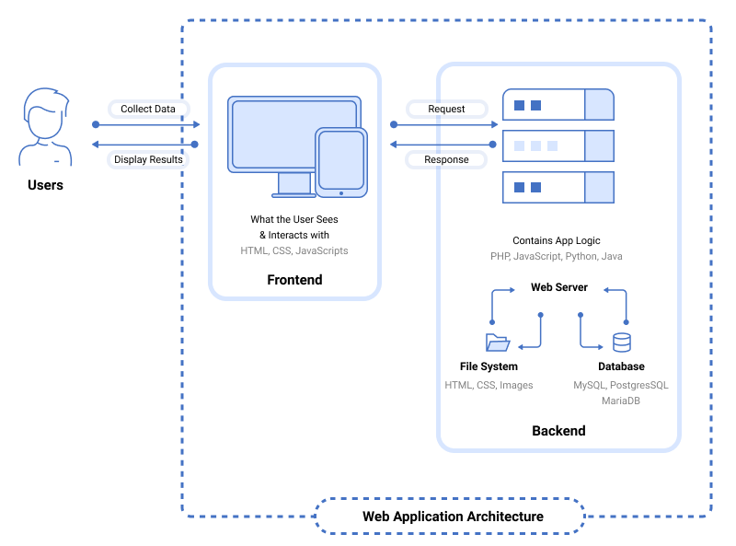
1. Primary components
1.2. Component

Slide 8
1. Primary components
Web-based database applications
User interface
Web application server
Database server
1.2. Component

Slide 9

1.3. OPERATION

Slide 10
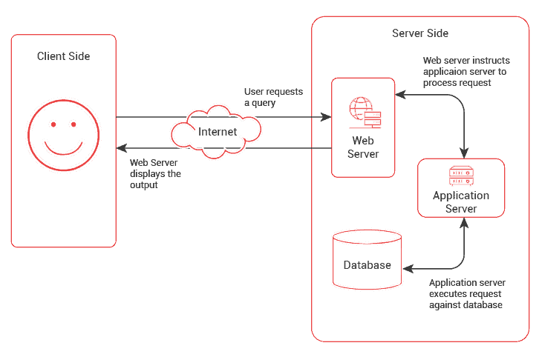
1. Operation of Web Application

Slide 11
2. Operation of Web Application on Azure
Step 1
Step 2
The Azure Server sends requests to the Azure Web App Service
Step 3
The Azure Web App Service connect to the Azure SQL Database Server (such as MySQL, PostgreSQL,...) to retrieve necessary data for users
The user interacts with the web browser and send requests to Azure Server
Step 4
The Azure Web App returns response to the user through client’s web interface

Slide 12
II. IMPLEMENTATION
Notes:
Now I will talk about the implementation of our web application.

Slide 13
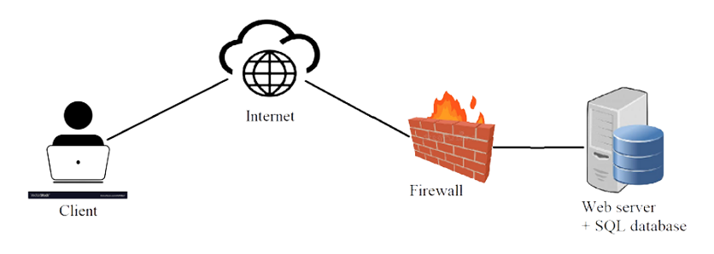
2.1. TOPOLOGY
Server | IP Address | Service / Application
Web Server | Virtual IP Address (Azure provides itself when creating a Web App) | Web App Service on Azure
Client Server (User) | IP address of user’s PC | Internet
Notes:
First, as we can see, the topology includes 4 agents. The web server hosts the web app that deployed and connected to Database. Through the firewall policy, it pushes the Web App to the Internet. Then, the client will access the web application through the browser with public IP address.

Slide 14



2.2. INSTALLATION
Visual Studio
PostgreSQL
Github Action
Azure Web App Service
WEB APP PUBLICATION
Code on Visual Studio
CI/CD via Github
Integrate PostgreSQL
Upload and deploy on Web App Service
Notes:
Next is the installation. To push a web app on the Internet, we need to install programs through 2 main services: Visual Studio and Azure Web App Service. Besides, we also use the CI/CD process via GitHub action and connect to PostgreSQL database to upload code and database from local code on Visual Studio.

Slide 15
1. Code on Visual Studio
Programming language
Django Framework 4.1.3
Python 3.10.8
Web is for
View restaurant reviews and detailed feedback from customers.
Add personal feedback about the visited restaurant.
2.2. INSTALLATION

Slide 16
Web Functions
Add
Add new review
Add new restaurant
View
Details of different restaurants
Customers’ feedback
2.2. INSTALLATION
Notes:
According to the design, our website has 2 functions for users to interact: adding and viewing

Slide 17
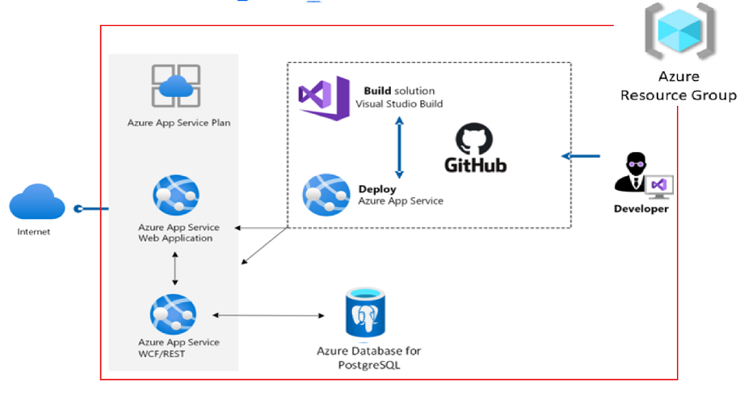
2.3. CONFIGURE
Notes:
After We created python code on visual.
-The next one we need to create is Resource group ,is a container which includes all resources we use.
-Then create a database. The kind of database that we use is PostgreSQL
- the last one, create Webapp via
+ App service plan: this will take the resources from resource group for setting up app service
+ App servicr web app: this is the base for building web, and it runs in the app service plan.
Then configure with azure app service on azure portal, connect to postgresql server to upload db. And all of these things will be deployed into a complete web app and public on the internet. For more details,now we turn to the following demo

Slide 18
III. DEMO & RESULT

Slide 19
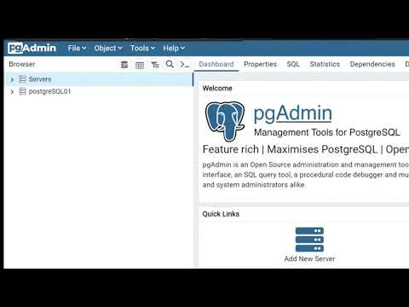

Slide 20
Conclusion
Azure Web App Service allows developers to conveniently deploy and publish web applications written by many coding languages on the Internet.
Though it has some disadvantages in terms of cost and limited using time, especially when the developer is a student.

Slide 21
THANK YOU FOR WATCHING
ANY QUESTIONS?

Slide 22
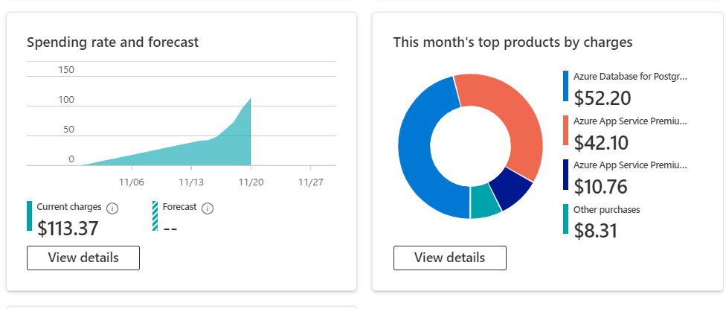
Phí tổn thất tinh thần

Slide 23
1. Operation of Web Application
Step 1
Step 2
The Web server sends this request to the Web App Server.
Step 3
The Web App Server executes the requested tasks and acquire data from Database Server.
Step 4
The Web App Server sends results back to the Web Server (according to the processed data)
Step 5
The Web Server responds requested tasks to the client (by network - connected devices)
Step 6
The requested information appears on user’s screen.
User makes a request to web server by connecting the Internet through the application's user interface.

Slide 24
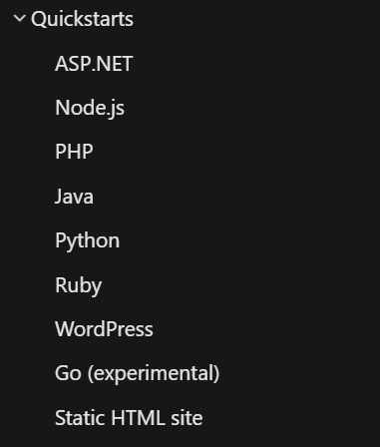
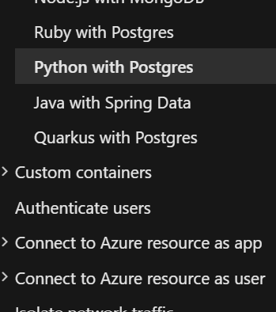
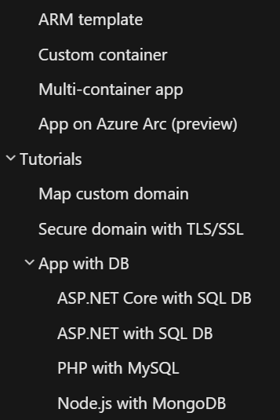

Slide 25
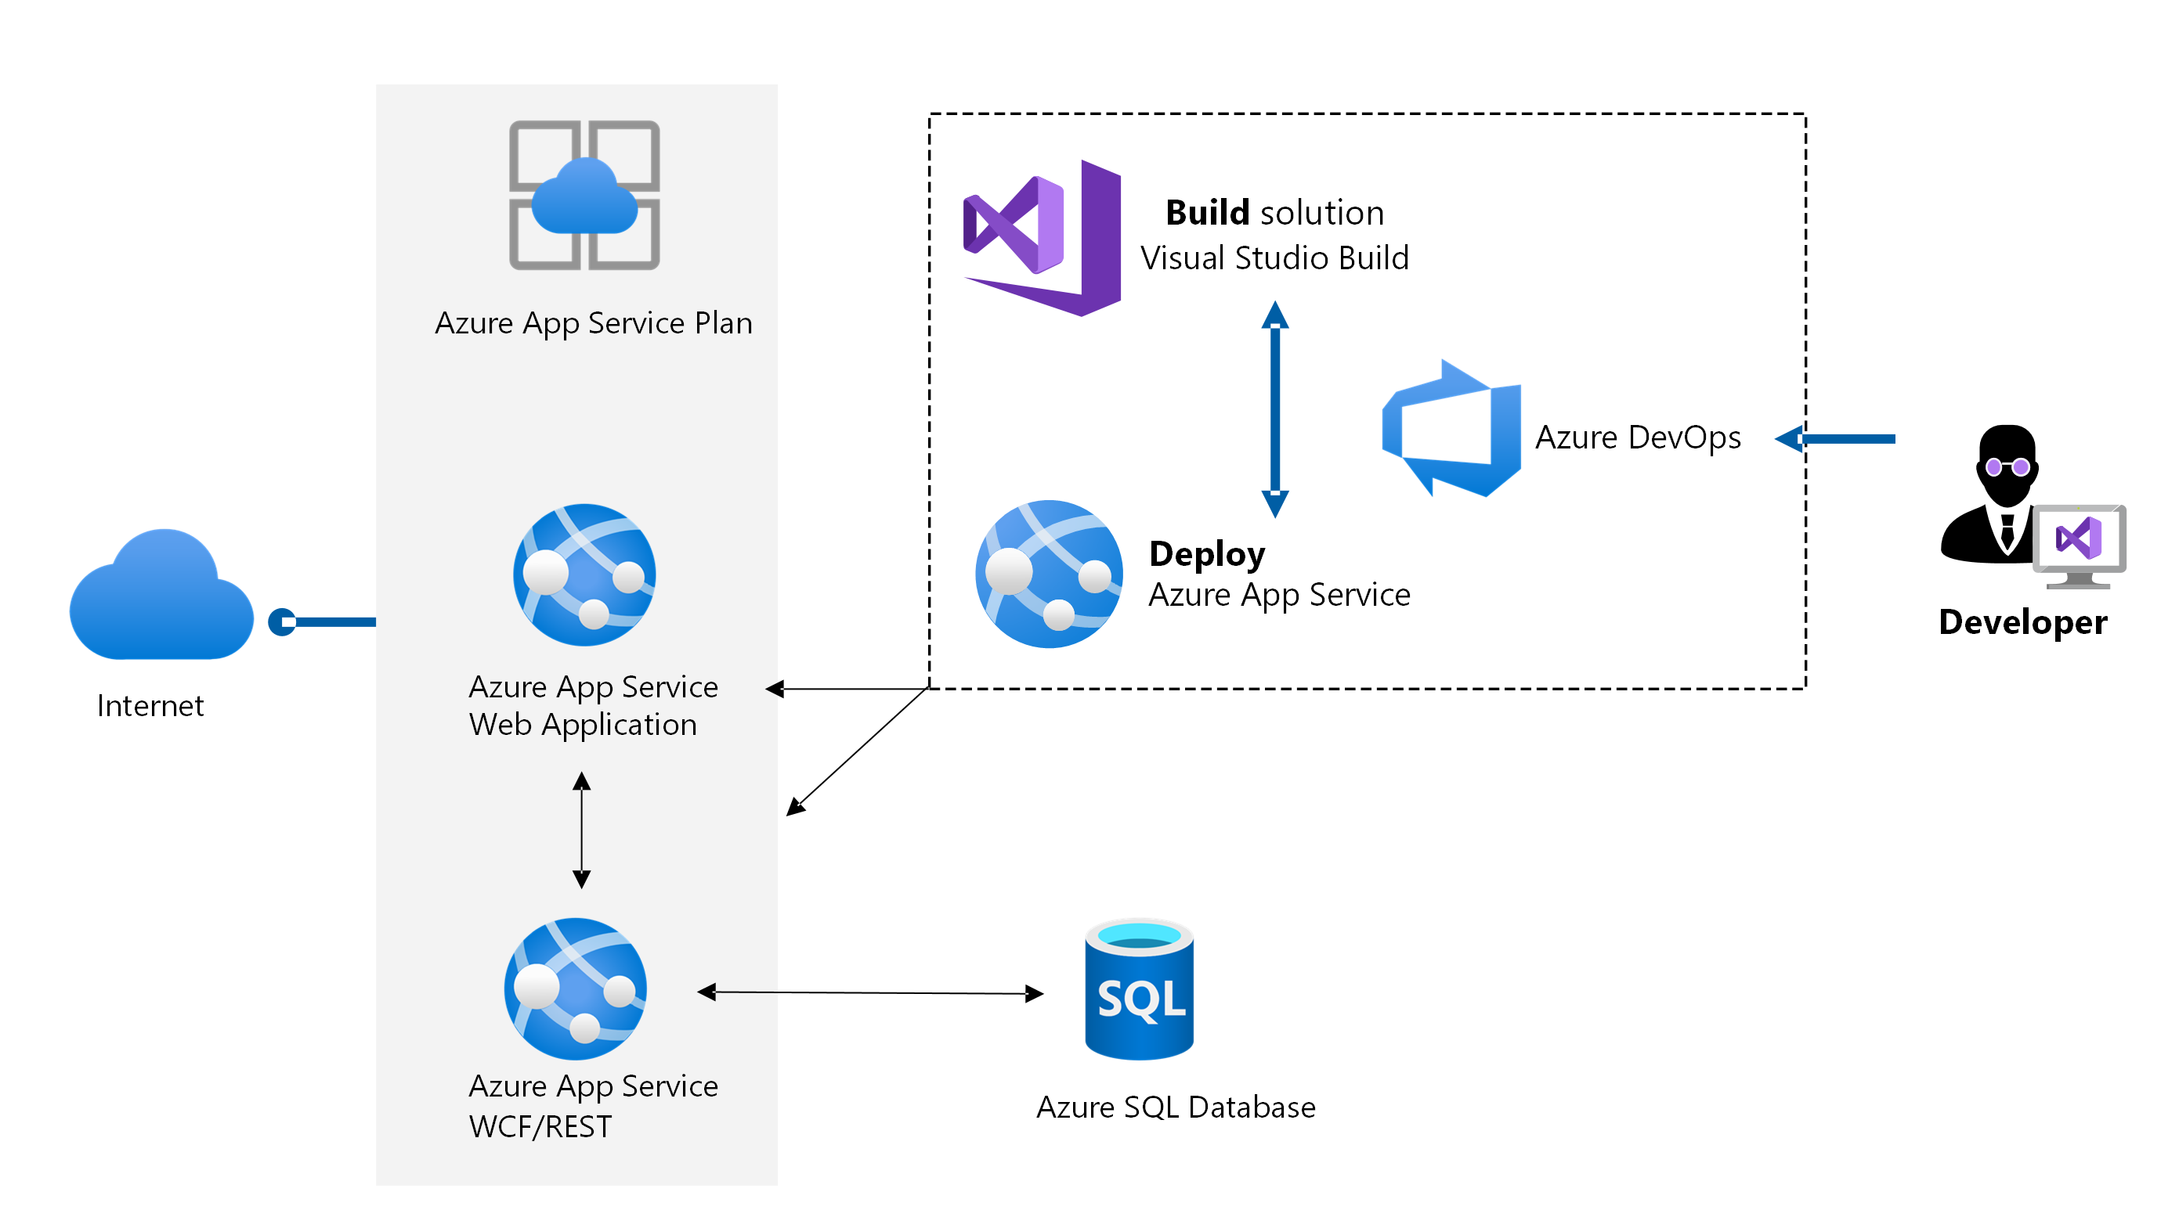





2. Diagram of fundamental components
1.2. Component
Notes:
The following structure will show the fundamental components of a basic Web Application.

Slide 26
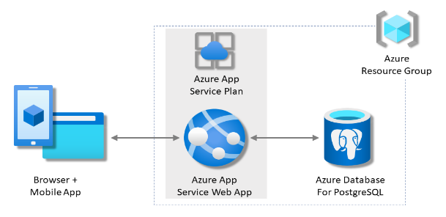
2.3. CONFIGURE
Web Application is deployed to model network with PostgreSQL database connection

