Slide 1

Using Machine Learning to Process and Analyze Ancient Biological Residues.
Korey Brownstein and Tung Nguyen

Slide 2
The problem

Slide 3
Our approach
Our approach is inspired by the field of Natural Language Processing. A quite general question in this field is: given a list of documents, how can we compare their pairwise similarity?
This idea is similar to how items (such as Amazon’s products) are recommended to buyers based on their historical data. Such an algorithm is often called a Recommender System.

Slide 4
How NLP works?
Words | D1 | D2
we | 1 | 1
love | 1 | 1
dogs | 1 | 1
they | 1 | 0
are | 1 | 0
smart | 1 | 0
animals | 0 | 2
our | 0 | 1
favorite | 0 | 1
is | 0 | 1
First, we need to transform each document into a vector so that computer can understand. The simplest way to do is to use word counts.
Let’s take an example.
1) We love dogs. They are smart.
2) We love animals. Our favorite animal is dog.

Slide 5
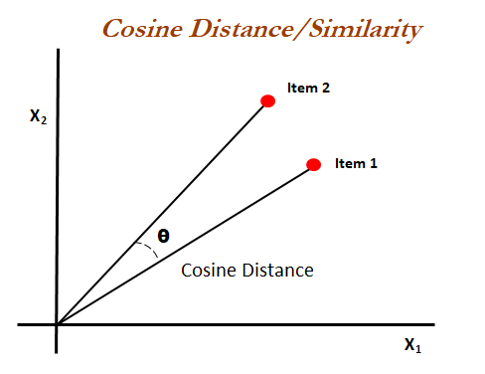
How NLP works?
We can use these vectors to compare their cosine-similarity.
Issue with this naïve approach: some words are more important than others!

Slide 6
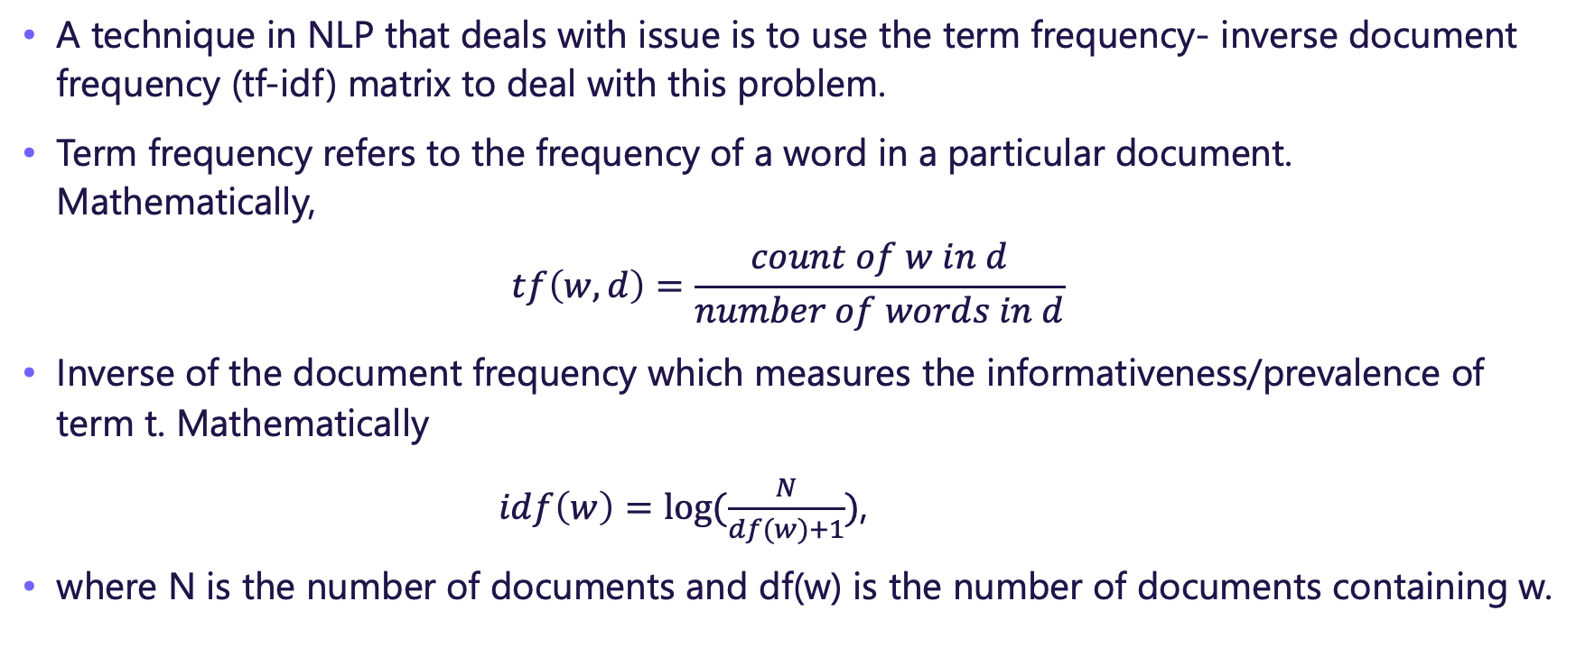
How NLP works?
A technique in NLP that deals with issue is to use the term frequency- inverse document frequency (tf-idf) matrix to deal with this problem.
Term frequency refers to the frequency of a word in a particular document. Mathematically,
$$tf\left(w,d\right)=\frac{count of w in d}{number of words in d}$$
Inverse of the document frequency which measures the informativeness/prevalence of term t. Mathematically
$idf\left(w\right)=log⁡(\frac{N}{df(w)+1})$,
where N is the number of documents and df(w) is the number of documents containing w.

Slide 7
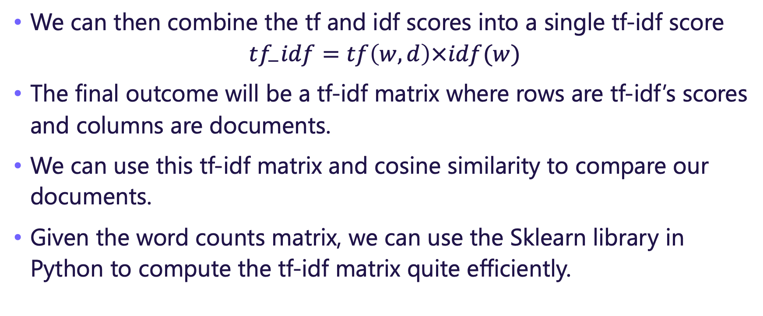
How NLP works?
We can then combine the tf and idf scores into a single tf-idf score
$$tf_{−}idf=tf\left(w,d\right)×idf(w)$$
The final outcome will be a tf-idf matrix where rows are tf-idf’s scores and columns are documents.
We can use this tf-idf matrix and cosine similarity to compare our documents.
Given the word counts matrix, we can use the Sklearn library in Python to compute the tf-idf matrix quite efficiently.

Slide 8
The analogy with our problem
We use the following analogy to approach our problem.
Documents <->Groups
Substance <-> Words
Need to add more but my understanding of biology is too limited to say something meaningful.

Slide 9
Results and comparison with the classical approach
Include the final outcome

Slide 10
Some potential limitations

