Slide 1
Post-correction: Increasing quantization performance with smart flipping

Slide 2
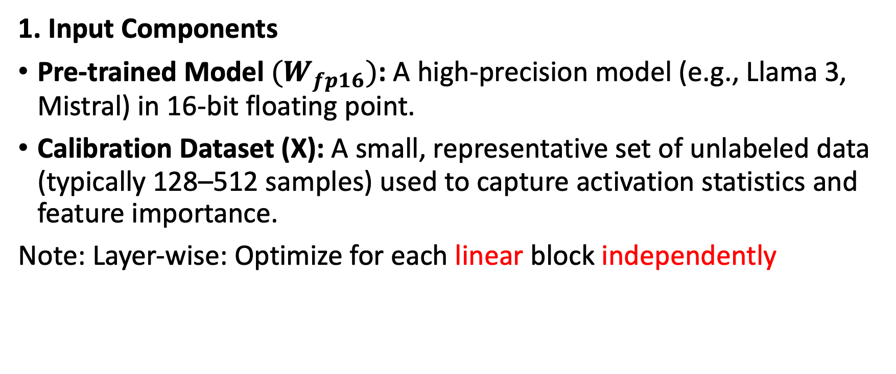
Weight-Only Layer-wise Post-Training Quantization
1. Input Components
Pre-trained Model $(W_{fp16})$: A high-precision model (e.g., Llama 3, Mistral) in 16-bit floating point.
Calibration Dataset (X): A small, representative set of unlabeled data (typically 128–512 samples) used to capture activation statistics and feature importance.
Note: Layer-wise: Optimize for each linear block independently

Slide 3
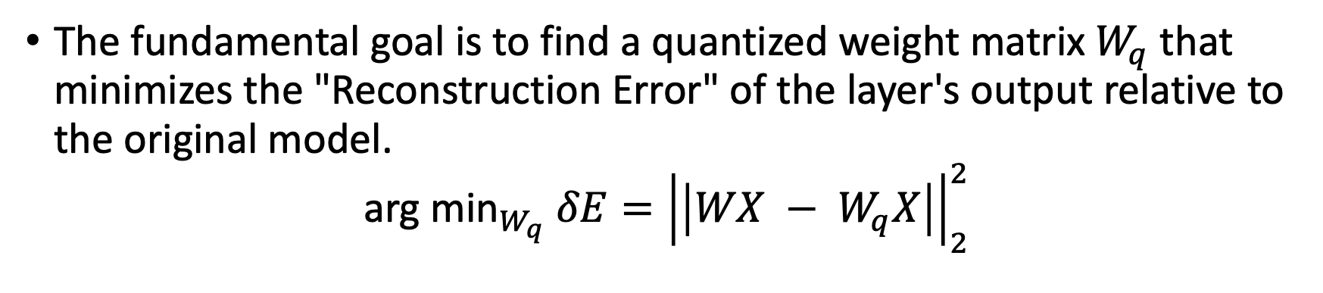
Objective function
The fundamental goal is to find a quantized weight matrix $W_{q}$that minimizes the "Reconstruction Error" of the layer's output relative to the original model.
$${\text{arg} \text{min}}_{W_{q}} {δE=\left|\left|{WX − W}_{q}X\right|\right|}_{2}^{2}$$
W
X
I
N
N
x
I
=
O
O
out_feature (O) x inp_feature (I)
inp_feature (I) x samples (N)
Note: out_feature dim: are normally consider independently

Slide 4
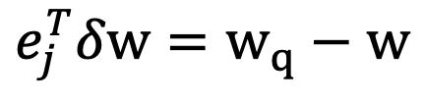

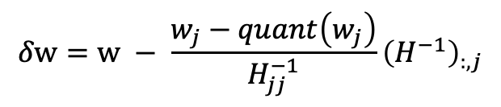
GPTQ
Approximate error, assuming first order error = 0
$$δE=\frac{1}{2}δw^{T}Hδw$$
With constraint:
$$e_{j}^{T}δw=w_{q}−w$$
Leading to the update (to the original weight)
$$δw=w − \frac{w_{j}−quant\left(w_{j}\right)}{H_{jj}^{−1}}{\left(H^{−1}\right)}_{:,j}$$
GPTQ: Accurate Post-Training Quantization for Generative Pre-trained Transformers,
https://arxiv.org/abs/2210.17323

Slide 5

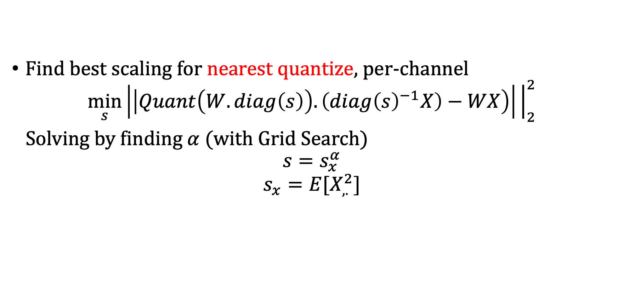
AWQ
Find best scaling for nearest quantize, per-channel
$$\min_{s}\left|\left|Quant\left(W.diag\left(s\right)\right).\left(diag{\left(s\right)}^{−1}X\right)−WX\right)\right|{\left.​\right|}_{2}^{2}$$
Solving by finding $α$(with Grid Search)
$$s=s_{x}^{α}$$
$$s_{x}=E[X_{,.}^{2}]$$
Input x larger is more important
So upscale the weight for large channel -> Reduce the error
$$error:x\left(w−w_{q}\right)$$
Simple, but better than GPTQ
AWQ: Activation-aware Weight Quantization for LLM Compression and Acceleration
https://arxiv.org/abs/2306.00978

Slide 6
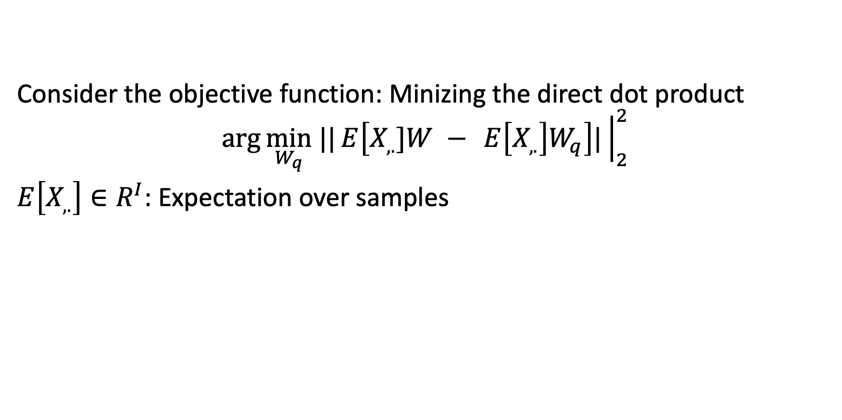
Smart Flipping (Ours)
Consider the objective function: Minizing the direct dot product
$$\arg{\min_{W_{q}} ||{E\left[{X_{,.}]W − }_{ }E\left[X_{,.}\right]W_{q}\right]|{\left.​\right|}_{2}^{2}}}$$
$E\left[X_{,.}\right]∈R^{I}$: Expectation over samples

Slide 7






Fast (Heuristics) Algorithm
Given $W_{q}$ be a quantization solution of some algorithm (e.g. nearest quantize, or AWQ), we will find a flipping strategy to change the quantize value to directly reduce the dot product error
$$w$$
Change absolute error by: $∆r$|x|
Nearest rouding
Flipped rouding
$${w_{q}}_{1}$$
$${w_{q}}_{2}$$
Resolution $∆r$

Slide 8
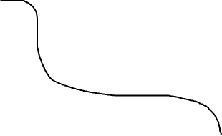
The distribution of |x|
Protected area: Big inputs are too sensitive
Use to find the indices’ of weight to consider
To flip
Flipping Candidate area (p%)
Morderate inputs
Magnitude
Sorted indices
Knee point
Number of the inp_feature dimension (I)

Slide 9
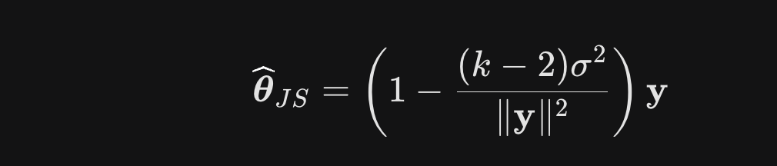
Using James-Stein Mean Estimation
The Problem: In high dimensions (k>=3), the standard Maximum Likelihood Estimator (MLE) is "inadmissible”, meaning there is always a better way to estimate the mean.
The Solution: By pulling all estimates toward a central point (usually zero), we reduce the total Mean Squared Error (MSE), even if the individual parameters are unrelated.

Slide 10
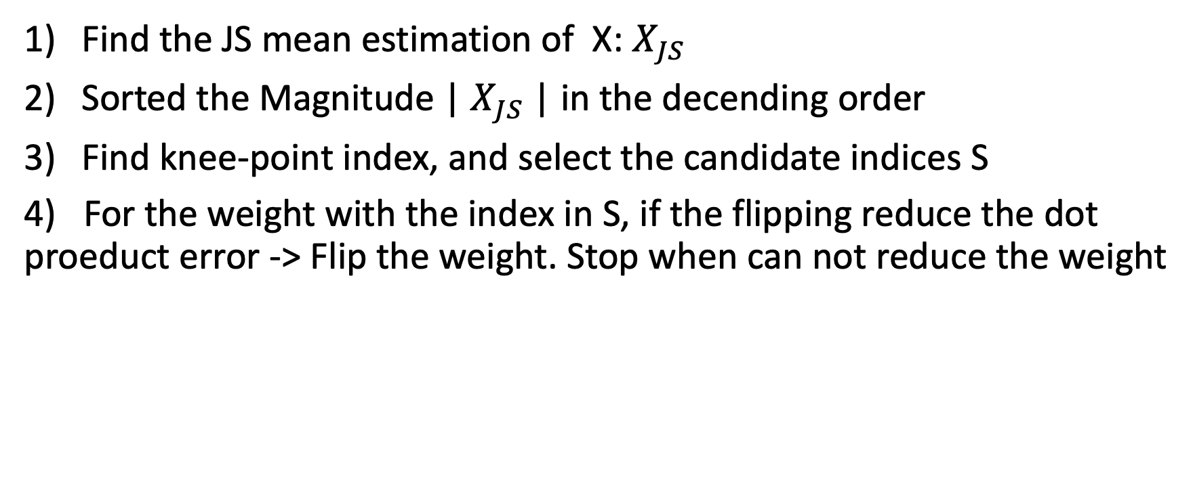
The procedure
Find the JS mean estimation of X: $X_{JS}$
Sorted the Magnitude | $X_{JS}$| in the decending order
Find knee-point index, and select the candidate indices S
4) For the weight with the index in S, if the flipping reduce the dot proeduct error -> Flip the weight. Stop when can not reduce the weight

Slide 11
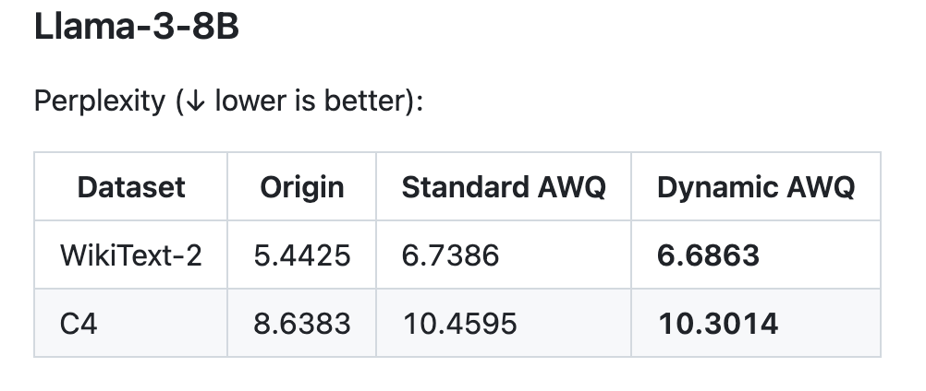
Performance

