Slide 1
DevOps Training

Slide 2
Contents
Introduction DevOps in FSOFT
DevOps Tool Chains
DevOps System
DevOps Flow
Guideline
GitLab
Jenkins Pipeline
Sonarqube
Blackduck
Coverity
Repository
Case study

Slide 3
Introduction DevOps in FSOFT

Slide 4
DevOps in FSOFT

Slide 5

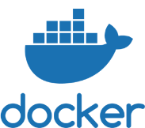








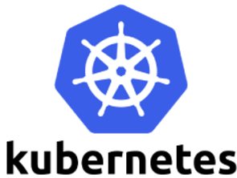















DevOps Tool Chains
Plan
Package
Code
Deploy
Orchestration
Build
Security
Source
Analysis
Operation
Test
Monitor & Analysis

Slide 6
DevOps System

Slide 7
DevOps Flow – Continues Integration (CI)

Slide 8
DevOps Flow – Continues Delivery (CD)

Slide 9
Guideline

Slide 10
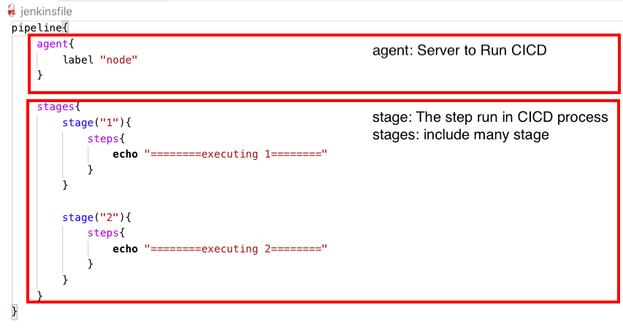
Jenkins Pipeline basic

Slide 11
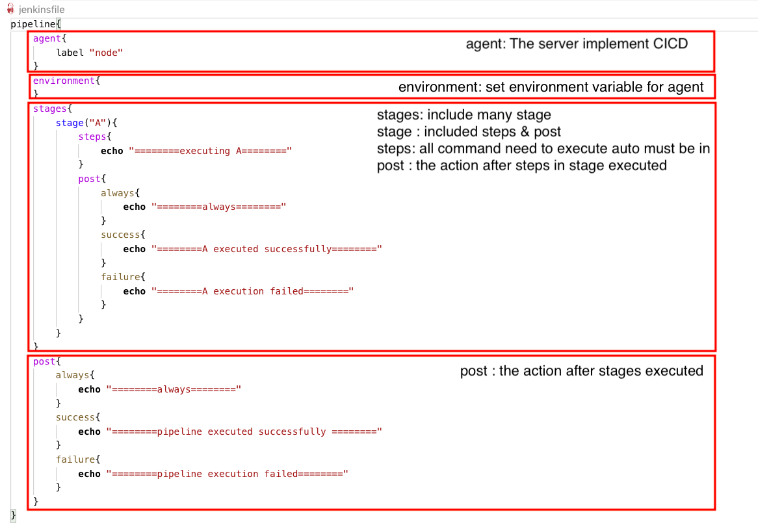
Jenkins Pipeline

Slide 12
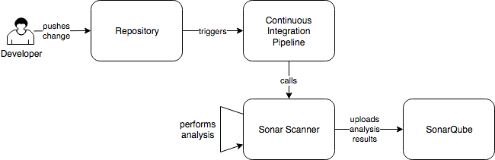
Sonarqube – What/ How ?
SonarQube is one of many static code analysis tools
SonarQube Server: https://sonar.fsoft.com.vn
Sonar Scanner : Set up on Client , support 20+ languages
Sonar-project.properties : is Config file which define option scan for sonar-scanner
How does it work?

Slide 13
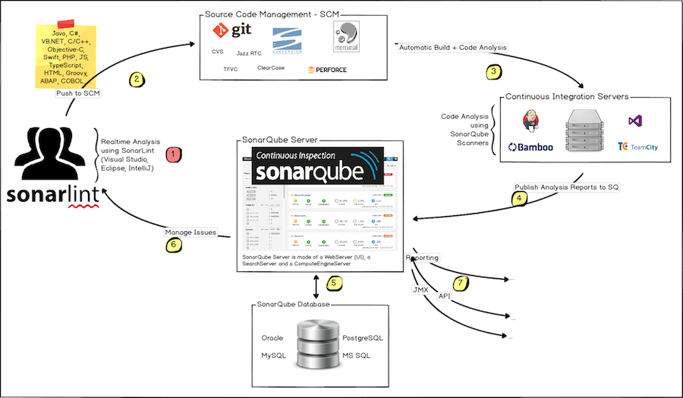
Sonarqube for Developer

Slide 14
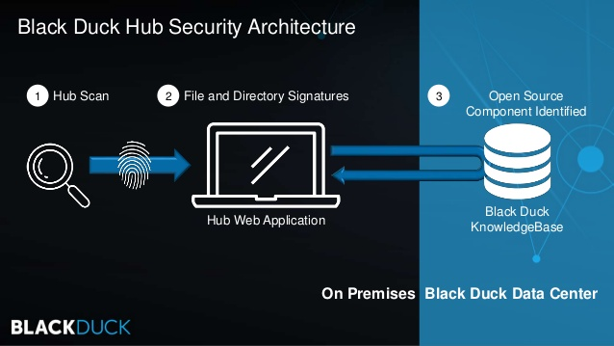
BlackDuck

Slide 15
Coverity

