Slide 1

Happiness and coordinate correction
latest_customer_review
is_happy_customer
sia = SentimentIntensityAnalyzer()
scores = sia.polarity_scores(review)
scores['compound'] >= 0.05
27 observations
coordinates
distance_to_nearest_warehouse
haversine_distance > 1000 km
and distance_to_nearest_warehouse != haversine_distance
27 swapped coordinates

Slide 2
Shopping cart and order price correction
shopping_cart
order_price
coupon_discount
Based on corrected rows calculate prices of every brand using np.linalg.solve()
delivery_charges
order_total
prices
If order price calculated from shopping cart != order_price and order_total != order_price*(1-coupon_discount/100) + delivery_charges
If order price calculated from shopping cart != order_price and order_total == order_price*(1-coupon_discount/100) + delivery_charges
27 order price correction
true value = (order_total -delivery_charges) / *(1-coupon_discount/100)
27 shopping_cart correction
by selecting the correct brand names in the shopping cart

Slide 3
Nearest warehouse and distance correction
coordinates
distance_to_nearest_warehouse
nearest_warehouse
distance_to_nearest_warehouse != haversine_distance
27 corrected distances
If based on haversine_distance the nearest warehouse is different + spelling of nearest warehouse errors
27 corrected nearest_warehouse
Assumption: if the error is not in the distance, but in the coordinates, then we do not have enough data to correct the coordinates, since there are an infinite number of possibilities. In this case, we believe that the error is in the distance.

Slide 4
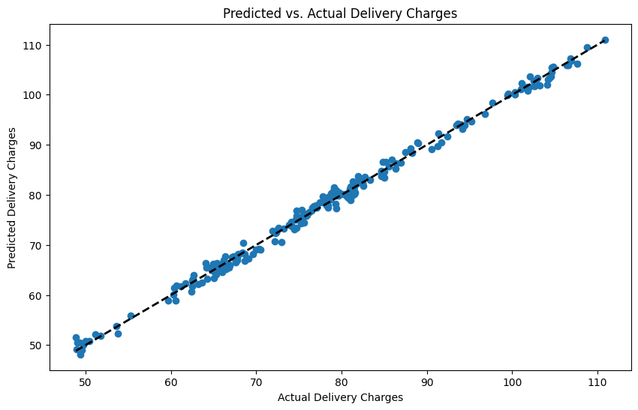
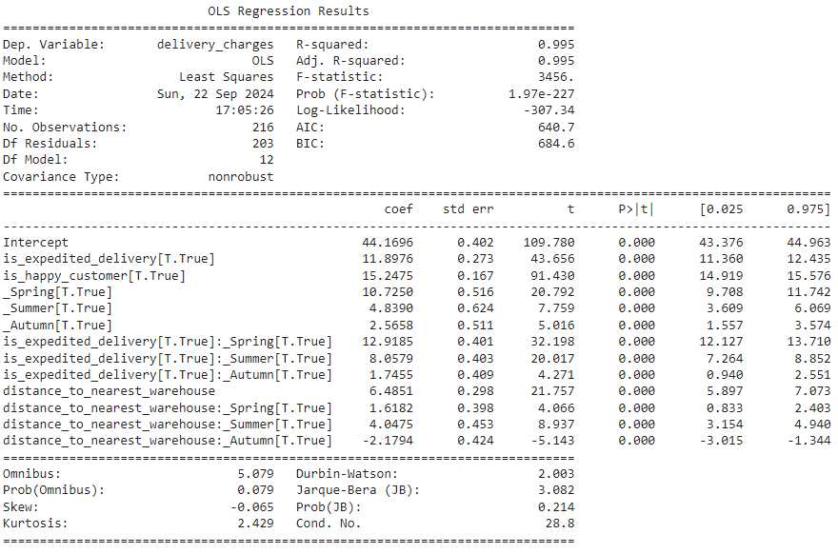
Delivery charges calculation
Based on corrected rows find the delivery charges calculation rule

Slide 5
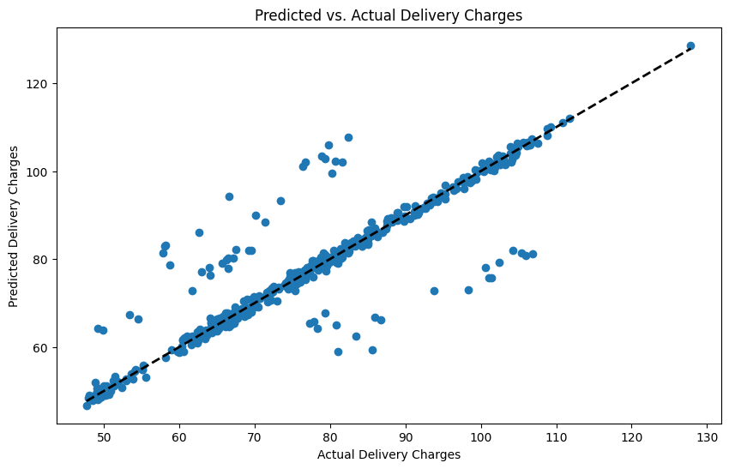
Date and season correction
Date
season
Misspelling of season
27 date-format corrections
+ Mismatching date and season
+ Outlier on the delivery charges regression
27 season corrections
Assumption: 1. We don't have enough data to identify errors like replacing 2019-01-12 with 2019-12-01, so we assume there are no such errors.
2. When dates like 02-12-2019 we cannot say with accuracy which is the month and which is the day, so we assume that all errors of this kind are day-month-year (this is consistent with other observations where the month can be determined by the season)

Slide 6
Is expedited delivery and order total correction
is_expedited_delivery
order_total
delivery_charges
If order_total != order_price*(1-coupon_discount/100) + delivery_charges but delivery_charges is not outlier
27 order_total corrections
54 is_expedited_delivery corrections
If delivery_charges is outlier and we corrected all other possible errors then only is expedited_delivery can be wrong

Slide 7
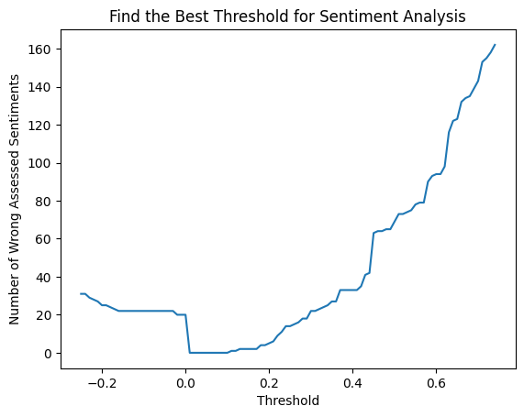
Missing happiness, distance or warehouse
latest_customer_review
is_happy_customer
sia = SentimentIntensityAnalyzer()
scores = sia.polarity_scores(review)
scores['compound'] >= optimal_threshold
40 observations
coordinates
distance_to_nearest_warehouse
nearest_warehouse
haversine_distance
31 observations
nearest warehouse based on haversine_distance
55 observations

Slide 8
Missing order price, order_total and delivery_charges
shopping_cart
delivery_charges
order_total
Based on filled rows calculate prices of every brand using np.linalg.solve()
order_total = order_price*(1-coupon_discount/100) + delivery_charges
15 observations
prices
Based on prices and shopping_cart we can calculate order_price
15 observations
40 observations
delivery_charges = order_total - order_price*(1-coupon_discount/100)
order_price
coupon_discount

Slide 9
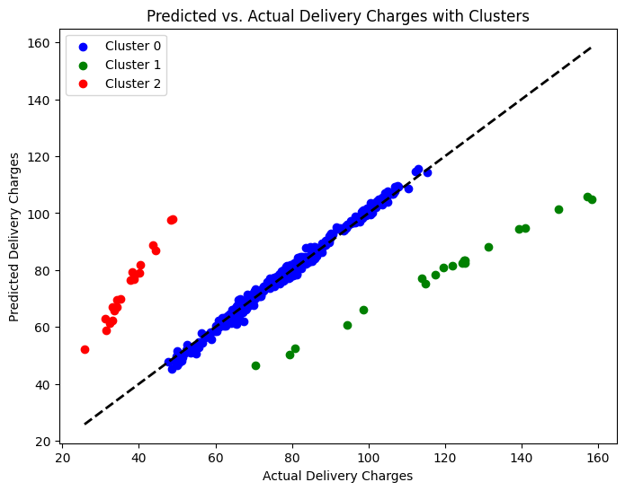
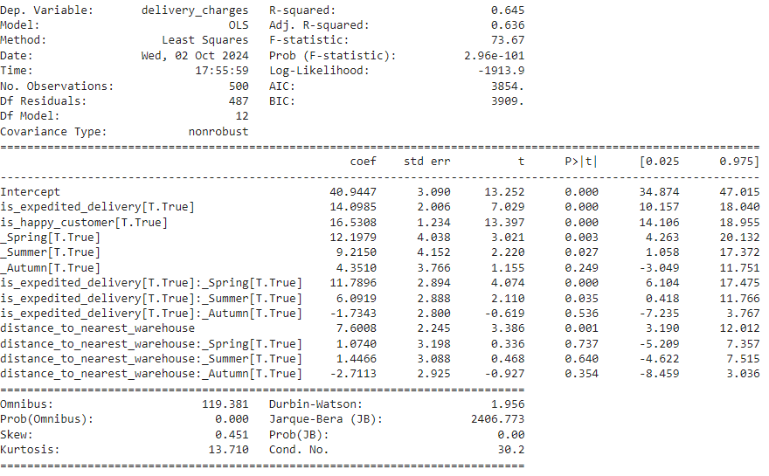
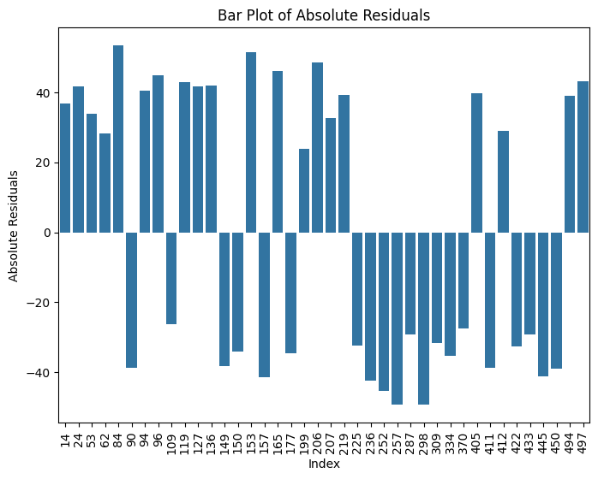
Outliers
Criteria: residual for observation > 3 sigmas
40 outliers

