Slide 1
Equality handling and efficiency improvement of SMT for non-linear constraints over reals.
Vu Xuan Tung – Ogawa lab - JAIST

Slide 2
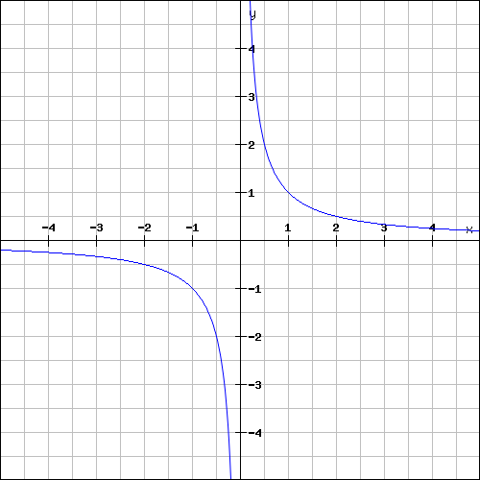
Polynomial constraints over reals

Slide 3
Polynomial constraints over reals
Polynomial constraints solving has applications in:
Automatic termination proving.
Roundoff error and overflow error analysis.
Loop Invariant generation.
Discovering inductive invariants in hybrid systems.

Slide 4
Polynomial constraints over reals
In 1930, Tarski: polynomial constraints is decidable
Methods:
QE-CAD: complete but DEXP complexity.
Interval constraint propagation: ISAT uses interval arithmetic (IA) only, ability of solving SAT problem is limited.
Bit-blasting: (UCLID, MiniSmt) suffers with high number of variables or high degree of polynomials.
Linearization: suffers with high degree of polynomials (Barcelogic, CORD).
Virtual substitution: Z3, SMT-RAT. Needs root formulas of polynomial
➔ degree <= 5
raSAT: IA + testing

Slide 5
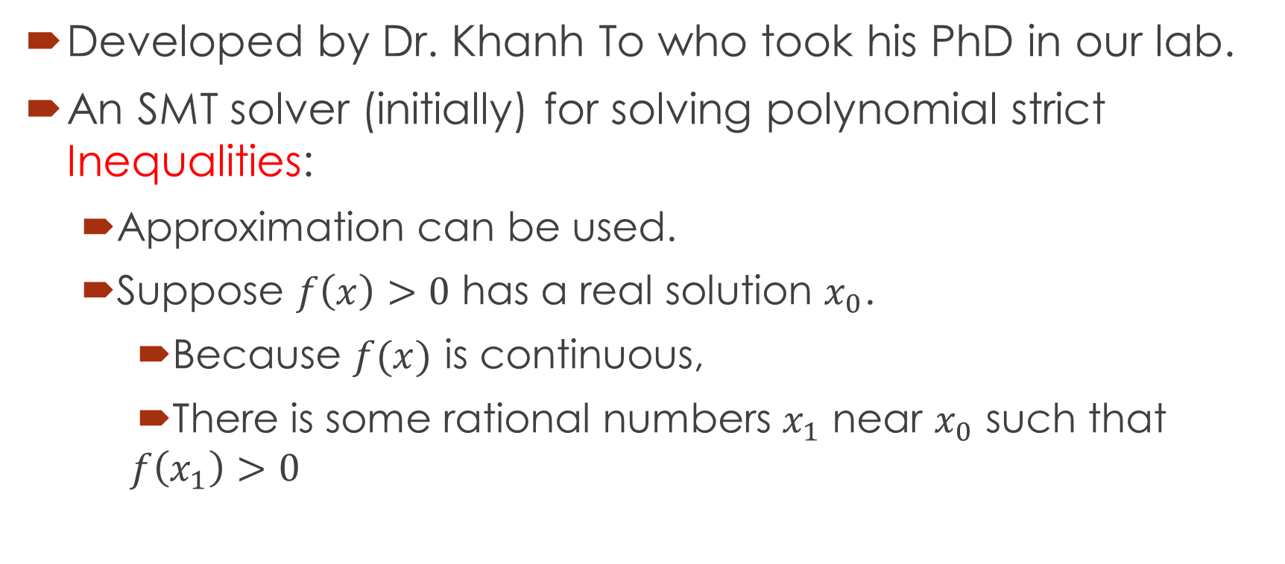
raSAT
Developed by Dr. Khanh To who took his PhD in our lab.
An SMT solver (initially) for solving polynomial strict Inequalities:
Approximation can be used.
Suppose $f\left(x\right)>0$ has a real solution $x_{0}$.
Because $f(x)$ is continuous,
There is some rational numbers $x_{1}$ near $x_{0}$ such that
$$f\left(x_{1}\right)>0$$

Slide 6
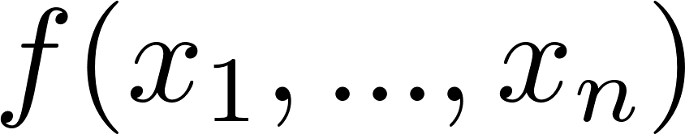
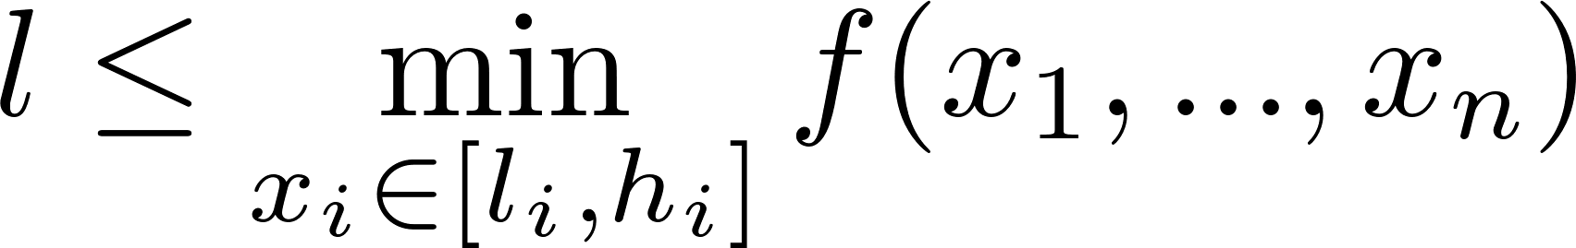
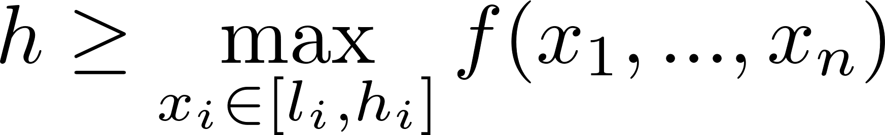
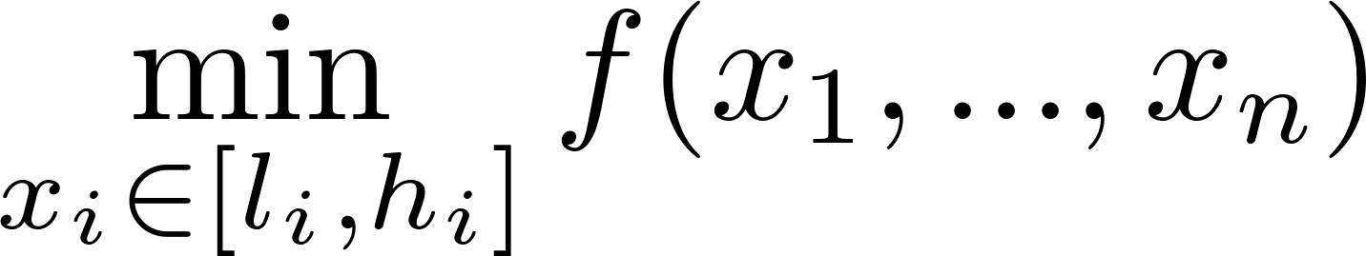
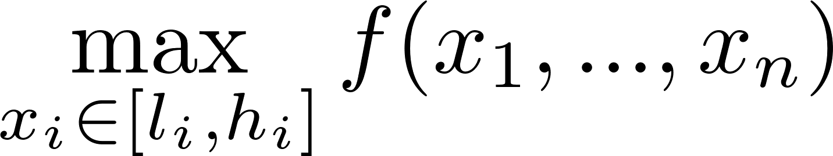

Over approximation - Interval arithmetic (IA)
Input:
Output: [l, h] such that:
l
h

Slide 7


Over approximation
l
h
IA-UNSAT
IA-VALID
l
h
IA-UNKNOWN
l
h

Slide 8
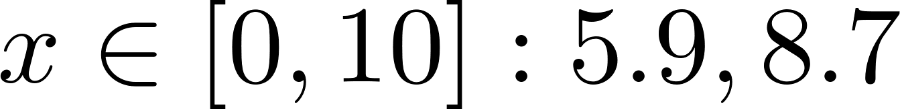
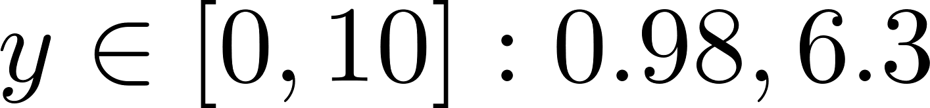
Under approximation - Testing
Randomly generate values (within the intervals) for variables.
Check the generated values against constraints.
If constraints satisfied (TEST-SAT) by some test case, such test case is returned.
Otherwise (TEST-UNSAT), decomposing intervals.

Slide 9
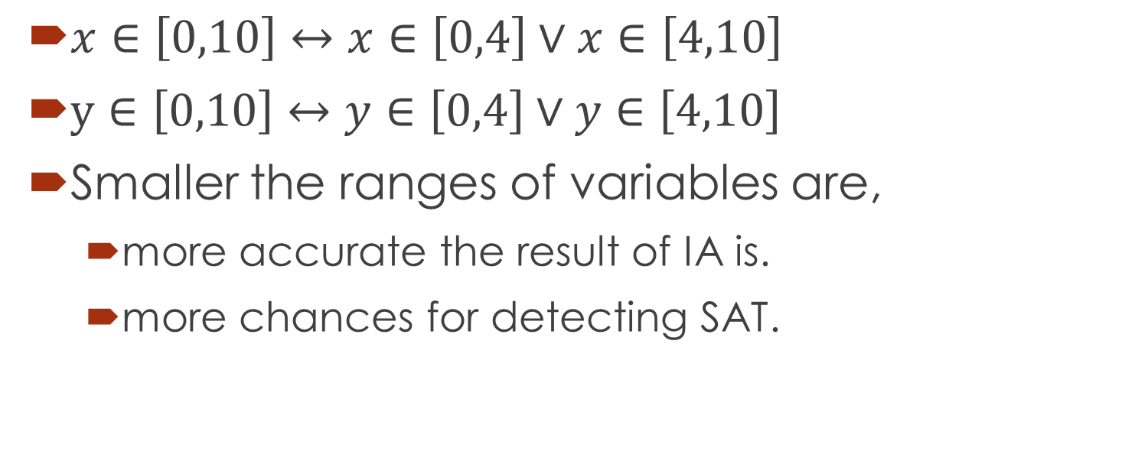
Decomposition
$x∈\left[0,10\right]↔x∈\left[0,4\right]∨x∈\left[4,10\right]$
$y∈\left[0,10\right]↔y∈\left[0,4\right]∨y∈\left[4,10\right]$
Smaller the ranges of variables are,
more accurate the result of IA is.
more chances for detecting SAT.

Slide 10

$$Constraints$$
raSAT
Yest
Threshold - Unknown
NO
SAT solver
UNSAT/
Unknown
Learn conflicts
Theory solver
Refined clauses
YES
IA-UNSAT
Interval Arithmetic
US Core
Refinement
IA-UNKNOWN
IA-VALID
Test-UNSAT
Testing
TEST-SAT
SAT

Slide 11
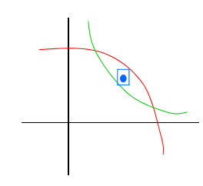
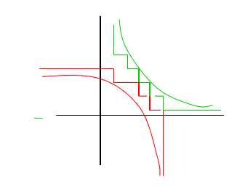
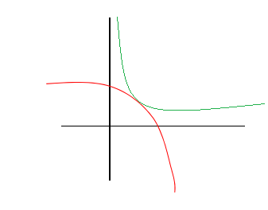
Completeness (strict inequality)
raSAT eventually detects SAT
UNSAT detected
UNSAT failed

Slide 12
raSAT
In this work:
Improve the efficiency of raSAT.
Handle equality.
Handle polynomial constraints over Integer (QF_NIA).

Slide 13
Problems

Slide 14

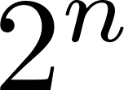
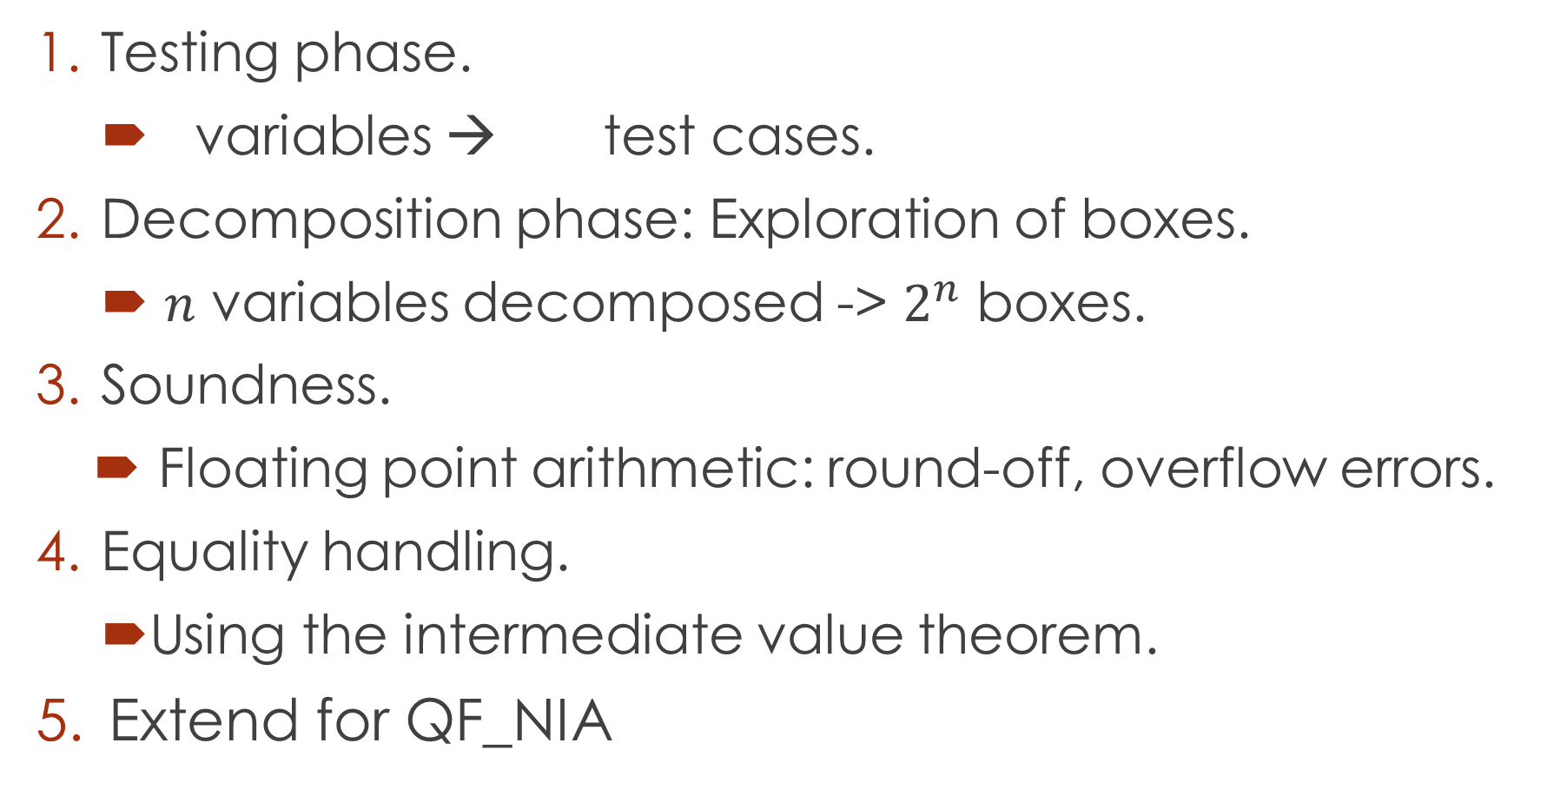
Problems
Testing phase.
variables → test cases.
Decomposition phase: Exploration of boxes.
$n$ variables decomposed -> $2^{n}$ boxes.
Soundness.
Floating point arithmetic: round-off, overflow errors.
Equality handling.
Using the intermediate value theorem.
Extend for QF_NIA

Slide 15
Current status

Slide 16
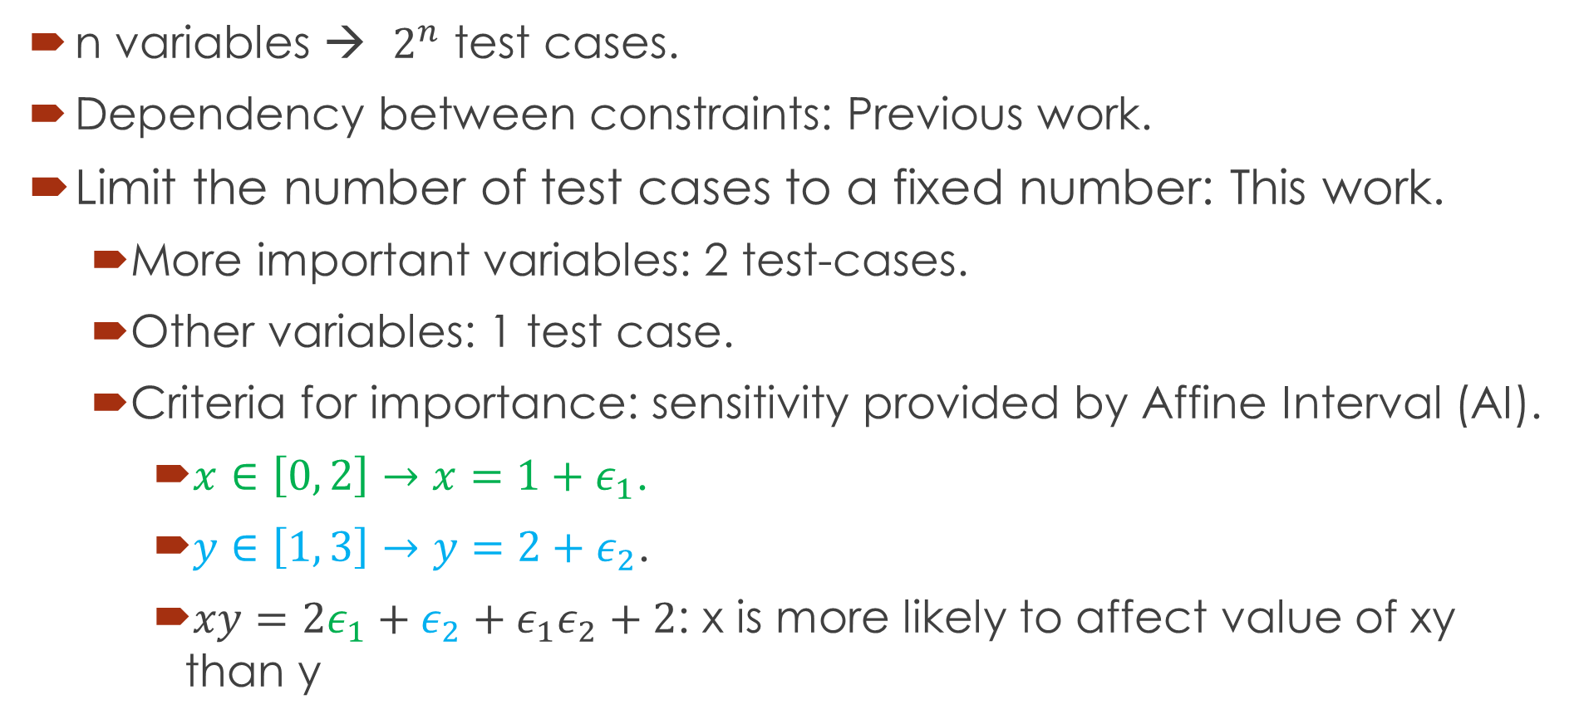
1. Testing phase
n variables → $2^{n}$ test cases.
Dependency between constraints: Previous work.
Limit the number of test cases to a fixed number: This work.
More important variables: 2 test-cases.
Other variables: 1 test case.
Criteria for importance: sensitivity provided by Affine Interval (AI).
$x∈\left[0, 2\right]→x=1+ε_{1}$.
$y∈\left[1, 3\right]→y=2+ε_{2}$.
$xy=2ε_{1}+ε_{2}+ε_{1}ε_{2}+2$: x is more likely to affect value of xy than y

Slide 17
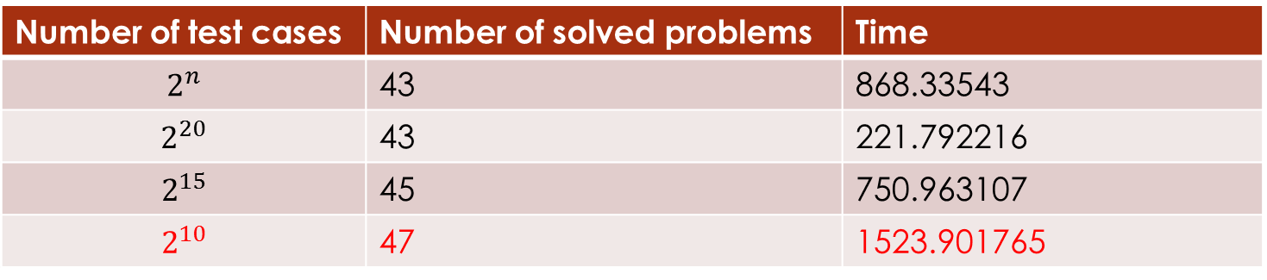
1. Testing phase - Experiments
Number of test cases | Number of solved problems | Time
$$2^{n}$$ | 43 | 868.33543
$$2^{20}$$ | 43 | 221.792216
$$2^{15}$$ | 45 | 750.963107
$$2^{10}$$ | 47 | 1523.901765

Slide 18
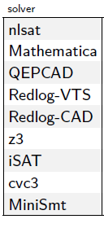
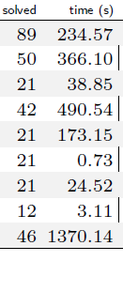

2. Decomposition
Boxes exploration.
$n$ variables decomposed -> $2^{n}$ boxes.
Limit the number of variables to be decomposed based on sensitivity:
Time out = 500 s
Time out = 900 s
Number of vars decomposed. | Number of solved problems. | Time
all | 47 | 1523.901765
1 | 50 | 1695.125339
2 | 47 | 2215.54318
3 | 45 | 787.156501
4 | 46 | 436.340371
5 | 47 | 458.867299

Slide 19
3. SAT, UNSAT verification
Round-off, overflow errors can make the result unsound.
iRRAM:
C++ package
Error-bounded real arithmetic
Integrated iRRAM into raSAT for SAT verification.
Future work: Verify UNSAT results
Improve UNSAT core.

Slide 20
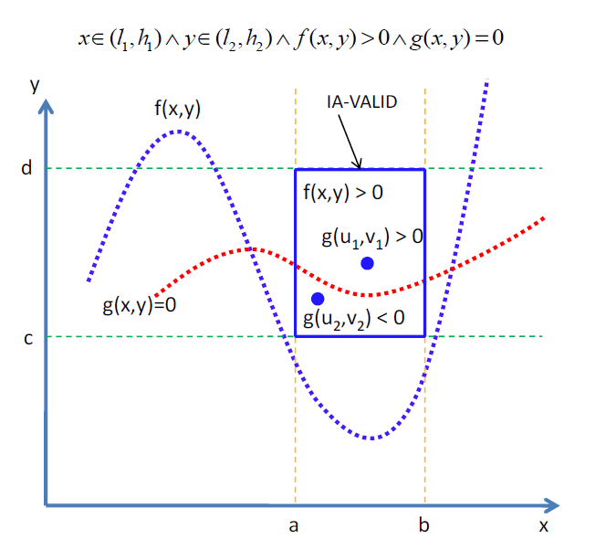
5. Equality handling.
Intermediate value
theorem
Single equality:
Done in previous
work.

Slide 21
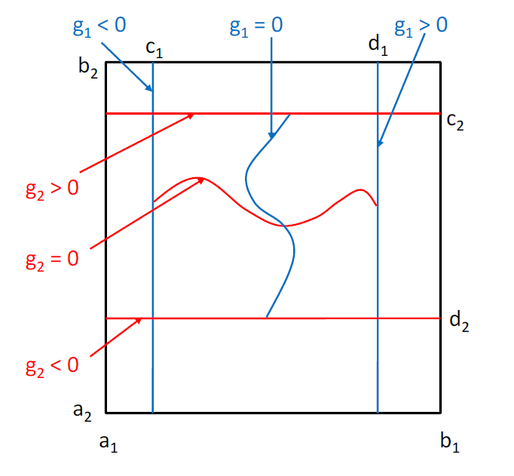

5. Equality handling.
Intermediate value
theorem
Multiple equalities:
Number of
variables $>$ number
of equations
To be done.

Slide 22
6. QF_NIA

Slide 23
Thank you for your attention

Slide 24
Doctor course Proposal

Slide 25
Problems.
Equality extension: Grobner basis.
UNSAT proof generation

Slide 26
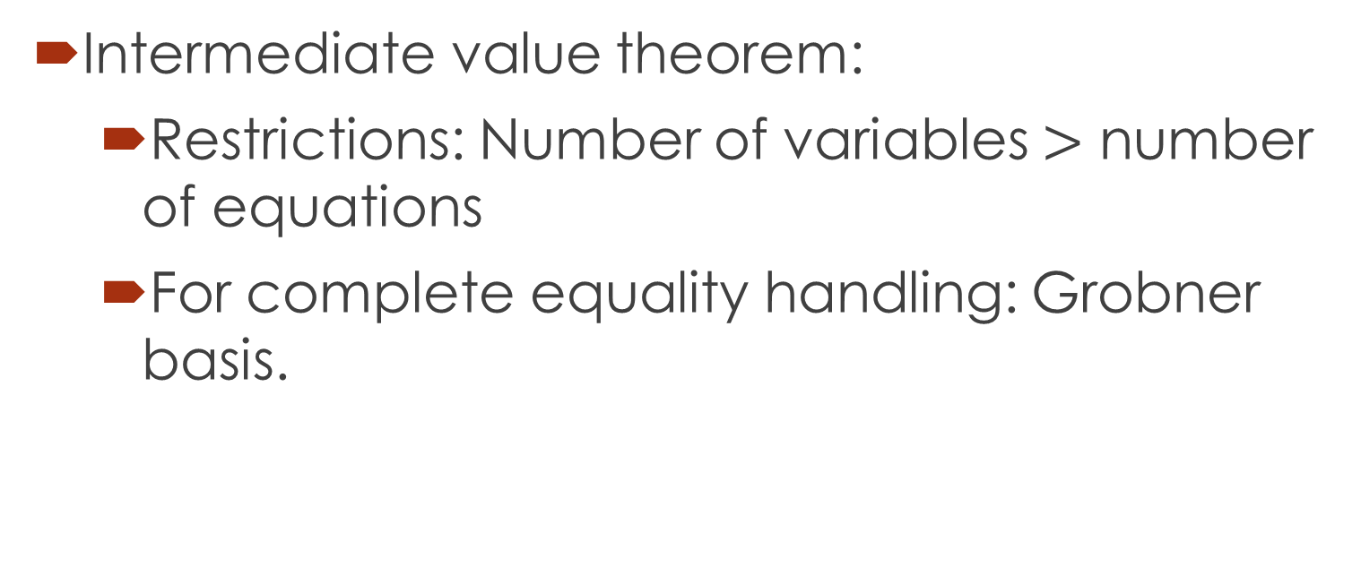
1. Equality extension: Grobner basis.
Intermediate value theorem:
Restrictions: Number of variables $>$ number of equations
For complete equality handling: Grobner basis.

Slide 27
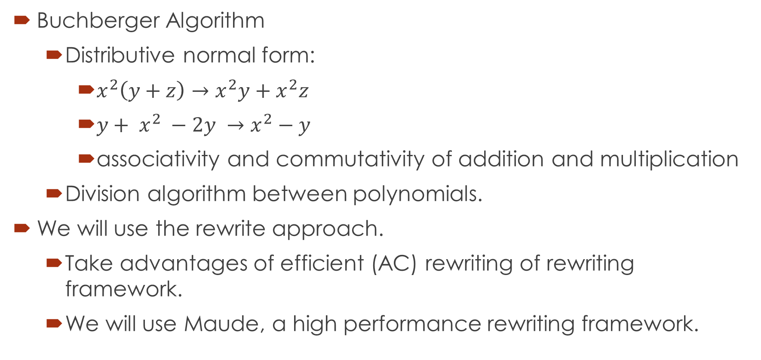
1. Equality extension: Grobner basis.
Buchberger Algorithm
Distributive normal form:
$x^{2}\left(y+z\right)→x^{2}y+x^{2}z$
${y+ x}^{2} −2y →x^{2}−y$
associativity and commutativity of addition and multiplication
Division algorithm between polynomials.
We will use the rewrite approach.
Take advantages of efficient (AC) rewriting of rewriting framework.
We will use Maude, a high performance rewriting framework.

Slide 28
1. Equality extension: Grobner basis.
Maximal completion:
Gradually extend the equations set.
For each step:
Generate terminating TRSs that uses maximal number of equations in the set.
Check if there exist a complete system for the original set.
Yes: Return the complete system
No: Add un-joinable pairs to the equations set.
MaxComp?

Slide 29
2. UNSAT proof generation
Proof of UNSAT can be used to extract Craig interpolants.
Abstraction refinement.
Invariant generation.
Most of the current works focus on Linear Arithmetic.
Not much research on interpolants of polynomial constraints.
Such interpolants arise during verification of complex systems such as hybrid ones.

Slide 30
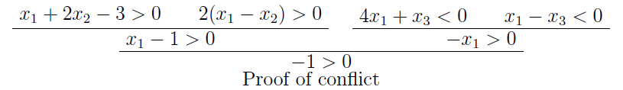
Related works
MATHSAT supports interpolation over Linear arithmetic.
Theory solver generates proofs for conflict clauses.
SAT solver generates resolution proof of unsatisfiability.
Resolution rule:
Interpolants are extracted from the above proofs.
CSIsat also support interpolants of LA constraints.

Slide 31
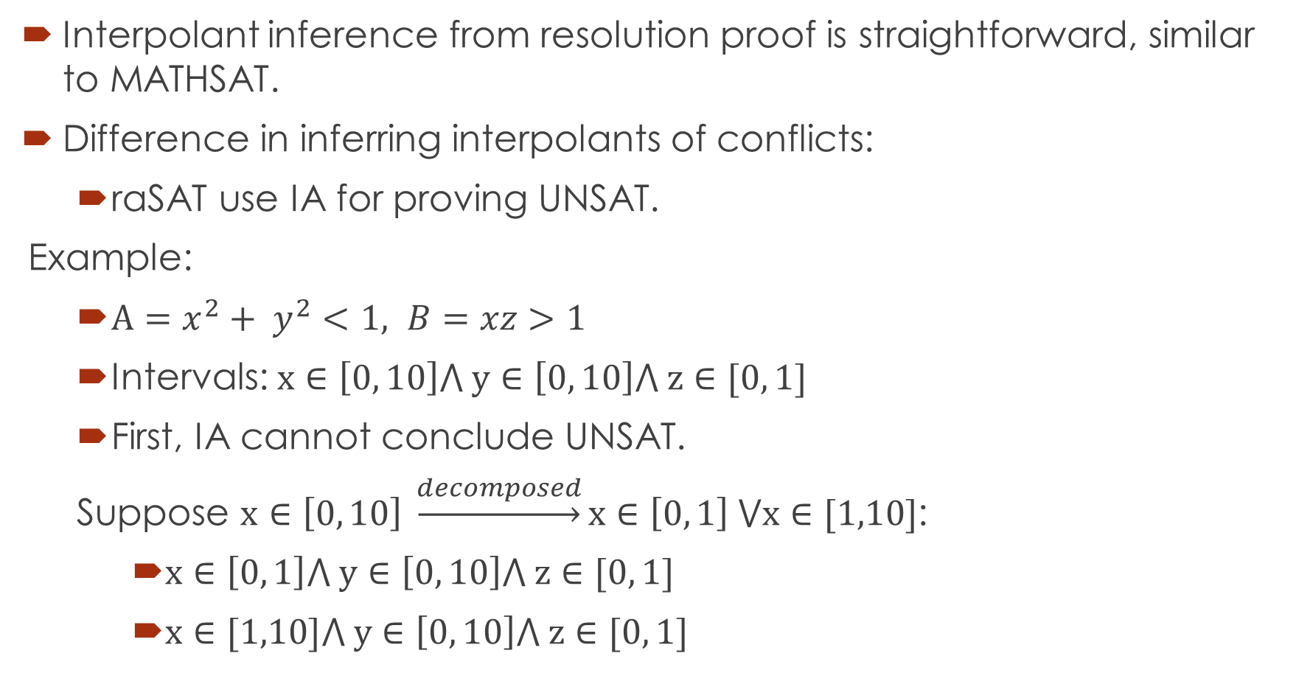
Primary idea
Interpolant inference from resolution proof is straightforward, similar to MATHSAT.
Difference in inferring interpolants of conflicts:
raSAT use IA for proving UNSAT.
Example:
$A=x^{2}+ y^{2}<1, B=xz>1$
Intervals: $x∈\left[0, 10\right]⋀ y∈\left[0, 10\right]⋀ z∈[0, 1]$
First, IA cannot conclude UNSAT.
Suppose $x∈\left[0, 10\right] \underset{→}{decomposed}x∈\left[0, 1\right] ⋁x∈[1,10]$:
$x∈\left[0, 1\right]⋀ y∈\left[0, 10\right]⋀ z∈[0, 1]$
$x∈[1,10]⋀ y∈\left[0, 10\right]⋀ z∈[0, 1]$

Slide 32
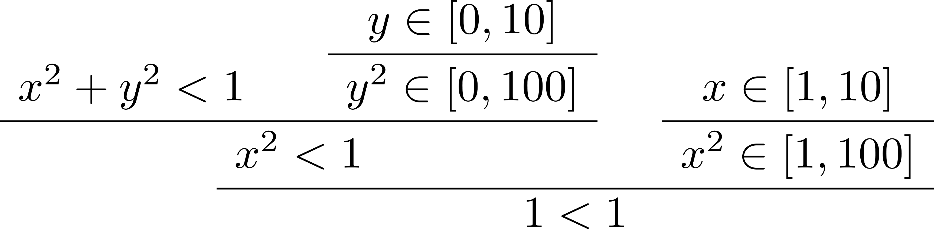
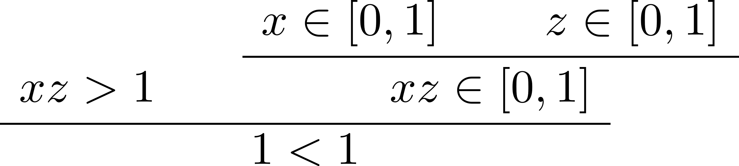

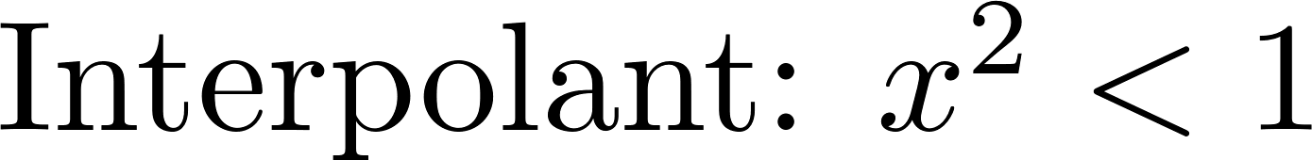


$$A=x^{2}+ y^{2}<1, B=xz>1$$
From resolution proof, we can infer as final interpolant

Slide 33
Thank you for your attention

