Slide 1
Equality handling and efficiency improvement of SMT for non-linear constraints over reals
Vu Xuan Tung - Ogawa lab
School of Information Science, JAIST

Slide 2
Non-linear (Polynomial) Constraints.
Find the real values of x, y such that:
If there exist an assignment of x, y that satisfies the constraints → satisfiable (SAT).
Otherwise, unsatisfiable (UNSAT)
x = 2.65219237745, y = 2.34617027147

Slide 3
Applications
Raised in many applications in Software Verification
Termination Proof of Term Rewriting Systems
Invariants Generation
Analysis of Round-off and Over-flow Errors

Slide 4
Related methods
QE-CAD: complete but DEXP
Without providing SAT instance: EXP (only output SAT or UNSAT).
Interval Constraint Propagation (ICP):
EXP on solvable constraints.
Bit-blasting:
Bounded variables.
Bounded precision.
Linearization:
Bounded variables.
Virtual substitution: degree < 5.

Slide 5
raSAT – an SMT solver for Polynomial Constraints
Developed by Dr. To Van Khanh who received his Ph.D. from JAIST in 2013.
raSAT: ICP + Testing.
Testing: boost SAT detection.
More precisely,
raSAT loop: over approximation + under approximation + refinement

Slide 6


Over-Approximation - Interval Arithmetic
(over)-estimate ranges of polynomials
Interval Arithmetic
$xy$
$x ∈\left[−2, 4\right]$
$y ∈\left[−1, 5\right]$
$$xy ∈\left[−10, 20\right]$$

Slide 7
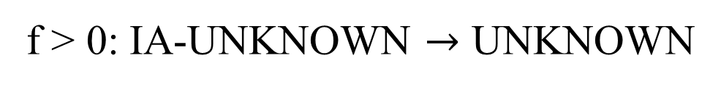
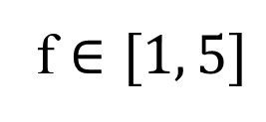
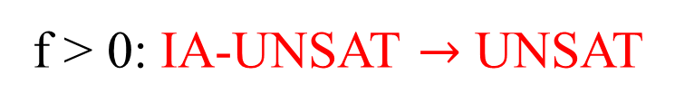

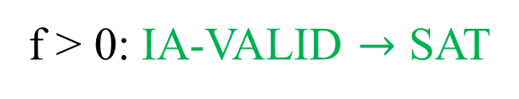

Over Approximation - Interval arithmetic
How to decide f > 0?
f $∈[−5, −1]$
f > 0: IA-UNSAT $→$ UNSAT
-5
-1
0
f $∈[1, 5]$
f > 0: IA-VALID $→$ SAT
0
1
5
f $∈[−2, 0.5]$
f > 0: IA-UNKNOWN $→$ UNKNOWN
-2
0
0.5

Slide 8
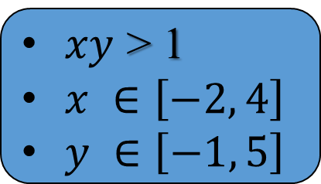
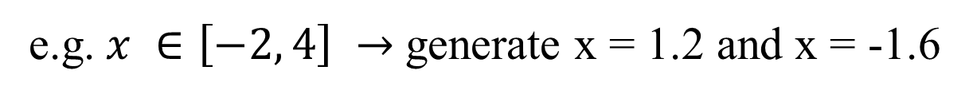
Under Approximation - Testing
find values for variables that satisfy the constraint
Testing
SAT with values for x, y
$xy$ > 1
$x ∈\left[−2, 4\right]$
$y ∈\left[−1, 5\right]$
UNKNOWN
Randomly generate 2 values for each variable
e.g. $x ∈\left[−2, 4\right] →$generate x = 1.2 and x = -1.6

Slide 9

raSAT loop
$$Constraint$$
SAT solver
UNSAT
UNSAT
SAT
IA_UNSAT
REFINE
Interval Arithmetic
Refinement
$$x ∈\left[1, 3\right]↔x ∈\left[1, 2\right]⋁x ∈\left[2, 3\right]$$
IA_VALID
IA_UNKNOWN
UNKNOWN
Testing
TEST_SAT
SAT

Slide 10
Contributions
Confirmation of SAT result: using iRRAM.
Efficiency Improvement:
Incremental widening and deepening.
Heuristics to choose satisfiable box.
Multiple Equalities Handling Implementation: Using the Intermediate Value Theorem.
Constraints over Integer Numbers Implementation.

Slide 11
Confirmation of SAT result
Round-off, over-flow errors can make the result unsound.
iRRAM:
C++ package
Error-bounded real arithmetic
Integrated iRRAM into raSAT for SAT verification.

Slide 12
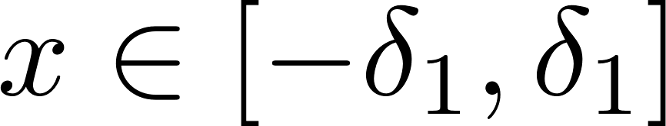
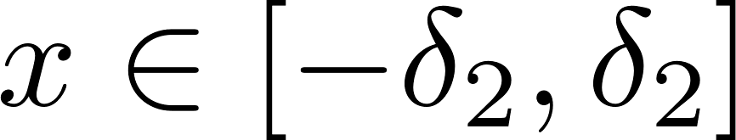
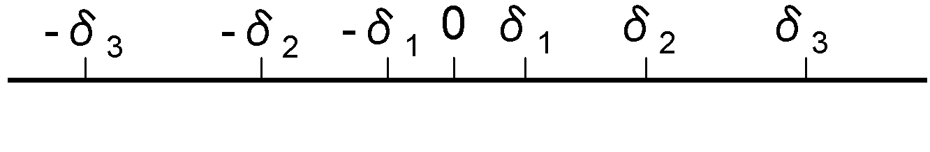
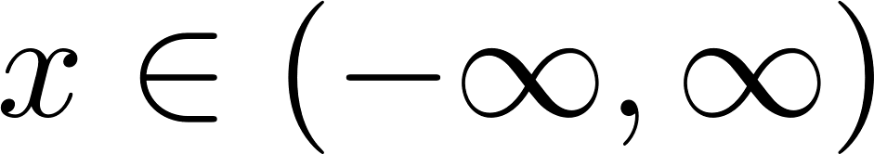
Incremental widening and deepening
Incremental widening
UNSAT
SAT
SAT
SAT
UNSAT
SAT
UNSAT
UNSAT
UNSAT

Slide 13
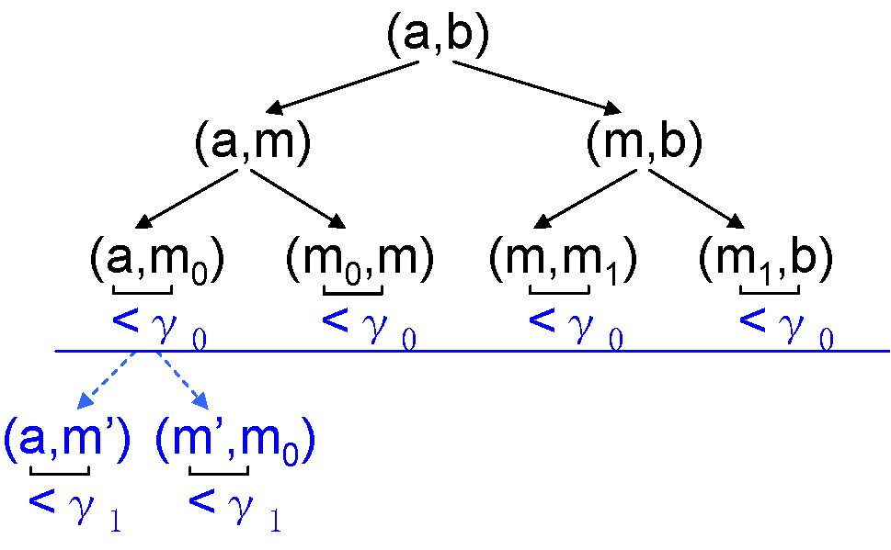
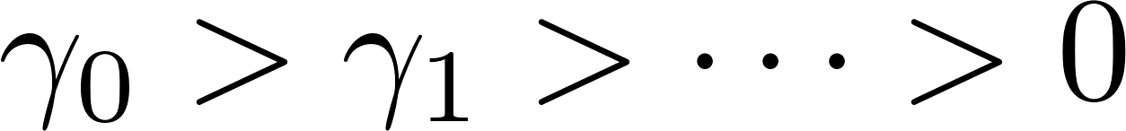
Incremental widening and deepening
Incremental deepening

Slide 14
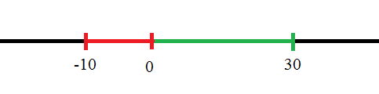
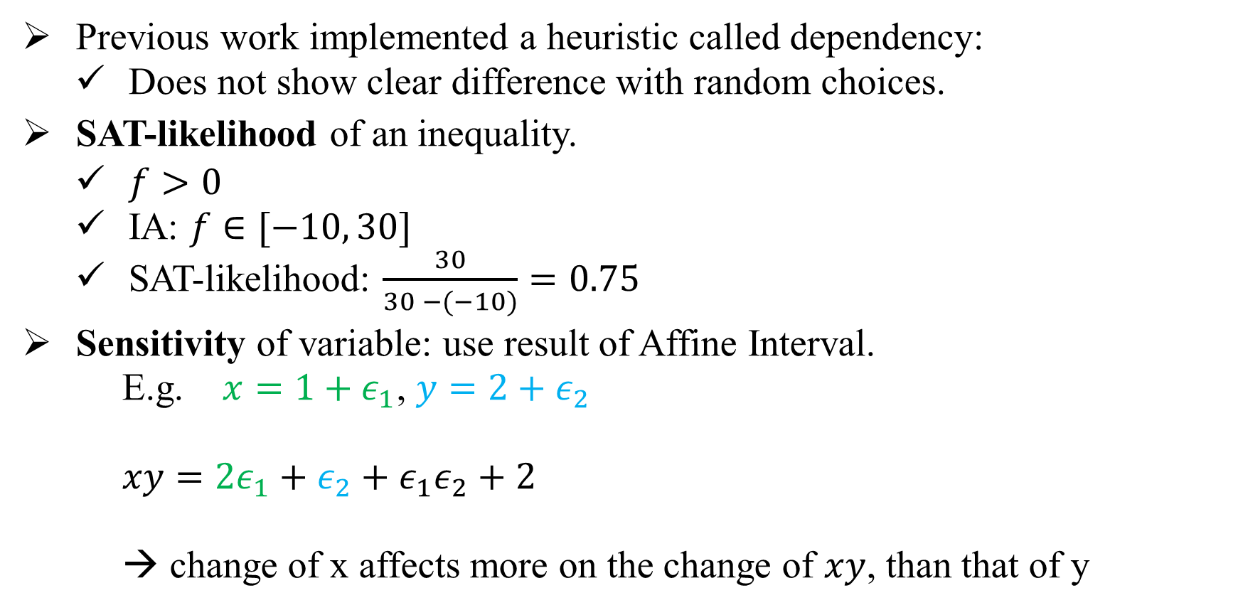

Heuristics for choosing satisfiable box
Previous work implemented a heuristic called dependency:
Does not show clear difference with random choices.
SAT-likelihood of an inequality.
$f>0$
IA: $f∈[−10, 30]$
SAT-likelihood: $\frac{30}{30 −(−10)}=0.75$
Sensitivity of variable: use result of Affine Interval.
E.g. $x=1+ε_{1}$, $y=2+ε_{2}$
$xy=2ε_{1}+ε_{2}+ε_{1}ε_{2}+2$
→ change of x affects more on the change of $xy$, than that of y
$$f>0$$

Slide 15
Heuristics choices for choosing satisfiable box
Select an inequality | Select a box | Select a variable
(1) Least SAT-likelihood | (3) Largest number of SAT inequalities | (8) Largest sensitibity
(2) Largest SAT-likelihood | (4) Least number of SAT inequalities
 | (5) Largest SAT-likelihood.
 | (6) Least SAT-likelihood.
(10) Random | (7) Random | (9) Random

Slide 16
Heuristics effects
Benchmark | No. of inequalities | (10)-(5)-(8) |  |  | (10)-(7)-(9)
 |  | SAT | UNSAT | Time(s) | SAT | UNSAT | Time (s)
Zankl tout=500s | 151 | 30 | 11 | 1406.03 | 21 | 10 | 933.39
Meti-tarski tout=60s | 5101 | 3325 | 1100 | 1496.6 | 3322 | 1076 | 1471.47
Except for (1)-(5)-(8), other combinations have almost the same performance as (10)-(7)-(9) – Random choices → combination (5)-(8) shows improvements.

Slide 17
Heuristics effects
On Zankl family:
(5)-(8) runs quicker than (10)-(7)-(9) for a same SAT benchmark.
SAT benchmarks that are solved by (5)-(8) but not by (10)-(7)-(9) often contains large number of variables (more than 20).
Meti-tarski:
Each benchmark has less than 5 variables.
(5)-(8) does not make clear difference with (10)-(7)-(9).

Slide 18
Comparison with other tools
iSAT3: Interval [-1000, 1000]
Tool | Zankl: 151 inequalities timeout = 500s |  |  | Meti-tarski: 5101 inequalities timeout = 60s |  |  | QEPCAD: 136 inequalities timeout = 900s
 | SAT | UNSAT | Time (s) | SAT | UNSAT | Time (s) | SAT | UNSAT | Time (s)
iSAT3 | 14 | 15 | 209.25 | 2916 | 1225 | 885.36 | - | - | -
raSAT | 31 | 10 | 756.58 | 3325 | 1100 | 1496.6 | 70 | 0 | 15.24
Z3 4.3 | 54 | 23 | 1034.7 | 3528 | 1568 | 129.78 | 114 | 22 | 0.45

Slide 19
Observations - Comparison with other tools
Large problems that are solved only by raSAT:
matrix-3-all-2: 47 variables, 87 inequalities/equations.
matrix-3-all-5: 81 variables, 142 inequalities/equations.
matrix-4-all-3: 139 variables, 244 inequalities/equations.
matrix-5-all-01: 132 variables, 276 inequalities/equations.
Z3 quickly solves constraints with small number of variables (up to around 10).
iSAT3 and Z3 quickly detect UNSAT:
Z3: A minimum set of asserted literals that is still UNSAT → conflicting core.
iSAT3: use implication graph to derive a conflict clause that contains few atoms.

Slide 20

Extensions
Constraints over integer numbers implementation:
Decomposition: Stop when length of interval is 1
Testing: Generate integer test cases.
Multiple equations handling implementation:
Repeatedly use the Intermediate Value Theorem.
Restriction: number of variables $≥$ number of equations.
Tool | SAT | UNSAT | Time (s)
raSAT | 6764 | 0 | 1230.54
Z3 | 6784 | 36 | 139.78
NIA/AProVE : 6850 inequalities – timeout = 60s

Slide 21
Future works
UNSAT-directed heuristic: UNSAT core.
Test generation heuristics.
Box Decomposition heuristics.

Slide 22
THANKS FOR ATTENTION

