Slide 1
raSAT – an SMT solver for Polynomial constraints
Vu Xuan Tung – Ogawa lab - JAIST

Slide 2
raSAT – an SMT solver for Polynomial constraints
Satisfiability Modulo Theories (SMT).
Theory of non-linear arithmetic.
raSAT.

Slide 3
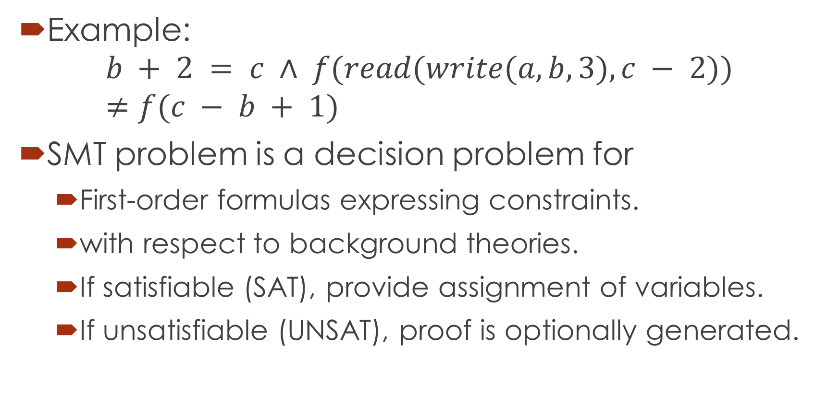
Satisfiability Modulo Theories (SMT)
Example:
$$b + 2 = c ∧ f(read(write(a, b, 3), c − 2))≠f(c − b + 1)$$
SMT problem is a decision problem for
First-order formulas expressing constraints.
with respect to background theories.
If satisfiable (SAT), provide assignment of variables.
If unsatisfiable (UNSAT), proof is optionally generated.

Slide 4
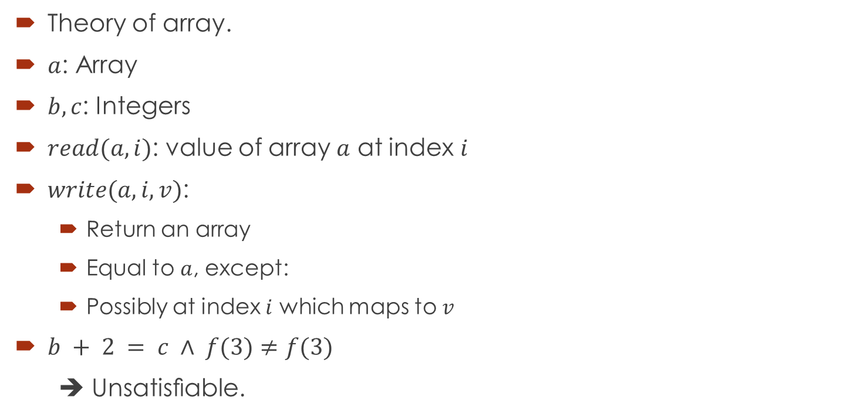
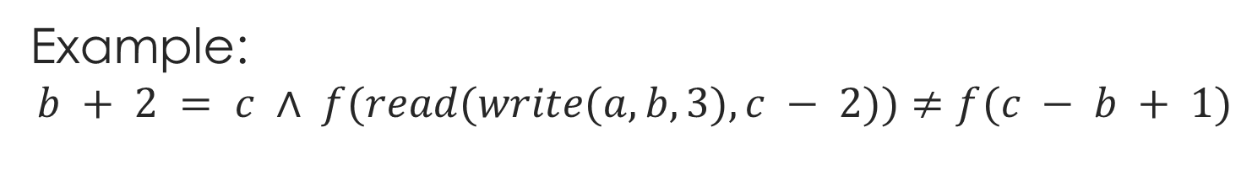
Example: $$b + 2 = c ∧ f(read(write(a, b, 3), c − 2))≠f(c − b + 1)$$
Theory of array.
$a$: Array
$b, c$: Integers
$read(a, i)$: value of array $a$ at index $i$
$write(a, i, v)$:
Return an array
Equal to $a$, except:
Possibly at index $i$ which maps to $v$
$b + 2 = c ∧ f(3)≠f(3)$
➔ Unsatisﬁable.

Slide 5

Back ground theories
Theory of array
Linear arithmetic: $+, −$
Non-linear arithmetic: $+, −, ∗$
…..

Slide 6
Why SMT?
Logical formulas: describe the program states and transformations.
Test–case generation
Model checking.
Program verification.
Others

Slide 7




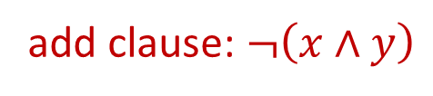
Formula
$$b + 2 = c ∧ f(read(write(a, b, 3), c − 2))≠f(c − b + 1)$$
SAT solver
Theory solver
$$x∧y$$
$$∧ ¬(x∧y)$$
YES
$$x∧y$$
$$b + 2 = c$$
$$∧ f(3)≠f(3)$$
$$x∧y$$
YES
SAT
NO
NO
Learn clauses
add clause: $¬\left(x∧y\right)$
SMT Solver
UNSAT

Slide 8
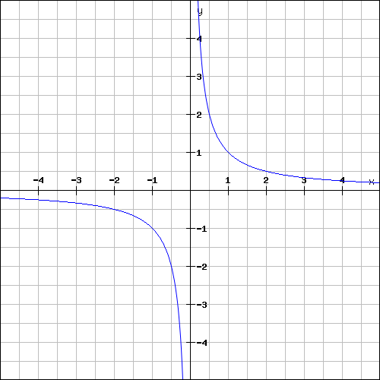

Theory of non-linear arithmetic
$$∃x,y(x^{2}+y^{2}<1 Λ x∗y>1)$$

Slide 9
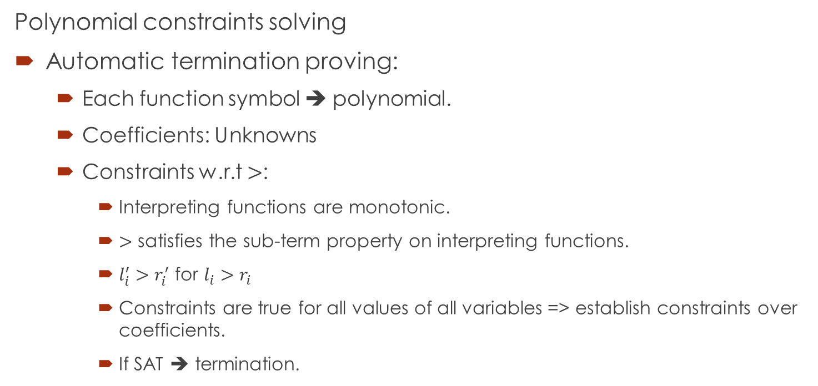
Theory of non-linear arithmetic
Polynomial constraints solving
Automatic termination proving:
Each function symbol ➔ polynomial.
Coefficients: Unknowns
Constraints w.r.t $>$:
Interpreting functions are monotonic.
$>$ satisfies the sub-term property on interpreting functions.
$l_{i}^{′}>r_{i}^{′}$ for $l_{i}>r_{i}$
Constraints are true for all values of all variables => establish constraints over coefficients.
If SAT ➔ termination.

Slide 10
Theory of non-linear arithmetic
Polynomial constraints solving
Roundoff error and overflow error analysis
Invariant generation.
Many others.

Slide 11
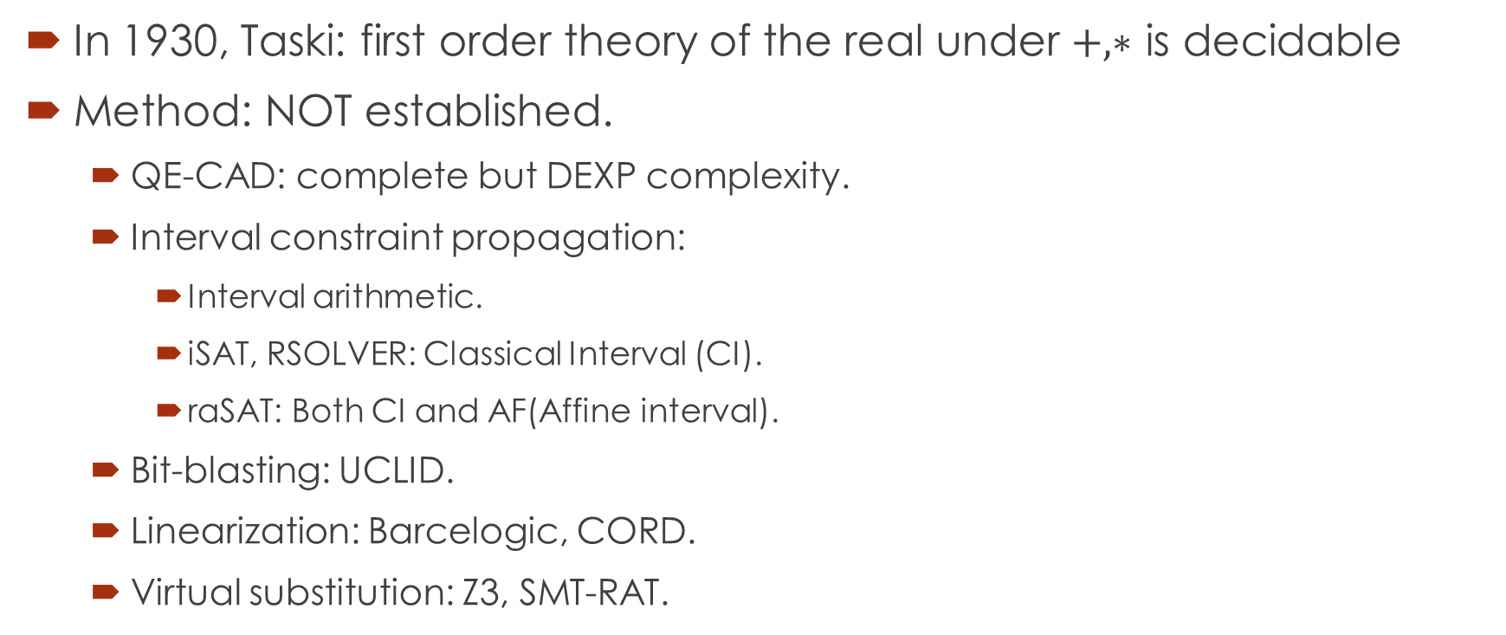
Why Polynomials over Reals?
In 1930, Taski: first order theory of the real under $+, ∗$ is decidable
Method: NOT established.
QE-CAD: complete but DEXP complexity.
Interval constraint propagation:
Interval arithmetic.
iSAT, RSOLVER: Classical Interval (CI).
raSAT: Both CI and AF(Affine interval).
Bit-blasting: UCLID.
Linearization: Barcelogic, CORD.
Virtual substitution: Z3, SMT-RAT.

Slide 12
raSAT
Polynomial Inequalities:
Fine approximation can decide.
Solving over Reals ➔ Solving over Rational numbers.

Slide 13

$$Constraints$$
raSAT
Yest
NO
SAT solver
UNSAT/Unknown
Theory solver
YES
Inconsistency checking
US Core
Refinement
Consistency testing

Slide 14
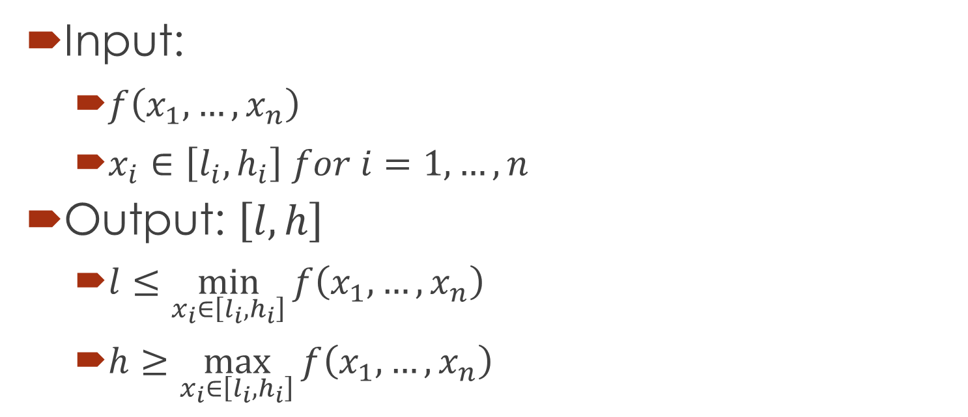
Interval Arithmetic (IA)
Input:
$f\left(x_{1},…,x_{n}\right)$
$x_{i}∈\left[l_{i},h_{i}\right] for i=1,…,n$
Output: $\left[l,h\right]$
$l≤\min_{x_{i}∈\left[l_{i},h_{i}\right]}{f\left(x_{1},…,x_{n}\right)}$
$h≥\max_{x_{i}∈\left[l_{i},h_{i}\right]}{f\left(x_{1},…,x_{n}\right)}$

Slide 15
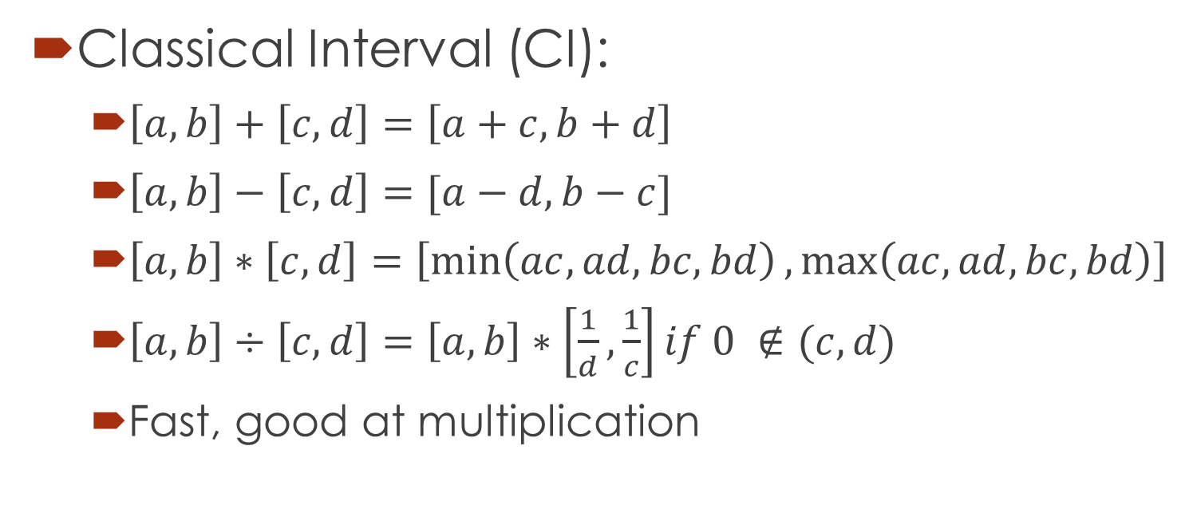
IAs: Classical Interval vs Affine Interval
Classical Interval (CI):
$\left[a,b\right]+\left[c,d\right]=\left[a+c,b+d\right]$
$\left[a,b\right]−\left[c,d\right]=[a−d,b−c]$
$\left[a,b\right]∗\left[c,d\right]=\left[\min\left(ac,ad,bc,bd\right),\max\left(ac,ad,bc,bd\right)\right]$
$\left[a,b\right]÷\left[c,d\right]=\left[a,b\right]∗\left[\frac{1}{d},\frac{1}{c}\right]if 0 ∉(c,d)$
Fast, good at multiplication

Slide 16
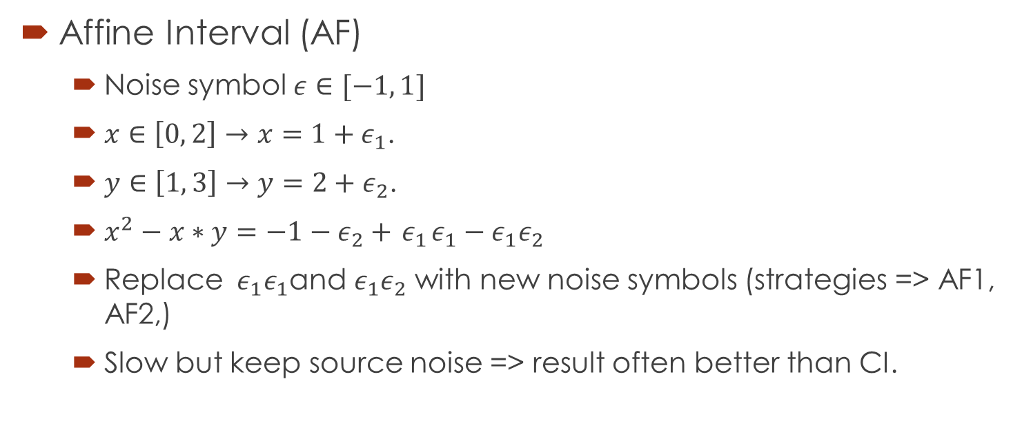
IAs: Classical Interval vs Affine Interval
Affine Interval (AF)
Noise symbol $ε∈[−1, 1]$
$x∈\left[0, 2\right]→x=1+ε_{1}$.
$y∈\left[1, 3\right]→y=2+ε_{2}$.
$x^{2}−x∗y=−1−ε_{2}+{ ε}_{1}ε_{1}−ε_{1}ε_{2}$
Replace ${ ε}_{1}ε_{1}$and $ε_{1}ε_{2}$ with new noise symbols (strategies => AF1, AF2,)
Slow but keep source noise => result often better than CI.

Slide 17
$$Constraints$$
raSAT
Yest
NO
SAT solver
UNSAT/Unknown
Learn conflicts
Theory solver
YES
Inconsistency checking
UNSAT
US Core
Refinement
UNKNOWN
VALID
Consistency testing
SAT

Slide 18
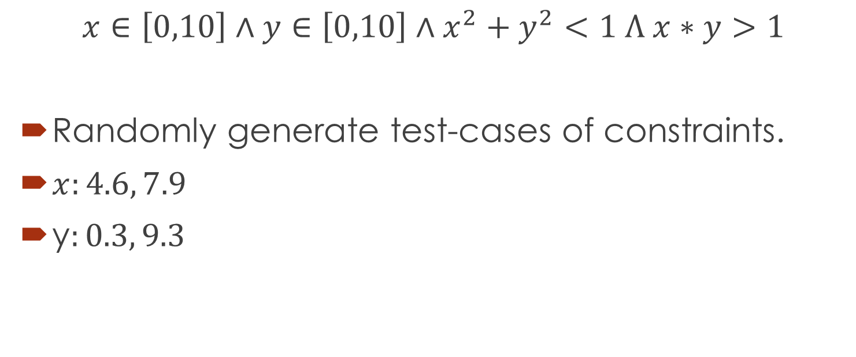
Consistency testing
$$x∈\left[0,10\right]∧y∈\left[0,10\right]∧x^{2}+y^{2}<1 Λ x∗y>1$$
Randomly generate test-cases of constraints.
$x:4.6, 7.9$
y$:0.3, 9.3$

Slide 19
$$Constraints$$
raSAT
Yest
NO
SAT solver
UNSAT/Unknown
Learn conflicts
Theory solver
YES
Inconsistency checking
UNSAT
US Core
Refinement
UNKNOWN
VALID
TEST-UNSAT
Consistency testing
SAT
SAT

Slide 20
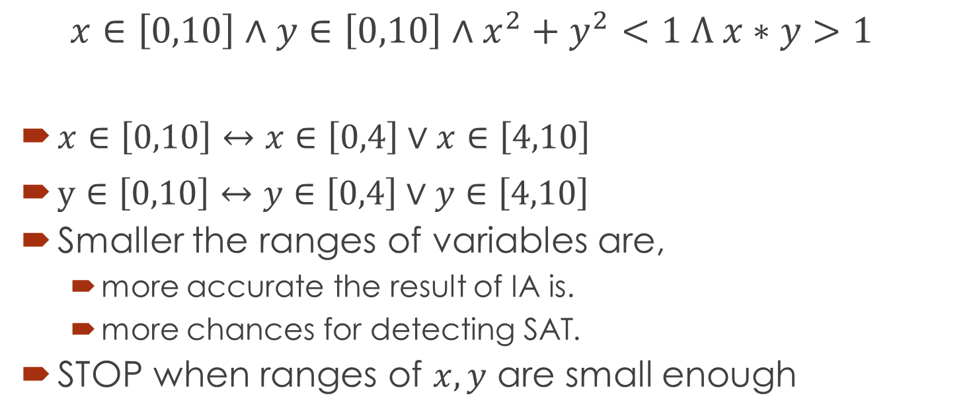
Refinement
$$x∈\left[0,10\right]∧y∈\left[0,10\right]∧x^{2}+y^{2}<1 Λ x∗y>1$$
$x∈\left[0,10\right]↔x∈\left[0,4\right]∨x∈\left[4,10\right]$
$y∈\left[0,10\right]↔y∈\left[0,4\right]∨y∈\left[4,10\right]$
Smaller the ranges of variables are,
more accurate the result of IA is.
more chances for detecting SAT.
STOP when ranges of $x, y$ are small enough

Slide 21
$$Constraints$$
raSAT
Yest
Threshold - Unknown
NO
SAT solver
UNSAT/Unknown
Learn conflicts
Theory solver
Refined clauses
YES
Inconsistency checking
UNSAT
US Core
Refinement
UNKNOWN
VALID
TEST-UNSAT
Consistency testing
SAT
SAT

Slide 22
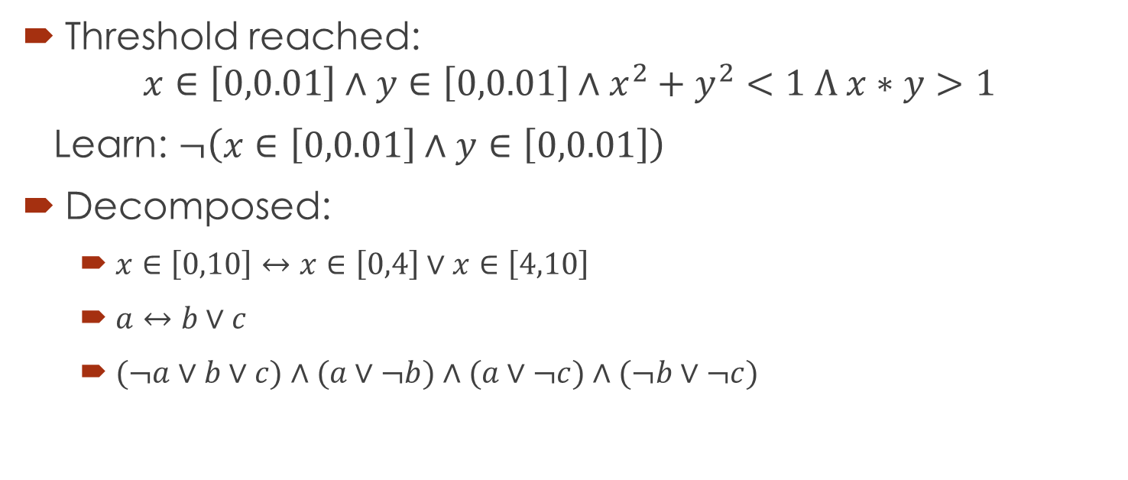
Clauses of Refinement
Threshold reached:
$$x∈\left[0,0.01\right]∧y∈\left[0,0.01\right]∧x^{2}+y^{2}<1 Λ x∗y>1$$
Learn: $¬\left(x∈\left[0,0.01\right]∧y∈\left[0,0.01\right]\right)$
Decomposed:
$x∈\left[0,10\right]↔x∈\left[0,4\right]∨x∈\left[4,10\right]$
$a↔b∨c$
$(¬a∨b∨c)∧(a∨¬b)∧(a∨¬c)∧(¬b∨¬c)$

Slide 23

$$Constraints$$
raSAT
Yest
Threshold - Unknown
NO
SAT solver
UNSAT/Unknown
Learn conflicts
Theory solver
Refined clauses
YES
Inconsistency checking
UNSAT
US Core
Refinement
UNKNOWN
VALID
TEST-UNSAT
Consistency testing
SAT
SAT

Slide 24
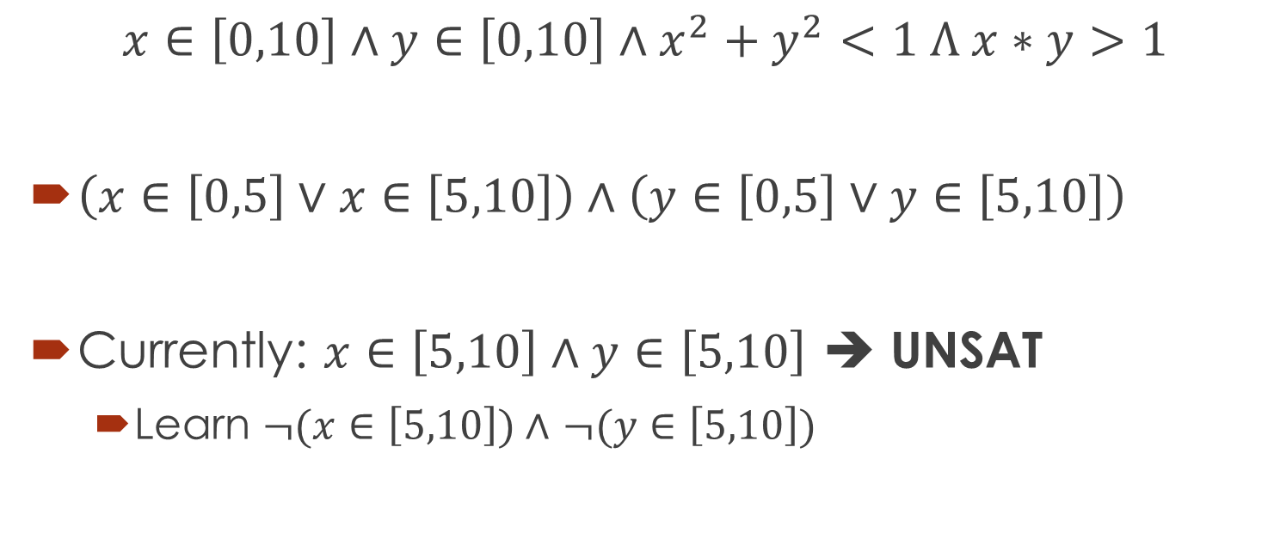
UNSAT core (US core)
$$x∈\left[0,10\right]∧y∈\left[0,10\right]∧x^{2}+y^{2}<1 Λ x∗y>1$$
$\left(x∈\left[0,5\right]∨x∈\left[5,10\right]\right)∧\left(y∈\left[0,5\right]∨y∈\left[5,10\right]\right)$
Currently: $x∈\left[5,10\right]∧y∈\left[5,10\right]$ ➔ UNSAT
Learn $¬(x∈\left[5,10\right])∧$ $¬(y∈\left[5,10\right])$

Slide 25
$$Constraints$$
raSAT
Yest
Threshold - Unknown
NO
SAT solver
UNSAT/Unknown
Learn conflicts
Theory solver
Refined clauses
YES
Inconsistency checking
UNSAT
US Core
Refinement
UNKNOWN
VALID
TEST-UNSAT
Consistency testing
SAT
SAT

Slide 26
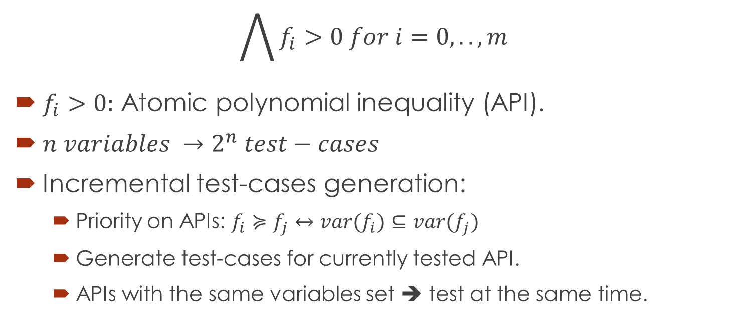
Testing strategy
$$\bigwedge{f_{i}>0 for i=0,..,m}$$
$f_{i}>0:$ Atomic polynomial inequality (API).
$n variables →2^{n} test−cases$
Incremental test-cases generation:
Priority on APIs: $f_{i}≽f_{j}↔var(f_{i})⊆var(f_{j})$
Generate test-cases for currently tested API.
APIs with the same variables set ➔ test at the same time.

Slide 27
Refinement strategy
What API: First test-UNSAT.
How to decompose: Monotonically increasing, decreasing.

Slide 28
Progress

Slide 29
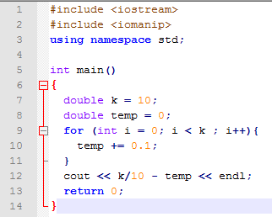



Is raSAT sound?
$$\frac{k}{10}−\sum_{i=1}^{k}{0.1}$$
Theoretically Yes.
Round-off error.
Overflow error
$$=0$$
C++, k= 10
Ocalm, k= 10
1.38777878078144568e-16
1.11022e-16

Slide 30
iRRAM
C++ package
Error-bounded real arithmetic
Integrated into raSAT for SAT verification.
Rarely iRRAM detects error.
Two times: zankle/matrix_2_all_6.smt2
Future works: Install iRRAM locally.

Slide 31
iRRAM – UNSAT verification
UNSAT concluded by IA.
raSAT: AF2 + CI
CI is already implemented in iRRAM.
AF2: we need to implement this! ➔ Future work.

Slide 32
Running statistics
Statistics for:
IA time
Testing time
Preprocessing time (parsing time + intervals filtering time)
UNSAT core time
miniSAT time
miniSAT clauses, calls, variables.

Slide 33
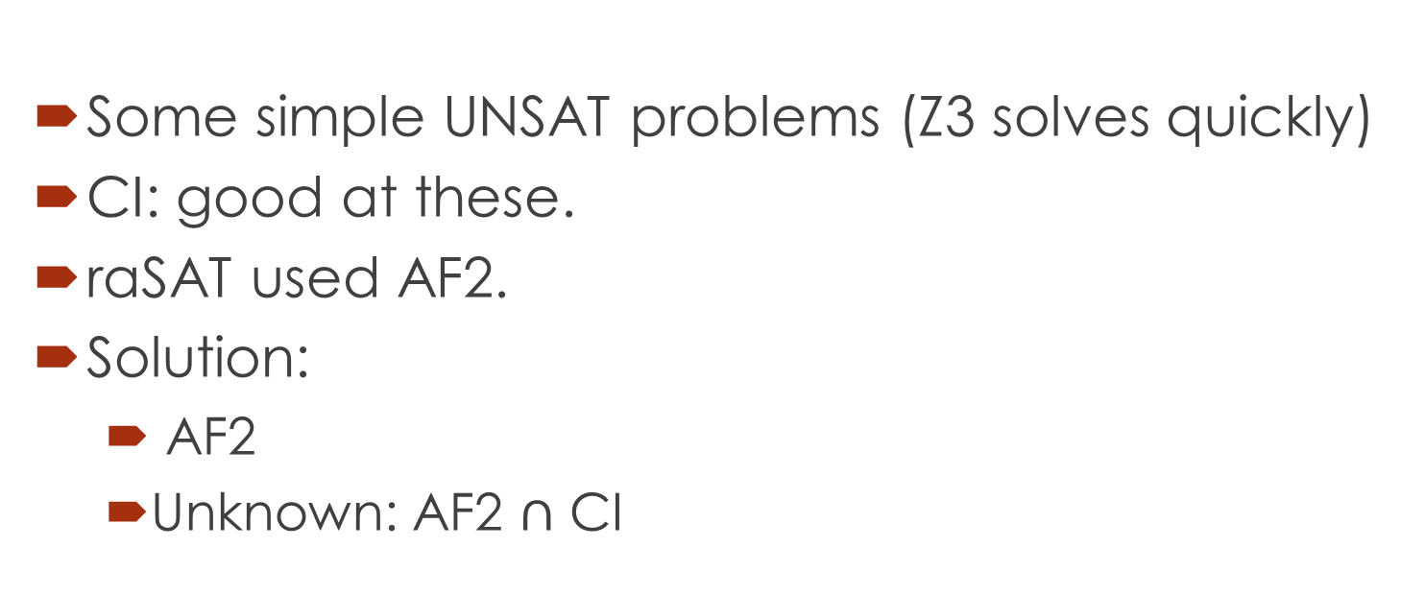
AF2 + CI
Some simple UNSAT problems (Z3 solves quickly)
CI: good at these.
raSAT used AF2.
Solution:
AF2
Unknown: AF2 $∩$ CI

Slide 34
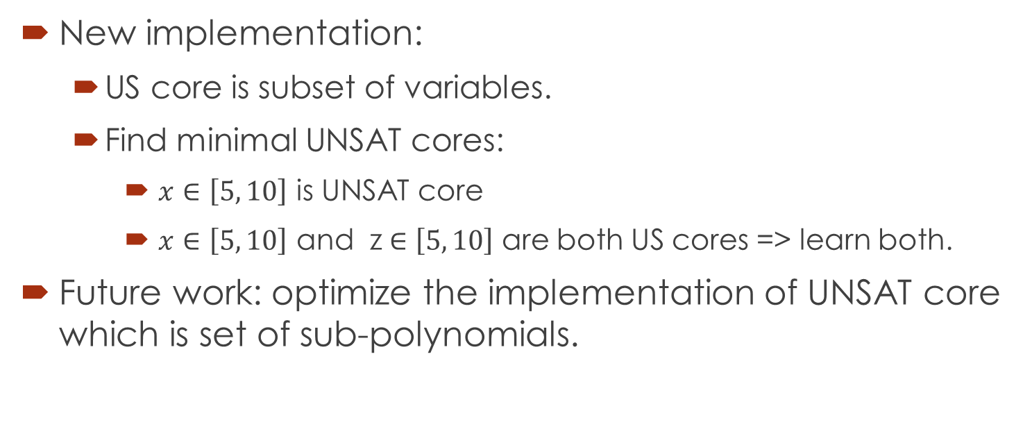

UNSAT core
New implementation:
US core is subset of variables.
Find minimal UNSAT cores:
$x∈\left[5, 10\right]$ is UNSAT core
$x∈\left[5, 10\right]$ and z$∈\left[5, 10\right]$ are both US cores => learn both.
Future work: optimize the implementation of UNSAT core which is set of sub-polynomials.
=> $x∈\left[5, 10\right]⋀y∈\left[5, 10\right]$ is UNSAT core

Slide 35
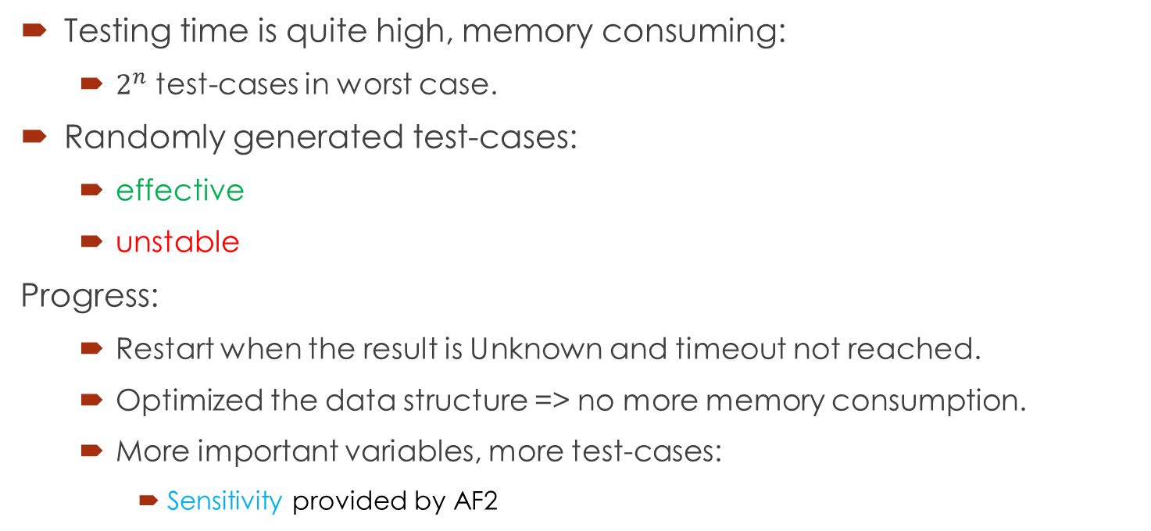
Testing
Testing time is quite high, memory consuming:
$2^{n}$ test-cases in worst case.
Randomly generated test-cases:
effective
unstable
Progress:
Restart when the result is Unknown and timeout not reached.
Optimized the data structure => no more memory consumption.
More important variables, more test-cases:
Sensitivity provided by AF2

Slide 36

Sensitivity
$x∈\left[0, 2\right]→x=1+ε_{1}$.
$y∈\left[1, 3\right]→y=2+ε_{2}$.
$xy=2ε_{1}+ε_{2}+ε_{1}ε_{2}+2$
Value of $x$ is more likely to affect the total value of $xy$ than $y$

Slide 37
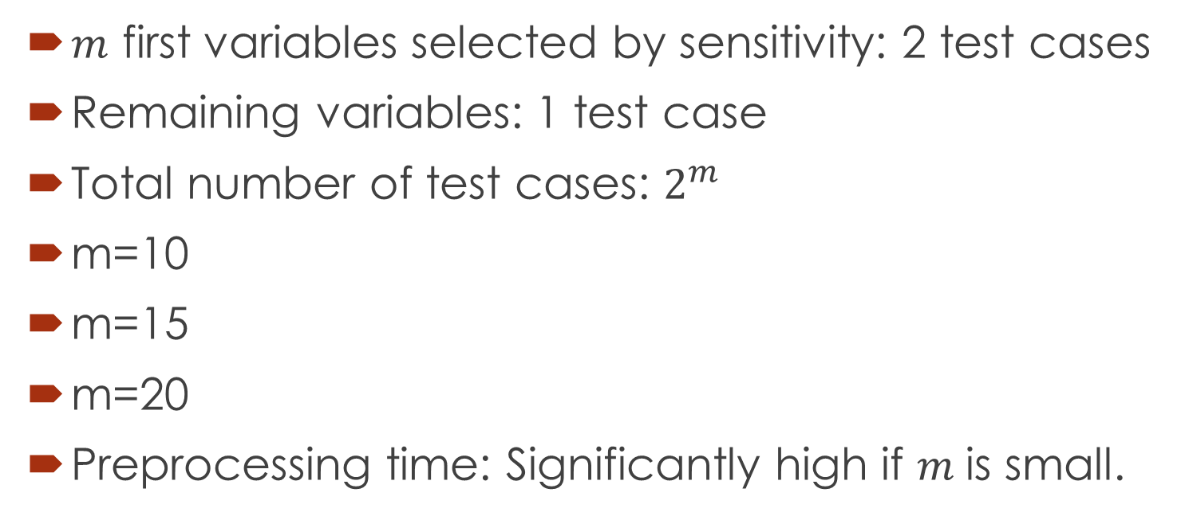
Sensitivity in testing
$m$ first variables selected by sensitivity: 2 test cases
Remaining variables: 1 test case
Total number of test cases: $2^{m}$
m=10
m=15
m=20
Preprocessing time: Significantly high if $m$is small.

Slide 38
Preprocessing
Reuse the polynomial constraints information: AST, variables set.
Reuse the intervals information.
Optimized the filtering intervals process.
Testing experiments
m=10:
m=15:
m=20:
Not much improvements in solved problems
More balance between testing time, IA time, miniSAT time.
43 problems in Zankl solved.
44 problems.
46 problems.

Slide 39
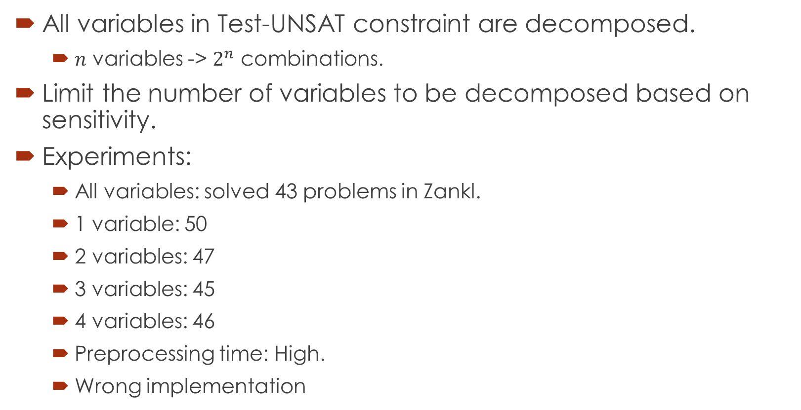
Decomposition
All variables in Test-UNSAT constraint are decomposed.
$n$ variables -> $2^{n}$ combinations.
Limit the number of variables to be decomposed based on sensitivity.
Experiments:
All variables: solved 43 problems in Zankl.
1 variable: 50
2 variables: 47
3 variables: 45
4 variables: 46
Preprocessing time: High.
Wrong implementation
➔ Suggest new idea

Slide 40
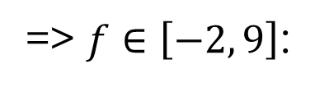
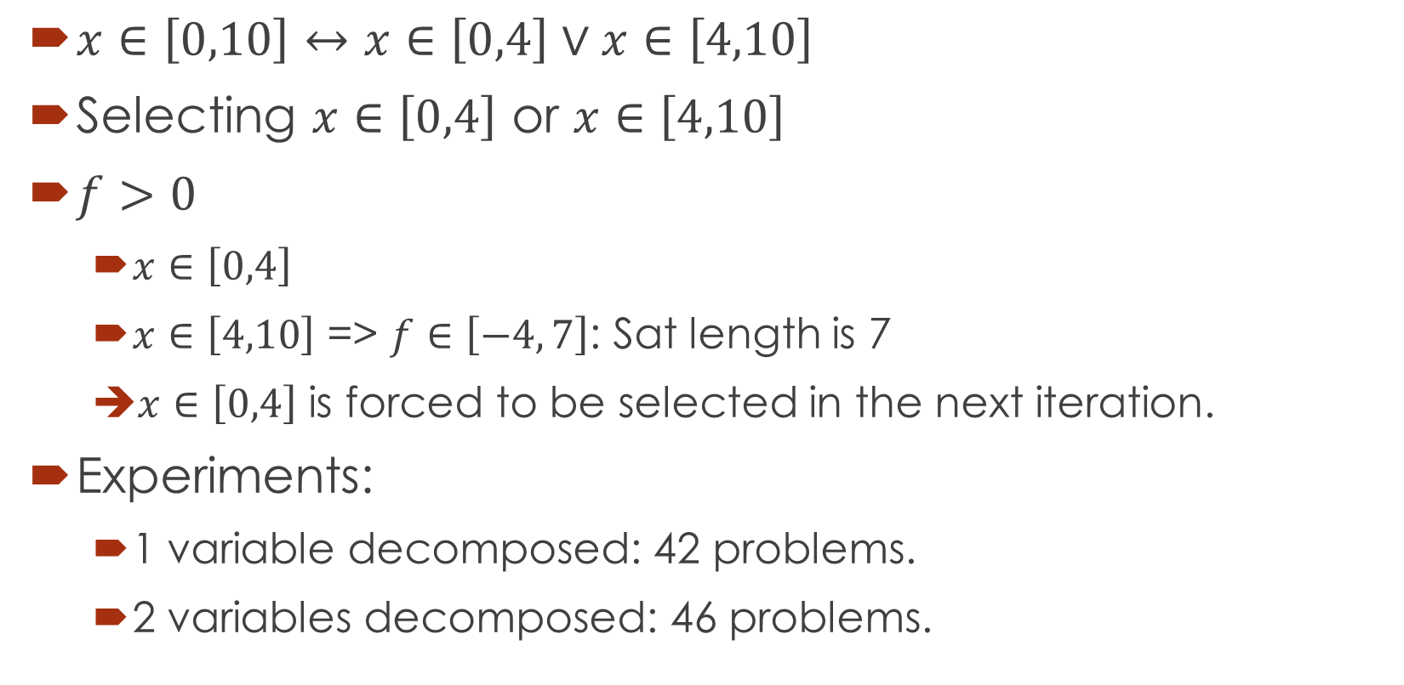
Box selection – SAT directed.
$x∈\left[0,10\right]↔x∈\left[0,4\right]∨x∈\left[4,10\right]$
Selecting $x∈\left[0,4\right]$ or $x∈\left[4,10\right]$
$f>0$
$x∈\left[0,4\right]$
$x∈\left[4,10\right]$ => $f∈\left[−4, 7\right]$: Sat length is 7
$x∈\left[0,4\right]$ is forced to be selected in the next iteration.
Experiments:
1 variable decomposed: 42 problems.
2 variables decomposed: 46 problems.
was up to MiniSAT
=> $f∈\left[−2, 9\right]$:
Sat length is 9

Slide 41

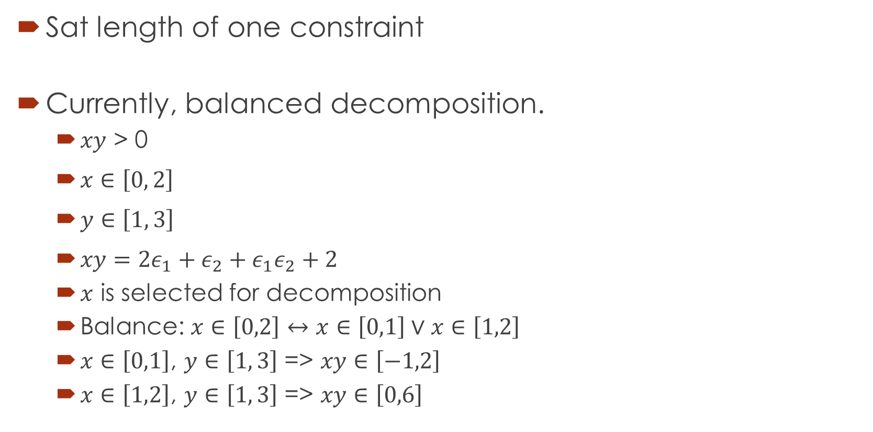


Other ideas
Sat length of one constraint
Currently, balanced decomposition.
$xy$ > 0
$x∈\left[0, 2\right]$
$y∈\left[1, 3\right]$
$xy=2ε_{1}+ε_{2}+ε_{1}ε_{2}+2$
$x$ is selected for decomposition
Balance: $x∈\left[0,2\right]↔x∈\left[0,1\right]∨x∈\left[1,2\right]$
$x∈\left[0,1\right]$, $y∈\left[1, 3\right]$ => $xy∈\left[−1,2\right]$
$x∈\left[1,2\right]$, $y∈\left[1, 3\right]$ => $xy∈\left[0,6\right]$
=> sum of sat lengths of all unknown constraints.
$→x=1+ε_{1}$.
$→y=2+ε_{2}$.
$$∈\left[−2, 6\right]$$

Slide 42
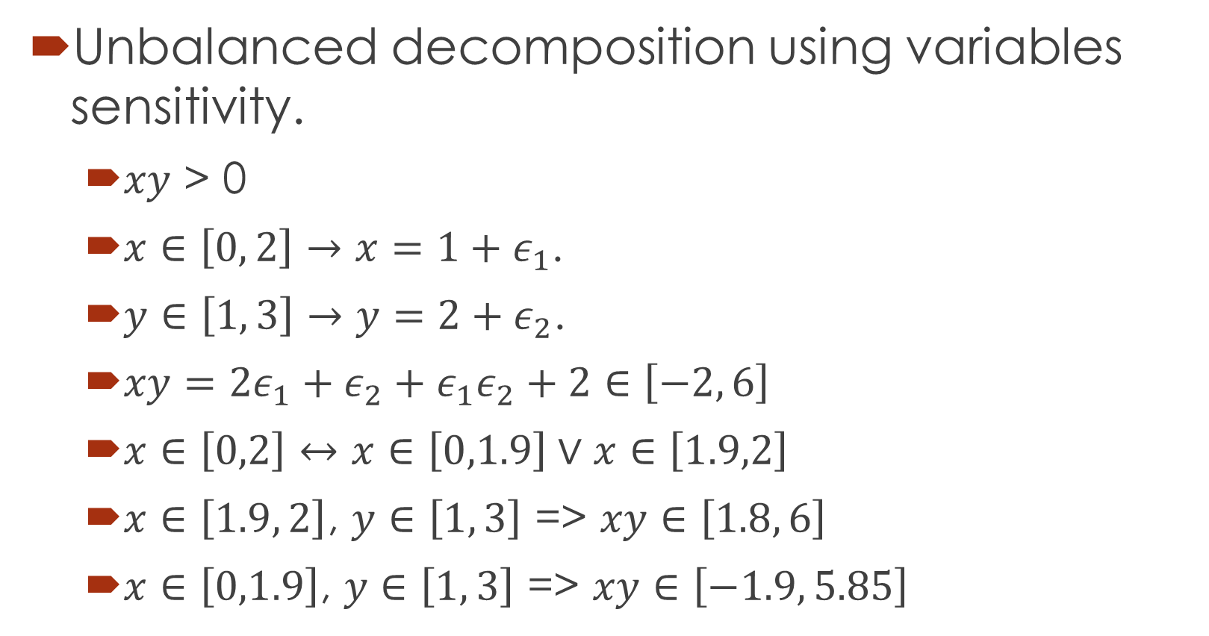
Unbalanced decomposition
Unbalanced decomposition using variables sensitivity.
$xy$ > 0
$x∈\left[0, 2\right]→x=1+ε_{1}$.
$y∈\left[1, 3\right]→y=2+ε_{2}$.
$xy=2ε_{1}+ε_{2}+ε_{1}ε_{2}+2∈\left[−2, 6\right]$
$x∈\left[0,2\right]↔x∈\left[0,1.9\right]∨x∈\left[1.9,2\right]$
$x∈\left[1.9, 2\right]$, $y∈\left[1, 3\right]$ => $xy∈\left[1.8, 6\right]$
$x∈\left[0,1.9\right]$, $y∈\left[1, 3\right]$ => $xy∈\left[−1.9, 5.85\right]$

Slide 43

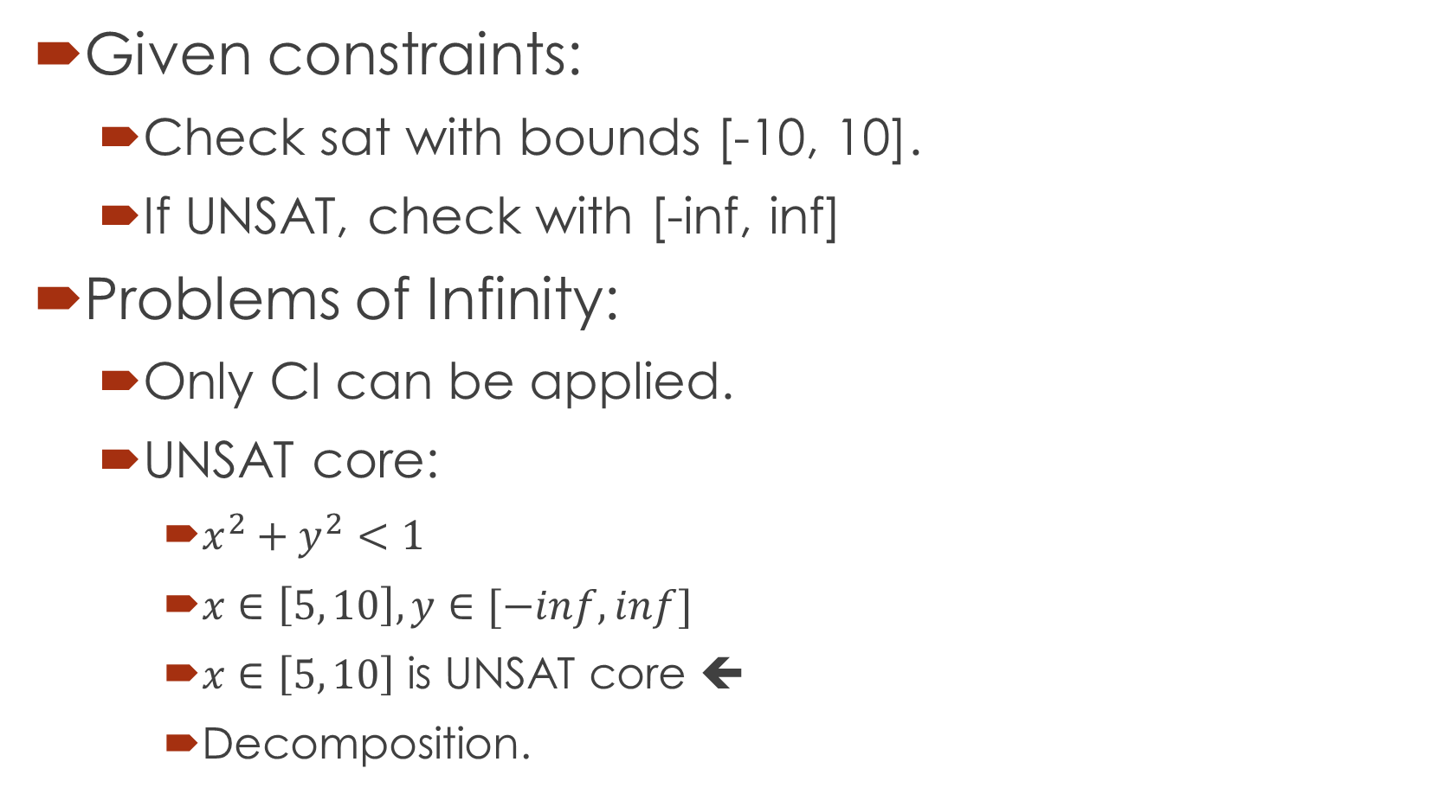
Infinite bounds.
Given constraints:
Check sat with bounds [-10, 10].
If UNSAT, check with [-inf, inf]
Problems of Infinity:
Only CI can be applied.
UNSAT core:
$x^{2}+y^{2}<1$
$x∈\left[5, 10\right], y∈[−inf, inf]$
$x∈\left[5, 10\right]$ is UNSAT core ⬅
Decomposition.
$$\{_{x^{2}≥\text{1} \text{for} x∈[5, 10]}^{y^{2}≥0 \text{for} y∈[−inf, inf]}$$

Slide 44
Or, Not operators
Or operators for constraints
Parsing
Convert to CNF
Add to miniSAT
To be done: UNSAT core, UNKNOWN learnt clauses, decomposition clauses.
Not: Easy, to be done.

Slide 45
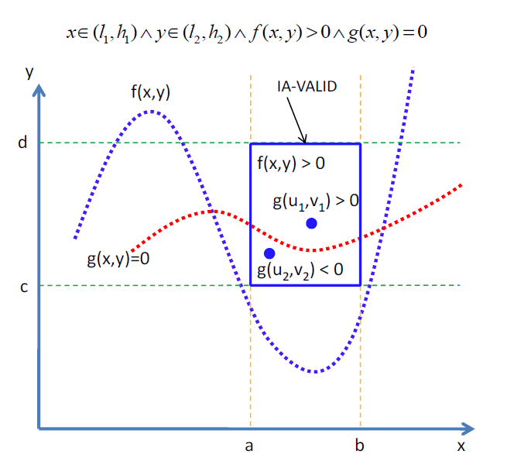
Equality extension
Intermediate theorem
Single equality:
Done

Slide 46
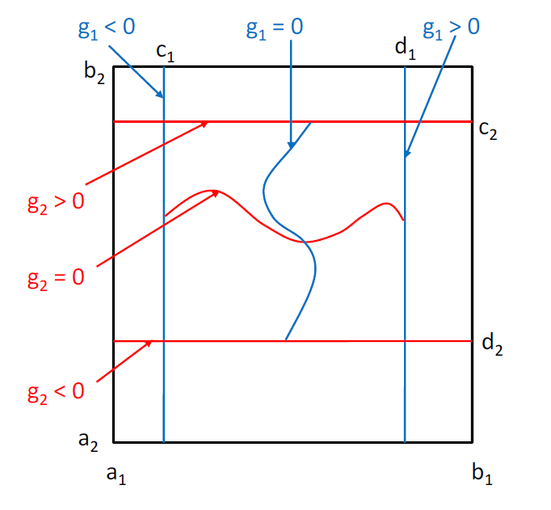
Equality extension
Intermediate theorem
Multiple equalities:
Partially done.

Slide 47
Equality extension
Grobner basis
Intermediate value theorem: restrictions.
Implemented in Mathematica, Reduce.
Performance: exponential complexity.

Slide 48
$$Constraints$$
raSAT
Yest
Threshold - Unknown
NO
SAT solver
UNSAT/Unknown
Learn conflicts
Theory solver
Refined clauses
YES
Inconsistency checking
UNSAT
US Core
Refinement
UNKNOWN
VALID
TEST-UNSAT
Consistency testing
SAT
SAT

Slide 49
Thank you for your attention

