Slide 1
raSAT: SMT for non-linear constraints over reals.
Vu Xuan Tung – Ogawa Lab - JAIST

Slide 2
Non-linear (polynomial) constraints over reals
If there exist an assignment of x, y that satisfies the constraints → satisfiable (SAT).
Otherwise, unsatisfiable (UNSAT)
x = 2.65219237745, y = 2.34617027147

Slide 3
Polynomial constraints over reals
Applications:
Automatic termination proving.
Roundoff error and overflow error analysis.
Invariant generation.

Slide 4
Polynomial constraints over reals
In 1930, Tarski: polynomial constraints is decidable
Methods:
QE-CAD: complete but DEXP complexity.
Interval constraint propagation: ISAT uses interval arithmetic (IA) only, ability of solving SAT problem is limited.
Bit-blasting: (UCLID, MiniSmt) suffers with high number of variables or high degree of polynomials.
Linearization: suffers with high degree of polynomials (Barcelogic, CORD).
Virtual substitution: Z3, SMT-RAT. Needs root formulas of polynomial
➔ degree <= 5
raSAT: IA + testing

Slide 5
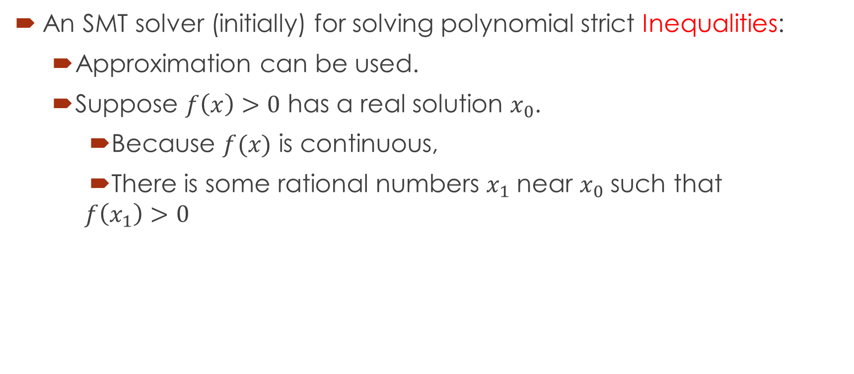
raSAT
An SMT solver (initially) for solving polynomial strict Inequalities:
Approximation can be used.
Suppose $f\left(x\right)>0$ has a real solution $x_{0}$.
Because $f(x)$ is continuous,
There is some rational numbers $x_{1}$ near $x_{0}$ such that
$$f\left(x_{1}\right)>0$$

Slide 6
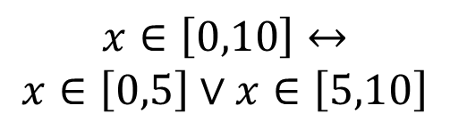

$$Constraints$$
raSAT
Yest
Threshold - Unknown
NO
SAT solver
UNSAT/
Unknown
Learn conflicts
Theory solver
Refined clauses
YES
IA-UNSAT
Interval Arithmetic
US Core
$$x∈\left[0,10\right]↔$$
$$x∈\left[0,5\right]∨x∈\left[5,10\right]$$
Refinement
IA-UNKNOWN
IA-VALID
Test-UNSAT
Testing
TEST-SAT
SAT

Slide 7






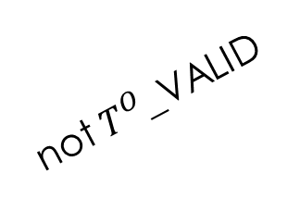


$$Constraints$$
$A=πr^{2}$Yest
Threshold - Unknown
$Π$_UNSAT
SAT solver
UNSAT/
Unknown
$Π$_SAT
Theory solver
REFINE
Interval Arithmetic
$T^{O}$_UNSAT
Refinement
$T^{O}$_SAT
not $T^{O}$_VALID
$T^{O}$_VALID
not $T^{U}$_SAT
$T^{U}$_SAT
SAT
Testing

Slide 8
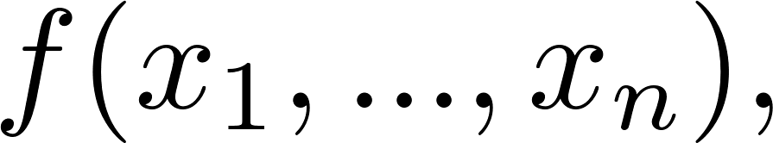
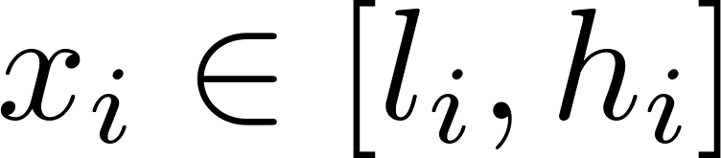

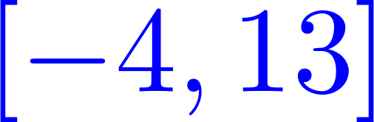

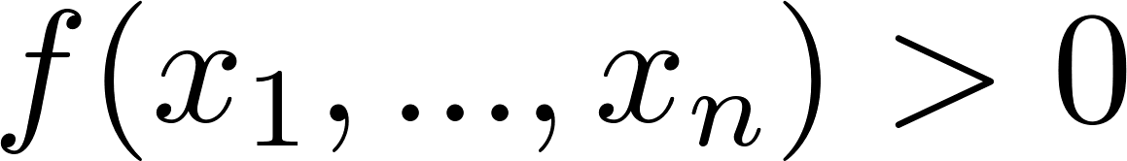



Over approximation - Interval arithmetic (IA)
Interval arithmetic
l
h
IA-UNSAT
UNSAT
l
h
0
IA-VALID
SAT
0
l
h
IA-UNKNOWN
UNKNOWN
l
0
h

Slide 9
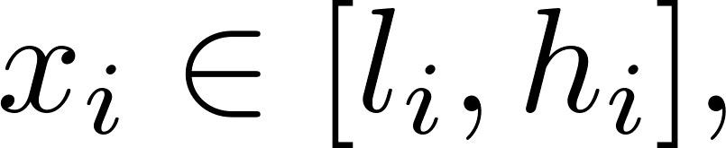
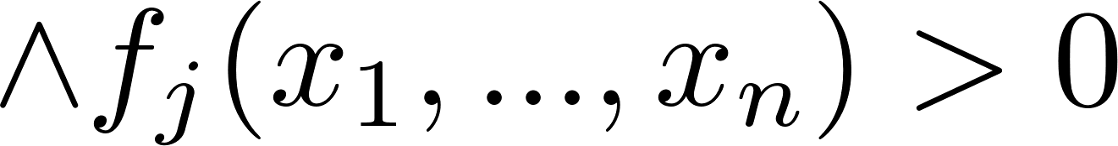
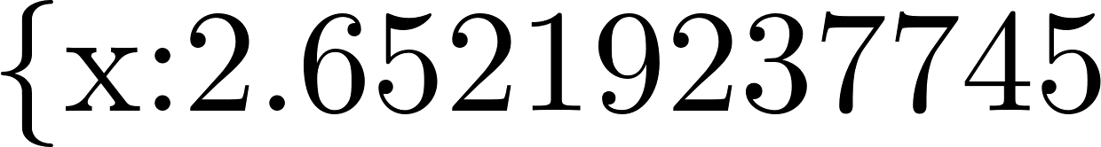
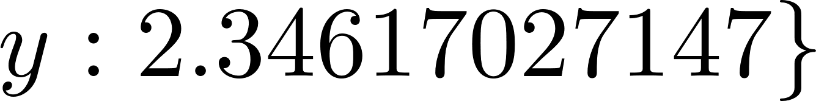
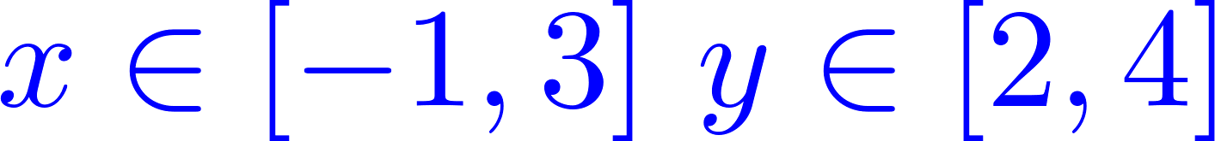
Under approximation - Testing
Testing:
Randomly generate values for variables
SAT with variables assignment
UNKNOWN
Example:
Testing:
Randomly generate values for variables
SAT with

Slide 10
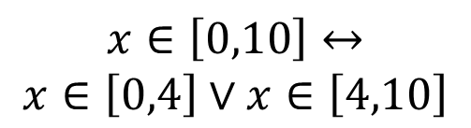
$$Constraints$$
raSAT
Yest
Threshold - Unknown
NO
SAT solver
UNSAT/
Unknown
Learn conflicts
YES
Theory solver
Refined clauses
IA-UNSAT
Interval Arithmetic
US Core
$$x∈\left[0,10\right]↔$$
$$x∈\left[0,4\right]∨x∈\left[4,10\right]$$
Refinement
IA-UNKNOWN
IA-VALID
Test-UNSAT
Testing
TEST-SAT
SAT

Slide 11
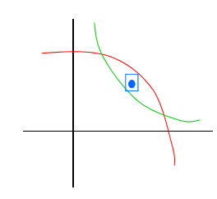
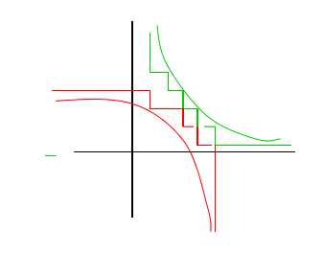
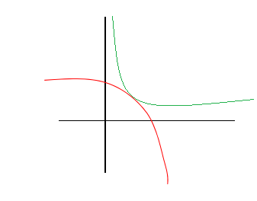
Completeness (strict inequality)
raSAT eventually detects SAT
UNSAT detected
UNSAT failed

Slide 12
Strategies
SAT directed heuristics.
Measure the SAT-likely hood of polynomial constraints.
Incremental search.
Incremental widening.
Incremental deepening.

Slide 13
SAT directed measures
Improve efficiency:
UNSAT: UNSAT core -> future work.
SAT:
Choose variable to decompose.
Choose box to explore.
Currently implemented.

Slide 14
SAT directed measures
Choose variable to decompose:
Choose TEST-UNSAT constraint: SAT-likehlyhood
Choose one variable in the selected constraint: Sensitivity
Choose box to explore: SAT-likelyhood

Slide 15
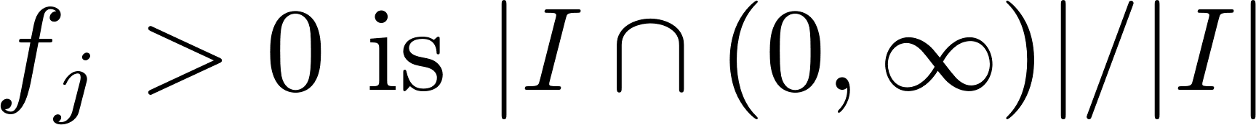

SAT directed measures
SAT-likelyhood of a constraint
: The interval estimated by IA.
Sensitivity of variable: using result of Affine interval.

Slide 16
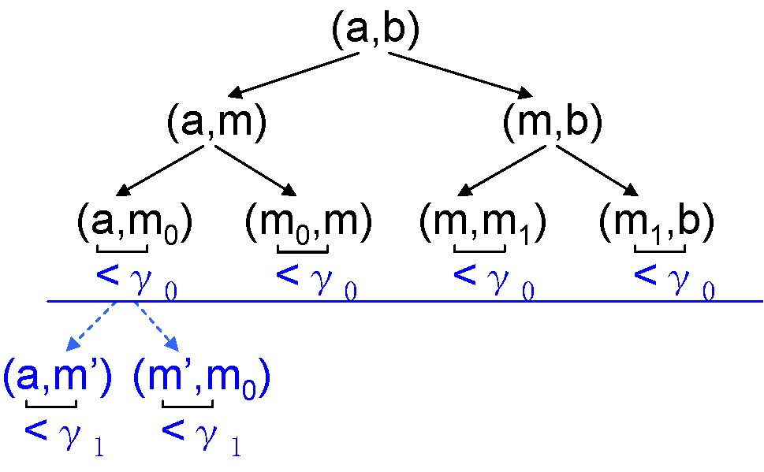
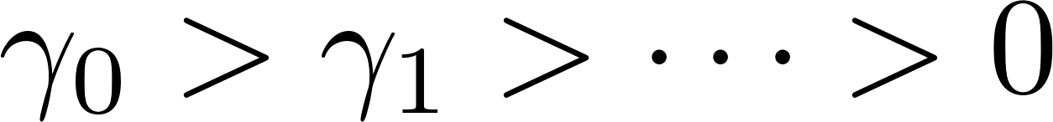
Incremental search
raSAT: depth-first search
-> threshold
Incremental deepening:

Slide 17

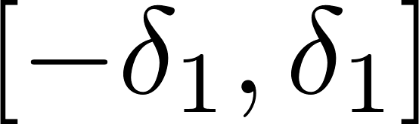
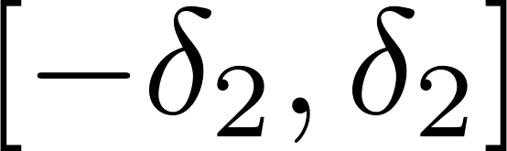
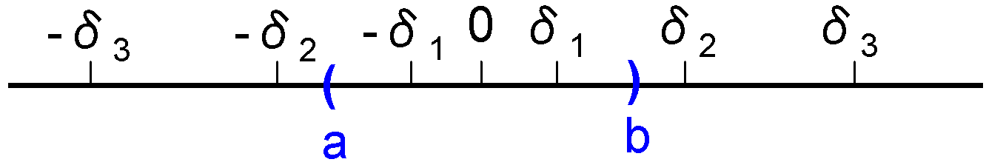
Incremental Windening
First, search on
If SAT -> conclude
If UNSAT, search on
Otherwise, deepens search.

Slide 18
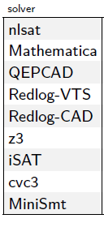
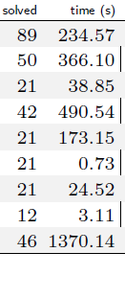
Experiments
Isat3: Interval [-1000, 1000]
Zankl family: 166 benchmarks extracted from termination problems.
Tool | SAT | UNSAT | Time
isat3 | 14 | 19 | 209.25
raSAT | 42 | 14 | 756.58
Z3 4.3 | 65 | 27 | 1034.73
Timeout = 500s
Dejan Jovanovic, Leonardo Mendonça de Moura: Solving Non-linear Arithmetic. IJCAR 2012: 339-354

Slide 19
Experiments – Zankl family
Z3 4.3 is very quick for small constraints:
short constraints (up to 5)
small number of variables (up to 10)
Otherwise, raSAT is comparable on SAT detection
Sometimes, raSAT outperforms on very long constraints (longer than 40 and more than 20 variables):
matrix-3-all-2 (47 variables, 87 APIs, and max length of an API is 27),
matrix-3-all-5 (81 variables, 142 APIs, and max length of an API is 20),
matrix-4-all-3 (139 variables, 244 APIs, and max length of an API is 73),
matrix-5-all-01 (132 variables, 276 APIs, and max length of an API is 47).

Slide 20
Experiments
Meti-Tarski contains 5101 inequalities among 7713:
taken from elementary physics.
small problems: up to 8 varaibles (mostly up to 5 variables), and up to 20 APIs.
Tool | SAT | UNSAT | Time
Isat3 | 2916 | 1225 | 885.36
raSAT | 3322 | 1052 | 753.00
Z3 | 3528 | 1568 | 129.78
Timeout = 60s

Slide 21
Extend for QF_NIA
Current approaches:
Bit blasting: suffers with high degree of polynomials.
Linearization:
Bit-blast one operand of a multiplication.
Can be solved by raSAT:
Decomposition: Stop when length of interval is 1
Generate integer test cases.

Slide 22
Experiments.
NIA/AProVE:
6850 inequalities among 8829.
Some has several hundred variables, but each API has
few variables (mostly just 2 variables)
Tool | SAT | UNSAT | Time
raSAT | 6764 | 0 | 1230.54
Z3 | 6784 | 36 | 139.78
Timeout = 60s

Slide 23
Future work
UNSAT core.
How to generate test cases.
How to decompose an interval.
Equality handling.
Confirmation of UNSAT.

Slide 24
raSAT
Downloadable from http://www.jaist.ac.jp/~mizuhito/tools/rasat.html
Participated in SMT-COMP 2014: 4th over 4 solvers of QF_NRA.
Submitted to TACAS 2015

Slide 25
Thank you for your attention

