Slide 1
Equality handling and efficiency improvement of SMT for non-linear constraints over reals.
Vu Xuan Tung – Ogawa lab - JAIST

Slide 2
Contents
Problems.
Current Status.
Doctor course proposal.

Slide 3
Problems

Slide 4
Satisfiability Modulo Theories (SMT)
SMT problem is a decision problem for
First-order formulas expressing constraints,
with respect to background theories.
If satisfiable (SAT), provide assignment of variables.
If unsatisfiable (UNSAT), proof is optionally generated.

Slide 5

Back ground theories
Theory of array
Linear arithmetic: $+, −$
Non-linear arithmetic: $+, −, ∗$
…..

Slide 6
Why SMT?
Logical formulas describes the program states and transformations.
Test–case generation
Model checking.
Program verification.
Others

Slide 7
Theory of non-linear arithmetic
Polynomial constraints solving has applications in:
Automatic termination proving.
Roundoff error and overflow error analysis.
Loop Invariant generation.
Analyzing reachability, discovering inductive invariants in hybrid systems.

Slide 8
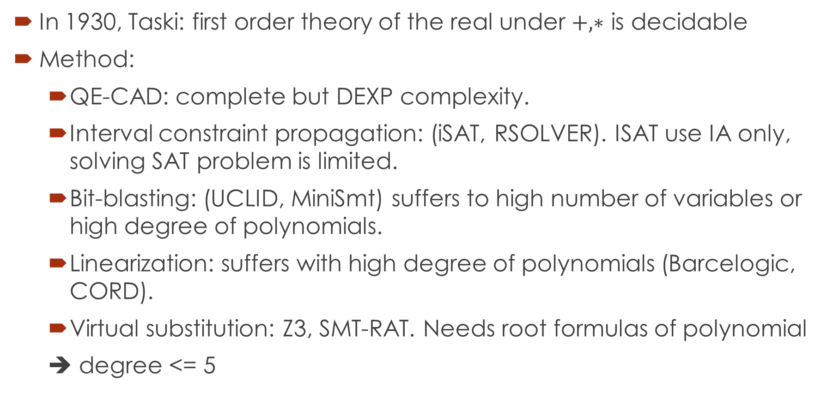
Theory of non-linear arithmetic
In 1930, Taski: first order theory of the real under $+, ∗$ is decidable
Method:
QE-CAD: complete but DEXP complexity.
Interval constraint propagation: (iSAT, RSOLVER). ISAT use IA only, solving SAT problem is limited.
Bit-blasting: (UCLID, MiniSmt) suffers to high number of variables or high degree of polynomials.
Linearization: suffers with high degree of polynomials (Barcelogic, CORD).
Virtual substitution: Z3, SMT-RAT. Needs root formulas of polynomial
➔ degree <= 5

Slide 9
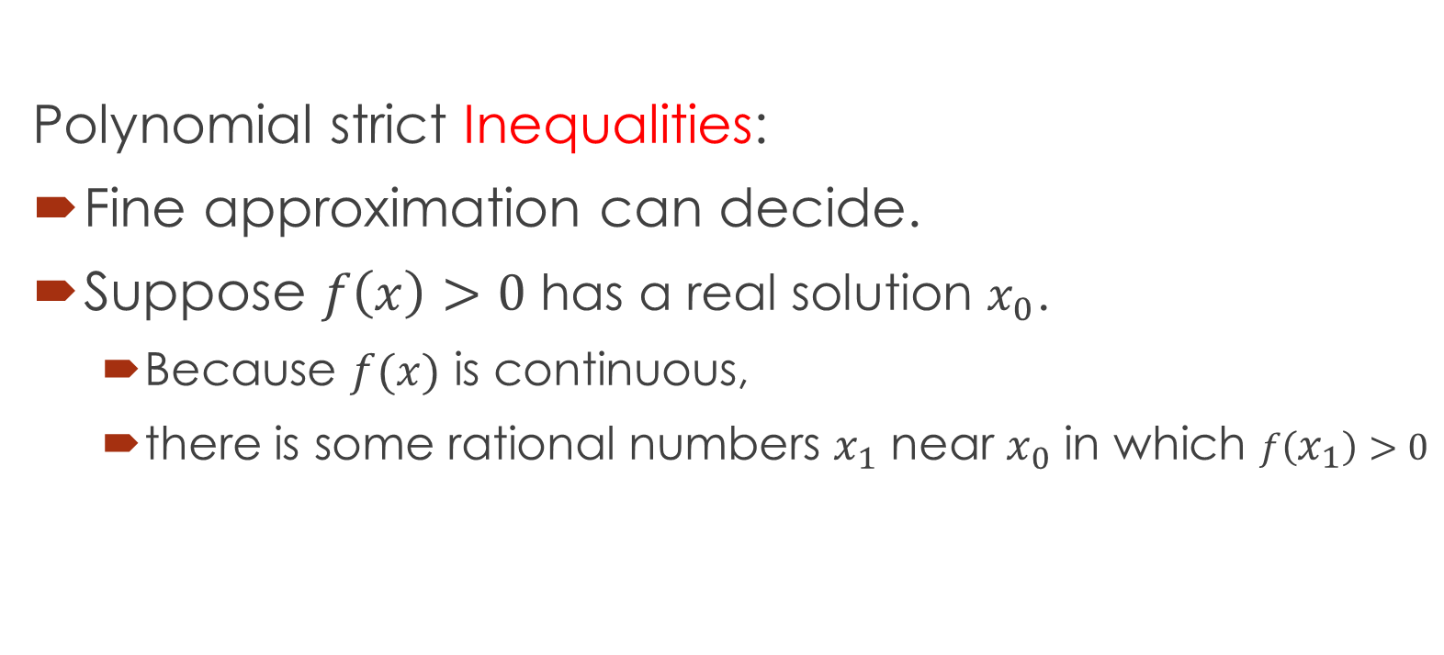
raSAT
Polynomial strict Inequalities:
Fine approximation can decide.
Suppose $f\left(x\right)>0$ has a real solution $x_{0}$.
Because $f(x)$ is continuous,
there is some rational numbers $x_{1}$ near $x_{0}$ in which $f\left(x_{1}\right)>0$

Slide 10

$$Constraints$$
raSAT
Yest
Threshold - Unknown
NO
SAT solver
UNSAT/Unknown
Learn conflicts
Theory solver
Refined clauses
YES
Interval Arithmetic
UNSAT
US Core
Refinement
UNKNOWN
VALID
TEST-UNSAT
Testing
SAT
SAT

Slide 11
Problems
SAT, UNSAT verification.
Round-off, overflow errors.
UNSAT core.
Running time: high, often causes timeout.
Testing phase.
Random test case generation:
Boosts efficiency,
Leads to unstable results.
Testing consumes memory.

Slide 12
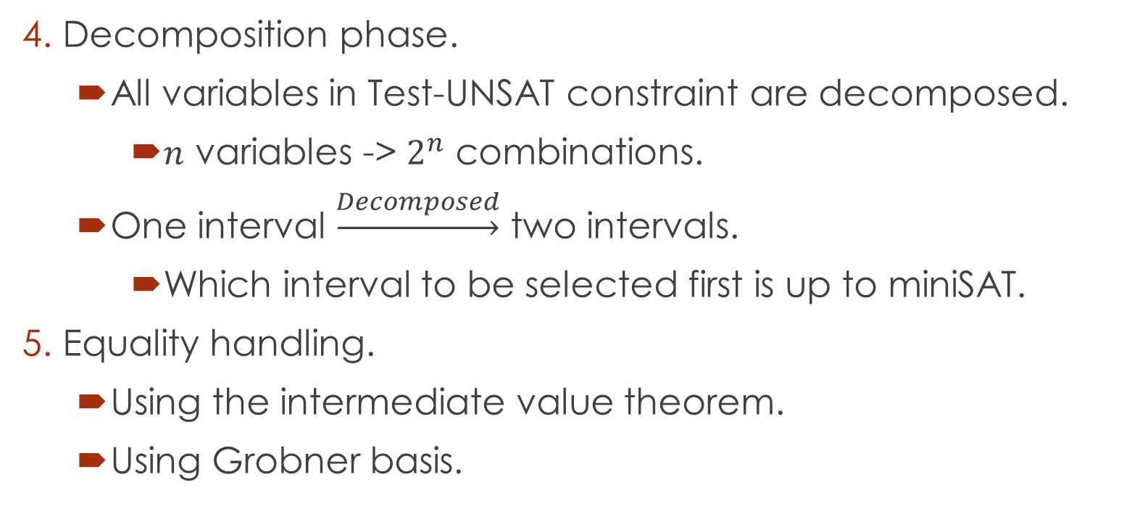
Problems
Decomposition phase.
All variables in Test-UNSAT constraint are decomposed.
$n$ variables -> $2^{n}$ combinations.
One interval $\underset{→}{Decomposed}$ two intervals.
Which interval to be selected first is up to miniSAT.
Equality handling.
Using the intermediate value theorem.
Using Grobner basis.

Slide 13
Current status

Slide 14
1. SAT, UNSAT verification
Round-off, overflow errors can make the result unsound.
iRRAM.
C++ package
Error-bounded real arithmetic
Integrated into raSAT for SAT verification.
Rarely iRRAM detects error.
Two times: zankle/matrix_2_all_6.smt2
Future work: Verify UNSAT results.

Slide 15
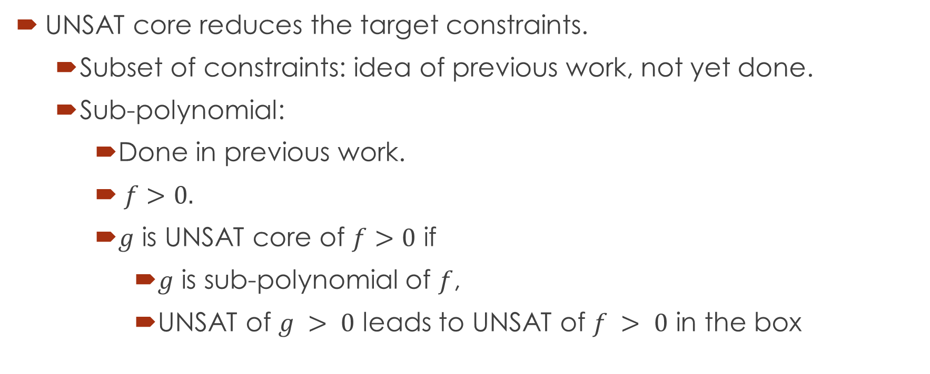
2. UNSAT core
UNSAT core reduces the target constraints.
Subset of constraints: idea of previous work, not yet done.
Sub-polynomial:
Done in previous work.
$f>0.$
$g$ is UNSAT core of $f>0$ if
$g$ is sub-polynomial of $f$,
UNSAT of $g > 0$ leads to UNSAT of $f > 0$ in the box

Slide 16
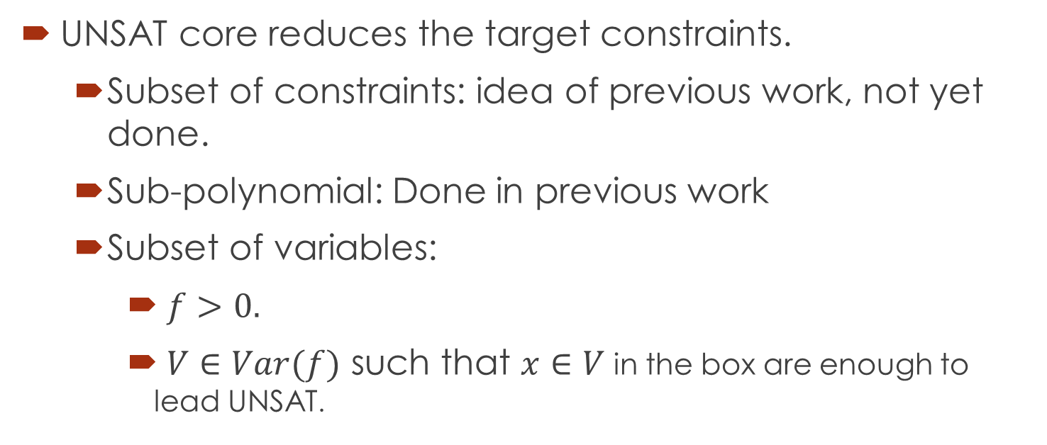
2. UNSAT core
UNSAT core reduces the target constraints.
Subset of constraints: idea of previous work, not yet done.
Sub-polynomial: Done in previous work
Subset of variables:
$f>0.$
$V∈Var(f)$ such that $x∈V$ in the box are enough to lead UNSAT.

Slide 17
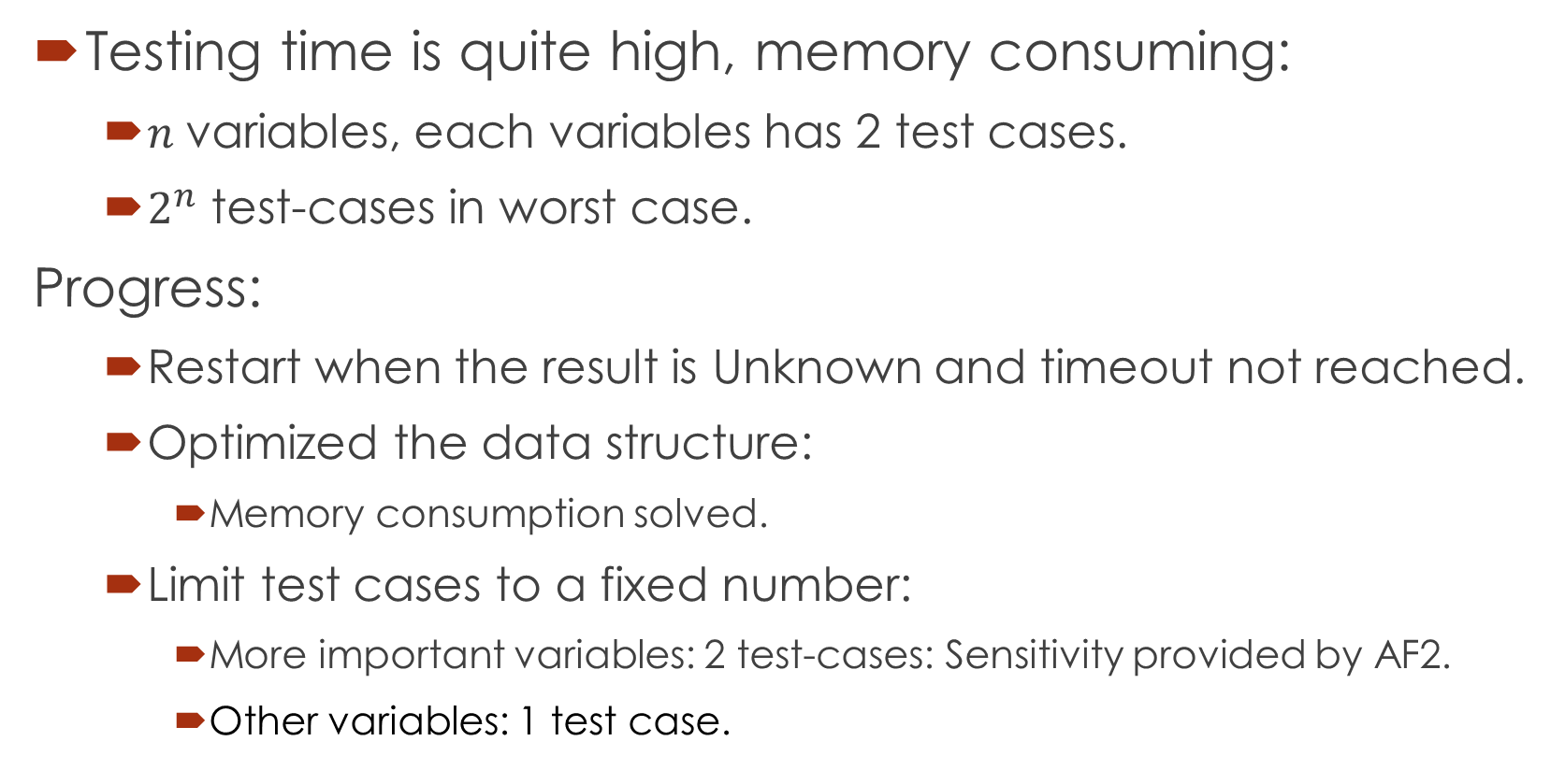
3. Testing phase
Testing time is quite high, memory consuming:
$n$ variables, each variables has 2 test cases.
$2^{n}$ test-cases in worst case.
Progress:
Restart when the result is Unknown and timeout not reached.
Optimized the data structure:
Memory consumption solved.
Limit test cases to a fixed number:
More important variables: 2 test-cases: Sensitivity provided by AF2.
Other variables: 1 test case.

Slide 18
3. Testing phase
Testing experiments
m=10:
m=15:
m=20:
Not much improvements in solved problems
More balance between testing time, IA time, miniSAT time.
43 problems in Zankl solved.
44 problems.
46 problems.

Slide 19
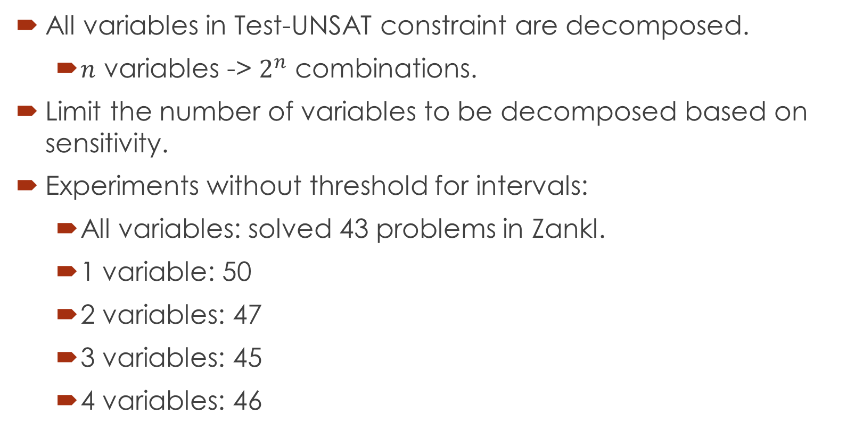
4. Decomposition
All variables in Test-UNSAT constraint are decomposed.
$n$ variables -> $2^{n}$ combinations.
Limit the number of variables to be decomposed based on sensitivity.
Experiments without threshold for intervals:
All variables: solved 43 problems in Zankl.
1 variable: 50
2 variables: 47
3 variables: 45
4 variables: 46

Slide 20
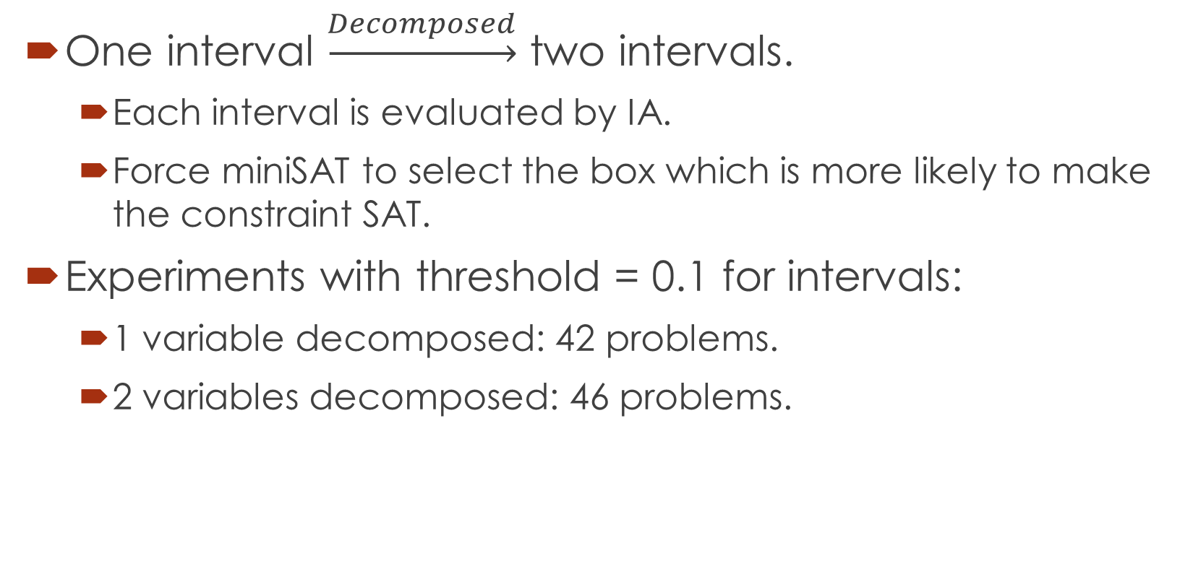
4. Decomposition - box selection
One interval $\underset{→}{Decomposed}$ two intervals.
Each interval is evaluated by IA.
Force miniSAT to select the box which is more likely to make the constraint SAT.
Experiments with threshold = 0.1 for intervals:
1 variable decomposed: 42 problems.
2 variables decomposed: 46 problems.

Slide 21
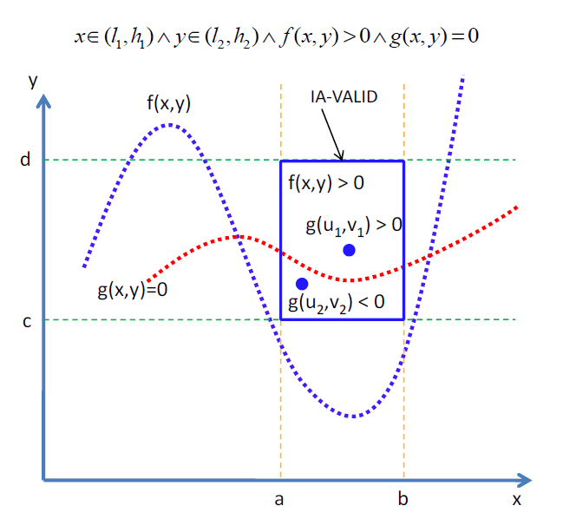
5. Equality handling.
Intermediate value
theorem
Single equality:
Done in previous
Work.

Slide 22
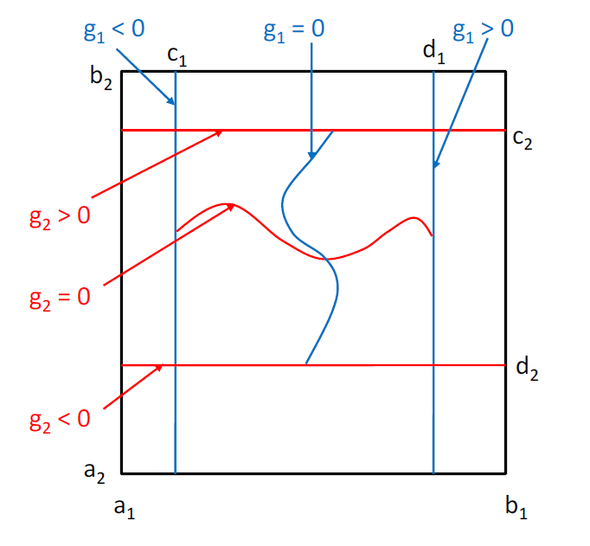

5. Equality handling.
Intermediate value
theorem
Multiple equalities:
Number of
variables $>$ number
of equations
To be done.

Slide 23
Doctor course Proposal

Slide 24
Problems.
Equality extension: Grobner basis.
UNSAT proof generation

Slide 25
1. Equality extension: Grobner basis.
Grobner basis
Intermediate value theorem: restrictions.
For complete equality handling: Grobner basis.
Implemented in Mathematica, Reduce.
We expect to implement efficiently.

Slide 26
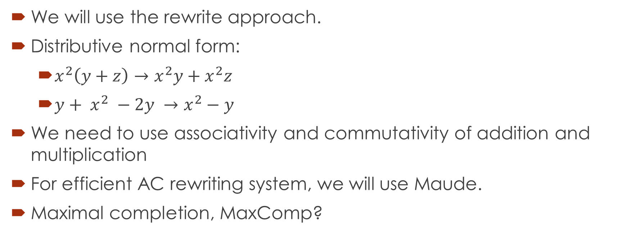
1. Equality extension: Grobner basis.
We will use the rewrite approach.
Distributive normal form:
$x^{2}\left(y+z\right)→x^{2}y+x^{2}z$
${y+ x}^{2} −2y →x^{2}−y$
We need to use associativity and commutativity of addition and multiplication
For efficient AC rewriting system, we will use Maude.
Maximal completion, MaxComp?

Slide 27
2. UNSAT proof generation
Proof of UNSAT can be used to extract Craig interpolants
Abstraction refinement
Invariant generation.
Most of the current works focus on Presburger Arithmetic.
Not much research on interpolants of polynomial constraints.
Such interpolants arise during verification of complex systems such as hybrid ones.

Slide 28
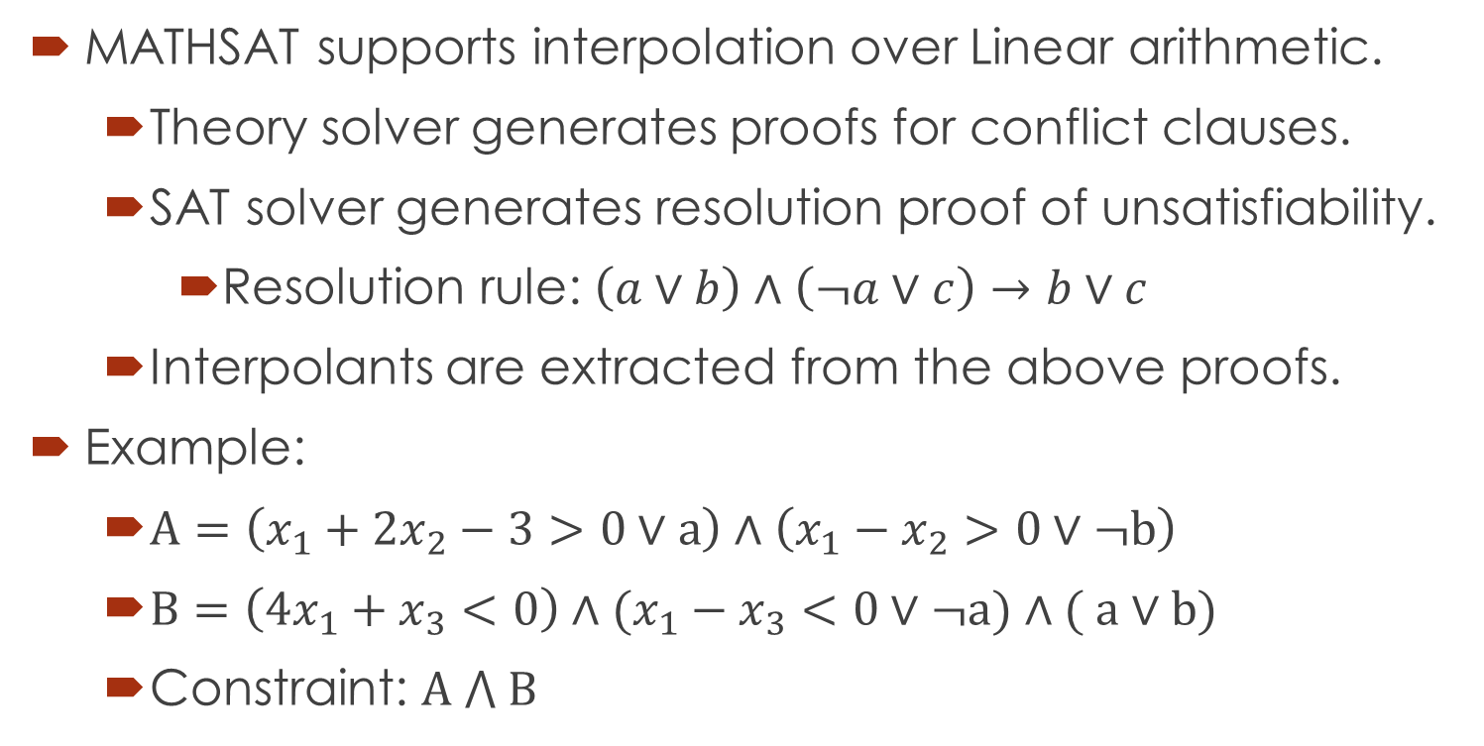
Related works
MATHSAT supports interpolation over Linear arithmetic.
Theory solver generates proofs for conflict clauses.
SAT solver generates resolution proof of unsatisfiability.
Resolution rule: $\left(a∨b\right)∧\left(¬a∨c\right)→b∨c$
Interpolants are extracted from the above proofs.
Example:
$A=\left(x_{1}+{2x}_{2}−3>0∨a\right)∧\left({x_{1}−x}_{2}>0∨¬b\right)$
$B=\left(4x_{1}+x_{3}<0\right)∧(x_{1}−x_{3}<0∨¬a)∧( a∨b)$
Constraint: $A ⋀ B$

Slide 29
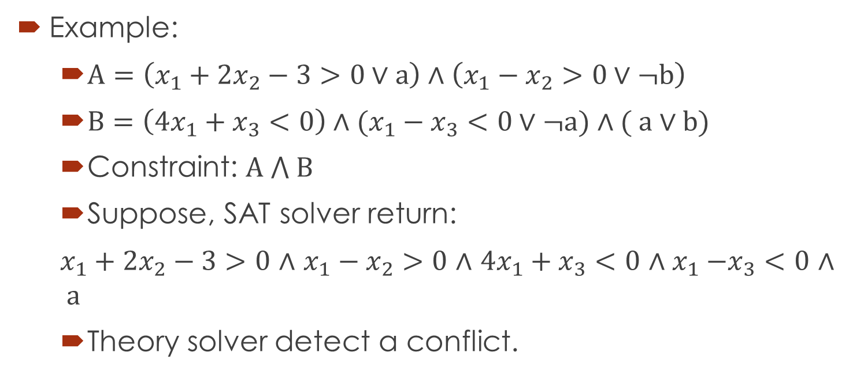
Related works - MATHSAT
Example:
$A=\left(x_{1}+{2x}_{2}−3>0∨a\right)∧\left({x_{1}−x}_{2}>0∨¬b\right)$
$B=\left(4x_{1}+x_{3}<0\right)∧(x_{1}−x_{3}<0∨¬a)∧( a∨b)$
Constraint: $A ⋀ B$
Suppose, SAT solver return:
$x_{1}+{2x}_{2}−3>0$ $∧$ ${x_{1}−x}_{2}>0$ $∧$ $4x_{1}+x_{3}<0$ ${∧x}_{1}−x_{3}<0$ $∧ a$
Theory solver detect a conflict.

Slide 30
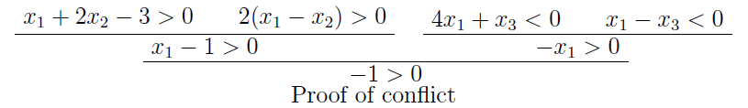
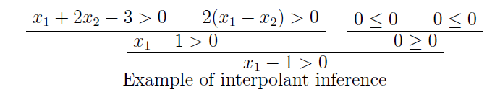

Related works - MATHSAT
$A=\left(x_{1}+{2x}_{2}−3>0∨a\right)∧\left({x_{1}−x}_{2}>0∨¬b\right)$
$B=\left(4x_{1}+x_{3}<0\right)∧(x_{1}−x_{3}<0∨¬a)∧( a∨b)$
$x_{1}+{2x}_{2}−3>0$ $∧$ ${x_{1}−x}_{2}>0$ $∧$ $4x_{1}+x_{3}<0$ ${∧x}_{1}−x_{3}<0∧a$

Slide 31
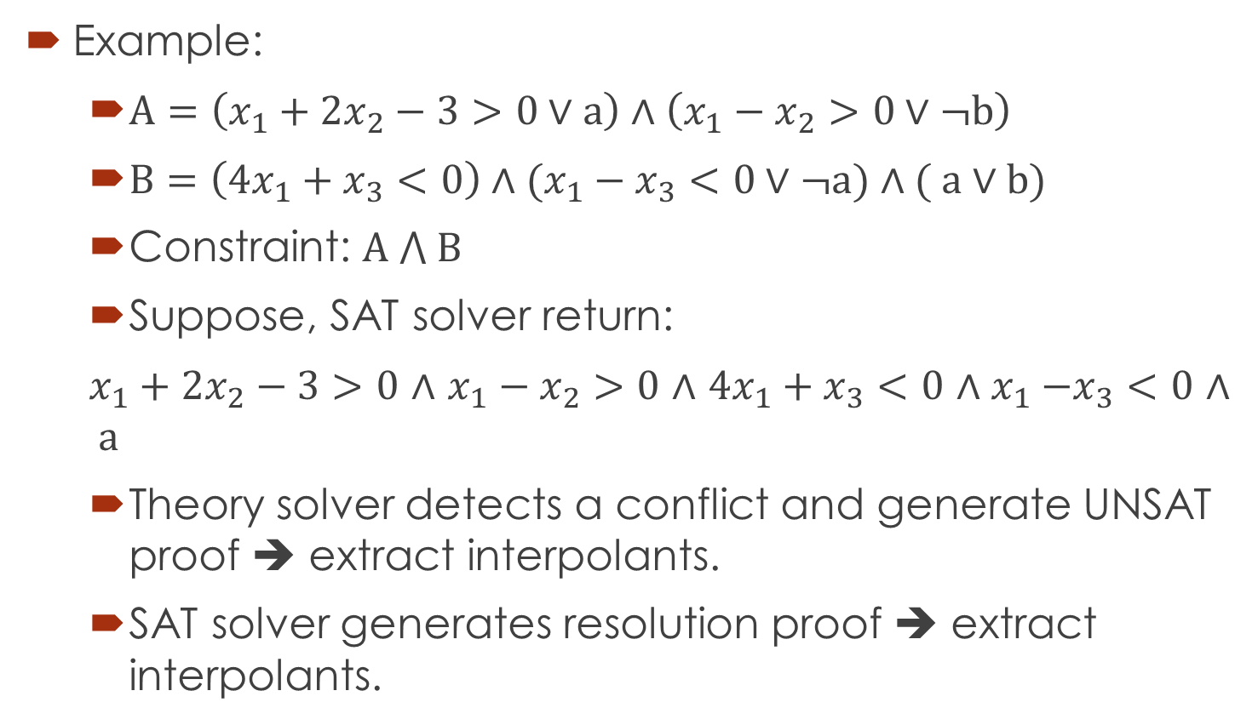
Related works - MATHSAT
Example:
$A=\left(x_{1}+{2x}_{2}−3>0∨a\right)∧\left({x_{1}−x}_{2}>0∨¬b\right)$
$B=\left(4x_{1}+x_{3}<0\right)∧(x_{1}−x_{3}<0∨¬a)∧( a∨b)$
Constraint: $A ⋀ B$
Suppose, SAT solver return:
$x_{1}+{2x}_{2}−3>0$ $∧$ ${x_{1}−x}_{2}>0$ $∧$ $4x_{1}+x_{3}<0$ ${∧x}_{1}−x_{3}<0$ $∧ a$
Theory solver detects a conflict and generate UNSAT proof ➔ extract interpolants.
SAT solver generates resolution proof ➔ extract interpolants.

Slide 32
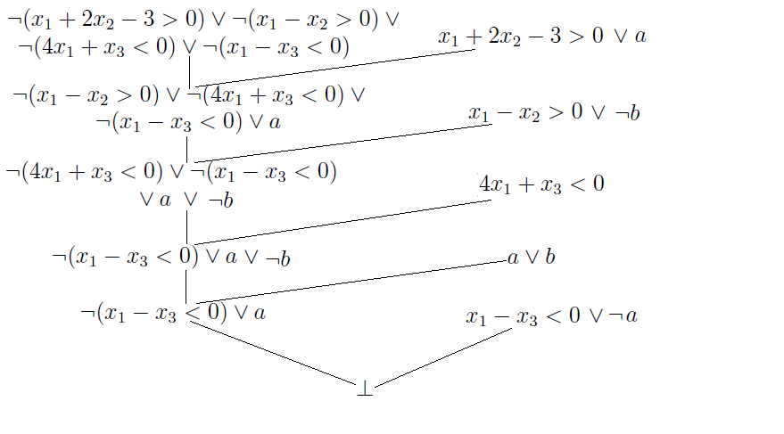
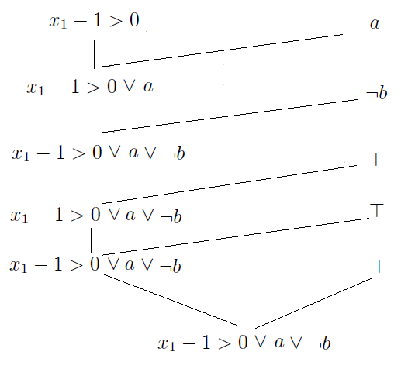
Related works - MATHSAT
Resolution Proof
Interpolants inference

Slide 33
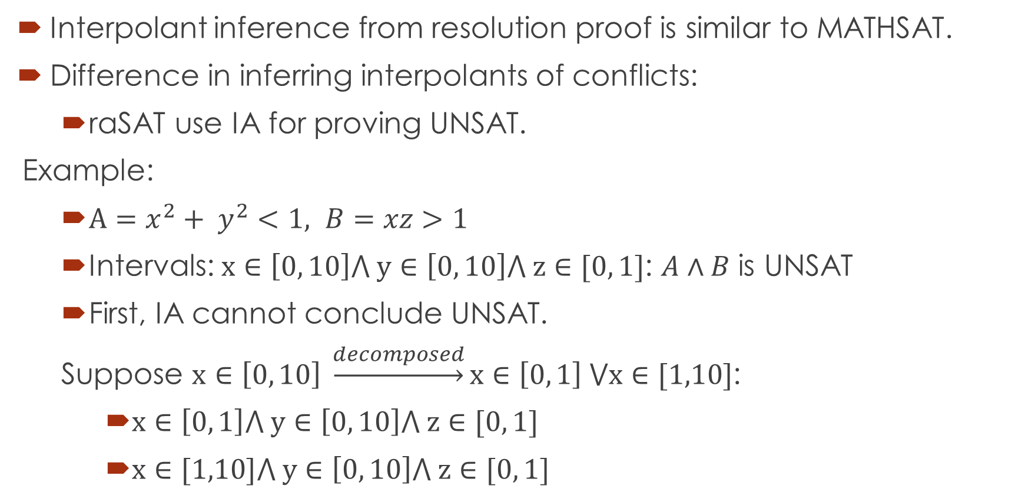
Primary idea
Interpolant inference from resolution proof is similar to MATHSAT.
Difference in inferring interpolants of conflicts:
raSAT use IA for proving UNSAT.
Example:
$A=x^{2}+ y^{2}<1, B=xz>1$
Intervals: $x∈\left[0, 10\right]⋀ y∈\left[0, 10\right]⋀ z∈[0, 1]$: $A∧B$ is UNSAT
First, IA cannot conclude UNSAT.
Suppose $x∈\left[0, 10\right] \underset{→}{decomposed}x∈\left[0, 1\right] ⋁x∈[1,10]$:
$x∈\left[0, 1\right]⋀ y∈\left[0, 10\right]⋀ z∈[0, 1]$
$x∈[1,10]⋀ y∈\left[0, 10\right]⋀ z∈[0, 1]$

Slide 34


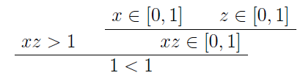
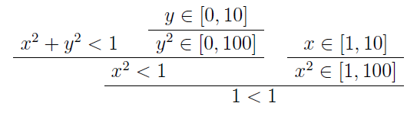



From resolution proof, we can infer as final interpolant

Slide 35
Thank you for your attention

