Slide 1
Equality handling and efficiency improvement of SMT for non-linear constraints over reals.
Vu Xuan Tung – Ogawa Lab - JAIST

Slide 2
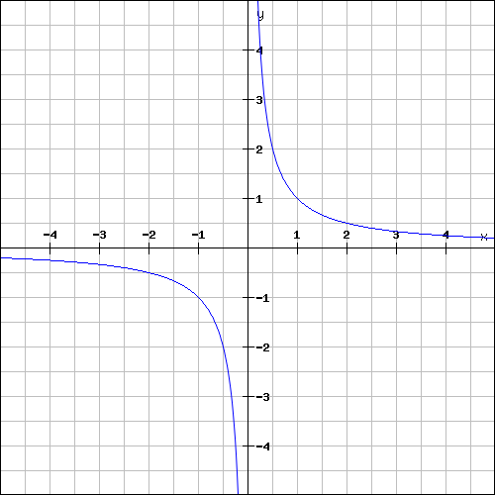
Non-linear (polynomial) constraints over reals

Slide 3
Polynomial constraints over reals
Polynomial constraints solving has applications in:
Automatic termination proving.
Roundoff error and overflow error analysis.
Invariant generation.

Slide 4
Polynomial constraints over reals
In 1930, Tarski: polynomial constraints is decidable
Methods:
QE-CAD: complete but DEXP complexity.
Interval constraint propagation: ISAT uses interval arithmetic (IA) only, ability of solving SAT problem is limited.
Bit-blasting: (UCLID, MiniSmt) suffers with high number of variables or high degree of polynomials.
Linearization: suffers with high degree of polynomials (Barcelogic, CORD).
Virtual substitution: Z3, SMT-RAT. Needs root formulas of polynomial
➔ degree <= 5
raSAT: IA + testing

Slide 5
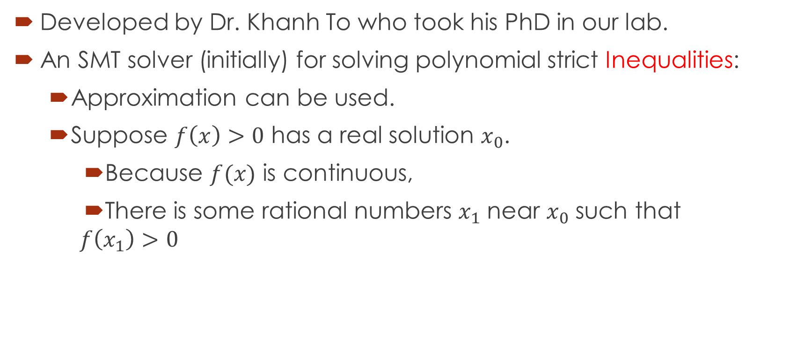
raSAT
Developed by Dr. Khanh To who took his PhD in our lab.
An SMT solver (initially) for solving polynomial strict Inequalities:
Approximation can be used.
Suppose $f\left(x\right)>0$ has a real solution $x_{0}$.
Because $f(x)$ is continuous,
There is some rational numbers $x_{1}$ near $x_{0}$ such that
$$f\left(x_{1}\right)>0$$

Slide 6
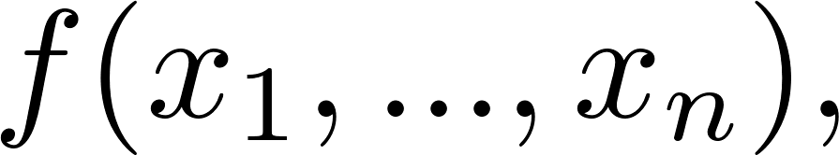
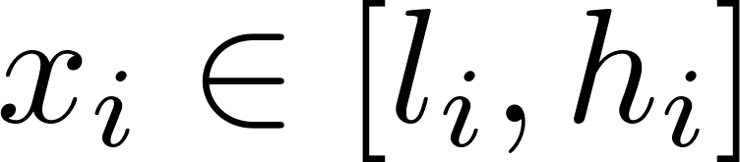
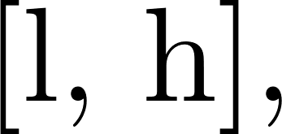

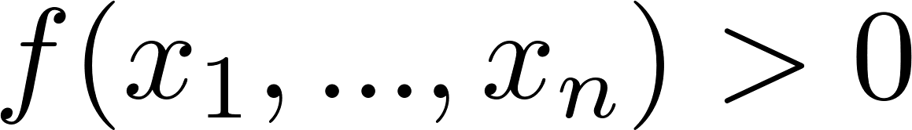



Over approximation - Interval arithmetic (IA)
Interval arithmetic
l
h
IA-UNSAT
UNSAT
l
h
0
IA-VALID
SAT
0
l
h
IA-UNKNOWN
UNKNOWN
l
0
h

Slide 7
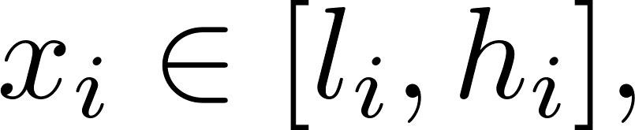
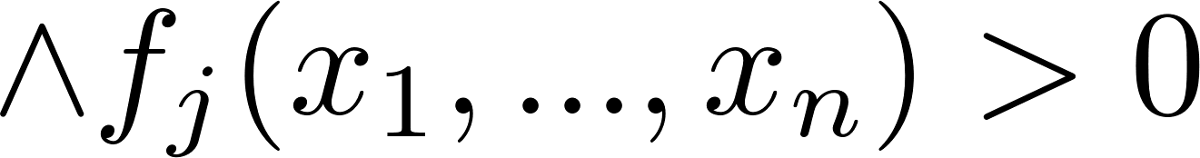
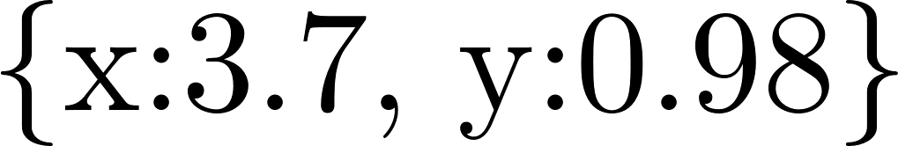
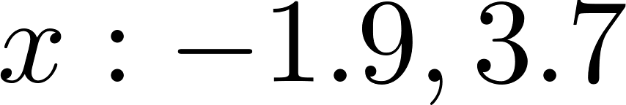
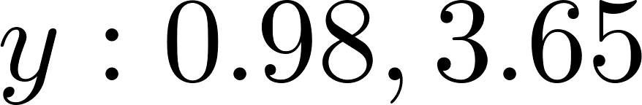
Under approximation - Testing
Testing:
Randomly generate values for variables
SAT with variables assignment
UNKNOWN
Example:
Testing:
Randomly generate values for variables
SAT with

Slide 8
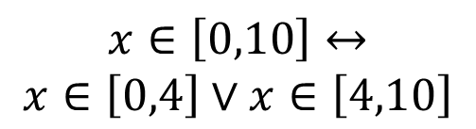

$$Constraints$$
raSAT
Yest
Threshold - Unknown
NO
SAT solver
UNSAT/
Unknown
Learn conflicts
Theory solver
Refined clauses
YES
IA-UNSAT
Interval Arithmetic
US Core
$$x∈\left[0,10\right]↔$$
$$x∈\left[0,4\right]∨x∈\left[4,10\right]$$
Refinement
IA-UNKNOWN
IA-VALID
Test-UNSAT
Testing
TEST-SAT
SAT

Slide 9
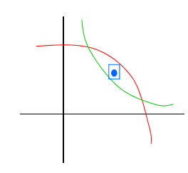
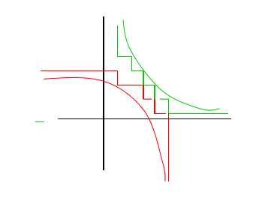
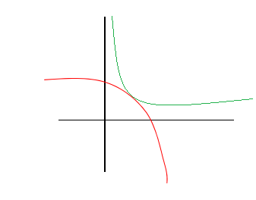
Completeness (strict inequality)
raSAT eventually detects SAT
UNSAT detected
UNSAT failed

Slide 10
raSAT
In this work:
Improve the efficiency of raSAT.
Handle equality.
Handle polynomial constraints over Integer (QF_NIA).

Slide 11
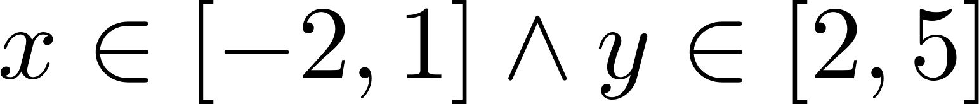
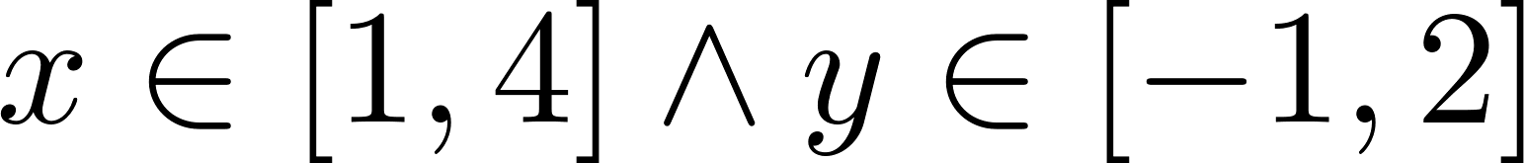
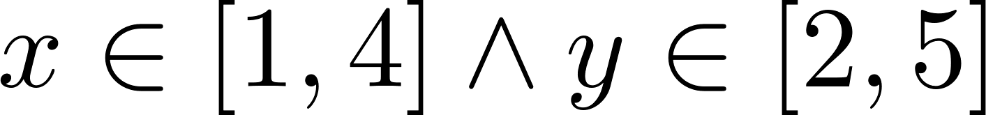
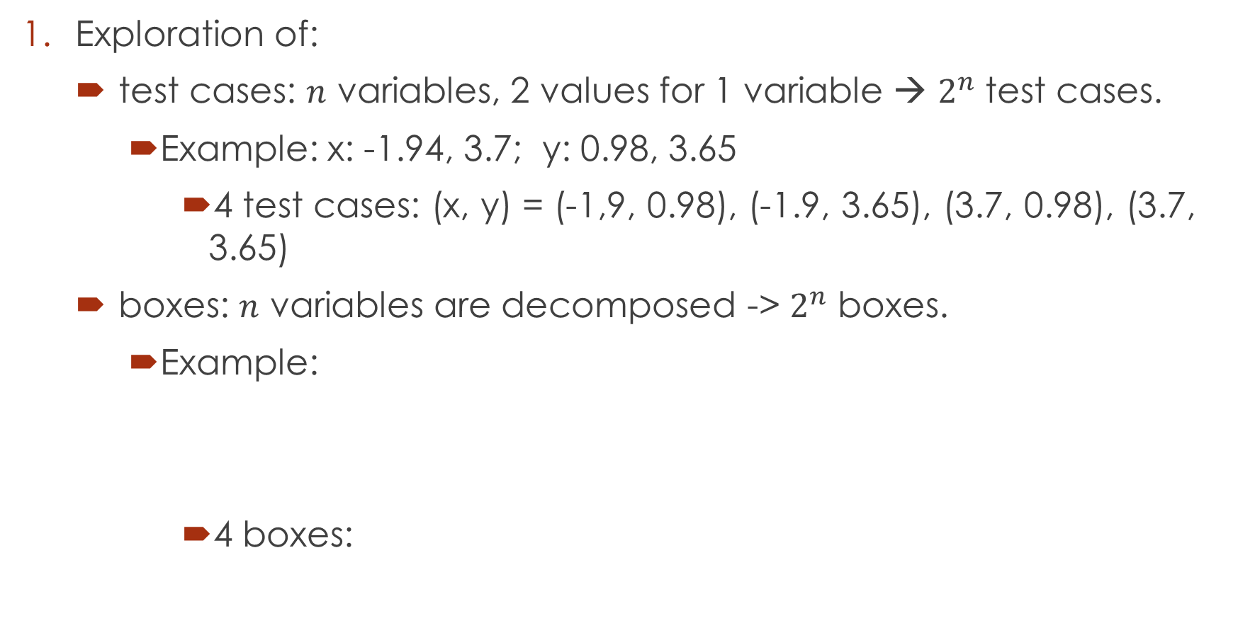
Problems
Exploration of:
test cases: $n$ variables, 2 values for 1 variable → $2^{n}$ test cases.
Example: x: -1.94, 3.7; y: 0.98, 3.65
4 test cases: (x, y) = (-1,9, 0.98), (-1.9, 3.65), (3.7, 0.98), (3.7, 3.65)
boxes: $n$ variables are decomposed -> $2^{n}$ boxes.
Example:
4 boxes:

Slide 12
Problems.
Soundness.
Floating point arithmetic: round-off, overflow errors.
Equality handling.
Using the intermediate value theorem.

Slide 13
Current status

Slide 14
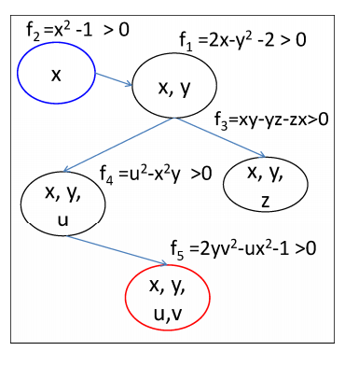
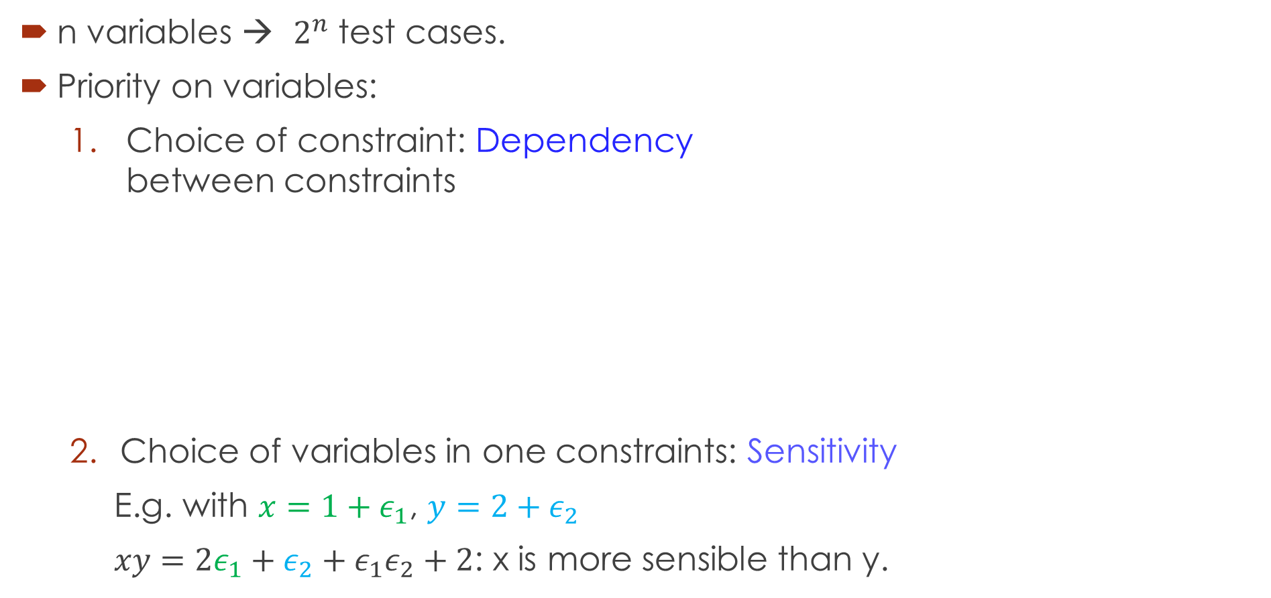
1. Exploration of test cases, boxes
n variables → $2^{n}$ test cases.
Priority on variables:
Choice of constraint: Dependency between constraints
Choice of variables in one constraints: Sensitivity
E.g. with $x=1+ε_{1}$, $y=2+ε_{2}$
$xy=2ε_{1}+ε_{2}+ε_{1}ε_{2}+2$: x is more sensible than y.

Slide 15
2. SAT, UNSAT verification
Round-off, overflow errors can make the result unsound.
iRRAM:
C++ package
Error-bounded real arithmetic
Integrated iRRAM into raSAT for SAT verification.
Future work: Verify UNSAT results
Improve UNSAT core.

Slide 16
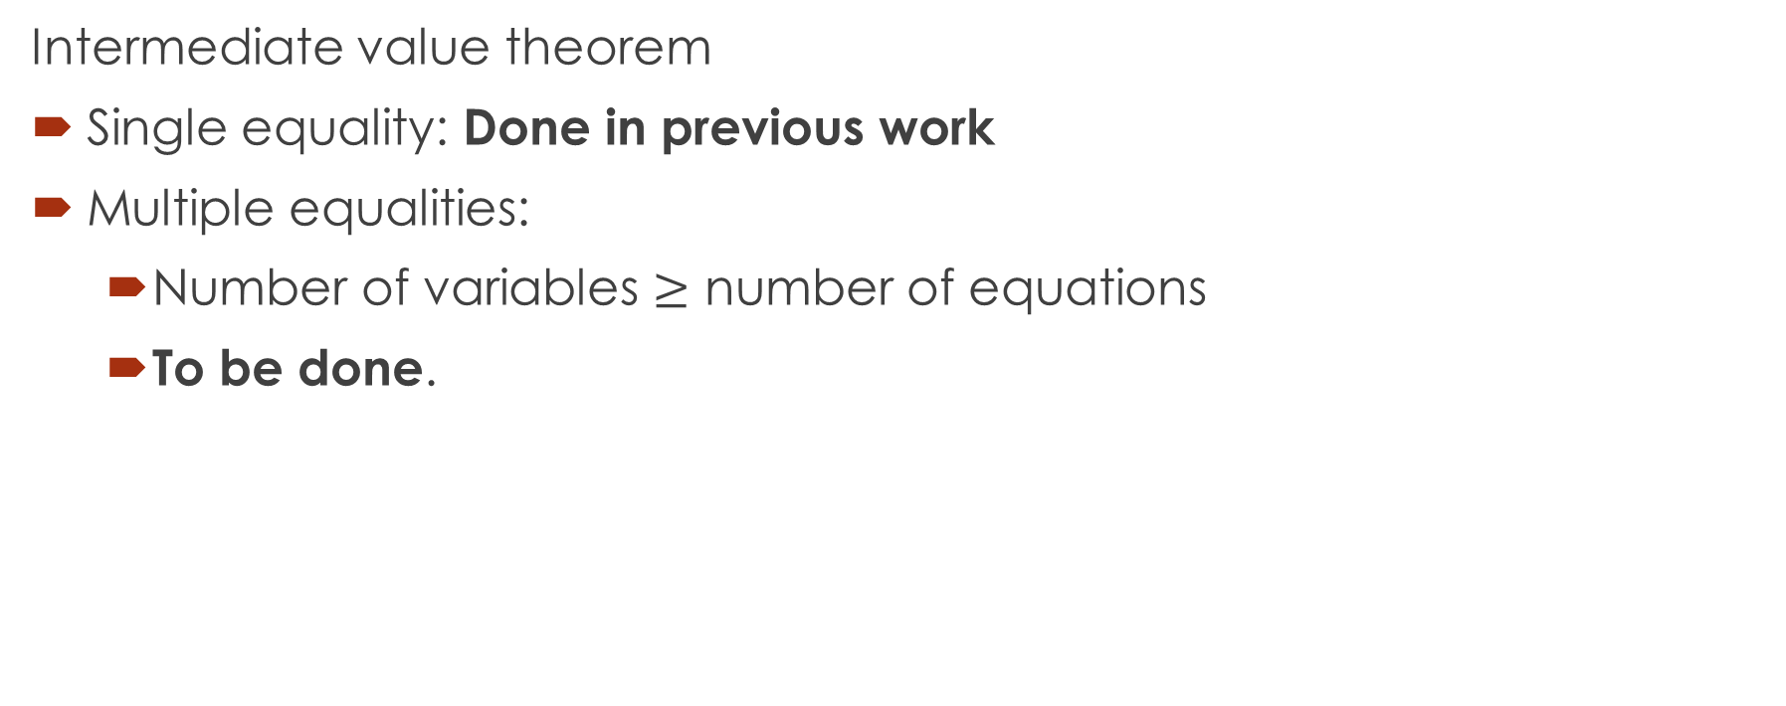
3. Equality handling.
Intermediate value theorem
Single equality: Done in previous work
Multiple equalities:
Number of variables $≥$ number of equations
To be done.

Slide 17
6. Extend for QF_NIA
Current approaches:
Bit blasting: suffers with high degree of polynomials.
Linearization:
Bit-blast one operand of a multiplication.
Can be solved by raSAT:
Decomposition: Stop when length of interval is 1
Generate integer test cases.
Future work

Slide 18
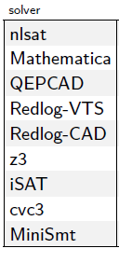
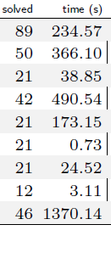
raSAT
Participated in SMT-COMP 2014: 4th over 4 solvers of QF_NRA
Preliminary experiments on SMTlib.
Mostly focus on Zankl family (166 benchmarks).
Around 50 problems solved (depending on tuning).
Dejan Jovanovic, Leonardo Mendonça de Moura: Solving Non-linear Arithmetic. IJCAR 2012: 339-354

Slide 19
Thank you for your attention

Slide 20
Doctor course Proposal

Slide 21
Problems.
Equality extension: Grobner basis.
UNSAT proof generation

Slide 22
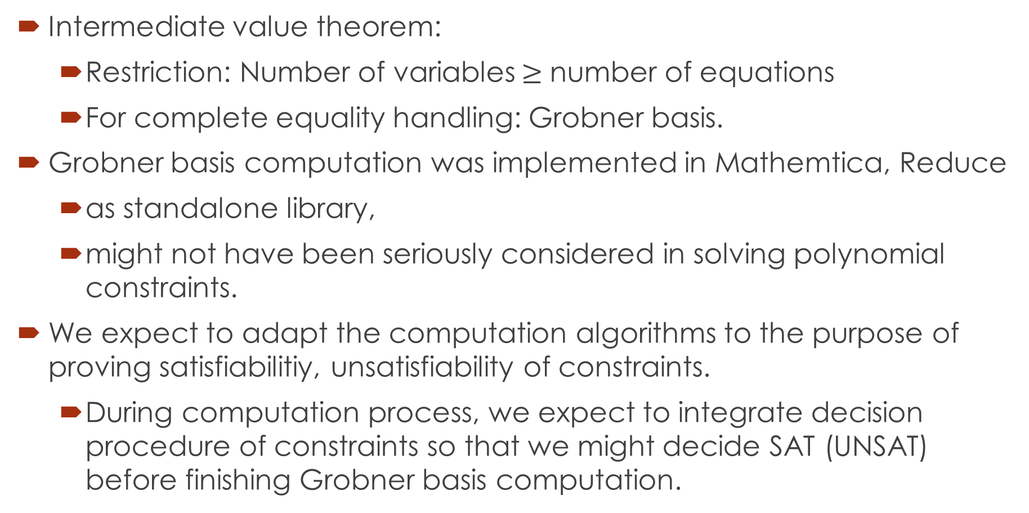
1. Equality extension: Grobner basis.
Intermediate value theorem:
Restriction: Number of variables$≥$ number of equations
For complete equality handling: Grobner basis.
Grobner basis computation was implemented in Mathemtica, Reduce
as standalone library,
might not have been seriously considered in solving polynomial constraints.
We expect to adapt the computation algorithms to the purpose of proving satisfiabilitiy, unsatisfiability of constraints.
During computation process, we expect to integrate decision procedure of constraints so that we might decide SAT (UNSAT) before finishing Grobner basis computation.

Slide 23
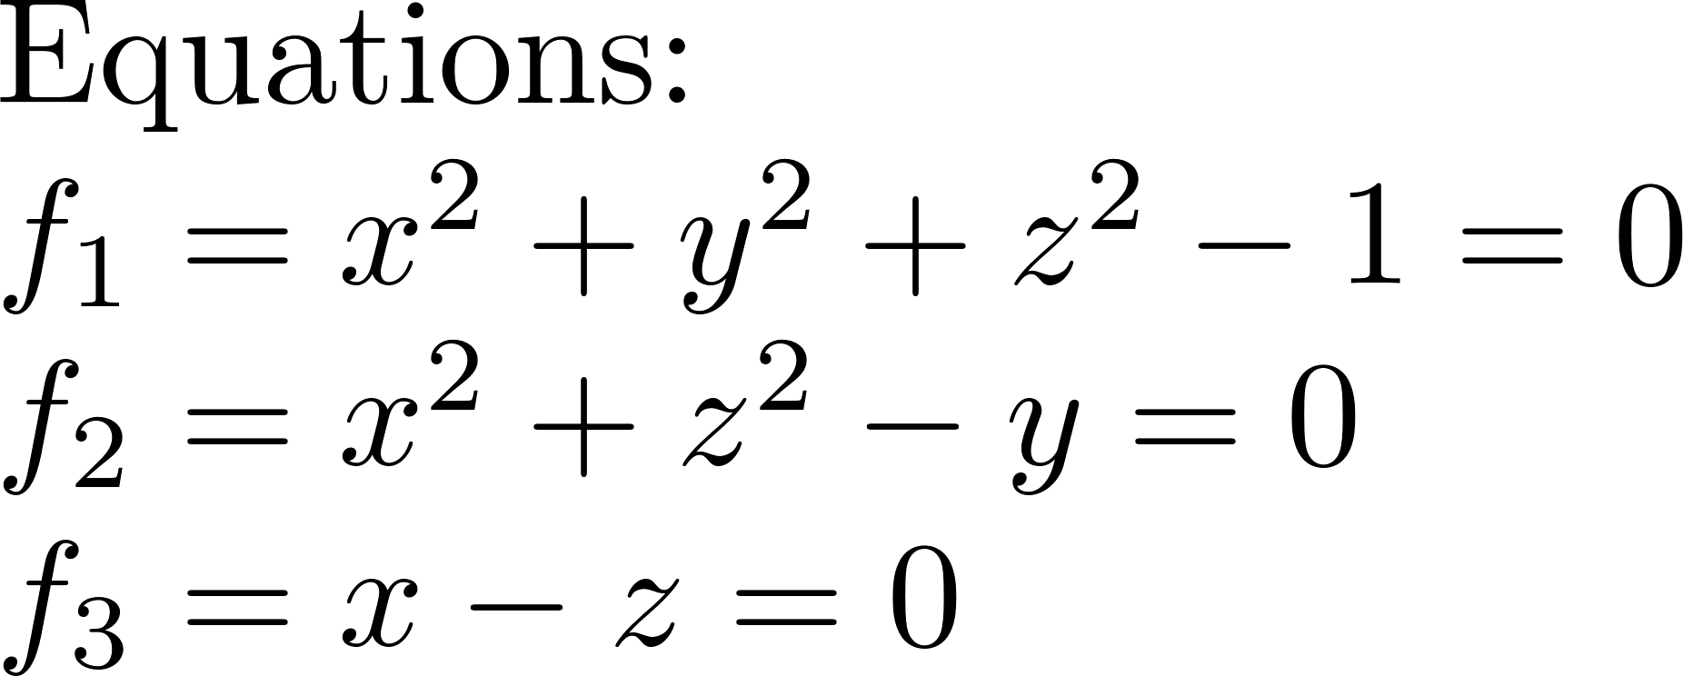

1. Grobner basis – Example

Slide 24
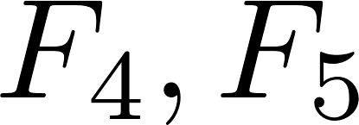
1. Grobner basis - Algorithms
Buchberger Algorithm.
Reduce one s-pair at a time
algorithms.
Reduce many s-pair at once.
Need more investigations on algorithms and on how to adapt them to raSAT.

Slide 25
2. UNSAT proof generation
Proof of UNSAT can be used to extract Craig interpolants.
Craig interpolants have applications in:
Abstraction refinement.
Invariant generation.
Most of the current works focus on Linear Arithmetic.
Not much research on interpolants of polynomial constraints.
Such interpolants arise during verification of complex systems such as hybrid ones.

Slide 26
Primary idea
Two kinds of proofs:
Resolution proof: produced by SAT solver.
Resolution rule:
Interpolation from resolution proof is straitforward.
Proof of conflict clauses: produced by theory solver of raSAT.
Theory solver also infers interpolants from this proof.

Slide 27
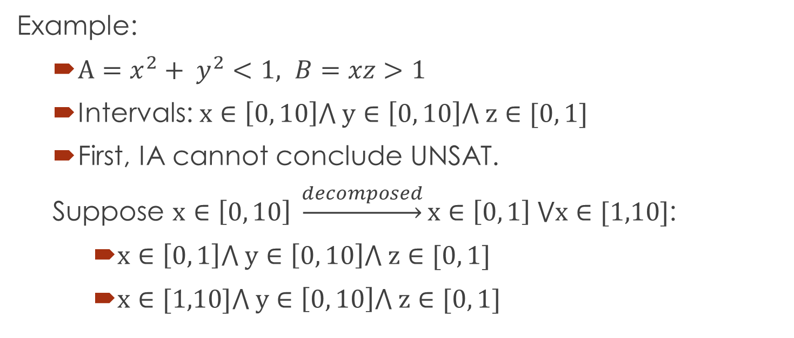
Primary idea
Example:
$A=x^{2}+ y^{2}<1, B=xz>1$
Intervals: $x∈\left[0, 10\right]⋀ y∈\left[0, 10\right]⋀ z∈[0, 1]$
First, IA cannot conclude UNSAT.
Suppose $x∈\left[0, 10\right] \underset{→}{decomposed}x∈\left[0, 1\right] ⋁x∈[1,10]$:
$x∈\left[0, 1\right]⋀ y∈\left[0, 10\right]⋀ z∈[0, 1]$
$x∈[1,10]⋀ y∈\left[0, 10\right]⋀ z∈[0, 1]$

Slide 28
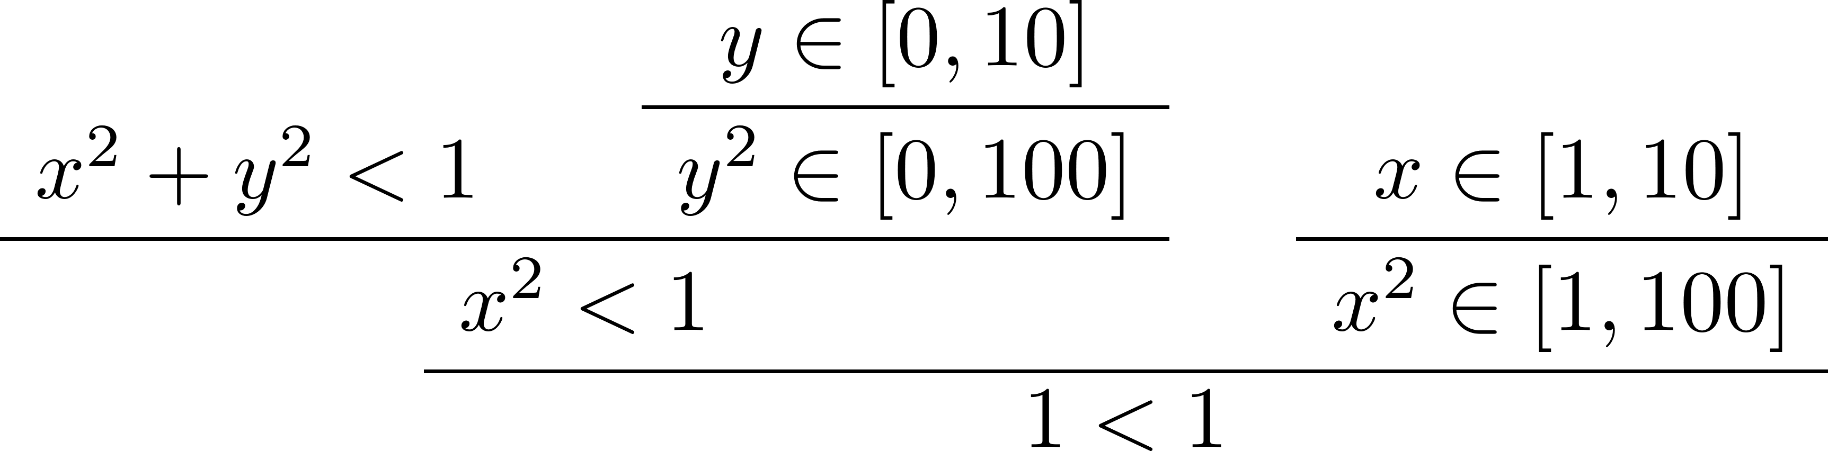
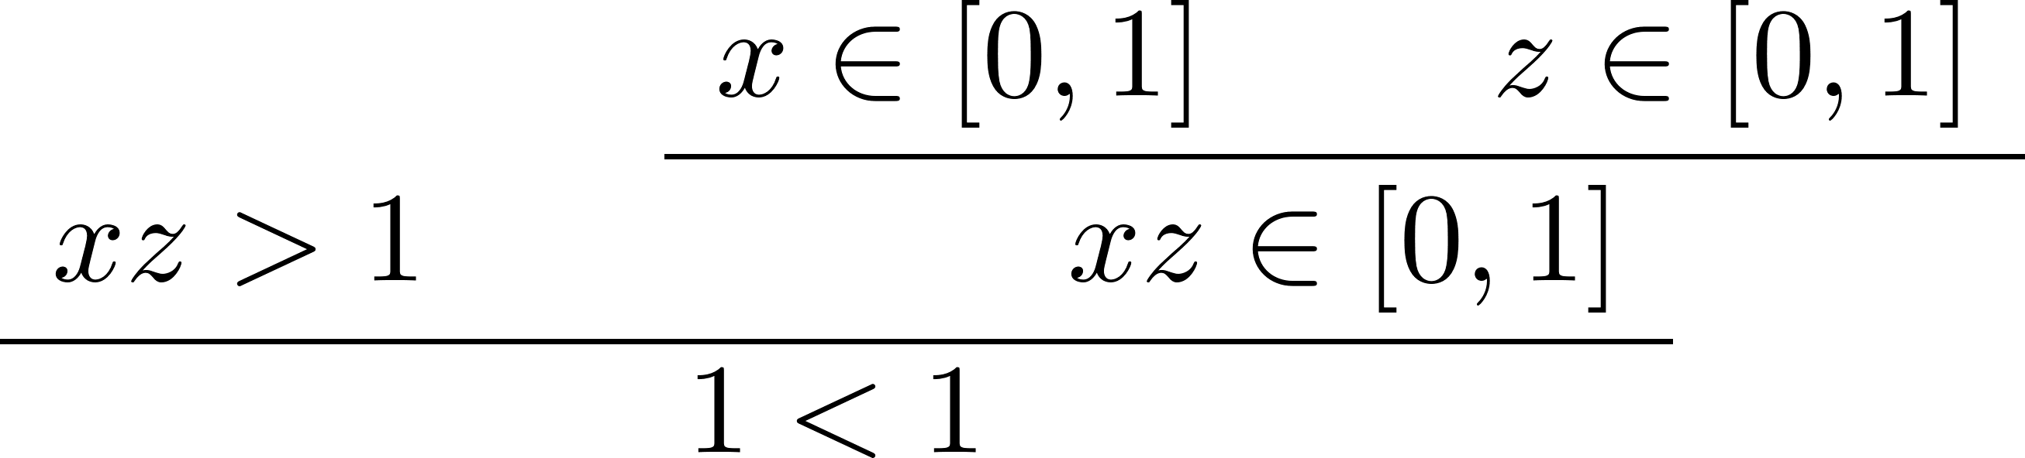

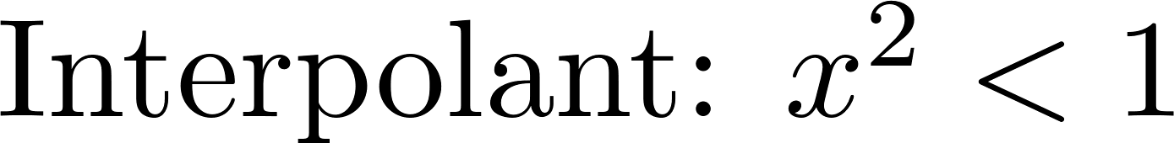


$$A=x^{2}+ y^{2}<1, B=xz>1$$
From resolution proof, we can infer as final interpolant of A and B

Slide 29
Thank you for your attention

