Slide 1
Equality handling and efficiency improvement of SMT for non-linear constraints over reals.
Vu Xuan Tung – Ogawa lab - JAIST

Slide 2
Contents
Introduction.
Problems.
Current status.
Doctor course proposal.

Slide 3
Introduction

Slide 4
Satisfiability Modulo Theories (SMT)
SMT problem is a decision problem
for first-order formulas expressing constraints,
with respect to background theories.
If satisfiable (SAT), provide assignment of variables.
If unsatisfiable (UNSAT), proof is optionally generated.

Slide 5

Back ground theories
Theory of array
Linear arithmetic: $+, −$
Non-linear arithmetic: $+, −, ∗$
…..

Slide 6
Theory of non-linear arithmetic
Polynomial constraints solving has applications in:
Automatic termination proving.
Roundoff error and overflow error analysis.
Loop Invariant generation.
Analyzing reachability, discovering inductive invariants in hybrid systems.

Slide 7
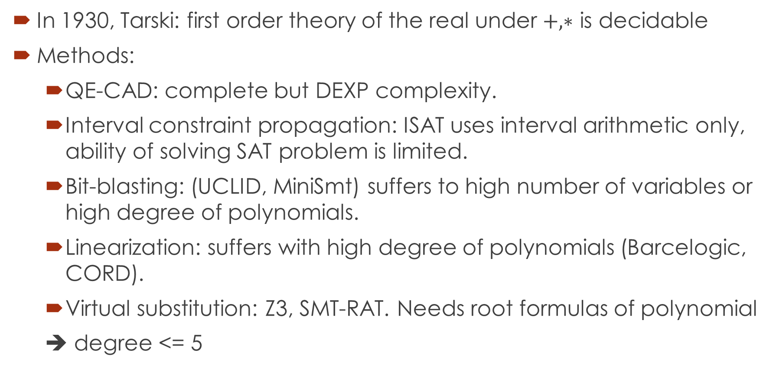
Theory of non-linear arithmetic
In 1930, Tarski: first order theory of the real under $+, ∗$ is decidable
Methods:
QE-CAD: complete but DEXP complexity.
Interval constraint propagation: ISAT uses interval arithmetic only, ability of solving SAT problem is limited.
Bit-blasting: (UCLID, MiniSmt) suffers to high number of variables or high degree of polynomials.
Linearization: suffers with high degree of polynomials (Barcelogic, CORD).
Virtual substitution: Z3, SMT-RAT. Needs root formulas of polynomial
➔ degree <= 5

Slide 8
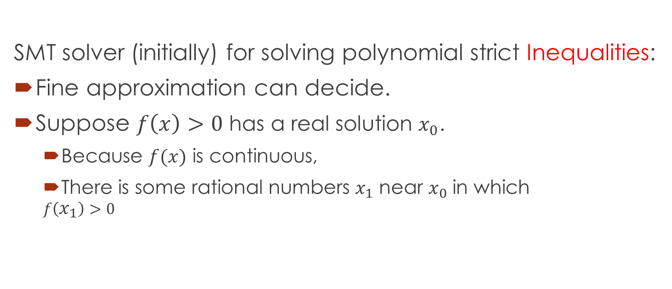
raSAT
SMT solver (initially) for solving polynomial strict Inequalities:
Fine approximation can decide.
Suppose $f\left(x\right)>0$ has a real solution $x_{0}$.
Because $f(x)$ is continuous,
There is some rational numbers $x_{1}$ near $x_{0}$ in which
$$f\left(x_{1}\right)>0$$

Slide 9

$$Constraints$$
raSAT
Yest
Threshold - Unknown
NO
SAT solver
UNSAT/Unknown
Learn conflicts
Theory solver
Refined clauses
YES
Interval Arithmetic
UNSAT
US Core
Refinement
UNKNOWN
VALID
TEST-UNSAT
Testing
SAT
SAT

Slide 10
raSAT
In this work:
Improve the efficiency of raSAT.
Extend it to handle equality.

Slide 11
Problems

Slide 12

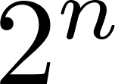
Problems
SAT, UNSAT results verification.
Round-off, overflow errors.
UNSAT core.
Running time: high, often causes timeout.
Testing phase.
Testing consumes time and memory.
variables → test cases.

Slide 13
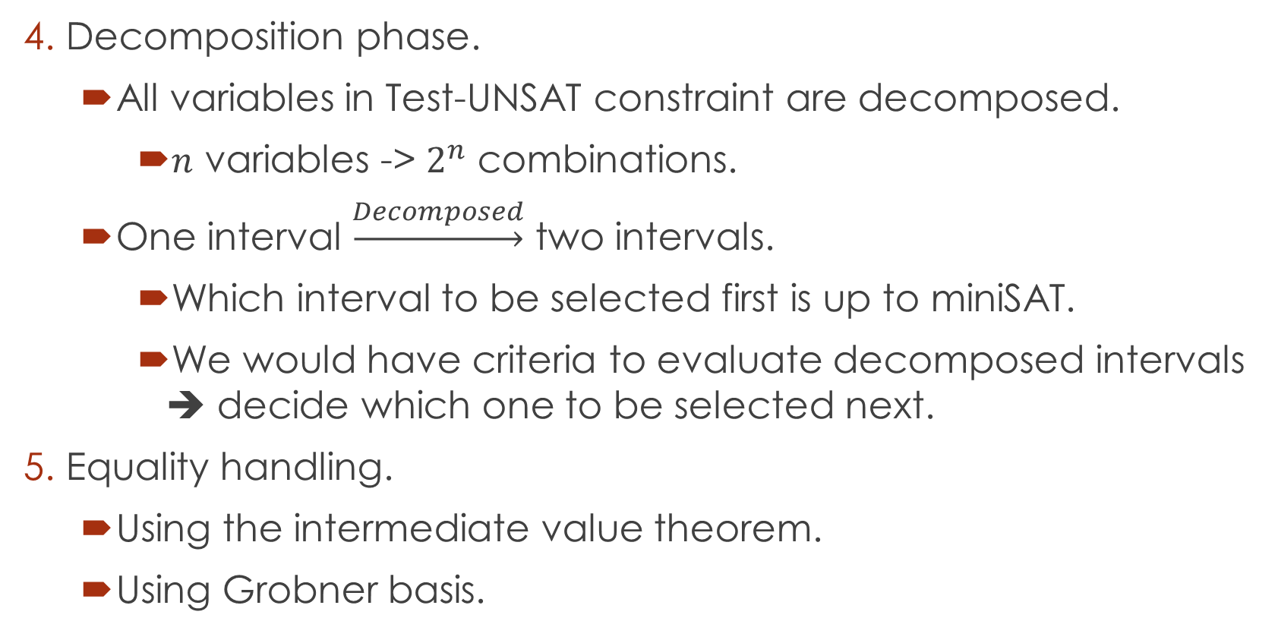
Problems
Decomposition phase.
All variables in Test-UNSAT constraint are decomposed.
$n$ variables -> $2^{n}$ combinations.
One interval $\underset{→}{Decomposed}$ two intervals.
Which interval to be selected first is up to miniSAT.
We would have criteria to evaluate decomposed intervals ➔ decide which one to be selected next.
Equality handling.
Using the intermediate value theorem.
Using Grobner basis.

Slide 14
Current status

Slide 15
1. SAT, UNSAT verification
Round-off, overflow errors can make the result unsound.
Integrated iRRAM into raSAT for SAT verification.
iRRAM:
C++ package
Error-bounded real arithmetic
Experiments:
Rarely iRRAM detects error.
Two times: zankle/matrix_2_all_6.smt2
Future work: Verify UNSAT results.

Slide 16
2. UNSAT core
UNSAT core prevents some unsatisfiable combination of intervals to be selected in the future.
Subset of constraints: idea of previous work, not yet done.
Sub-polynomial: Done in previous work
Subset of variables: new idea, implemented in raSAT.
Showed good results when variables are bounded.
Future: UNSAT core with infinity bounds.

Slide 17
3. Testing phase
Testing time is quite high, memory consuming:
Limit test cases to a fixed number.
More important variables: 2 test-cases: Sensitivity provided by AF2.
Other variables: 1 test case.

Slide 18
3. Testing phase
Testing experiments
Tested on Zankl family: 166 problems generated from termination problems.
m: the number of variables to generate 2 test cases.
m=10: 43 problems in Zankl solved.
m=15: 44 problems.
m=20: 46 problems.
Not much improvements in solved problems
More balance between testing time, IA time, miniSAT time.

Slide 19
3. Testing phase
Future:
Test with the condition that
Use Sturm sequence to guide test generation:
Sturm sequence is used to determines the number of roots of polynomial over an interval
Find witnesses (as intervals) of sign changes and generate test case for each part in which sign of polynomial does not change.

Slide 20
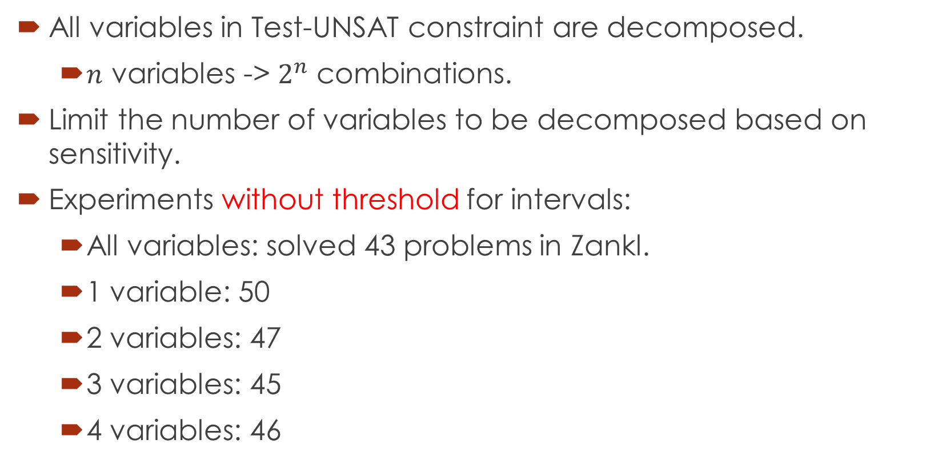
4. Decomposition
All variables in Test-UNSAT constraint are decomposed.
$n$ variables -> $2^{n}$ combinations.
Limit the number of variables to be decomposed based on sensitivity.
Experiments without threshold for intervals:
All variables: solved 43 problems in Zankl.
1 variable: 50
2 variables: 47
3 variables: 45
4 variables: 46

Slide 21
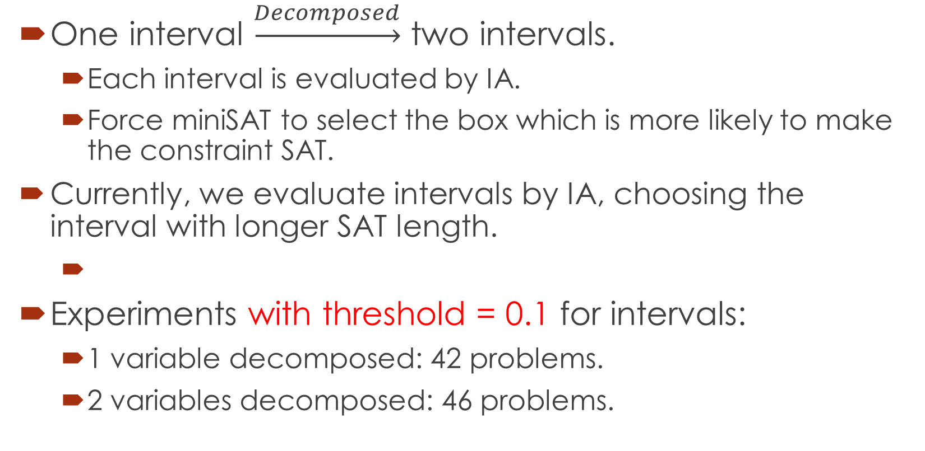
4. Decomposition - box selection
One interval $\underset{→}{Decomposed}$ two intervals.
Each interval is evaluated by IA.
Force miniSAT to select the box which is more likely to make the constraint SAT.
Currently, we evaluate intervals by IA, choosing the interval with longer SAT length.
Experiments with threshold = 0.1 for intervals:
1 variable decomposed: 42 problems.
2 variables decomposed: 46 problems.

Slide 22
4. Decomposition
Future:
Box selection: Evaluate intervals using sum of SAT length of all constraints.
Currently, balanced decomposition
Unbalanced decomposition using sensitivity.

Slide 23
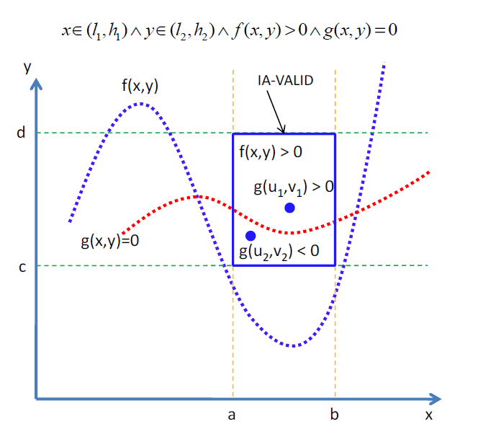
5. Equality handling.
Intermediate value
theorem
Single equality:
Done in previous
Work.

Slide 24
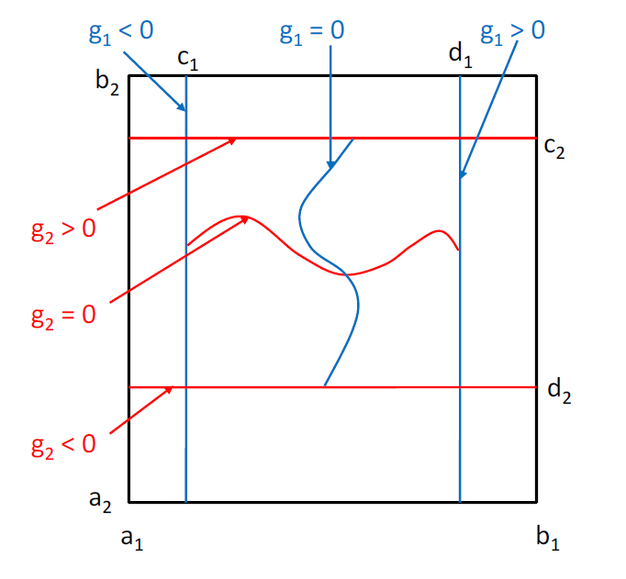

5. Equality handling.
Intermediate value
theorem
Multiple equalities:
Number of
variables $>$ number
of equations
To be done.

Slide 25
Doctor course Proposal

Slide 26
Problems.
Equality extension: Grobner basis.
UNSAT proof generation

Slide 27
1. Equality extension: Grobner basis.
Intermediate value theorem: restrictions.
For complete equality handling: Grobner basis.

Slide 28
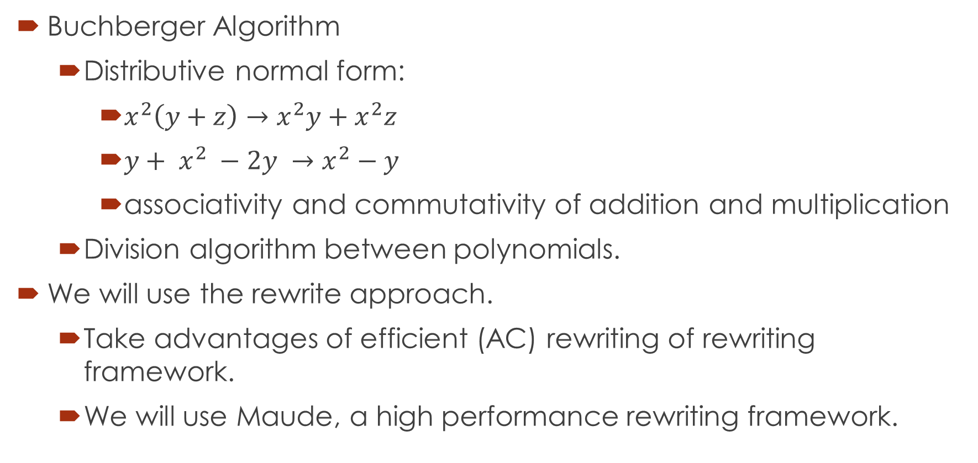
1. Equality extension: Grobner basis.
Buchberger Algorithm
Distributive normal form:
$x^{2}\left(y+z\right)→x^{2}y+x^{2}z$
${y+ x}^{2} −2y →x^{2}−y$
associativity and commutativity of addition and multiplication
Division algorithm between polynomials.
We will use the rewrite approach.
Take advantages of efficient (AC) rewriting of rewriting framework.
We will use Maude, a high performance rewriting framework.

Slide 29





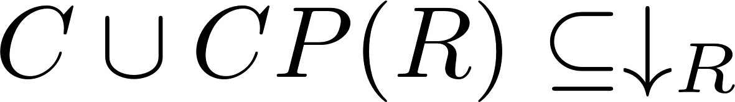
1. Equality extension: Grobner basis.
Maximal completion:
Given a equational system .
We find terminating TRSs such that they use maximal number of equations in .
If there exists a TRS in such that , is the complete system of
Otherwise, extend to
MaxComp?

Slide 30
2. UNSAT proof generation
Proof of UNSAT can be used to extract Craig interpolants.
Abstraction refinement.
Invariant generation.
Most of the current works focus on Presburger Arithmetic.
Not much research on interpolants of polynomial constraints.
Such interpolants arise during verification of complex systems such as hybrid ones.

Slide 31
Related works
MATHSAT supports interpolation over Linear arithmetic.
Theory solver generates proofs for conflict clauses.
SAT solver generates resolution proof of unsatisfiability.
Resolution rule:
Interpolants are extracted from the above proofs.
CSIsat also support interpolants of LA constraints.

Slide 32
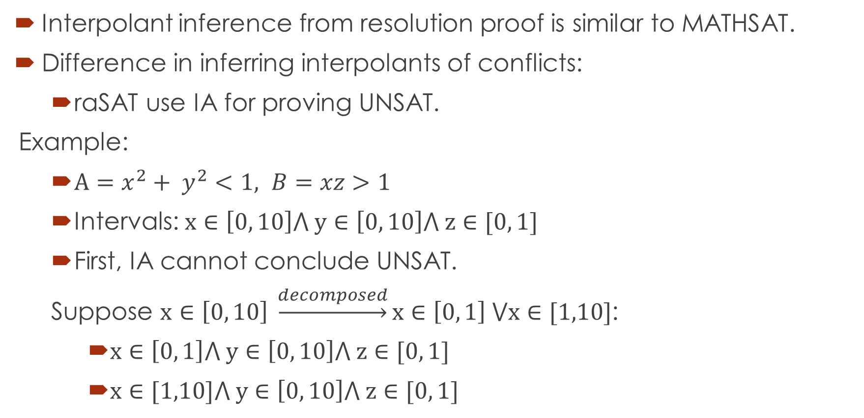
Primary idea
Interpolant inference from resolution proof is similar to MATHSAT.
Difference in inferring interpolants of conflicts:
raSAT use IA for proving UNSAT.
Example:
$A=x^{2}+ y^{2}<1, B=xz>1$
Intervals: $x∈\left[0, 10\right]⋀ y∈\left[0, 10\right]⋀ z∈[0, 1]$
First, IA cannot conclude UNSAT.
Suppose $x∈\left[0, 10\right] \underset{→}{decomposed}x∈\left[0, 1\right] ⋁x∈[1,10]$:
$x∈\left[0, 1\right]⋀ y∈\left[0, 10\right]⋀ z∈[0, 1]$
$x∈[1,10]⋀ y∈\left[0, 10\right]⋀ z∈[0, 1]$

Slide 33
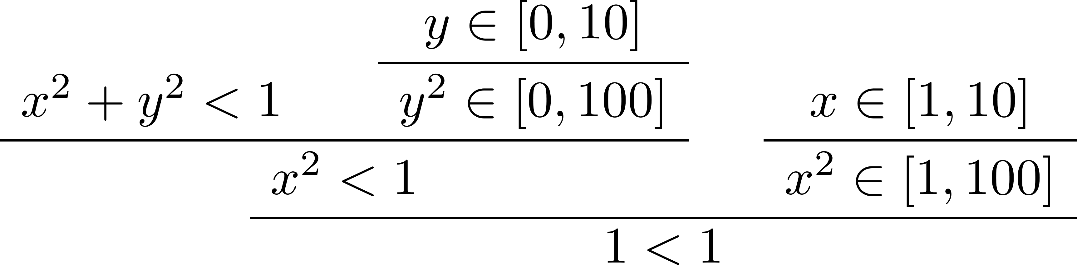
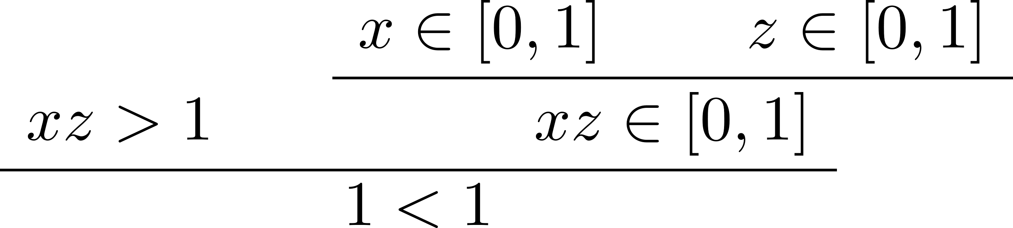

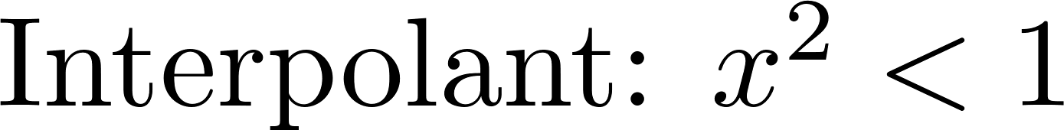

From resolution proof, we can infer as final interpolant

Slide 34
Thank you for your attention

