Slide 1
Equality handling and efficiency improvement of SMT for non-linear constraints over reals.
Vu Xuan Tung – Ogawa lab - JAIST

Slide 2
Contents
Introduction.
Problems.
Current status.
Doctor course proposal.

Slide 3
Introduction

Slide 4
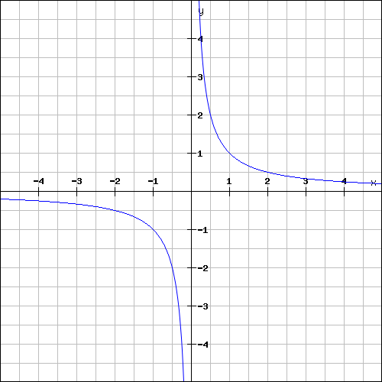
Polynomial constraints

Slide 5
Polynomial constraints
Polynomial constraints solving has applications in:
Automatic termination proving.
Roundoff error and overflow error analysis.
Loop Invariant generation.
Discovering inductive invariants in hybrid systems.

Slide 6
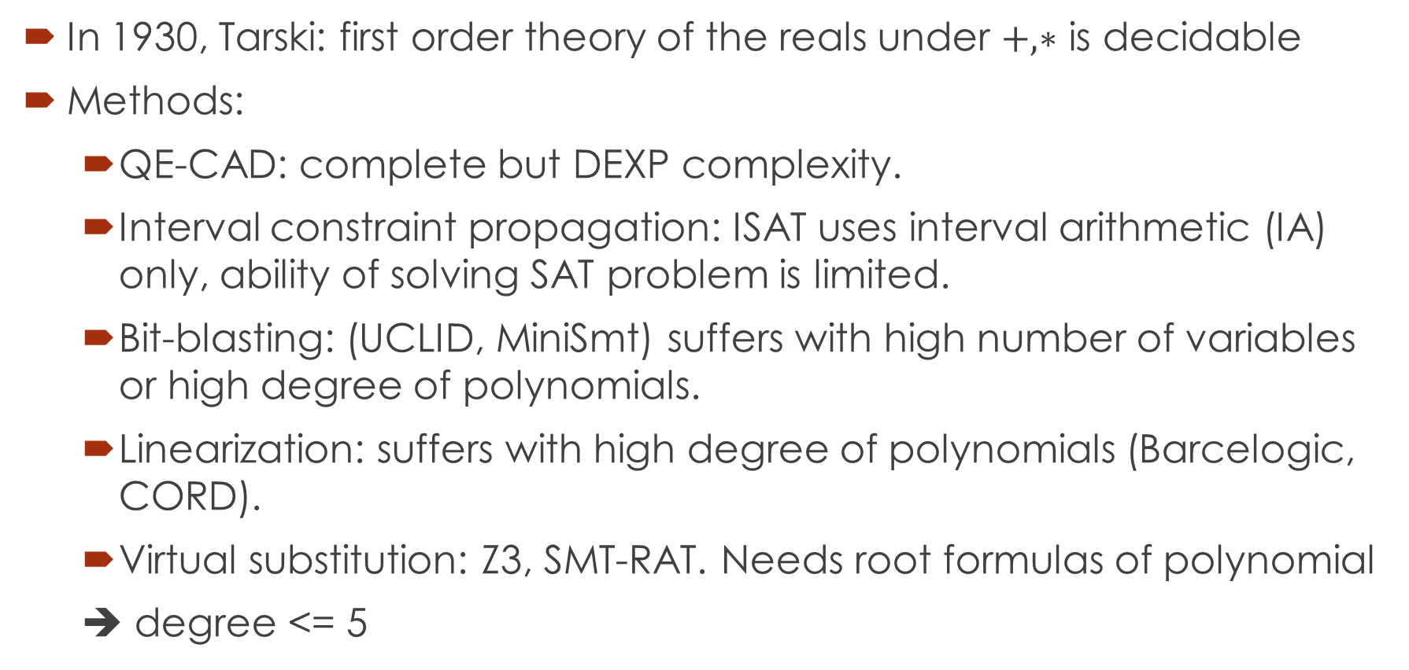
Polynomial constraints
In 1930, Tarski: first order theory of the reals under $+, ∗$ is decidable
Methods:
QE-CAD: complete but DEXP complexity.
Interval constraint propagation: ISAT uses interval arithmetic (IA) only, ability of solving SAT problem is limited.
Bit-blasting: (UCLID, MiniSmt) suffers with high number of variables or high degree of polynomials.
Linearization: suffers with high degree of polynomials (Barcelogic, CORD).
Virtual substitution: Z3, SMT-RAT. Needs root formulas of polynomial
➔ degree <= 5
raSAT: IA + testing

Slide 7
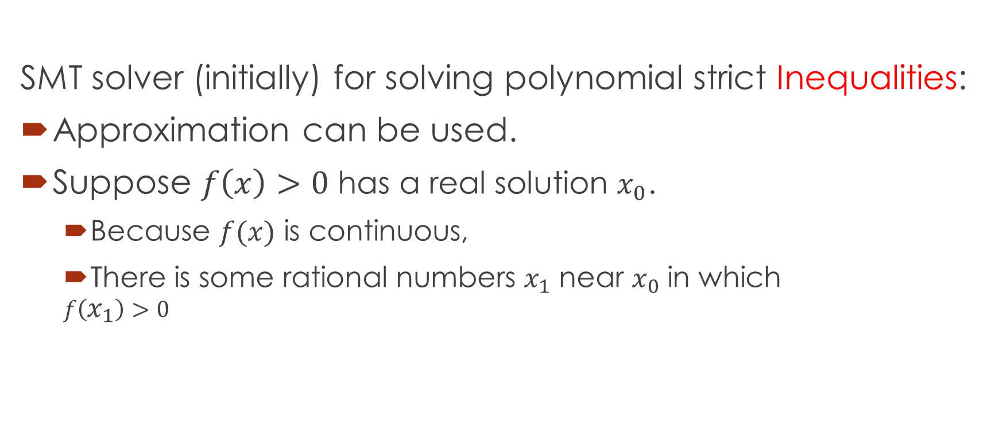
raSAT
SMT solver (initially) for solving polynomial strict Inequalities:
Approximation can be used.
Suppose $f\left(x\right)>0$ has a real solution $x_{0}$.
Because $f(x)$ is continuous,
There is some rational numbers $x_{1}$ near $x_{0}$ in which
$$f\left(x_{1}\right)>0$$

Slide 8
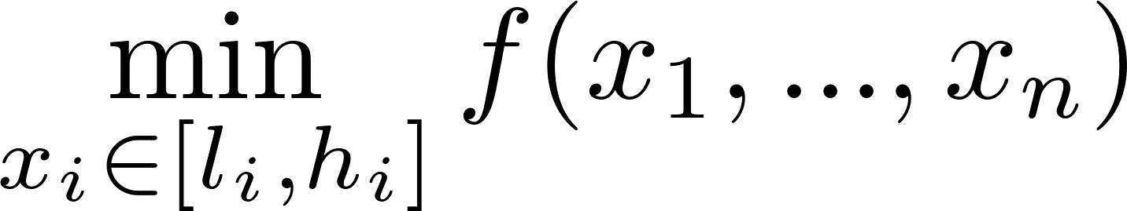
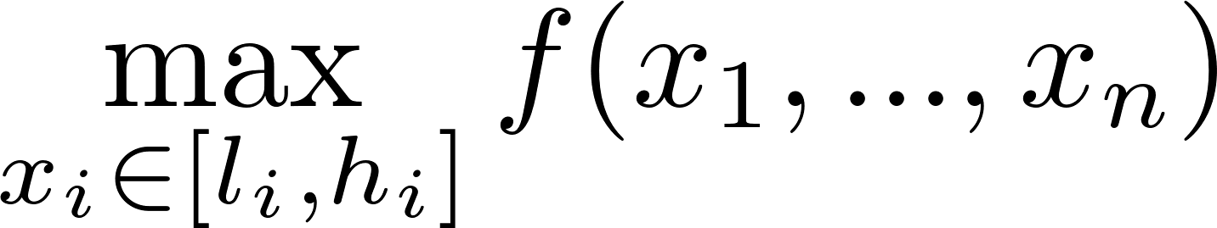



Over approximation.
Over-approximation:
Instance: Interval Arithmetic (IA)
OT-UNSAT
OT-VALID
OT-UNKNOWN

Slide 9


Under approximation
Instance: Testing, randomly generate values for variables
UT-UNSAT
UT-SAT

Slide 10


$$Constraints$$
raSAT
Yest
Threshold - Unknown
NO
SAT solver
UNSAT/
Unknown
Learn conflicts
Theory solver
Refined clauses
YES
OT-UNSAT
Interval Arithmetic
US Core
$$x∈\left[0,10\right] →$$
$$x∈\left[0,4\right]∨x∈\left[4,10\right]$$
Refinement
OT-UNKNOWN
OT_VALID
OT-UNSAT
Testing
UT-SAT
SAT

Slide 11
raSAT
In this work:
Improve the efficiency of raSAT.
Extend it to handle equality.

Slide 12
Problems

Slide 13

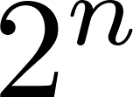
Problems
SAT, UNSAT results verification.
Round-off, overflow errors.
UNSAT core.
Running time: high, often causes timeout.
Testing phase.
Testing consumes time and memory.
variables → test cases.

Slide 14
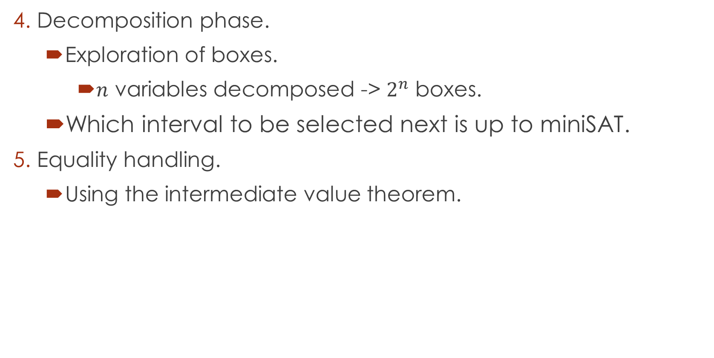
Problems
Decomposition phase.
Exploration of boxes.
$n$ variables decomposed -> $2^{n}$ boxes.
Which interval to be selected next is up to miniSAT.
Equality handling.
Using the intermediate value theorem.

Slide 15
Current status

Slide 16
1. SAT, UNSAT verification
Round-off, overflow errors can make the result unsound.
iRRAM:
C++ package
Error-bounded real arithmetic
Integrated iRRAM into raSAT for SAT verification.
Future work: Verify UNSAT results.

Slide 17
2. UNSAT core
UNSAT core reduces the target constraints.
Subset of constraints: idea of previous work, not yet done.
Sub-polynomial: Done in previous work
Subset of variables: new idea, implemented in raSAT.
Future: UNSAT core with infinity bounds.

Slide 18
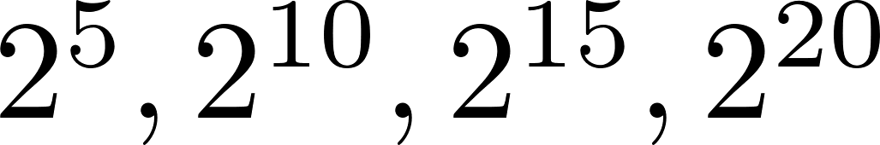
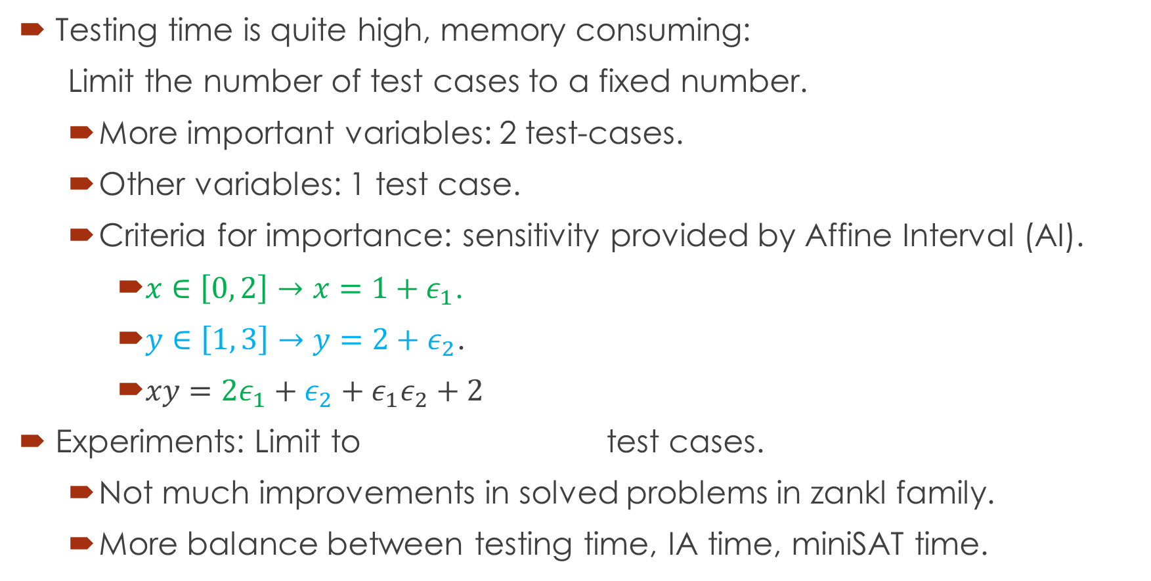
3. Testing phase
Testing time is quite high, memory consuming:
Limit the number of test cases to a fixed number.
More important variables: 2 test-cases.
Other variables: 1 test case.
Criteria for importance: sensitivity provided by Affine Interval (AI).
$x∈\left[0, 2\right]→x=1+ε_{1}$.
$y∈\left[1, 3\right]→y=2+ε_{2}$.
$xy=2ε_{1}+ε_{2}+ε_{1}ε_{2}+2$
Experiments: Limit to test cases.
Not much improvements in solved problems in zankl family.
More balance between testing time, IA time, miniSAT time.

Slide 19
3. Testing phase
Future:
Test with the condition that
Use Sturm sequence to guide test generation.
Sturm sequence is used to determines the number of roots of polynomial over an interval
Find witnesses (as intervals) of sign changes and generate test case for each part in which sign of polynomial does not change.

Slide 20
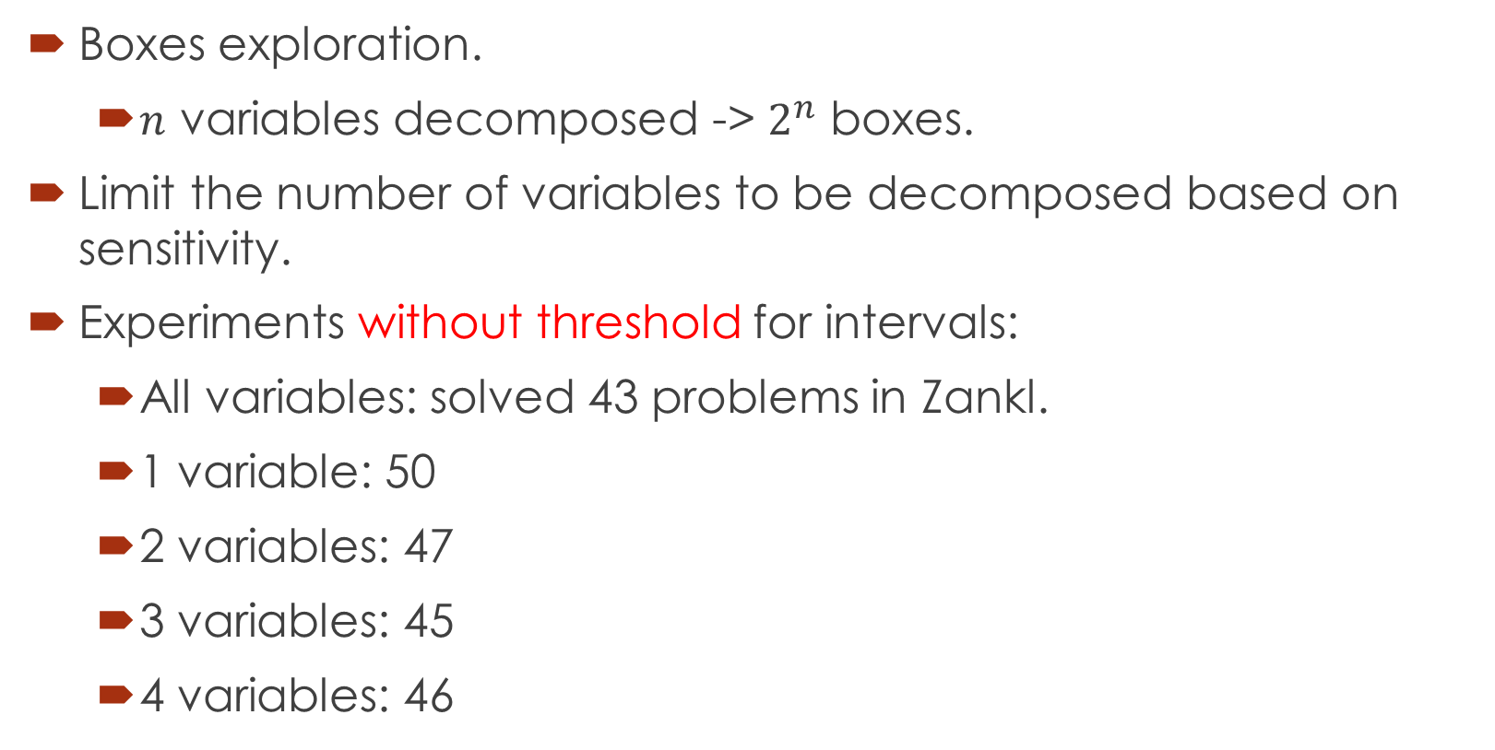
4. Decomposition
Boxes exploration.
$n$ variables decomposed -> $2^{n}$ boxes.
Limit the number of variables to be decomposed based on sensitivity.
Experiments without threshold for intervals:
All variables: solved 43 problems in Zankl.
1 variable: 50
2 variables: 47
3 variables: 45
4 variables: 46

Slide 21
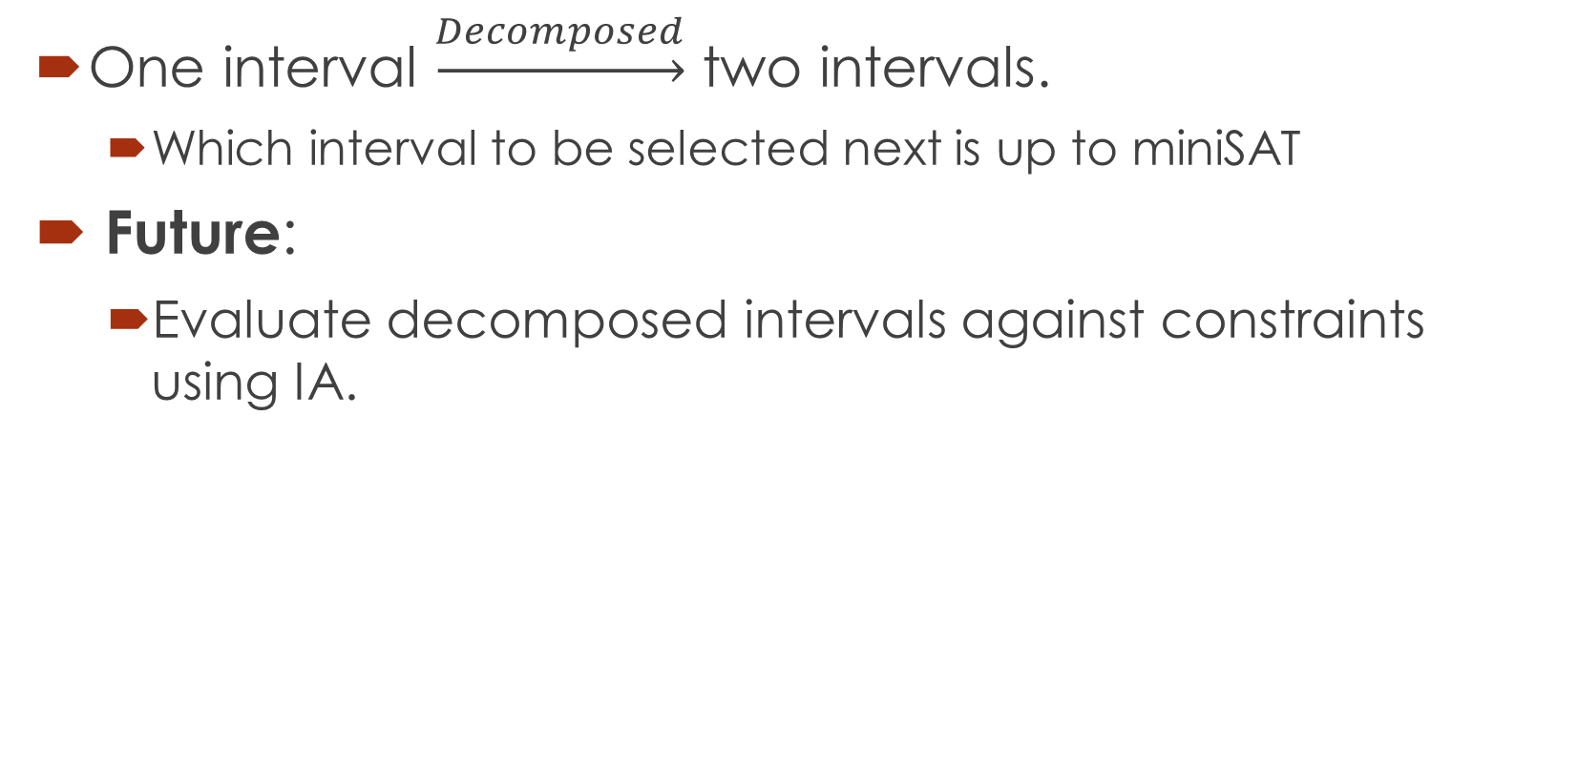
4. Decomposition - box selection
One interval $\underset{→}{Decomposed}$ two intervals.
Which interval to be selected next is up to miniSAT
Future:
Evaluate decomposed intervals against constraints using IA.

Slide 22
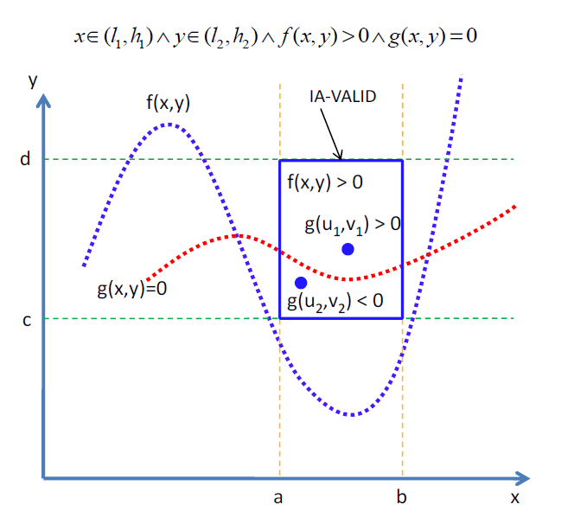
5. Equality handling.
Intermediate value
theorem
Single equality:
Done in previous
Work.

Slide 23
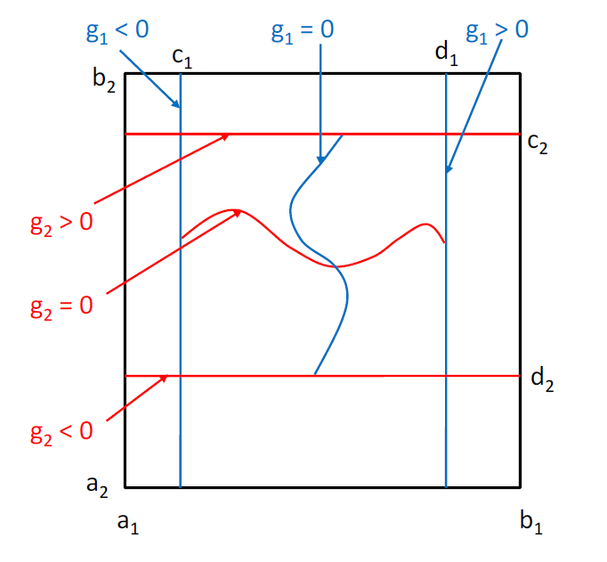

5. Equality handling.
Intermediate value
theorem
Multiple equalities:
Number of
variables $>$ number
of equations
To be done.

Slide 24
Doctor course Proposal

Slide 25
Problems.
Equality extension: Grobner basis.
UNSAT proof generation

Slide 26
1. Equality extension: Grobner basis.
Intermediate value theorem: restrictions.
For complete equality handling: Grobner basis.

Slide 27
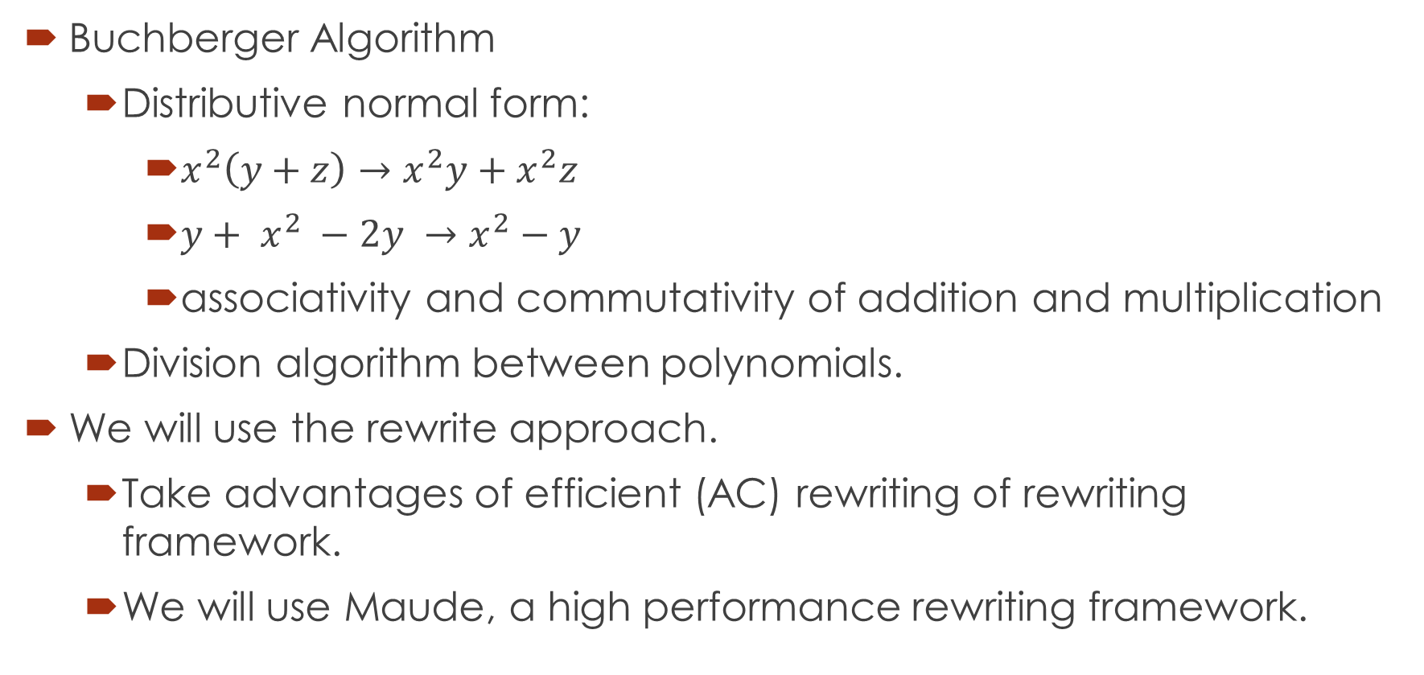
1. Equality extension: Grobner basis.
Buchberger Algorithm
Distributive normal form:
$x^{2}\left(y+z\right)→x^{2}y+x^{2}z$
${y+ x}^{2} −2y →x^{2}−y$
associativity and commutativity of addition and multiplication
Division algorithm between polynomials.
We will use the rewrite approach.
Take advantages of efficient (AC) rewriting of rewriting framework.
We will use Maude, a high performance rewriting framework.

Slide 28





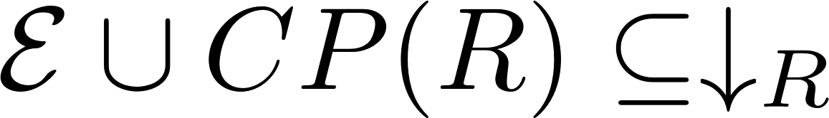
1. Equality extension: Grobner basis.
Maximal completion:
Given a equational system .
We find terminating TRSs such that they use maximal number of equations in .
If there exists a TRS in such that , is the complete system of
Otherwise, extend to
MaxComp?

Slide 29
2. UNSAT proof generation
Proof of UNSAT can be used to extract Craig interpolants.
Abstraction refinement.
Invariant generation.
Most of the current works focus on Presburger Arithmetic.
Not much research on interpolants of polynomial constraints.
Such interpolants arise during verification of complex systems such as hybrid ones.

Slide 30
Related works
MATHSAT supports interpolation over Linear arithmetic.
Theory solver generates proofs for conflict clauses.
SAT solver generates resolution proof of unsatisfiability.
Resolution rule:
Interpolants are extracted from the above proofs.
CSIsat also support interpolants of LA constraints.

Slide 31
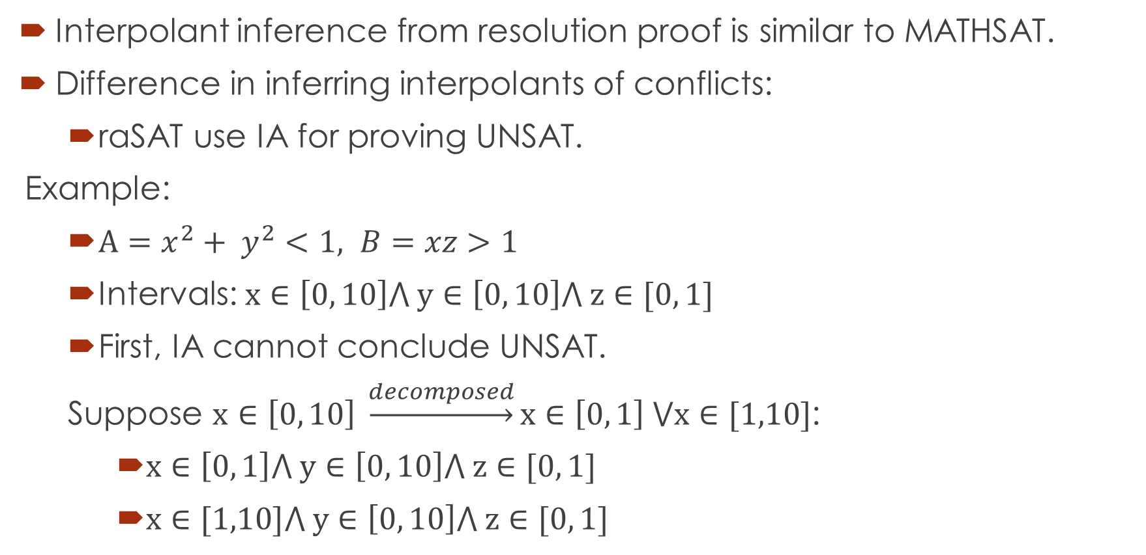
Primary idea
Interpolant inference from resolution proof is similar to MATHSAT.
Difference in inferring interpolants of conflicts:
raSAT use IA for proving UNSAT.
Example:
$A=x^{2}+ y^{2}<1, B=xz>1$
Intervals: $x∈\left[0, 10\right]⋀ y∈\left[0, 10\right]⋀ z∈[0, 1]$
First, IA cannot conclude UNSAT.
Suppose $x∈\left[0, 10\right] \underset{→}{decomposed}x∈\left[0, 1\right] ⋁x∈[1,10]$:
$x∈\left[0, 1\right]⋀ y∈\left[0, 10\right]⋀ z∈[0, 1]$
$x∈[1,10]⋀ y∈\left[0, 10\right]⋀ z∈[0, 1]$

Slide 32
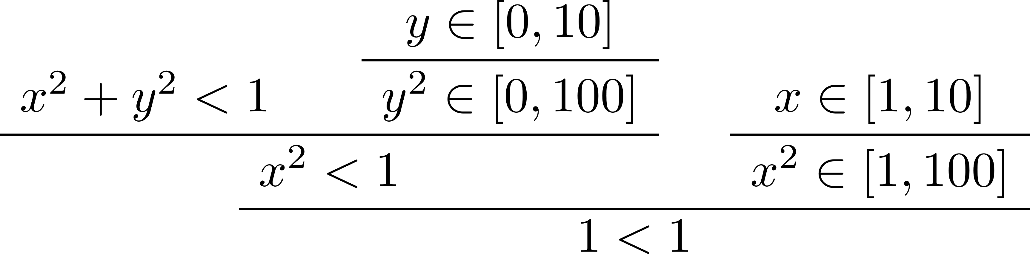
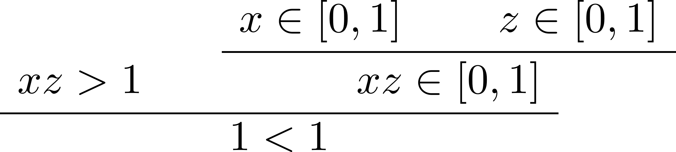

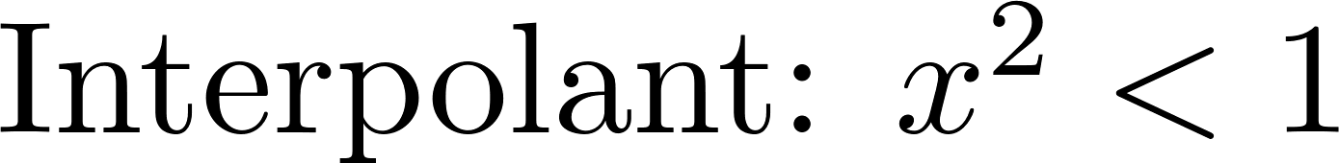

From resolution proof, we can infer as final interpolant

Slide 33
Thank you for your attention

