Slide 1
Equality handling and efficiency improvement of SMT for non-linear constraints over reals
Vu Xuan Tung - Ogawa lab
School of Information Science, JAIST

Slide 2
Non-linear (Polynomial) Constraint.
Find the real values of x, y such that:
If there exist an assignment of x, y that satisfies the constraints → satisfiable (SAT).
Otherwise, unsatisfiable (UNSAT)
x = 2.65219237745, y = 2.34617027147

Slide 3
Applications
Raised in many applications in Software Verification
Termination Proof of Term Rewriting Systems
Invariants Generation
Analysis of Round-off and Over-flow Errors

Slide 4
Related methods
QE-CAD: DEXP
Interval Constraint Propagation (ICP): exploration of boxes.
Bit-blasting: suffers with high number of variables or high degree of polynomials.
Linearization: suffers with high degree of polynomials.
Virtual substitution: degree < 5.
raSAT: ICP + Testing + heuristics

Slide 5


Over-Approximation - Interval arithmetic
(over)-estimate ranges of polynomials
Interval Arithmetic
$xy$
$x ∈\left[−2, 4\right]$
$y ∈\left[−1, 5\right]$
$$xy ∈\left[−10, 20\right]$$

Slide 6
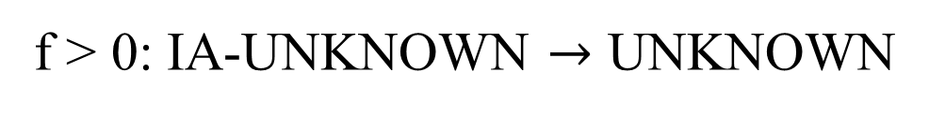
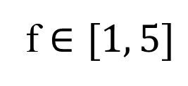
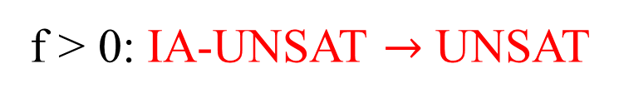

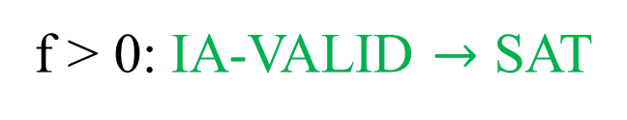

Over-Approximation - Interval arithmetic
How to decide f > 0?
f $∈[−5, −1]$
f > 0: IA-UNSAT $→$ UNSAT
-5
-1
0
f $∈[1, 5]$
f > 0: IA-VALID $→$ SAT
0
1
5
f $∈[−2, 0.5]$
f > 0: IA-UNKNOWN $→$ UNKNOWN
-2
0
0.5

Slide 7
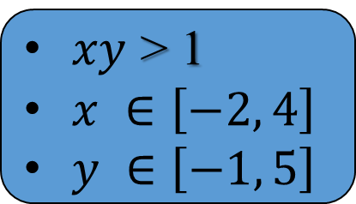
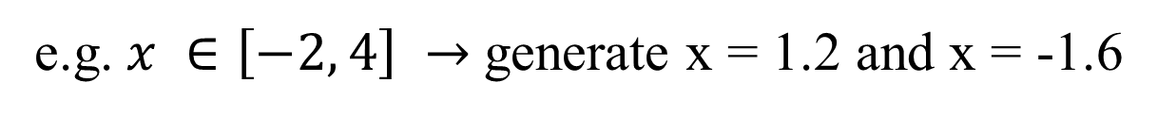
Under Approximation - Testing
find values for variables that satisfy the constraint
Testing
SAT with values for x, y
$xy$ > 1
$x ∈\left[−2, 4\right]$
$y ∈\left[−1, 5\right]$
UNKNOWN
Randomly generate 2 values for each variable
e.g. $x ∈\left[−2, 4\right] →$generate x = 1.2 and x = -1.6

Slide 8
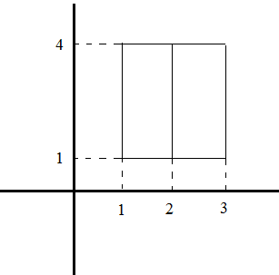

raSAT loop
$$Constraint$$
THRESHOLD
SAT solver
UNSAT
UNSAT /
UNKNOWN
SAT
IA_UNSAT
REFINE
Interval Arithmetic
Refinement
$$x ∈\left[1, 3\right]↔x ∈\left[1, 2\right]⋁x ∈\left[2, 3\right]$$
IA_VALID
IA_UNKNOWN
UNKNOWN
Testing
TEST_SAT
SAT

Slide 9
Contributions
Confirmation of satisfiability: iRRAM.
Efficiency Improvement:
Incremental widening and deepening.
Heuristics to choose satisfiable box.
Equality Handling implementation: Using the Intermediate Value Theorem.
Constraints over integer numbers implementation.

Slide 10
Confirmation of satisfiability
Round-off, overflow errors can make the result unsound.
iRRAM:
C++ package
Error-bounded real arithmetic
Integrated iRRAM into raSAT for satisfiability verification.

Slide 11
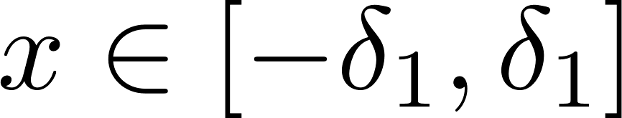
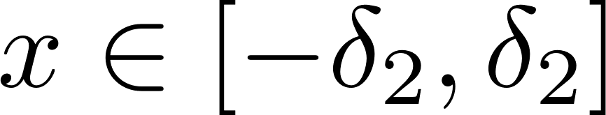
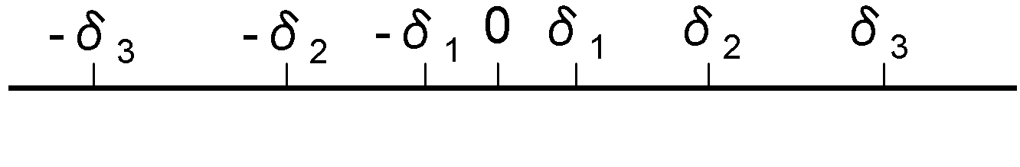
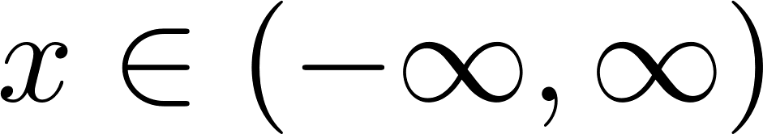
Incremental widening and deepening
Incremental widening
UNSAT
SAT
SAT
SAT
UNSAT
SAT
UNSAT
UNSAT
UNSAT

Slide 12
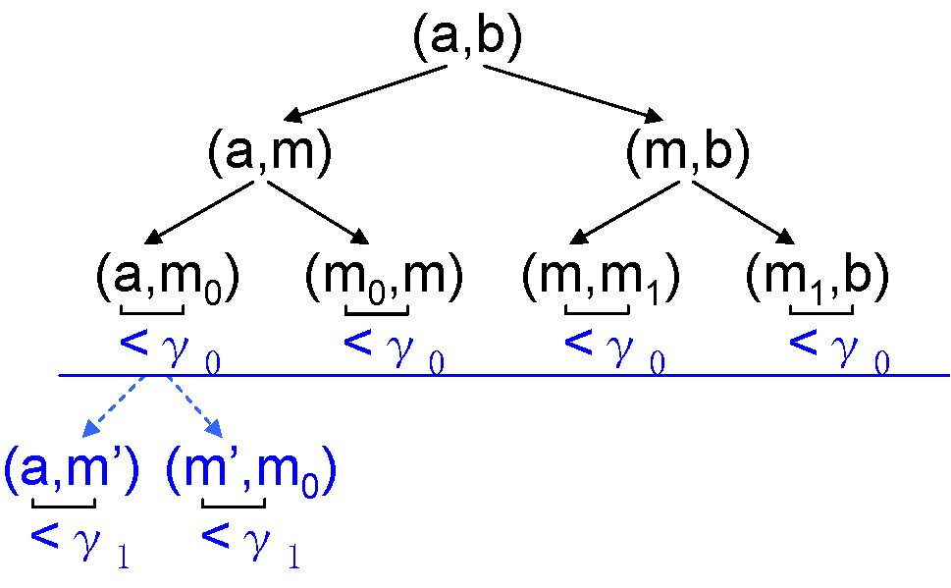
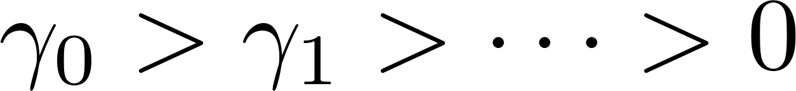
Incremental widening and deepening
Incremental deepening

Slide 13
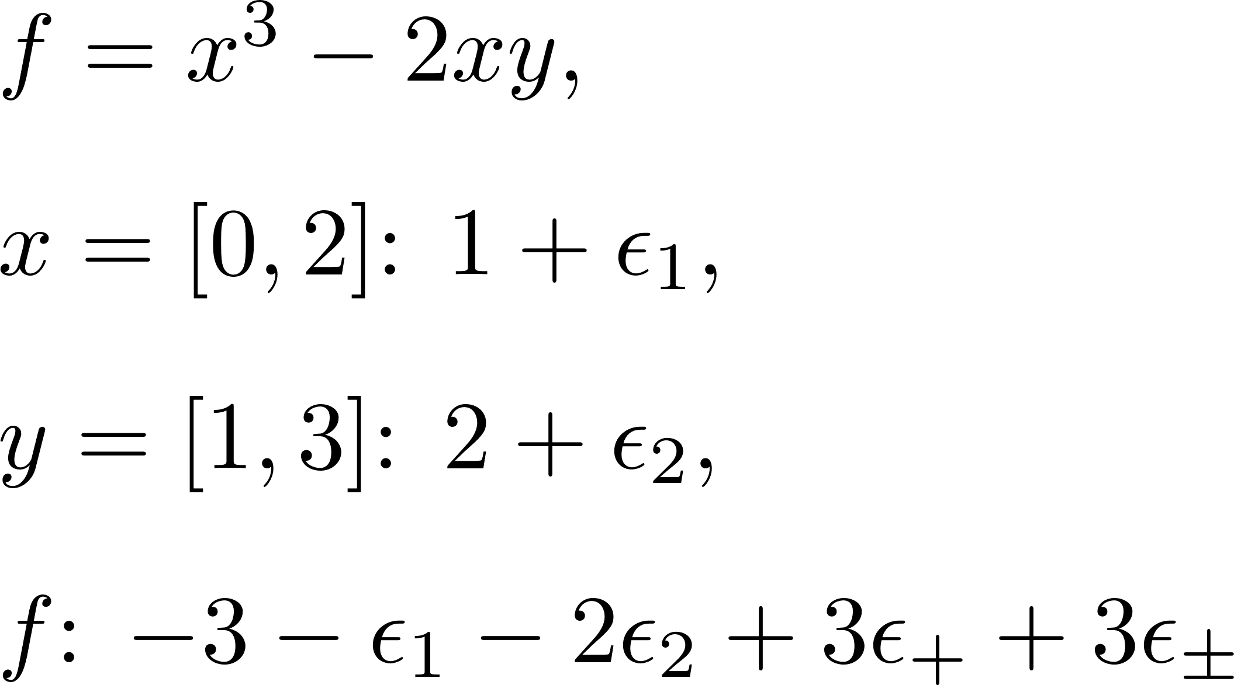
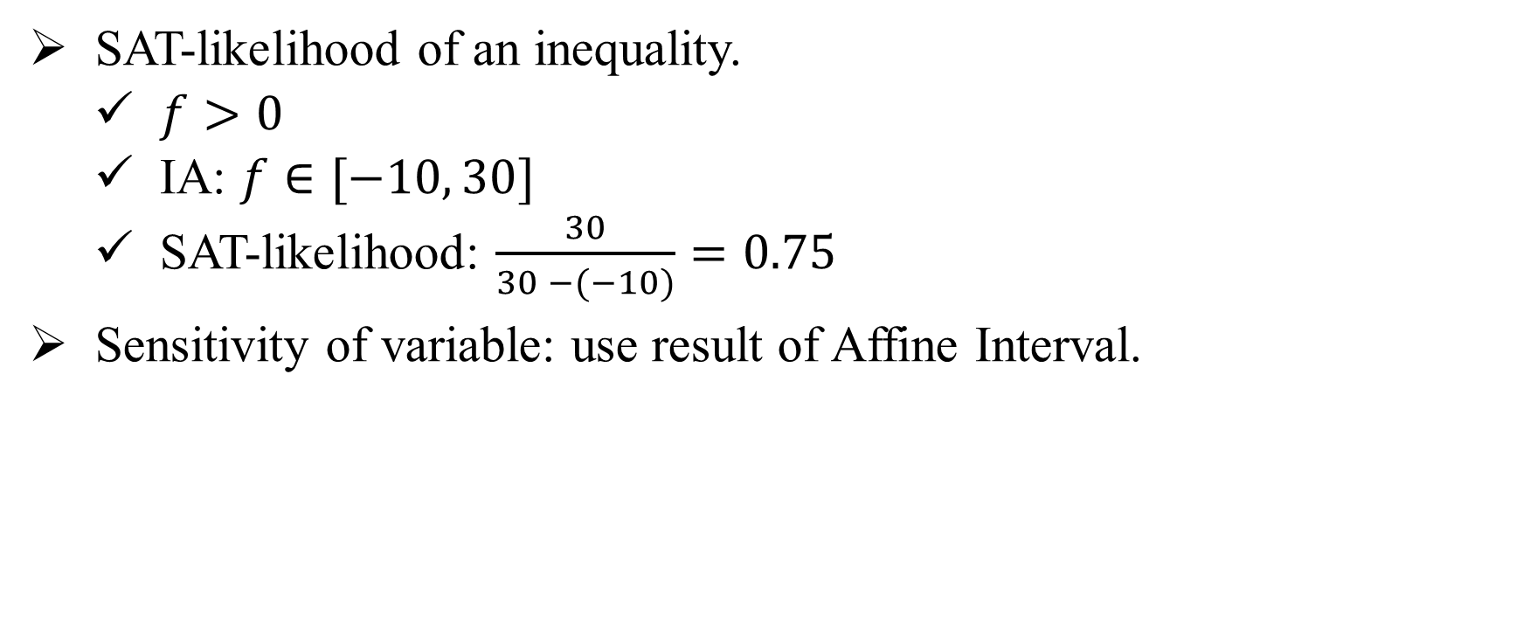
Heuristics for Efficiency
SAT-likelihood of an inequality.
$f>0$
IA: $f∈[−10, 30]$
SAT-likelihood: $\frac{30}{30 −(−10)}=0.75$
Sensitivity of variable: use result of Affine Interval.

Slide 14
Heuristics effects
Benchmark | No. of inequalities | Heuristics |  |  | No Heuristics
 |  | SAT | UNSAT | Time(s) | SAT | UNSAT | Time (s)
Zankl tout=500s | 151 | 31 | 10 | 765.46 | 21 | 10 | 933.39
Meti-tarski tout=60s | 5101 | 3325 | 1100 | 1496.6 | 3322 | 1076 | 1471.47
Zankl.
Difference

Slide 15
Comparison with other tools
iSAT3: Interval [-1000, 1000]
Tool | Zankl: 151 inequalities timeout = 500s |  |  | Meti-tarski: 5101 inequalities timeout = 60s
 | SAT | UNSAT | Time (s) | SAT | UNSAT | Time (s)
iSAT3 | 14 | 15 | 209.25 | 2916 | 1225 | 885.36
raSAT | 31 | 10 | 756.58 | 3325 | 1100 | 1496.6
Z3 4.3 | 54 | 23 | 1034.73 | 3528 | 1568 | 129.78

Slide 16
Observations - Comparison with other tools
Large problems that are solved only by raSAT:
matrix-3-all-2: 47 variables, 87 inequalities/equations.
matrix-3-all-5: 81 variables, 142 inequalities/equations.
matrix-4-all-3: 139 variables, 244 inequalities/equations.
matrix-5-all-01: 132 variables, 276 inequalities/equations.

Slide 17

Extensions
Constraints over integer numbers implementation:
Decomposition: Stop when length of interval is 1
Testing: Generate integer test cases.
Multiple equations handling implementation:
Repeatedly use the Intermediate Value Theorem.
Restriction: number of variables $≥$ number of equations.
Tool | SAT | UNSAT | Time (s)
raSAT | 6764 | 0 | 1230.54
Z3 | 6784 | 36 | 139.78
NIA/AProVE : 6850 inequalities – timeout = 60s

Slide 18
Future works
UNSAT-directed heuristic: UNSAT core.
Test generation heuristics.
Box Decomposition heuristics.

Slide 19
THANKS FOR ATTENTION

