Slide 1
Equality handling and efficiency improvement of SMT for non-linear constraints over reals.
Vu Xuan Tung – Ogawa lab - JAIST

Slide 2
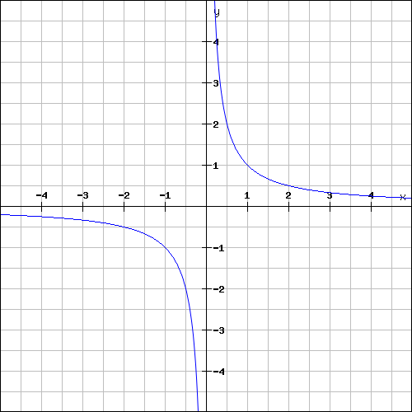
Polynomial constraints over reals

Slide 3
Polynomial constraints
Polynomial constraints solving has applications in:
Automatic termination proving.
Roundoff error and overflow error analysis.
Loop Invariant generation.
Discovering inductive invariants in hybrid systems.

Slide 4
Polynomial constraints
In 1930, Tarski: polynomial constraints is decidable
Methods:
QE-CAD: complete but DEXP complexity.
Interval constraint propagation: ISAT uses interval arithmetic (IA) only, ability of solving SAT problem is limited.
Bit-blasting: (UCLID, MiniSmt) suffers with high number of variables or high degree of polynomials.
Linearization: suffers with high degree of polynomials (Barcelogic, CORD).
Virtual substitution: Z3, SMT-RAT. Needs root formulas of polynomial
➔ degree <= 5
raSAT: IA + testing

Slide 5
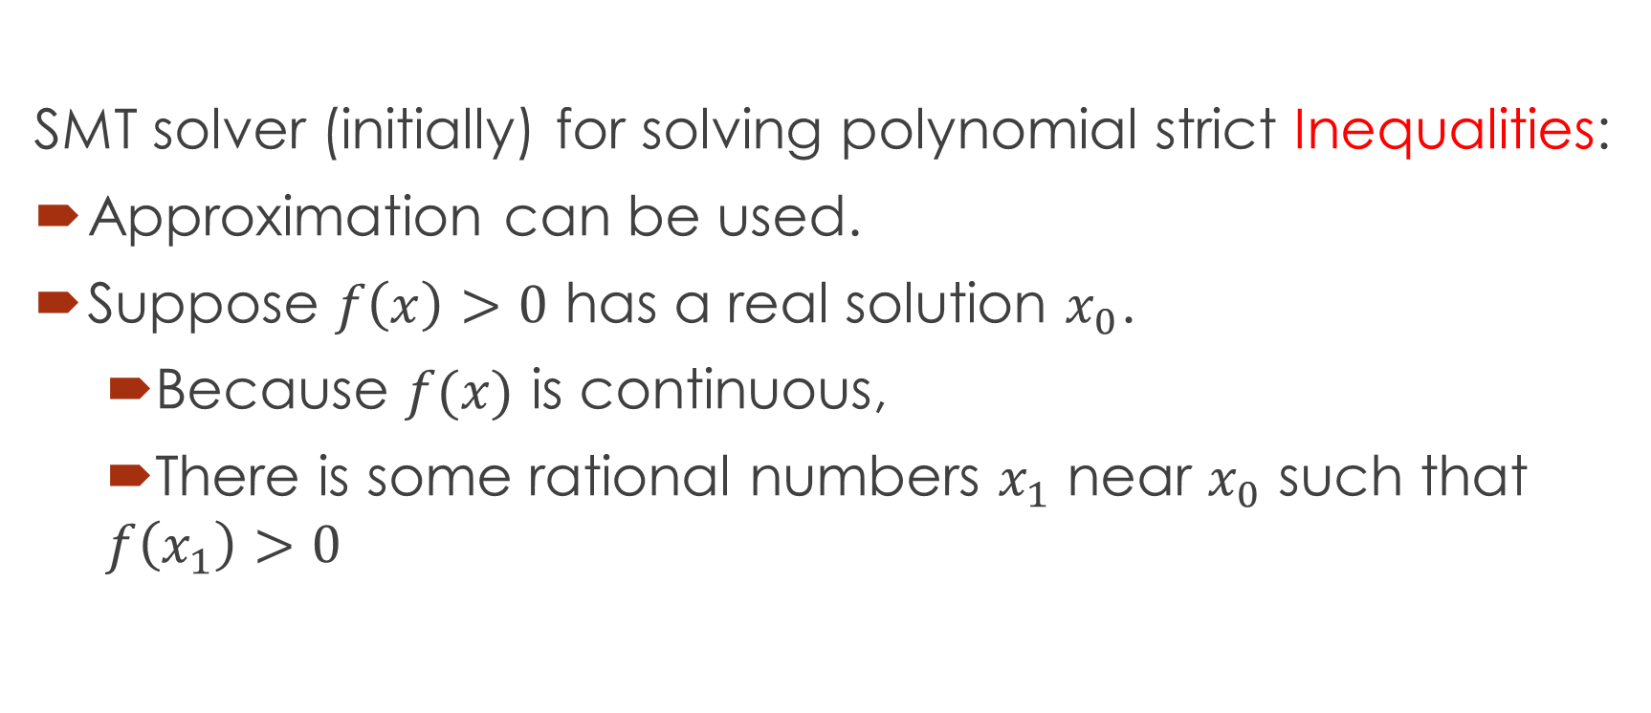
raSAT
SMT solver (initially) for solving polynomial strict Inequalities:
Approximation can be used.
Suppose $f\left(x\right)>0$ has a real solution $x_{0}$.
Because $f(x)$ is continuous,
There is some rational numbers $x_{1}$ near $x_{0}$ such that
$$f\left(x_{1}\right)>0$$

Slide 6
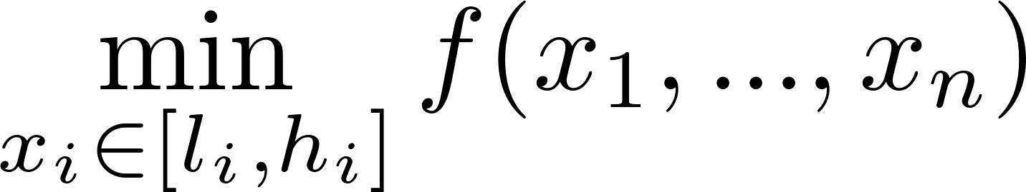
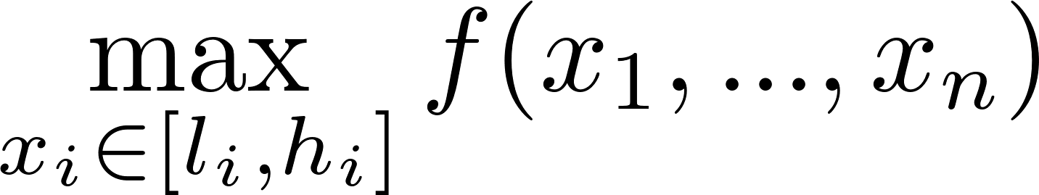



Over approximation.
Over-approximation:
Instance: Interval Arithmetic (IA)
OT-UNSAT
OT-VALID
OT-UNKNOWN

Slide 7


Under approximation
Instance: Testing, randomly generate values for variables
UT-UNSAT
UT-SAT

Slide 8


$$Constraints$$
raSAT
Yest
Threshold - Unknown
NO
SAT solver
UNSAT/
Unknown
Learn conflicts
Theory solver
Refined clauses
YES
OT-UNSAT
Interval Arithmetic
US Core
$$x∈\left[0,10\right] →$$
$$x∈\left[0,4\right]∨x∈\left[4,10\right]$$
Refinement
OT-UNKNOWN
OT_VALID
OT-UNSAT
Testing
UT-SAT
SAT

Slide 9
raSAT
In this work:
Improve the efficiency of raSAT.
Extend it to handle equality.

Slide 10
Problems

Slide 11

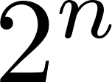
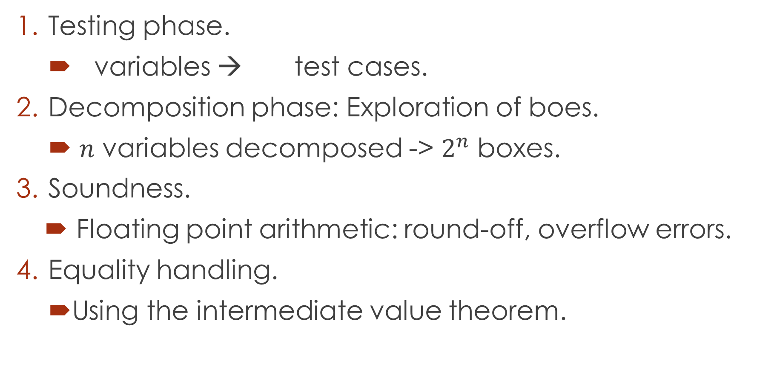
Problems
Testing phase.
variables → test cases.
Decomposition phase: Exploration of boes.
$n$ variables decomposed -> $2^{n}$ boxes.
Soundness.
Floating point arithmetic: round-off, overflow errors.
Equality handling.
Using the intermediate value theorem.

Slide 12
Current status

Slide 13
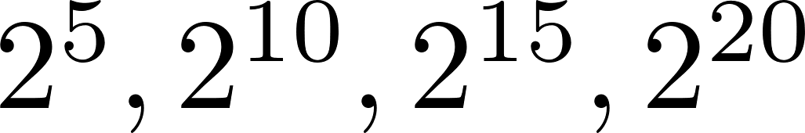
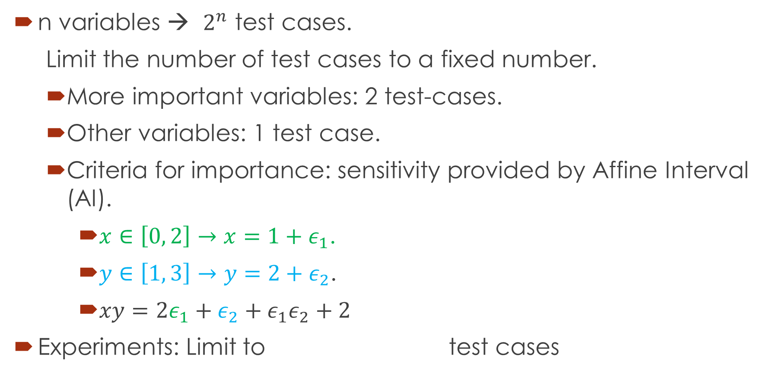
1. Testing phase
n variables → $2^{n}$ test cases.
Limit the number of test cases to a fixed number.
More important variables: 2 test-cases.
Other variables: 1 test case.
Criteria for importance: sensitivity provided by Affine Interval (AI).
$x∈\left[0, 2\right]→x=1+ε_{1}$.
$y∈\left[1, 3\right]→y=2+ε_{2}$.
$xy=2ε_{1}+ε_{2}+ε_{1}ε_{2}+2$
Experiments: Limit to test cases

Slide 14
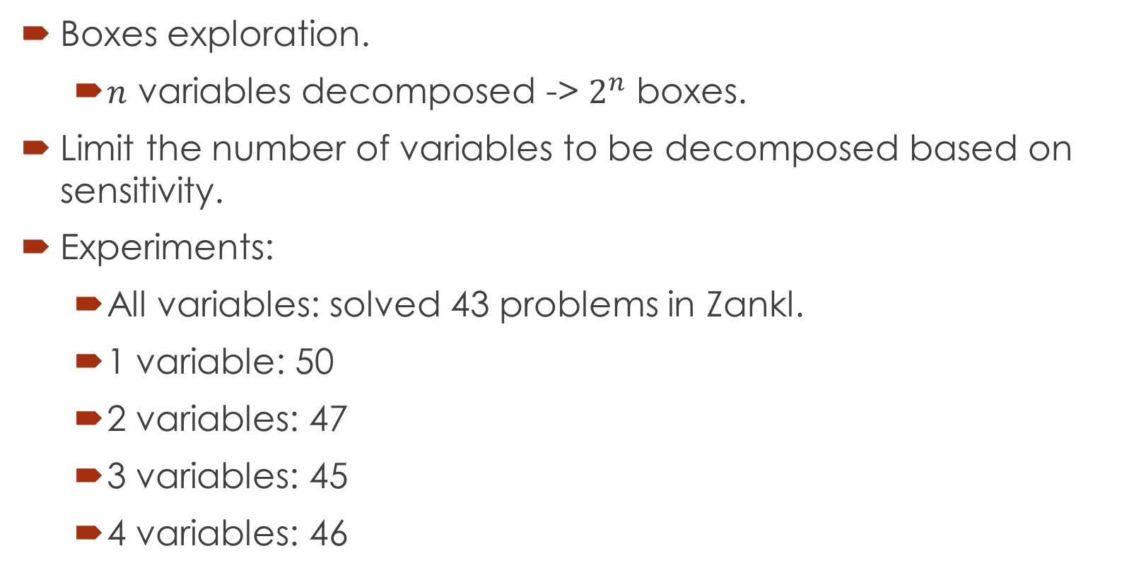
2. Decomposition
Boxes exploration.
$n$ variables decomposed -> $2^{n}$ boxes.
Limit the number of variables to be decomposed based on sensitivity.
Experiments:
All variables: solved 43 problems in Zankl.
1 variable: 50
2 variables: 47
3 variables: 45
4 variables: 46

Slide 15
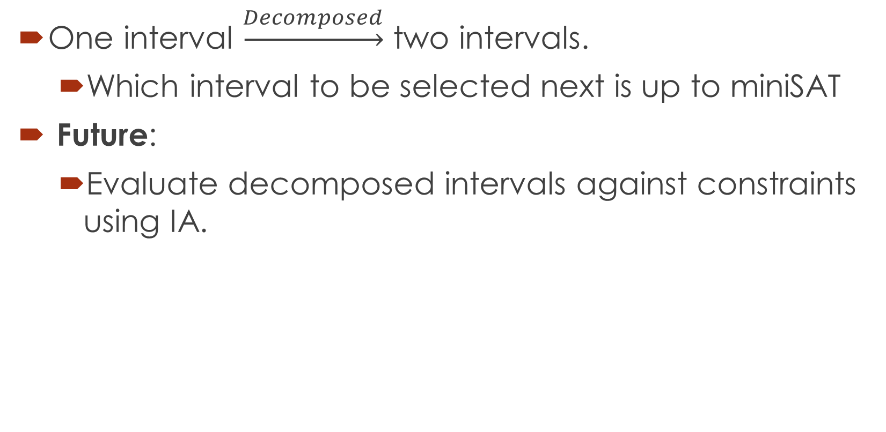
2. Decomposition
One interval $\underset{→}{Decomposed}$ two intervals.
Which interval to be selected next is up to miniSAT
Future:
Evaluate decomposed intervals against constraints using IA.

Slide 16
3. SAT, UNSAT verification
Round-off, overflow errors can make the result unsound.
iRRAM:
C++ package
Error-bounded real arithmetic
Integrated iRRAM into raSAT for SAT verification.
Future work: Verify UNSAT results.

Slide 17
2. UNSAT core
UNSAT core reduces the target constraints.
Subset of constraints: idea of previous work, not yet done.
Sub-polynomial: Done in previous work
Subset of variables: new idea, implemented in raSAT.
Future: UNSAT core with infinity bounds.

Slide 18
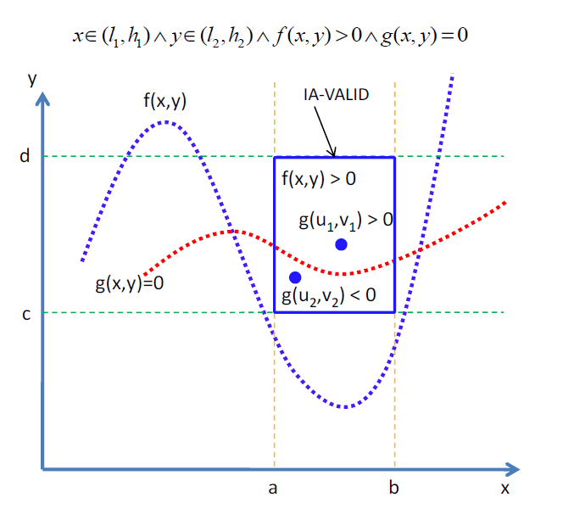
5. Equality handling.
Intermediate value
theorem
Single equality:
Done in previous
Work.

Slide 19
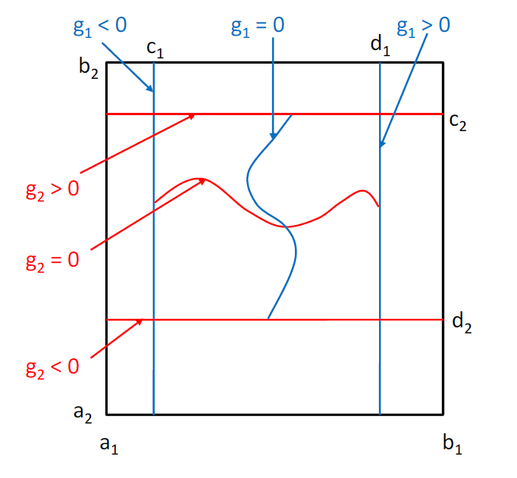

5. Equality handling.
Intermediate value
theorem
Multiple equalities:
Number of
variables $>$ number
of equations
To be done.

Slide 20
Doctor course Proposal

Slide 21
Problems.
Equality extension: Grobner basis.
UNSAT proof generation

Slide 22
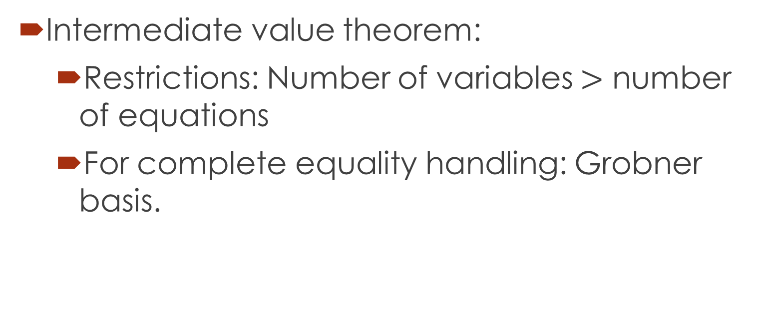
1. Equality extension: Grobner basis.
Intermediate value theorem:
Restrictions: Number of variables $>$ number of equations
For complete equality handling: Grobner basis.

Slide 23
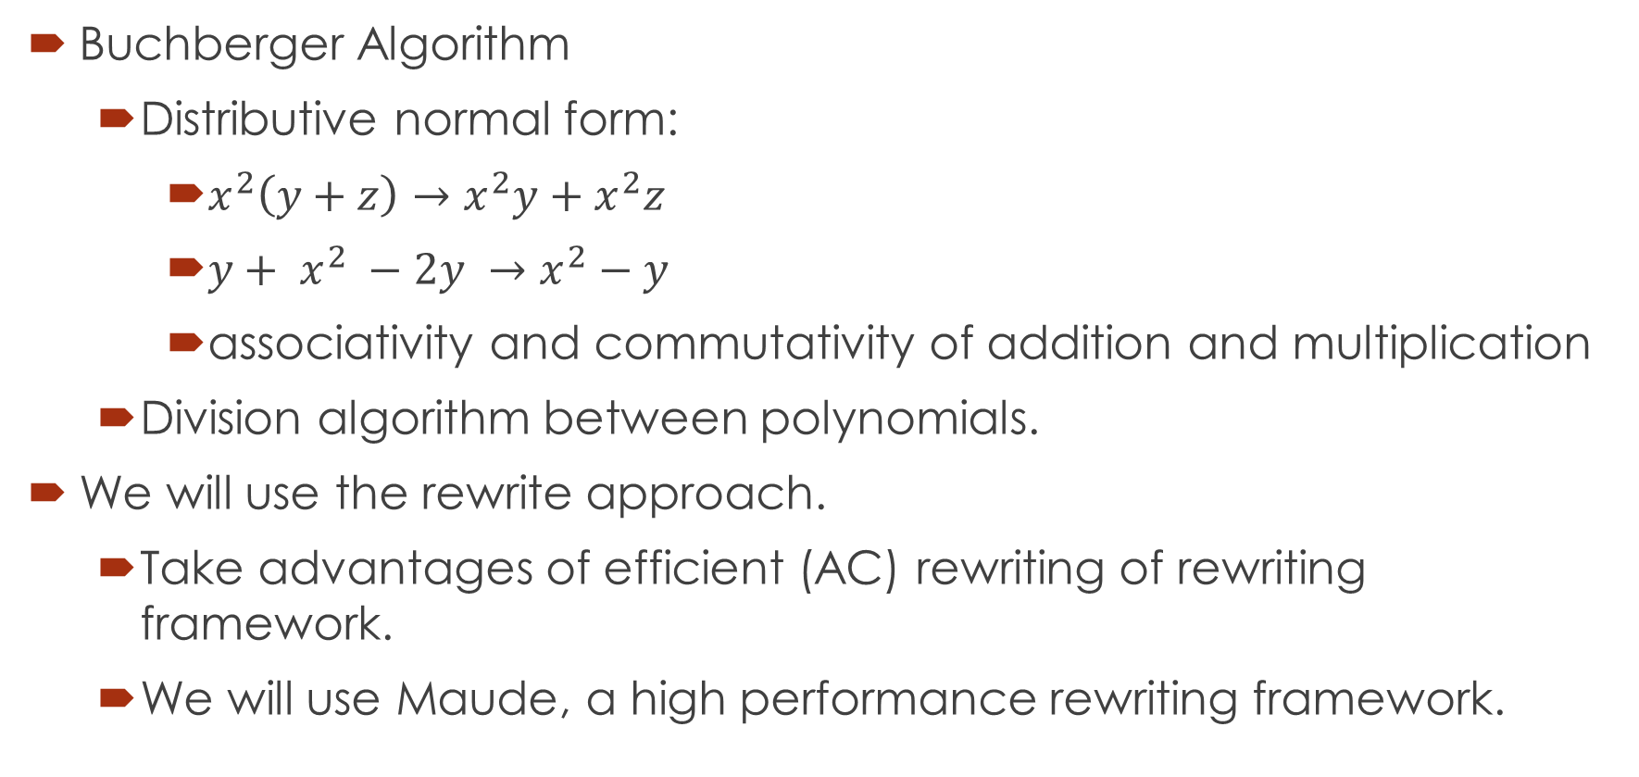
1. Equality extension: Grobner basis.
Buchberger Algorithm
Distributive normal form:
$x^{2}\left(y+z\right)→x^{2}y+x^{2}z$
${y+ x}^{2} −2y →x^{2}−y$
associativity and commutativity of addition and multiplication
Division algorithm between polynomials.
We will use the rewrite approach.
Take advantages of efficient (AC) rewriting of rewriting framework.
We will use Maude, a high performance rewriting framework.

Slide 24
1. Equality extension: Grobner basis.
Maximal completion:
Gradually extend the equations set.
For each step:
Generate terminating TRSs that uses maximal number of equations in the set.
Check if there exist a complete system for the original set.
Yes: Return the complete system
No: Add un-joinable pairs to the equations set.
MaxComp?

Slide 25
2. UNSAT proof generation
Proof of UNSAT can be used to extract Craig interpolants.
Abstraction refinement.
Invariant generation.
Most of the current works focus on Linear Arithmetic.
Not much research on interpolants of polynomial constraints.
Such interpolants arise during verification of complex systems such as hybrid ones.

Slide 26
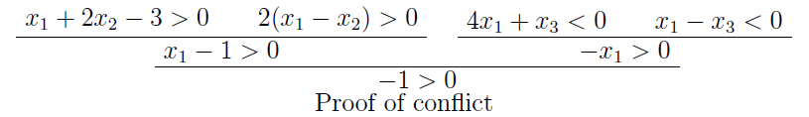
Related works
MATHSAT supports interpolation over Linear arithmetic.
Theory solver generates proofs for conflict clauses.
SAT solver generates resolution proof of unsatisfiability.
Resolution rule:
Interpolants are extracted from the above proofs.
CSIsat also support interpolants of LA constraints.

Slide 27
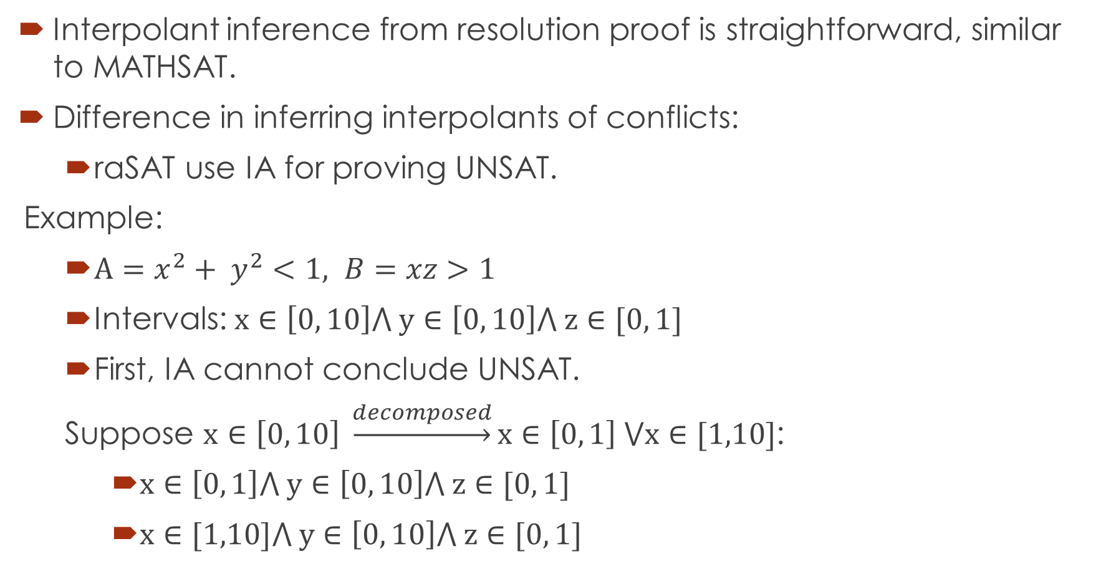
Primary idea
Interpolant inference from resolution proof is straightforward, similar to MATHSAT.
Difference in inferring interpolants of conflicts:
raSAT use IA for proving UNSAT.
Example:
$A=x^{2}+ y^{2}<1, B=xz>1$
Intervals: $x∈\left[0, 10\right]⋀ y∈\left[0, 10\right]⋀ z∈[0, 1]$
First, IA cannot conclude UNSAT.
Suppose $x∈\left[0, 10\right] \underset{→}{decomposed}x∈\left[0, 1\right] ⋁x∈[1,10]$:
$x∈\left[0, 1\right]⋀ y∈\left[0, 10\right]⋀ z∈[0, 1]$
$x∈[1,10]⋀ y∈\left[0, 10\right]⋀ z∈[0, 1]$

Slide 28
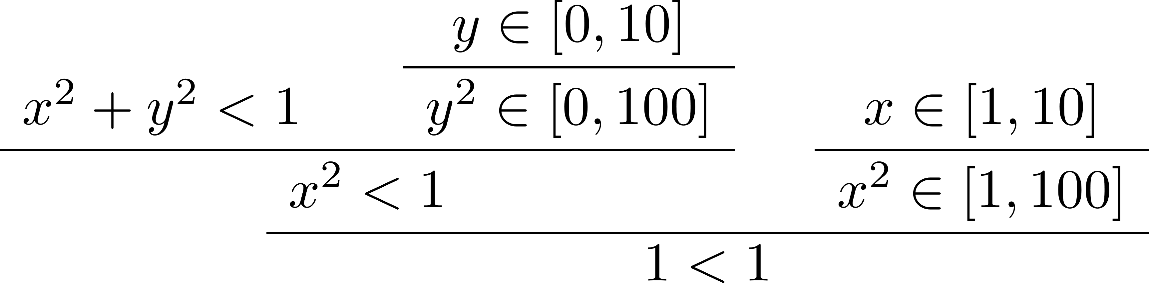
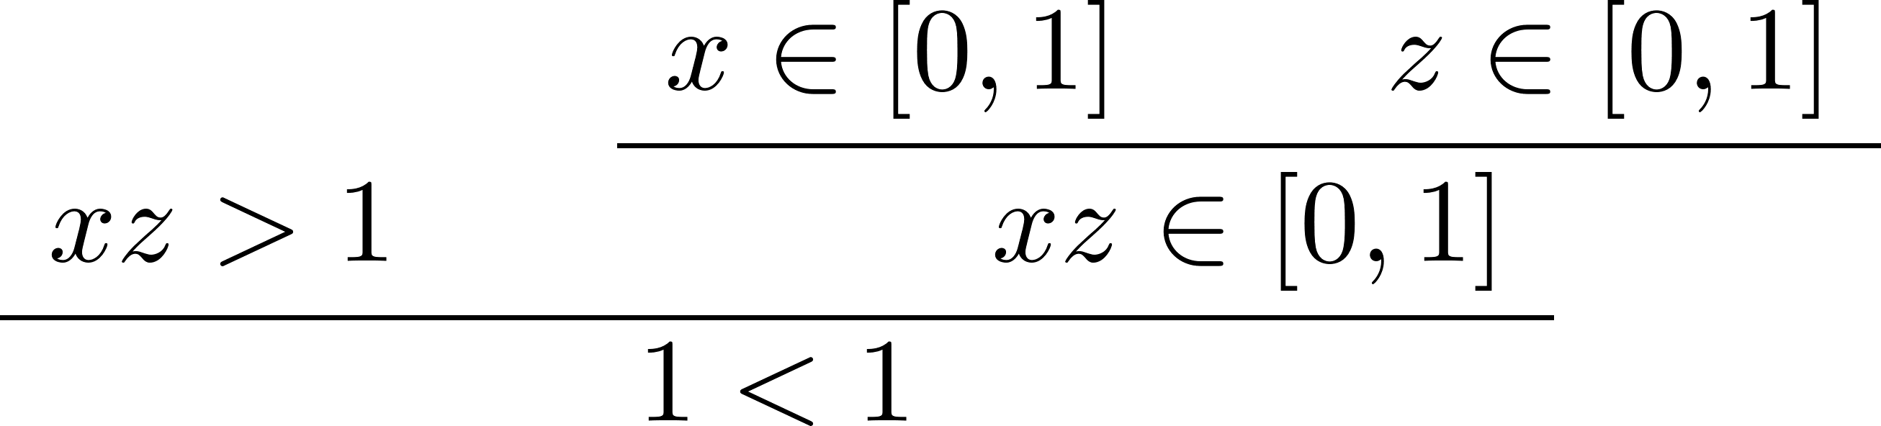

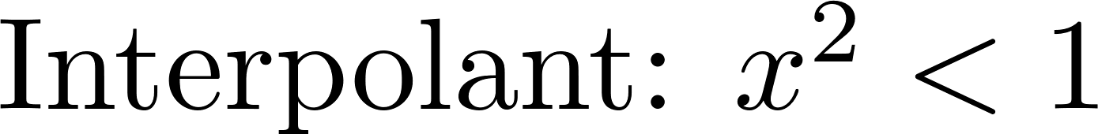


$$A=x^{2}+ y^{2}<1, B=xz>1$$
From resolution proof, we can infer as final interpolant

Slide 29
Thank you for your attention

