Slide 1
Equality handling and efficiency improvement of SMT for non-linear constraints over reals
Vu Xuan Tung - Ogawa lab
School of Information Science, JAIST

Slide 2
Non-linear (Polynomial) Constraints.
If there exist an assignment of free variables that satisfies the constraints → satisfiable (SAT).
Otherwise, unsatisfiable (UNSAT)

Slide 3
Non-linear (Polynomial) Constraints.
We focus on:
Quantifier free constraints over reals (QF_NRA),
Inequalities.
Example:
x = 2.652, y = 2.346

Slide 4
Applications
Raised in many applications in Software Verification
Termination Proof of Term Rewriting Systems
Invariants Generation
Analysis of Round-off and Over-flow Errors

Slide 5
Related methods
QE-CAD: complete
DEXP for general quantified formulas.
EXP for Quantifier-free formulas with optimizations.
Virtual substitution: degree < 5.
EXP.
Grobner basis: equalities.
EXP
Interval Constraint Propagation (ICP): inequalities.
EXP on solvable constraints.
Bit-blasting:
Bounded variables and precision.
Linearization:
Bounded variables and precision.

Slide 6
raSAT – an SMT solver for QF_NRA
Developed by Dr. To Van Khanh who received his Ph.D. from JAIST in 2013.
raSAT: ICP + Testing.
Testing: boost SAT detection.
More precisely,
raSAT loop: over approximation + under approximation + refinement

Slide 7

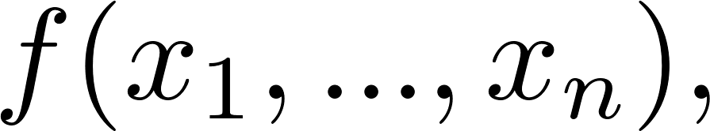
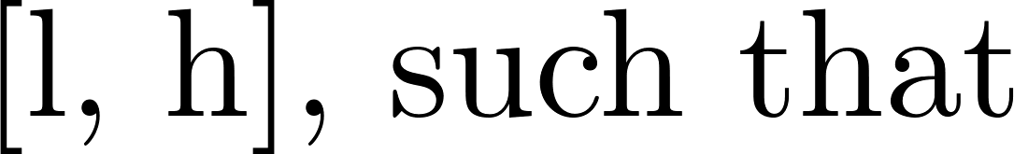
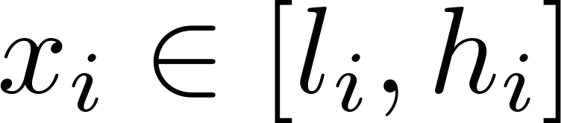
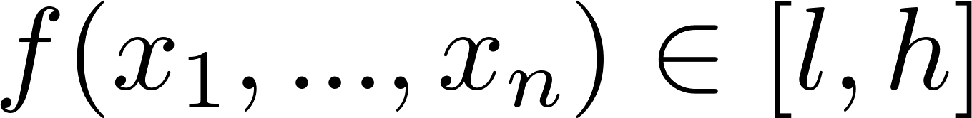
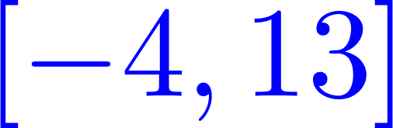
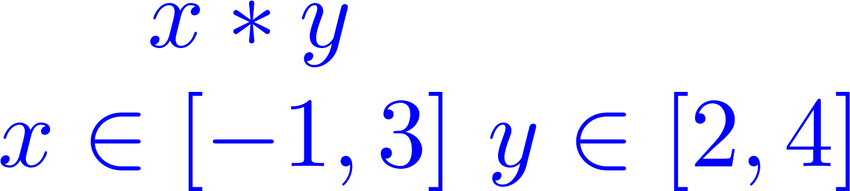
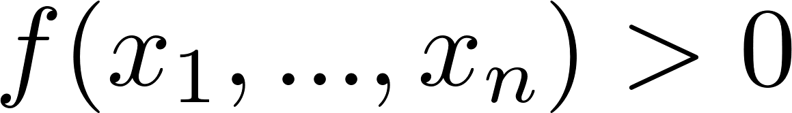



Over-Approximation - Interval Arithmetic
(over)-estimate ranges of polynomials
Interval Arithmetic
l
h
IA-UNSAT
UNSAT
l
h
0
IA-VALID
SAT
0
l
h
IA-SAT
UNKNOWN
l
0
h

Slide 8
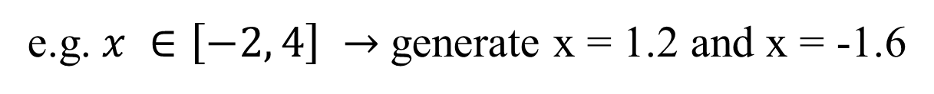
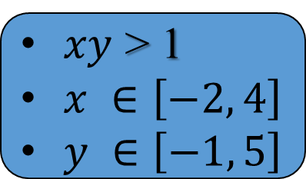
Under Approximation - Testing
find values for variables that satisfy the constraint
$xy$ > 1
$x ∈\left[−2, 4\right]$
$y ∈\left[−1, 5\right]$
Testing
SAT with values for x, y
UNKNOWN
Randomly generate 2 values for each variable
e.g. $x ∈\left[−2, 4\right] →$generate x = 1.2 and x = -1.6

Slide 9

raSAT loop
$$Constraint$$
SAT solver
UNSAT
UNSAT
SAT
IA_UNSAT
REFINE
Interval Arithmetic
Refinement
$$x ∈\left[1, 3\right]↔x ∈\left[1, 2\right]⋁x ∈\left[2, 3\right]$$
IA_VALID
IA_UNKNOWN
UNKNOWN
Testing
TEST_SAT
SAT

Slide 10
Contributions
Incremental search:
Incremental refinement → raSAT loop
Incremental widening
Incremental deepening
Effective 2 heuristics:
Previous heuristics have no visible difference from random choice
SAT-directed heuristics for box selection
Implementation:
Multiple equalities handling
Constraints over Integer Numbers
SAT confirmation

Slide 11
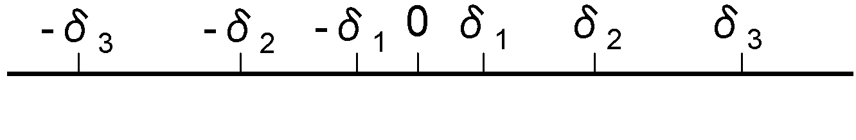
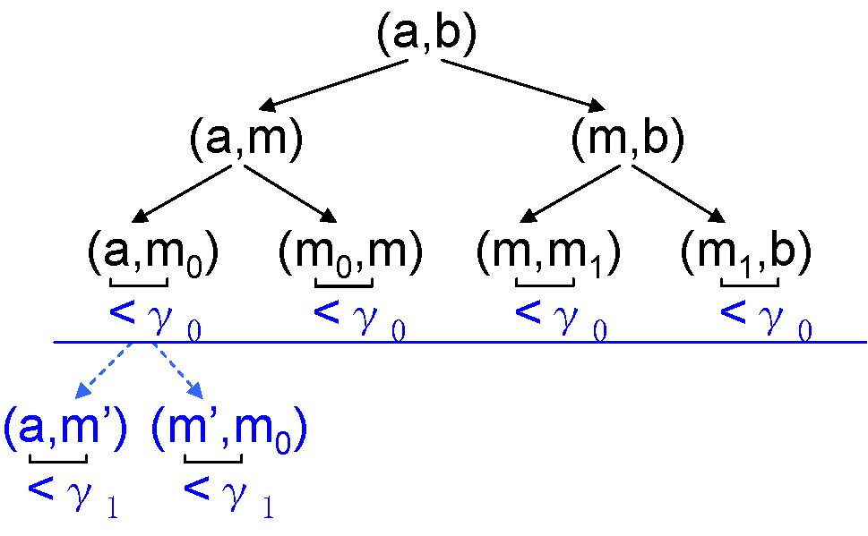
Incremental search
Incremental refinement → raSAT loop
Incremental widening
Start with small input range
Incrementally enlarge the range
Incremental deepening
raSAT has depth-first search manner
Threshold to stop deep search
Incrementally narrow the threshold

Slide 12
SAT-directed heuristics for box selection
UNSAT detection may work by finding a small set of conflicting inequalities.
Z3: conflicting core heuristics
iSAT3: apply UNSAT core detection by implication graph
raSAT: left for future investigation.
SAT detection needs to satisfy all inequalities:
Exponential increase the number of boxes.
Key for efficiency: selecting likely satisfiable box to explore
raSAT: SAT-likelihood of an inequality + Sensitivity of a variable

Slide 13
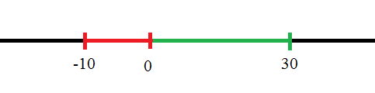
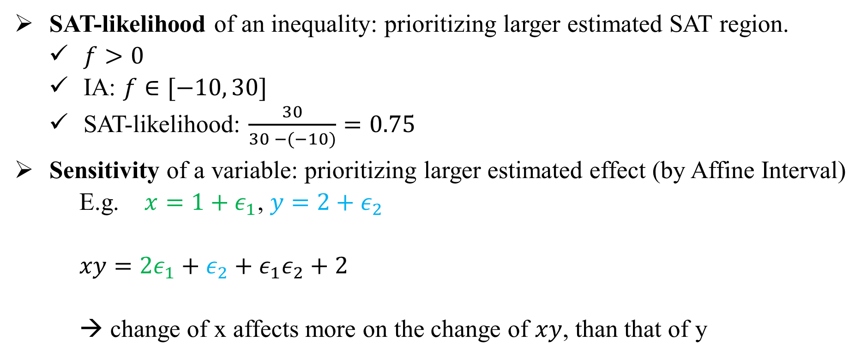

SAT-directed heuristics for box selection
SAT-likelihood of an inequality: prioritizing larger estimated SAT region.
$f>0$
IA: $f∈[−10, 30]$
SAT-likelihood: $\frac{30}{30 −(−10)}=0.75$
Sensitivity of a variable: prioritizing larger estimated effect (by Affine Interval)
E.g. $x=1+ε_{1}$, $y=2+ε_{2}$
$xy=2ε_{1}+ε_{2}+ε_{1}ε_{2}+2$
→ change of x affects more on the change of $xy$, than that of y
$$f>0$$

Slide 14
Heuristics choices for choosing satisfiable box
Select variable for decomposition |  | Select a decomposed box
Select an inequality | Select a variable of inequality
(1) Least SAT-likelihood | (8) Largest sensitivity | (3) Largest number of SAT inequalities
(2) Largest SAT-likelihood |  | (4) Least number of SAT inequalities
 |  | (5) Largest SAT-likelihood.
 |  | (6) Least SAT-likelihood.
(10) Random | (9) Random | (7) Random

Slide 15
Heuristics effects
Benchmark | No. of inequalities | (10)-(5)-(8) |  |  | (10)-(7)-(9)
 |  | SAT | UNSAT | Time(s) | SAT | UNSAT | Time (s)
Zankl tout=500s | 151 | 30 | 11 | 1406.03 | 21 | 10 | 933.39
Meti-tarski tout=60s | 5101 | 3325 | 1100 | 1496.6 | 3322 | 1076 | 1471.47
Only (10)-(5)-(8), show visible difference from random choices (10)-(7)-(9)

Slide 16
Comparison with other tools
iSAT3: Interval [-1000, 1000]
Tool | Zankl: 151 inequalities timeout = 500s |  |  | Meti-tarski: 5101 inequalities timeout = 60s |  |  | QEPCAD: 136 inequalities timeout = 900s
 | SAT | UNSAT | Time (s) | SAT | UNSAT | Time (s) | SAT | UNSAT | Time (s)
iSAT3 | 14 | 15 | 209.25 | 2916 | 1225 | 885.36 | - | - | -
raSAT | 31 | 10 | 756.58 | 3325 | 1100 | 1496.6 | 70 | 0 | 15.24
Z3 4.3 | 54 | 23 | 1034.7 | 3528 | 1568 | 129.78 | 114 | 22 | 0.45

Slide 17
Observations - Comparison with other tools
Z3 quickly (completely) solves constraints with number of variables up to around 10.
Large problems that are solved only by raSAT:
matrix-3-all-2: 47 variables, 87 inequalities/equations.
matrix-3-all-5: 81 variables, 142 inequalities/equations.
matrix-4-all-3: 139 variables, 244 inequalities/equations.
matrix-5-all-01: 132 variables, 276 inequalities/equations.
iSAT3 and Z3 quickly detect UNSAT.
Efficient UNSAT core.

Slide 18

Implementation
Constraints over integer numbers:
Decomposition: Stop when the length of an interval become 1
Testing: Generate integer test cases.
Multiple equations handling:
Repeatedly use the Intermediate Value Theorem.
Restriction: Number of variables $≥$ Number of equations.
SAT confirmation using iRRAM – an error-bounded package for reals.
Tool | SAT | UNSAT | Time (s)
raSAT | 6764 | 0 | 1230.54
Z3 | 6784 | 36 | 139.78
NIA/AProVE : 6850 inequalities – timeout = 60s

Slide 19
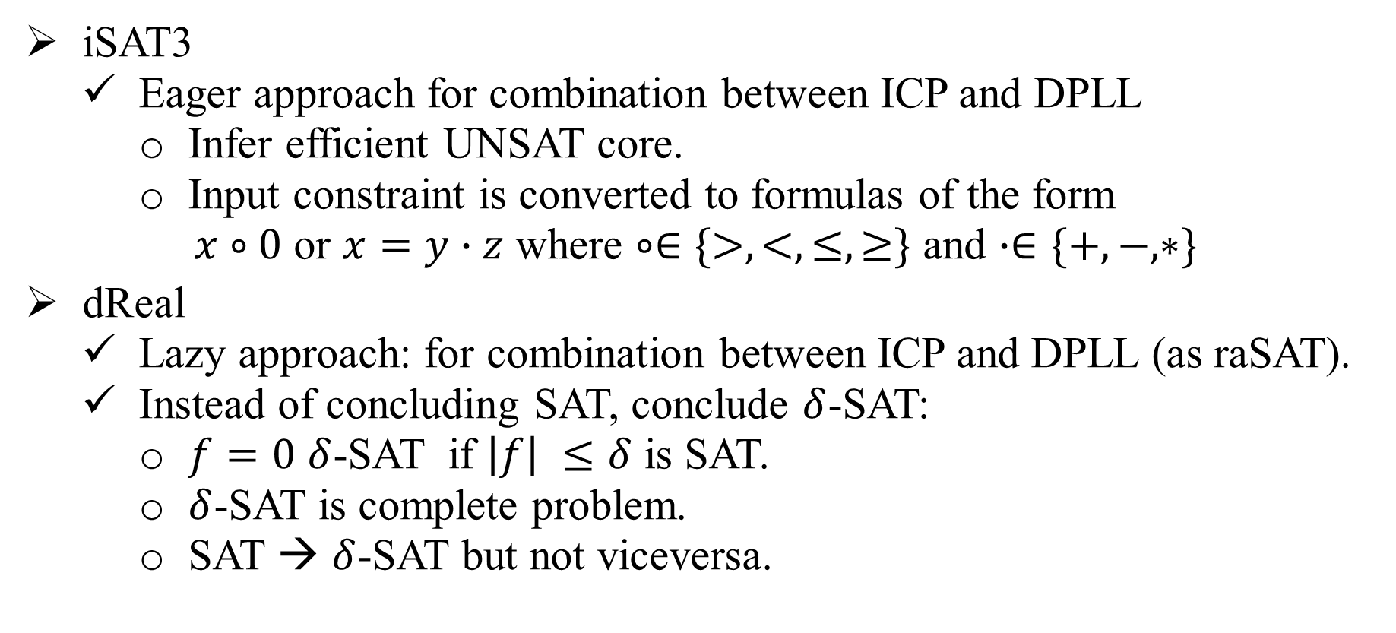
Related Works
iSAT3
Eager approach for combination between ICP and DPLL
Infer efficient UNSAT core.
Input constraint is converted to formulas of the form
$x∘0$ or $x=y∙z$ where $∘∈\{>,<,≤,≥\}$ and $∙∈\{+,−,∗\}$
dReal
Lazy approach: for combination between ICP and DPLL (as raSAT).
Instead of concluding SAT, conclude $δ$-SAT:
$f=0$ $δ$-SAT if $\left|f\right| ≤δ$ is SAT.
$δ$-SAT is complete problem.
SAT → $δ$-SAT but not viceversa.

Slide 20
Conclusion
Improvements and extensions for raSAT.
Took part in SMT-COMP 2014: 4th over 4 solvers → SMT-COMP 2015 challenge
Future works
UNSAT result confirmation.
Efficient heuristics
UNSAT-directed heuristic: UNSAT core.
Test generation heuristics.
Box Decomposition heuristics.
Complete quality handling using Grobner basis.

Slide 21
THANKS FOR ATTENTION

