Slide 1
Equality handling and efficiency improvement of SMT for non-linear constraints over reals
Vu Xuan Tung - Ogawa lab
School of Information Science, JAIST

Slide 2
Summary
Hook
Why do people need to solve Polynomial Constraints?
Raised in many applications in Software Verification
Termination Proof of Term Rewriting Systems
Loop Invariant Generation
Analysis of Round-off and Over-flow Errors

Slide 3
Summary
Hook
Why are we interested in solving Polynomial Constraints?
The complete method QE-CAD: DEXP.
Interval Constraint Propagation (ICP): exploration of boxes.
Bit-blasting: suffers with high number of variables or high degree of polynomials.
Linearization: suffers with high degree of polynomials.
Virtual substitution: degree <= 5
raSAT: ICP + Testing + heuristics

Slide 4
Summary
Research Purpose:
Efficiency Improvement: Heuristics.
Equality Handling: The Intermediate Value Theorem.
Outcome:
Proposed 2 heuristics.
Experiments on SMT-LIB Benchmarks: raSAT is able to solve large constraints which are difficult for other tools.
Implemented equality handling.

Slide 5
Summary
Contents
What is a Polynomial Constraint?
Approximation schemes.
Interval Arithmetic.
Testing.
Framework Design.
Heuristics for efficiency
Experiments: evaluate heuristics and compare with other tools: iSAT3, Z3
Extensions: Constraints over Integers and Equations Handling.

Slide 6
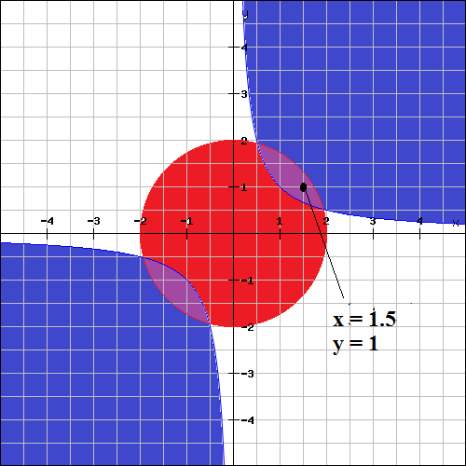

What is a Polynomial Constraint?
Q: Find the real values of x, y such that:
$x^{2}$ + $y^{2}<4$and $xy>1$

Slide 7


Approximation schemes
Interval Arithmetic
(over)-estimate ranges of polynomials
Interval Arithmetic
$xy$
$x ∈\left[−2, 4\right]$
$y ∈\left[−1, 5\right]$
$$xy ∈\left[−10, 20\right]$$

Slide 8

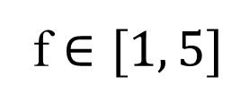

Approximation schemes
Interval Arithmetic
How to decide f > 0?
f $∈[−5, −1]$
f > 0: Unsatisfiable - UNSAT
-5
-1
0
f $∈[1, 5]$
f > 0: Satisfiable - VALID
0
1
5
f $∈[−2, 0.5]$
f > 0: Unknown
-2
0
0.5

Slide 9
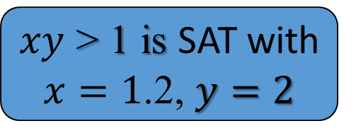
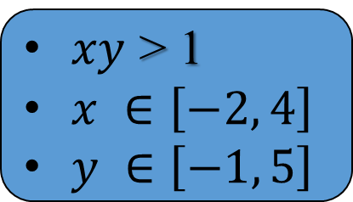
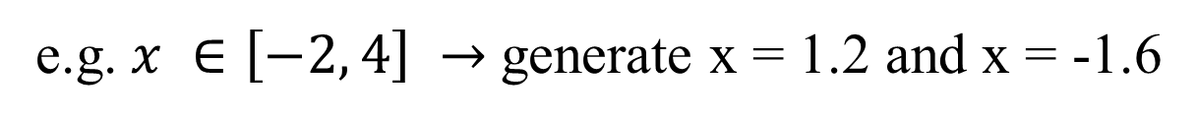
Approximation schemes
Testing
find values for variables that satisfy the constraint
Testing
$xy$ > 1
$x ∈\left[−2, 4\right]$
$y ∈\left[−1, 5\right]$
$xy$ > 1 is SAT with
$x=1$.2, $y=2$
Randomly generate 2 values for each variable
e.g. $x ∈\left[−2, 4\right] →$generate x = 1.2 and x = -1.6

Slide 10
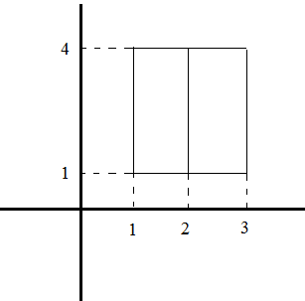

Framework Design
$$Constraint$$
THRESHOLD
UNSAT
UNSAT /
UNKNOWN
SAT solver
SAT
REFINE
Interval Arithmetic
IA_UNSAT
Refinement
$$x ∈\left[1, 3\right]↔x ∈\left[1, 2\right]⋁x ∈\left[2, 3\right]$$
IA_VALID
IA_UNKNOWN
UNSAT
Testing
TEST_SAT
SAT

Slide 11
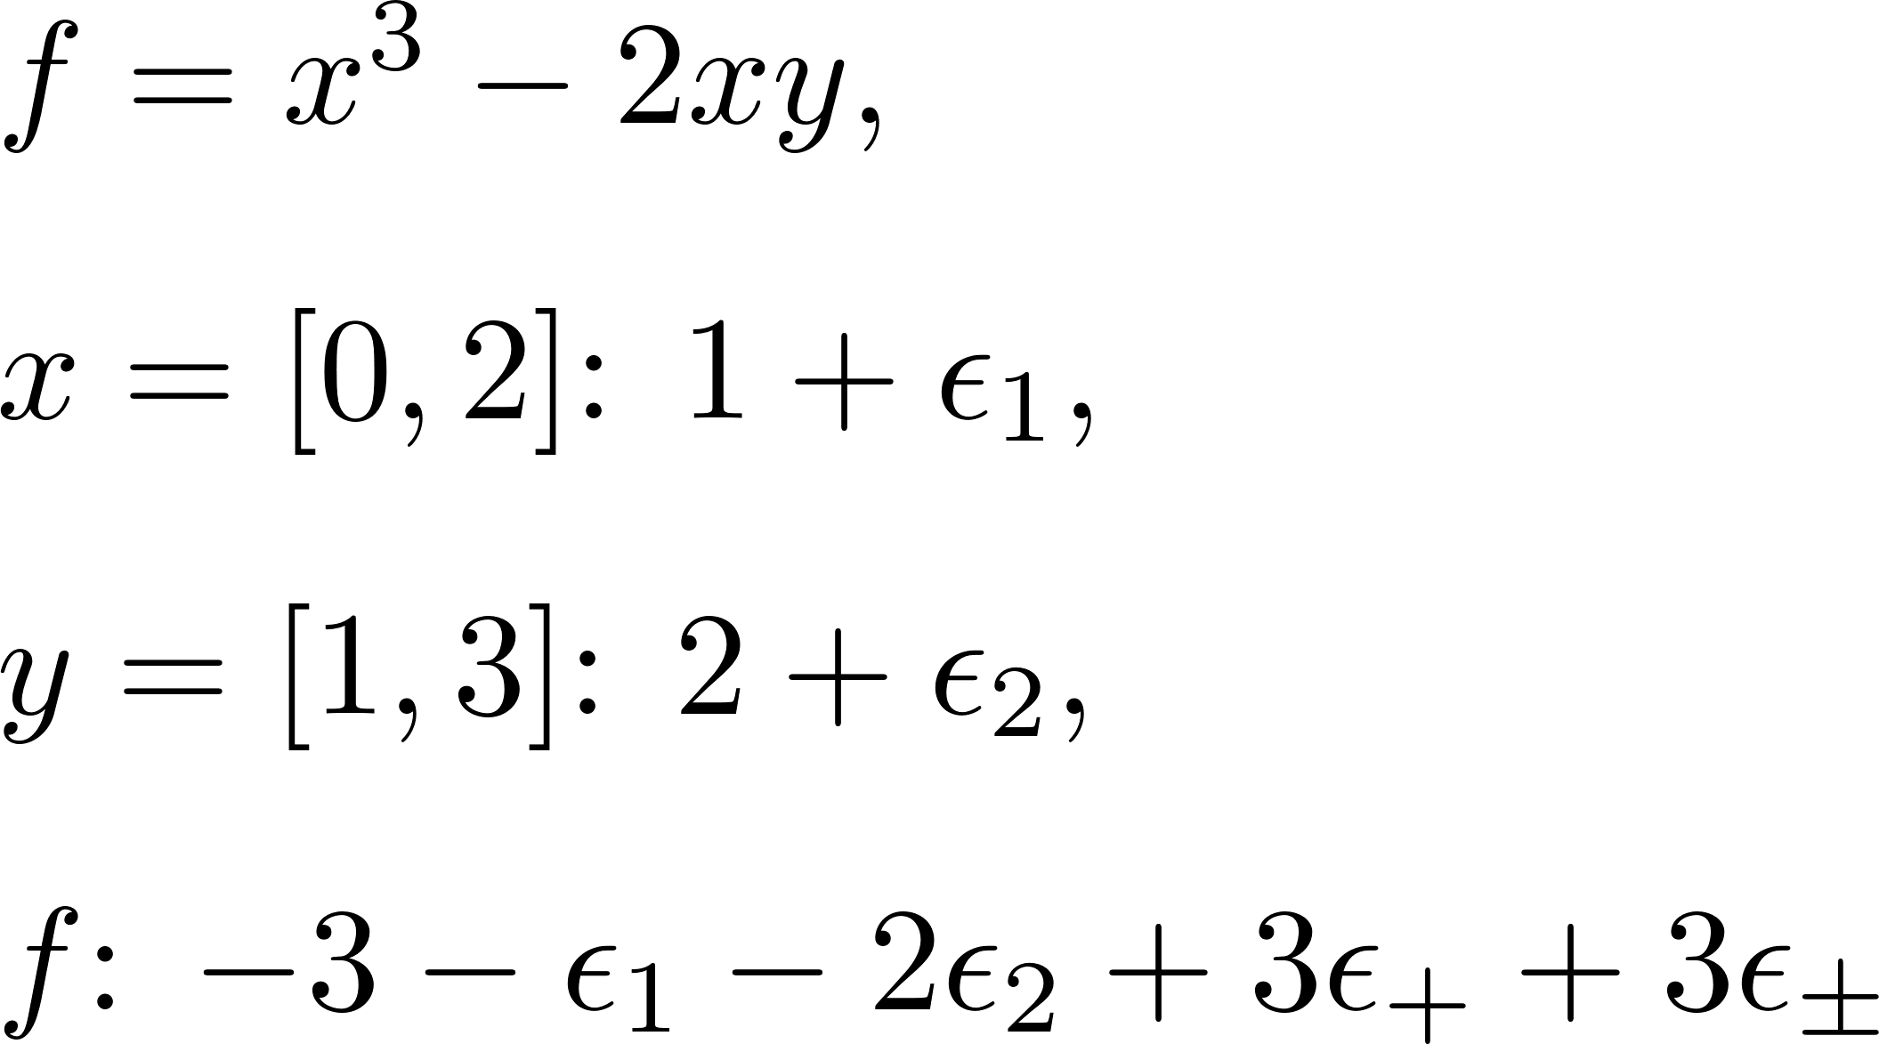
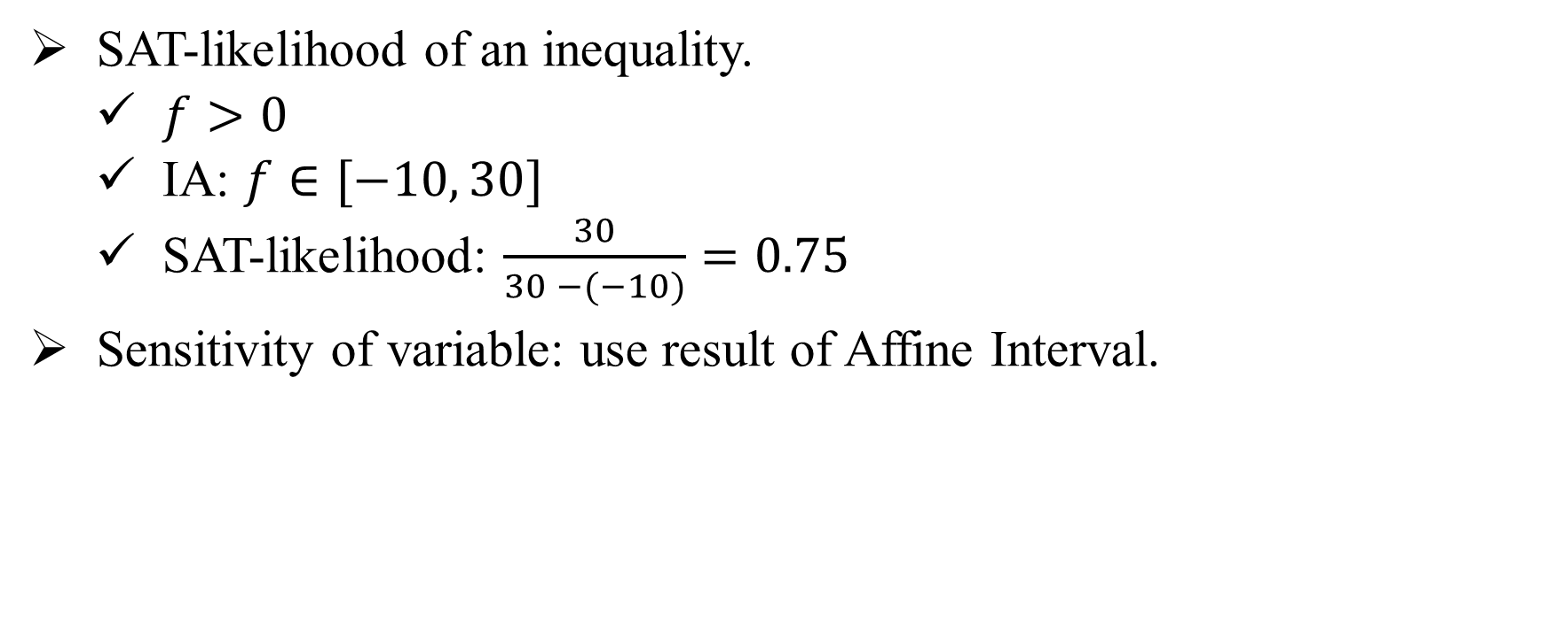
Heuristics for Efficiency
SAT-likelihood and sensitivity
SAT-likelihood of an inequality.
$f>0$
IA: $f∈[−10, 30]$
SAT-likelihood: $\frac{30}{30 −(−10)}=0.75$
Sensitivity of variable: use result of Affine Interval.

Slide 12
Heuristics for Efficiency
$$Constraint$$
THRESHOLD
UNSAT
UNSAT /
UNKNOWN
SAT solver
SAT
REFINE
Interval Arithmetic
IA_UNSAT
Refinement
IA_VALID
IA_UNKNOWN
SAT-likelihood
Sensitivity
UNSAT
Testing
TEST_SAT
SAT

Slide 13
Experiments
Efficiency of strategies
Benchmark | Heuristics |  |  | No Heuristics
 | SAT | UNSAT | Time | SAT | UNSAT | Time
Zankl (151) | 31 | 10 | 765.46 | 21 | 10 | 933.39
Meti-tarski(5101) | 3325 | 1100 | 1496.6 | 3322 | 1076 | 1471.47

Slide 14
Experiments
Compare with other tools: iSAT3 and Z3
iSAT3: Interval [-1000, 1000]
Tool | SAT | UNSAT | Time
iSAT3 | 14 | 15 | 209.25
raSAT | 31 | 10 | 756.58
Z3 4.3 | 54 | 23 | 1034.73
Zankl: 151 inequalities

Slide 15
Experiments
Comparison with other tools: iSAT and Z3
Large problems that are solved only by raSAT:
matrix-3-all-2: 47 variables, 87 inequalities/equations.
matrix-3-all-5: 81 variables, 142 inequalities/equations.
matrix-4-all-3: 139 variables, 244 inequalities/equations.
matrix-5-all-01: 132 variables, 276 inequalities/equations.

Slide 16
Experiments
Compare with other tools: iSAT3 and Z3
Tool | SAT | UNSAT | Time
iSAT3 | 2916 | 1225 | 885.36
raSAT | 3325 | 1100 | 1496.6
Z3 | 3528 | 1568 | 129.78
Meti-tarski: 5101 inequalities

Slide 17
Extensions
Constraints over Integers
Current approaches:
Bit blasting
Linearization
Can be solved by raSAT:
Decomposition: Stop when length of interval is 1
Testing: Generate integer test cases.

Slide 18
Extensions
Constraints over Integers
Tool | SAT | UNSAT | Time
raSAT | 6764 | 0 | 1230.54
Z3 | 6784 | 36 | 139.78
NIA/AProVE : 6850 inequalities

Slide 19
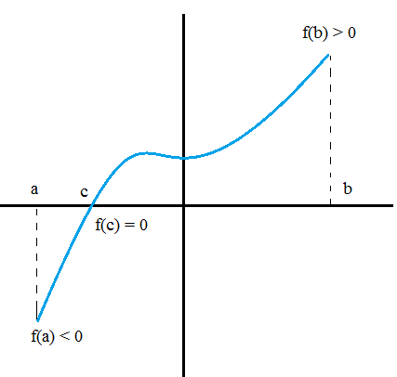
Extensions
Equations Handling
The Intermediate Value Theorem

Slide 20
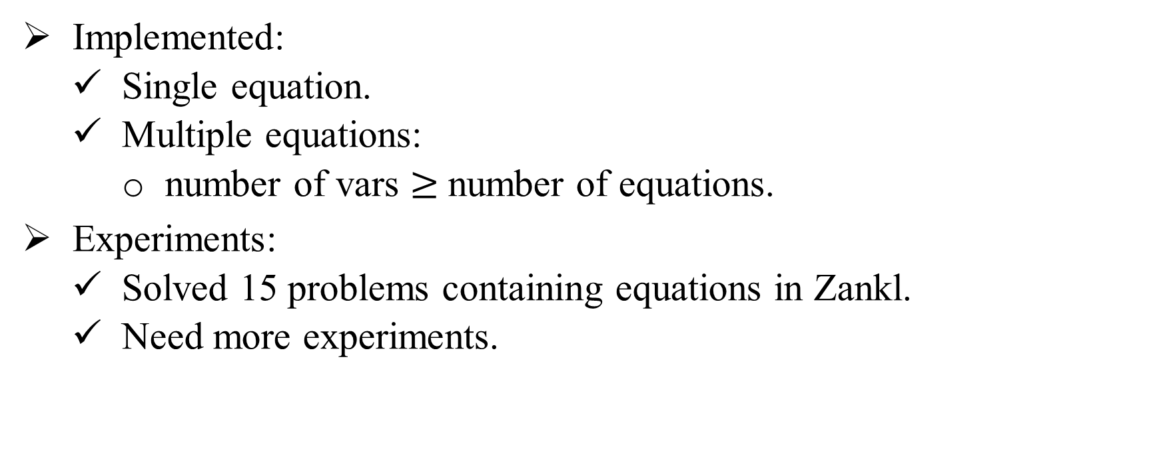
Extensions
Equations Handling
Implemented:
Single equation.
Multiple equations:
number of vars $≥$number of equations.
Experiments:
Solved 15 problems containing equations in Zankl.
Need more experiments.

Slide 21
Conclusion
Research Purpose:
Efficiency Improvement: Heuristics.
Equality Handling: The Intermediate Value Theorem.
Observation: raSAT can solve some large constraints from SMT-LIB benchmarks which are difficult for other tools.
Future:
UNSAT core.
Test generation.
Box Decomposition.

Slide 22
THANKS FOR ATTENTION

