Slide 1
MODULE NAME: DATA MINING & DATA WAREHOUSE
ASSIGNMENT:
University Library Analytics
Notes:
Welcome. We are Group X. In 30 minutes: the problem, our design, the ETL and data quality, the analytics and dashboards, security and backup, and a live demo. Introduce the three members and their roles: Data Architect, ETL Specialist, Analytics & Security Lead.

Slide 2
GROUP 3
GROUP MEMBERS
1. HAKIZIMANA Leon / BT000301IT26F
2. TUYISHIME Joseph / BT001001IT26F
3. UWIMANA Jeanine / BT001701IT26F
Notes:
Welcome. We are Group X. In 30 minutes: the problem, our design, the ETL and data quality, the analytics and dashboards, security and backup, and a live demo. Introduce the three members and their roles: Data Architect, ETL Specialist, Analytics & Security Lead.

Slide 3
Three systems, no single truth
Book Lending
Digital Resources
Study Rooms
MySQL · checkouts and returns
"CS", "CompSci", "Computer Science"
three date formats
Excel, one sheet per year
"E-book" vs "e-Book"
missing reading times
web app CSV export
"R101", "R-101", "Room101"
walk-ins without student ID
15+ hours
3+ weeks
6 questions
of manual copying every month - and the reports still contradict each other
to produce a report; no history, no trends, no dashboards
the Library Committee cannot answer today (departments, peak times, digital vs books ...)
Notes:
The Library Director copies numbers by hand from three systems that write the same things differently. Result: 15+ hours a month, contradictory reports, no trend analysis. Our mission: consolidate, clean, model, analyse, secure.

Slide 4
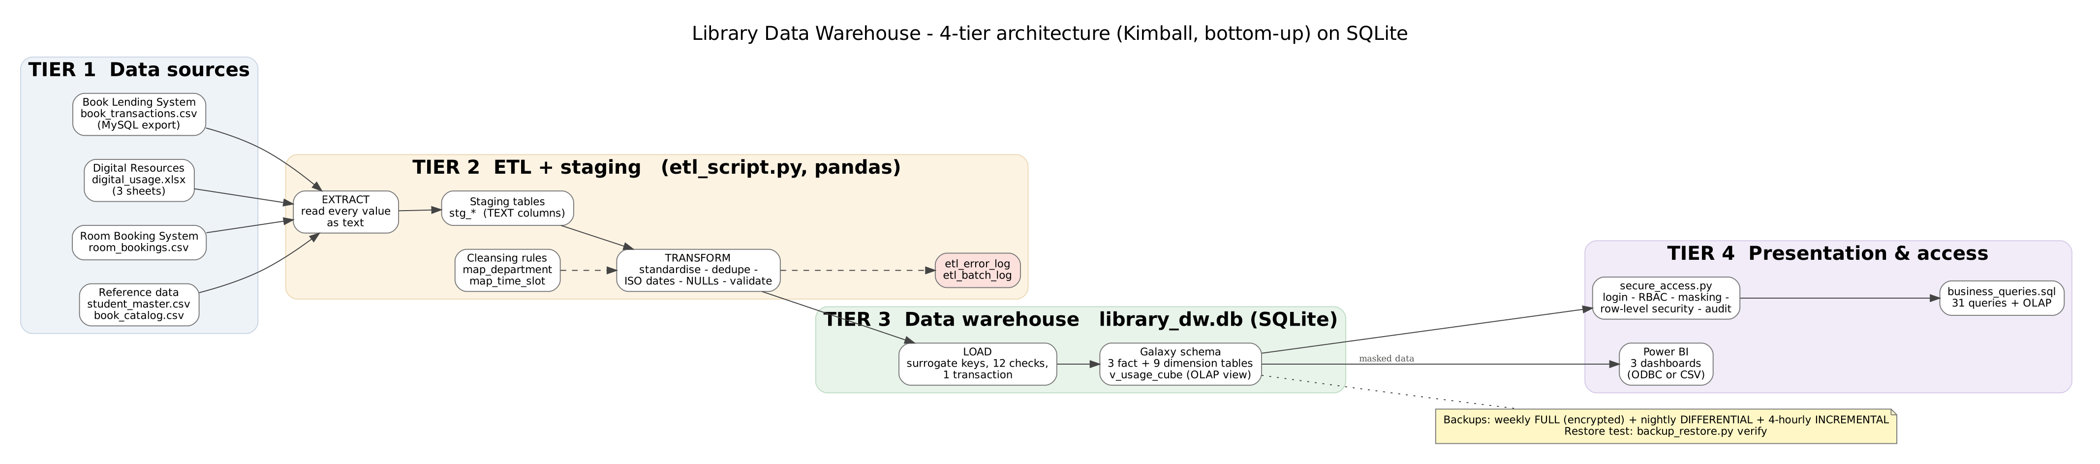
Our solution: a 4-tier data warehouse
Kimball, bottom-up
SQLite + Python
Power BI
one subject area, clear questions, fast results
one portable file, no server; pandas ETL; built-in to Python
three dashboards on masked data, refreshed every night
Notes:
Tier 1 sources, tier 2 ETL with a staging area, tier 3 the warehouse in one SQLite file, tier 4 secure access, queries and Power BI. We chose Kimball because we have one subject area and fixed questions. SQLite is in the brief's tool list: zero installation, one file the whole team and the examiner can open.

Slide 5
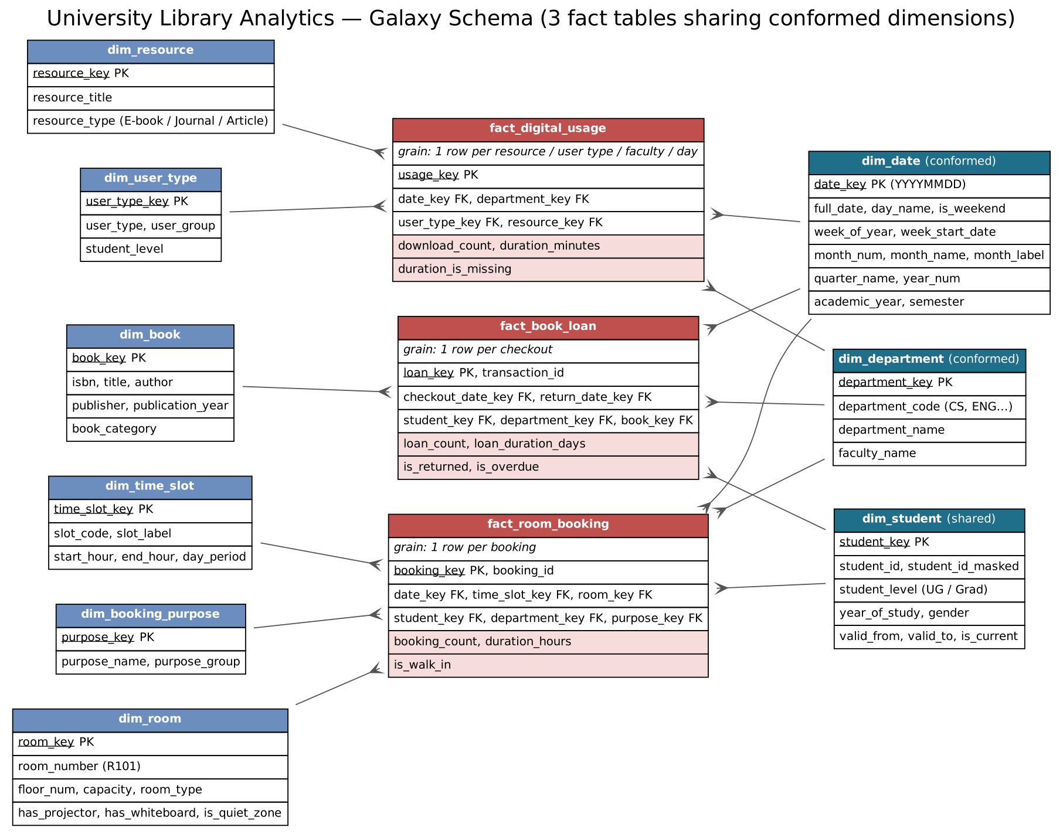
Galaxy schema: three stars sharing dimensions
3 fact tables, one per service: loans, downloads, room bookings - each at its own grain
Conformed dim_date and dim_department let us compare all services in one report
Not one library_usage_fact: it would be mostly empty columns
Not snowflake: more joins, slower, harder in Power BI
Surrogate keys, 'Unknown' member (key 1), masked StudentID, SCD-2 history on students
Notes:
Stakeholder question 2: why star and not snowflake? Our dimensions are small, so normalising them saves nothing but costs joins. We used a galaxy: three stars sharing conformed dimensions. The view v_usage_cube stacks the three facts for cross-service questions.

Slide 6
ETL: from messy exports to a clean warehouse
1 Extract
5 files read as text into staging
2 Clean
30 rules: dates, names, numbers, NULLs
3 De-duplicate
exact, logical and near duplicates
4 Validate
12 checks; fail = nothing loaded
5 Load
one transaction, surrogate keys
9,390
9,065
527
~1 s
raw rows extracted from 3 sources
clean rows loaded into the warehouse
problems logged with row, value and action
per ETL run; full rebuild of everything in about 5 s
Notes:
Stakeholder question 1: how do we handle failures? Value problems are logged and the run continues. If any of the 12 validation checks fails, the batch stops before loading. The load is one transaction: an error rolls back everything and the batch is marked FAILED, so the warehouse keeps yesterday's good data.

Slide 7
Every inconsistency reduced to one standard
0 duplicates left
216 exact, 22 logical and 43 near duplicates removed
Dates in ISO 8601
'01/15/2024', '2024-15-01', 'Jan 15, 2024' → 2024-01-15 (format chosen per Excel sheet)
Missing values handled
207 walk-ins → 'Unknown' student; 319 loans flagged 'not returned'; reading time kept NULL
Notes:
Before/after metrics from the data quality report. 55 different room spellings became 11 rooms, 32 department spellings became 8 departments. Query Q19 proves zero duplicates in the warehouse. We never invent data: missing reading time stays NULL with a flag.

Slide 8
What the data tells us
31 SQL queries · all 10 required questions + 3 bonus · OLAP cube view
Notes:
Now the answers to the business questions. All results are in query_results.xlsx and reproducible with run_business_queries.py.

Slide 9
Digital resources are replacing physical books
+30.3%
digital downloads in 2025 vs 2024
-13.2%
book loans in 2025 vs 2024
5.9 to 12.3
downloads per book loan, 2023 → 2025
Notes:
Q1 and Q14. One scale for all three lines: an index where 100 is an average month of 2023. Downloads rise, loans fall, rooms grow slightly. Downloads per loan doubled. Recommendation: shift part of the book budget to e-resources, keep study rooms.

Slide 10
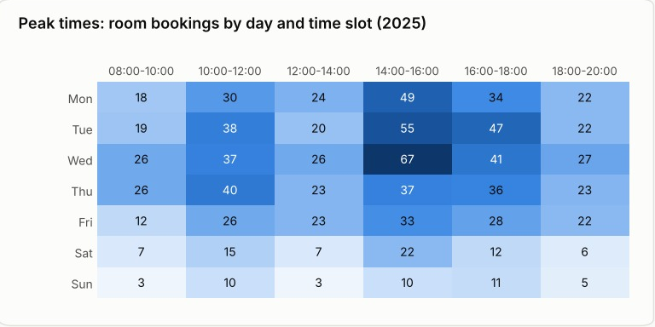
Who uses the library - and when
Peak: Wednesday 14:00 - 16:00
Tuesday-Thursday afternoons are the busiest; weekends and early mornings are quiet. Plan desk staff and an overflow room for the peak, cleaning for quiet slots.
Notes:
Q2: Engineering and Computer Science are the heaviest users. Q3: the heat map shows day x time slot; the single busiest combination is Wednesday 14:00 - 16:00.

Slide 11
Loans, students and rooms: three findings
Loan duration
Graduates vs undergraduates
Why rooms are popular
Average 13.9 days; 12% of loans kept longer than the 21-day period. Slowest: Natural Sciences (14.7 days).
Graduates keep books 17.9 vs 12.8 days, borrow 68.6% research books and use 49.5% journals (UG 20.4%).
Group rooms with a projector lead (R201: 8.3% of open hours); the 20-seat seminar room R302 is least used (2%).
Notes:
Q5 efficiency, Q15 room popularity and the undergraduate/graduate comparison from section 2 of the brief. Recommendation: add a projector to R202 and R101; convert part of the seminar room R302 into group spaces.

Slide 12
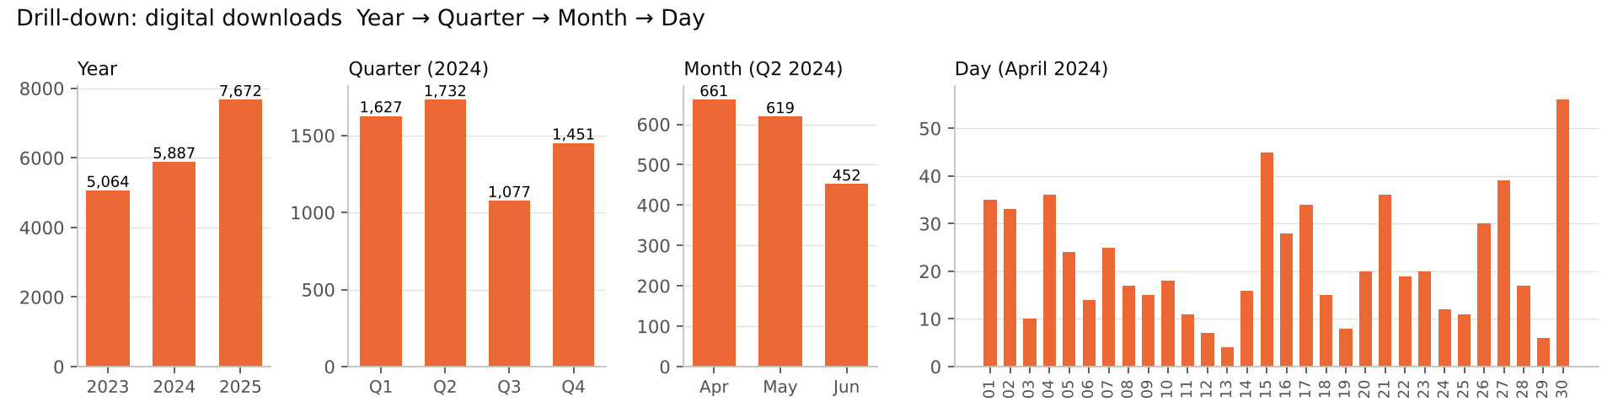
OLAP operations, demonstrated
Drill-down
Roll-up
Slice
Dice
Pivot
Year → Quarter → Month → Day (Q06)
Day → Week → Month (Q07)
only Q1 2024 (Q08)
Engineering × Digital × March (Q09)
departments × resource types (Q10)
Notes:
All five OLAP operations work in SQL (olap_operations_demo.pdf) and by clicking in Power BI: drill arrows on the Calendar hierarchy, slicers for slice and dice, the Matrix visual for pivot. Show this live in the demo.

Slide 13
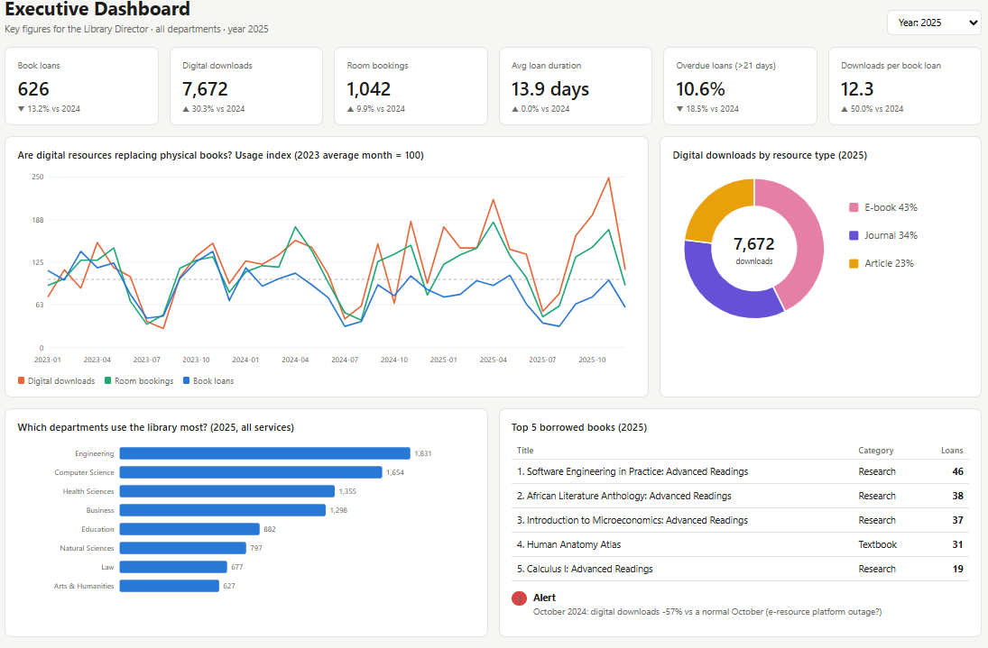
Executive dashboard for the Library Director
Notes:
Power BI page 1: KPI cards with change vs last year, the index line chart, resource mix, department ranking, top books. Slicers for year and department.

Slide 14
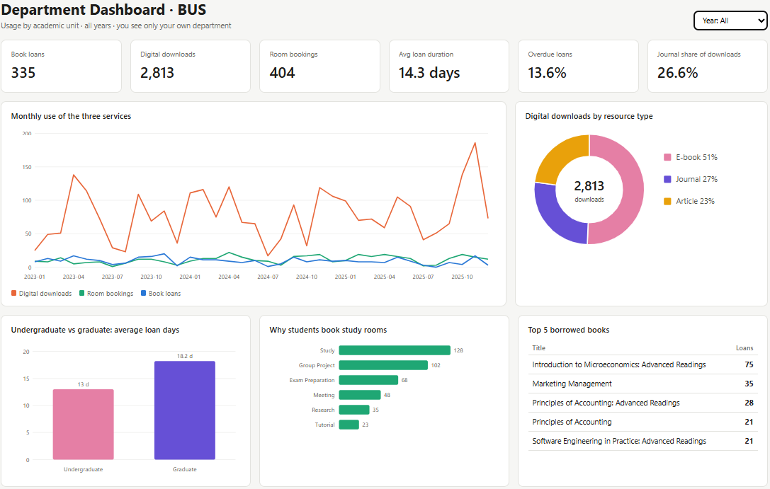
Department and Operational dashboards
Department: usage per academic unit, pivot heat map, loan duration, undergraduate vs graduate. Heads see only their own department (Row-Level Security).
Operational: last 30 days, peak-time heat map, daily bookings, room utilisation, books not returned and alerts for the desk staff.
Notes:
Pages 2 and 3. The guide (dashboard_guide.pdf) lists every visual, field and DAX measure.

Slide 15
Security: everyone sees only what they need
Role | Who | Can
Admin | IT administrator | everything
Analyst | Director, analysts, Power BI | read all - real StudentID blocked
Department head | heads / deans | read own department only
ETL / Backup | scheduled jobs | load data / copy the file
Tested live (--demo)
analyst SELECT student_id → REFUSED
analyst DELETE → REFUSED
analyst staging / passwords → REFUSED
head_cs → only Computer Science rows
head_cs reads all facts → REFUSED
3 wrong passwords → account LOCKED
admin UPDATE → audit row by trigger
Passwords: PBKDF2 hash + salt, locked after 3 failures
Masking: STU-2024-001 → STU-****-001
SQLite authorizer checks every column read and change
Every login and query recorded in audit_log; triggers on changes
Encrypted backups (AES); BitLocker; HTTPS for Power BI
Notes:
Stakeholder question 9: student privacy. SQLite has no users, so secure_access.py enforces the roles with SQLite's authorizer. Question 11: nobody can see salaries - the warehouse stores none.

Slide 16
Backup and recovery - tested by deleting the database
Full
Differential
Incremental
weekly, encrypted, checksum
nightly after the ETL
every 4 hours, 08-20 h
26 / 26
< 1 s
≤ 4 h
tables identical after restoring the deleted database
measured restore time (RTO target: 1 hour)
maximum data loss (RPO) during opening hours
Our first restore test failed - it skipped the differential backup. The automatic verify step caught it; we fixed the restore chain. A backup is only proven when it has been restored.
Notes:
Stakeholder question 12: how quickly can we recover? We deleted library_dw.db and ran restore latest: full + differential applied, every table PASS. 3-2-1 storage rule; the key is kept separately.

Slide 17
Ready for growth
New branch next year
Reading-time tracking
Format changes
Add dim_branch and a branch_key on the three facts - no redesign of existing tables.
duration_minutes already exists; detailed sessions become one more star in the galaxy.
Raw text staging never fails; a new spelling is one row in a map_ table; bad batches are stopped.
15 h to 5 s
MySQL / PostgreSQL
monthly reporting before vs a complete automatic rebuild now
migration path for many simultaneous users: same model, GRANTs replace the access program
Notes:
Stakeholder questions 3, 5, 6, 8 and 10. Incremental loads: batch IDs, watermark, UNIQUE source IDs.

Slide 18
Recommendations for the Library Committee
Invest in digital
Staff for the peaks
Upgrade rooms
Downloads +30.3% a year, loans -13.2%: move part of the book budget to e-books and journals.
Wednesday 14:00 - 16:00 is the busiest slot: open an overflow room and add desk staff.
Group rooms with projectors are full; equip R101/R202, repurpose the seminar room R302.
Monitor e-platforms
Recall old loans
Fix data at the source
Keep the anomaly alert: it flagged the October 2024 drop automatically, so an outage shows up at the next monthly review.
319 books are not returned, most for more than 90 days: run a recall campaign.
Use one department list and one date format in all three systems.
Notes:
Close with decisions the committee can take. Each recommendation is backed by a query and a dashboard.

Slide 19
Live demo · Questions
1 python run_all.py - rebuild everything in about 5 seconds
2 DB Browser for SQLite: run Q01 and Q10a
3 Power BI: drill-down, slice, dice, pivot
4 python secure_access.py --demo - roles, masking, lock-out
5 python backup_restore.py verify - restore test
Notes:
Demo order with timings: run_all (1 min), queries (2 min), Power BI OLAP clicks (4 min), security demo (2 min), backup verify (1 min). Then questions - the design document section 12 has prepared answers to all 12 stakeholder questions.

