Slide 1
KT Session: Topics Covered
Sdlc Models
Testing
Type Of Testing
Testing Methods
Test Scenario
Test Case
Test Case Writing

Slide 2
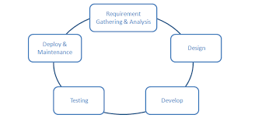
SDLC
It is software development life cycle model.
Software Development Life Cycle (SDLC) is a process used by the software industry to design, develop and test high quality softwares.

Slide 3
SDLC MODELS
Waterfall Model
V-shaped Model
Agile Model
Waterfall Model:
It is also referred to as a linear-sequential life cycle model.
In a waterfall model, each phase must be completed before the next phase begins.
In this model software testing starts only after the development is complete.

Slide 4
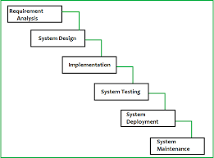
Disadvantage:
Not a good model for complex projects.
All requirement should be known in starting.
No working software is produced until late during the life cycle.

Slide 5
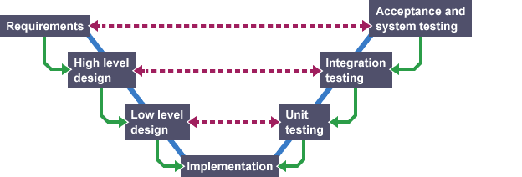
V-shaped Model
V- model means Verification and Validation model.
Testing of the product is planned in parallel with a corresponding phase of development in V-model.

Slide 6
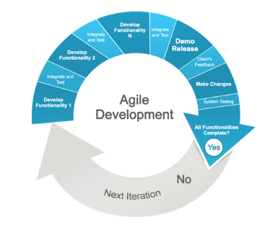
Agile Model
Software is developed in incremental, rapid cycles.
Both development and testing activities are concurrent unlike the Waterfall model.
Testers and developers work together.
Unlike the waterfall model in agile model very limited planning is required to get started with the project.

Slide 7
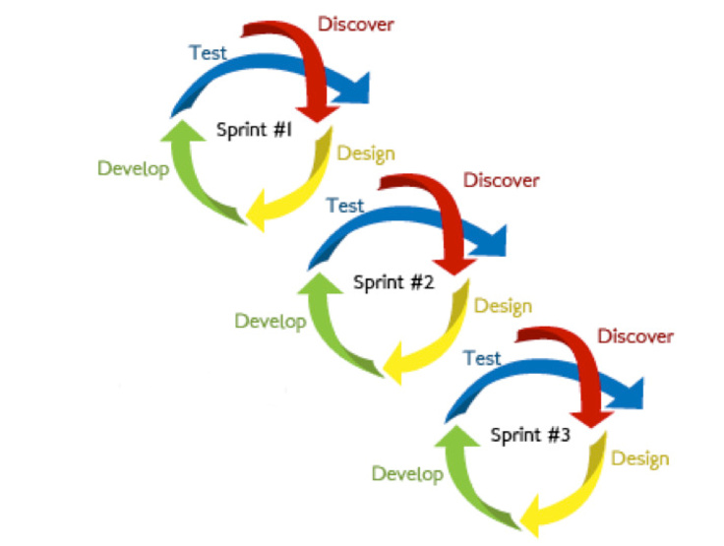

Slide 8
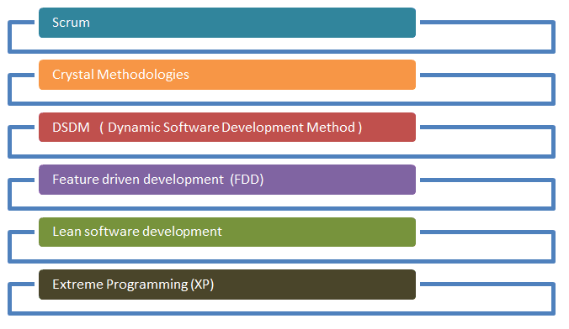
Agile Testing Methadology

Slide 9
Scrum
Scrum is a subset of Agile. It is a lightweight process framework for agile development, and the most widely-used one. A “process framework” is a particular set of practices that must be followed in order for a process to be consistent with the framework. (For example, the Scrum process framework requires the use of development cycles called Sprints, the XP framework requires pair programming, and so forth.)
“Lightweight” means that the overhead of the process is kept as small as possible, to maximize the amount of productive time available for getting useful work done.
It consists of three roles, and their responsibilities are explained as follows:
Scrum Master
Master is responsible for setting up the team, sprint meeting and removes obstacles to progress. He / she make sure that the scrum team is productive and progressive.
Product owner
The Product Owner creates product backlog, prioritizes the backlog and is responsible for the delivery of the functionality at each iteration
Scrum Team
Team manages its own work and organizes the work to complete the sprint or cycle

Slide 10
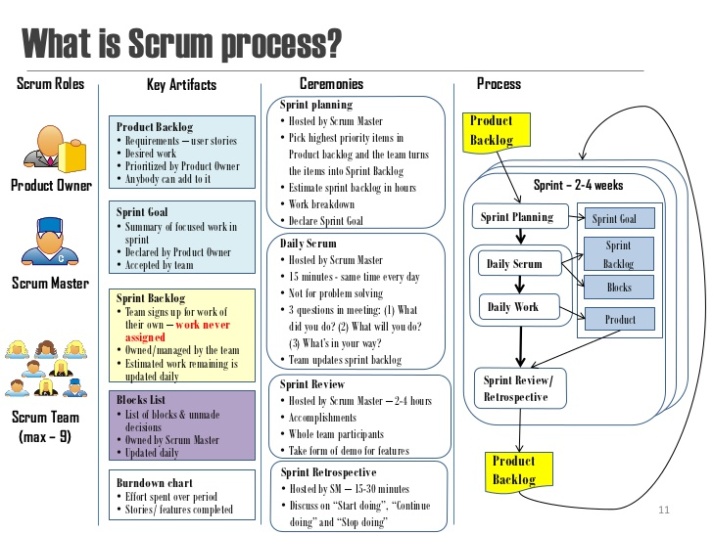

Slide 11
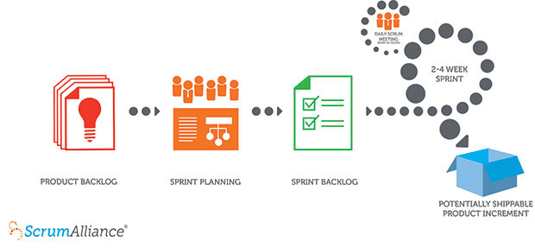
A product owner creates a prioritized wish list called a product backlog(list of all things that needs to be done within the project or we can say kind of bucket or source where all the user stories are kept).
During sprint planning, the team pulls a small chunk from the top of that wish list, a sprint backlog(The sprint backlog is a list of tasks identified by the Scrum team to be completed during the sprint), and decides how to implement those pieces.
The team has a certain amount of time — a sprint (usually two to four weeks) — to complete its work, but it meets each day to assess its progress (daily Scrum).
Along the way, the Scrum Master keeps the team focused on its goal.
At the end of the sprint, the work should be potentially shippable: ready to hand to a customer, put on a store shelf, or show to a stakeholder.
The sprint ends with a sprint review and retrospective.
As the next sprint begins, the team chooses another chunk of the product backlog and begins working again.

Slide 12
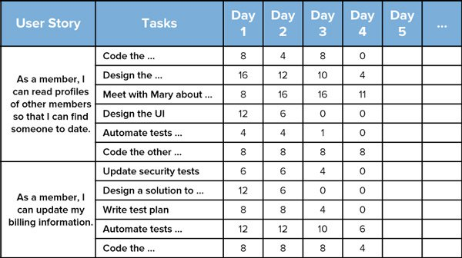
Sprint backlog
The Scrum team is the car itself, ready to speed along in whatever direction it is pointed. The product owner is the driver, making sure that the car is always going in the right direction. And the Scrum Master is the chief mechanic, keeping the car well tuned and performing at its best.

Slide 13
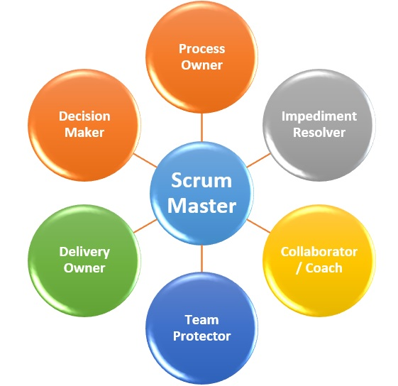
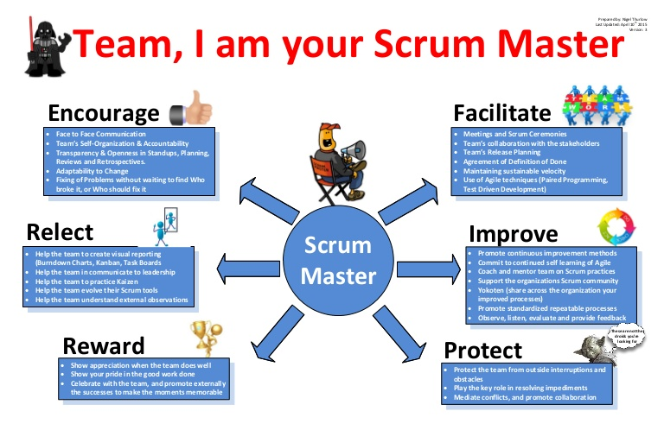
Scrum Master

Slide 14

Testing
Software testing is a process of executing a program or application with the intent of finding the software bugs.

Slide 15

Why Testing?
To find and correct defects.
To provide Quality of the product.
It’s required to stay in the business.

Slide 16
Types of Testing:
Manual Testing:
Manual Testing is a type of Software Testing where Testers manually execute test cases without using any automation tools. Any new application must be manually tested before its testing can be automated.
Automation Testing:
Automation Testing means using an automation tool to execute your test case suite.
Example: Selenium, TestComplete etc.

Slide 17
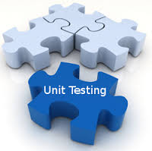
Unit Testing:
Unit testing of software is done during the development (coding) of an application.
Unit testing is a method by which individual modules of source code are tested.
Unit testing is usually performed by the developer.

Slide 18
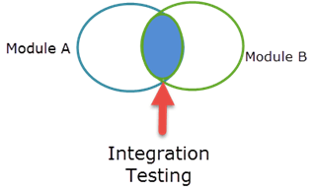
Integration Testing:
In Integration Testing, individual software modules are integrated logically and tested as a group.
Integration testing focuses on checking data communication amongst these modules.
Integration testing can be done in two ways: Bottom-up integration testing and Top-down integration testing.

Slide 19
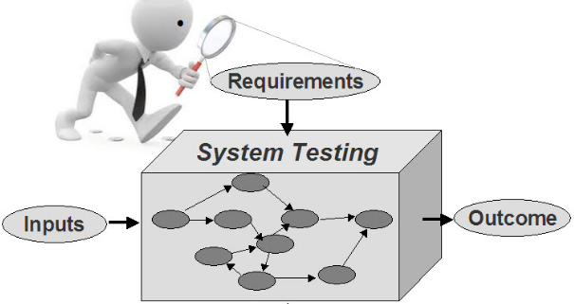
System Testing
In System testing behavior of whole system is tested.
System testing should investigate both functional( authentication, functionality etc.) and non-functional( security, performance ,stability etc.) requirements of the testing.
The application is tested in an environment that is very close to the production environment where the application will be deployed.

Slide 20
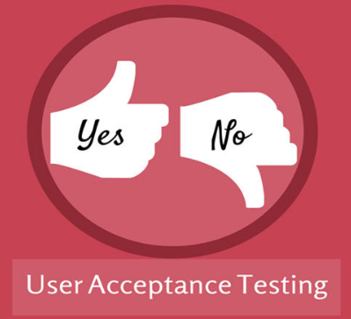
Acceptance Testing
After the system test has corrected all or most defects, the system will be delivered to the user or customer for Acceptance Testing or User Acceptance Testing (UAT).
Acceptance testing is basically done by the user or customer.

Slide 21

Regression Testing
Regression testing is defined as a type of software testing to confirm that a recent program or code change has not adversely affected existing features.
It ensures that old code still works once the new code changes are done.

Slide 22
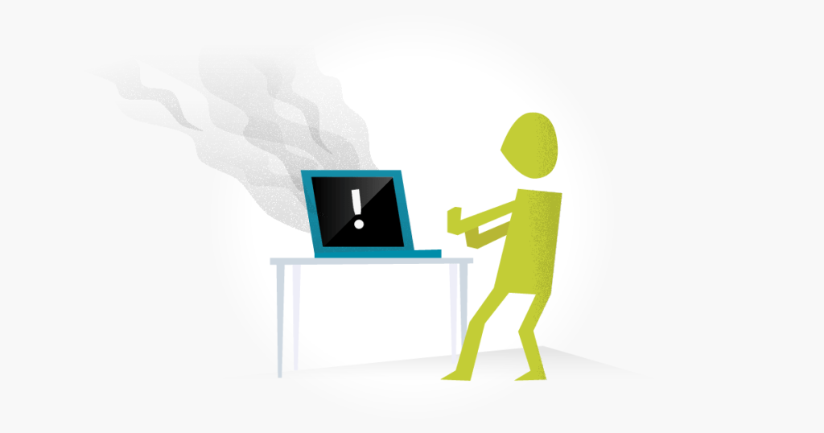
Smoke Testing
Smoke testing covers most of the major functions of the software. This testing is performed by the developers or testers.

Slide 23
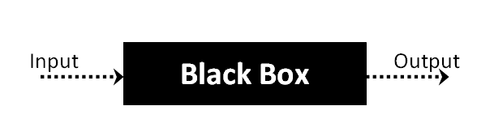
Software Testing Methods
Black Box
Black box testing is a software testing techniques in which functionality of the software is tested without looking at the internal code structure, implementation details and knowledge of internal paths of the software.
In Black Box Testing we just focus on inputs and output of the software system.

Slide 24
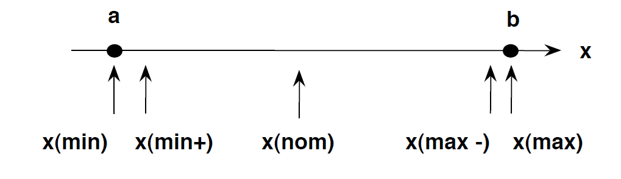
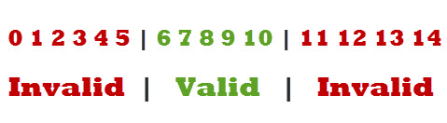
Boundary value analysis:
Boundary testing is the process of testing between extreme ends or boundaries between partitions of the input values.
Equivalence partitioning:
Equivalence partitioning is a Test Case Design Technique to divide the input data of software into different equivalence data classes.
Example: Text field take input a numeric value, length must be 6-10 characters long

Slide 25
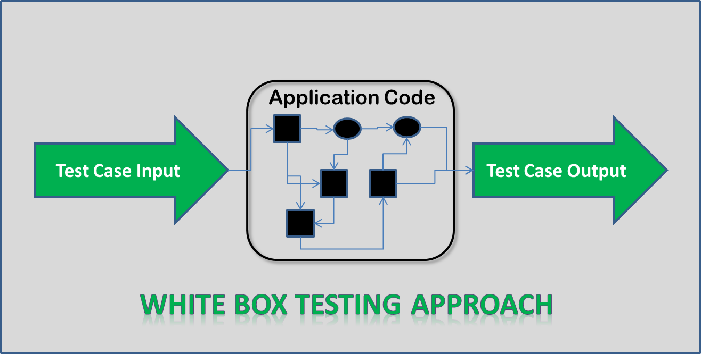
White box
White-box testing is the detailed investigation of internal logic and structure of the code.
In order to perform white-box testing on an application, a tester needs to know the internal workings of the code.

Slide 26
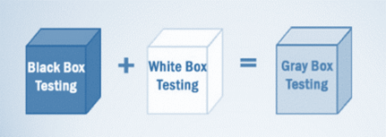
Grey Box
Grey Box Testing is a software testing method, which is a combination of both White Box Testing and Black Box Testing method.
In Grey Box Testing internal structure (code) is partially known.

Slide 27
User Story:
The user stories should be written by the business in the language of the customer so that it is clear to both the business and the development team what the customer wants and why he wants it.
The user story describes the type of user, what they want and why. A user story helps to create a simplified description of a requirement.
A user story template often uses the following type of format:
As a <role>, I want <feature> so that <reason>.
Examples of user stories are:
As a user, I want to upload photos so that I can share photos with others.
User stories are nothing but the requirements or feature which has to be implemented. In scrum, we don’t have those huge requirements documents, rather the requirements are defined in a single paragraph, typically having the format as:
As a <User / type of user> I want to <Some achievable goal / target> To achieve <some result or reason of doing the thing>

Slide 28
Acceptance Criteria
Define the boundaries for a user story/feature.
Help the team gain a shared understanding of the story/feature
Help developers and testers to derive tests.
Help developers know when to stop adding more functionality to a story.
Example user story: As an internet banking customer I want to see a rolling balance for my everyday accounts so that I know the balance of my account after each transaction is applied
Example acceptance criteria:
The rolling balance is displayed
The rolling balance is calculated for each transaction
The balance is displayed for every transaction for the full period of time transactions are available The balance is not displayed if a filter has been applie

Slide 29
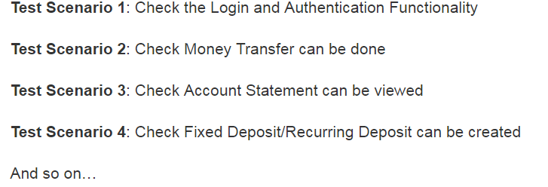
Test Scenario
A Test Scenario is any functionality that can be tested.
Example: Test Scenarios for a Banking Site

Slide 30
Basic principles used to identify scenarios
User stories and associated acceptance criteria
Impacted user stories
Impacted components/modules

Slide 31

Test Case
A Test Case is a set of actions executed to verify a particular feature or functionality of your software application.
A Test Case is split into:
Prerequisites
Test Procedure
Test Data
Expected results
Format of Standard Test Cases:

Slide 32
Example:
Check Login Functionality there many possible cases like
Test Case 1: Check results on entering valid User Id & Password
Test Case 2: Check results on entering Invalid User ID & Password
Test Case 3: Check response when User ID is Empty & Login Button is pressed, and many more..

Slide 33
Why Test Case?
Easy way to understand functionality
Captures thought process went in a tester
Less KT to other team members
Creates less dependency between team members
Builds confidence
Facilitates to cross check if there are any gaps in validating functionality.
Point to be note before drafting Test case:
need to be kept in mind anyone can easily execute.
each test should be independent to each other.
Write clear assumptions and preconditions in prerequisite step
Prefix "Manual:" for manual test cases and "API:" for api test cases
Avoid test case repetitions
Ensure 100% coverage(Use tracebility matrix)

Slide 34
Types of Test case:
Functionality Test Cases
User Interface Test Cases
Performance Test Cases
Security Test Cases
Usability Test Cases
Refer:https://blog.testlodge.com/types-of-test-cases-in-software-testing/

Slide 35
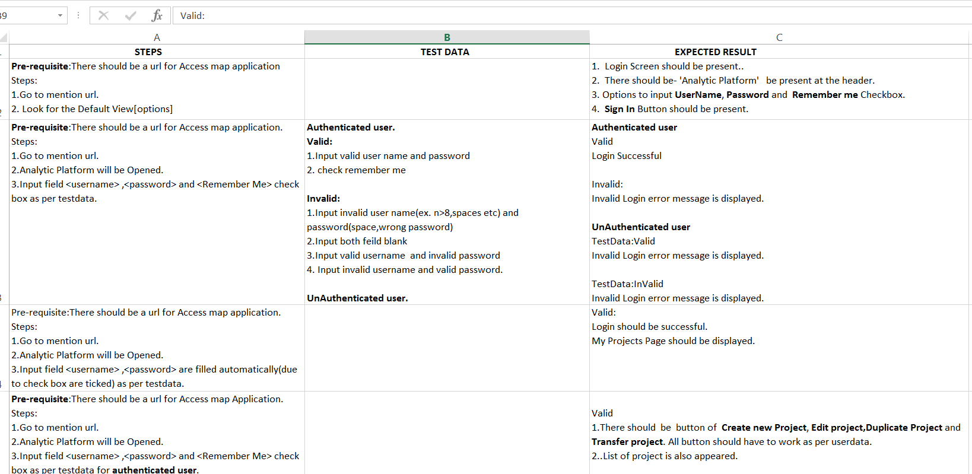
Test Case Using Excel

Slide 36
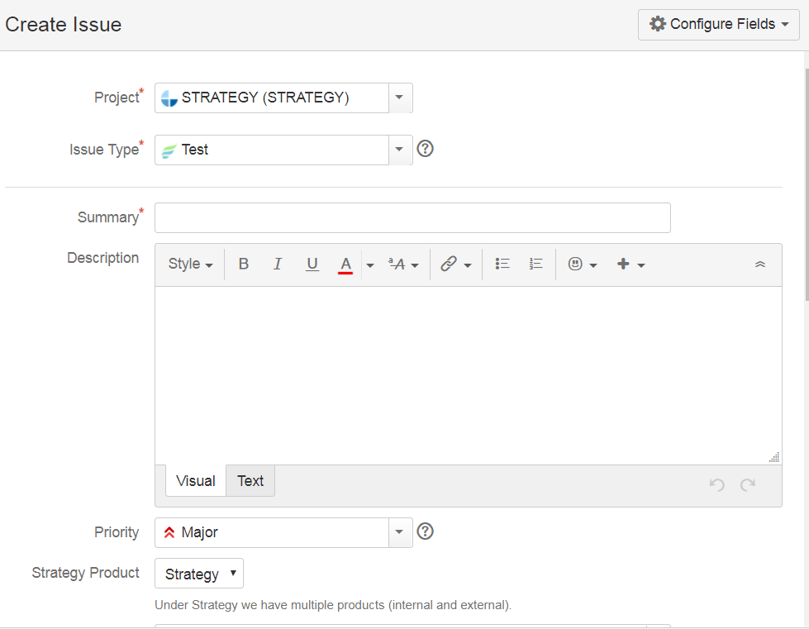
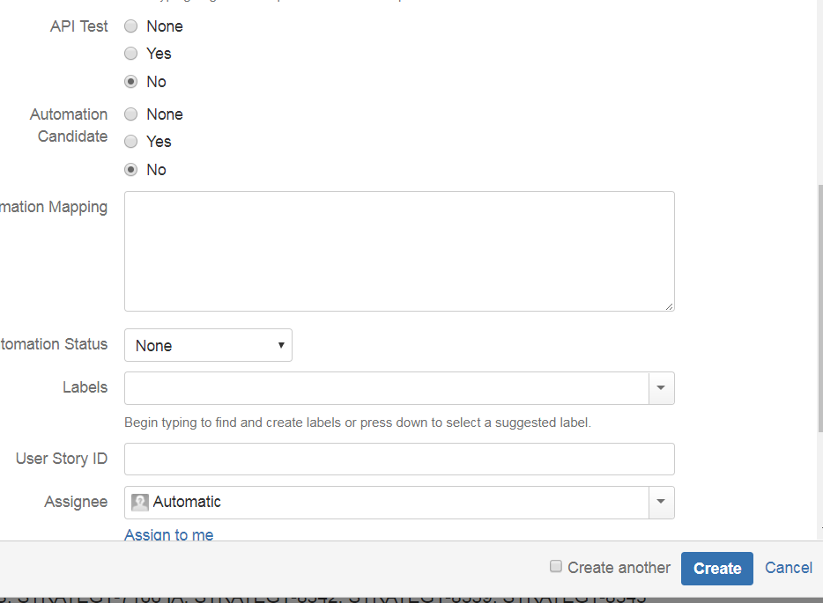
Test Case Using Zephyr

Slide 37
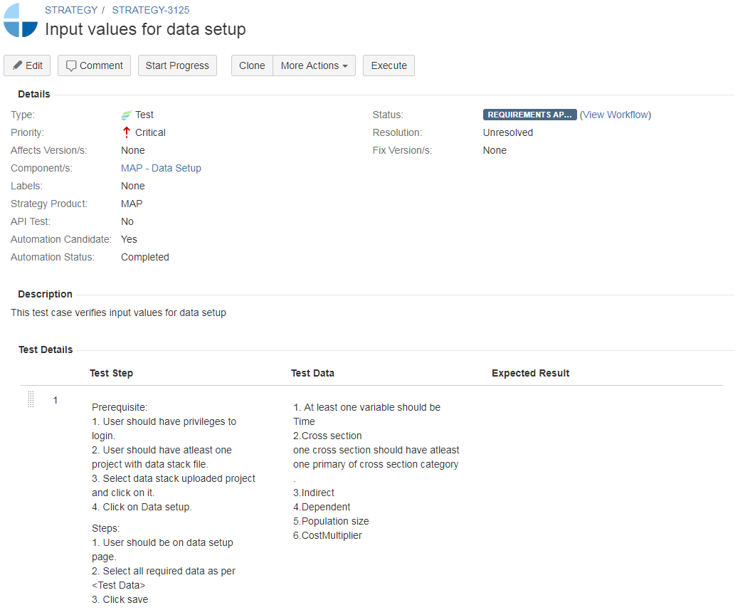

Slide 38


