Slide 1
Development and Performance Analysis of a Novel Pulse Oximetry Measurement Circuit
Master’s Thesis Mikko Tuohimaa

Slide 2
Contents
Physiology of Oxygenation
Introduction to Pulse Oximetry
The New Measurement Circuit
Performance Analysis
Conclusions

Slide 3
Tissue Oxygenation
Proper oxygenation vital for all organs
Oxygen doesn’t dissolve easily in blood plasma
Specialized protein complex, hemoglobin, in red blood cells able to reversibly bind oxygen molecules

Slide 4
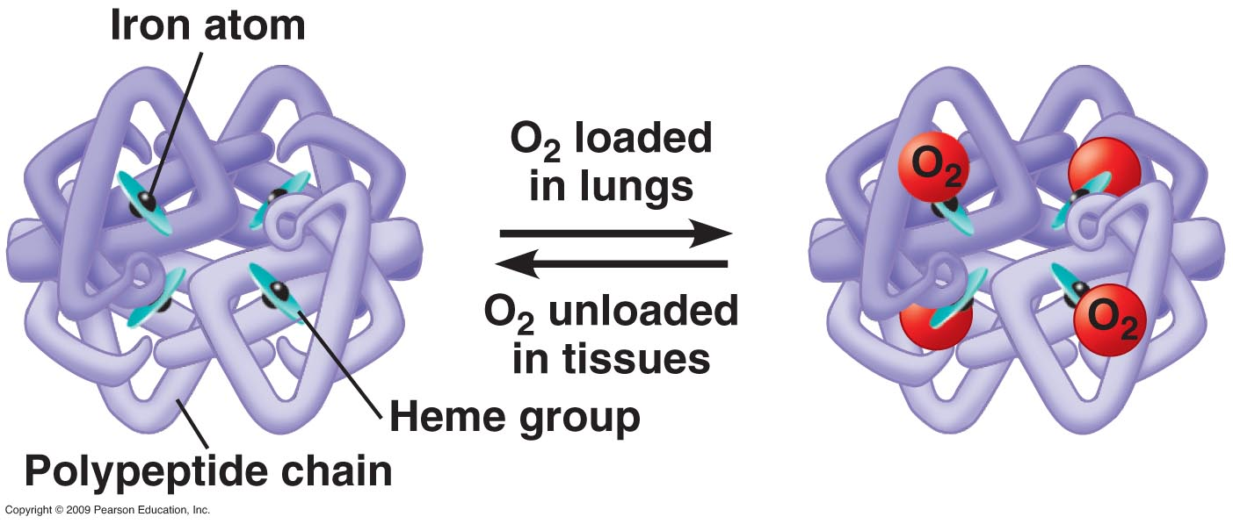
Hemoglobin
Hb: 97% of the dry content of red blood cells

Slide 5
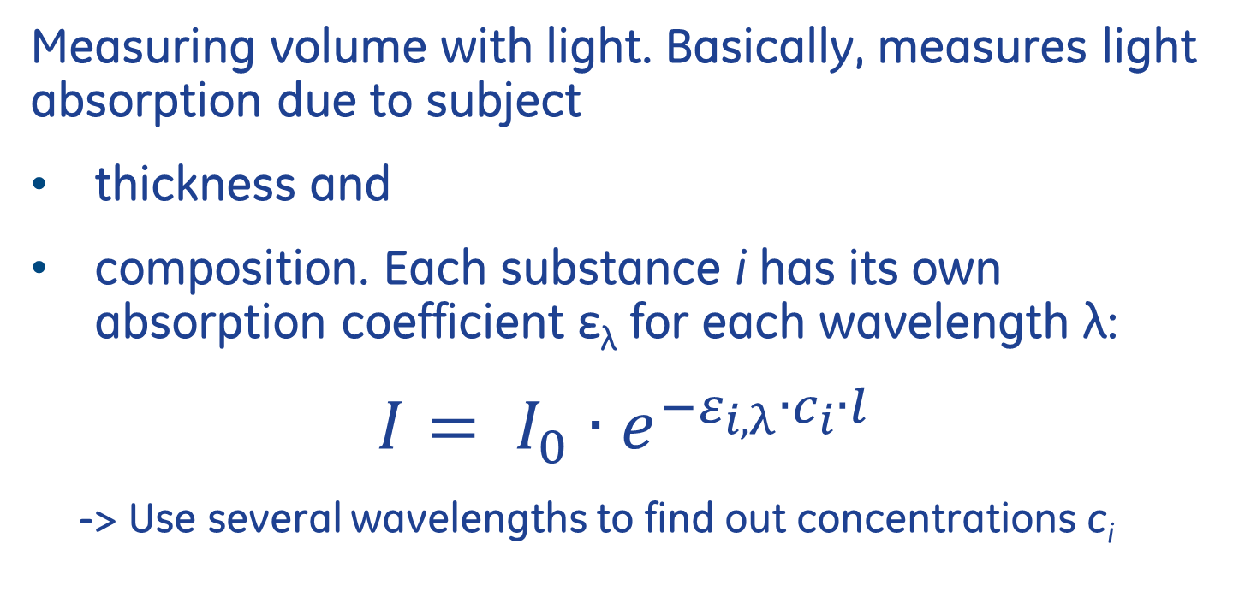
Photoplethysmography
Measuring volume with light. Basically, measures light absorption due to subject
thickness and
composition. Each substance i has its own absorption coefficient ε_{λ} for each wavelength λ:
$$I= I_{0}∙e^{−ε_{i,λ}∙c_{i}∙l}$$
-> Use several wavelengths to find out concentrations c_{i}

Slide 6
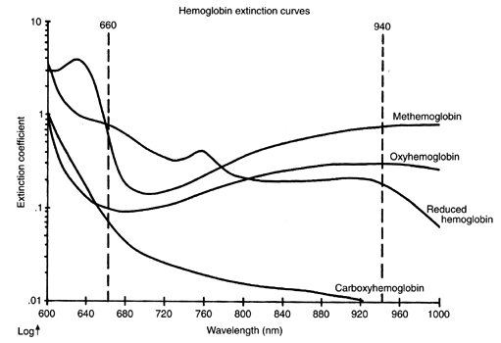
Hemoglobin Absorption Spectra

Slide 7
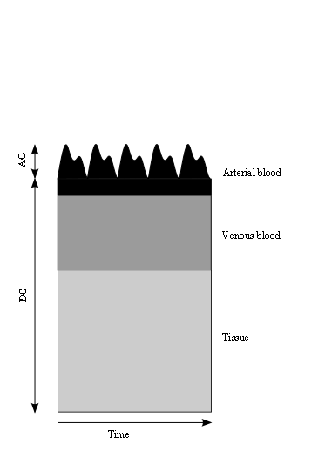
Photoplethysmography
Optical path length l changes due to heart beating: A time-variant signal
Problem: extract information about arterial blood
Solution: focus on the AC signal

Slide 8
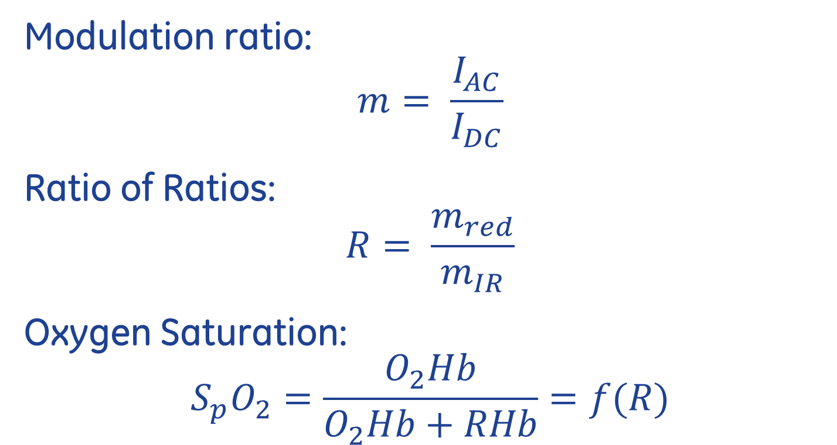
Pulse Oximetry: Theory
Modulation ratio:
$$m= \frac{I_{AC}}{I_{DC}}$$
Ratio of Ratios:
$$R= \frac{m_{red}}{m_{IR}}$$
Oxygen Saturation:
$$S_{p}O_{2}=\frac{O_{2}Hb}{O_{2}Hb+RHb}=f(R)$$

Slide 9
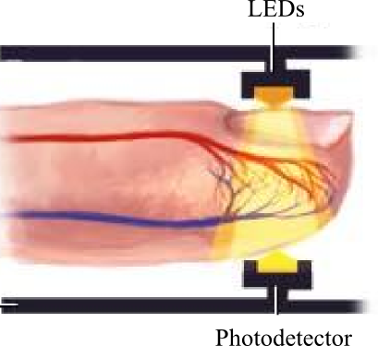
Pulse Oximetry: Practice
Red and IR LEDs on one side of a tissue bed, a photodetector on the other side
A pulsed sampling scheme with ambient removal

Slide 10
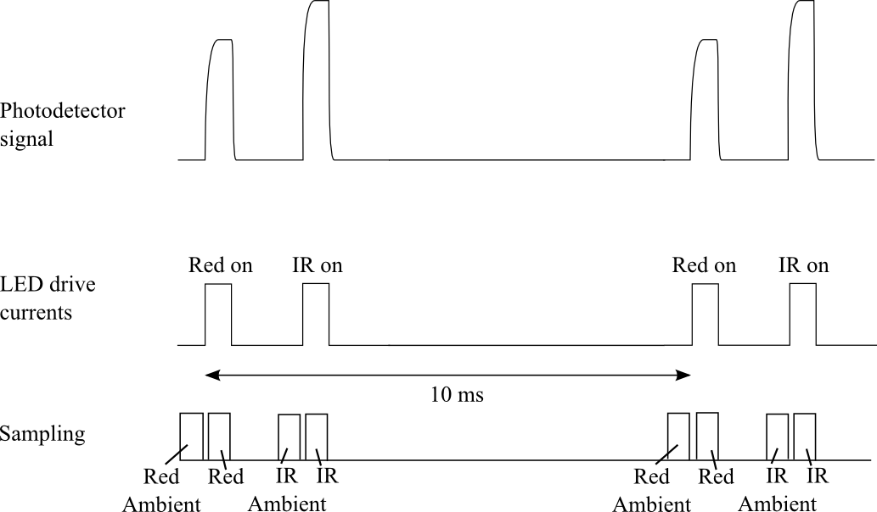
Pulse Oximetry: Sampling Timing

Slide 11
Pulse Oximetry: Sources of Error
System Noise
Motion Artifacts
Medical Dyes in Blood
High dysfunctional hemoglobin content (e.g. CO poisoning)

Slide 12
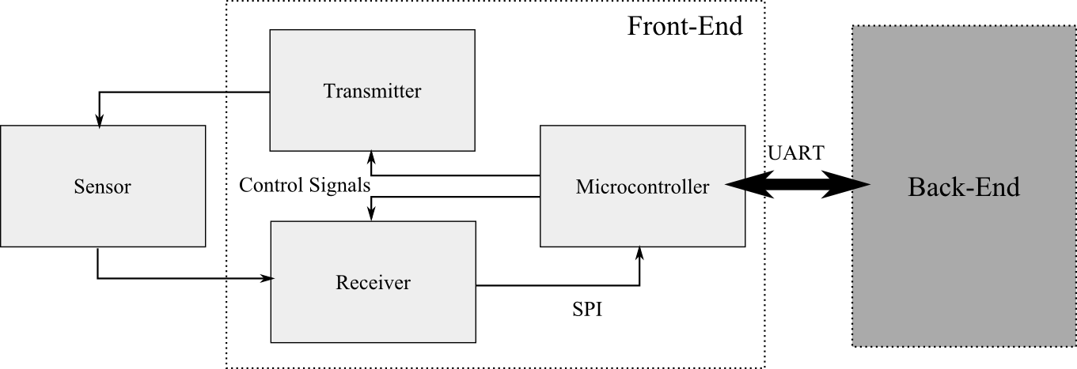
The New Measurement Circuit
Designed to be an autonomous module for easy integration

Slide 13
The New Measurement Circuit
The measurement hardware controlled by an embedded microcontroller
Control parameters:
Timing
Receiver gain and filtering properties
Transmitter LED current
Diagnostics

Slide 14
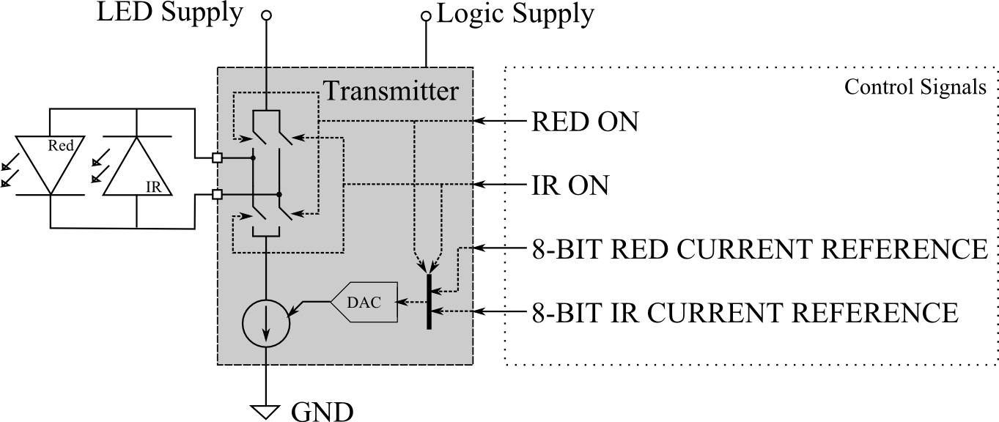
The New Measurement Circuit: Tx
A switched constant current source with a reference provided by an 8-bit DAC

Slide 15
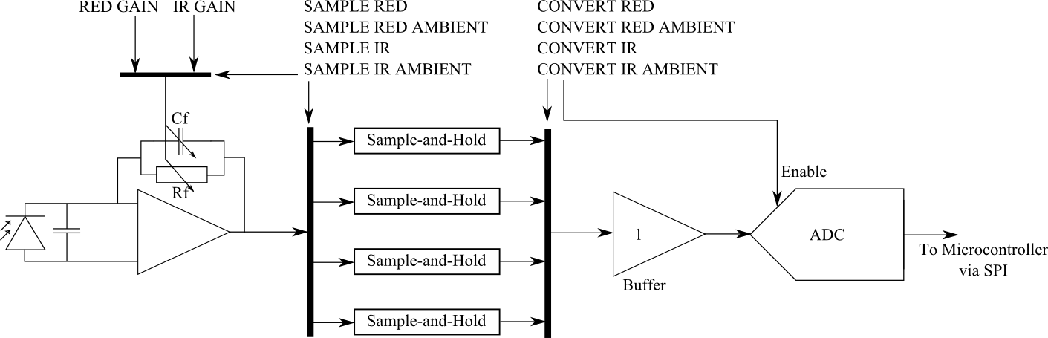
The New Measurement Circuit: Rx
A differential transimpedance amplifier with 7 selectable gains per channel feeding 4 sample-and-hold circuits and a 22-bit ΣΔ ADC.

Slide 16
Performance Analysis: Methods
Key performance indicator: measurement noise
Compact design and extremely small signals mean that it’s impossible to measure subsystems directly
The performance of individual subsystems can be examined with regression analysis
One isolated system parameter is modified at a time and the resulting change in performance is fitted into the system model

Slide 17
Performance Analysis: Data
The transmitter was found satisfactory
-> main focus on the receiver.
Isolated receiver operating parameters:
Gain
Sampling time and low-pass cutoff freq
Conversion time
Signal level

Slide 18
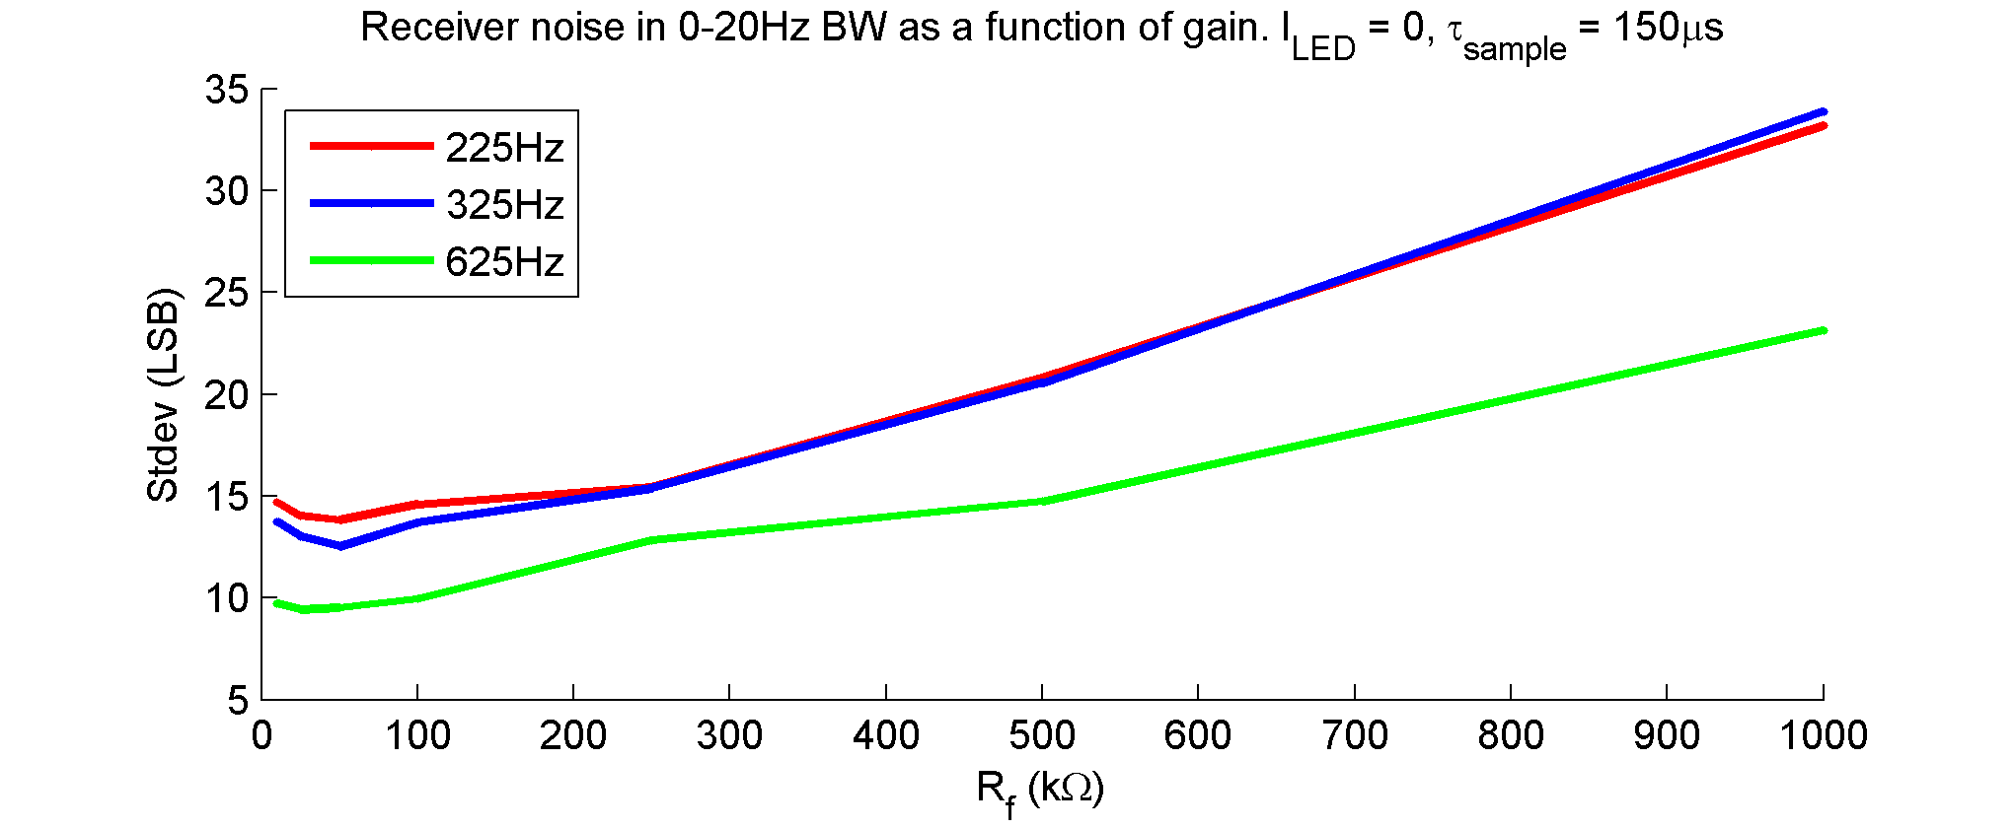
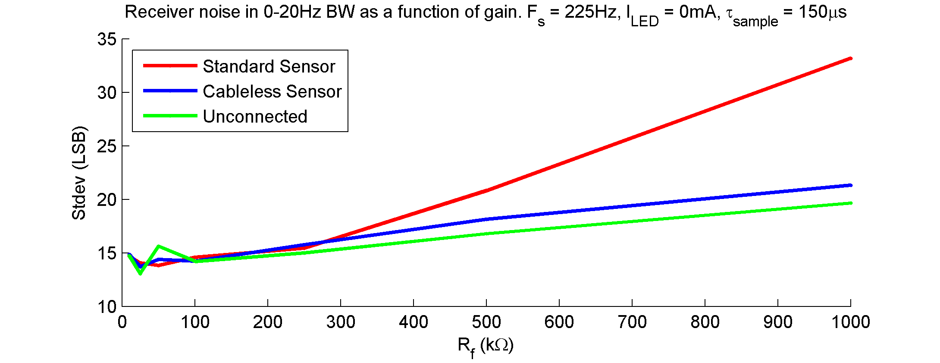
Performance Analysis: Data
Design Spec:
σ < 18
Performance OK with zero signal

Slide 19
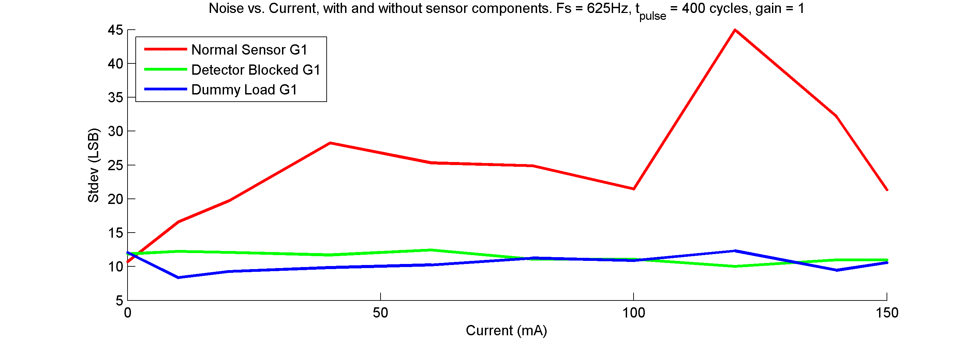
Performance Analysis: Data
Pulsed current introduced
-> performance degrades
No unwanted crosstalk

Slide 20
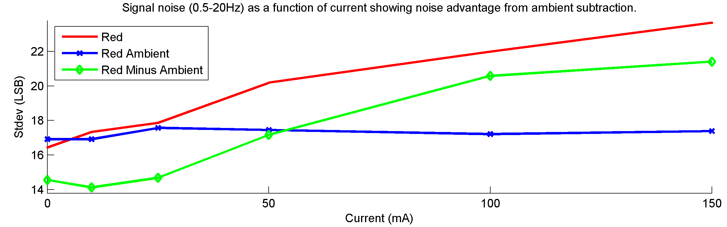
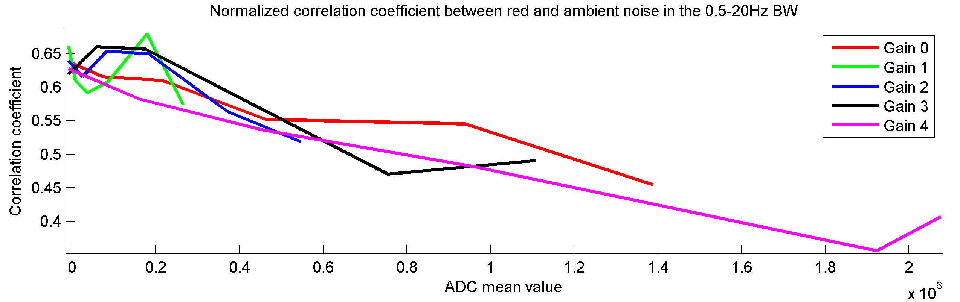
Performance Analysis: Data

Slide 21
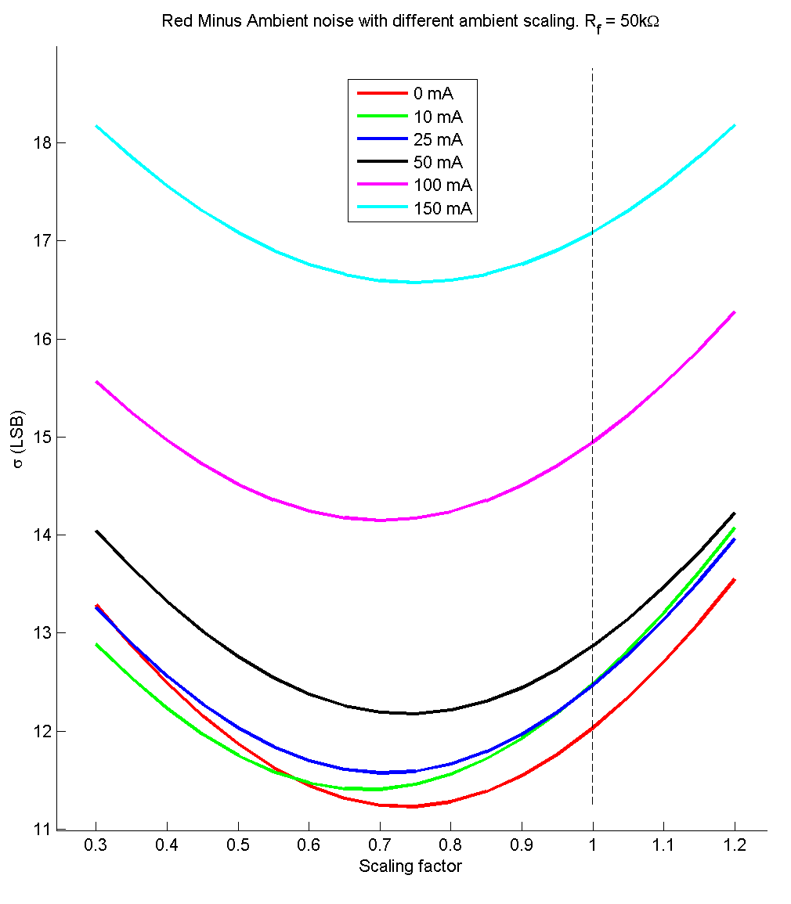
Performance Analysis: Data

Slide 22
Performance Analysis: Results 1
Optimal ambient scaling is ca. 0.7, yet signal paths for red and red ambient have no difference in gain.
Conclusion: there’s a significant amount of seemingly uncorrelated noise in the two signals. Transmitter has been ruled out as the source.

Slide 23
Performance Analysis: Results 2
There is a component in the signal chain the noise behavior of which is signal-dependent. The buffer feeding the ADC was identified as the source.

Slide 24
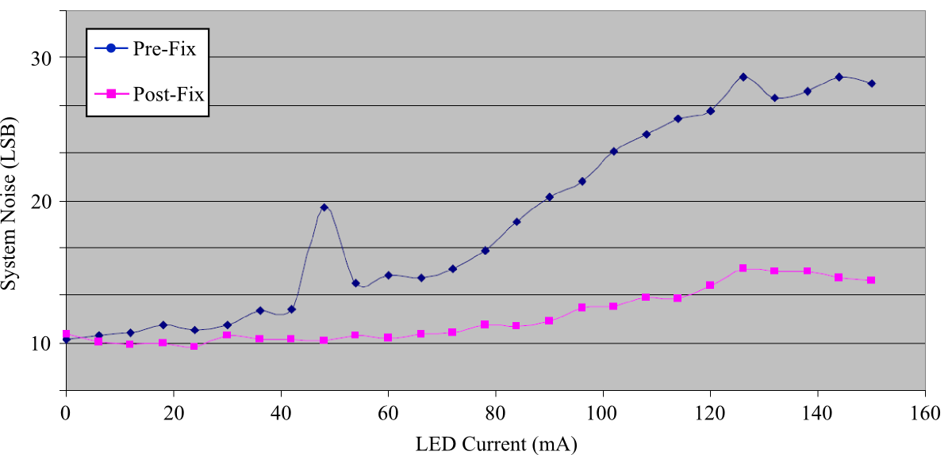
Performance Analysis: Results 3
A temporary fix, while not perfect, proved the hypothesis true.

Slide 25
Conclusions
Bug identified in the receiver signal chain
No expensive precision measurement equipment needed
Performance deemed satisfactory provided that the bug is adequately fixed

