Slide 1


Develop 2D game application using Unity framework
TEACHER:
TS. NGUYEN THIEN BAO
Nguyễn Thanh Tường - 19110066
Nguyễn Khang Duy - 19110109
Bùi Thị Thảo Thảo - 19110125

Slide 2
TABLE OF CONTENTS
01
02
INTRODUCTION
SURVEY
03
FUNDAMENTAL

Slide 3


01
INTRODUCTION

Slide 4
Urgency and objectives of project
If you are looking for shooting games, fight with the monster with pixel graphics, our project will be the most suitable choice. Your task in the game is to try to overcome the troublesome and zigzag maze to reach the exit gate. Each level has very few traps, enemies or attacking monsters, so you only focus on finding a way out to be able to complete the level.

Slide 5
02
SURVEY

Slide 6
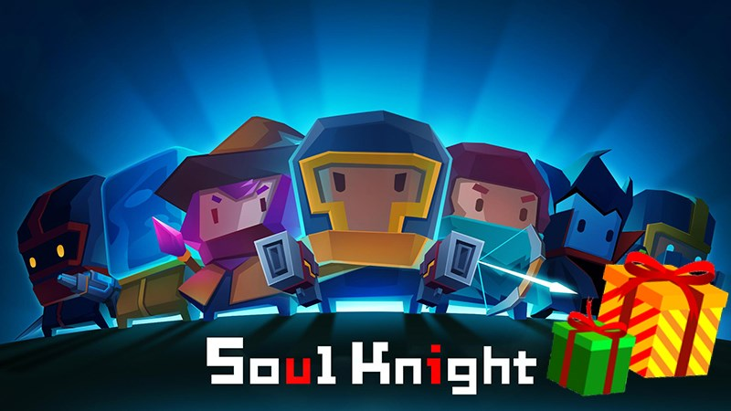
SOUL KNIGHT
Soul Knight is a traditional top-down shooter with cutting-edge graphics and a bunch of different upgrades to enjoy along the way. Set in ancient times, players must fight against an advanced alien civilization to obtain a magical stone and maintain balance on earth. Smooth gameplay and highly intuitive controls add to the benefits you can experience.

Slide 7
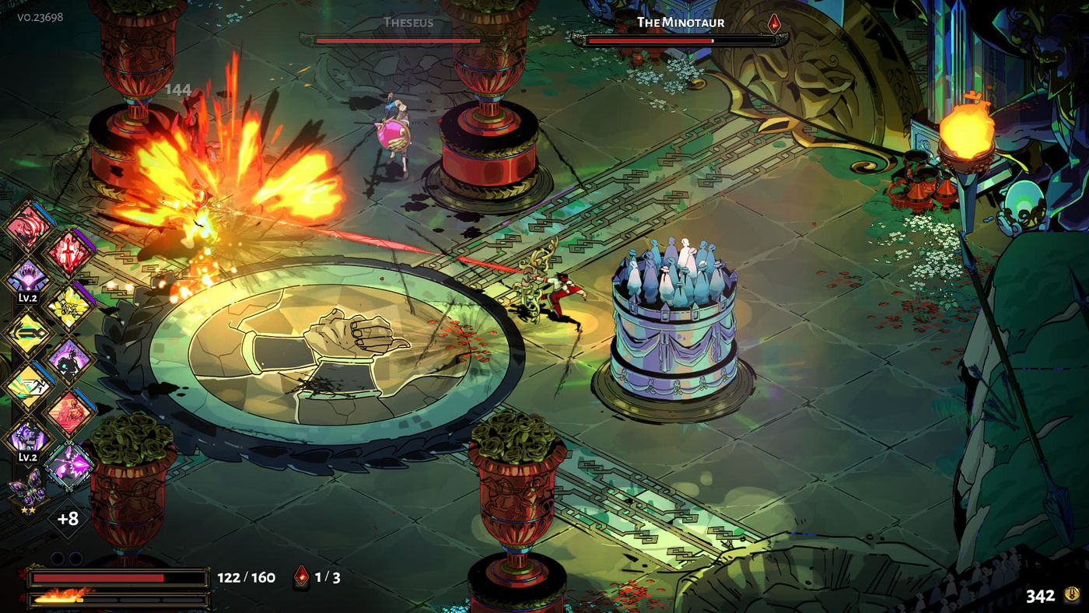
SOUL KNIGHT
Hades is a god-like rogue-like dungeon crawler that combines the best aspects of Supergiant's critically acclaimed titles, including the fast-paced action of Bastion, the rich atmosphere and depth of Transistor, and the character-driven storytelling of Pyre.

Slide 8
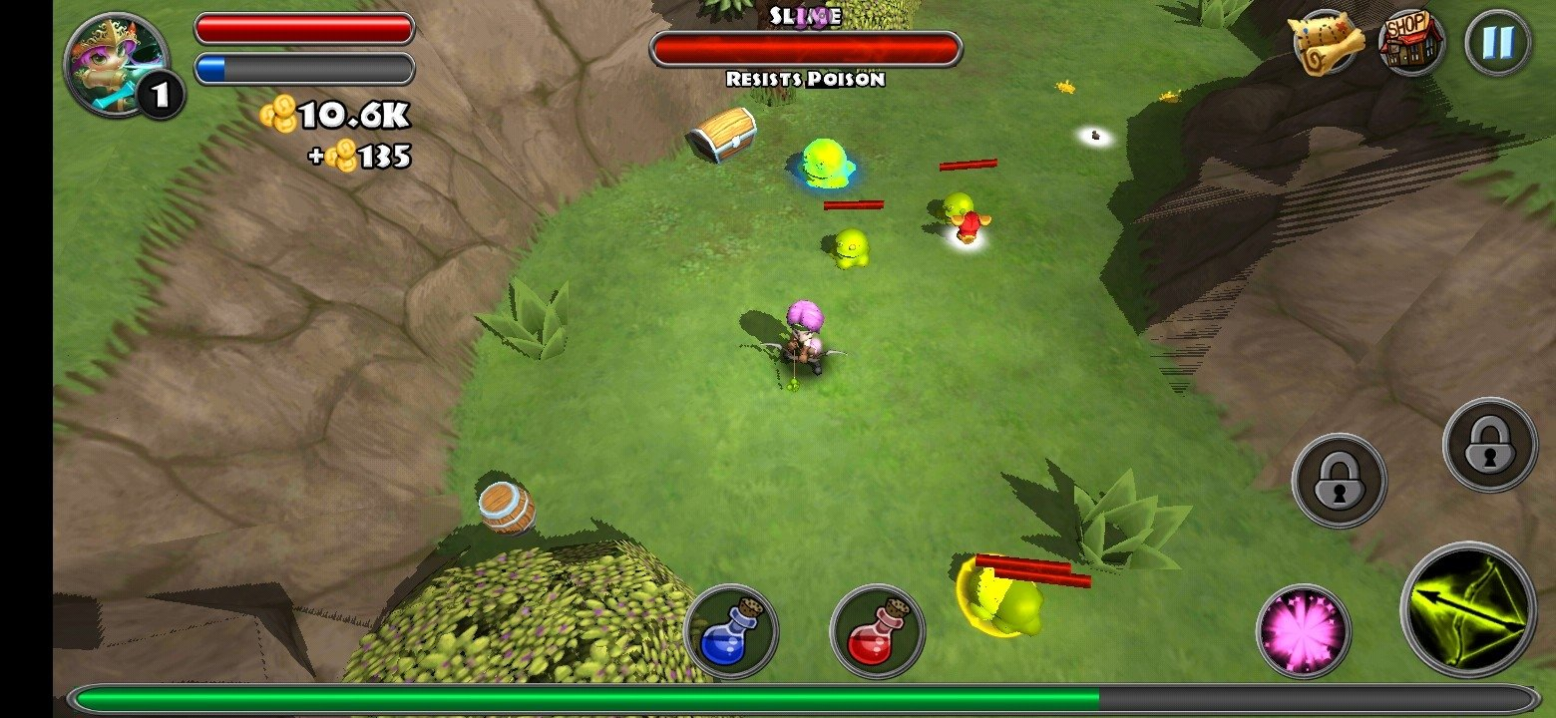
SOUL KNIGHT
The object of this game for 1–4 players game is to enter the ruins of Dragonfire Castle at dawn when the castle's guardian dragon falls asleep, navigate a labyrinth to the dragon's hoard at the center of the castle, and exit the castle. The game ends at sunset; any characters still in the castle at that point are automatically killed by the dragon. The player who successfully escapes from the castle with the largest amount of treasure is the winner.

Slide 9
03
FUNDEMENTAL

Slide 10
OVERVIEW ABOUT UNITY
DEFINITION
FEATURE

Slide 11
DEFINITION
Unity is a cross-platform game engine developed by Unity Technologies, first announced and released in June 2005 at Apple Worldwide Developers Conference as a Mac OS X game engine. The engine has since been gradually extended to support a variety of desktop, mobile, console and virtual reality platforms. It is particularly popular for iOS and Android mobile game development, is considered easy to use for beginner developers, and is popular for indie game development

Slide 12
UNITY EDITOR
Scene view and Game view
Hierarchy window
Project window
Inspector window
Toolbar

Slide 13
FRAMEWORK
Unity uses the open-source .NET platform to ensure that applications you make with Unity can run on a wide variety of different hardware configurations. The .NET platform supports a range of languages and API libraries.

