Slide 1
Predictive Analysis on Obesity
By Idunnu Akinola, Zach Goldstein, and Anh Do

Slide 2

Introduction
Obesity prevalence has jumped from 4%-18%
Increased concern from medical practitioners and nutritionists
Leading cause of death, heart failure, stroke, cancer and diabetes in society today

Slide 3
Motivation
We will use the selected explanatory variables to determine if a family member has suffered from obesity
Results will aid scientists, doctors and nutritionists

Slide 4

Research Goals
Build a predictive model that will perform the best at predicting family history with obesity for new datasets
Build a model that yields reliable interpretative insights about the nature of the relationship between variables
Describe the nature of the variables and their relationships
Notes:
- Clearly states their research goals
- Clearly states the extent to which they achieved their research goals

Slide 5

Dataset Discussion
Data source: Anonymous survey of people from Mexico, Peru and Colombia
Response variable: Family history with overweight
Explanatory variables:
Weight
Frequency of consumption of vegetables
Physical activity frequency
Number of main meals
Frequent consumption of high-caloric food

Slide 6
Data Cleaning
In the dataset we found no implicit outliers
We detected outliers in our scatterplots and confirmed them using the outlier formula
Dropping outliers pro: Reducing data skewing due to extreme values
Dropping outliers con: Losing potentially meaningful data points

Slide 7
Noteworthy Visualizations
Notes:
- Explain why visualizations are noteworthy

Slide 8
Relationships with Response Variable
FAVC (Frequent consumption of high caloric food), NCP (Number of main meals) and Weight have strong relationships with the response variable with Weight having the strongest one.
FCVC (Frequent consumption of vegetables) and FAF (Physical activity frequency) have weak relationships with the response variables with FCVC being the weakest.

Slide 9
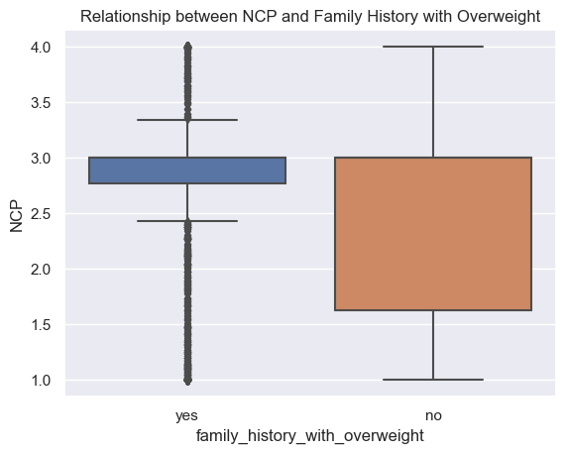
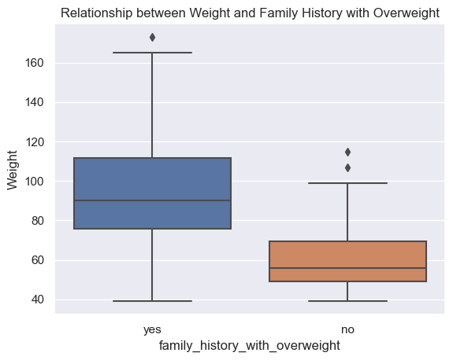
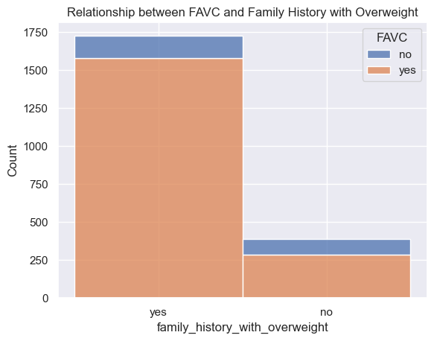
Strong Relationship with Response Variable

Slide 10
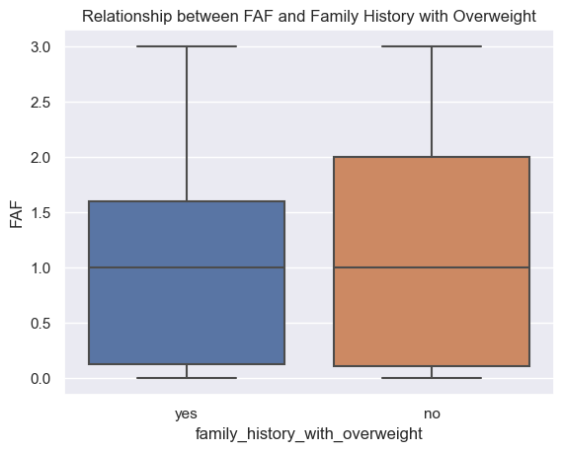
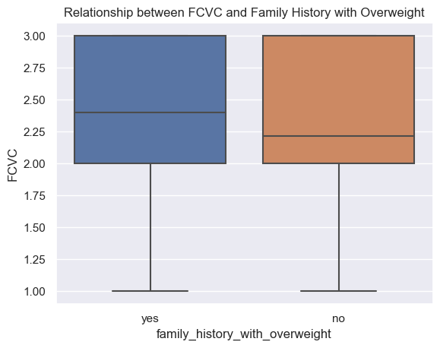
Weak Relationship with Response Variable

Slide 11
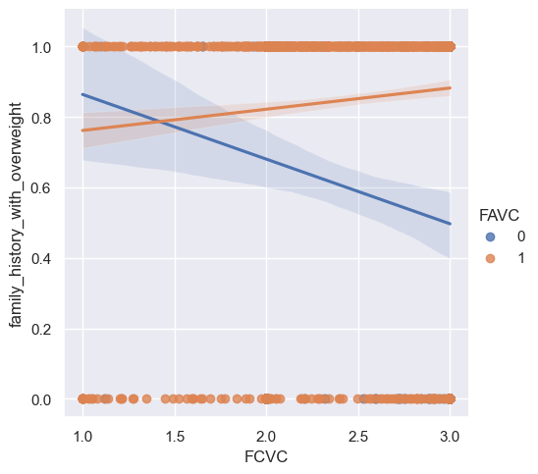
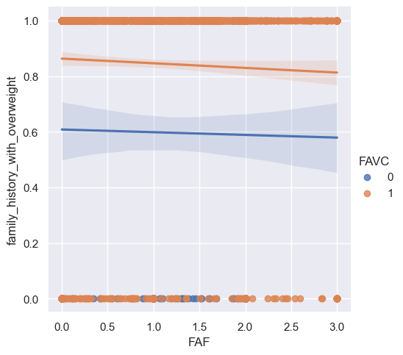
Interaction Effects

Slide 12
Model Selection Technique
Technique: backward elimination with cross-validation
We started with a model containing the variables below and removed one each time
Weight
Frequency of consumption of vegetables
Physical activity frequency
Number of main meals
Frequent consumption of high-caloric food
One iteration was completed
Candidate models had AUC means between 0.660 and 0.882

Slide 13
Best Model
Best model: full model with no variables removed
Mean AUC score: 0.882
AUC standard deviation: 0.0157
No multicollinearity or overfitting was indicated
Model equation
Notes:
Show AUC
Discuss insights from best model discussion section

Slide 14
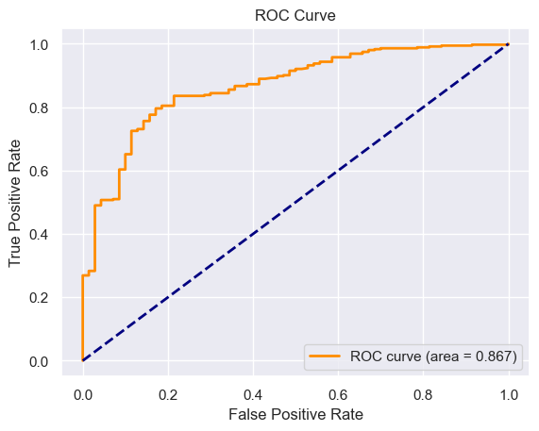
Best Model
Most important variables: Weight and Frequent consumption of high caloric food
ROC curve AUC: 0.867
Best predictive probability threshold: 0.75
TPR: 0.836
FPR: 0.214
Notes:
Show AUC
Discuss insights from best model discussion section

Slide 15
Best Model
Most important variables: Weight and Frequent consumption of high caloric food
ROC curve AUC: 0.867
Best predictive probability threshold: 0.75
TPR: 0.836
FPR: 0.214
Notes:
Show AUC
Discuss insights from best model discussion section

Slide 16
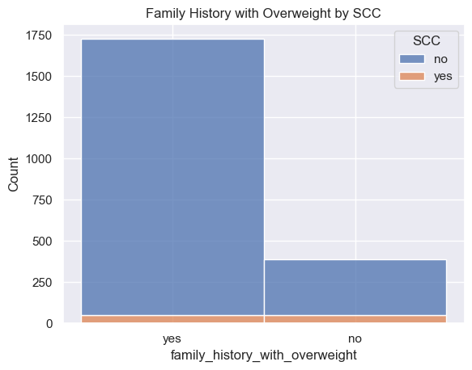
Additional Analysis
We looked at the relationships between gender, Calories consumption monitoring (SCC), and Consumption of alcohol and the response variable (CALC)
Calories consumption monitoring had a positive correlation with family history with overweight

Slide 17
Conclusion
We built a strong model that can be utilized by doctors, medical professionals, etc. with some improvements
All explanatory variables brought enough predictive power
Improvements:
Using different feature selection techniques
Using LASSO, Ridge, or Elastic Net modeling
Removing outliers
Trying different combinations of variables
Using a bigger/more complete dataset
Notes:
- Shortcomings

