Slide 1
Session 16
How to design a database
Notes:
Session: Ghi số thứ tự session trong môn học
Session Name: ghi tên của session sẽ dạy

Slide 2
Objectives
How to design a data structure
How to normalize a data structure
How to apply the third normal form
A database design tool
Notes:
Mô tả nội dung mà học viên phải đạt được khi kết thúc môn học này

Slide 3
How to design a data structure

Slide 4
The basic steps for designing a data structure
A relational database system should model the real-world environment where it’s used.
A table in a relational database typically represents an object, or entity, in the real world.
To model a database and the relationships between its tables after a real-world system, you can use a technique called entity-relationship (ER) modeling.

Slide 5
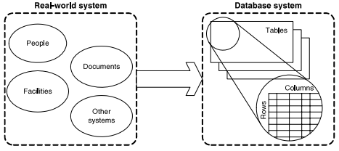
The basic steps for designing a data structure (cont.)
A database system is modeled after

Slide 6
The basic steps for designing a data structure (cont.)
The six basic steps for designing a data structure
Step 1: Identify the data elements
Step 2: Subdivide each element into its smallest useful components
Step 3: Identify the tables and assign columns
Step 4: Identify the primary and foreign keys
Step 5: Review whether the data structure is normalized
Step 6: Identify the indexes

Slide 7
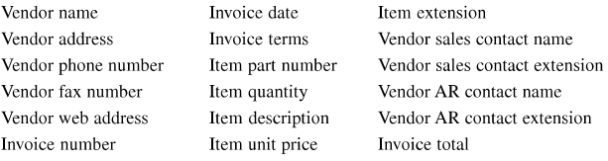
How to identify the data elements
Depending on the nature of the system, you can identify data elements in a variety of ways, including interviewing users, analyzing existing systems, and evaluating comparable systems.
The data elements identified on the invoice document

Slide 8
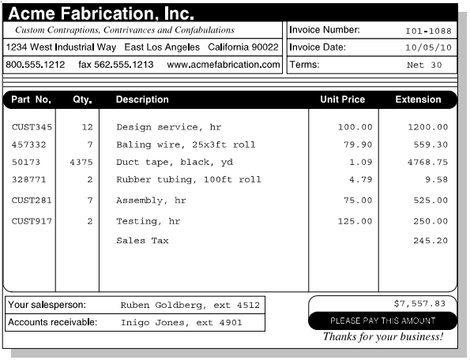
How to identify the data elements (cont.)
An invoice that can be used to identify data elements

Slide 9
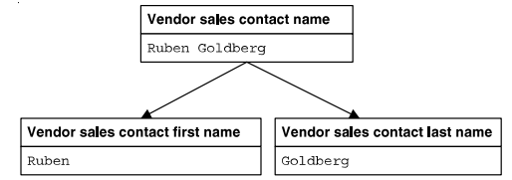
How to subdivide the data elements
If a data element contains two or more components, you should consider subdividing the element into those components.
A name that’s divided into first and last names

Slide 10
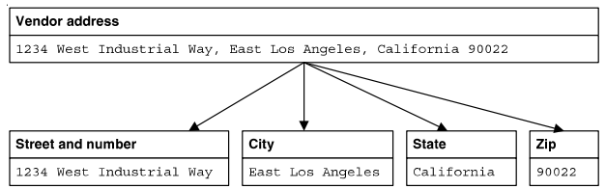
How to subdivide the data elements (cont.)
An address that’s divided into street address, city, state, and zip code

Slide 11
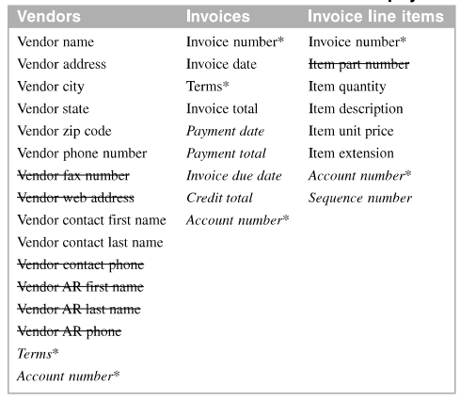
How to identify the tables and assign columns
Possible tables and columns for an accounts payable system

Slide 12
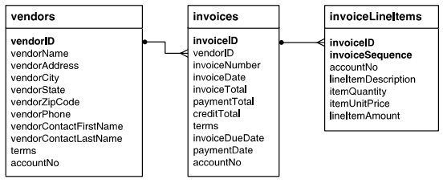
How to identify the primary and foreign keys
Each table should have a primary key that uniquely identifies each row.
The relationships between the tables in the accounts payable system

Slide 13
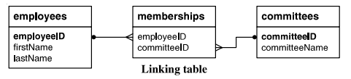
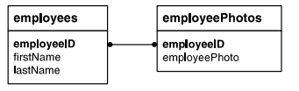
How to identify the primary and foreign keys (cont.)
Two tables with a many-to-may relationship
Two tables with a one-to-one relationship

Slide 14
How to enforce the relationships between tables
Referential integrity means that relationship tables are maintained correctly.
A table with a foreign key doesn’t have rows with foreign key values that don’t have matching primary key values in the related table.

Slide 15
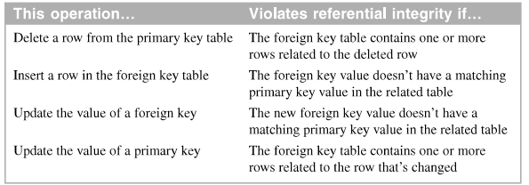
How to enforce the relationships between tables (cont.)
Operations that can violate referential integrity

Slide 16
How normalization works
Normalization is a formal process that you can use to separate the data in a data structure into related tables
Normalization reduces data redundancy, which can cause storage and maintenance problems.
To normalize a data structure, you apply the normal forms in sequence.

Slide 17
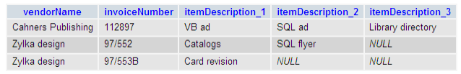
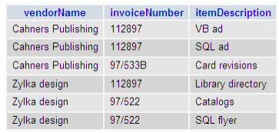
How normalization works (cont.)
A table that contains repeating columns
A table that contains redundant data

Slide 18
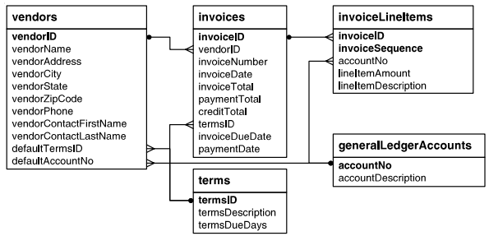
How normalization works (cont.)
The accounts payable system in third normal form

Slide 19
How to identify the columns to be indexed
MySQL automatically creates an index for a primary key
AN index provides a way for a database management system to locate information more quickly.
Indexes speed performance when searching and joining tables.

Slide 20
How to identify the columns to be indexed (cont.)
When to create an index
When the column is a foreign key
When the column is used frequently in search conditions or joins
When the columns contains a large number of distinct values
When the column is updated infrequently.

Slide 21
How to normalize a data structure

Slide 22
The benefits of normalization
Since a normalized database has more tables than an unnormalized database, and since each table has an index on its primary key, the database has more indexes. That makes data retrieval more efficient.
Since each table contains information about a single entity, each index has fewer columns (usually one) and fewer rows. That makes data retrieval and insert, update, and delete operations more efficient.
Each table has fewer indexes, which makes insert, update, and delete operations more efficient
Data redundancy is minimized, which simplifies maintenance and reduces storage.

Slide 23
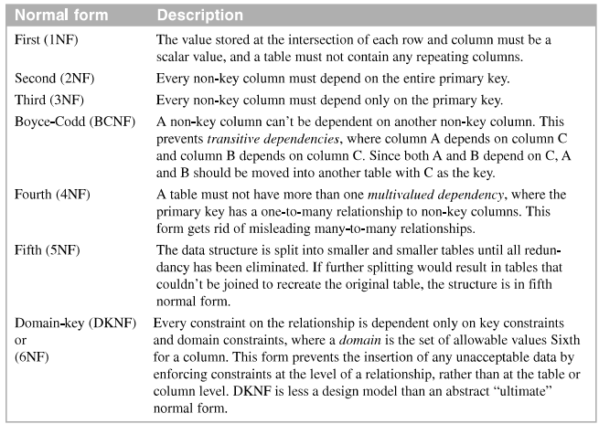
The seven normal forms (cont.)
The seven normal forms

Slide 24
How to apply the first normal form
For a table to be in first normal form , its columns must not contain repeating values.
So you must remove duplicate column and divide column to it only contain scalar value. It is to be a first form.
A table in first normal form often has repeating values in its rows. This can be resolved by applying the second normal form.

Slide 25
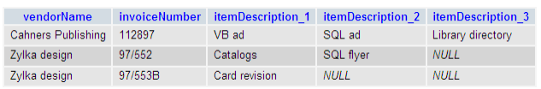
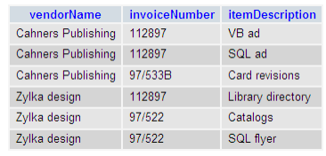
How to apply the first normal form (cont.)
The invoice data with repeating columns
The invoice data in first normal form

Slide 26
How to apply the second normal form
For a table to be in second normal form, every non-key must depend on the entire primary key.
To apply second normal form, you move columns that don’t depend on the entire primary key to another table and then establish a relationship between the two tables.
Second normal form helps remove redundant row data. Which can save storage space, make maintenance easier, and reduce the chance of storing inconsistent data.

Slide 27
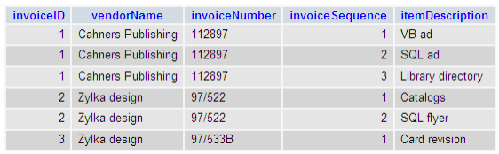
How to apply the second normal form (cont.)
The invoice data in first normal form with keys added

Slide 28
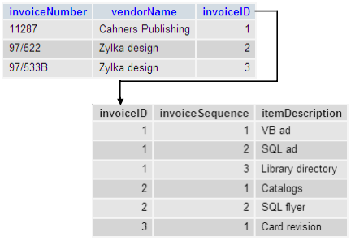
How to apply the second normal form (cont.)
The invoice data in second normal form

Slide 29
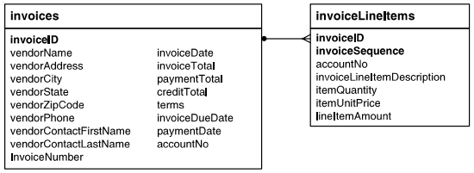
How to apply the third normal form
For a table to be in third normal form, every non-key columns must depend only on the primary key.
To apply third normal form, you move columns that are not complete depend on the entire primary key to another table and then establish a relationship between the two tables.
The accounts payable system in second normal form

Slide 30
How to apply the third normal form (cont.)
Question about the structure
Does the vendor information (vendor_name, vendor_address, etc) depend only on the invoice_id column?
Does the terms column depend only on the invoice_id column?
Does the account_no column depend only on the invoice_id column?
Can the invoice_due_date and line_item_amount columns be derived from other data?

Slide 31
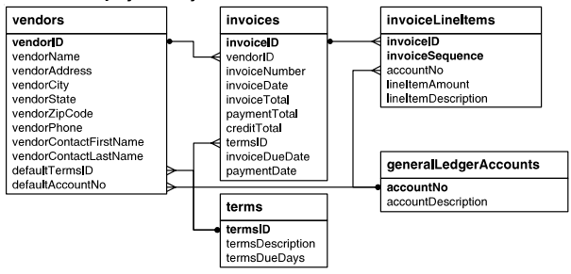
How to apply the third normal form (cont.)
The accounts payable system in third normal form

Slide 32
Denormalization
Denormalization is the deliberate deviation from the normal forms.

Slide 33
When and how to denormalize a data structure
Data structures that are normalized to the fourth normal form and beyond typically require more joins that tables normalized to the third form and can therefore be less efficient.
Denormalization can result in larger tables, redundant data, and reduced performance.

Slide 34
When and how to denormalize a data structure
Add a non redundancy to eliminate a join.
Improve effective retrieve if this field is updated infrequently.
Include columns with derived values when those values are used frequently in search conditions.

Slide 35
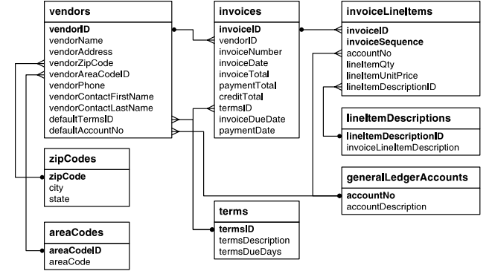
When and how to denormalize a data structure (cont.)
The accounts payable system in fifth normal form

Slide 36
A database design tool

Slide 37
An introduction to MySQL Workbench
MySQL Workbench is a database design tool that’s available for free and runs on most modern operating systems.
The MySQL Workbench web site

Slide 38
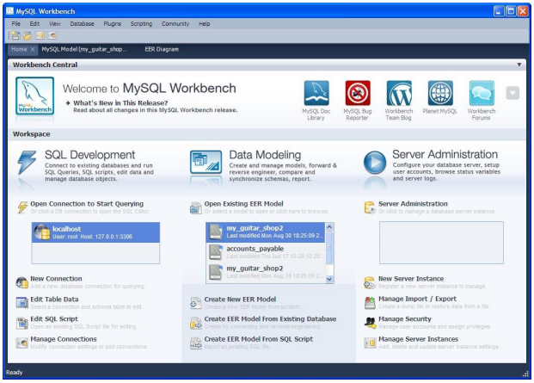
An introduction to MySQL Workbench (cont.)
The Home Page

Slide 39
An introduction to MySQL Workbench (cont.)
MySQL Workbench
Lets you create and edit diagrams
Let you define the table, columns, and indexes for a database
Lets you define the relationships between the tables in a database
Lets you generate a diagram from a SQL creation script
Lets you generate a SQL creation script from diagram

Slide 40
An introduction to MySQL Workbench (cont.)
How to install MySQL Workbench
Go to the MySQL Workbench web site shown above
Download the version for your system
Run the installer or setup file and respond to the prompts.

Slide 41
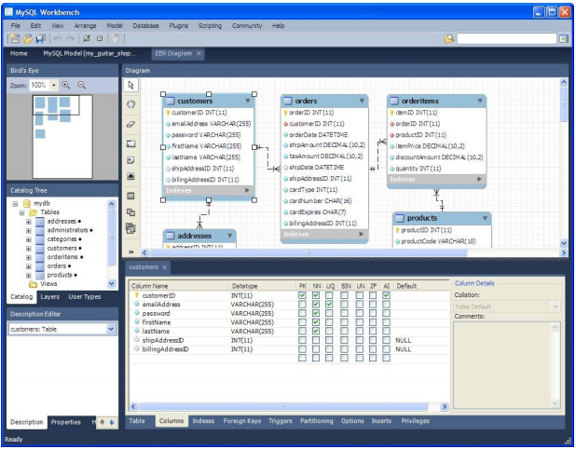
How to use MySQL Workbench to create database diagrams
MySQL Workbench

Slide 42
Summary
Database are often designed and maintained by database administrators (DBAs)
A table in a relational database typically represents an object, or entity, in the real world.
To model database and the relationships between its tables after real-world system. You can use entity-relationship (ER) modeling.
You can use a CASE (Computer-Aided Software Engineering) tool to help you design a database.
Notes:
Tóm tắt lại nội dung đã học

Slide 43
Summary (2)
Add foreign key column : one-to-many relationship, many – to –many relationship, one-to-one relationship
Normalization is a formal process you can use to separate the data in a data structure into related tables.
Denormalized data structures to some extent, usually to the third normal form.

Slide 44
Discussion
Notes:
Trả lời câu hỏi WHY?

