Slide 1
Session 17
How to use SQL
to create a database
Notes:
Session: Ghi số thứ tự session trong môn học
Session Name: ghi tên của session sẽ dạy

Slide 2
Objectives
How to work with databases
How to work with tables
How to work with indexes
How to work with users and privileges
Other skills for creating a database
Notes:
Mô tả nội dung mà học viên phải đạt được khi kết thúc môn học này

Slide 3
How to work with database

Slide 4
How to use a database
How to create a database
How to create a database only if it does not exist
How to select a database
How to drop a database

Slide 5
How to work with tables

Slide 6
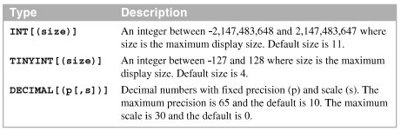
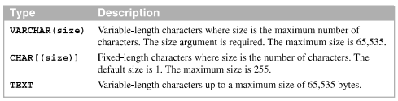
An introduction to MySQL data types
Common numeric data types
Common string data types

Slide 7
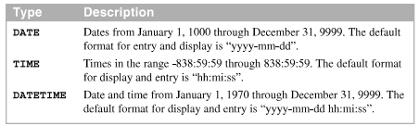
An introduction to MySQL data types (cont.)
Common date and time data types
MySQL uses the Latin-1-character set, which provides for 256 characters with 1 byte per character.
The Unicode character set provides for over 65,000 characters, usually with 2 bytes per character.

Slide 8

How to create a table
The CREATE TABLE statement creates based on the column definitions and column attributes you specify.
The syntax of the CREATE TABLE statement

Slide 9
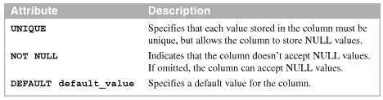

How to create a table (cont.)
Three common column attributes
A table without column attributes

Slide 10

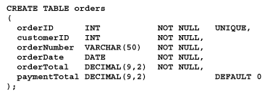
How to create a table (cont.)
A table with column attributes
Another table with column attributes

Slide 11
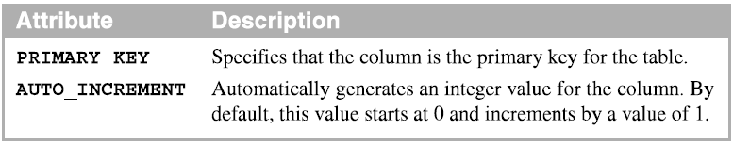
How to code a primary key
A primary key requires that each row has unique values for the column or columns that are used for the primary key, and it does not allow NULL values.
You code a column-level primary key as part of the definition of the column definition.
Two column attributes for working with a primary key

Slide 12
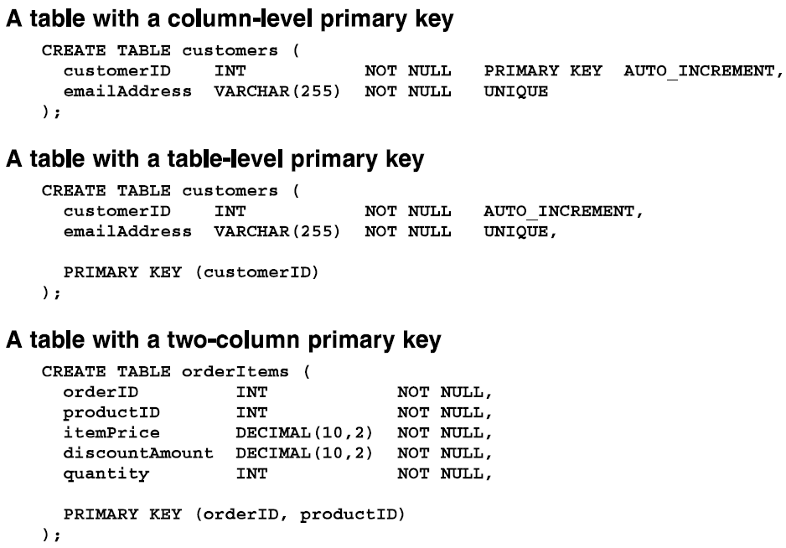
How to code a primary key (cont.)

Slide 13
How to alter a table
You can use the ALTER TABLE statement to modify the columns of an existing tables
Statement that renames a table
Statement that adds a new column at the end of the table
Statement that adds a new column after a specified column

Slide 14
How to alter a table (cont.)
Statement that drops a column
Statement that renames a column
Statement that changes the definition of a column
Statement that changes the data type of a column
Statement that may cause data be lost

Slide 15
How to alter a table (cont.)
Statement that sets the default value of a column
Statement that drops the default value of a column

Slide 16
How to drop a table
You can use the DROP TABLE statement to delete a table
Statement that drops a table
Statement that drops a table if it exists

Slide 17
How to work with indexes

Slide 18
Introduction to database index
An index improves performance when MySQL searches for rows in the table
MySQL automatically creates an index for primary keys and for unique constraints
You can use the CREATE INDEX statement to create indexes for a table

Slide 19

How to create an index
The syntax of the CREATE INDEX statement
Statement that creates an index based on a single column
Statement that creates a unique index
Statement that creates an index based on two columns

Slide 20
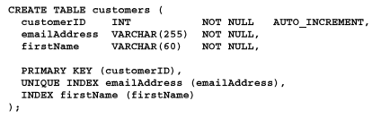
How to create an index (cont.)
Statement that creates an index that’s sorted in descending order
You can use CREATE TABLE statement to create indexes for a table

Slide 21
How to drop an index
You can use the DROP INDEX statement to drop an index

Slide 22
How to work with users and privileges

Slide 23
Introduction about privileges
The first group of privileges allows the user to work with the data that’s stored in the tables of the database.
The second group of privileges allows the user to modify the structure of the database.
MySQL makes it possible to specify privileges at the global level, the database level, the table level, and the column level.

Slide 24
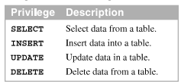
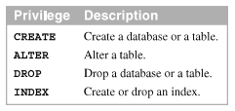
Introduction about privileges (cont.)
Privileges for working data
Privileges for modifying the database structure

Slide 25
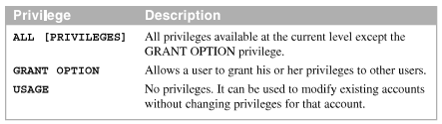
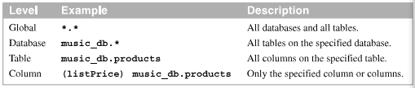
Introduction about privileges (cont.)
Other privileges
The four privilege levels

Slide 26
How to create, rename, and drop users
You use the CREATE USER statement to create a user that has no privileges
Create a user from a specific host
Create a user from any host
Rename a user from a specific host

Slide 27

How to create, rename, and drop users (cont.)
Change a user’s password
Drop a user from a specific host
Drop a user from any host

Slide 28

How to grant privileges
The WITH GRANT OPTION clause allows the user to grant the privileges for that user other users.
You can use the asterisk (*) to specify all databases or all tables
The syntax of the GRANT statement

Slide 29


How to grant privileges (cont.)
A statement that creates a user with no privileges
A statement that creates a user with database privileges

Slide 30

How to grant privileges (cont.)
A statement that creates user with database privileges
A statement that creates a user with global privileges

Slide 31



How to grant privileges (cont.)
A statement that grants table privileges to a user
A statement that grants database privileges to a user
A statement that grants global privileges to a user

Slide 32

How to grant privileges (cont.)
A statement that grants column privileges to a user
A statement that uses the current database

Slide 33


How to revoke privileges
You can use the REVOKE statement to revoke privileges from a user
The syntax of the REVOKE statement for all privileges
A statement that revokes all privileges from a user

Slide 34



How to revoke privileges (cont.)
A statement that revokes all privileges from multiple users
The syntax of the REVOKE statement for specific privileges
A statement that revokes specific privi

Slide 35
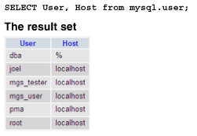
How to view privileges
A statement that lists all user

Slide 36

How to view privileges (cont.)
The syntax of the SHOW GRANTS statement
A statement that shows the privileges for a user from any host

Slide 37
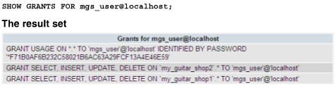
How to view privileges (cont.)
A statement that shows the privileges for a user with a specific host
The statement that shows the privileges for the current user

Slide 38
Other skills for creating a database

Slide 39
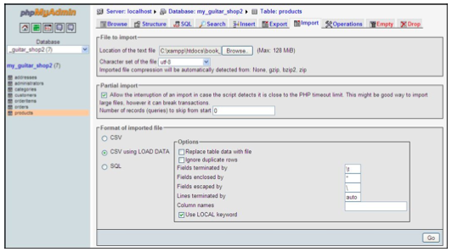
How to load data from text files
Use phpMyAdmin or the LOAD command to load data into a MySQL database from a text file.
The Import tab for the table named products

Slide 40


How to load data from text files (cont.)
A tab-delimited text file that’s stored in users.txt
How to use phpMyAdmin to load data from a text file

Slide 41

How to load data from text files (cont.)
How to use the Windows command prompt to load data from a text file

Slide 42

How to dump a database to a SQL script
Use phpMyAdmin or the mysqldump command to generate a SQL script that includes all of the CREATE and INSERT statement needed to create a copy of the database
How to use phpMyAdmin to dump a database to a SQL script

Slide 43

How to dump a database to a SQL script (cont.)
How to use the Windows command prompt to dump a database to a SQL script

Slide 44
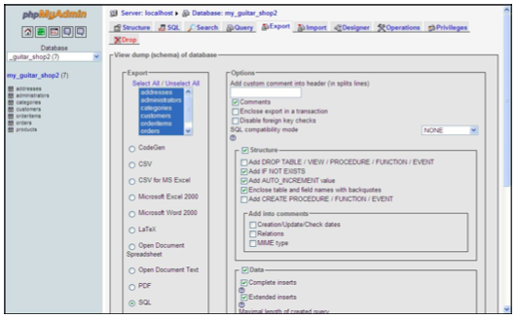
How to dump a database to a SQL script (cont.)
The Export tab for the database

Slide 45
Summary
By default MySQL uses the Latin character set, which provides for 256 characters with 1 byte per character.
The CHAR data type is typically used for fixed-length strings. The VARCHAR data type is typically used for variable-length strings.
The precision of a DECIMAL type indicates the total number of digit can be stored in the data type.
The CREATE TABLE statement creates a table based on the column definitions and columns attribute specify
Notes:
Tóm tắt lại nội dung đã học

Slide 46
Summary (2)
A primary key requires that each row has a unique value for the column or columns for the primary key, and it doesn’t allow NULL values.
You code a column-level primary key as part of the definition of the column definition
An index improves performance when MySQL searches for rows in the table
A user can be granted privileges for working with different part of the data-base
A script is a file that contain one or more SQL statement.

