Slide 1
How to use SQL to work with a database
Session 18

Slide 2
Objectives
How to select data from a single table
How to select data from multiple tables
How to code summary queries
How to code sub queries
How to insert, update, and delete rows

Slide 3
How to select data from a single table

Slide 4

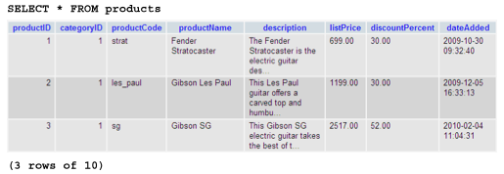
How to select columns from a table
The simplified syntax of the SELECT statement
Retrieve all rows and columns from a table

Slide 5
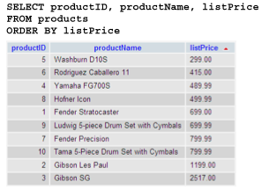
How to select columns from a table (cont.)
Retrieve three columns and sort them by price

Slide 6
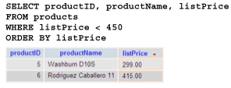

How to select columns from a table (cont.)
Retrieve rows in the specified price range
Retrieve an empty result set

Slide 7
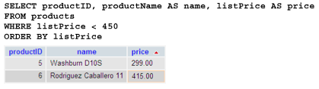
How to use an alias for a columns
By default, a column in the result set is given the same name as the column in the base table.
You can specify a column alias for the column.
Use the AS keyword to specify an alias

Slide 8
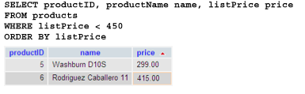
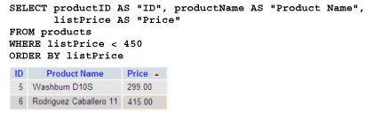
How to use an alias for a columns (cont.)
Omit the AS keyword
Use quotes to include spaces

Slide 9
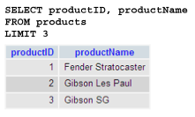
How to select rows with a LIMIT clause
You can use the LIMIT clause to limit the number of rows that are included in the result set.
The syntax of the LIMIT clause
Retrieve the first three rows of the result set

Slide 10
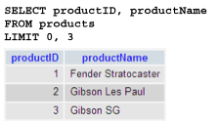
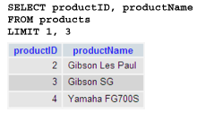
How to select rows with a LIMIT clause (cont.)
Another way to retrieve the first three rows
Retrieve three rows starting at the second row

Slide 11
How to select rows with a WHERE clause
If the result of a comparison results in a TRUE value, the row being tested is included in the result set. If it’s FALSE or unknown, the row isn’t included.
The syntax of the WHERE clause with comparison operators

Slide 12
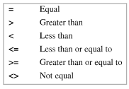
How to select rows with a WHERE clause (cont.)
The comparison operators

Slide 13
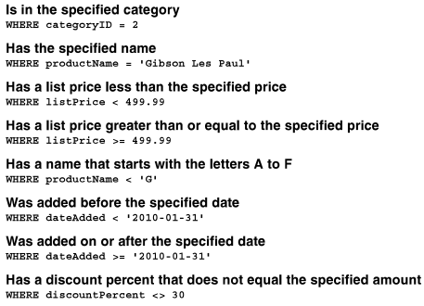
How to select rows with a WHERE clause (cont.)
A WHERE clause that selects products where the product…

Slide 14
How to use the logical operators
Logical operators to create compound conditions that consist of two or more conditions.
The syntax of the WHERE clause with logical operators
A search condition that uses the AND operator
A Search condition that uses the OR operator

Slide 15

How to use the logical operators (cont.)
A search condition that uses the NOT operator
The same condition rephrased to eliminate the NOT operator
A compound condition without parentheses

Slide 16
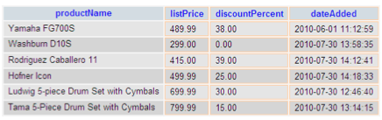
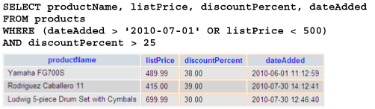
How to use the logical operators (cont.)
The same compound condition with parentheses

Slide 17
How to use the ISNULL operator
If the database allows NULL values in a column, you can use the IS NULL operator to select rows that have or don’t have NULL values in that column
The syntax of the WHERE clause with the IS NULL operator

Slide 18
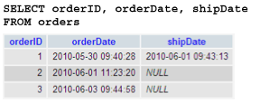
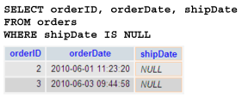
How to use the ISNULL operator (cont. )
Retrieve all rows
Retrieve rows for orders that haven’t been shipped

Slide 19

How to use the ISNULL operator (cont.)
Retrieve rows for orders that have been shipped

Slide 20

How to use the LIKE operator
Use the LIKE operator to retrieve rows that match a string pattern, called a mask.
The syntax of the WHERE clause with the LIKE operator
Wildcard symbols

Slide 21
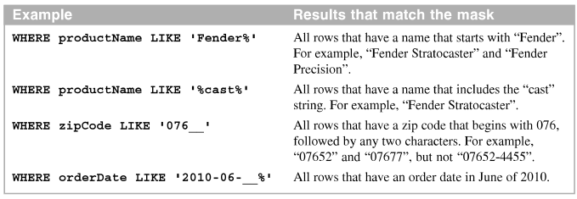
How to use the LIKE operator (cont.)
WHERE clause that use the LIKE operator

Slide 22
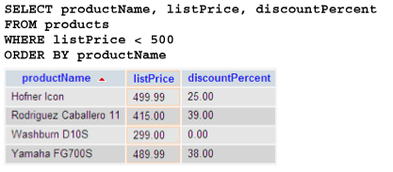
How to sort rows with an ORDER BY clause
The ORDER BY clause specifies how you want the rows in the result set sorted.
The syntax of the ORDER BY clause
Sort by one column in ascending sequence

Slide 23
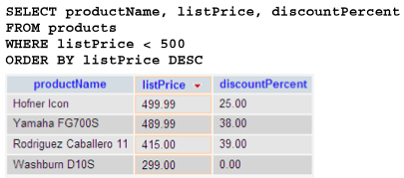
How to sort rows with an ORDER BY clause (cont.)
Sort by one column in descending sequence

Slide 24
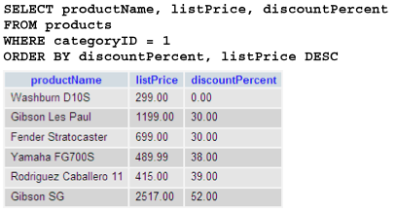
How to sort rows with an ORDER BY clause (cont.)
Sort by two columns

Slide 25
How to select data from multiple tables

Slide 26

How to code an inner join
A join is used combine columns from two or more tables into a result set based on the join conditions you specify.
The explicit syntax for an inner join

Slide 27
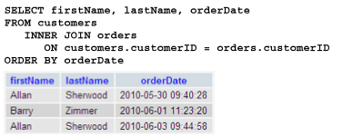
How to code an inner join (cont.)
A SELECT statement that joins the customers and orders tables

Slide 28
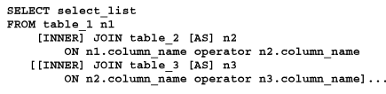
When and how to use table aliases
A table alias is an alternative table name assigned in the FROM clause
The syntax for an inner join that uses table aliases

Slide 29
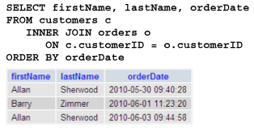
When and how to use table aliases (cont.)
An inner join with aliases for all tables

Slide 30
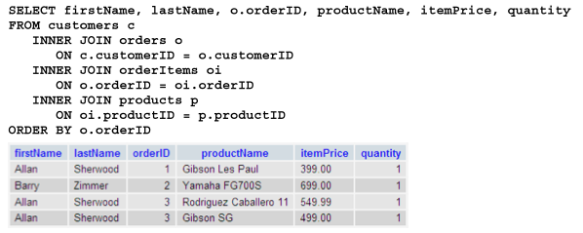
When and how to use table aliases (cont.)
An inner join with aliases for four tables

Slide 31
How to code summary queries

Slide 32
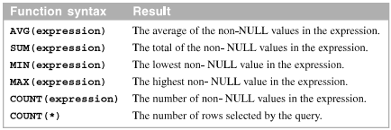
How to code aggregate functions
Aggregate functions perform calculation on the values in a set of selected rows.
The syntax of the aggregate functions

Slide 33


How to code aggregate functions (cont.)
Count all products
Count all orders and orders that have been shaped

Slide 34
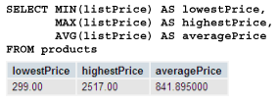

How to code aggregate functions (cont.)
Find lowest, highest, and average prices
Get the total of the calculated values for all orders

Slide 35
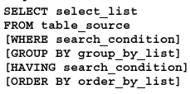
How to group queries by column
The GROUP BY clause groups rows of a result set based on one or more columns or expressions.
The HAVING clause specifies a search condition for a group or an aggregate.
The syntax of the GROUP BY and HAVING clauses

Slide 36
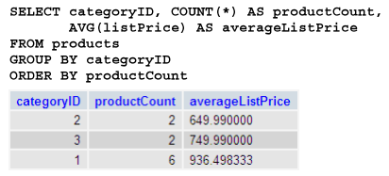
How to group queries by column (cont.)
Calculate the average list price by category

Slide 37
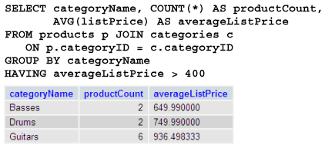
How to group queries by column (cont.)
Use columns from multiple tables

Slide 38
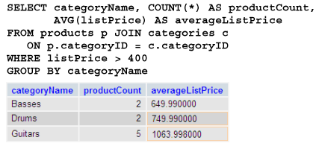
How to group queries by column (cont.)
Use a WHERE clause to filter rows before grouping them

Slide 39
How to code subqueries

Slide 40
Where to use subqueries
A subqueries is a SELECT statement that’s coded within another SQL statement.
A subquery can return a single value, a column that contains multiple values, or multiple columns that contain multiple values
Four ways to introduce a subquery in a SELECT statement
In a WHERE clause as a search condition
In a HAVING clause as a search condition
In the FROM clause as a table specification
In the SELECT clause as a column specification

Slide 41
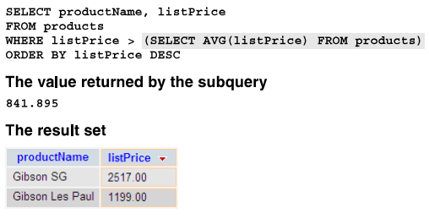
Where to use subqueries (cont.)
Use a subquery in the WHERE clause

Slide 42
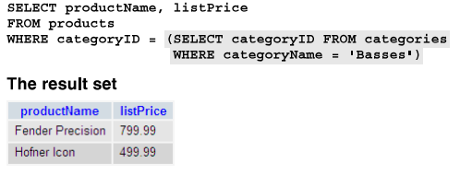
Where to use subqueries (cont.)
Use another subquery in the WHERE clause

Slide 43
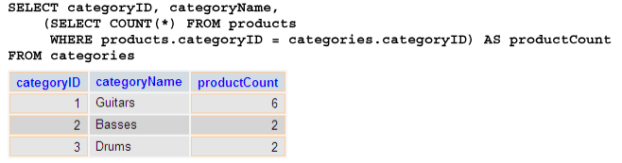
How to code correlated subqueries
A correlated subquery is a subquery that is executed once for each row processed by the outer query
Use a correlated subquery in the SELECT clause

Slide 44

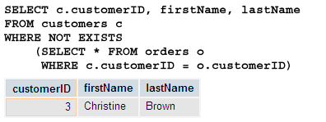
How to code correlated subqueries (cont.)
The syntax of a subquery that uses the EXISTS operator
Get all categories that don’t have any products

Slide 45
How to insert, update, and delete rows

Slide 46

How to insert rows
You use the INSERT statement to add new row to a table
The syntax of the INSERT statement

Slide 47
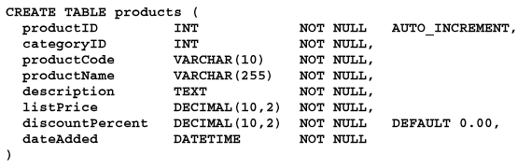

How to insert rows (cont.)
The table definition
Add a single row without using a column list

Slide 48
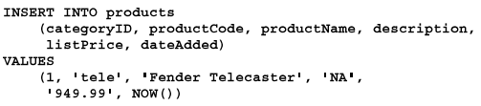
How to insert rows (cont.)
Add a single row using a column list
Add multiple rows

Slide 49

How to update rows
You use the UPDATE statement to modify one or more rows in the table named in the UPDATE clause
The syntax of the UPDATE statement
Update one column of one row

Slide 50


How to update rows (cont.)
Update multiple columns of one row
Update one column of multiple rows

Slide 51

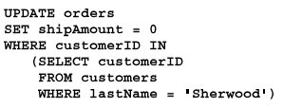
How to update rows (cont.)
Update one column of all rows in the table
Use a subquery to update multiple rows

Slide 52


How to delete rows
You can use the DELETE statement to delete one or more rows from the table you name in the DELETE clause
The syntax of the DELETE statement
Delete one row

Slide 53



How to delete rows (cont.)
Delete multiple rows
Another way to delete multiple rows
Use subquery to delete all order items for a customer

Slide 54
Summary
You can specify a column alias for the column
Use the AND and OR logical operators to create compound conditions that consist of two or more conditions
Use LIKE operator to retrieve rows that match a string pattern, called a mask.
A join is used to combine columns from two or more tables into a result set based on the join conditions you specify.
A aggregate function performs a calculation on the values in a set of selected rows

Slide 55
Summary (2)
A subquery is a SELECT statement that’s coded within another SQL statement.
A correlated subquery is a subquery that is executed once for each row processed by the outer query.

Slide 56

Discussion
Notes:
Trả lời câu hỏi WHY?

