Slide 1
Session 3
Introduction to relational databases and MySQL

Slide 2
Objectives
An introduction to relational databases
The SQL statements for data manipulation
An introduction to MySQL
How to use phpMyAdmin

Slide 3
An introduction to relational databases

Slide 4
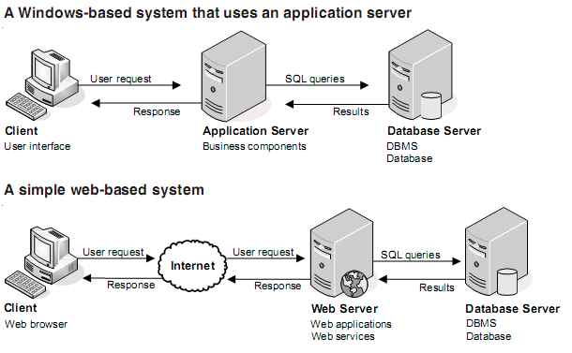
Client/Server system architectures

Slide 5

What is a database?
A database is an organized form of data consisting of one or more related data items called records.
A database is like a data collection to which we can ask different questions.
For example, “What are the phone numbers and addresses of the five nearest post offices to the college?”

Slide 6
Why use databases?
Databases are used to store data in an efficient and organized manner. A database allows us quick and easy management of data.
For example, a company may maintain details of its employees in a database.
FirstName | LastName | Hiredate
Karla | Jablonski | 1994-03-11
Martine | Rance | 1992-02-05
Margaret | Smith | 1988-09-29
Gary | Thomas | 1988-08-09

Slide 7

What is a DBMS?
Database
A003
Allen
A007
Shane
A004
Brian
A008
Ricky
Retrieve Data
Update Data
Insert Data
DBMS
Delete Data

Slide 8
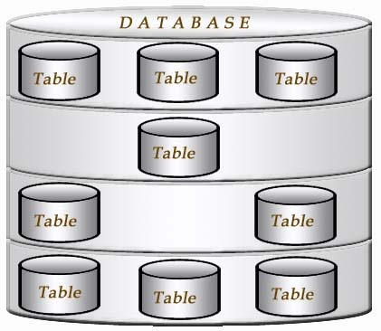
An introduction to relational databases
A database is a collection of information that can be accessed, managed, and updated.
Relational Database is a new model of database was developed by Dr.E.F.Codd in 1970.
The relational database can help you reduce data redundancy, more efficiently in data retrieve.

Slide 9
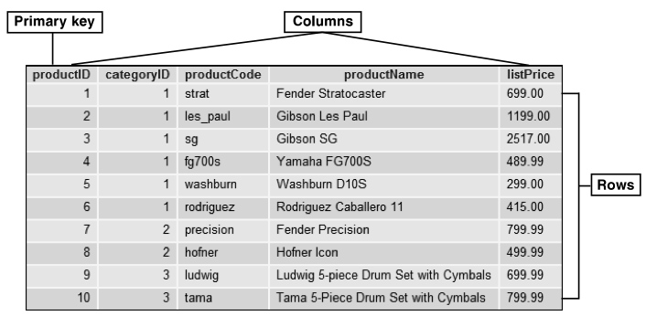
How a database table is organized

Slide 10
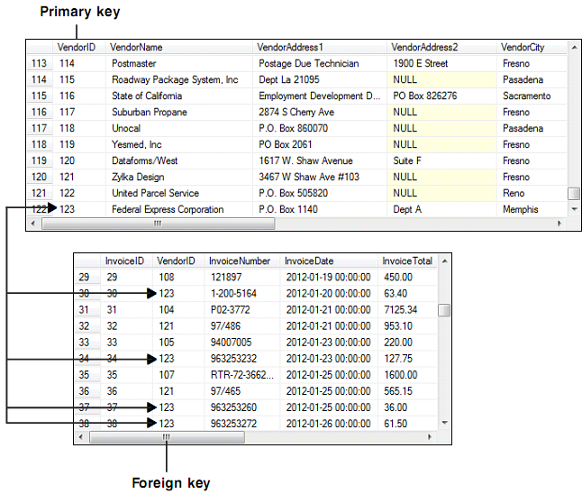
How a database table is organized
Concepts:
Relational database
Table
Column
Row
Cell
Primary Key
Non-Primary Key
or Unique Key
Index

Slide 11
How the tables in a relational database are related
Concepts
Foreign Key
One To Many relationship
One To One relationship
Many To Many relationship
Notes:
One to

Slide 12
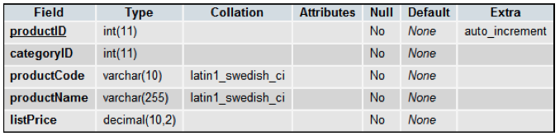
How the columns in a table are defined
The data type that’s assigned to a column determines the type and size of the information that can be stored in the column.
The columns of the products table

Slide 13
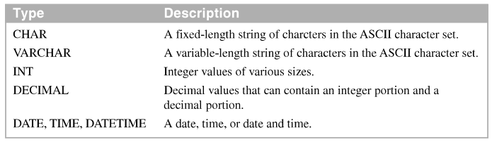
How the columns in a table are defined (cont.)
Common MySQL data types
A column definition null values. A null value indicates that the value of the column is unknown.

Slide 14
How the columns in a table are defined (cont.)
A column can defined with a default value. That value is used if another value isn’t provided when a row is added to the table
A column can defined as an auto-increment column. An auto-increment column is a numeric column whose value is generated automatically when a row is added to the table.

Slide 15
The SQL statements for data manipulation

Slide 16
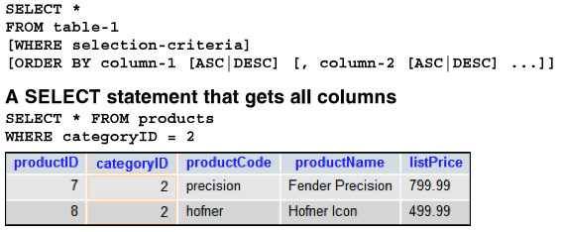
How to select data from a single table
A SELECT statement is a SQL statement that returns a result set that consists of the specified rows and columns
The syntax for a SELECT statement that gets all columns

Slide 17
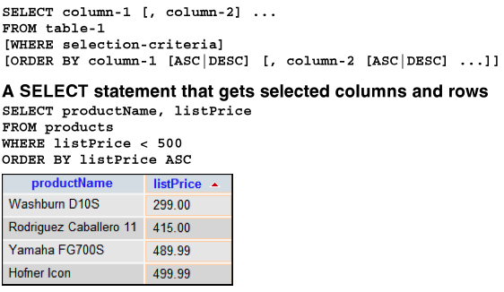
How to select data from a single table (cont.)
The syntax for a SELECT statement that gets selected columns and rows

Slide 18
How to select data from multiple tables
To return a result set that contains data from two tables, you join the tables. To do that, you can use a JOIN clause.
To code an inner join so that rows are only included when the key of a row in the first table is equal to matches the key of a row in the second table.
An outer join returns rows from one table in the join even if the other table doesn’t contain a matching row.

Slide 19
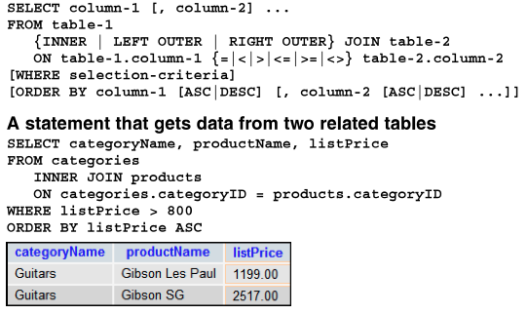
How to select data from multiple tables (cont.)
The syntax for a SELECT statement that joins two tables

Slide 20
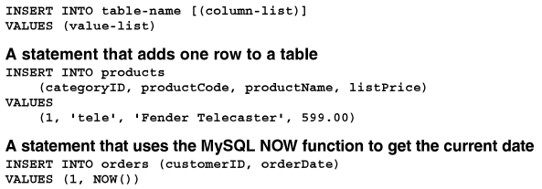
How to insert, update, and delete data
The INSERT, UPDATE and DELETE statement modify the data that’s stored in a database.
The syntax for the INSERT statement

Slide 21
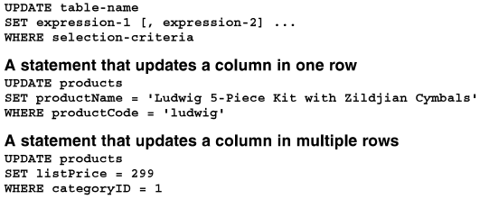
How to insert, update, and delete data (cont.)
A syntax for the UPDATE statement

Slide 22
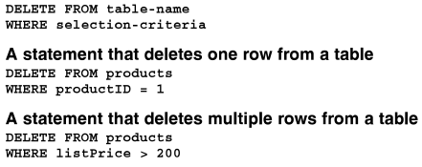
How to insert, update, and delete data (cont.)
The syntax for the DELETE statement

Slide 23
An introduction to MySQL

Slide 24
An introduction to MySQL
MySQL is an open-source database management system(DBMS).
Download MySQL free from http://www.mysql.com/downloads/
We can install MySQL with XAMPP package or install MySQL alone and using MySQL Workbench client to access server.

Slide 25
MySQL is
Inexpensive. MySQL is free for most uses and relatively inexpensive for other uses
Fast. By many accounts, MySQL is one of the fastest relational database currently available
Easy to use. Compared to other database management systems, MySQL is easy to install and use
Portable, MySQL runs on most modern operating systems including Windows, Unix, Solaris and OS/2

Slide 26
What MySQL provides
MySQL provides
Support for SQL.
Support for multiple clients
Connectivity
Security
Referential integrity
Transaction processing

Slide 27
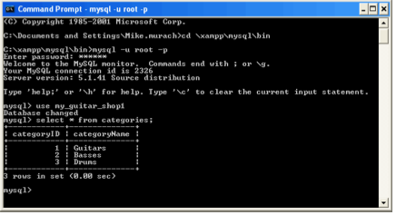
Two ways to work with MySQL
A command-line client

Slide 28
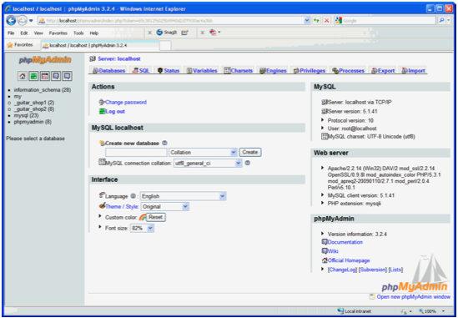
Two ways to work with MySQL (cont.)
A web-based client

Slide 29
How to use phpMyAdmin

Slide 30
How to start phpMyAdmin
You can start the XAMPP Control Panel and click the Admin button for MySQL.
Another way to start phpMyAdmin on a local system is to use your browser to navigate to this URL:
http://localhost/phpmyadmin

Slide 31
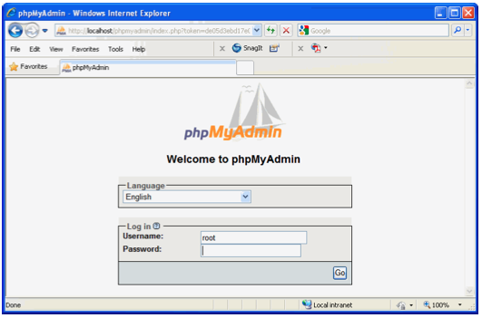
How to log in, log out, and change your password
The Welcome page

Slide 32
How to log in, log out, and change your password (cont.)
The Welcome page is only displayed of you have configured phpMyAdmin as shown in the appendix and your username and password isn’t already stored in a cookie.
How to start phpMyAdmin on a local computer and log in.
How to log out and return to the Welcome page
How to change your password

Slide 33
How to import and run a SQL script that creates a database
The script consists of one or more SQL statement that are stored in a file
How to import and run a SQL script
The script for creating the databases used by this book
\xampp\htdocs\book_apps\_create_db\create_db.sql

Slide 34
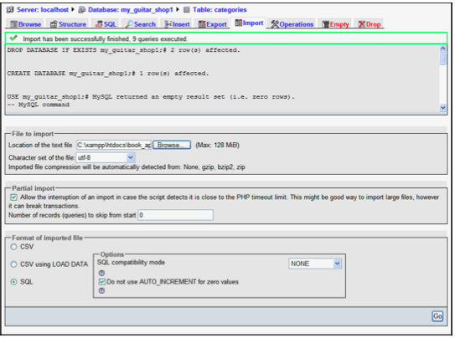
How to import and run a SQL script that creates a database (cont.)
A import tab that import and runs a SQL script that creates a database

Slide 35
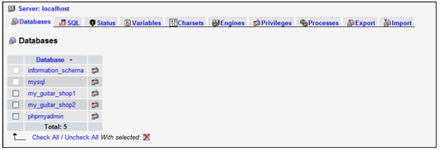
How to review the data and structure of a table
The Databases tab

Slide 36
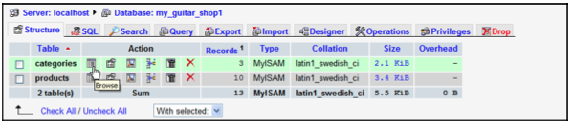
How to review the data and structure of a table (cont.)
The Structure tab for the my_guiter_shop1 database

Slide 37
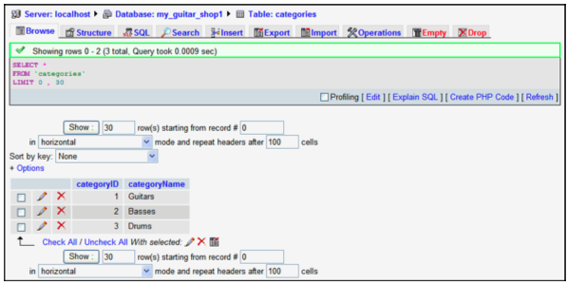
How to review the data and structure of a table (cont.)
The Browser tab for the categories table

Slide 38
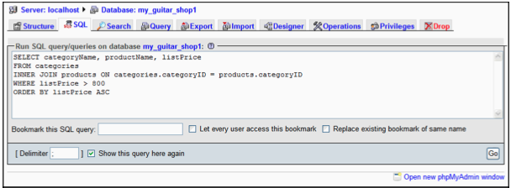
How to run SQL statements
To execute a SQL statement, select a database and click the SQL tab.

Slide 39
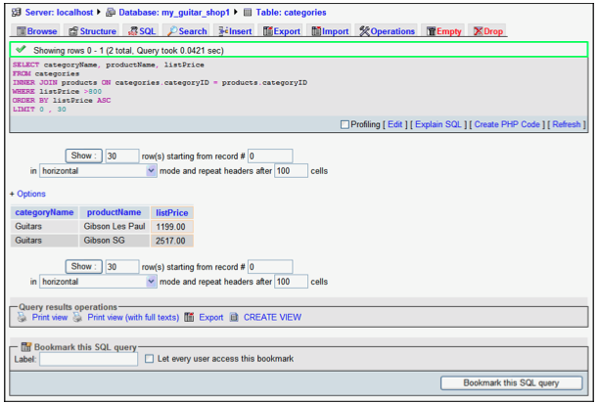
How to run SQL statements (cont.)
The SQL tab after a SQL statement has been executed

Slide 40


How to create users with limited privileges
How to create a user with limited privileges on a single table
How to create a user with limited privileges on all tables in a table.

Slide 41
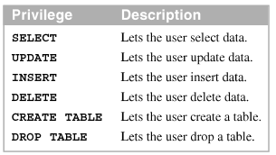
How to create users with limited privileges (cont.)
Common privileges

Slide 42
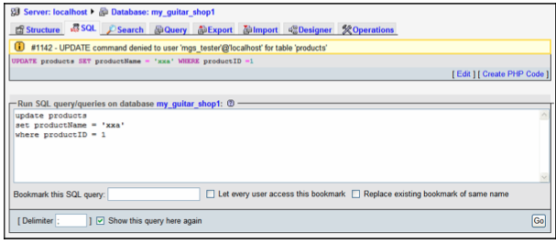
How to create users with limited privileges (cont.)
The SQL tab for mgs_tester after an UPDATE statement failed

Slide 43
Summary
A Relational database consists of tables that store data in rows and columns. A primary key is used to identify each row in a table
The table in a relational database are related by foreign keys in one table that have the same values as primary keys in another table.
To work with the data in a database, you use SQL.
To update the data in a database, you use the INSERT, UPDATE, and DELETE statement.

Slide 44
Summary (2)
The SELECT statement returns data from one or more tables in a result set.
To create a database including its tables and data, you can use phpMyAdmin to run a SQL script.
The create database users with limited privileges, you can use phpMyAdmin to run GRANT statements.

