Slide 1
Session 4
How to use PHP with
a MySQL database
Notes:
Session: Ghi số thứ tự session trong môn học
Session Name: ghi tên của session sẽ dạy

Slide 2
Objectives
How to connect a database
How to get and modify data
The Product Viewer application
The Product Manager application
Notes:
Mô tả nội dung mà học viên phải đạt được khi kết thúc môn học này

Slide 3
PHP for working with MySQL

Slide 4
How to connect to a MySQL database
The syntax for creating an object from any class
The syntax for creating a database object from the PDO(PHP Data Objects) class
The syntax for a DSN (Data Source Name) for a MySQL database

Slide 5

How to connect to a MySQL database (cont.)
How to connect to a MySQL database named my_guitar_shop1

Slide 6
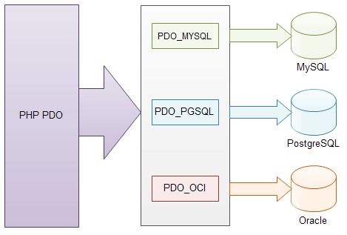
PDO (PHP Data Objects)
PDO is a database abstraction layer. The PDO extension to PHP defines a consistent interface for accessing databases.

Slide 7
How to handle exceptions
Use try/catch statement to handle exception.
Syntax:
try{
//Statement that may throw an exception
}catch(ExceptionClass $exception_name){
// statement that handle the exception
}

Slide 8
How to handle exceptions (cont.)
How to handle a PDO exception
try{
$db = new PDO($dsn,$username,$password);
echo ‘<p>You are connected to the database</p>’
}catch(PDOException $e){
$error_message = $e->getMessage();
echo “<p>An error occurred while connecting to the database: $error_message </p>”;
}

Slide 9
How to get data from a result set

Slide 10
How to execute SELECT statement
A method of the PDO class for executing a SELECT statement
Two methods of the PDOStatement class for executing a statement.
Method | Description
prepare($sql_statement) | Prepares the specified SQL statement for execution and returns a PDOStatement object. You can use a colon(:) to add parameter to the statement.
Method | Description
bindValue($param, $value) execute() | Binds the specified value to the specified parameter in the prepared statement. Execute the prepared statement.

Slide 11
How to execute SELECT statement (cont.)
How to execute a SQL statement without parameters
$query = “SELECT * FROM products”;
$statement = $db->prepare($query);
$statement->execute();
How to execute a SQL statement that have a parameter
$query = “SELECT * FROM products
WHERE categoryID =:category_id”;
$statement = $db->prepare($query);
$statement->bindValue(‘:category_id’,$category_id);
$statement->execute();

Slide 12
How to work with result set
The data from execution SELECT statement will store in result set. You can get it by use fetch() or fetchAll() from PDO class.
Three more methods from PDO class
Method | Description
fetch() | Return an array for the next row in the result set.
fetchAll() | Return an array for all rows in the result set.
closeCursor() | Close the cursor and free the connection to the server.

Slide 13
How to get one row from result set
Code to get a result set contains one row
$query = “SELECT productCode, productName, listPrice
FROM products
WHERE productID =:product_id”;
$statement = $db->prepare($query);
$statement->bindValue(‘:product_id’,$product_id);
$statement->execute();
$product = $statement->fetch();
$statement->closeCursor();
Code to access the column
$product_code = $product[‘productCode’];
Or
$product_code = $product[0];

Slide 14
How to get all the rows of a result set
Code to get a result set contains two or more rows
$query = “SELECT productCode, productName, listPrice
FROM products
WHERE categoryID =:category_id”;
$statement = $db->prepare($query);
$statement->bindValue(‘:category_id’,$category_id);
$statement->execute();
$products = $statement->fetchAll();
$statement->closeCursor();
Code to access the column
<?php foreach($products as $product): ?>
<tr>
<td><?php echo $product[‘productCode’]; ?></td>
</tr>
<?php endforeach; ?>

Slide 15
How to execute INSERT, UPDATE, and DELETE statements
Similar of SELECT statement, INSERT, UPDATE or DELETE statement still use prepare(), bindValue() and execute() methods of PDO to execute statement.

Slide 16
How to execute INSERT statement
$category_id=1;
$code=‘strat’;
$name=‘Fender Stratocaster’;
$price = 699.99;
$query = “INSERT INTO products(categoryID,
productCode, productName, listPrice)
VALUES(:category_id,:code,:name,:price)”;
$statement = $db->prepare($query);
$statement->bindValue(‘:category_id’,$category_id);
$statement->bindValue(‘:code’,$code);
$statement->bindValue(‘:name’,$name);
$statement->bindValue(‘:price’,$price);
$statement->execute();
$statement->closeCursor();

Slide 17
How to execute UPDATE statement
$product_id=4;
$price=599.99;
$query = “UPDATE products
SET listPrice = :price
WHERE productID = :product_id”;
$statement = $db->prepare($query);
$statement->bindValue(‘:price’,$price);
$statement->bindValue(‘:product_id’,$product_id);
$statement->execute();
$statement->closeCursor();

Slide 18
How to execute DELETE statement
$product_id=4;
$query = “DELETE FROM products
WHERE productID = :product_id”;
$statement = $db->prepare($query);
$statement->bindValue(‘:product_id’,$product_id);
$statement->execute();
$statement->closeCursor();

Slide 19
The Product Viewer application

Slide 20
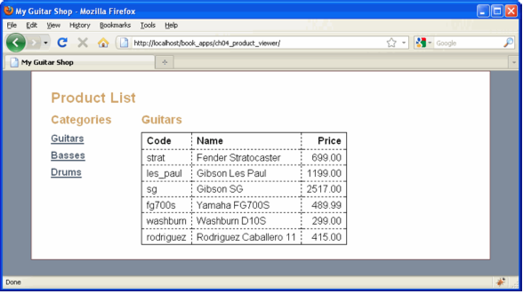
The user interface
The user interface

Slide 21
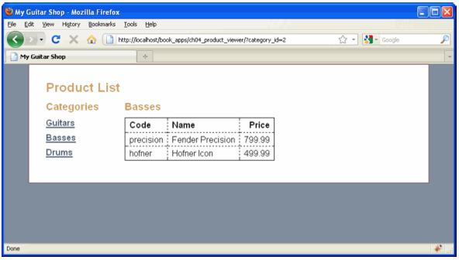
The user interface (cont.)
The user interface after the user selects a new category

Slide 22
Codes in page 141 - 145

Slide 23
The Product Manager application

Slide 24
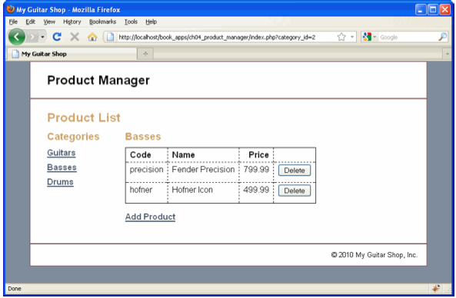
The user interface
The Product List page

Slide 25
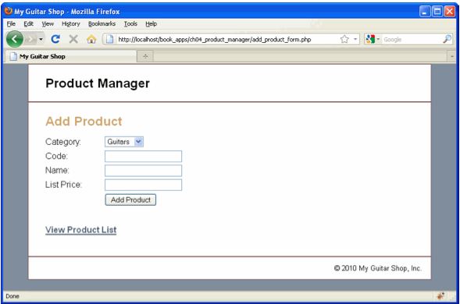
The user interface (cont.)
The Add Product page

Slide 26
Codes in page 141 - 155

Slide 27
Summary
The PDO (PHP Data Object) extension to PHP defines an interface for accessing databases
Use new keyword to create an object from a class
The DSN (Data Source Name) for a MySQL connection specifies the host computer for the MySQL database and the name of the database.
Use -> to call a method from any object.
Use query method of PDO to execute a SELECT statement
Notes:
Tóm tắt lại nội dung đã học

Slide 28
Summary (2)
Use exec method to execute an INSERT, UPDATE, or DELETE statement.
An exception is an object that contains information about an error.
To handle exception, you use a try/catch statement.
An array can store one or more elements. To refer to the elements in an array, you use a string index or a numeric index.
Use foreach statement to loop through the roes in the result set.

