Slide 1
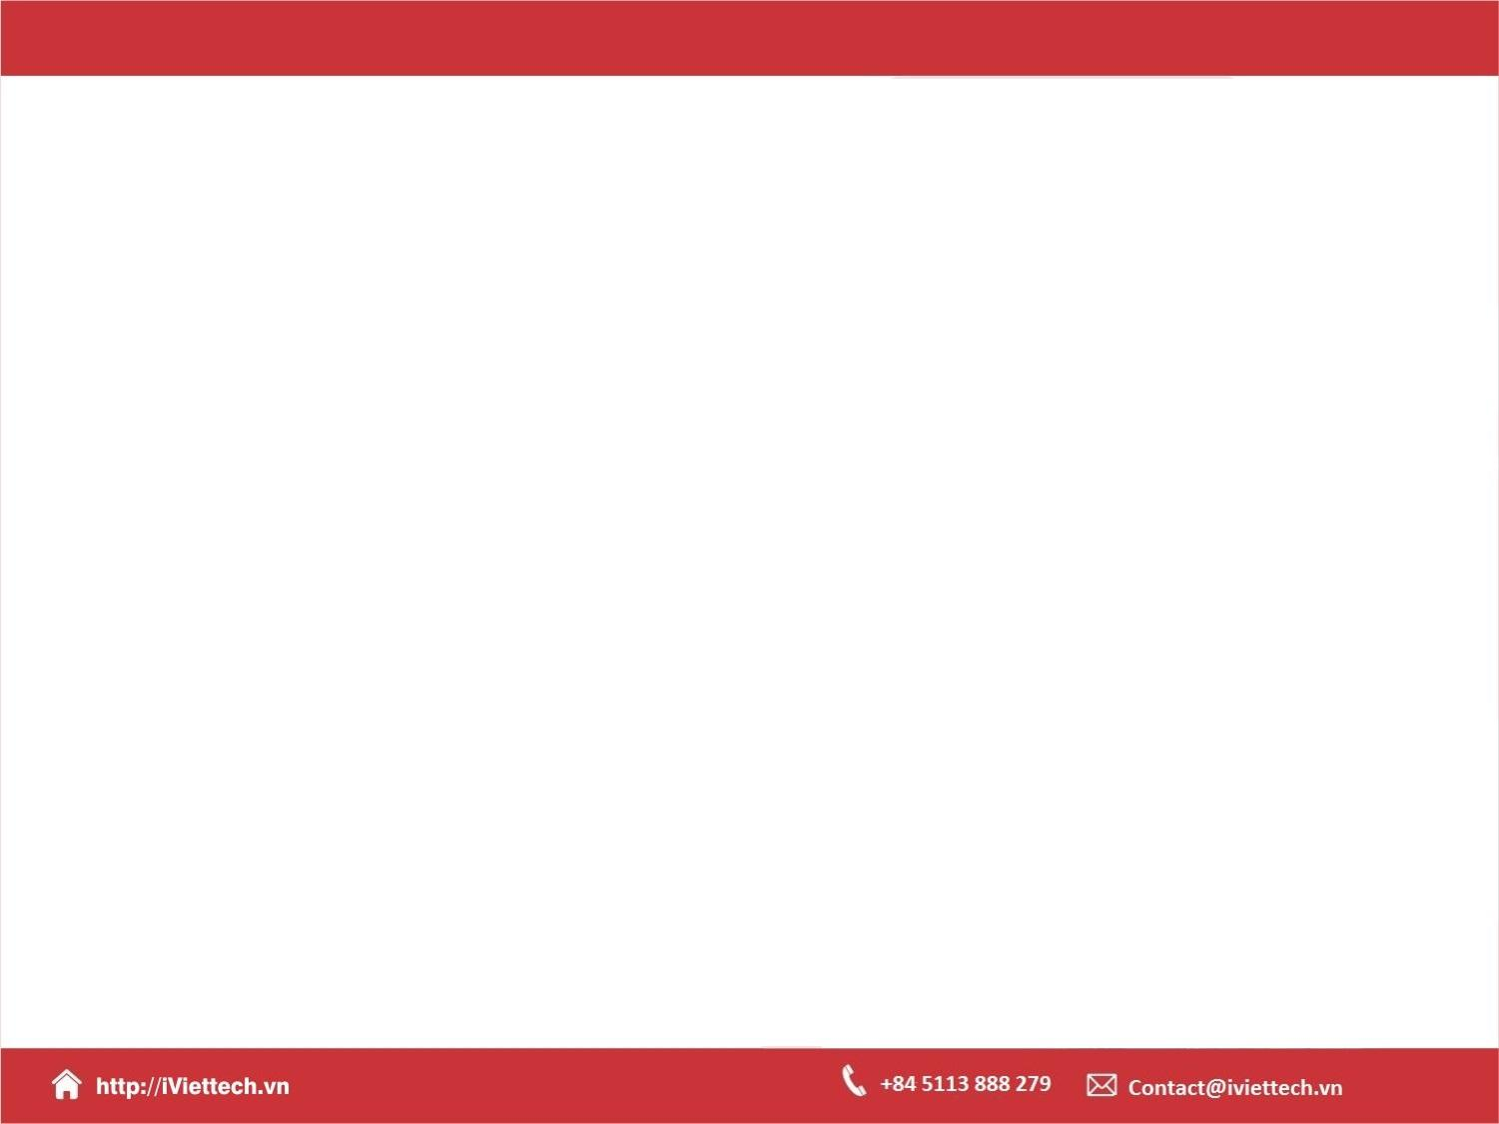

Chapter 1
An Introduction to Laravel

Slide 2

Objectives
The limitations of homemade tools
Why use a framework ?
A new approach to developing PHP applications
Why Laravel ?
Laravel’s main features
Structure of a Laravel application

Slide 3
The limitations of homemade tools

Slide 4
The limitations of homemade tools
Will be solely responsible for the maintenance, inclusion of new features, and documentation
Make a tedious and time-consuming task

Slide 5
Why use a framework ?
Framework reuses and assembles existing components to provide you with a cohesive layer upon which you can build your web applications in a more structured and pragmatic way
The benefit of using a framework in general is that someone has made decisions not just about individual components for you, but also about how those components should fit together.
Consistency and flexibility. Frameworks provide a carefully considered answer to the question “Which component should we use here?” and ensuring that the particular components chosen work well together. Additionally, frameworks provide conventions that reduce the amount of code a developer new to the project.

Slide 6
A new approach to developing PHP applications

Slide 7
A new approach to developing PHP applications
The PHP has rapidly evolved to include new features such as closures and traits, and a de facto package manager in Composer
A more robust HTTP foundation. Instead of re-inventing the wheel, Laravel decided to hop on the shoulder of giants and embrace these pre-existing mature components.
Embracing PHP. Using Laravel, you will get to grips with some of the newer features of PHP (Namespaces, Interfaces, Anonymous functions, Overloading, Shorter array syntax)

Slide 8
Why Laravel ?

Slide 9
Why Laravel ?
Laravel provide clear, simple, and beautiful code and features that help developers quickly learn, start, and develop, and write code that’s simple, clear, and lasting.
Laravel is a rapid application development framework. It focuses on a shallow (easy) learning curve and on minimizing the steps between starting a new app and publishing it

Slide 10
Why Laravel ?
All of the most common tasks in building web applications, from database interactions to authentication to queues to email to caching, are made simpler by the components Laravel provides
Laravel provides an entire ecosystem of tools for building and launching applications.
Laravel focuses on “convention over configuration”. Projects built on Laravel take less time than those built on most other PHP frameworks.
Laravel has a good documentation and a welcoming community

Slide 11
Laravel's main features and sources of inspiration

Slide 12
Laravel's main features
Modularity
Testability
Routing
Configuration management
Query builder and Eloquent (ORM)
Schema builder, migrations, and seeding
Template engine
E-mailing
Authentication
Redis
Queues
Event and command bus

Slide 13
Structure of a Laravel application

Slide 14
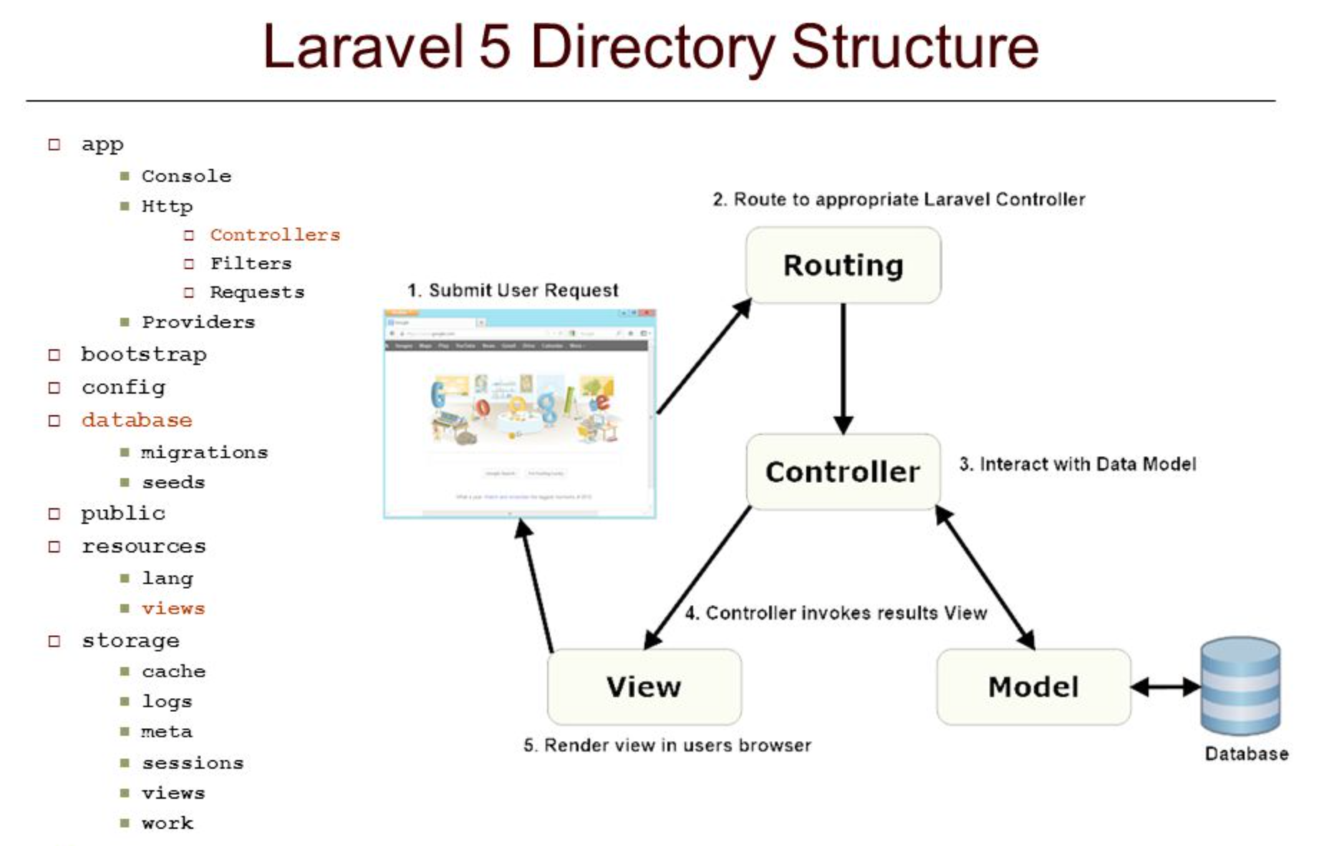
Structure of a Laravel application

Slide 15

Summary
The limitations of homemade tools
Why use a framework ?
A new approach to developing PHP applications
Why Laravel ?
Laravel’s main features
Structure of a Laravel application

Slide 16
The End

