Slide 1


Chapter 2
Setting Up a Development Environment

Slide 2

Objectives
System Requirements
Meeting Composer
Working with the command line
Local Development Environments
Create a new Laravel application

Slide 3
System Requirements

Slide 4
System Requirements
PHP >= 7.1.3 for Laravel versions 5.6 to 5.8, PHP >= 7.0.0 for version 5.5, PHP >= 5.6.4 for version 5.4, PHP between 5.6.4 and 7.1.* for version 5.3, or PHP >= 5.5.9 for versions 5.2 and 5.1
OpenSSL PHP extension
PDO PHP extension
Mbstring PHP extension
Tokenizer PHP extension

Slide 5
System Requirements
XML PHP extension (Laravel 5.3 and higher)
Ctype PHP extension (Laravel 5.6 and higher)
JSON PHP extension (Laravel 5.6 and higher)
BCMath PHP extension (Laravel 5.7 and higher)

Slide 6
Metting Composer

Slide 7
Metting Composer
Rather than including these external dependencies in its own source code, Laravel uses a dependency manager called Composer to download them and keep them up to date. Since Laravel is made up of multiple packages, they too are downloaded and installed each time you create a new Laravel project
Composer brings these features to PHP and has quickly become the de facto dependency manager in PHP

Slide 8
Working with the command line

Slide 9
Working with the command line
If you are just getting started with web development, you might not be completely familiar with the command-line interface (CLI). Working with Composer, virtual machines, and Homestead, and later on with Artisan, Laravel's CLI utility, will require some interaction with it.
Here is how you can start with CLI:
On Windows, look for the Command Prompt program. If you cannot find it, just navigate to Start | Run and type in cmd.exe.
On Mac OS X, CLI is called Terminal, and it can be found at /Applications/Utilities.
On Linux, depending on your distribution of Linux, it will be called Terminal or Konsole, but if you are running Linux, you are probably already familiar with it.

Slide 10
Local Development Environments

Slide 11
Laravel Valet
Valet is a Laravel development environment for Mac minimalists. No Vagrant, no /etc/hosts file. You can even share your sites publicly using local tunnels.
Laravel Valet configures your Mac to always run Nginx in the background when your machine starts. Then, using DnsMasq, Valet proxies all requests on the *.test domain to point to sites installed on your local machine.

Slide 12
Meet Homestead
The creators of Laravel have created an official Vagrant box called Homestead. Vagrant is software that allows you to create virtual development environments on your personal computer. You can install Homestead and start creating Laravel projects right away
if you don't need it any more, you can just remove it from your machine, without anything else being affected
if you are currently using a globally installed development environment such as WAMP or MAMP, Homestead won't conflict with it

Slide 13
Installing Homestead
Homestead is a Vagrant-based VM. Therefore, before using it you will need to install two utilities:
VirtualBox (https://www.virtualbox.org/wiki/Downloads)
Vagrant (http://www.vagrantup.com/downloads.html)

Slide 14
Installing Homestead
To install Homestead, follow these steps
> $ composer global require “laravel/homestead=~2.0"
> $ homestead init
> $ homestead edit
Edit folders and sites sections in Homestead.yml file

Slide 15
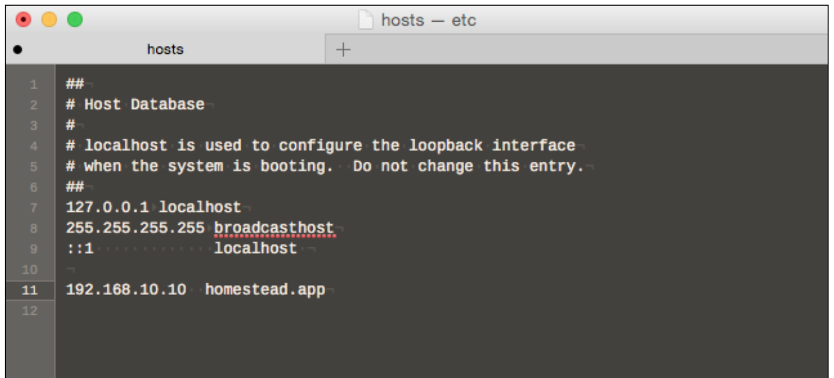
Installing Homestead
To install Homestead, follow these steps
> $ homestead up
Edit hosts file, add the following line to the bottom 192.168.10.10 homesteap.app

Slide 16
Everyday usage of Homestead
To stop and save current state Homestead > $ homestead suspend
To resume Homestead > $ homestead resume
To shutdown virtual machine > $ homestead halt
To start Homestead > $ homestead up
To connect to the machine > $ homestead ssh

Slide 17
Connecting to your databases
To connect, all you have to do is specify the following parameters:
Host: 127.0.0.1
Port: 33060
Username: homestead
Password: secret

Slide 18
Creating a new Laravel application

Slide 19
Creating a new Laravel application
First, check whether Homestead is running by using the following command: > $ homestead status
If the status is anything other than running, bring it up with the homestead reload command. We now need to add our site. It will be a browsable database of cat profiles, so let's call it "Furbook" and give it the fictional domain name of furbook.com.

Slide 20
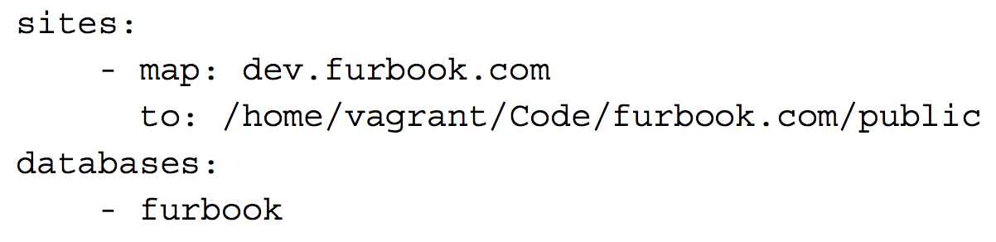
Creating a new Laravel application
We can set this up in Homestead by editing the configuration file and adding the following mappings:
Run $ homestead reload, which should reprovision the sites and also create a new, empty database

Slide 21
Creating a new Laravel application
Now with our workspace prepared, we need to actually create a new Laravel project. To do this, we need to SSH into our running VM. Homestead makes this incredibly simple: > $ homestead ssh
This will create a new SSH session and log us in to the running Homestead VM instance. We can now run a Composer command to create a brand new Laravel project as follows: > $ cd /home/vagrant/Code/furbook.com > $ composer create-project --prefer-dist laravel/laravel 5.8.*

Slide 22

Summary
Composer
Working with the command line
Homestead
Create a new Laravel application

Slide 23
The End

